Slide 1
High Frequency Quoting:
Short-Term Volatility in Bids and Offers
Big Data Finance Conference
May 3, 2013
Joel Hasbrouck
Stern School, NYU

Slide 2
Disclaimers
I teach in an entry-level training program at a large financial firm that is generally thought to engage in high frequency trading.
I serve on a CFTC advisory committee that discusses issues related to high frequency trading.
I accept honoraria for presentations at events sponsored by financial firms.

Slide 3
What does quote volatility look like?
In US equity markets, bids and offers from all trading venues are consolidated and disseminated in real time.
  The highest bid is the National Best Bid (NBB)
  The lowest offer is the National Best Offer (NBO)
Next slide: the NBBO for AEPI on April 29, 2011

Slide 4
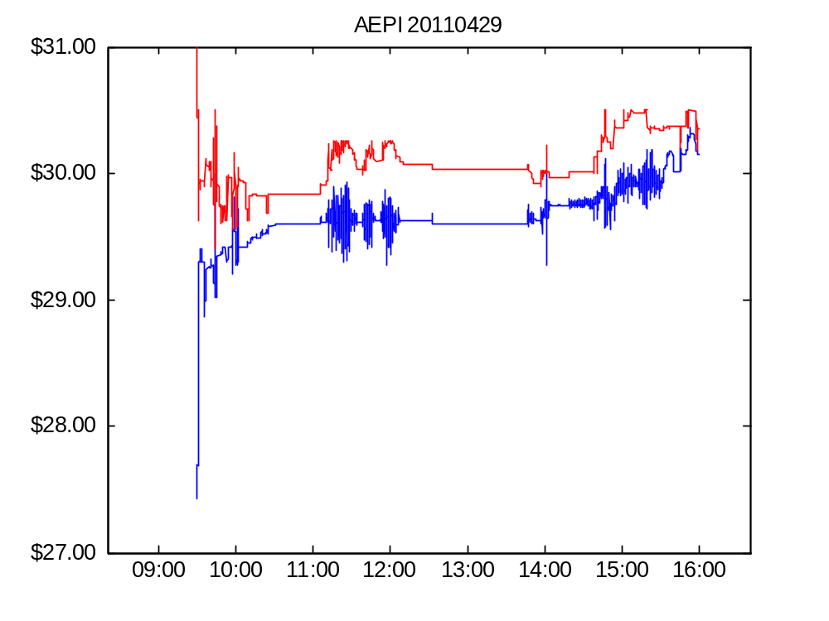
Figure 1. AEPI bid and offer, April 29, 2011

Slide 5
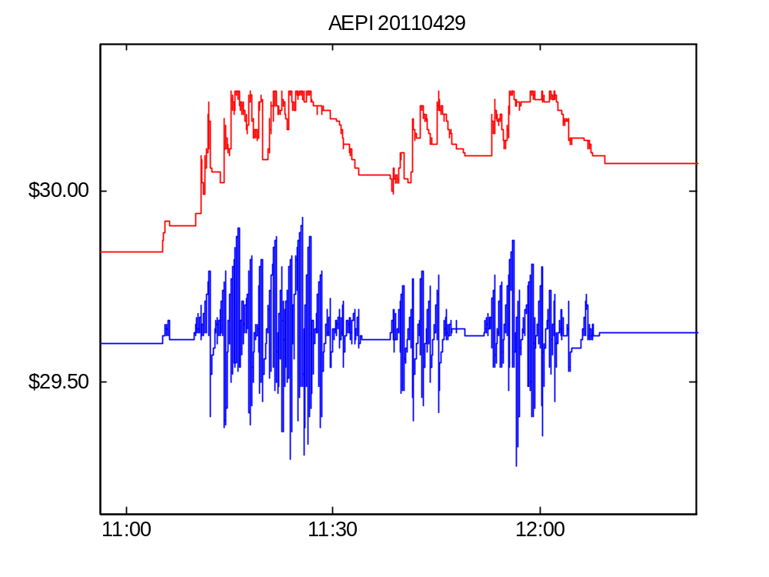
Figure 1. AEPI bid and offer on April 29, 2011 (detail)

Slide 6
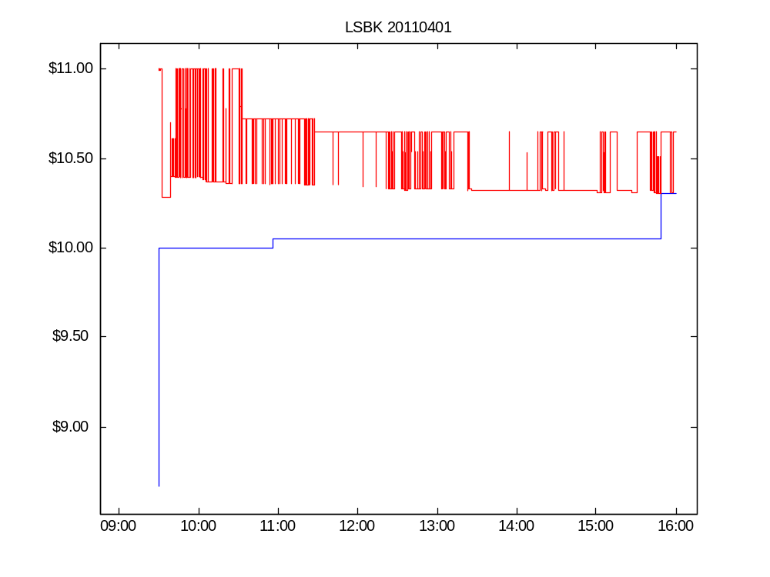

Slide 7
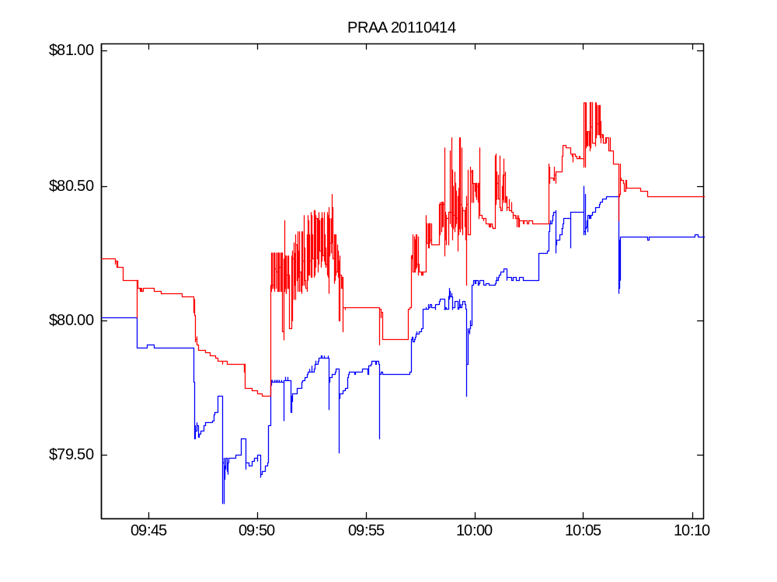

Slide 8
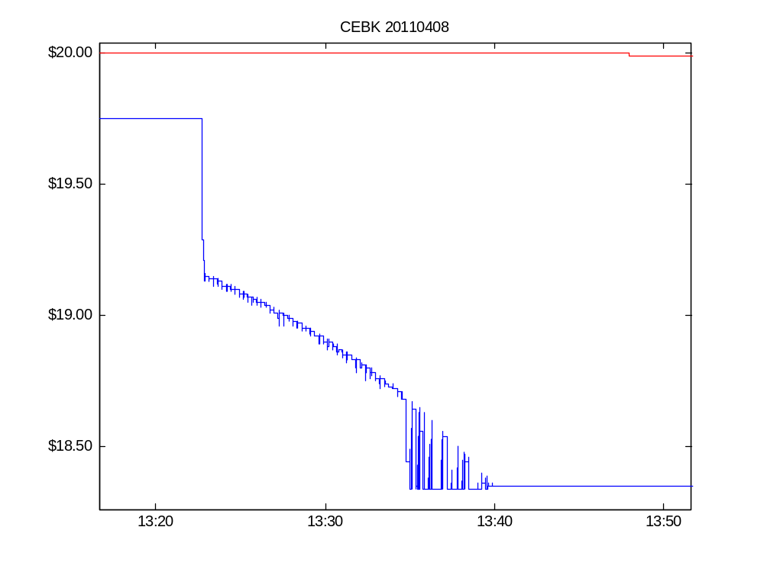

Slide 9
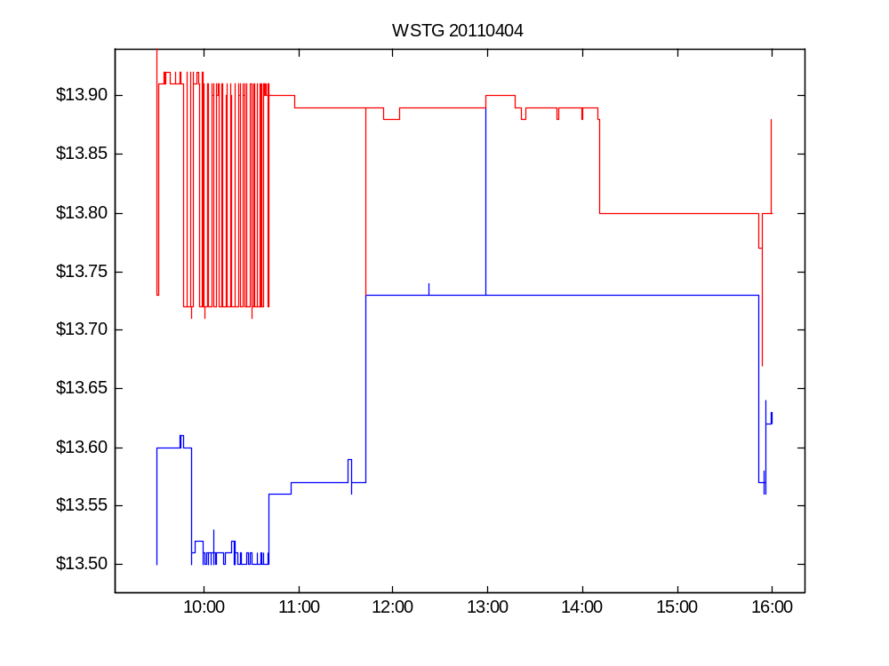

Slide 10
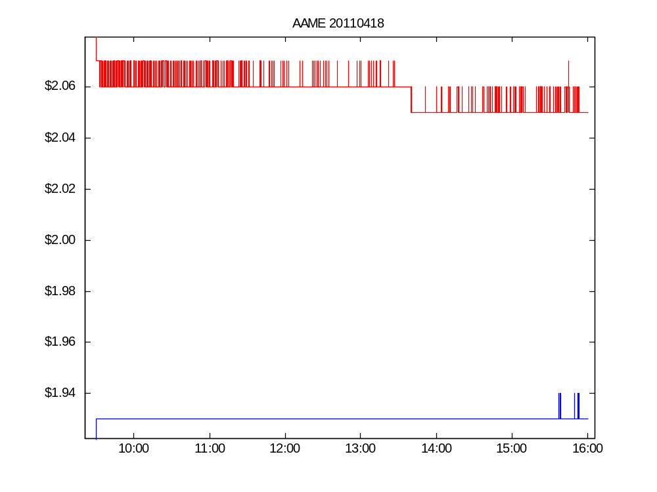

Slide 11
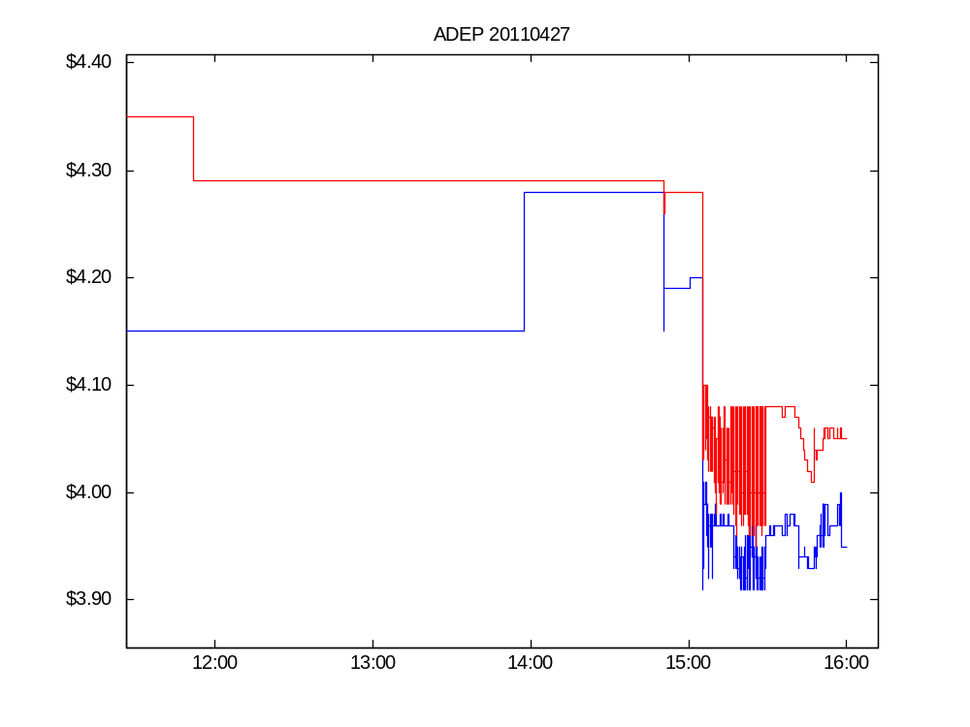

Slide 12
Quote volatility: the questions
What is its economic meaning and importance?
How should we measure it?
Is it elevated? Relative to what?
Has it increased along with wider adoption of high-speed trading technology?

Slide 13
Economic consequences of quote volatility
Noise due to flickering quotes
Execution price risk
  For marketable orders
  For dark trades
Intermediaries’ look-back options
Quote-stuffing
Spoofing

Slide 14
Descriptive statistics: computation and interpretation

Slide 15
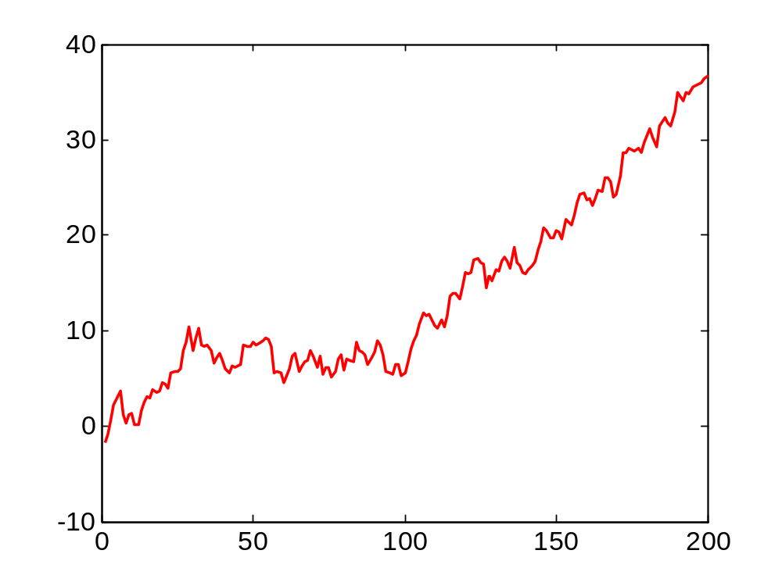
Local variances about local means
n = length of averaging interval.
Depends on trader’s latency and order strategies: we want a range of n

Slide 16
Interpretation
To assess economic importance, I present the (wavelet and rough) variance estimates in three ways.
  In mils per share
  In basis points
  As a short-term/long-term ratio

Slide 17
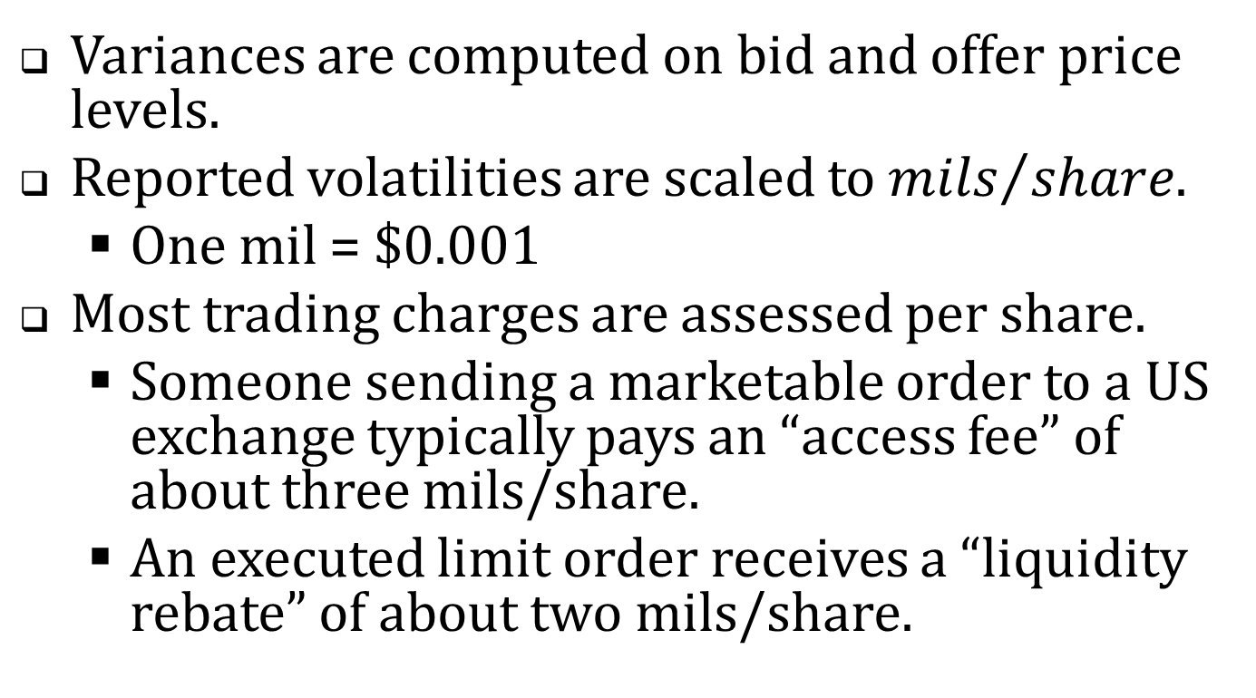
Mils per share
Variances are computed on bid and offer price levels.
Reported volatilities are scaled to ${mils}/{share}$.
  One mil = $0.001
Most trading charges are assessed per share.
  Someone sending a marketable order to a US exchange typically pays an “access fee” of about three mils/share.
  An executed limit order receives a “liquidity rebate” of about two mils/share.

Slide 18
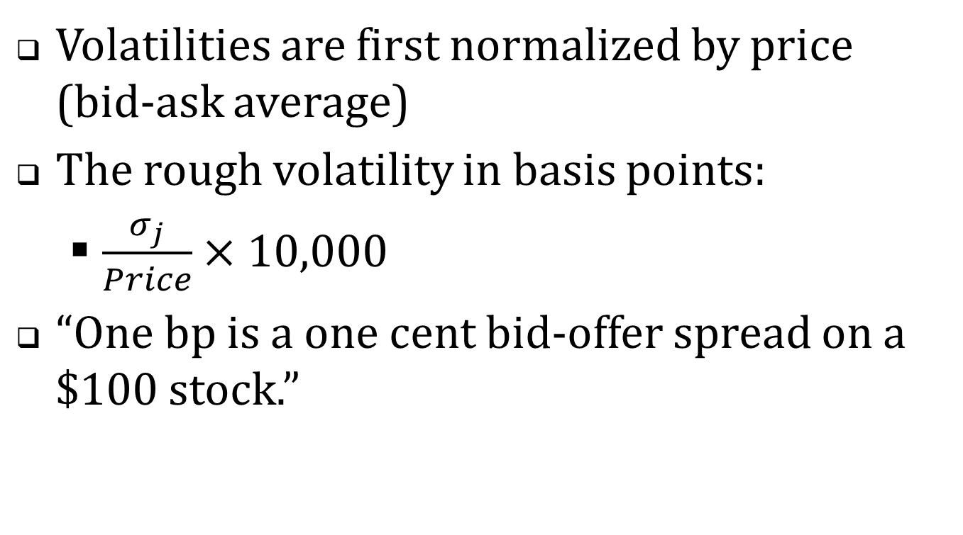
Basis points (One bp = 0.01%)
Volatilities are first normalized by price (bid-ask average)
The rough volatility in basis points:
  $\frac{σ_{j}}{Price}×10,000$
“One bp is a one cent bid-offer spread on a $100 stock.”

Slide 19
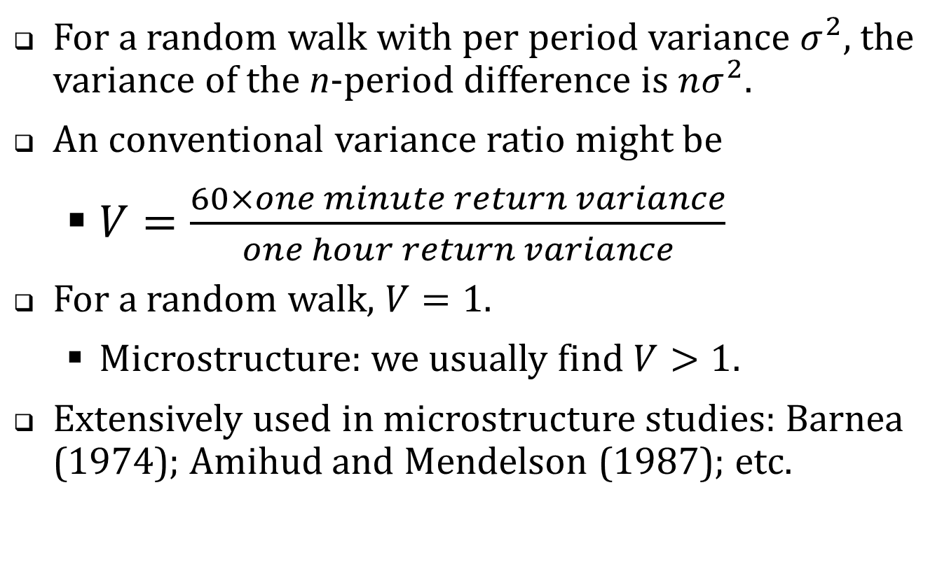
The short/long variance ratio
For a random walk with per period variance $σ^{2}$, the variance of the n-period difference is $nσ^{2}$.
An conventional variance ratio might be
  $V=\frac{60×one minute return variance}{one hour return variance}$
For a random walk, $V=1$.
  Microstructure: we usually find $V>1$.
Extensively used in microstructure studies: Barnea (1974); Amihud and Mendelson (1987); etc.

Slide 20
The empirical analysis
CRSP Universe 2001-2011
In each year, chose 150 firms in a random sample stratified by dollar trading volume
2011 April TAQ with one-millisecond time stamps
2001-2011
April TAQ data with one-second time stamps
High-resolution analysis
Lower-resolution analysis

Slide 21
Table 1. Summary Statistics, 2011
 |  | Dollar trading volume quintile
 | Full sample | 1 (low) | 2 | 3 | 4 | 5 (high)
No. of firms | 150 | 30 | 30 | 30 | 30 | 30
NYSE | 47 | 0 | 5 | 7 | 16 | 19
Amex | 6 | 2 | 2 | 0 | 1 | 1
NASDAQ | 97 | 28 | 23 | 23 | 13 | 10
Avg. daily trades | 1,331 | 31 | 431 | 1,126 | 3,478 | 16,987
Avg. daily quotes | 23,928 | 967 | 7,706 | 24,026 | 53,080 | 181,457
Avg. daily NBBO records | 7,138 | 328 | 3,029 | 7,543 | 16,026 | 46,050
Avg. daily NBB changes | 1,245 | 120 | 511 | 1,351 | 2,415 | 4,124
Avg. daily NBO changes | 1,164 | 103 | 460 | 1,361 | 2,421 | 4,214
Avg. price | $15.62 | $4.87 | $5.46 | $17.86 | $27.76 | $51.60
Market capitalization of equity, $ Million | $683 | $41 | $202 | $747 | $1,502 | $8,739

Slide 22
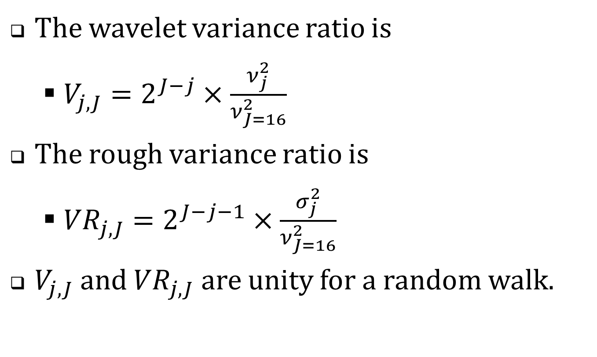
Table 2. Time scale variance estimates, 2011
 | Rough volatilities, $σ_{j}^{}$ |  |  | Wavelet variances, $ν_{j}^{2}$
 | (1) | (2) | (3) | (4) | (5) | (6) | (7)
Time scale | $σ_{j},$mils | $$σ_{j}, bp$$ | Variance ratio | $\sqrt{ν_{j}^{2}},$mils | $$\sqrt{ν_{j}^{2}}, bp$$ | Variance ratio | Bid-Offer Corr
< 50 ms | 0.28 | 0.16 | 4.22
50 ms | 0.39 | 0.22 | 3.99 | 0.27 | 0.15 | 3.76 | 0.32
100 ms | 0.55 | 0.31 | 3.79 | 0.38 | 0.21 | 3.58 | 0.36
200 ms | 0.76 | 0.43 | 3.53 | 0.53 | 0.30 | 3.27 | 0.41
400 ms | 1.05 | 0.59 | 3.21 | 0.73 | 0.41 | 2.88 | 0.44
800 ms | 1.46 | 0.83 | 2.90 | 1.01 | 0.57 | 2.59 | 0.47
1,600 ms | 2.02 | 1.14 | 2.64 | 1.40 | 0.79 | 2.38 | 0.51
3.2 sec | 2.80 | 1.58 | 2.40 | 1.94 | 1.09 | 2.16 | 0.55
6.4 sec | 3.90 | 2.18 | 2.12 | 2.71 | 1.49 | 1.84 | 0.60
12.8 sec | 5.43 | 2.99 | 1.88 | 3.77 | 2.04 | 1.65 | 0.64
25.6 sec | 7.54 | 4.10 | 1.70 | 5.23 | 2.79 | 1.51 | 0.69
51.2 sec | 10.48 | 5.61 | 1.54 | 7.25 | 3.82 | 1.39 | 0.74
102.4 sec | 14.53 | 7.68 | 1.42 | 10.04 | 5.22 | 1.29 | 0.79
3.4 min | 20.12 | 10.51 | 1.32 | 13.87 | 7.14 | 1.21 | 0.83
6.8 min | 27.88 | 14.40 | 1.23 | 19.22 | 9.78 | 1.15 | 0.86
13.7 min | 38.55 | 19.70 | 1.16 | 26.45 | 13.33 | 1.08 | 0.88
27.3 min | 52.84 | 26.79 | 1.08 | 35.73 | 17.91 | 1.00 | 0.90
A trader who faces time uncertainty of 400 ms incurs price risk of $1.05 mils/share$
or $0.59 basis points$.
At a time scale of 400 ms., the rough variance is 3.21 times the value implied by a random walk with variance calibrated to 27.3 minutes.

Slide 23
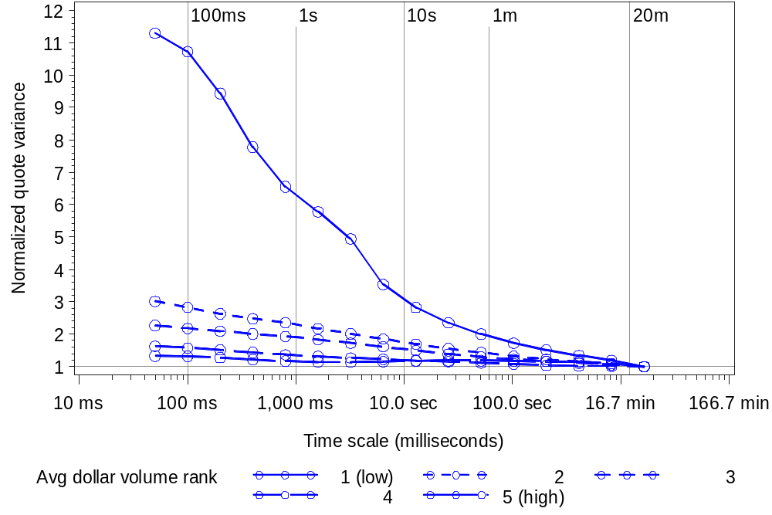
Figure 2. Wavelet variance ratios across time scale and dollar volume quintiles

Slide 24
The 2011 results: a summary
Variance ratios: short term volatility is much higher than we’d expect relative to a random-walk.
In mils per share or basis points, average short term volatility is economically meaningful, but small.

Slide 25
Historical analysis
CRSP Universe 2001-2011
In each year, chose 150 firms in a random sample stratified by dollar trading volume
2011 April TAQ with one-millisecond time stamps
2001-2011
April TAQ data with one-second time stamps
High-resolution analysis
Lower-resolution analysis

Slide 26
Table 5. Summary statistics, historical sample,
2001-2011 (only odd numbered years are shown)
 | 2001 |  | 2003 |  | 2005 |  | 2007 |  | 2009 |  | 2011
No. firms | 146 |  | 150 |  | 150 |  | 150 |  | 150 |  | 150
NYSE | 108 |  | 51 |  | 48 |  | 55 |  | 56 |  | 47
Amex | 22 |  | 11 |  | 8 |  | 14 |  | 5 |  | 6
NASDAQ | 16 |  | 88 |  | 94 |  | 81 |  | 89 |  | 97
Avg. daily trades | 142 |  | 187 |  | 425 |  | 970 |  | 1,790 |  | 1,331
Avg. daily quotes | 1,078 |  | 1,299 |  | 5,828 |  | 12,521 |  | 39,378 |  | 23,928
Avg. daily NBB changes | 103 |  | 203 |  | 596 |  | 772 |  | 1,618 |  | 1,210
Avg. daily NBO changes | 103 |  | 213 |  | 729 |  | 789 |  | 1,731 |  | 1,126
Avg. price | $18.85 |  | $14.83 |  | $16.10 |  | $15.81 |  | $10.72 |  | $15.62
Market equity cap $ Million | $745 |  | $189 |  | $325 |  | $480 |  | $316 |  | $683

Slide 27
Table 5. Summary statistics, historical sample,
2001-2011 (only odd numbered years are shown)
 | 2001 |  | 2003 |  | 2005 |  | 2007 |  | 2009 |  | 2011
No. firms | 146 |  | 150 |  | 150 |  | 150 |  | 150 |  | 150
NYSE | 108 |  | 51 |  | 48 |  | 55 |  | 56 |  | 47
Amex | 22 |  | 11 |  | 8 |  | 14 |  | 5 |  | 6
NASDAQ | 16 |  | 88 |  | 94 |  | 81 |  | 89 |  | 97
Avg. daily trades | 142 |  | 187 |  | 425 |  | 970 |  | 1,790 |  | 1,331
Avg. daily quotes | 1,078 |  | 1,299 |  | 5,828 |  | 12,521 |  | 39,378 |  | 23,928
Avg. daily NBB changes | 103 |  | 203 |  | 596 |  | 772 |  | 1,618 |  | 1,210
Avg. daily NBO changes | 103 |  | 213 |  | 729 |  | 789 |  | 1,731 |  | 1,126
Avg. price | $18.85 |  | $14.83 |  | $16.10 |  | $15.81 |  | $10.72 |  | $15.62
Market equity cap $ Million | $745 |  | $189 |  | $325 |  | $480 |  | $316 |  | $683
25% CAGR
36% CAGR

Slide 28
What statistics to consider?
Long-term volatilities changed dramatically over the sample period.
Variance ratios (normalized to long-term volatility) are the most reliable indicators of trends.

Slide 29
Table 6. Wavelet variance ratios for bids and offers, 2001-2011
Panel A: Computed from unadjusted bids and offers
Time scale | 2001 | 2002 | 2003 | 2004 | 2005 | 2006 | 2007 | 2008 | 2009 | 2010 | 2011
50 ms | 5.22 | 7.16 | 6.03 | 10.28 | 6.69 | 8.57 | 6.96 | 6.06 | 4.52 | 7.08 | 4.70
100 ms | 5.44 | 6.58 | 5.28 | 9.69 | 6.51 | 8.07 | 6.27 | 5.38 | 4.12 | 6.26 | 4.32
200 ms | 5.28 | 6.28 | 5.13 | 9.03 | 6.22 | 7.34 | 5.33 | 4.64 | 3.68 | 5.40 | 3.74
400 ms | 4.59 | 5.23 | 5.00 | 8.16 | 5.75 | 6.30 | 4.25 | 3.84 | 3.21 | 4.53 | 3.07
800 ms | 3.12 | 4.04 | 3.93 | 5.57 | 5.03 | 5.10 | 3.41 | 3.11 | 2.76 | 3.71 | 2.56
1,600 ms | 2.11 | 2.55 | 3.25 | 4.11 | 4.14 | 4.05 | 2.89 | 2.59 | 2.43 | 3.04 | 2.23
3.2 sec | 1.98 | 2.24 | 2.93 | 3.38 | 3.48 | 3.37 | 2.56 | 2.29 | 2.17 | 2.53 | 2.01
6.4 sec | 1.94 | 2.11 | 2.62 | 2.91 | 2.93 | 2.92 | 2.35 | 2.08 | 1.95 | 2.16 | 1.82

Slide 30
No trend in quote volatilities?
Maybe …
  “Flickering quotes” aren’t new.
  Recent concerns about high frequency trading are all media hype.
  The good old days weren’t really so great after all.
What did quote volatility look like circa 2001?

Slide 31
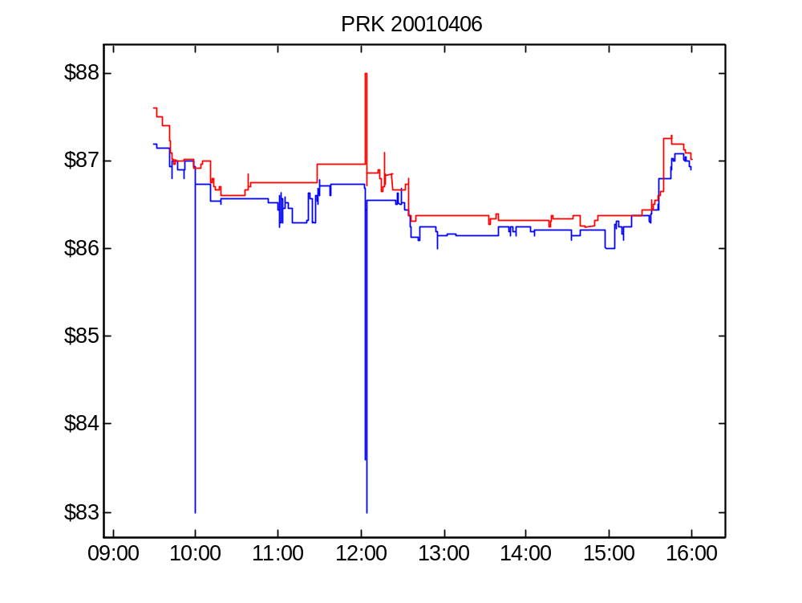
Figure 4 Panel A. Bid and offer for PRK, April 6, 2001.

Slide 32
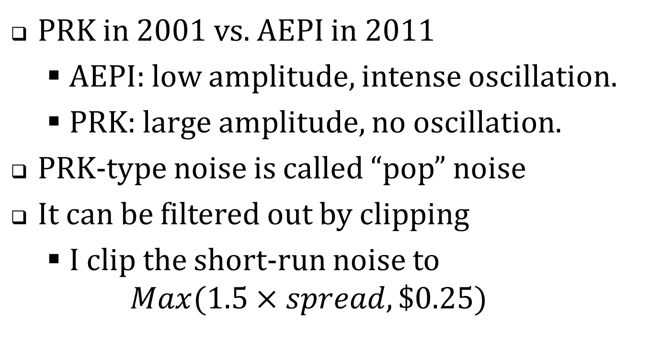
Compare
PRK in 2001 vs. AEPI in 2011
  AEPI: low amplitude, intense oscillation.
  PRK: large amplitude, no oscillation.
PRK-type noise is called “pop” noise
It can be filtered out by clipping
  I clip the short-run noise to
  $Max(1.5×spread,\$0.25)$

Slide 33
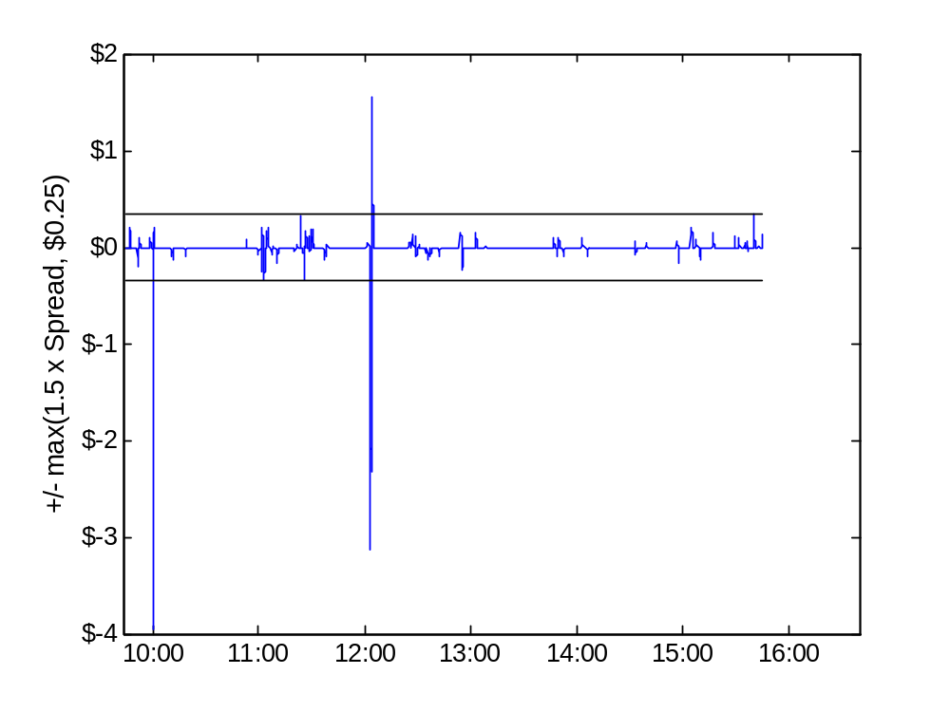
Figure 4 Panel B. PRK, April 6, 2001, Rough component of the bid

Slide 34
Table 6. Wavelet variance ratios for bids and offers, 2001-2011
Panel B. Computed from denoised bids and offers
Time scale | 2001 | 2002 | 2003 | 2004 | 2005 | 2006 | 2007 | 2008 | 2009 | 2010 | 2011
50 ms | 1.60 | 2.37 | 3.15 | 7.02 | 6.09 | 8.24 | 6.56 | 5.83 | 4.20 | 6.79 | 4.46
100 ms | 1.57 | 2.32 | 3.09 | 6.82 | 5.89 | 7.76 | 5.89 | 5.17 | 3.83 | 6.00 | 4.07
200 ms | 1.56 | 2.27 | 3.03 | 6.48 | 5.61 | 7.04 | 4.99 | 4.45 | 3.41 | 5.18 | 3.57
400 ms | 1.55 | 2.23 | 2.94 | 5.90 | 5.16 | 6.02 | 3.96 | 3.68 | 2.97 | 4.36 | 3.00
800 ms | 1.57 | 2.19 | 2.83 | 5.00 | 4.47 | 4.82 | 3.13 | 2.98 | 2.56 | 3.58 | 2.52
1,600 ms | 1.64 | 2.20 | 2.71 | 3.99 | 3.60 | 3.79 | 2.63 | 2.51 | 2.27 | 2.94 | 2.20
3.2 sec | 1.81 | 2.30 | 2.62 | 3.44 | 3.02 | 3.16 | 2.33 | 2.23 | 2.04 | 2.46 | 2.00
6.4 sec | 2.11 | 2.51 | 2.59 | 3.20 | 2.65 | 2.75 | 2.15 | 2.04 | 1.86 | 2.11 | 1.82

Slide 35
So has quote volatility increased?
Apples vs. oranges
  The nature of quotes has changed.
Quote volatility has changed
  From infrequent large changes to frequent (and oscillatory) small changes.
Possibly a overall small increase,
  But nothing as strong as the trend implied by the growth in quote messaging rates.

