Slide 1
High Frequency Quoting:
Short-Term Volatility in Bids and Offers
Joel Hasbrouck
Stern School, NYU
Presentation at Paris HFT Conference,
April 18, 2013

Slide 2
Disclaimers
I teach in an entry-level training program at a large financial firm that is generally thought to engage in high frequency trading.
I serve on a CFTC advisory committee that discusses issues related to high frequency trading.
I accept honoraria for presentations at events sponsored by financial firms.

Slide 3
What does quote volatility look like?
In US equity markets, bids and offers from all trading venues are consolidated and disseminated in real time.
  The highest bid is the National Best Bid (NBB)
  The lowest offer is the National Best Offer (NBO)
Next slide: the NBBO for AEPI on April 29, 2011

Slide 4
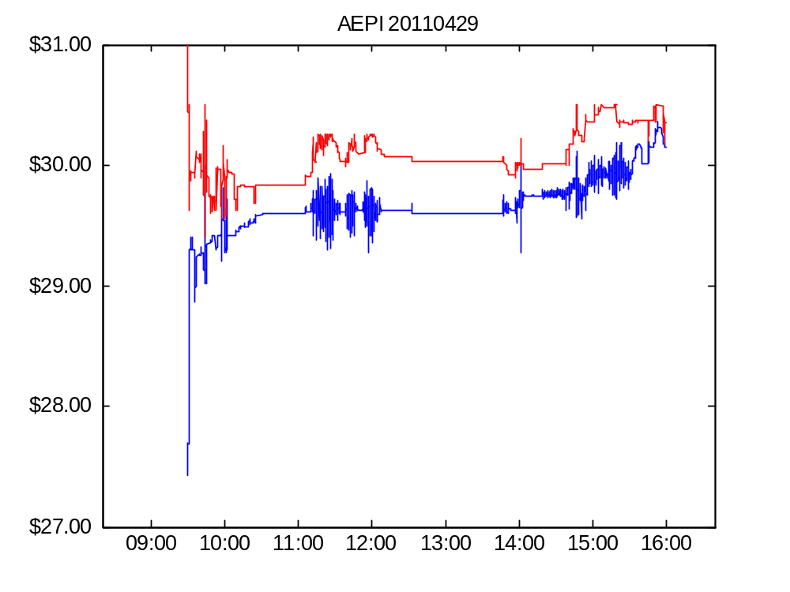
Figure 1. AEPI bid and offer, April 29, 2011

Slide 5
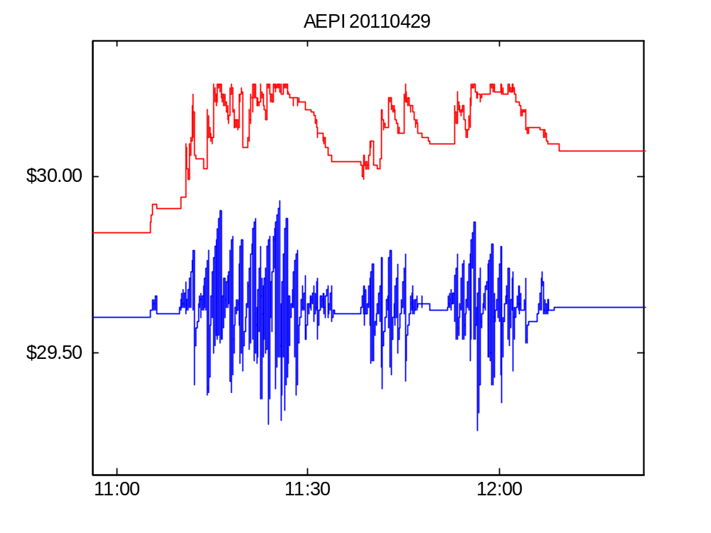
Figure 1. AEPI bid and offer on April 29, 2011 (detail)

Slide 6
Features of the AEPI episodes
Extremely rapid oscillations in the bid.
Start and stop abruptly
Mostly one-sided
  activity on the ask side is much smaller
Episodes don’t coincide with large long-term changes in the stock price.

Slide 7
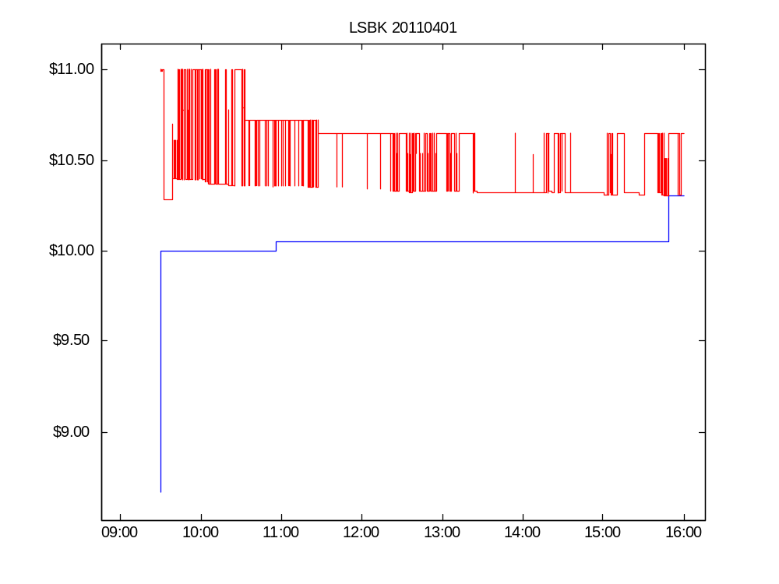

Slide 8
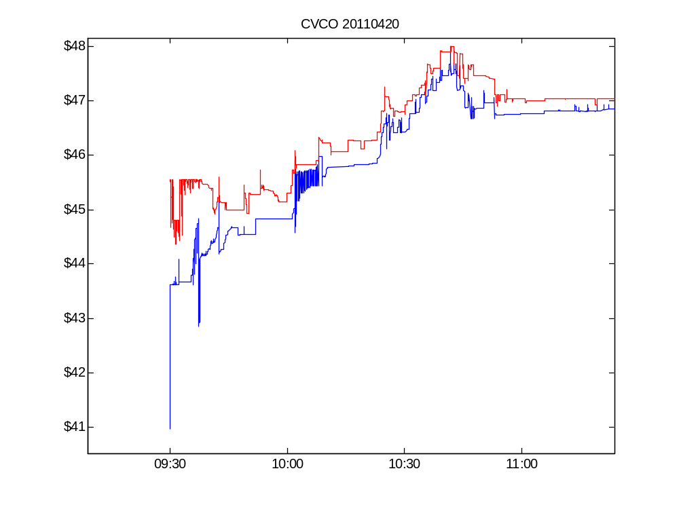

Slide 9
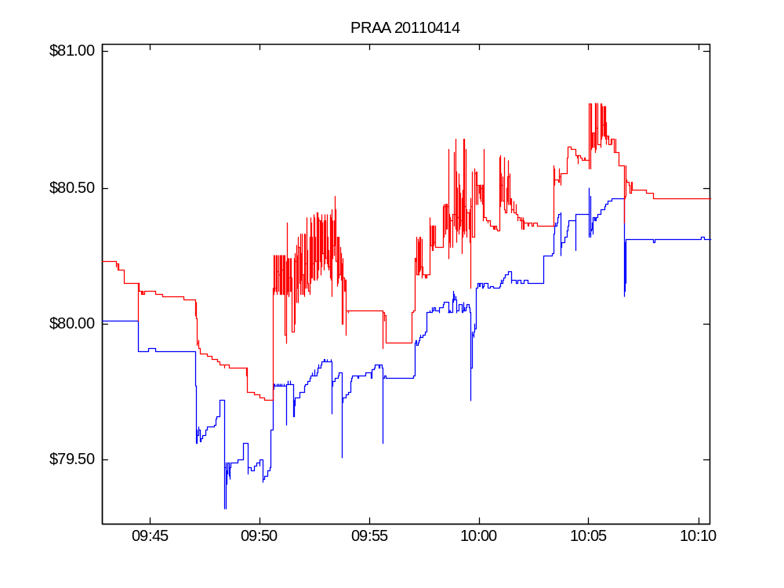

Slide 10
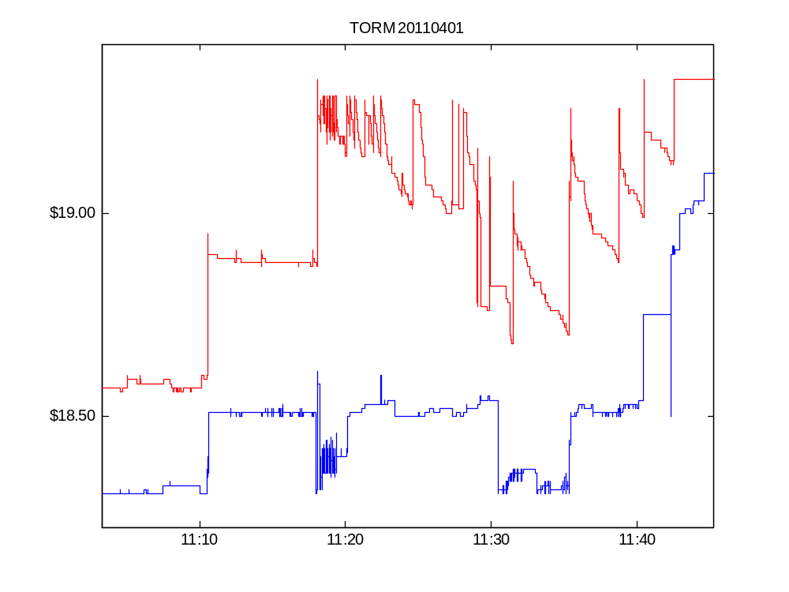

Slide 11
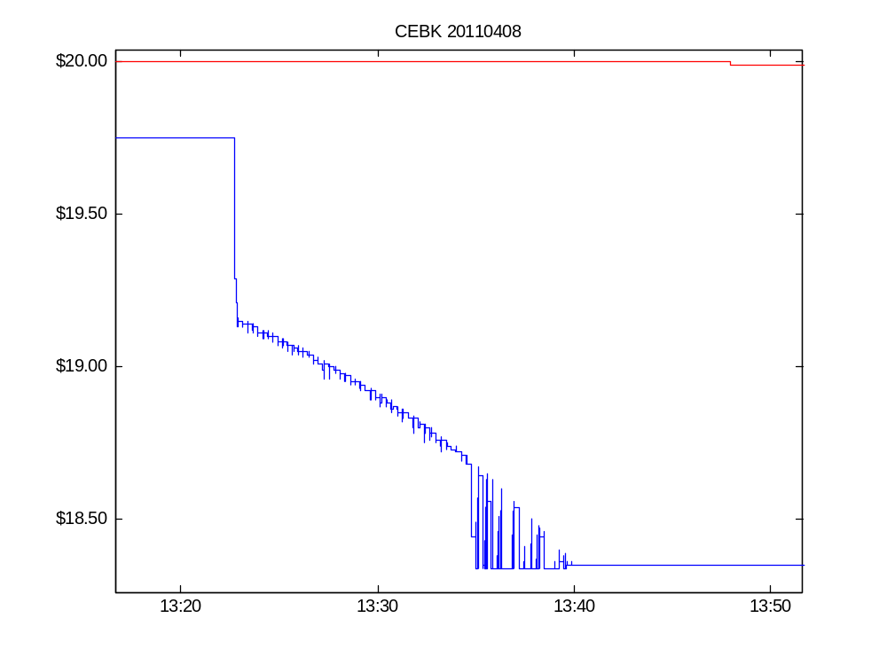

Slide 12
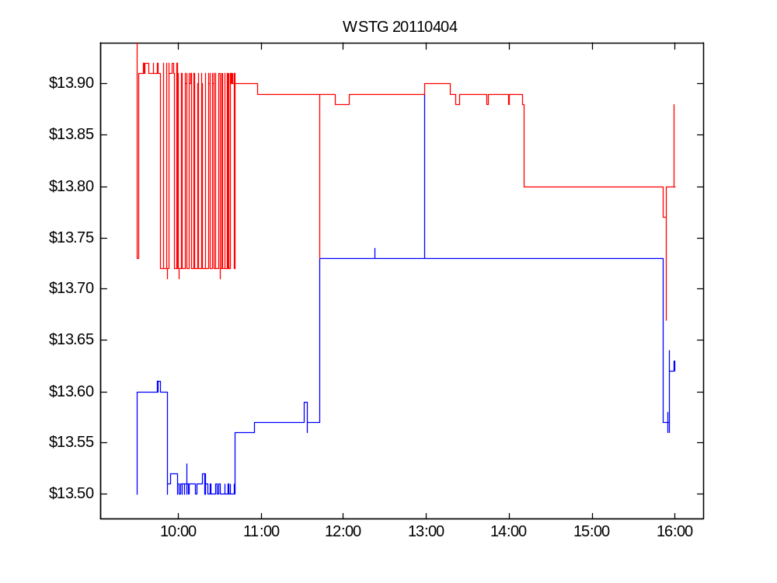

Slide 13
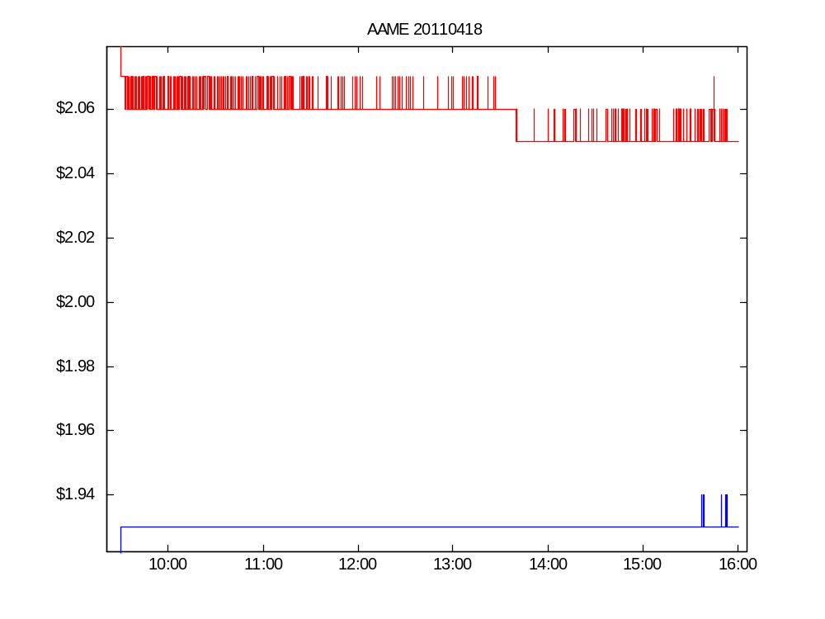

Slide 14
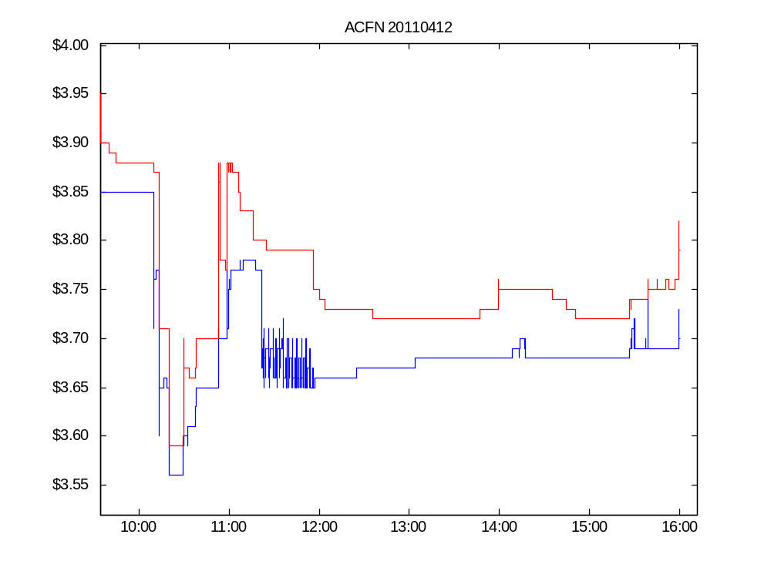

Slide 15
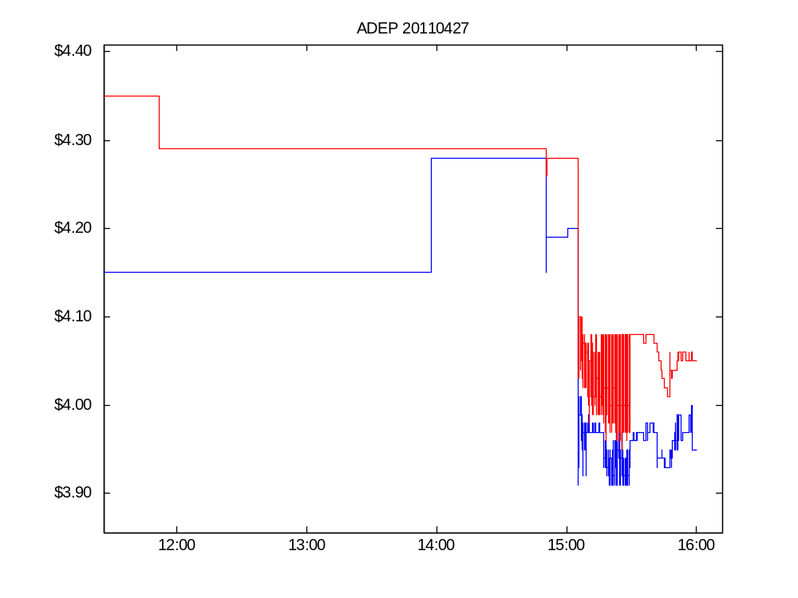

Slide 16
Quote volatility: the questions
What is its economic meaning and importance?
How should we measure it?
Is it elevated? Relative to what?
Has it increased along with wider adoption of high-speed trading technology?

Slide 17
Economic consequences of quote volatility
Noise
Execution price risk
  For marketable orders
  For dark trades
Intermediaries’ look-back options
Quote-stuffing
Spoofing

Slide 18
Quote volatility and noise: “flickering quotes”
Noise degrades the informational value of a price signal.
“The improvements in market structure have also created new challenges, one of which is the well-known phenomenon of “ephemeral” or “flickering” quotes.
Flickering quotes create problems like bandwidth consumption and decreased price transparency.”
  CIBC World Markets, comment letter to SEC, Feb. 4, 2005.

Slide 19
Execution price risk for marketable orders
A marketable order is one that is priced to be executed immediately.
  “Buy 100 shares at the market” instructs the broker to buy, paying the current market asking price (no matter how high).
All orders face arrival time uncertainty.
Time uncertainty → price uncertainty

Slide 20
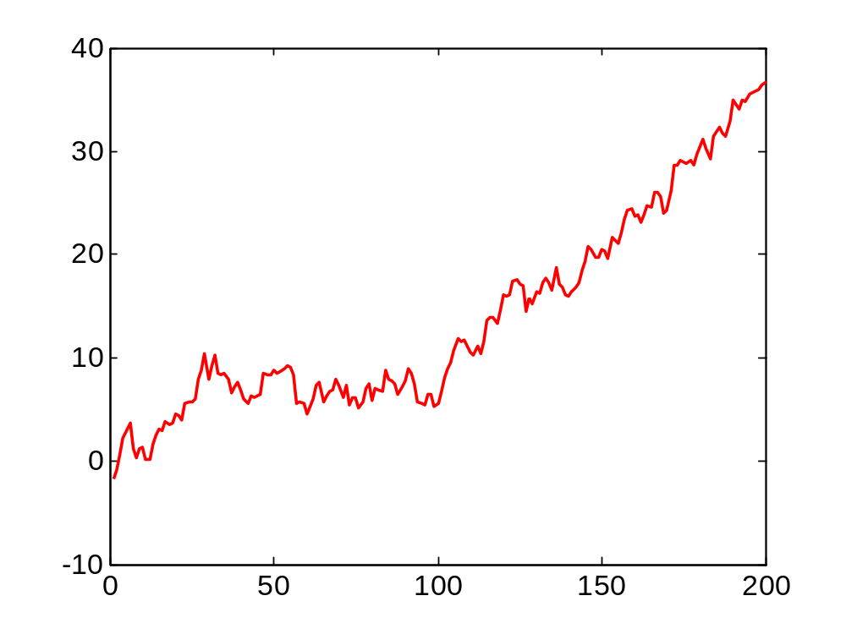
Execution price risk for marketable orders
A buyer who has arrival time uncertainty can expect to pay the average offer over the arrival period (and has price risk relative to this average).
Offer (ask) quote

Slide 21
Execution price risk for dark trades
A dark trading venue does not display a bid or offer.
  Roughly 30% of total volume is dark.
In a dark market the execution price of a trade is set by reference to the bid and offer displayed by a lit market.
Volatility in these reference prices induces execution price risk for the dark trades.

Slide 22
Quote volatility and look-back options
Many market rules and practices reference “the current NBBO”
  Due to network latencies, “current” is a fuzzy term.
  In practice, “current” means “at any time in the past few seconds”
One dominant party might enjoy the flexibility to pick a price within this window.
“Lookback option” Stoll and Schenzler (2002)

Slide 23
“Spoofing” manipulations
A dark pool buyer enter a spurious sell order in a visible market.
The sell order drives down the NBBO midpoint.
The buyer pays a lower price in the dark pool.

Slide 24
What are the connections between high-frequency quoting and high-frequency trading?

Slide 25
The first studies: HFT is beneficial/benign
“HF traders are the new market makers.”
Empirical studies
  Hendershott, Jones and Menkveld (2011)
  Hasbrouck and Saar (2012)
  Brogaard, Hendershott and Riordan (2012)
Studies generally find that HFT activity is associated with (causes?) higher market quality.

Slide 26
Follow-on: “Maybe HF traders are predatory.”
They profit from HF information asymmetries at the expense of natural liquidity seekers.
Theory: Jarrow and Protter (2011); Foucault, Hombert and Rosu (2012); Biais, Declerk and Moinas (2013)
Empirical: Baron, Brogaard and Kirilenko (2012); Weller (2012); Clark-Joseph (2012)

Slide 27
The spillover questions
Quote volatility is an inverse measure of market quality.
  It measures a kind of liquidity risk.
HFT is perceived to have grown over the past decade.
  Quoting and trading use the same technology.
  Certainly some market participants perceive a rise in quote volatility.
  What do the data say?

Slide 28
Descriptive statistics: computation and interpretation

Slide 29
Local variances about local means
n = length of averaging interval.
Depends on trader’s latency and order strategies: we want a range of n

Slide 30
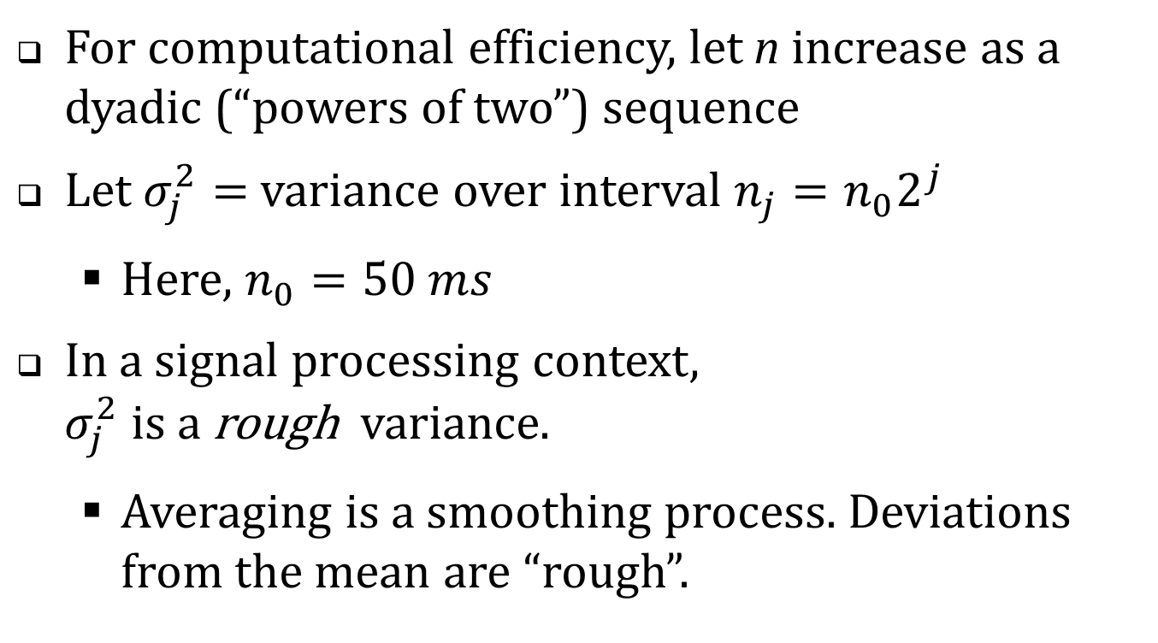
Rough variances
For computational efficiency, let n increase as a dyadic (“powers of two”) sequence
Let $σ_{j}^{2}=$ variance over interval $n_{j}=n_{0}2^{j}$
  Here, $n_{0}=50 ms$
In a signal processing context,
$σ_{j}^{2}$ is a rough variance.
  Averaging is a smoothing process. Deviations from the mean are “rough”.

Slide 31
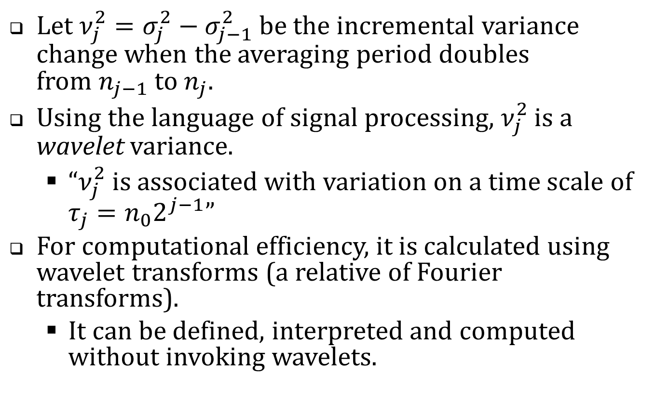
The incremental (“wavelet”) variances
Let $ν_{j}^{2}=σ_{j}^{2}−σ_{j−1}^{2}$ be the incremental variance change when the averaging period doubles
from $n_{j−1}$ to $n_{j}$.
Using the language of signal processing, $ν_{j}^{2}$ is a wavelet variance.
  “$ν_{j}^{2}$ is associated with variation on a time scale of $τ_{j}=n_{0}2^{j−1}$”
For computational efficiency, it is calculated using wavelet transforms (a relative of Fourier transforms).
  It can be defined, interpreted and computed without invoking wavelets.

Slide 32
Interpretation
To assess economic importance, I present the (wavelet and rough) variance estimates in three ways.
  In mils per share
  In basis points
  As a short-term/long-term ratio

Slide 33
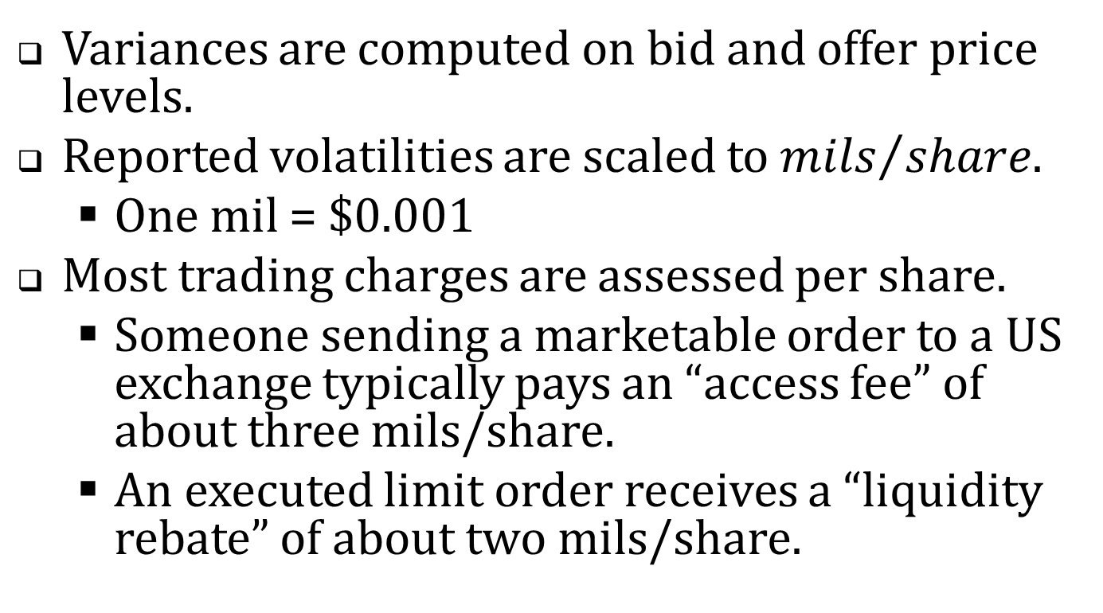
Mils per share
Variances are computed on bid and offer price levels.
Reported volatilities are scaled to ${mils}/{share}$.
  One mil = $0.001
Most trading charges are assessed per share.
  Someone sending a marketable order to a US exchange typically pays an “access fee” of about three mils/share.
  An executed limit order receives a “liquidity rebate” of about two mils/share.

Slide 34
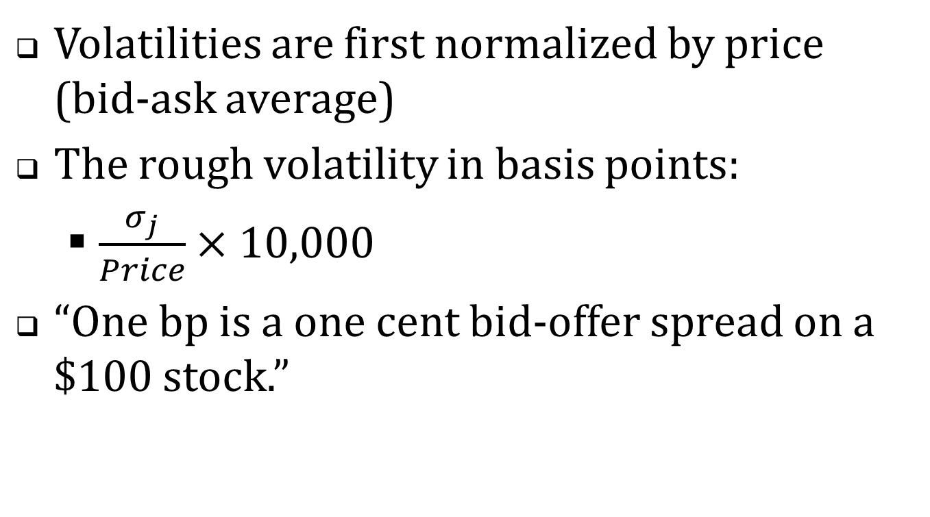
Basis points (One bp = 0.01%)
Volatilities are first normalized by price (bid-ask average)
The rough volatility in basis points:
  $\frac{σ_{j}}{Price}×10,000$
“One bp is a one cent bid-offer spread on a $100 stock.”

Slide 35
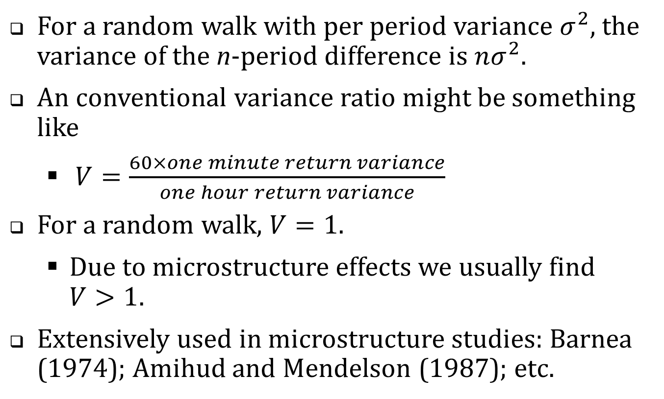
The short/long variance ratio
For a random walk with per period variance $σ^{2}$, the variance of the n-period difference is $nσ^{2}$.
An conventional variance ratio might be something like
  $V=\frac{60×one minute return variance}{one hour return variance}$
For a random walk, $V=1$.
  Due to microstructure effects we usually find $V>1$.
Extensively used in microstructure studies: Barnea (1974); Amihud and Mendelson (1987); etc.

Slide 36
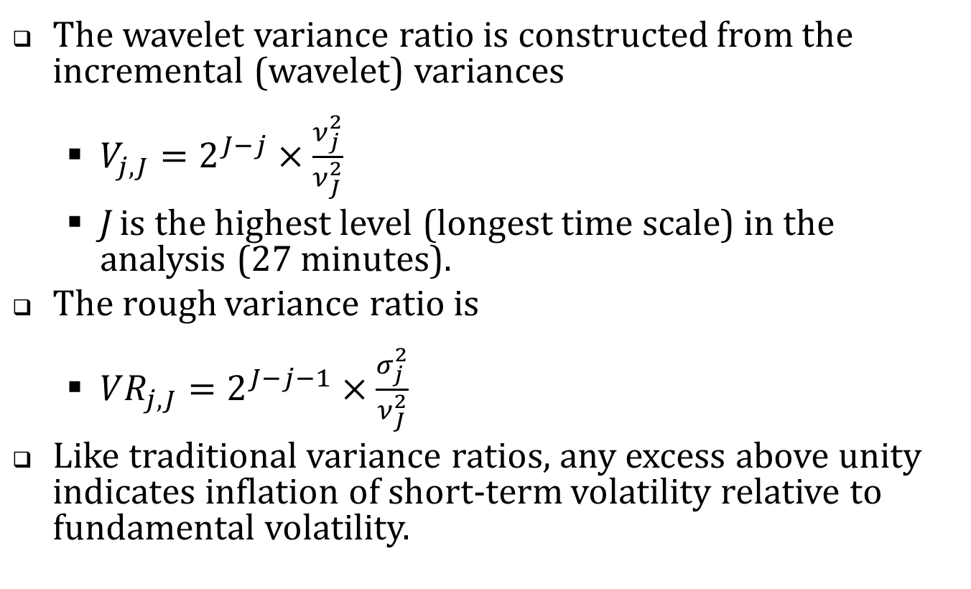
Variance ratios (cont’d)
The wavelet variance ratio is constructed from the incremental (wavelet) variances
  $V_{j,J}=2^{J−j}×\frac{ν_{j}^{2}}{ν_{J}^{2}}$
  J is the highest level (longest time scale) in the analysis (27 minutes).
The rough variance ratio is
  ${VR}_{j,J}=2^{J−j−1}×\frac{σ_{j}^{2}}{ν_{J}^{2}}$
Like traditional variance ratios, any excess above unity indicates inflation of short-term volatility relative to fundamental volatility.

Slide 37
The empirical analysis
CRSP Universe 2001-2011. (Share code = 10 or 11; average price $2 to $1,000; listing NYSE, Amex or NASDAQ)
In each year, chose 150 firms in a random sample stratified by dollar trading volume
2011 April TAQ with one-millisecond time stamps
2001-2011
April TAQ data with one-second time stamps
High-resolution analysis
Lower-resolution analysis

Slide 38
Table 1. Summary Statistics, 2011
 |  | Dollar trading volume quintile
 | Full sample | 1 (low) | 2 | 3 | 4 | 5 (high)
No. of firms | 150 | 30 | 30 | 30 | 30 | 30
NYSE | 47 | 0 | 5 | 7 | 16 | 19
Amex | 6 | 2 | 2 | 0 | 1 | 1
NASDAQ | 97 | 28 | 23 | 23 | 13 | 10
Avg. daily trades | 1,331 | 31 | 431 | 1,126 | 3,478 | 16,987
Avg. daily quotes | 23,928 | 967 | 7,706 | 24,026 | 53,080 | 181,457
Avg. daily NBBO records | 7,138 | 328 | 3,029 | 7,543 | 16,026 | 46,050
Avg. daily NBB changes | 1,245 | 120 | 511 | 1,351 | 2,415 | 4,124
Avg. daily NBO changes | 1,164 | 103 | 460 | 1,361 | 2,421 | 4,214
Avg. price | $15.62 | $4.87 | $5.46 | $17.86 | $27.76 | $51.60
Market capitalization of equity, $ Million | $683 | $41 | $202 | $747 | $1,502 | $8,739

Slide 39
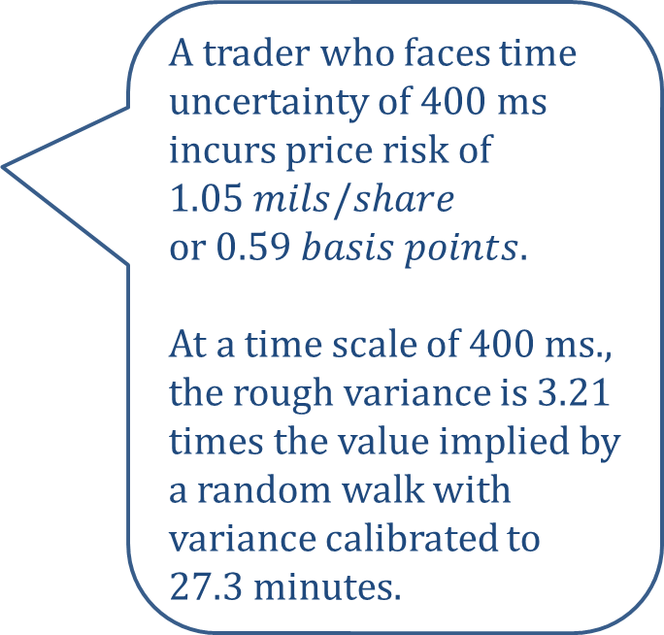
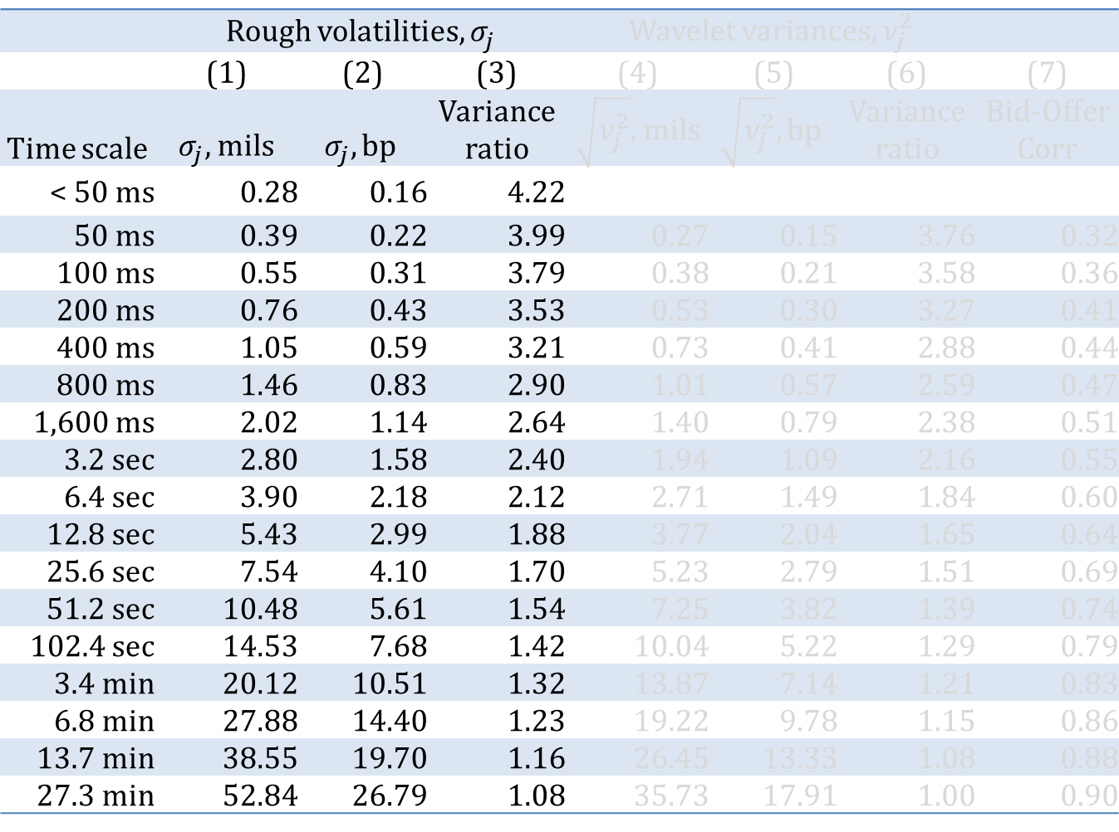
Table 2. Time scale variance estimates, 2011
 | Rough volatilities, $σ_{j}^{}$ |  |  | Wavelet variances, $ν_{j}^{2}$
 | (1) | (2) | (3) | (4) | (5) | (6) | (7)
Time scale | $σ_{j},$mils | $$σ_{j}, bp$$ | Variance ratio | $\sqrt{ν_{j}^{2}},$mils | $$\sqrt{ν_{j}^{2}}, bp$$ | Variance ratio | Bid-Offer Corr
< 50 ms | 0.28 | 0.16 | 4.22
50 ms | 0.39 | 0.22 | 3.99 | 0.27 | 0.15 | 3.76 | 0.32
100 ms | 0.55 | 0.31 | 3.79 | 0.38 | 0.21 | 3.58 | 0.36
200 ms | 0.76 | 0.43 | 3.53 | 0.53 | 0.30 | 3.27 | 0.41
400 ms | 1.05 | 0.59 | 3.21 | 0.73 | 0.41 | 2.88 | 0.44
800 ms | 1.46 | 0.83 | 2.90 | 1.01 | 0.57 | 2.59 | 0.47
1,600 ms | 2.02 | 1.14 | 2.64 | 1.40 | 0.79 | 2.38 | 0.51
3.2 sec | 2.80 | 1.58 | 2.40 | 1.94 | 1.09 | 2.16 | 0.55
6.4 sec | 3.90 | 2.18 | 2.12 | 2.71 | 1.49 | 1.84 | 0.60
12.8 sec | 5.43 | 2.99 | 1.88 | 3.77 | 2.04 | 1.65 | 0.64
25.6 sec | 7.54 | 4.10 | 1.70 | 5.23 | 2.79 | 1.51 | 0.69
51.2 sec | 10.48 | 5.61 | 1.54 | 7.25 | 3.82 | 1.39 | 0.74
102.4 sec | 14.53 | 7.68 | 1.42 | 10.04 | 5.22 | 1.29 | 0.79
3.4 min | 20.12 | 10.51 | 1.32 | 13.87 | 7.14 | 1.21 | 0.83
6.8 min | 27.88 | 14.40 | 1.23 | 19.22 | 9.78 | 1.15 | 0.86
13.7 min | 38.55 | 19.70 | 1.16 | 26.45 | 13.33 | 1.08 | 0.88
27.3 min | 52.84 | 26.79 | 1.08 | 35.73 | 17.91 | 1.00 | 0.90
A trader who faces time uncertainty of 400 ms incurs price risk of $1.05 mils/share$
or $0.59 basis points$.
At a time scale of 400 ms., the rough variance is 3.21 times the value implied by a random walk with variance calibrated to 27.3 minutes.

Slide 40
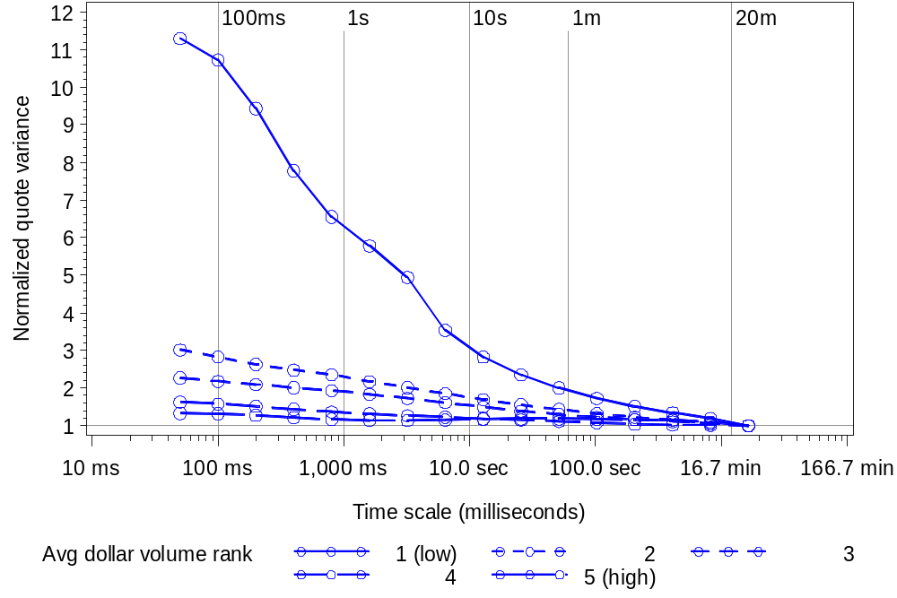
Figure 2. Wavelet variance ratios across time scale and dollar volume quintiles

Slide 41
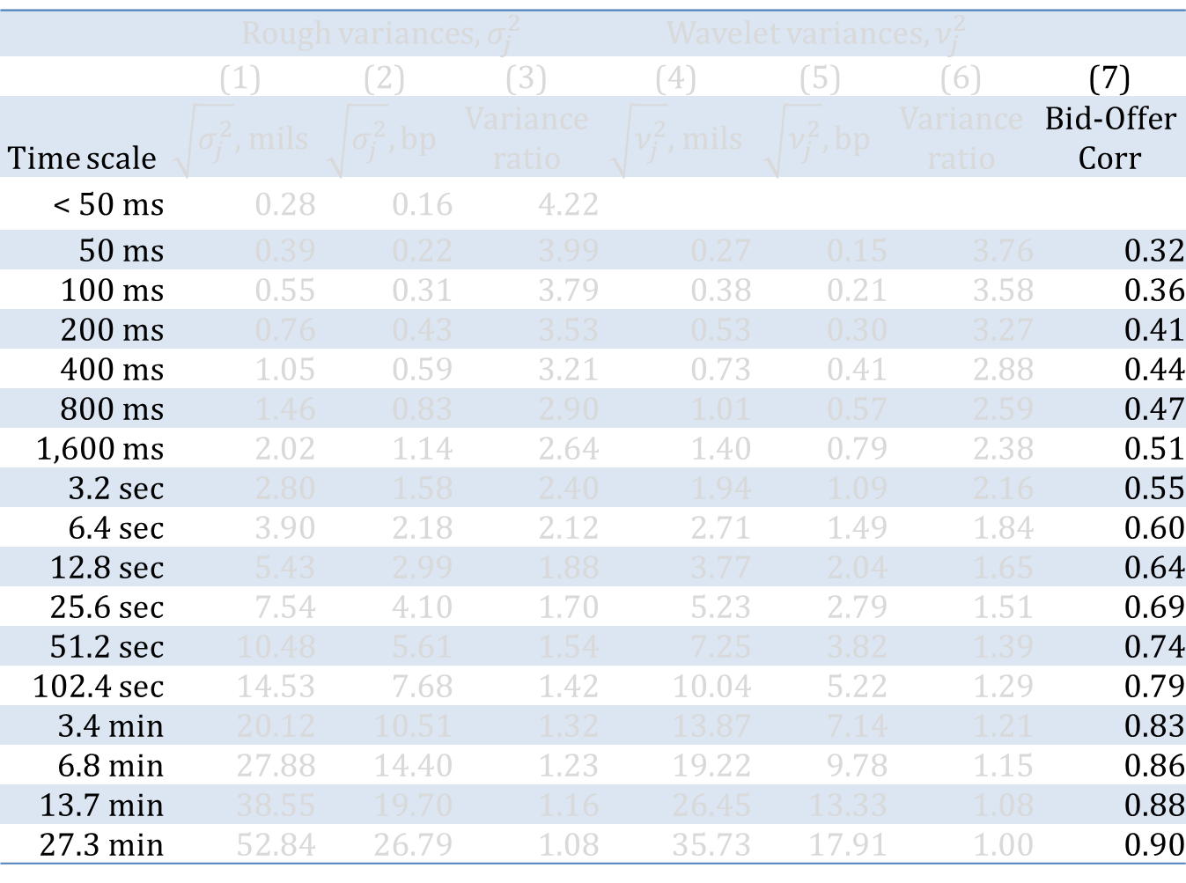
Table 2. Time scale variance estimates, 2011
 | Rough variances, $σ_{j}^{2}$ |  |  | Wavelet variances, $ν_{j}^{2}$
 | (1) | (2) | (3) | (4) | (5) | (6) | (7)
Time scale | $\sqrt{σ_{j}^{2}},$mils | $$\sqrt{σ_{j}^{2}}, bp$$ | Variance ratio | $\sqrt{ν_{j}^{2}},$mils | $$\sqrt{ν_{j}^{2}}, bp$$ | Variance ratio | Bid-Offer Corr
< 50 ms | 0.28 | 0.16 | 4.22
50 ms | 0.39 | 0.22 | 3.99 | 0.27 | 0.15 | 3.76 | 0.32
100 ms | 0.55 | 0.31 | 3.79 | 0.38 | 0.21 | 3.58 | 0.36
200 ms | 0.76 | 0.43 | 3.53 | 0.53 | 0.30 | 3.27 | 0.41
400 ms | 1.05 | 0.59 | 3.21 | 0.73 | 0.41 | 2.88 | 0.44
800 ms | 1.46 | 0.83 | 2.90 | 1.01 | 0.57 | 2.59 | 0.47
1,600 ms | 2.02 | 1.14 | 2.64 | 1.40 | 0.79 | 2.38 | 0.51
3.2 sec | 2.80 | 1.58 | 2.40 | 1.94 | 1.09 | 2.16 | 0.55
6.4 sec | 3.90 | 2.18 | 2.12 | 2.71 | 1.49 | 1.84 | 0.60
12.8 sec | 5.43 | 2.99 | 1.88 | 3.77 | 2.04 | 1.65 | 0.64
25.6 sec | 7.54 | 4.10 | 1.70 | 5.23 | 2.79 | 1.51 | 0.69
51.2 sec | 10.48 | 5.61 | 1.54 | 7.25 | 3.82 | 1.39 | 0.74
102.4 sec | 14.53 | 7.68 | 1.42 | 10.04 | 5.22 | 1.29 | 0.79
3.4 min | 20.12 | 10.51 | 1.32 | 13.87 | 7.14 | 1.21 | 0.83
6.8 min | 27.88 | 14.40 | 1.23 | 19.22 | 9.78 | 1.15 | 0.86
13.7 min | 38.55 | 19.70 | 1.16 | 26.45 | 13.33 | 1.08 | 0.88
27.3 min | 52.84 | 26.79 | 1.08 | 35.73 | 17.91 | 1.00 | 0.90
How closely do the bid and offer track at the indicated time scale?

Slide 42
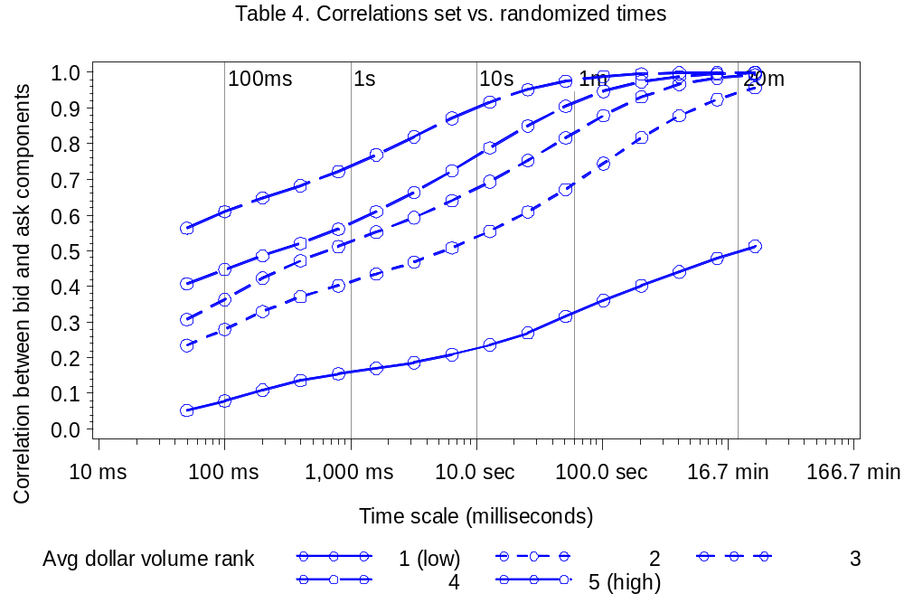
Figure 3. Wavelet correlations between the National Best Bid and National Best Offer

Slide 43
The 2011 results: a summary
Variance ratios: short term volatility is much higher than we’d expect relative to a random-walk.
In mils per share or basis points, average short term volatility is economically meaningful, but small.

Slide 44
Historical analysis
CRSP Universe 2001-2011. (Share code = 10 or 11; average price $2 to $1,000; listing NYSE, Amex or NASDAQ)
In each year, chose 150 firms in a random sample stratified by dollar trading volume
2011 April TAQ with one-millisecond time stamps
2001-2011
April TAQ data with one-second time stamps
High-resolution analysis
Lower-resolution analysis

Slide 45
High-resolution analysis …
… with low resolution data
TAQ with millisecond time stamps only available from 2006 onwards
TAQ with one second time stamps available back to 1993.
Can we draw inferences about subsecond variation from second-stamped data?

Slide 46
The problem
Quote A | 10:01:35
Quote B | 10:01:35
Quote C | 10:01:35
Where within the second did these quotes actually occur?
With a few simple assumptions, we know how they are distributed and how they may be simulated.

Slide 47
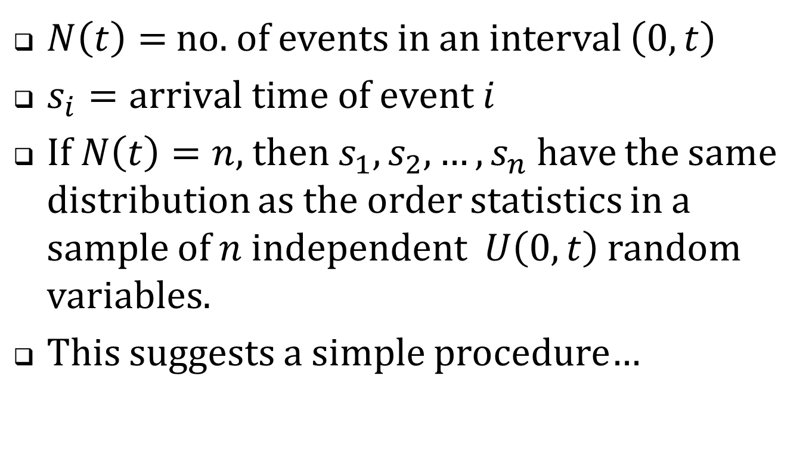
Recall the constant intensity Poisson process …
$N\left(t\right)=$ no. of events in an interval $\left(0,t\right)$
$s_{i}=arrival time of event i$
If $N\left(t\right)=n$, then $s_{1},s_{2},…,s_{n}$ have the same distribution as the order statistics in a sample of $n$ independent $U\left(0,t\right)$ random variables.
This suggests a simple procedure…

Slide 48
Quote A | 10:01:35
Quote B | 10:01:35
Quote C | 10:01:35
Draw three U(0,1) random numbers
Sort them
Assign them as the millisecond remainders
Quote A | 10:01:35.243
Quote B | 10:01:35.347
Quote C | 10:01:35.912
Compute variance estimates using the simulated time stamps.

Slide 49
Formalities
Assume that
  The quotes are correctly sequenced.
  Arrivals within the second are Poisson with (unknown) constant intensity.
  The bid and offer process is independent of the within-second arrival times.
Then each calculated statistic constitutes a draw from the corresponding Bayesian posterior.

Slide 50
Does this really work?
2011 millisecond-stamped TAQ data
Strip the millisecond portions of the time-stamps
Simulate new ms stamps
Wavelet variance estimates using actual ms time-stamps
Wavelet variance estimates using simulated ms. time-stamps.
Correlation?

Slide 51
Back to the 2001-2011 historical sample
Variance estimations will be based on simulated millisecond time-stamps.

Slide 52
Table 5. Summary statistics, historical sample,
2001-2011 (only odd numbered years are shown)
 | 2001 |  | 2003 |  | 2005 |  | 2007 |  | 2009 |  | 2011
No. firms | 146 |  | 150 |  | 150 |  | 150 |  | 150 |  | 150
NYSE | 108 |  | 51 |  | 48 |  | 55 |  | 56 |  | 47
Amex | 22 |  | 11 |  | 8 |  | 14 |  | 5 |  | 6
NASDAQ | 16 |  | 88 |  | 94 |  | 81 |  | 89 |  | 97
Avg. daily trades | 142 |  | 187 |  | 425 |  | 970 |  | 1,790 |  | 1,331
Avg. daily quotes | 1,078 |  | 1,299 |  | 5,828 |  | 12,521 |  | 39,378 |  | 23,928
Avg. daily NBB changes | 103 |  | 203 |  | 596 |  | 772 |  | 1,618 |  | 1,210
Avg. daily NBO changes | 103 |  | 213 |  | 729 |  | 789 |  | 1,731 |  | 1,126
Avg. price | $18.85 |  | $14.83 |  | $16.10 |  | $15.81 |  | $10.72 |  | $15.62
Market equity cap $ Million | $745 |  | $189 |  | $325 |  | $480 |  | $316 |  | $683

Slide 53
Table 5. Summary statistics, historical sample,
2001-2011 (only odd numbered years are shown)
 | 2001 |  | 2003 |  | 2005 |  | 2007 |  | 2009 |  | 2011
No. firms | 146 |  | 150 |  | 150 |  | 150 |  | 150 |  | 150
NYSE | 108 |  | 51 |  | 48 |  | 55 |  | 56 |  | 47
Amex | 22 |  | 11 |  | 8 |  | 14 |  | 5 |  | 6
NASDAQ | 16 |  | 88 |  | 94 |  | 81 |  | 89 |  | 97
Avg. daily trades | 142 |  | 187 |  | 425 |  | 970 |  | 1,790 |  | 1,331
Avg. daily quotes | 1,078 |  | 1,299 |  | 5,828 |  | 12,521 |  | 39,378 |  | 23,928
Avg. daily NBB changes | 103 |  | 203 |  | 596 |  | 772 |  | 1,618 |  | 1,210
Avg. daily NBO changes | 103 |  | 213 |  | 729 |  | 789 |  | 1,731 |  | 1,126
Avg. price | $18.85 |  | $14.83 |  | $16.10 |  | $15.81 |  | $10.72 |  | $15.62
Market equity cap $ Million | $745 |  | $189 |  | $325 |  | $480 |  | $316 |  | $683
25% CAGR
36% CAGR

Slide 54
What statistics to consider?
Long-term volatilities changed dramatically over the sample period.
Variance ratios (normalized to long-term volatility) are the most reliable indicators of trends.

Slide 55
Table 6. Wavelet variance ratios for bids and offers, 2001-2011
Panel A: Computed from unadjusted bids and offers
Time scale | 2001 | 2002 | 2003 | 2004 | 2005 | 2006 | 2007 | 2008 | 2009 | 2010 | 2011
50 ms | 5.22 | 7.16 | 6.03 | 10.28 | 6.69 | 8.57 | 6.96 | 6.06 | 4.52 | 7.08 | 4.70
100 ms | 5.44 | 6.58 | 5.28 | 9.69 | 6.51 | 8.07 | 6.27 | 5.38 | 4.12 | 6.26 | 4.32
200 ms | 5.28 | 6.28 | 5.13 | 9.03 | 6.22 | 7.34 | 5.33 | 4.64 | 3.68 | 5.40 | 3.74
400 ms | 4.59 | 5.23 | 5.00 | 8.16 | 5.75 | 6.30 | 4.25 | 3.84 | 3.21 | 4.53 | 3.07
800 ms | 3.12 | 4.04 | 3.93 | 5.57 | 5.03 | 5.10 | 3.41 | 3.11 | 2.76 | 3.71 | 2.56
1,600 ms | 2.11 | 2.55 | 3.25 | 4.11 | 4.14 | 4.05 | 2.89 | 2.59 | 2.43 | 3.04 | 2.23
3.2 sec | 1.98 | 2.24 | 2.93 | 3.38 | 3.48 | 3.37 | 2.56 | 2.29 | 2.17 | 2.53 | 2.01
6.4 sec | 1.94 | 2.11 | 2.62 | 2.91 | 2.93 | 2.92 | 2.35 | 2.08 | 1.95 | 2.16 | 1.82

Slide 56
No trend in quote volatilities?
Maybe …
  “Flickering quotes” aren’t new.
  Recent concerns about high frequency trading are all media hype.
  The good old days weren’t really so great after all.
What did quote volatility look like circa 2001?

Slide 57
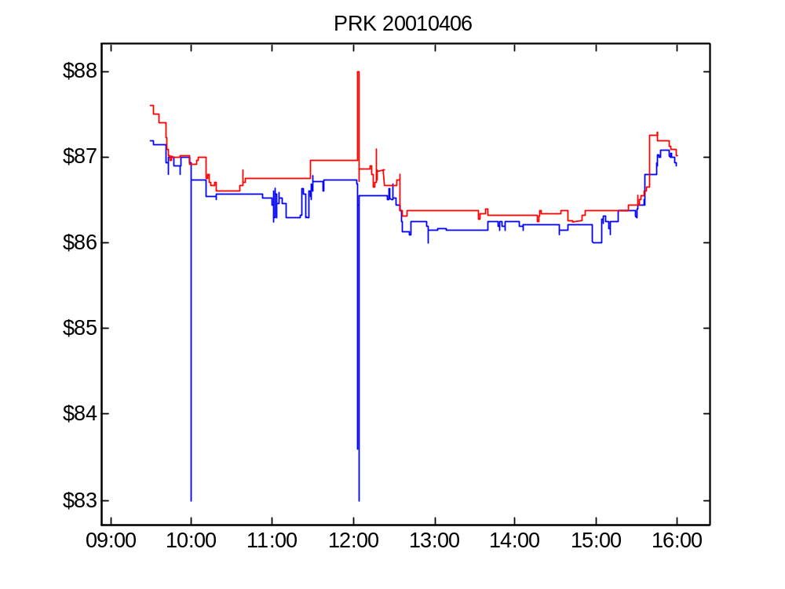
Figure 4 Panel A. Bid and offer for PRK, April 6, 2001.

Slide 58
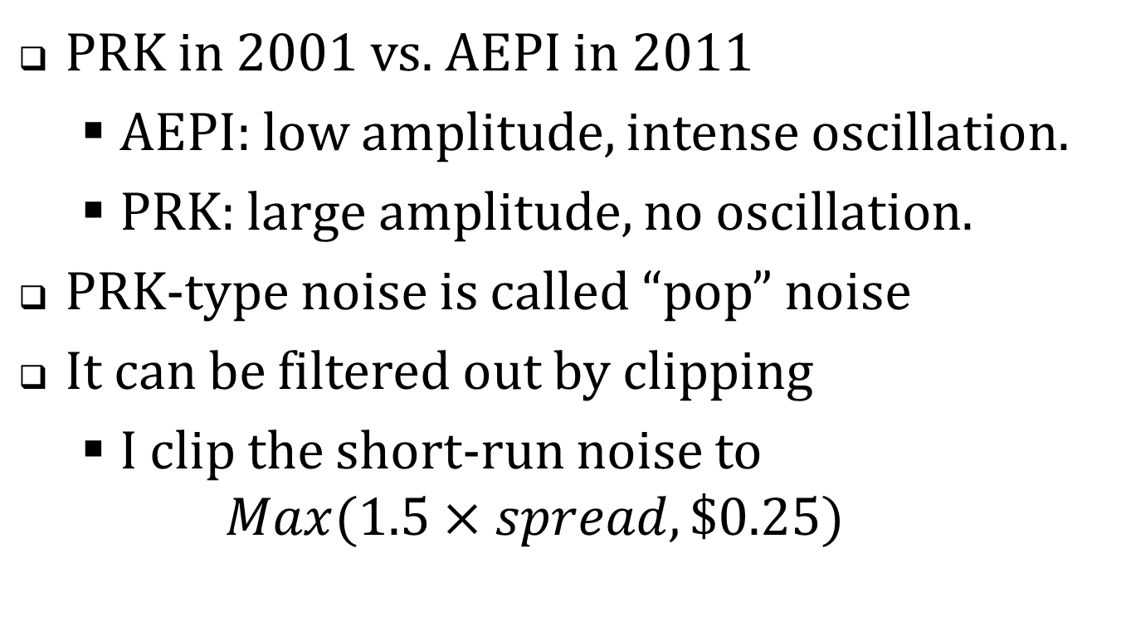
Compare
PRK in 2001 vs. AEPI in 2011
  AEPI: low amplitude, intense oscillation.
  PRK: large amplitude, no oscillation.
PRK-type noise is called “pop” noise
It can be filtered out by clipping
  I clip the short-run noise to
  $Max(1.5×spread,\$0.25)$

Slide 59
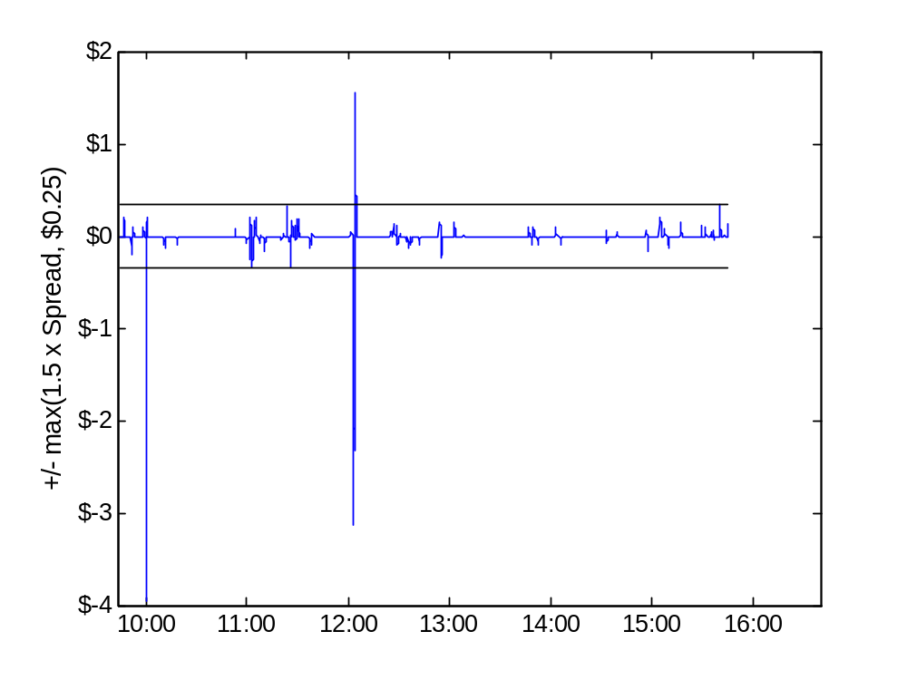
Figure 4 Panel B. PRK, April 6, 2001, Rough component of the bid

Slide 60
Table 6. Wavelet variance ratios for bids and offers, 2001-2011, Detail
Panel A: Computed from unadjusted bids and offers
Panel B: Computed from denoised bids and offers
Time scale | 2001 | … | 2011
50 ms | 5.22 |  | 4.70
100 ms | 5.44 |  | 4.32
200 ms | 5.28 |  | 3.74
400 ms | 4.59 |  | 3.07
800 ms | 3.12 |  | 2.56
1,600 ms | 2.11 |  | 2.23
3.2 sec | 1.98 |  | 2.01
6.4 sec | 1.94 |  | 1.82
Time scale | 2001 | … | 2011
50 ms | 1.60 |  | 4.46
100 ms | 1.57 |  | 4.07
200 ms | 1.56 |  | 3.57
400 ms | 1.55 |  | 3.00
800 ms | 1.57 |  | 2.52
1,600 ms | 1.64 |  | 2.20
3.2 sec | 1.81 |  | 2.00
6.4 sec | 2.11 |  | 1.82

Slide 61
Table 6. Wavelet variance ratios for bids and offers, 2001-2011
Panel B. Computed from denoised bids and offers
Time scale | 2001 | 2002 | 2003 | 2004 | 2005 | 2006 | 2007 | 2008 | 2009 | 2010 | 2011
50 ms | 1.60 | 2.37 | 3.15 | 7.02 | 6.09 | 8.24 | 6.56 | 5.83 | 4.20 | 6.79 | 4.46
100 ms | 1.57 | 2.32 | 3.09 | 6.82 | 5.89 | 7.76 | 5.89 | 5.17 | 3.83 | 6.00 | 4.07
200 ms | 1.56 | 2.27 | 3.03 | 6.48 | 5.61 | 7.04 | 4.99 | 4.45 | 3.41 | 5.18 | 3.57
400 ms | 1.55 | 2.23 | 2.94 | 5.90 | 5.16 | 6.02 | 3.96 | 3.68 | 2.97 | 4.36 | 3.00
800 ms | 1.57 | 2.19 | 2.83 | 5.00 | 4.47 | 4.82 | 3.13 | 2.98 | 2.56 | 3.58 | 2.52
1,600 ms | 1.64 | 2.20 | 2.71 | 3.99 | 3.60 | 3.79 | 2.63 | 2.51 | 2.27 | 2.94 | 2.20
3.2 sec | 1.81 | 2.30 | 2.62 | 3.44 | 3.02 | 3.16 | 2.33 | 2.23 | 2.04 | 2.46 | 2.00
6.4 sec | 2.11 | 2.51 | 2.59 | 3.20 | 2.65 | 2.75 | 2.15 | 2.04 | 1.86 | 2.11 | 1.82

Slide 62
Summary of the variance ratio evidence
Without filtering: no trend in quote volatility.
With filtering
  Volatility in earlier years is lower
  Maybe a trend
    But highest values are mostly
    in 2004-2006
The effects of filtering suggest that
  Early years: volatility due to spikes
  Later years: volatility reflects oscillations
What changed?

Slide 63
SEC’s Reg NMS (“National Market System”)
Proposed in 2004; adopted 2005; implemented in 2006.
Defined the framework for competition among equity markets.
Enhanced protection against trade-throughs
  Example: market A is bidding $10 and market B executes a trade at $9.
For a market’s bid and offer to be protected, they have to accessible instantly (electronically)
  This requirement essentially forced all markets to become electronic.

Slide 64
Before and after
Prior to Reg NMS
  Trading dominated by slow, manual floor markets
  Weak protection against trade-throughs
Post Reg NMS
  Bids and offers are firm and accessible.
  Strong trade-through protection

Slide 65
So has quote volatility increased?
Apples vs. oranges
  The nature of quotes has changed.
Quote volatility has changed
  From infrequent large changes to frequent (and oscillatory) small changes.
Possibly a overall small increase,
  But nothing as strong as the trend implied by the growth in quote messaging rates.

Slide 66
Follow-up questions
What strategies give rise to the episodic oscillations?
Are the HFQ episodes unstable algos?
Are they sensible strategies to detect and access liquidity?

Slide 67
Extra overheads

Slide 68
Dark trades: internalized execution
A broker receives a retail buy order.
  The order is not sent to an exchange or any other venue.
  The broker sells directly to the customer at the National Best Offer (NBO)
Volatility in the NBO → volatility in execution price.

Slide 69
Dark trading
“Dark” the market executing the order did not previously post a visible bid or offer at the execution price.
  The trade itself is promptly reported.
Dark mechanisms
  Hidden (undisplayed) limit orders
  Internalized executions
  Dark pools

Slide 70
Dark trades: dark pools
Mechanism
  Traders send buy and sell orders to a computer.
  The orders are not displayed.
  If the computer finds a feasible match, a trade occurs.
The trade is priced at the midpoint of the National Best Bid and Offer (NBBO)
Volatility in the NBBO causes volatility in the execution price.

Slide 71
Look-back options
Internalization: a broker receives a retail buy order and executes the order at the NBO.
Problem: how does the customer know what the NBO is or was?
Might the dealer take the highest price in the interval of indeterminacy?
  Stoll and Schenzler (2002)

Slide 72
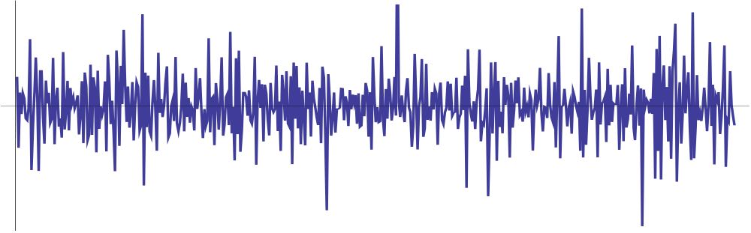
What’s lost by first-differencing?
First difference plot of a simulated series.

Slide 73
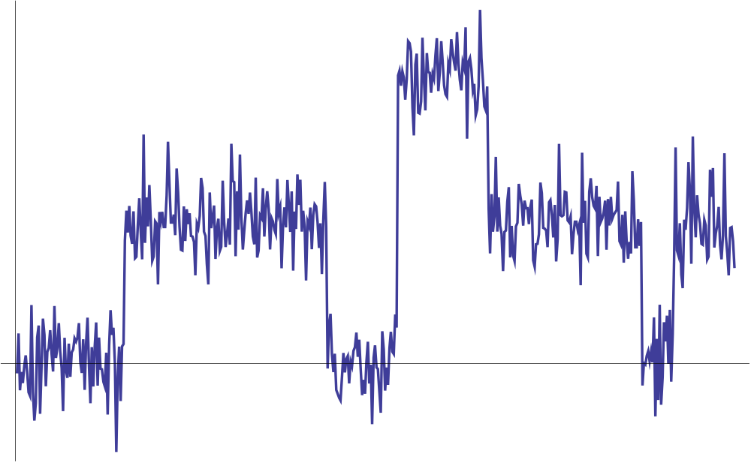
… and the integrated series

Slide 74
Analyzing quote volatility
Usual approach
  parametric model for variance of price changes (ARCH, GARCH, …)
This study
  Non-parametric analysis of variances of price levels

Slide 75
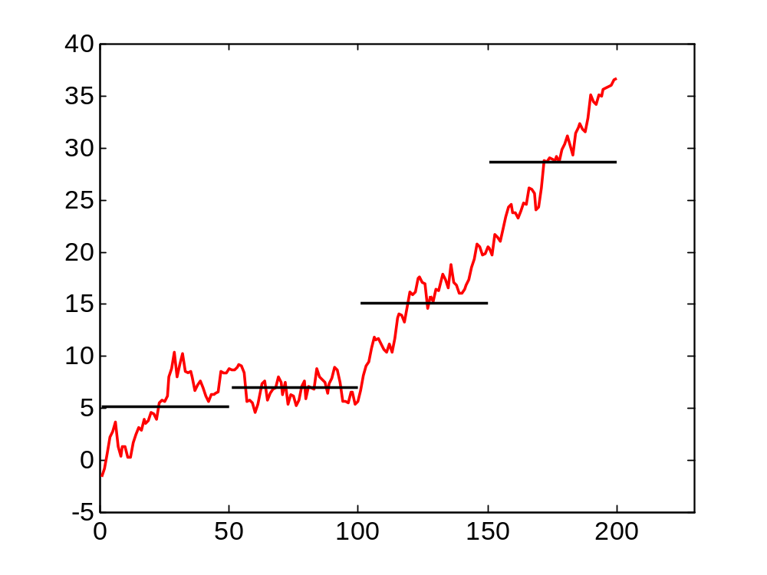
Variance about a local mean of a random walk

Slide 76
Table 8. Wavelet bid and offer variances, 2001-2011
Panel A. Rough variances, mils per share
time scale | 2001 |  | 2003 |  | 2005 |  | 2007 |  | 2009 |  | 2011
50 ms | 0.05 |  | 0.07 |  | 0.23 |  | 0.08 |  | 0.25 |  | 0.07
 | (<0.01) |  | (<0.01) |  | (0.03) |  | (<0.01) |  | (0.03) |  | (0.01)
200 ms | 0.34 |  | 0.45 |  | 1.52 |  | 0.45 |  | 1.50 |  | 0.40
 | (0.01) |  | (0.02) |  | (0.17) |  | (0.02) |  | (0.19) |  | (0.08)
800 ms | 1.50 |  | 1.85 |  | 5.56 |  | 1.42 |  | 5.16 |  | 1.42
 | (0.05) |  | (0.07) |  | (0.53) |  | (0.07) |  | (0.42) |  | (0.22)
3.2 sec | 6.82 |  | 6.77 |  | 16.03 |  | 4.19 |  | 16.45 |  | 4.74
 | (0.52) |  | (0.22) |  | (1.25) |  | (0.16) |  | (0.96) |  | (0.49)
25.6 sec | 80.46 |  | 47.03 |  | 84.18 |  | 25.18 |  | 109.42 |  | 30.76
 | (16.17) |  | (2.57) |  | (5.75) |  | (0.98) |  | (13.16) |  | (3.22)
6.8 min | 735.03 |  | 489.43 |  | 862.96 |  | 302.16 |  | 1,638.73 |  | 333.50
 | (30.23) |  | (12.26) |  | (73.94) |  | (23.79) |  | 492.40) |  | (12.05)
27.3 min | 2,511.15 |  | 1,554.80 |  | 2,872.45 |  | 1,046.55 |  | 4,623.58 |  | 1,164.98
 | (80.99) |  | (39.18) |  | 335.55) |  | 101.74) |  | 849.95) |  | (41.65)

Slide 77
Table 8. Wavelet bid and offer variances, 2001-2011
Panel B. Rough variance ratios
Time scale | 2001 |  | 2003 |  | 2005 |  | 2007 |  | 2009 |  | 2011
50 ms | 1.60 |  | 3.15 |  | 6.09 |  | 6.56 |  | 4.20 |  | 4.46
 | (0.02) |  | (0.11) |  | (0.39) |  | (0.40) |  | (0.31) |  | (1.42)
200 ms | 1.57 |  | 3.06 |  | 5.76 |  | 5.47 |  | 3.65 |  | 3.84
 | (0.02) |  | (0.10) |  | (0.36) |  | (0.30) |  | (0.26) |  | (1.16)
800 ms | 1.56 |  | 2.91 |  | 4.94 |  | 3.87 |  | 2.91 |  | 2.94
 | (0.03) |  | (0.09) |  | (0.27) |  | (0.17) |  | (0.16) |  | (0.69)
3.2 sec | 1.71 |  | 2.71 |  | 3.64 |  | 2.78 |  | 2.31 |  | 2.28
 | (0.09) |  | (0.10) |  | (0.15) |  | (0.09) |  | (0.09) |  | (0.35)
25.6 sec | 2.36 |  | 2.60 |  | 2.42 |  | 2.03 |  | 1.74 |  | 1.70
 | (0.37) |  | (0.29) |  | (0.07) |  | (0.05) |  | (0.04) |  | (0.12)
6.8 min | 1.37 |  | 1.50 |  | 1.49 |  | 1.37 |  | 1.32 |  | 1.23
 | (0.04) |  | (0.03) |  | (0.02) |  | (0.02) |  | (0.03) |  | (0.02)
27.3 min | 1.12 |  | 1.16 |  | 1.16 |  | 1.12 |  | 1.11 |  | 1.08
 | (0.02) |  | (0.02) |  | (0.02) |  | (0.02) |  | (0.02) |  | (0.01)

Slide 78
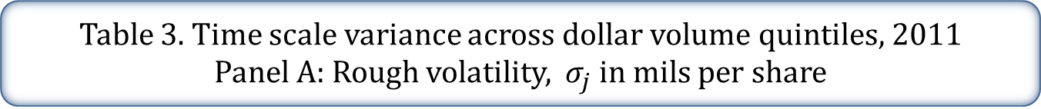
Table 3. Time scale variance across dollar volume quintiles, 2011
Panel A: Rough volatility, $σ_{j}$ in mils per share
 |  |  | Dollar trading volume quintiles
Level, j | Time scale | Full sample | 1 (low) | 2 | 3 | 4 | 5 (high)
0 | < 50 ms | 0.28 | 0.15 | 0.19 | 0.29 | 0.37 | 0.40
 |  | (<0.01) | (0.01) | (0.01) | (0.01) | (0.01) | (0.01)
1 | 50 ms | 0.39 | 0.21 | 0.27 | 0.40 | 0.51 | 0.56
 |  | (0.01) | (0.01) | (0.01) | (0.01) | (0.01) | (0.01)
3 | 200 ms | 0.76 | 0.40 | 0.50 | 0.76 | 0.99 | 1.11
 |  | (0.01) | (0.03) | (0.02) | (0.02) | (0.02) | (0.02)
5 | 800 ms | 1.46 | 0.76 | 0.95 | 1.45 | 1.91 | 2.14
 |  | (0.02) | (0.04) | (0.03) | (0.03) | (0.04) | (0.04)
7 | 3.2 sec | 2.80 | 1.46 | 1.79 | 2.75 | 3.70 | 4.19
 |  | (0.04) | (0.07) | (0.06) | (0.06) | (0.08) | (0.09)
10 | 25.6 sec | 7.54 | 3.63 | 4.51 | 7.05 | 10.12 | 12.02
 |  | (0.10) | (0.15) | (0.15) | (0.15) | (0.23) | (0.27)
14 | 6.8 min | 27.88 | 11.83 | 15.29 | 24.76 | 38.35 | 47.61
 |  | (0.39) | (0.47) | (0.50) | (0.52) | (0.94) | (1.14)
16 | 27.3 min | 52.84 | 20.94 | 28.09 | 46.87 | 74.69 | 90.49
 |  | (0.78) | (0.86) | (0.91) | (1.03) | (2.04) | (2.26)

Slide 79
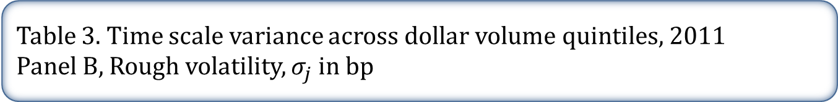
Table 3. Time scale variance across dollar volume quintiles, 2011
Panel B, Rough volatility, $σ_{j}$ in bp
 |  |  | Dollar trading volume quintiles
Level, j | Time scale | Full sample | 1 (low) | 2 | 3 | 4 | 5 (high)
0 | < 50 ms | 0.16 | 0.26 | 0.21 | 0.14 | 0.11 | 0.08
 |  | (<0.01) | (0.01) | (<0.01) | (<0.01) | (<0.01) | (<0.01)
1 | 50 ms | 0.22 | 0.37 | 0.29 | 0.20 | 0.16 | 0.11
 |  | (<0.01) | (0.02) | (0.01) | (<0.01) | (<0.01) | (<0.01)
3 | 200 ms | 0.43 | 0.70 | 0.56 | 0.38 | 0.31 | 0.22
 |  | (0.01) | (0.03) | (0.01) | (0.01) | (<0.01) | (<0.01)
5 | 800 ms | 0.83 | 1.34 | 1.07 | 0.73 | 0.59 | 0.43
 |  | (0.01) | (0.05) | (0.02) | (0.01) | (0.01) | (0.01)
7 | 3.2 sec | 1.58 | 2.56 | 2.03 | 1.41 | 1.15 | 0.85
 |  | (0.02) | (0.08) | (0.04) | (0.02) | (0.01) | (0.01)
10 | 25.6 sec | 4.10 | 6.32 | 5.17 | 3.65 | 3.13 | 2.42
 |  | (0.04) | (0.17) | (0.09) | (0.06) | (0.04) | (0.03)
14 | 6.8 min | 14.40 | 20.19 | 17.85 | 12.96 | 11.92 | 9.64
 |  | (0.14) | (0.52) | (0.35) | (0.22) | (0.16) | (0.15)
16 | 27.3 min | 26.79 | 35.62 | 33.19 | 24.41 | 23.20 | 18.38
 |  | (0.27) | (0.95) | (0.72) | (0.43) | (0.35) | (0.30)

Slide 80
Table 3. Time scale variance estimates across $ volume quintiles, 2011
Panel C. Rough variance ratios
 |  |  | Dollar trading volume quintiles
Level, j | Time scale | Full sample | 1 (low) | 2 | 3 | 4 | 5 (high)
0 | < 50 ms | 4.22 | 12.72 | 3.45 | 2.62 | 1.76 | 1.37
 |  | (1.28) | (6.96) | (0.18) | (0.07) | (0.04) | (0.02)
1 | 50 ms | 3.99 | 12.01 | 3.23 | 2.44 | 1.69 | 1.35
 |  | (1.25) | (6.81) | (0.16) | (0.06) | (0.04) | (0.02)
3 | 200 ms | 3.53 | 10.40 | 2.83 | 2.20 | 1.57 | 1.30
 |  | (1.06) | (5.77) | (0.11) | (0.05) | (0.03) | (0.02)
5 | 800 ms | 2.90 | 7.82 | 2.50 | 2.02 | 1.43 | 1.21
 |  | (0.66) | (3.56) | (0.08) | (0.04) | (0.03) | (0.02)
7 | 3.2 sec | 2.40 | 5.87 | 2.17 | 1.82 | 1.32 | 1.15
 |  | (0.38) | (2.08) | (0.06) | (0.04) | (0.02) | (0.02)
10 | 25.6 sec | 1.70 | 3.06 | 1.70 | 1.49 | 1.19 | 1.17
 |  | (0.12) | (0.64) | (0.04) | (0.03) | (0.02) | (0.02)
14 | 6.8 min | 1.23 | 1.58 | 1.24 | 1.17 | 1.04 | 1.16
 |  | (0.02) | (0.12) | (0.03) | (0.03) | (0.02) | (0.02)
16 | 27.3 min | 1.08 | 1.19 | 1.08 | 1.06 | 1.01 | 1.06
 |  | (0.01) | (0.06) | (0.03) | (0.02) | (0.02) | (0.02)

Slide 81
Table 3. Time scale variance estimates across $ volume quintiles, 2011
Panel D. Bid-offer correlations
 |  |  | Dollar trading volume quintiles
Level, j | Time scale | Full sample | 1 (low) | 2 | 3 | 4 | 5 (high)
1 | 50 ms | 0.32 | 0.05 | 0.23 | 0.31 | 0.41 | 0.56
 |  | (0.01) | (0.01) | (0.01) | (0.01) | (0.01) | (0.01)
3 | 200 ms | 0.41 | 0.11 | 0.33 | 0.42 | 0.49 | 0.65
 |  | (0.01) | (0.01) | (0.02) | (0.02) | (0.01) | (0.02)
5 | 800 ms | 0.48 | 0.15 | 0.40 | 0.51 | 0.56 | 0.72
 |  | (0.01) | (0.01) | (0.02) | (0.02) | (0.02) | (0.02)
7 | 3.2 sec | 0.55 | 0.19 | 0.47 | 0.59 | 0.66 | 0.82
 |  | (0.01) | (0.02) | (0.02) | (0.02) | (0.02) | (0.02)
10 | 25.6 sec | 0.70 | 0.27 | 0.61 | 0.75 | 0.85 | 0.95
 |  | (0.01) | (0.02) | (0.03) | (0.02) | (0.02) | (0.03)
14 | 6.8 min | 0.86 | 0.44 | 0.88 | 0.97 | 0.99 | 1.00
 |  | (0.02) | (0.03) | (0.04) | (0.03) | (0.03) | (0.03)
16 | 27.3 min | 0.90 | 0.51 | 0.96 | 0.99 | 1.00 | 1.00
 |  | (0.02) | (0.04) | (0.05) | (0.03) | (0.04) | (0.03)

Slide 82
Context and connections
Mainstream volatility modeling
Analyses of high frequency trading
Methodology: time scale resolution and variance estimation

Slide 83
Volatility Modeling
Mainstream ARCH, GARCH, and similar models focus on fundamental/informational volatility.
  Statistically: volatility in the unit-root component of prices.
  Economically important for portfolio allocation, derivatives valuation and hedging.
Quote volatility is non-informational
  Statistically: short-term, stationary, transient volatility
  Economically important for trading and market making.

Slide 84
Realized volatility (RV)
Volatility estimates formed from HF data.
  RV = average (absolute/squared)
  price changes.
  Andersen, Bollerslev, Diebold and Ebens (2001), and others
At high frequencies, microstructure noise becomes the dominant component of RV.
Hansen and Lunde (2006) advocate using local level averaging (“pre-averaging”) to eliminate microstructure noise.

Slide 85
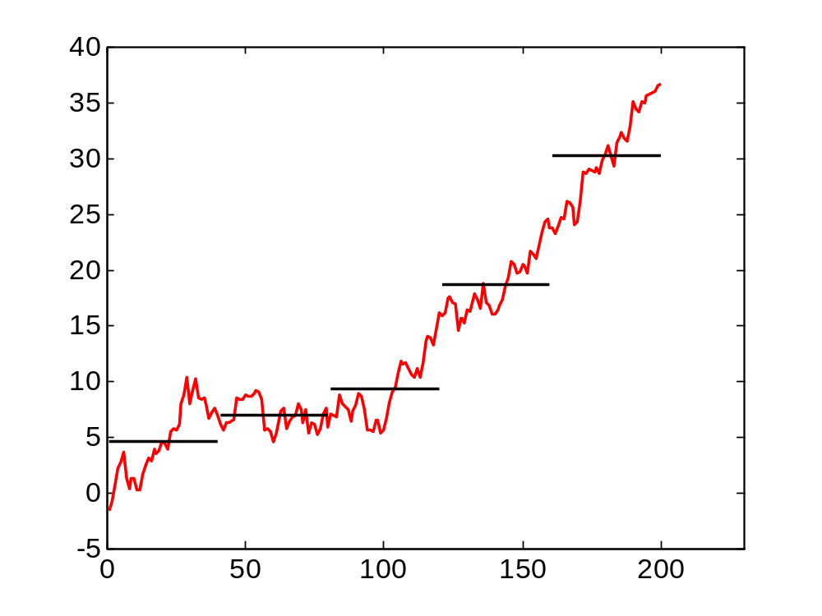
Pre-averaging

Slide 86
Quote volatility is microstructure noise
Present study
  Form local level averages
  Examine volatility centered on these averages.
Other contrasts with mainstream volatility modeling
  Trade prices vs. bid and offer quotes
  “Liquid” securities (indexes, Dow stocks, FX) vs. mid- and low-cap issues

Slide 87
High-frequency trading (HFT)
Institutional background of US equity markets
HFT: a working definition
The current debate

Slide 88
US equity markets
Fragmentation
  There are multiple trading venues (market centers)
Lit and dark markets
  Lit markets display bid and offer quotes
  Dark markets post no visible quotes.
Low latency / high-frequency trading
  The arms race for first-mover advantage
  The segmentation of traders into the quick and the dead.

Slide 89
HFT: Commodities Futures Trading Commission draft definition
A form of automated trading that employs:
  (a) algorithms for decision making, order initiation, generation, routing, or execution, for each individual transaction without human direction;
  (b) low-latency technology that is designed to minimize response times, including proximity and co-location services;
  (c) high speed connections to markets for order entry; and
  (d) high message rates (orders, quotes or cancellations)

Slide 90
The economic/regulatory debate
“HF traders are the new market makers.”
  Like traditional dealers and specialists.
  They provide valuable intermediation services.
“HF traders profit by anticipating and front-running the orders of long-term investors.”
  They impose costs on these investors.
  This will discourage the production and analysis of fundamental information.

Slide 91
Is this risk zero-mean and diversifiable?
For low-cap stocks, the volatility over three seconds averages 2.5 basis points (0.025%)
  In a portfolio of 100 trades, the volatility is 0.25 basis points.
What if, for particular agents, the risk is not zero-mean?

