Slide 1
High Frequency Quoting:
Short-Term Volatility in Bids and Offers
Joel Hasbrouck
Stern School, NYU
Presentation at Penn Econometrics Workshop, April 15, 2013

Slide 2
Disclaimers
I teach in an entry-level training program at a large financial firm that is generally thought to engage in high frequency trading.
I serve on a CFTC advisory committee that discusses issues related to high frequency trading.
I accept honoraria for presentations at events sponsored by financial firms.

Slide 3
What does quote volatility look like?
In US equity markets, a bid or offer can originate from any market participant.
  “Traditional” dealers, retail and institutional investors.
Bids and offers from all trading venues are consolidated and disseminated in real time.
  The highest bid is the National Best Bid (NBB)
  The lowest offer is the National Best Offer (NBO)
Next slide: the NBBO for AEPI on April 29, 2011

Slide 4
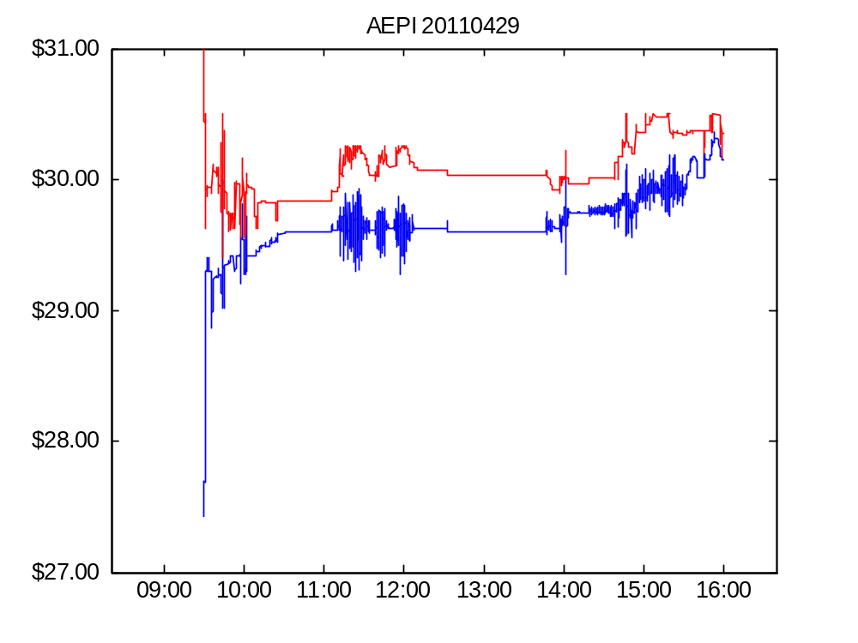
Figure 1. AEPI bid and offer, April 29, 2011

Slide 5
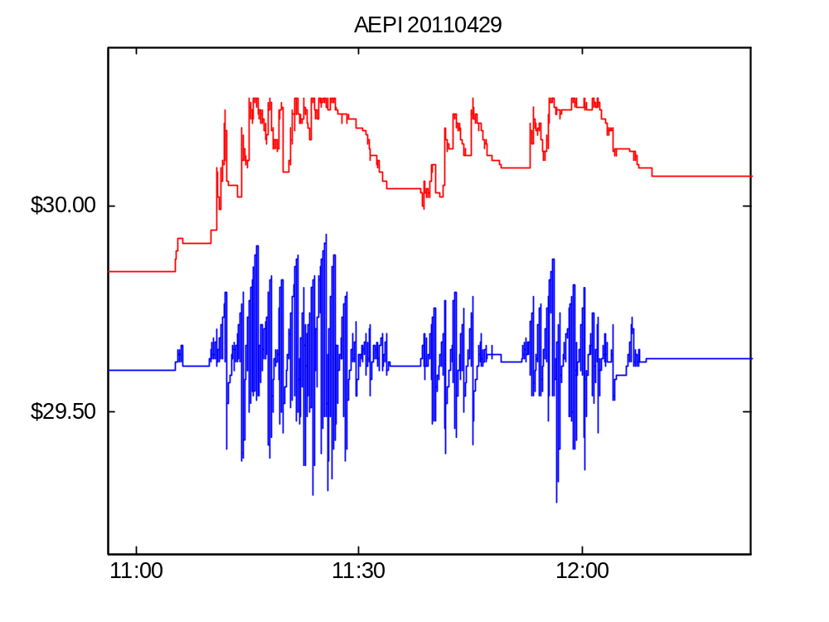
Figure 1. AEPI bid and offer on April 29, 2011 (detail)

Slide 6
Features of the AEPI episodes
Extremely rapid oscillations in the bid.
Start and stop abruptly
Mostly one-sided
  activity on the ask side is much smaller
Episodes don’t coincide with large long-term changes in the stock price.

Slide 7
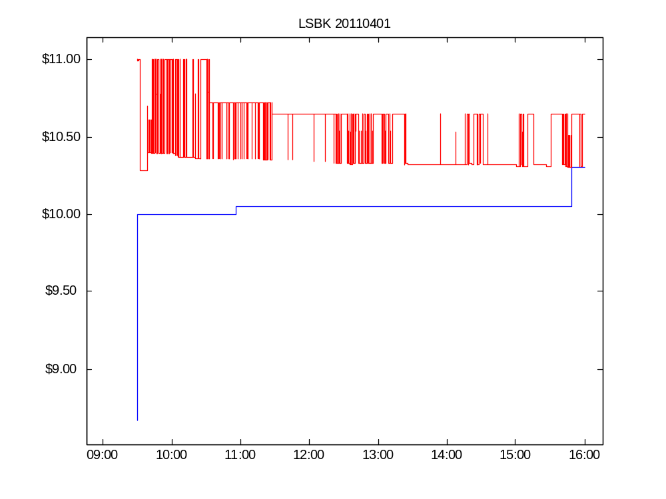

Slide 8
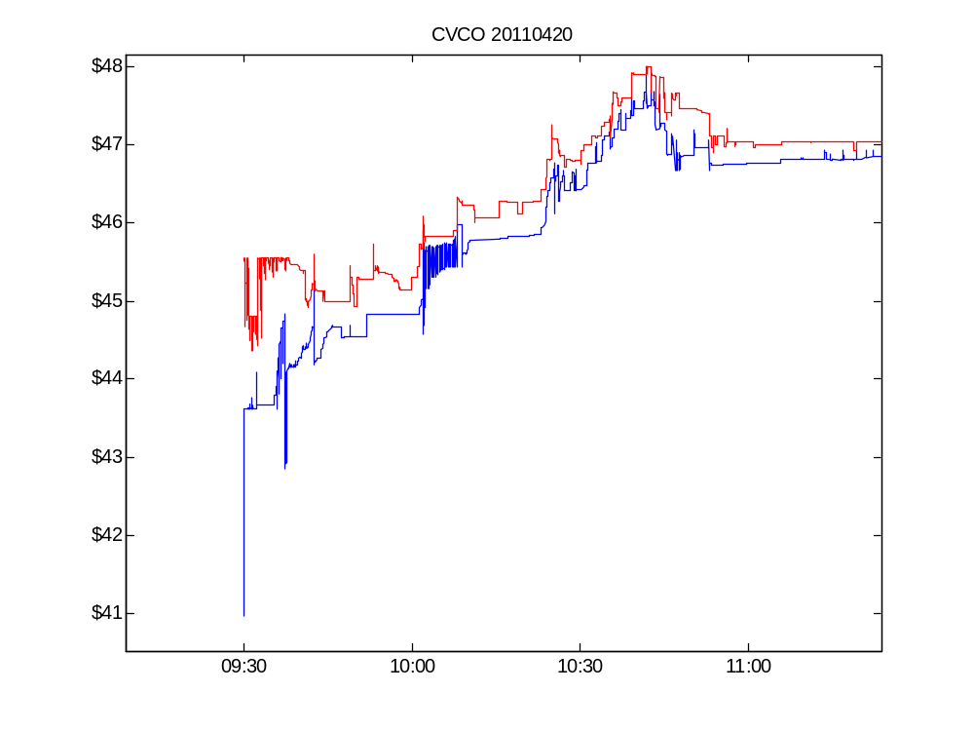

Slide 9
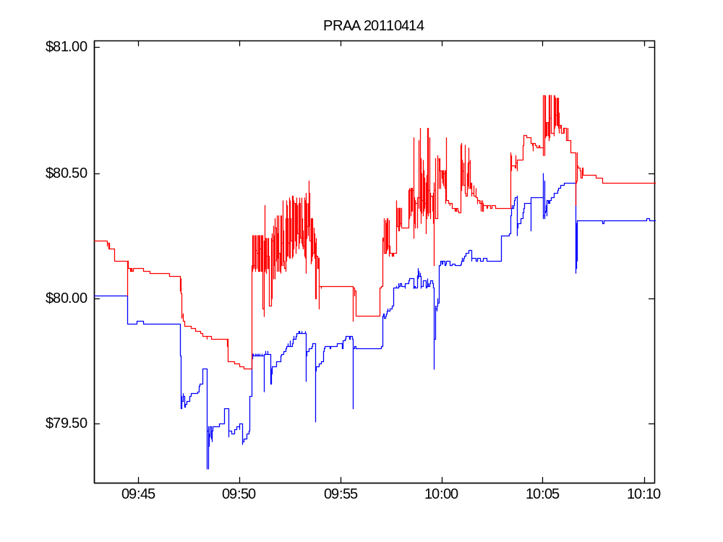

Slide 10
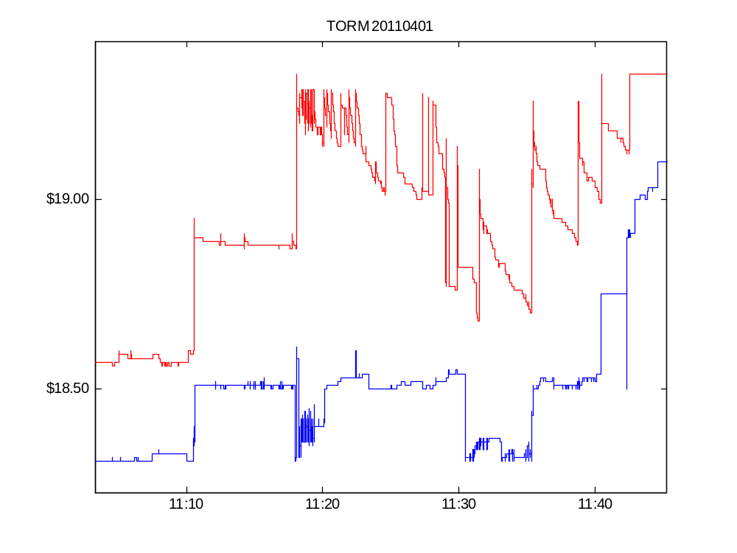

Slide 11
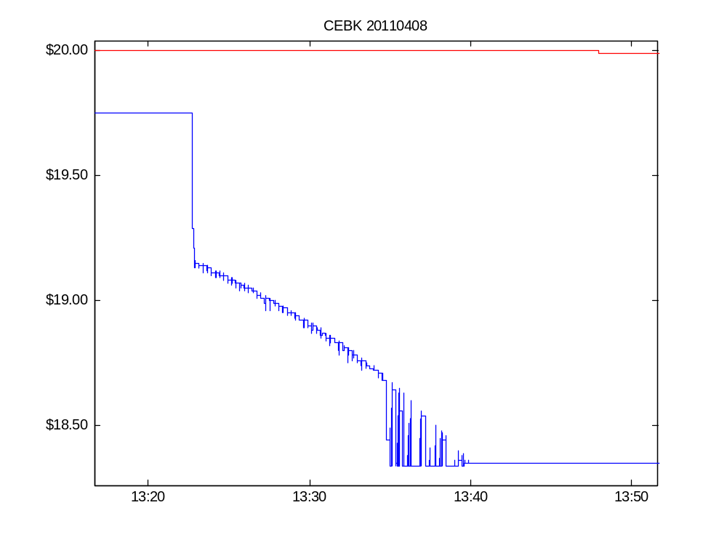

Slide 12
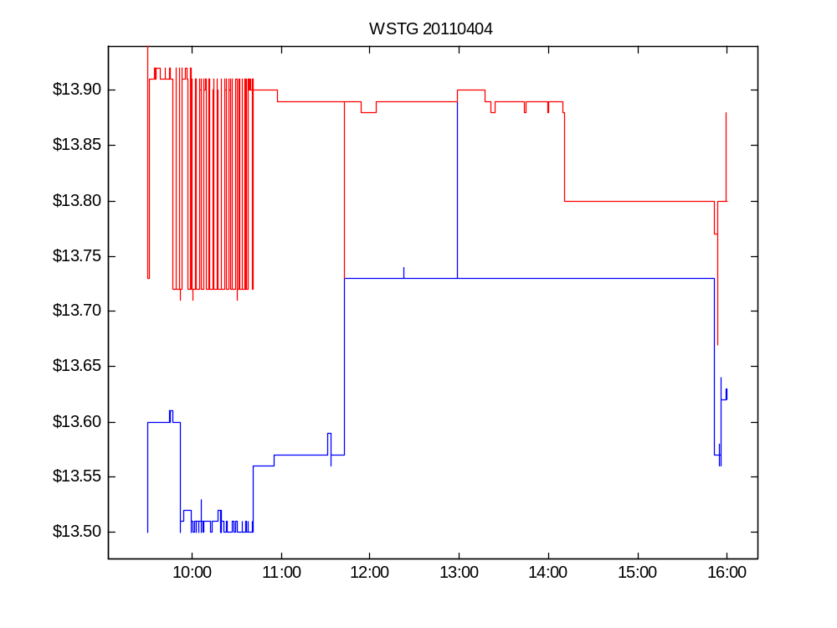

Slide 13
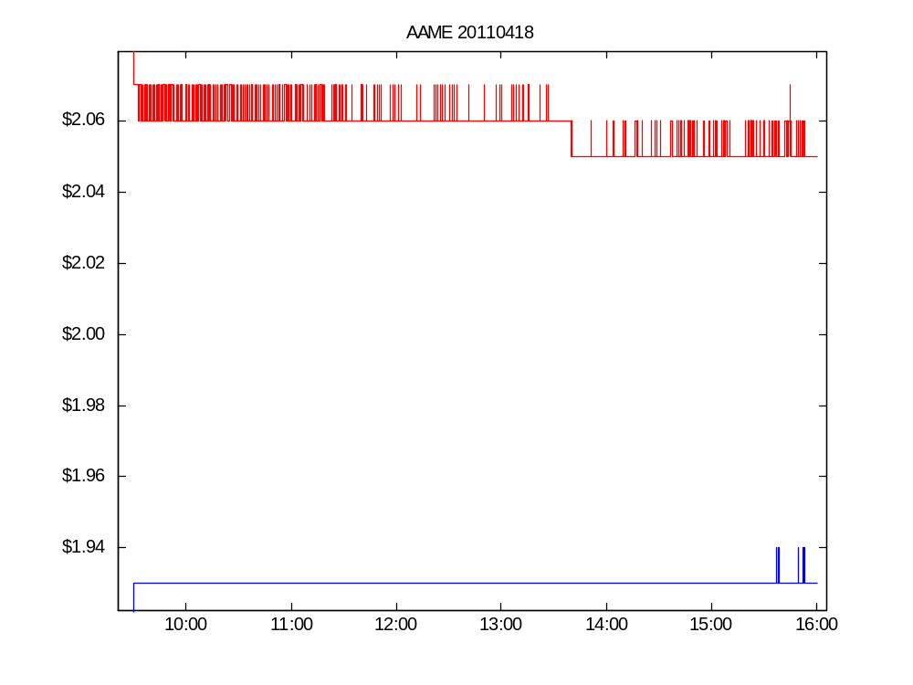

Slide 14
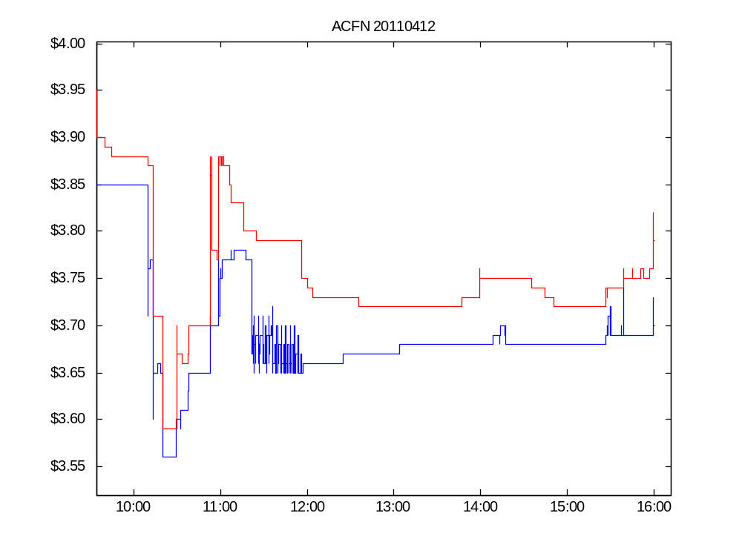

Slide 15
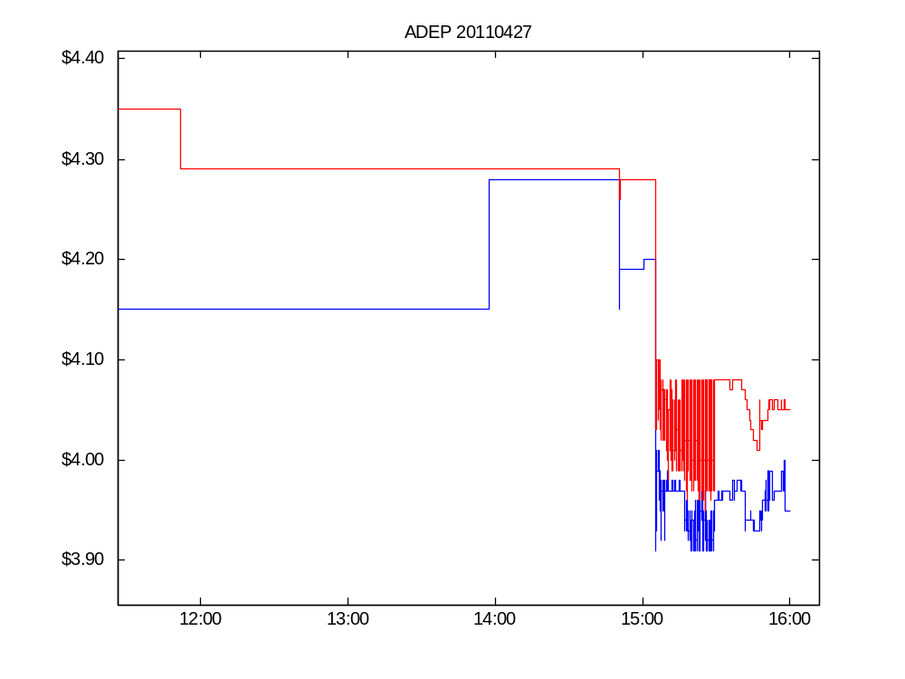

Slide 16
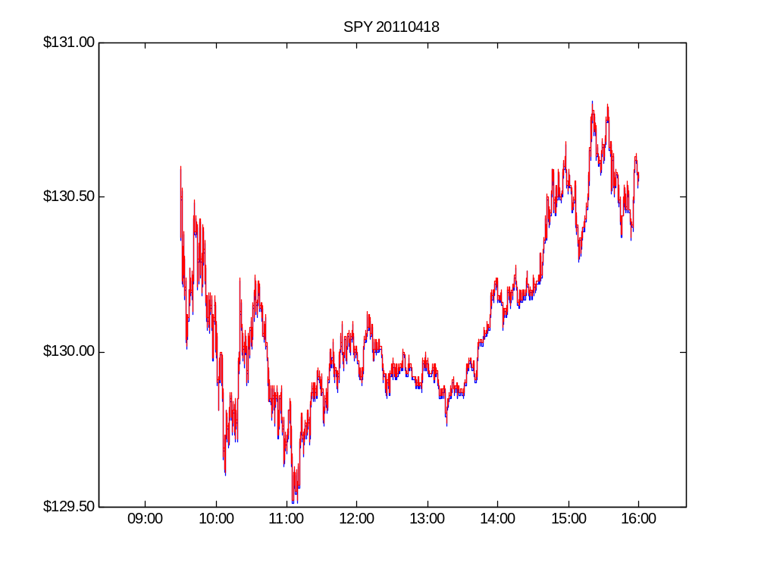

Slide 17
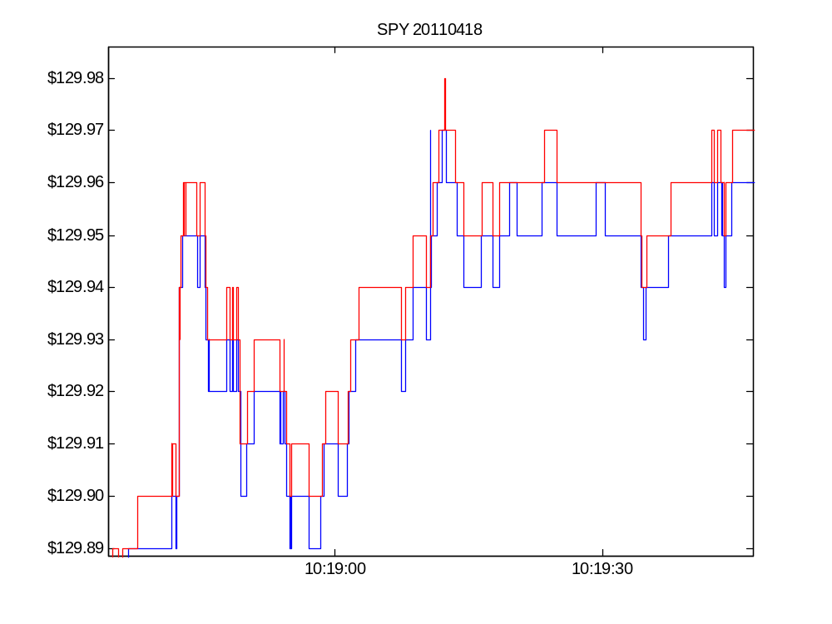

Slide 18
Quote volatility: the questions
What is its economic meaning and importance?
How should we measure it?
Is it elevated? Relative to what?
Has it increased along with wider adoption of high-speed trading technology?

Slide 19
Context and connections
Mainstream volatility modeling
Analyses of high frequency trading
Methodology: time scale resolution and variance estimation

Slide 20
Volatility Modeling
Mainstream ARCH, GARCH, and similar models focus on fundamental/informational volatility.
  Statistically: volatility in the unit-root component of prices.
  Economically important for portfolio allocation, derivatives valuation and hedging.
Quote volatility is non-informational
  Statistically: short-term, stationary, transient volatility
  Economically important for trading and market making.

Slide 21
Realized volatility (RV)
Volatility estimates formed from HF data.
  RV = average (absolute/squared)
  price changes.
  Andersen, Bollerslev, Diebold and Ebens (2001), and others
At high frequencies, microstructure noise becomes the dominant component of RV.
Hansen and Lunde (2006) advocate using local level averaging (“pre-averaging”) to eliminate microstructure noise.

Slide 22
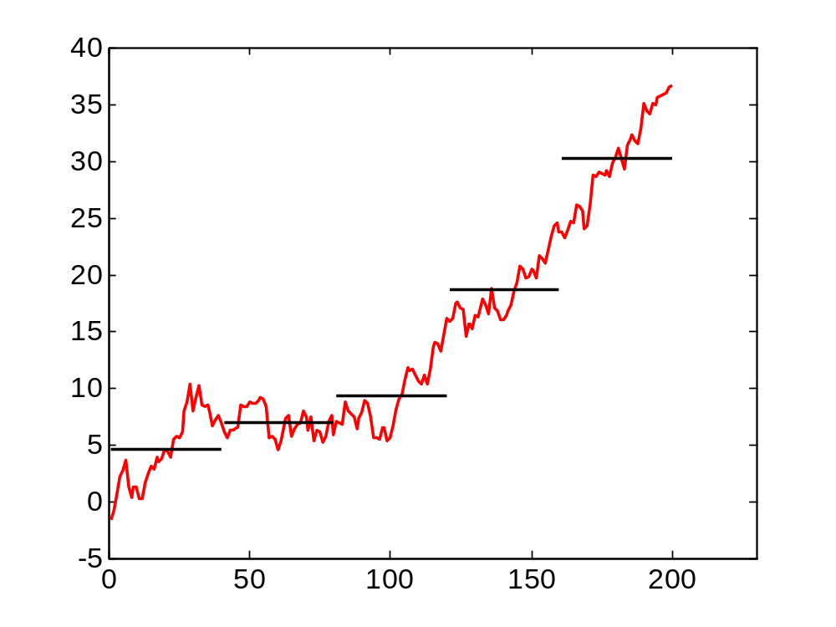
Pre-averaging

Slide 23
Quote volatility is microstructure noise
Present study
  Form local level averages
  Examine volatility centered on these averages.
Other contrasts with mainstream volatility modeling
  Trade prices vs. bid and offer quotes
  “Liquid” securities (indexes, Dow stocks, FX) vs. mid- and low-cap issues

Slide 24
High-frequency trading (HFT)
Institutional background of US equity markets
HFT: a working definition
The current debate

Slide 25
US equity markets
Fragmentation
  There are multiple trading venues (market centers)
Lit and dark markets
  Lit markets display bid and offer quotes
  Dark markets post no visible quotes.
Low latency / high-frequency trading
  The arms race for first-mover advantage
  The segmentation of traders into the quick and the dead.

Slide 26
HFT: Commodities Futures Trading Commission draft definition
A form of automated trading that employs:
  (a) algorithms for decision making, order initiation, generation, routing, or execution, for each individual transaction without human direction;
  (b) low-latency technology that is designed to minimize response times, including proximity and co-location services;
  (c) high speed connections to markets for order entry; and
  (d) high message rates (orders, quotes or cancellations)

Slide 27
The economic/regulatory debate
“HF traders are the new market makers.”
  Like traditional dealers and specialists.
  They provide valuable intermediation services.
“HF traders profit by anticipating and front-running the orders of long-term investors.”
  They impose costs on these investors.
  This will discourage the production and analysis of fundamental information.

Slide 28
Economic consequences of quote volatility
Noise
Execution price risk
  For marketable orders
  For dark trades
Intermediaries’ look-back options
Quote-stuffing
Spoofing

Slide 29
Quote volatility and noise: “flickering quotes”
Noise degrades the informational value of a price signal.
“The improvements in market structure have also created new challenges, one of which is the well-known phenomenon of “ephemeral” or “flickering” quotes. Flickering quotes create problems like bandwidth consumption and decreased price transparency.”
  CIBC World Markets, comment letter to SEC, Feb. 4, 2005.

Slide 30
Execution price risk for marketable orders
A marketable order is one that is priced to be executed immediately.
  “Buy 100 shares at the market” instructs the broker to buy, paying the current market asking price (no matter how high).
All orders face arrival time uncertainty.
Time uncertainty → price uncertainty

Slide 31
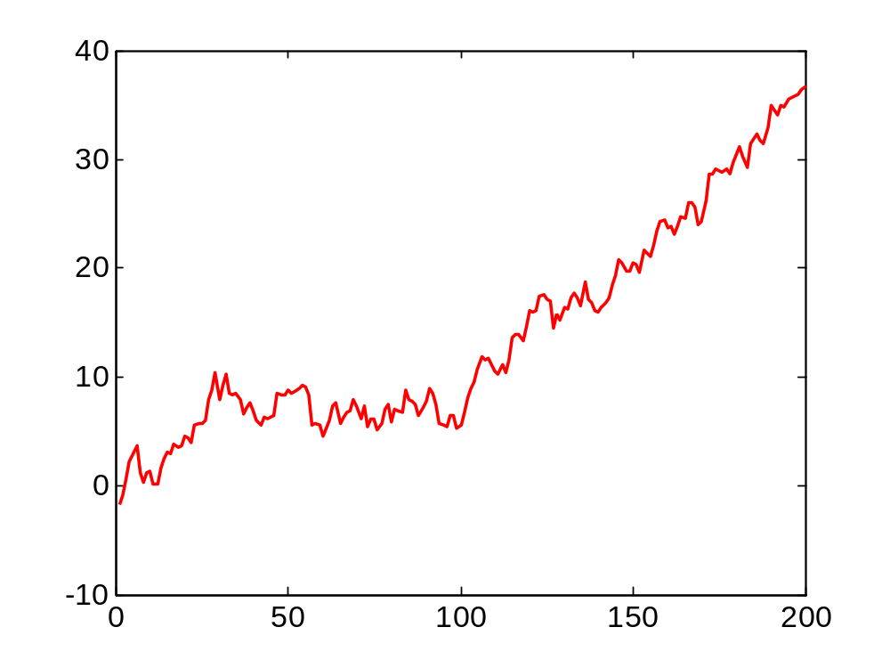
Execution price risk for marketable orders
A buyer who has arrival time uncertainty can expect to pay the average offer over the arrival period (and has price risk relative to this average).
Offer (ask) quote

Slide 32
Execution price risk for dark trades
A dark trading venue does not display a bid or offer.
  Roughly 30% of total volume is dark.
In a dark market the execution price of a trade is set by reference to the bid and offer displayed by a lit market.
Volatility in these reference prices induces execution price risk for the dark trades.

Slide 33
Is this risk zero-mean and diversifiable?
For low-cap stocks, the volatility over three seconds averages 2.5 basis points (0.025%)
  In a portfolio of 100 trades, the volatility is 0.25 basis points.
What if, for particular agents, the risk is not zero-mean?

Slide 34
Quote volatility and look-back options
Many market rules and practices reference “the current NBBO”
  Due to network latencies, “current” is a fuzzy term.
  In practice, “current” means “at any time in the past few seconds”
One dominant party might enjoy the flexibility to pick a price within this window.

Slide 35
Internalization of retail orders
Most retail orders are passed to “broker dealers” who agree to match the NBBO.
  A dealer who receives a retail buy order will sell to the buyer at the NBO.
  NBO as of when?
  The dealer has an incentive to pick the highest price within the window of time indeterminacy.
“Lookback option” Stoll and Schenzler (2002)

Slide 36
“Spoofing” manipulations
A dark pool buyer enter a spurious sell order in a visible market.
The sell order drives down the NBBO midpoint.
The buyer pays a lower price in the dark pool.

Slide 37
Descriptive statistics: computation and interpretation

Slide 38
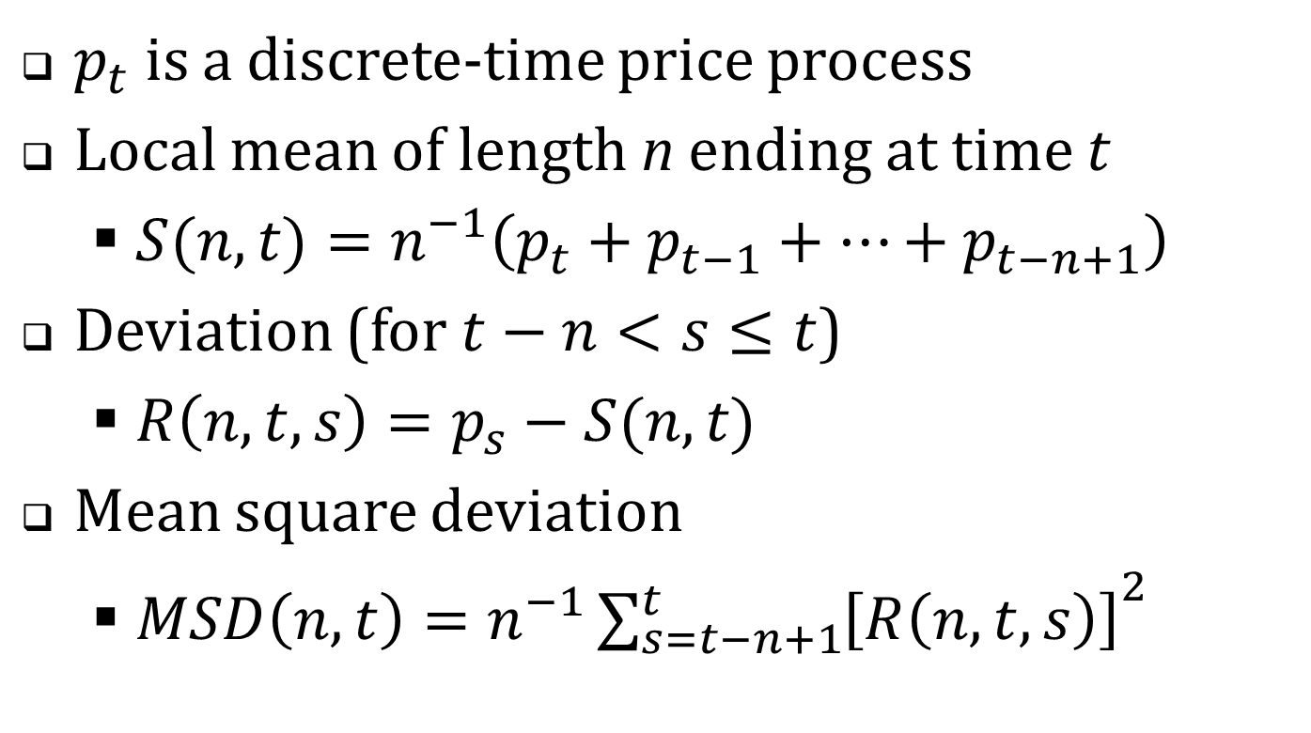
Local means and variances
$p_{t}$ is a discrete-time price process
Local mean of length n ending at time t
  $S(n,t)=n^{−1}\left(p_{t}+p_{t−1}+…+p_{t−n+1}\right)$
Deviation (for $t−n<s≤t$)
  $R\left(n,t,s\right)=p_{s}−S(n,t)$
Mean square deviation
  $MSD\left(n,t\right)={n^{−1}\sum_{s=t−n+1}^{t}{\left[R\left(n,t,s\right)\right]}}^{2}$

Slide 39
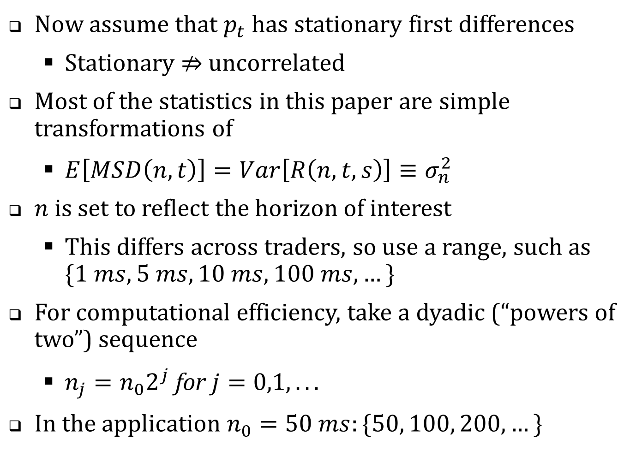
Now assume that $p_{t}$ has stationary first differences
  Stationary $⇏$ uncorrelated
Most of the statistics in this paper are simple transformations of
  $E\left[MSD\left(n,t\right)\right]=Var\left[R\left(n,t,s\right)\right]≡σ_{n}^{2}$
$n$ is set to reflect the horizon of interest
  This differs across traders, so use a range, such as $\{1 ms, 5 ms, 10 ms, 100 ms, …\}$
For computational efficiency, take a dyadic (“powers of two”) sequence
  $n_{j}=n_{0}2^{j} \text{for} j=0,1,...$
In the application $n_{0}=50 ms:\{50, 100, 200, …\}$

Slide 40
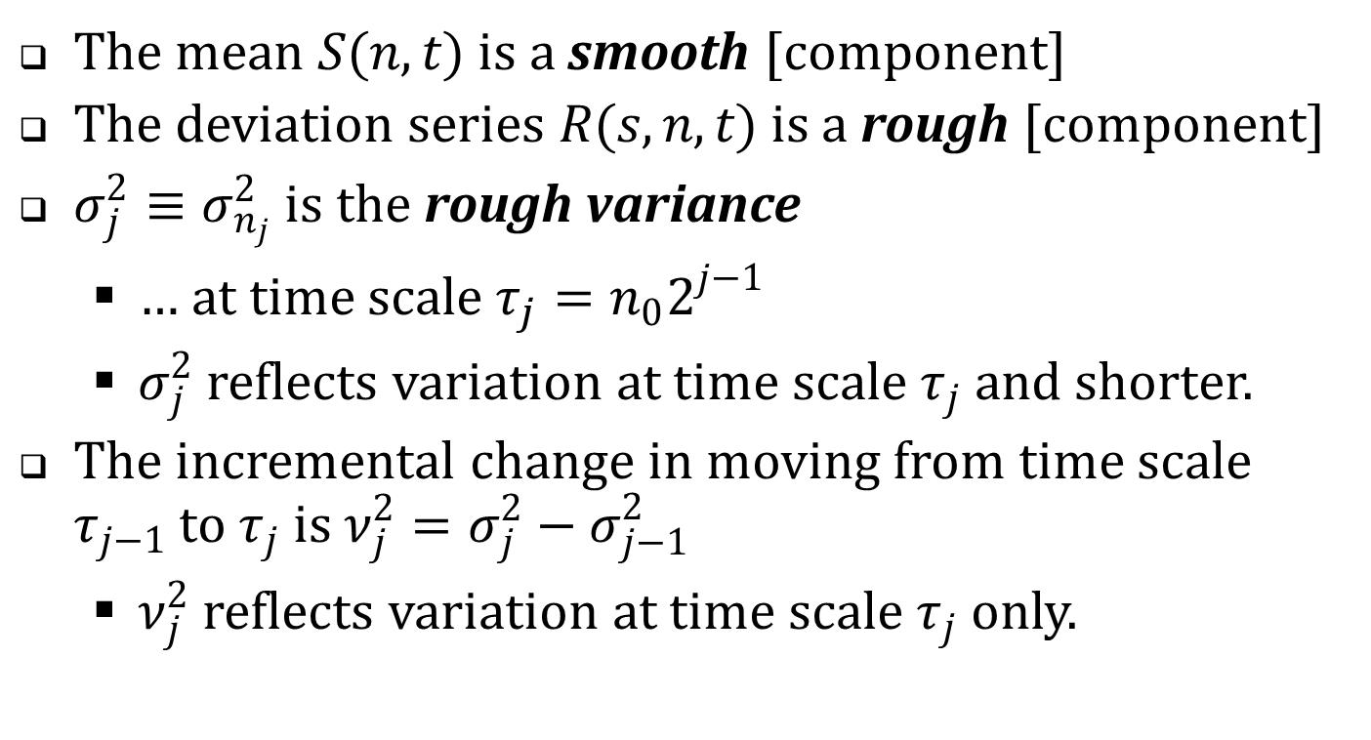
Signal processing and time scale decompositions
The mean $S(n,t)$ is a smooth [component]
The deviation series $R(s,n,t)$ is a rough [component]
$σ_{j}^{2}≡σ_{n_{j}}^{2}$ is the rough variance
  … at time scale $τ_{j}=n_{0}2^{j−1}$
  $σ_{j}^{2}$ reflects variation at time scale $τ_{j}$ and shorter.
The incremental change in moving from time scale $τ_{j−1}$ to $τ_{j}$ is $ν_{j}^{2}=σ_{j}^{2}−σ_{j−1}^{2}$
  $ν_{j}^{2}$ reflects variation at time scale $τ_{j}$ only.

Slide 41
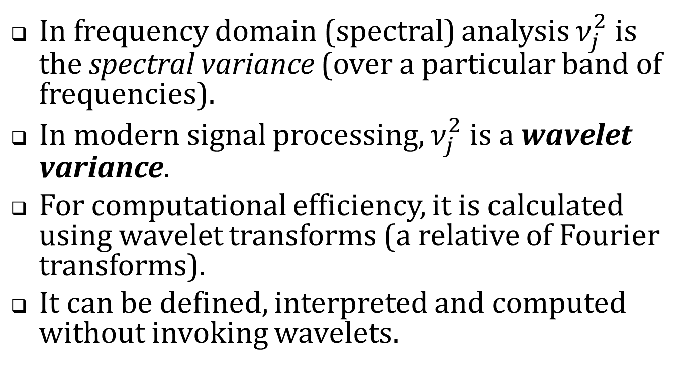
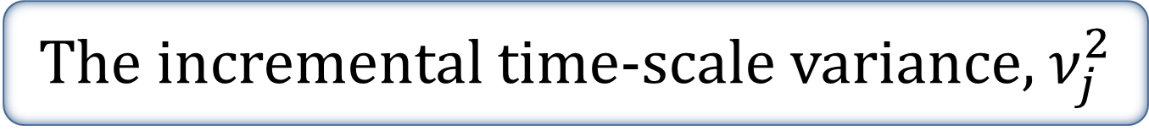
The incremental time-scale variance, $ν_{j}^{2}$
In frequency domain (spectral) analysis $ν_{j}^{2}$ is the spectral variance (over a particular band of frequencies).
In modern signal processing, $ν_{j}^{2}$ is a wavelet variance.
For computational efficiency, it is calculated using wavelet transforms (a relative of Fourier transforms).
It can be defined, interpreted and computed without invoking wavelets.

Slide 42
Interpretation
To assess economic importance, I present the (wavelet and rough) variance estimates in three ways.
  In mils per share
  In basis points
  As a short-term/long-term ratio

Slide 43
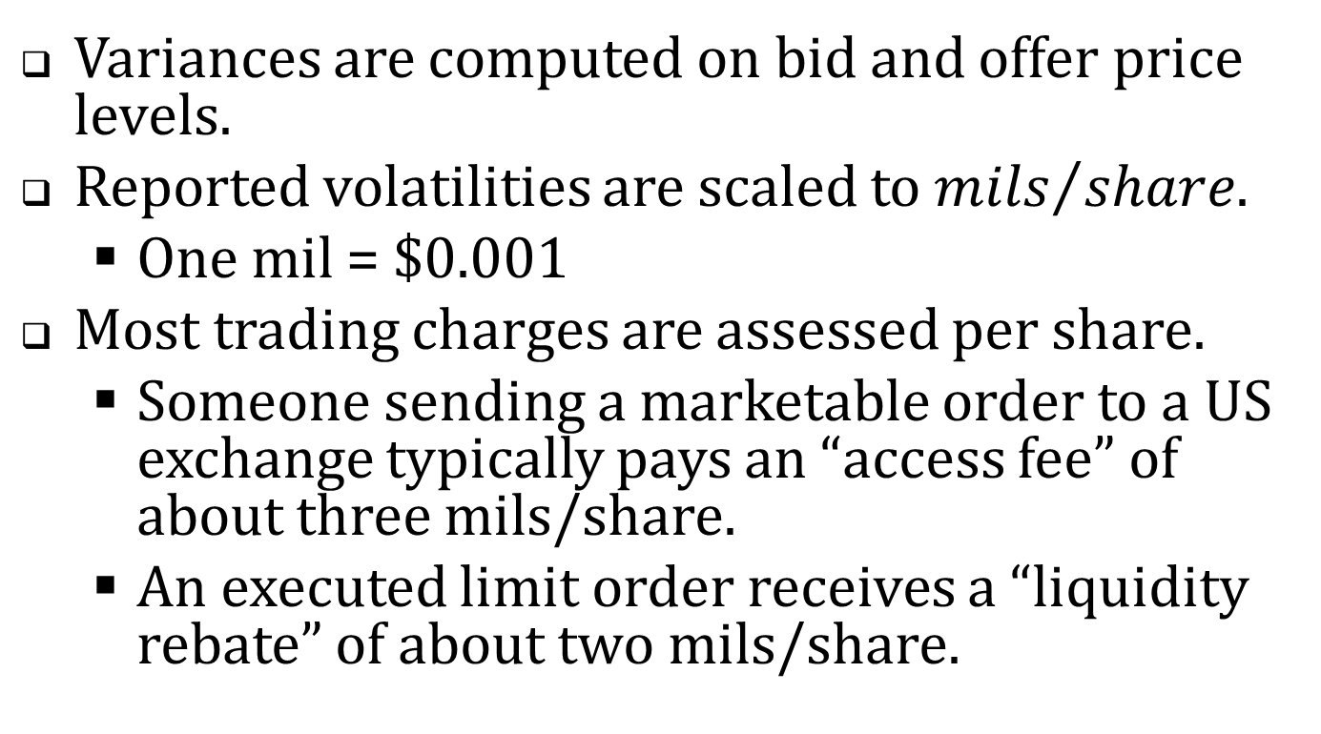
Mils per share
Variances are computed on bid and offer price levels.
Reported volatilities are scaled to ${mils}/{share}$.
  One mil = $0.001
Most trading charges are assessed per share.
  Someone sending a marketable order to a US exchange typically pays an “access fee” of about three mils/share.
  An executed limit order receives a “liquidity rebate” of about two mils/share.

Slide 44
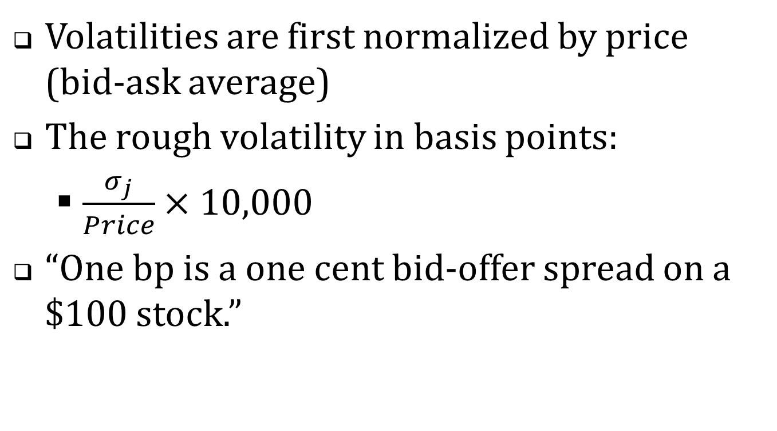
Basis points (One bp = 0.01%)
Volatilities are first normalized by price (bid-ask average)
The rough volatility in basis points:
  $\frac{σ_{j}}{Price}×10,000$
“One bp is a one cent bid-offer spread on a $100 stock.”

Slide 45
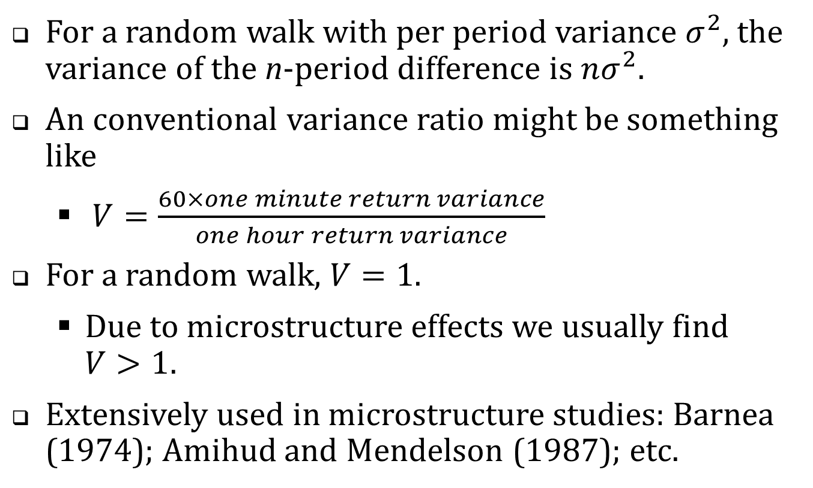
The short/long variance ratio
For a random walk with per period variance $σ^{2}$, the variance of the n-period difference is $nσ^{2}$.
An conventional variance ratio might be something like
  $V=\frac{60×one minute return variance}{one hour return variance}$
For a random walk, $V=1$.
  Due to microstructure effects we usually find $V>1$.
Extensively used in microstructure studies: Barnea (1974); Amihud and Mendelson (1987); etc.

Slide 46
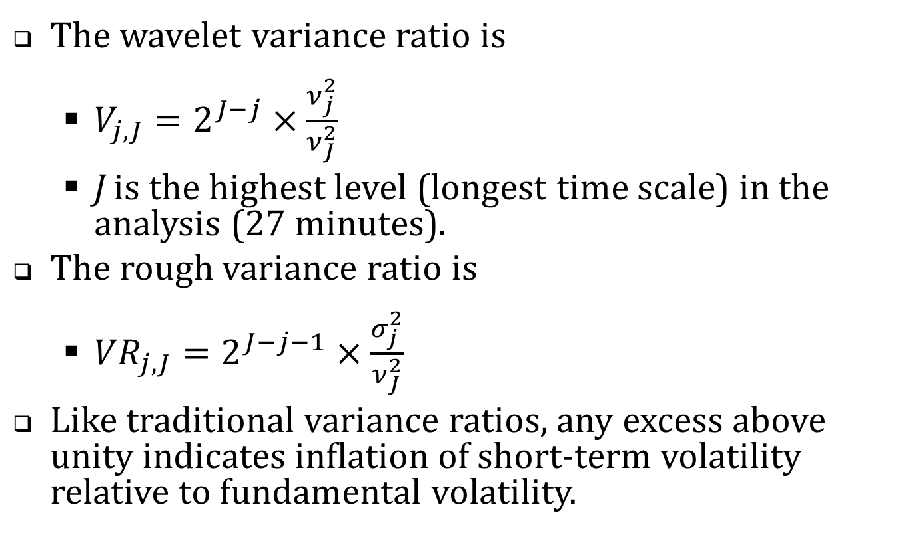
Variance ratios (cont’d)
The wavelet variance ratio is
  $V_{j,J}=2^{J−j}×\frac{ν_{j}^{2}}{ν_{J}^{2}}$
  J is the highest level (longest time scale) in the analysis (27 minutes).
The rough variance ratio is
  ${VR}_{j,J}=2^{J−j−1}×\frac{σ_{j}^{2}}{ν_{J}^{2}}$
Like traditional variance ratios, any excess above unity indicates inflation of short-term volatility relative to fundamental volatility.

Slide 47
The empirical analysis
CRSP Universe 2001-2011. (Share code = 10 or 11; average price $2 to $1,000; listing NYSE, Amex or NASDAQ)
In each year, chose 150 firms in a random sample stratified by dollar trading volume
2011 April TAQ with one-millisecond time stamps
2001-2011
April TAQ data with one-second time stamps
High-resolution analysis
Lower-resolution analysis

Slide 48
Table 1. Summary Statistics, 2011
 |  | Dollar trading volume quintile
 | Full sample | 1 (low) | 2 | 3 | 4 | 5 (high)
No. of firms | 150 | 30 | 30 | 30 | 30 | 30
NYSE | 47 | 0 | 5 | 7 | 16 | 19
Amex | 6 | 2 | 2 | 0 | 1 | 1
NASDAQ | 97 | 28 | 23 | 23 | 13 | 10
Avg. daily trades | 1,331 | 31 | 431 | 1,126 | 3,478 | 16,987
Avg. daily quotes | 23,928 | 967 | 7,706 | 24,026 | 53,080 | 181,457
Avg. daily NBBO records | 7,138 | 328 | 3,029 | 7,543 | 16,026 | 46,050
Avg. daily NBB changes | 1,245 | 120 | 511 | 1,351 | 2,415 | 4,124
Avg. daily NBO changes | 1,164 | 103 | 460 | 1,361 | 2,421 | 4,214
Avg. price | $15.62 | $4.87 | $5.46 | $17.86 | $27.76 | $51.60
Market capitalization of equity, $ Million | $683 | $41 | $202 | $747 | $1,502 | $8,739

Slide 49
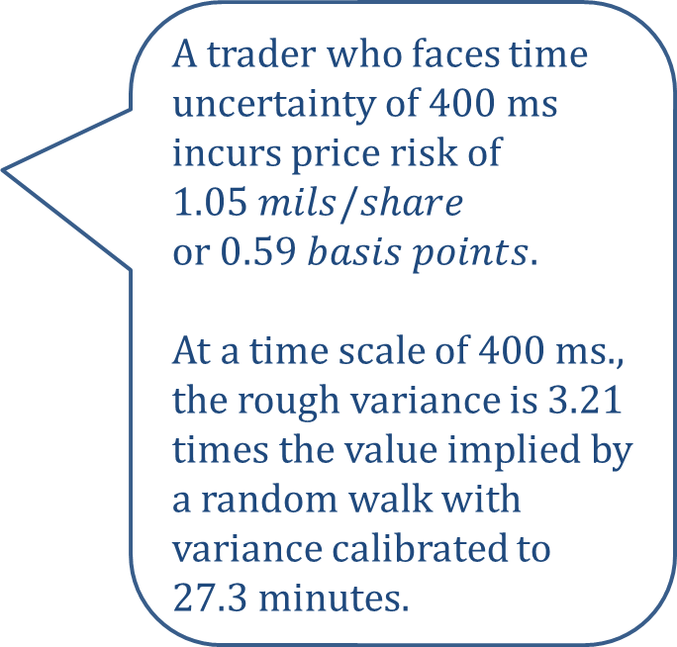
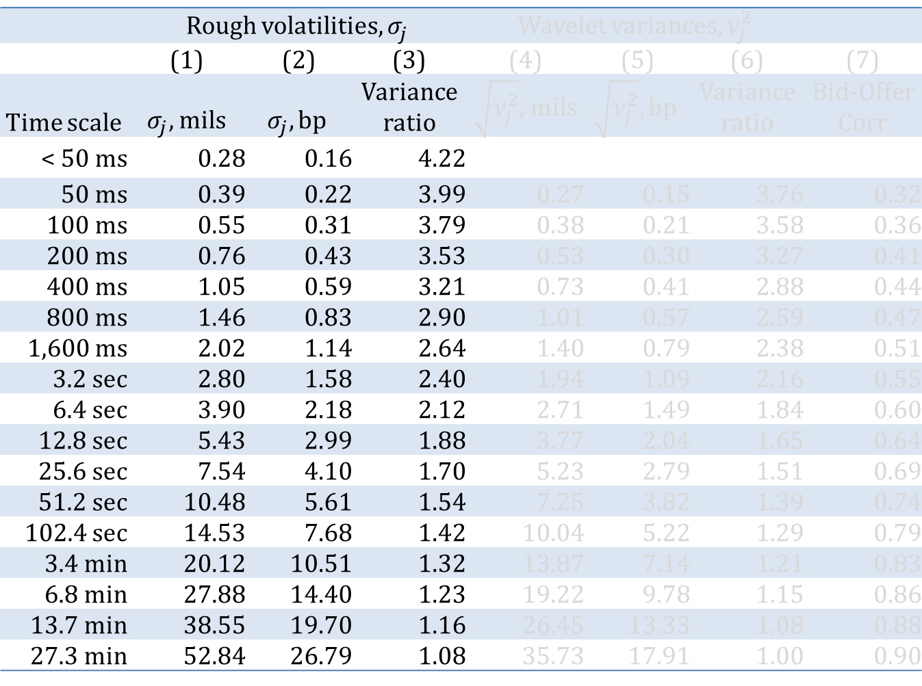
Table 2. Time scale variance estimates, 2011
 | Rough volatilities, $σ_{j}^{}$ |  |  | Wavelet variances, $ν_{j}^{2}$
 | (1) | (2) | (3) | (4) | (5) | (6) | (7)
Time scale | $σ_{j},$mils | $$σ_{j}, bp$$ | Variance ratio | $\sqrt{ν_{j}^{2}},$mils | $$\sqrt{ν_{j}^{2}}, bp$$ | Variance ratio | Bid-Offer Corr
< 50 ms | 0.28 | 0.16 | 4.22
50 ms | 0.39 | 0.22 | 3.99 | 0.27 | 0.15 | 3.76 | 0.32
100 ms | 0.55 | 0.31 | 3.79 | 0.38 | 0.21 | 3.58 | 0.36
200 ms | 0.76 | 0.43 | 3.53 | 0.53 | 0.30 | 3.27 | 0.41
400 ms | 1.05 | 0.59 | 3.21 | 0.73 | 0.41 | 2.88 | 0.44
800 ms | 1.46 | 0.83 | 2.90 | 1.01 | 0.57 | 2.59 | 0.47
1,600 ms | 2.02 | 1.14 | 2.64 | 1.40 | 0.79 | 2.38 | 0.51
3.2 sec | 2.80 | 1.58 | 2.40 | 1.94 | 1.09 | 2.16 | 0.55
6.4 sec | 3.90 | 2.18 | 2.12 | 2.71 | 1.49 | 1.84 | 0.60
12.8 sec | 5.43 | 2.99 | 1.88 | 3.77 | 2.04 | 1.65 | 0.64
25.6 sec | 7.54 | 4.10 | 1.70 | 5.23 | 2.79 | 1.51 | 0.69
51.2 sec | 10.48 | 5.61 | 1.54 | 7.25 | 3.82 | 1.39 | 0.74
102.4 sec | 14.53 | 7.68 | 1.42 | 10.04 | 5.22 | 1.29 | 0.79
3.4 min | 20.12 | 10.51 | 1.32 | 13.87 | 7.14 | 1.21 | 0.83
6.8 min | 27.88 | 14.40 | 1.23 | 19.22 | 9.78 | 1.15 | 0.86
13.7 min | 38.55 | 19.70 | 1.16 | 26.45 | 13.33 | 1.08 | 0.88
27.3 min | 52.84 | 26.79 | 1.08 | 35.73 | 17.91 | 1.00 | 0.90
A trader who faces time uncertainty of 400 ms incurs price risk of $1.05 mils/share$
or $0.59 basis points$.
At a time scale of 400 ms., the rough variance is 3.21 times the value implied by a random walk with variance calibrated to 27.3 minutes.

Slide 50
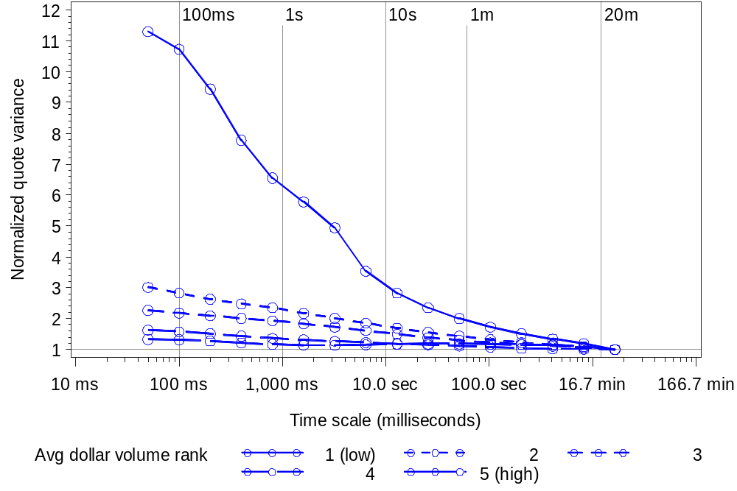
Figure 2. Wavelet variance ratios across time scale and dollar volume quintiles

Slide 51
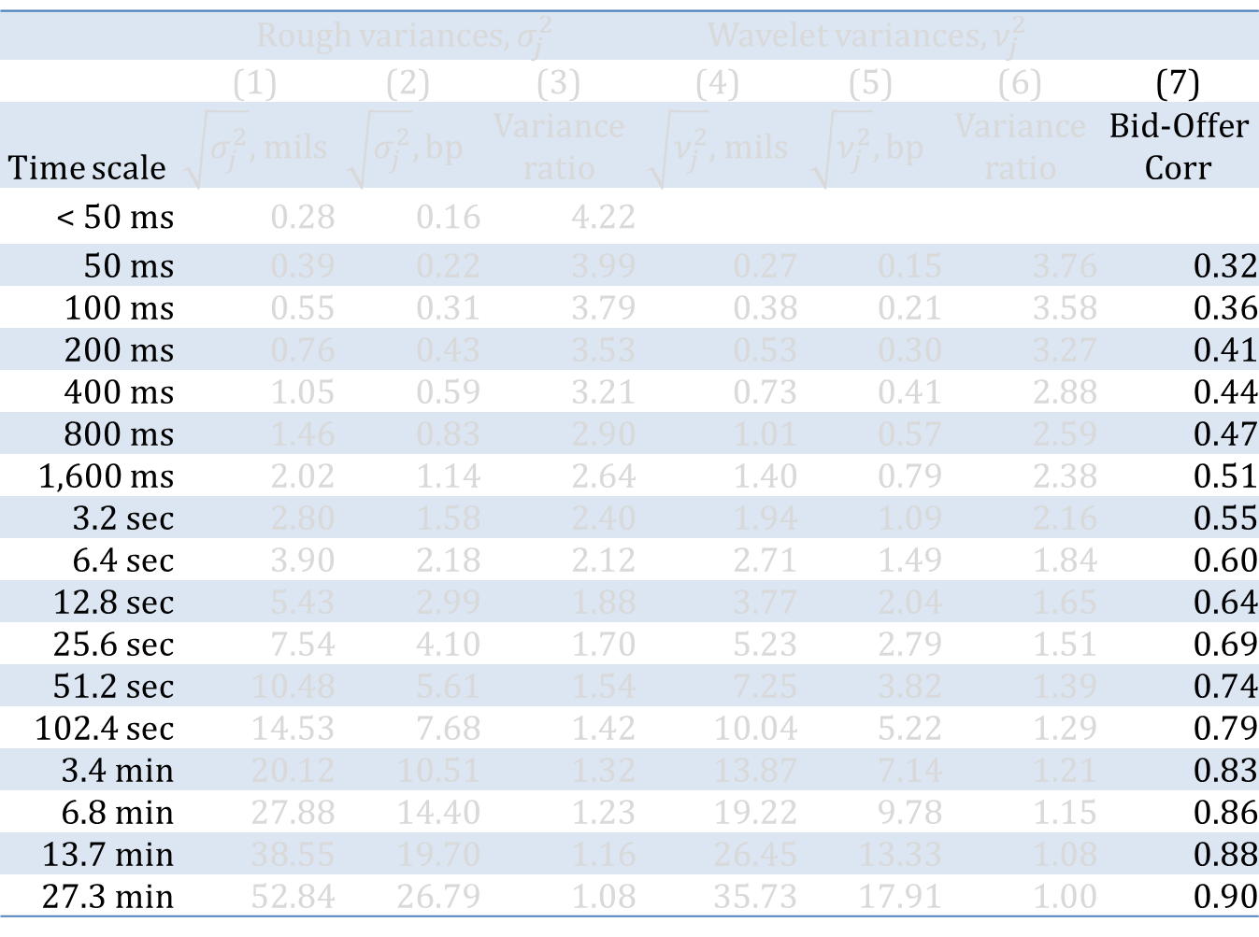
Table 2. Time scale variance estimates, 2011
 | Rough variances, $σ_{j}^{2}$ |  |  | Wavelet variances, $ν_{j}^{2}$
 | (1) | (2) | (3) | (4) | (5) | (6) | (7)
Time scale | $\sqrt{σ_{j}^{2}},$mils | $$\sqrt{σ_{j}^{2}}, bp$$ | Variance ratio | $\sqrt{ν_{j}^{2}},$mils | $$\sqrt{ν_{j}^{2}}, bp$$ | Variance ratio | Bid-Offer Corr
< 50 ms | 0.28 | 0.16 | 4.22
50 ms | 0.39 | 0.22 | 3.99 | 0.27 | 0.15 | 3.76 | 0.32
100 ms | 0.55 | 0.31 | 3.79 | 0.38 | 0.21 | 3.58 | 0.36
200 ms | 0.76 | 0.43 | 3.53 | 0.53 | 0.30 | 3.27 | 0.41
400 ms | 1.05 | 0.59 | 3.21 | 0.73 | 0.41 | 2.88 | 0.44
800 ms | 1.46 | 0.83 | 2.90 | 1.01 | 0.57 | 2.59 | 0.47
1,600 ms | 2.02 | 1.14 | 2.64 | 1.40 | 0.79 | 2.38 | 0.51
3.2 sec | 2.80 | 1.58 | 2.40 | 1.94 | 1.09 | 2.16 | 0.55
6.4 sec | 3.90 | 2.18 | 2.12 | 2.71 | 1.49 | 1.84 | 0.60
12.8 sec | 5.43 | 2.99 | 1.88 | 3.77 | 2.04 | 1.65 | 0.64
25.6 sec | 7.54 | 4.10 | 1.70 | 5.23 | 2.79 | 1.51 | 0.69
51.2 sec | 10.48 | 5.61 | 1.54 | 7.25 | 3.82 | 1.39 | 0.74
102.4 sec | 14.53 | 7.68 | 1.42 | 10.04 | 5.22 | 1.29 | 0.79
3.4 min | 20.12 | 10.51 | 1.32 | 13.87 | 7.14 | 1.21 | 0.83
6.8 min | 27.88 | 14.40 | 1.23 | 19.22 | 9.78 | 1.15 | 0.86
13.7 min | 38.55 | 19.70 | 1.16 | 26.45 | 13.33 | 1.08 | 0.88
27.3 min | 52.84 | 26.79 | 1.08 | 35.73 | 17.91 | 1.00 | 0.90
How closely do the bid and offer track at the indicated time scale?

Slide 52
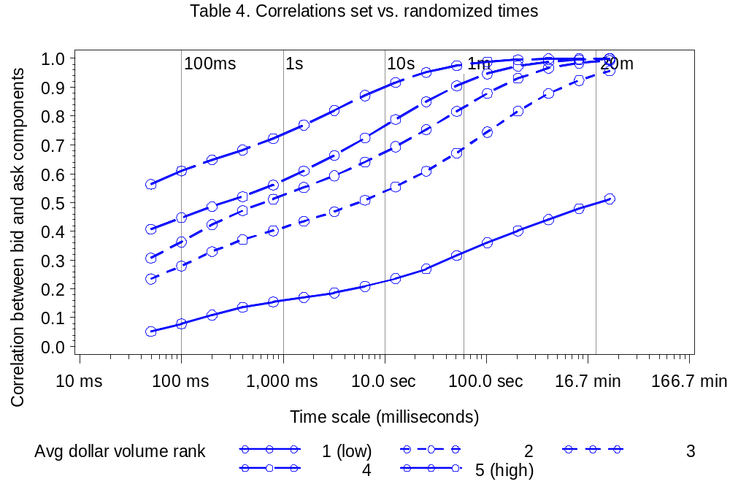
Figure 3. Wavelet correlations between the National Best Bid and National Best Offer

Slide 53
The 2011 results: a summary
Variance ratios: short term volatility is much higher than we’d expect relative to a random-walk.
In mils per share or basis points, average short term volatility is economically meaningful, but small.

Slide 54
Historical analysis
CRSP Universe 2001-2011. (Share code = 10 or 11; average price $2 to $1,000; listing NYSE, Amex or NASDAQ)
In each year, chose 150 firms in a random sample stratified by dollar trading volume
2011 April TAQ with one-millisecond time stamps
2001-2011
April TAQ data with one-second time stamps
High-resolution analysis
Lower-resolution analysis

Slide 55
High-resolution analysis …
… with low resolution data
TAQ with millisecond time stamps only available from 2006 onwards
TAQ with one second time stamps available back to 1993.
Can we draw inferences about subsecond variation from second-stamped data?

Slide 56
The problem
Quote A | 10:01:35
Quote B | 10:01:35
Quote C | 10:01:35
Where within the second did these quotes actually occur?
With a few simple assumptions, we know how they are distributed and how they may be simulated.

Slide 57
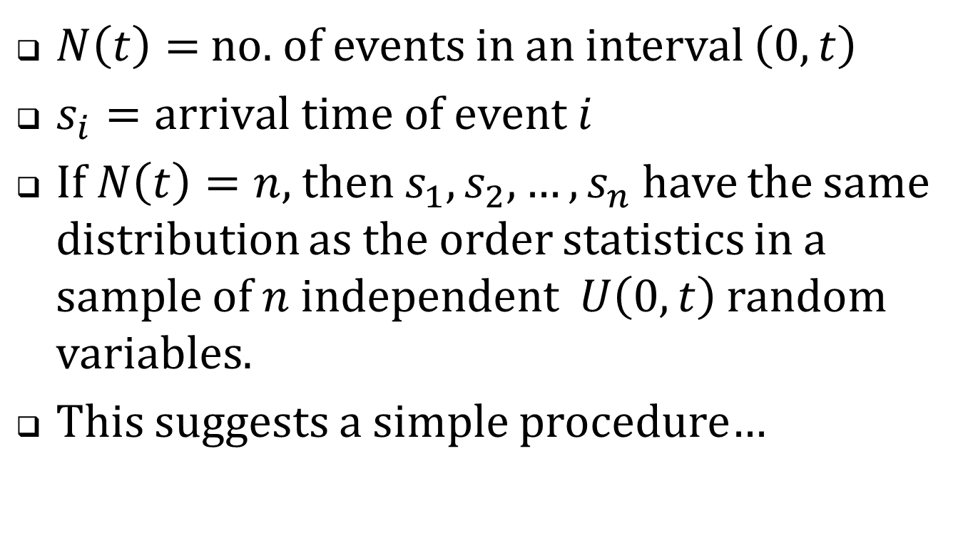
Recall the constant intensity Poisson process …
$N\left(t\right)=$ no. of events in an interval $\left(0,t\right)$
$s_{i}=arrival time of event i$
If $N\left(t\right)=n$, then $s_{1},s_{2},…,s_{n}$ have the same distribution as the order statistics in a sample of $n$ independent $U\left(0,t\right)$ random variables.
This suggests a simple procedure…

Slide 58
Quote A | 10:01:35
Quote B | 10:01:35
Quote C | 10:01:35
Draw three U(0,1) random numbers
Sort them
Assign them as the millisecond remainders
Quote A | 10:01:35.243
Quote B | 10:01:35.347
Quote C | 10:01:35.912
Compute variance estimates using the simulated time stamps.

Slide 59
Formalities
Assume that
  The quotes are correctly sequenced.
  Arrivals within the second are Poisson with (unknown) constant intensity.
  The bid and offer process is independent of the within-second arrival times.
Then each calculated statistic constitutes a draw from the corresponding Bayesian posterior.

Slide 60
Does this really work?
2011 millisecond-stamped TAQ data
Strip the millisecond portions of the time-stamps
Simulate new ms stamps
Wavelet variance estimates using actual ms time-stamps
Wavelet variance estimates using simulated ms. time-stamps.
Correlation?

Slide 61
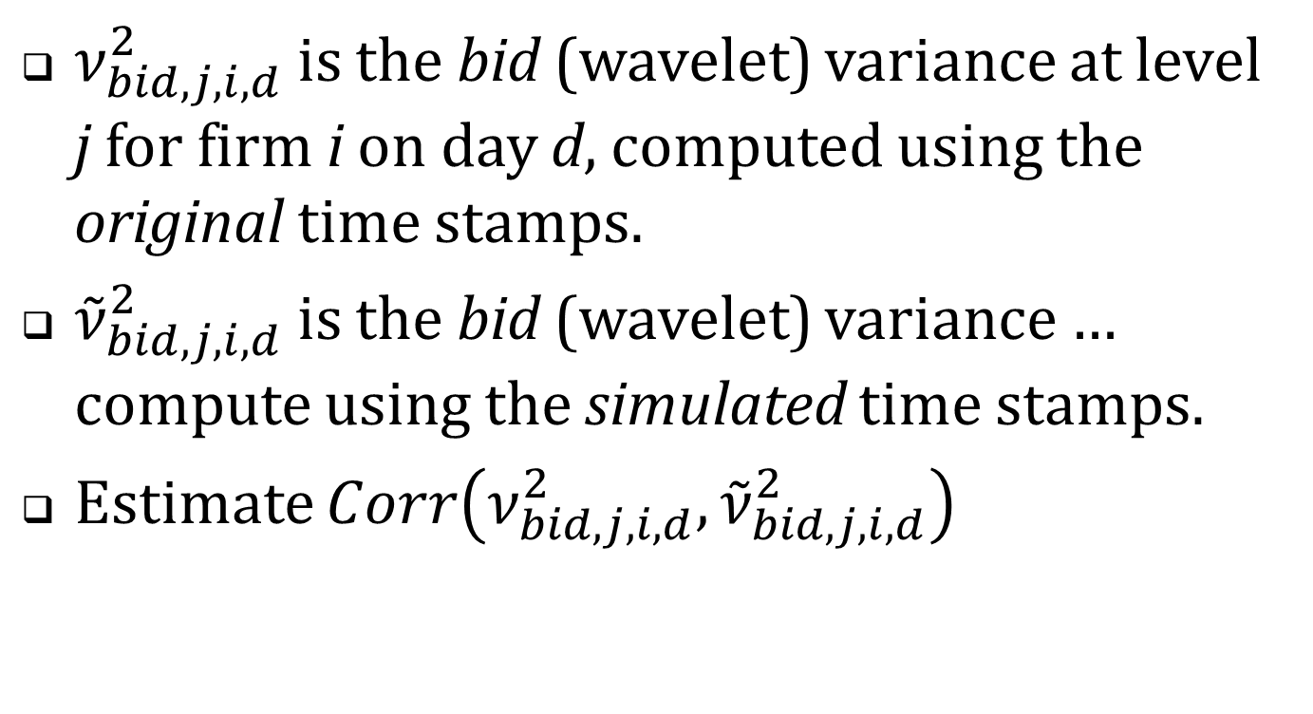
More precisely …
$ν_{bid,j,i,d}^{2}$ is the bid (wavelet) variance at level j for firm i on day d, computed using the original time stamps.
${\tilde{ν}}_{bid,j,i,d}^{2}$ is the bid (wavelet) variance …
compute using the simulated time stamps.
Estimate $Corr\left(ν_{bid,j,i,d}^{2},{\tilde{ν}}_{bid,j,i,d}^{2}\right)$

Slide 62
Table 4. Correlations between statistics based on actual vs. simulated millisecond time stamps.
Panel A: $Corr\left(ν_{bid,j,i,d}^{2},{\tilde{ν}}_{bid,j,i,d}^{2}\right)$
 |  | Dollar trading volume quintiles
Time scale | Full sample | 1 (low) | 2 | 3 | 4 | 5 (high)
< 50 ms | 0.952 | 0.948 | 0.960 | 0.958 | 0.916 | 0.979
50 ms | 0.953 | 0.944 | 0.952 | 0.952 | 0.937 | 0.982
200 ms | 0.975 | 0.965 | 0.969 | 0.975 | 0.977 | 0.988
800 ms | 0.994 | 0.991 | 0.989 | 0.995 | 0.996 | 0.998
3.2 sec | 0.999 | 0.999 | 0.999 | 1.000 | 1.000 | 1.000
25.6 sec | 1.000 | 1.000 | 1.000 | 1.000 | 1.000 | 1.000
6.8 min | 1.000 | 1.000 | 1.000 | 1.000 | 1.000 | 1.000
27.3 min | 1.000 | 1.000 | 1.000 | 1.000 | 1.000 | 1.000

Slide 63
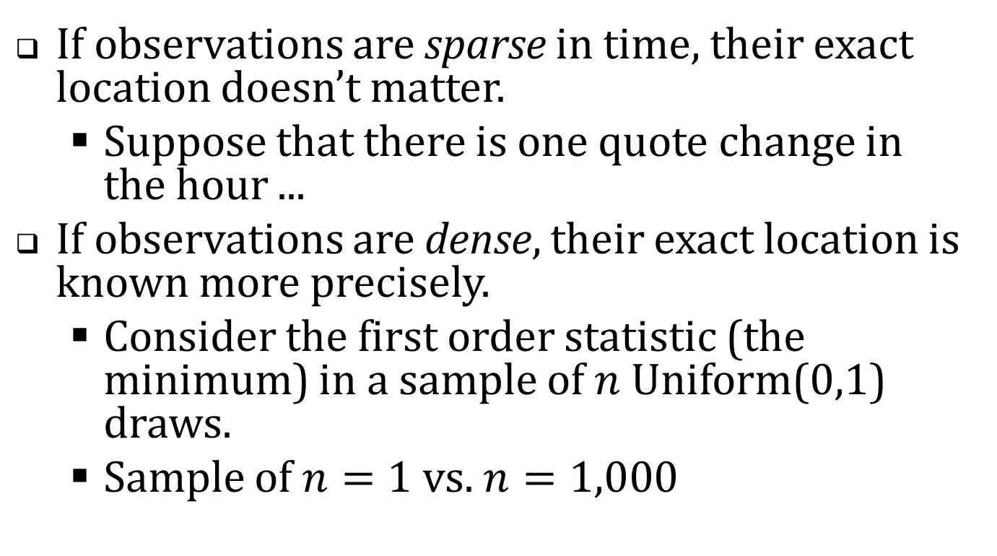
The correlations are terrific. Why?
If observations are sparse in time, their exact location doesn’t matter.
  Suppose that there is one quote change in the hour ...
If observations are dense, their exact location is known more precisely.
  Consider the first order statistic (the minimum) in a sample of $n$ Uniform(0,1) draws.
  Sample of $n=1$ vs. $n=1,000$

Slide 64
Table 4. Correlations between estimates based on actual vs. simulated millisecond time stamps.
Panel B: $Corr\left(ν_{bid,offer,j,i,d}^{2},{\tilde{ν}}_{bid,offer,j,i,d}^{2}\right)$, [the bid/offer covariances]
 |  | Dollar trading volume quintiles
Time scale | Full sample | 1 (low) | 2 | 3 | 4 | 5 (high)
< 50 ms | 0.775 | 0.333 | 0.768 | 0.896 | 0.919 | 0.943
50 ms | 0.900 | 0.662 | 0.926 | 0.965 | 0.972 | 0.978
200 ms | 0.979 | 0.921 | 0.986 | 0.995 | 0.995 | 0.998
800 ms | 0.999 | 0.998 | 0.999 | 1.000 | 1.000 | 1.000
3.2 sec | 1.000 | 1.000 | 1.000 | 1.000 | 1.000 | 1.000
25.6 sec | 1.000 | 1.000 | 1.000 | 1.000 | 1.000 | 1.000
6.8 min | 1.000 | 1.000 | 1.000 | 1.000 | 1.000 | 1.000
27.3 min | 1.000 | 1.000 | 1.000 | 1.000 | 1.000 | 1.000

Slide 65
Back to the 2001-2011 historical sample
Variance estimations will be based on simulated millisecond time-stamps.

Slide 66
Table 5. Summary statistics, historical sample,
2001-2011 (only odd numbered years are shown)
 | 2001 |  | 2003 |  | 2005 |  | 2007 |  | 2009 |  | 2011
No. firms | 146 |  | 150 |  | 150 |  | 150 |  | 150 |  | 150
NYSE | 108 |  | 51 |  | 48 |  | 55 |  | 56 |  | 47
Amex | 22 |  | 11 |  | 8 |  | 14 |  | 5 |  | 6
NASDAQ | 16 |  | 88 |  | 94 |  | 81 |  | 89 |  | 97
Avg. daily trades | 142 |  | 187 |  | 425 |  | 970 |  | 1,790 |  | 1,331
Avg. daily quotes | 1,078 |  | 1,299 |  | 5,828 |  | 12,521 |  | 39,378 |  | 23,928
Avg. daily NBB changes | 103 |  | 203 |  | 596 |  | 772 |  | 1,618 |  | 1,210
Avg. daily NBO changes | 103 |  | 213 |  | 729 |  | 789 |  | 1,731 |  | 1,126
Avg. price | $18.85 |  | $14.83 |  | $16.10 |  | $15.81 |  | $10.72 |  | $15.62
Market equity cap $ Million | $745 |  | $189 |  | $325 |  | $480 |  | $316 |  | $683

Slide 67
Table 5. Summary statistics, historical sample,
2001-2011 (only odd numbered years are shown)
 | 2001 |  | 2003 |  | 2005 |  | 2007 |  | 2009 |  | 2011
No. firms | 146 |  | 150 |  | 150 |  | 150 |  | 150 |  | 150
NYSE | 108 |  | 51 |  | 48 |  | 55 |  | 56 |  | 47
Amex | 22 |  | 11 |  | 8 |  | 14 |  | 5 |  | 6
NASDAQ | 16 |  | 88 |  | 94 |  | 81 |  | 89 |  | 97
Avg. daily trades | 142 |  | 187 |  | 425 |  | 970 |  | 1,790 |  | 1,331
Avg. daily quotes | 1,078 |  | 1,299 |  | 5,828 |  | 12,521 |  | 39,378 |  | 23,928
Avg. daily NBB changes | 103 |  | 203 |  | 596 |  | 772 |  | 1,618 |  | 1,210
Avg. daily NBO changes | 103 |  | 213 |  | 729 |  | 789 |  | 1,731 |  | 1,126
Avg. price | $18.85 |  | $14.83 |  | $16.10 |  | $15.81 |  | $10.72 |  | $15.62
Market equity cap $ Million | $745 |  | $189 |  | $325 |  | $480 |  | $316 |  | $683
25% CAGR
36% CAGR

Slide 68
What statistics to consider?
Long-term volatilities changed dramatically over the sample period.
Variance ratios (normalized to long-term volatility) are the most reliable indicators of trends.

Slide 69
Table 6. Wavelet variance ratios for bids and offers, 2001-2011
Panel A: Computed from unadjusted bids and offers
Time scale | 2001 | 2002 | 2003 | 2004 | 2005 | 2006 | 2007 | 2008 | 2009 | 2010 | 2011
50 ms | 5.22 | 7.16 | 6.03 | 10.28 | 6.69 | 8.57 | 6.96 | 6.06 | 4.52 | 7.08 | 4.70
100 ms | 5.44 | 6.58 | 5.28 | 9.69 | 6.51 | 8.07 | 6.27 | 5.38 | 4.12 | 6.26 | 4.32
200 ms | 5.28 | 6.28 | 5.13 | 9.03 | 6.22 | 7.34 | 5.33 | 4.64 | 3.68 | 5.40 | 3.74
400 ms | 4.59 | 5.23 | 5.00 | 8.16 | 5.75 | 6.30 | 4.25 | 3.84 | 3.21 | 4.53 | 3.07
800 ms | 3.12 | 4.04 | 3.93 | 5.57 | 5.03 | 5.10 | 3.41 | 3.11 | 2.76 | 3.71 | 2.56
1,600 ms | 2.11 | 2.55 | 3.25 | 4.11 | 4.14 | 4.05 | 2.89 | 2.59 | 2.43 | 3.04 | 2.23
3.2 sec | 1.98 | 2.24 | 2.93 | 3.38 | 3.48 | 3.37 | 2.56 | 2.29 | 2.17 | 2.53 | 2.01
6.4 sec | 1.94 | 2.11 | 2.62 | 2.91 | 2.93 | 2.92 | 2.35 | 2.08 | 1.95 | 2.16 | 1.82

Slide 70
No trend in quote volatilities?
Maybe …
  “Flickering quotes” aren’t new.
  Recent concerns about high frequency trading are all media hype.
  The good old days weren’t really so great after all.
What did quote volatility look like circa 2001?

Slide 71
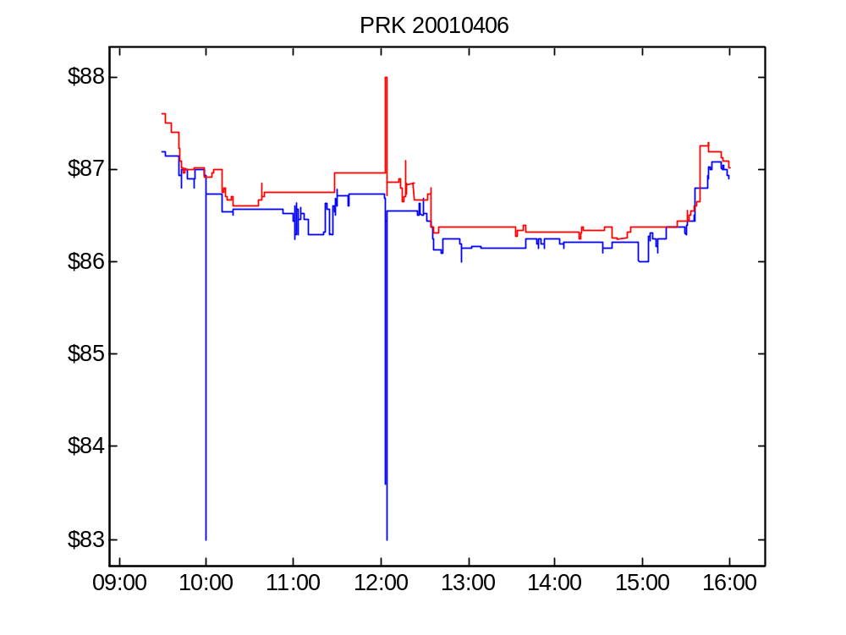
Figure 4 Panel A. Bid and offer for PRK, April 6, 2001.

Slide 72
Compare
PRK in 2001 vs. AEPI in 2011
  PRK: large amplitude, no oscillation.
  AEPI: low amplitude, intense oscillation.

Slide 73
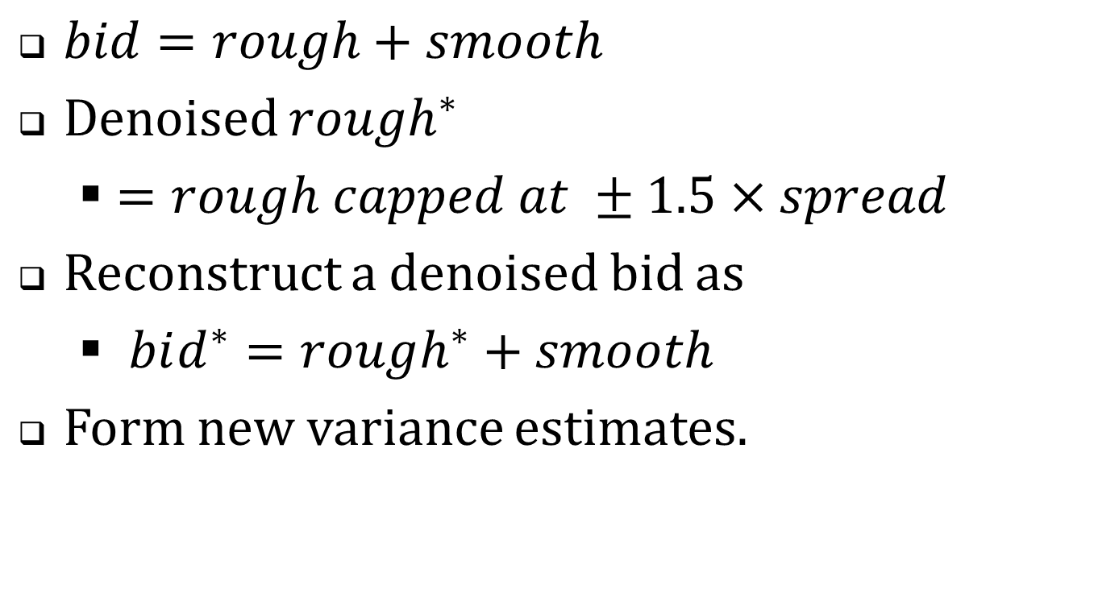
Denoising (filtering) “pops”
$bid=rough+smooth$
Denoised $rough^{∗}$
  $=rough capped at ±1.5×spread$
Reconstruct a denoised bid as
  $bid^{∗}=rough^{∗}+smooth$
Form new variance estimates.

Slide 74
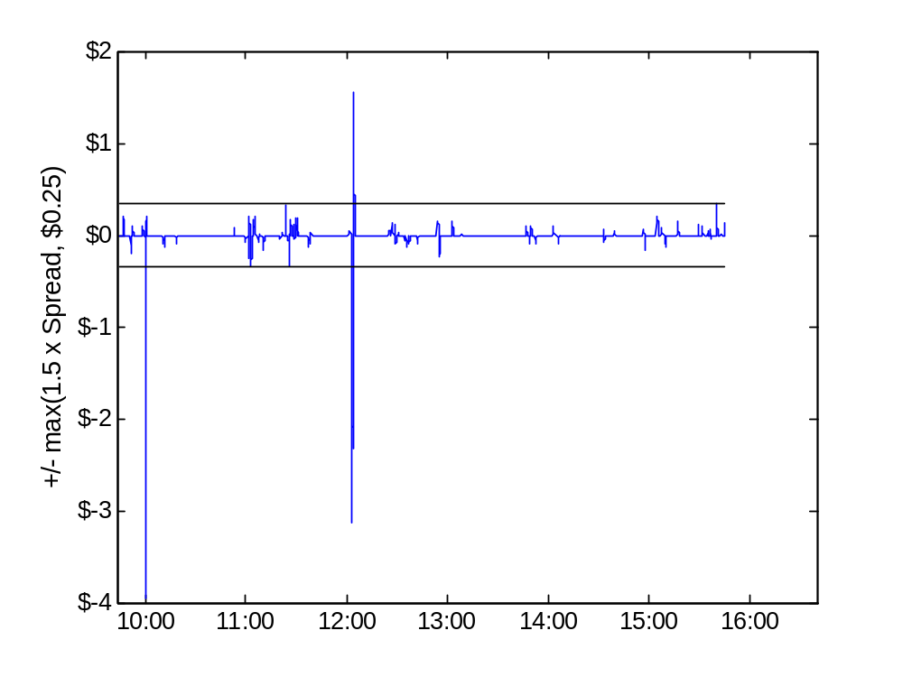
Figure 4 Panel B. PRK, April 6, 2001, Rough component of the bid

Slide 75
Table 6. Wavelet variance ratios for bids and offers, 2001-2011, Detail
Panel A: Computed from unadjusted bids and offers
Panel B: Computed from denoised bids and offers
Time scale | 2001 | … | 2011
50 ms | 5.22 |  | 4.70
100 ms | 5.44 |  | 4.32
200 ms | 5.28 |  | 3.74
400 ms | 4.59 |  | 3.07
800 ms | 3.12 |  | 2.56
1,600 ms | 2.11 |  | 2.23
3.2 sec | 1.98 |  | 2.01
6.4 sec | 1.94 |  | 1.82
Time scale | 2001 | … | 2011
50 ms | 1.60 |  | 4.46
100 ms | 1.57 |  | 4.07
200 ms | 1.56 |  | 3.57
400 ms | 1.55 |  | 3.00
800 ms | 1.57 |  | 2.52
1,600 ms | 1.64 |  | 2.20
3.2 sec | 1.81 |  | 2.00
6.4 sec | 2.11 |  | 1.82

Slide 76
Table 6. Wavelet variance ratios for bids and offers, 2001-2011
Panel B. Computed from denoised bids and offers
Time scale | 2001 | 2002 | 2003 | 2004 | 2005 | 2006 | 2007 | 2008 | 2009 | 2010 | 2011
50 ms | 1.60 | 2.37 | 3.15 | 7.02 | 6.09 | 8.24 | 6.56 | 5.83 | 4.20 | 6.79 | 4.46
100 ms | 1.57 | 2.32 | 3.09 | 6.82 | 5.89 | 7.76 | 5.89 | 5.17 | 3.83 | 6.00 | 4.07
200 ms | 1.56 | 2.27 | 3.03 | 6.48 | 5.61 | 7.04 | 4.99 | 4.45 | 3.41 | 5.18 | 3.57
400 ms | 1.55 | 2.23 | 2.94 | 5.90 | 5.16 | 6.02 | 3.96 | 3.68 | 2.97 | 4.36 | 3.00
800 ms | 1.57 | 2.19 | 2.83 | 5.00 | 4.47 | 4.82 | 3.13 | 2.98 | 2.56 | 3.58 | 2.52
1,600 ms | 1.64 | 2.20 | 2.71 | 3.99 | 3.60 | 3.79 | 2.63 | 2.51 | 2.27 | 2.94 | 2.20
3.2 sec | 1.81 | 2.30 | 2.62 | 3.44 | 3.02 | 3.16 | 2.33 | 2.23 | 2.04 | 2.46 | 2.00
6.4 sec | 2.11 | 2.51 | 2.59 | 3.20 | 2.65 | 2.75 | 2.15 | 2.04 | 1.86 | 2.11 | 1.82

Slide 77
Summary of the variance ratio evidence
Without filtering: no trend in quote volatility.
With filtering
  Volatility in earlier years is lower
  Maybe a trend
    But highest values are mostly
    in 2004-2006
The effects of filtering suggest that
  Early years: volatility due to spikes
  Later years: volatility reflects oscillations
What changed?

Slide 78
SEC’s Reg NMS (“National Market System”)
Proposed in 2004; adopted 2005; implemented in 2006.
Defined the framework for competition among equity markets.
Enhanced protection against trade-throughs
  Example: market A is bidding $10 and market B executes a trade at $9.
For a market’s bid and offer to be protected, they have to accessible instantly (electronically)
  This requirement essentially forced all markets to become electronic.

Slide 79
Before and after
Prior to Reg NMS
  Trading dominated by slow, manual floor markets
  Weak protection against trade-throughs
Post Reg NMS
  Bids and offers are firm and accessible.
  Strong trade-through protection

Slide 80
So has quote volatility increased?
Apples vs. oranges
  The nature of quotes has changed.
Quote volatility has changed
  From infrequent large changes to frequent (and oscillatory) small changes.
Possibly a overall small increase,
  But nothing as strong as the trend implied by the growth in quote messaging rates.

Slide 81
Follow-up questions
What strategies give rise to the episodic oscillations?
Are the HFQ episodes unstable algos?
Are they sensible strategies to detect and access liquidity?

Slide 82
Extra overheads

Slide 83
Dark trades: internalized execution
A broker receives a retail buy order.
  The order is not sent to an exchange or any other venue.
  The broker sells directly to the customer at the National Best Offer (NBO)
Volatility in the NBO → volatility in execution price.

Slide 84
Dark trading
“Dark” the market executing the order did not previously post a visible bid or offer at the execution price.
  The trade itself is promptly reported.
Dark mechanisms
  Hidden (undisplayed) limit orders
  Internalized executions
  Dark pools

Slide 85
Dark trades: dark pools
Mechanism
  Traders send buy and sell orders to a computer.
  The orders are not displayed.
  If the computer finds a feasible match, a trade occurs.
The trade is priced at the midpoint of the National Best Bid and Offer (NBBO)
Volatility in the NBBO causes volatility in the execution price.

Slide 86
Look-back options
Internalization: a broker receives a retail buy order and executes the order at the NBO.
Problem: how does the customer know what the NBO is or was?
Might the dealer take the highest price in the interval of indeterminacy?
  Stoll and Schenzler (2002)

Slide 87
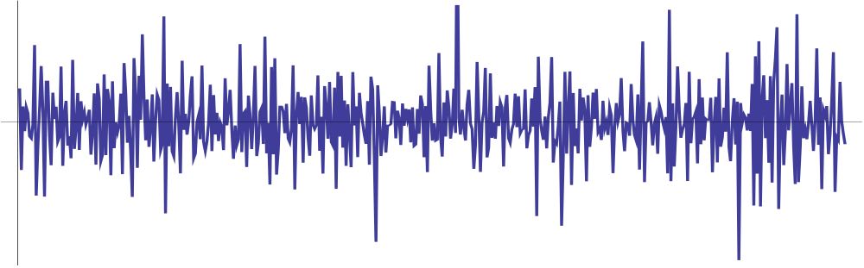
What’s lost by first-differencing?
First difference plot of a simulated series.

Slide 88
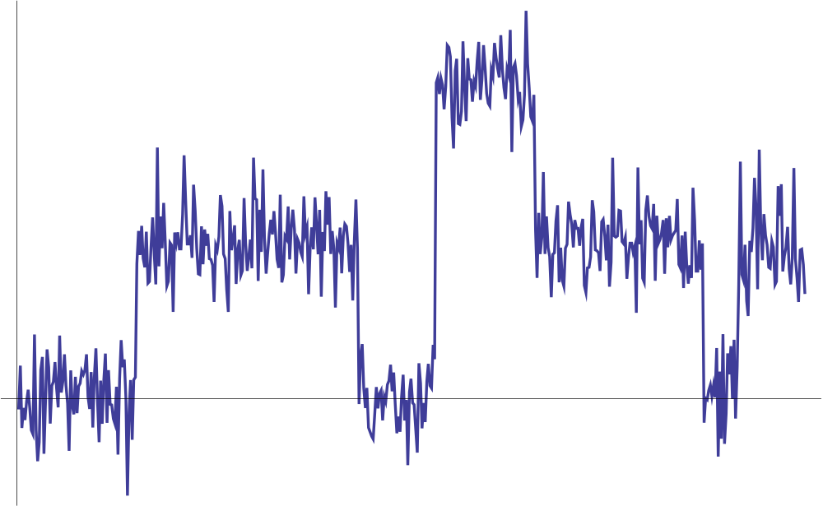
… and the integrated series

Slide 89
Analyzing quote volatility
Usual approach
  parametric model for variance of price changes (ARCH, GARCH, …)
This study
  Non-parametric analysis of variances of price levels

Slide 90
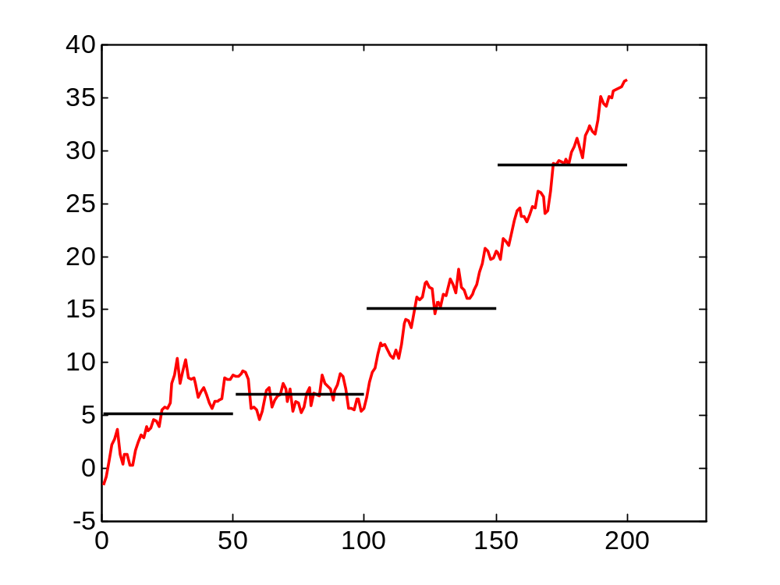
Variance about a local mean of a random walk

Slide 91
“HF traders are the new market makers.”
Provide valuable intermediation services.
  Like traditional designated dealers and specialists.
Hendershott, Jones and Menkveld (2011): NYSE message traffic
Hasbrouck and Saar (2012): strategic runs / order chains
Brogaard, Hendershott and Riordan (2012) use Nasdaq HFT dataset in which trades used to define a set of high frequency traders.
Studies generally find that HFT activity is associated with (causes?) higher market quality.

Slide 92
“HF traders are predatory.”
They profit from HF information asymmetries at the expense of natural liquidity seekers (hedgers, producers of fundamental information).
Jarrow and Protter (2011); Foucault and Rosu (2012)
Baron, Brogaard and Kirilenko (2012); Weller (2012); Clark-Joseph (2012)

Slide 93
Table 8. Wavelet bid and offer variances, 2001-2011
Panel A. Rough variances, mils per share
time scale | 2001 |  | 2003 |  | 2005 |  | 2007 |  | 2009 |  | 2011
50 ms | 0.05 |  | 0.07 |  | 0.23 |  | 0.08 |  | 0.25 |  | 0.07
 | (<0.01) |  | (<0.01) |  | (0.03) |  | (<0.01) |  | (0.03) |  | (0.01)
200 ms | 0.34 |  | 0.45 |  | 1.52 |  | 0.45 |  | 1.50 |  | 0.40
 | (0.01) |  | (0.02) |  | (0.17) |  | (0.02) |  | (0.19) |  | (0.08)
800 ms | 1.50 |  | 1.85 |  | 5.56 |  | 1.42 |  | 5.16 |  | 1.42
 | (0.05) |  | (0.07) |  | (0.53) |  | (0.07) |  | (0.42) |  | (0.22)
3.2 sec | 6.82 |  | 6.77 |  | 16.03 |  | 4.19 |  | 16.45 |  | 4.74
 | (0.52) |  | (0.22) |  | (1.25) |  | (0.16) |  | (0.96) |  | (0.49)
25.6 sec | 80.46 |  | 47.03 |  | 84.18 |  | 25.18 |  | 109.42 |  | 30.76
 | (16.17) |  | (2.57) |  | (5.75) |  | (0.98) |  | (13.16) |  | (3.22)
6.8 min | 735.03 |  | 489.43 |  | 862.96 |  | 302.16 |  | 1,638.73 |  | 333.50
 | (30.23) |  | (12.26) |  | (73.94) |  | (23.79) |  | 492.40) |  | (12.05)
27.3 min | 2,511.15 |  | 1,554.80 |  | 2,872.45 |  | 1,046.55 |  | 4,623.58 |  | 1,164.98
 | (80.99) |  | (39.18) |  | 335.55) |  | 101.74) |  | 849.95) |  | (41.65)

Slide 94
Table 8. Wavelet bid and offer variances, 2001-2011
Panel B. Rough variance ratios
Time scale | 2001 |  | 2003 |  | 2005 |  | 2007 |  | 2009 |  | 2011
50 ms | 1.60 |  | 3.15 |  | 6.09 |  | 6.56 |  | 4.20 |  | 4.46
 | (0.02) |  | (0.11) |  | (0.39) |  | (0.40) |  | (0.31) |  | (1.42)
200 ms | 1.57 |  | 3.06 |  | 5.76 |  | 5.47 |  | 3.65 |  | 3.84
 | (0.02) |  | (0.10) |  | (0.36) |  | (0.30) |  | (0.26) |  | (1.16)
800 ms | 1.56 |  | 2.91 |  | 4.94 |  | 3.87 |  | 2.91 |  | 2.94
 | (0.03) |  | (0.09) |  | (0.27) |  | (0.17) |  | (0.16) |  | (0.69)
3.2 sec | 1.71 |  | 2.71 |  | 3.64 |  | 2.78 |  | 2.31 |  | 2.28
 | (0.09) |  | (0.10) |  | (0.15) |  | (0.09) |  | (0.09) |  | (0.35)
25.6 sec | 2.36 |  | 2.60 |  | 2.42 |  | 2.03 |  | 1.74 |  | 1.70
 | (0.37) |  | (0.29) |  | (0.07) |  | (0.05) |  | (0.04) |  | (0.12)
6.8 min | 1.37 |  | 1.50 |  | 1.49 |  | 1.37 |  | 1.32 |  | 1.23
 | (0.04) |  | (0.03) |  | (0.02) |  | (0.02) |  | (0.03) |  | (0.02)
27.3 min | 1.12 |  | 1.16 |  | 1.16 |  | 1.12 |  | 1.11 |  | 1.08
 | (0.02) |  | (0.02) |  | (0.02) |  | (0.02) |  | (0.02) |  | (0.01)

Slide 95
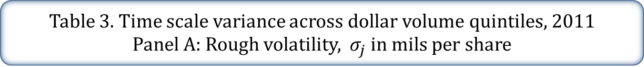
Table 3. Time scale variance across dollar volume quintiles, 2011
Panel A: Rough volatility, $σ_{j}$ in mils per share
 |  |  | Dollar trading volume quintiles
Level, j | Time scale | Full sample | 1 (low) | 2 | 3 | 4 | 5 (high)
0 | < 50 ms | 0.28 | 0.15 | 0.19 | 0.29 | 0.37 | 0.40
 |  | (<0.01) | (0.01) | (0.01) | (0.01) | (0.01) | (0.01)
1 | 50 ms | 0.39 | 0.21 | 0.27 | 0.40 | 0.51 | 0.56
 |  | (0.01) | (0.01) | (0.01) | (0.01) | (0.01) | (0.01)
3 | 200 ms | 0.76 | 0.40 | 0.50 | 0.76 | 0.99 | 1.11
 |  | (0.01) | (0.03) | (0.02) | (0.02) | (0.02) | (0.02)
5 | 800 ms | 1.46 | 0.76 | 0.95 | 1.45 | 1.91 | 2.14
 |  | (0.02) | (0.04) | (0.03) | (0.03) | (0.04) | (0.04)
7 | 3.2 sec | 2.80 | 1.46 | 1.79 | 2.75 | 3.70 | 4.19
 |  | (0.04) | (0.07) | (0.06) | (0.06) | (0.08) | (0.09)
10 | 25.6 sec | 7.54 | 3.63 | 4.51 | 7.05 | 10.12 | 12.02
 |  | (0.10) | (0.15) | (0.15) | (0.15) | (0.23) | (0.27)
14 | 6.8 min | 27.88 | 11.83 | 15.29 | 24.76 | 38.35 | 47.61
 |  | (0.39) | (0.47) | (0.50) | (0.52) | (0.94) | (1.14)
16 | 27.3 min | 52.84 | 20.94 | 28.09 | 46.87 | 74.69 | 90.49
 |  | (0.78) | (0.86) | (0.91) | (1.03) | (2.04) | (2.26)

Slide 96

Table 3. Time scale variance across dollar volume quintiles, 2011
Panel B, Rough volatility, $σ_{j}$ in bp
 |  |  | Dollar trading volume quintiles
Level, j | Time scale | Full sample | 1 (low) | 2 | 3 | 4 | 5 (high)
0 | < 50 ms | 0.16 | 0.26 | 0.21 | 0.14 | 0.11 | 0.08
 |  | (<0.01) | (0.01) | (<0.01) | (<0.01) | (<0.01) | (<0.01)
1 | 50 ms | 0.22 | 0.37 | 0.29 | 0.20 | 0.16 | 0.11
 |  | (<0.01) | (0.02) | (0.01) | (<0.01) | (<0.01) | (<0.01)
3 | 200 ms | 0.43 | 0.70 | 0.56 | 0.38 | 0.31 | 0.22
 |  | (0.01) | (0.03) | (0.01) | (0.01) | (<0.01) | (<0.01)
5 | 800 ms | 0.83 | 1.34 | 1.07 | 0.73 | 0.59 | 0.43
 |  | (0.01) | (0.05) | (0.02) | (0.01) | (0.01) | (0.01)
7 | 3.2 sec | 1.58 | 2.56 | 2.03 | 1.41 | 1.15 | 0.85
 |  | (0.02) | (0.08) | (0.04) | (0.02) | (0.01) | (0.01)
10 | 25.6 sec | 4.10 | 6.32 | 5.17 | 3.65 | 3.13 | 2.42
 |  | (0.04) | (0.17) | (0.09) | (0.06) | (0.04) | (0.03)
14 | 6.8 min | 14.40 | 20.19 | 17.85 | 12.96 | 11.92 | 9.64
 |  | (0.14) | (0.52) | (0.35) | (0.22) | (0.16) | (0.15)
16 | 27.3 min | 26.79 | 35.62 | 33.19 | 24.41 | 23.20 | 18.38
 |  | (0.27) | (0.95) | (0.72) | (0.43) | (0.35) | (0.30)

Slide 97
Table 3. Time scale variance estimates across $ volume quintiles, 2011
Panel C. Rough variance ratios
 |  |  | Dollar trading volume quintiles
Level, j | Time scale | Full sample | 1 (low) | 2 | 3 | 4 | 5 (high)
0 | < 50 ms | 4.22 | 12.72 | 3.45 | 2.62 | 1.76 | 1.37
 |  | (1.28) | (6.96) | (0.18) | (0.07) | (0.04) | (0.02)
1 | 50 ms | 3.99 | 12.01 | 3.23 | 2.44 | 1.69 | 1.35
 |  | (1.25) | (6.81) | (0.16) | (0.06) | (0.04) | (0.02)
3 | 200 ms | 3.53 | 10.40 | 2.83 | 2.20 | 1.57 | 1.30
 |  | (1.06) | (5.77) | (0.11) | (0.05) | (0.03) | (0.02)
5 | 800 ms | 2.90 | 7.82 | 2.50 | 2.02 | 1.43 | 1.21
 |  | (0.66) | (3.56) | (0.08) | (0.04) | (0.03) | (0.02)
7 | 3.2 sec | 2.40 | 5.87 | 2.17 | 1.82 | 1.32 | 1.15
 |  | (0.38) | (2.08) | (0.06) | (0.04) | (0.02) | (0.02)
10 | 25.6 sec | 1.70 | 3.06 | 1.70 | 1.49 | 1.19 | 1.17
 |  | (0.12) | (0.64) | (0.04) | (0.03) | (0.02) | (0.02)
14 | 6.8 min | 1.23 | 1.58 | 1.24 | 1.17 | 1.04 | 1.16
 |  | (0.02) | (0.12) | (0.03) | (0.03) | (0.02) | (0.02)
16 | 27.3 min | 1.08 | 1.19 | 1.08 | 1.06 | 1.01 | 1.06
 |  | (0.01) | (0.06) | (0.03) | (0.02) | (0.02) | (0.02)

Slide 98
Table 3. Time scale variance estimates across $ volume quintiles, 2011
Panel D. Bid-offer correlations
 |  |  | Dollar trading volume quintiles
Level, j | Time scale | Full sample | 1 (low) | 2 | 3 | 4 | 5 (high)
1 | 50 ms | 0.32 | 0.05 | 0.23 | 0.31 | 0.41 | 0.56
 |  | (0.01) | (0.01) | (0.01) | (0.01) | (0.01) | (0.01)
3 | 200 ms | 0.41 | 0.11 | 0.33 | 0.42 | 0.49 | 0.65
 |  | (0.01) | (0.01) | (0.02) | (0.02) | (0.01) | (0.02)
5 | 800 ms | 0.48 | 0.15 | 0.40 | 0.51 | 0.56 | 0.72
 |  | (0.01) | (0.01) | (0.02) | (0.02) | (0.02) | (0.02)
7 | 3.2 sec | 0.55 | 0.19 | 0.47 | 0.59 | 0.66 | 0.82
 |  | (0.01) | (0.02) | (0.02) | (0.02) | (0.02) | (0.02)
10 | 25.6 sec | 0.70 | 0.27 | 0.61 | 0.75 | 0.85 | 0.95
 |  | (0.01) | (0.02) | (0.03) | (0.02) | (0.02) | (0.03)
14 | 6.8 min | 0.86 | 0.44 | 0.88 | 0.97 | 0.99 | 1.00
 |  | (0.02) | (0.03) | (0.04) | (0.03) | (0.03) | (0.03)
16 | 27.3 min | 0.90 | 0.51 | 0.96 | 0.99 | 1.00 | 1.00
 |  | (0.02) | (0.04) | (0.05) | (0.03) | (0.04) | (0.03)

