Slide 1
Dark markets
Chapter 8
Securities Trading: Principles and Procedures
Readings
  STPP Ch 8
  Investment Technology Group, 2017, A plain English guide to executions in POSIT. (Brightspace)
  Shorter, Gary, and Rena S Miller, 2014, Dark pools in equity trading: Policy concerns and recent developments, Congressional Research Service 1. (Brightspace)

Slide 2
Notes
Additional readings (Brightspace)
  Investment Technology Group, 2017, A plain English guide to executions in POSIT.
  Shorter, Gary, and Rena S Miller, 2014, Dark pools in equity trading: Policy concerns and recent developments, Congressional Research Service 1.

Slide 3
Darkness
A dark market does not display bids and asks.
  Bids and asks may exist, but they are always hidden.
  A market that generally displays its bids and asks is lit.
In a dark trade, the exchange or dealer who executes the trade is not bidding or offering at the trade price.
In US equity markets, dark trades are reported.
  Mostly to a FINRA (Financial Industry Regulatory Authority ) TRF
  https://www.finra.org/filing-reporting/trade-reporting-facility-trf
“Darkness” generally refers to an absence of visible bid or offer.
“Darkness” does not mean that there is no trade report.

Slide 4
Where/how does dark trading occur?
Some lit markets allow dark trades.
  Hidden orders
In dark markets, all trades are dark.
  Crossing markets/sessions
  Continuous dark pools
  Internalization

Slide 5
Hidden (undisplayed) limit orders
The NBBO is 20.00 bid, offered at 20.10.
Market Z has a visible ask of 20.50.
  But Z has a hidden order to sell, limit 20.10.
Z receives an order to buy priced at 20.10 or better.
  There’s trade at 20.10 against the hidden order.
Why is it considered dark?
  Z was not displaying a bid or offer at 20.10.
Hidden order trades are reported on the executing exchange.

Slide 6
Point-in time (scheduled) crossing markets
Traders submit directions and quantities (but not prices)
  “Buy 40,000 IBM”
Orders are held, but not displayed.
At a scheduled time, the system looks for a match (or partial match).
If there is a “Sell 30,000 IBM” the buyer and seller are matched for 30,000 shares.
  The price is usually the NBBO midpoint (the average of the best bid and ask).
Examples:
  ITG’s original POSIT system
  VWAP (volume-weighted average price) and closing-price crossings are run by Instinet.

Slide 7
ITG’s POSIT system
ITG (Investment Technology Group) started in1987.
  In 2019 it was acquired by Virtu. Virtu has kept the “POSIT” name.
POSIT was originally a scheduled-match crossing system
  10:00am, 11:30am, 12:30pm, 1:30pm, 3:00pm
Customers enter orders to buy or sell; buyers and sellers are matched at the NBBO midpoint at the time of the cross.
“Each scheduled cross [was] executed within a seven-minute window selected randomly by the system.”
POSIT is currently operated as a continuous dark pool.
  Scheduled crossing markets have mostly been replaced by continuous dark pools.

Slide 8
Crossing at a price determined post-match
In (the original) POSIT, buyer and seller are matched,
  … and a few minutes later the price is determined (the NBBO midpoint)
Instead of “a few minutes” could we use a price determined hours later?
  The Instinet VWAP cross.

Slide 9
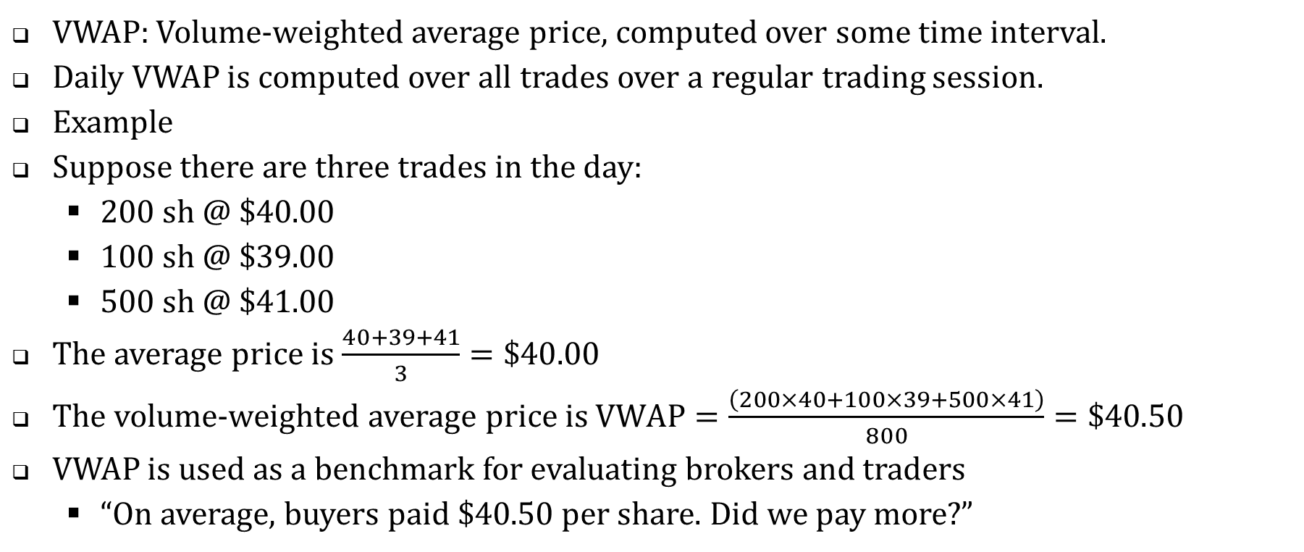
Instinet’s US VWAP Cross, https://www.instinet.com/us-vwap-cross
VWAP: Volume-weighted average price, computed over some time interval.
Daily VWAP is computed over all trades over a regular trading session.
Example
Suppose there are three trades in the day:
  200 sh @ $40.00
  100 sh @ $39.00
  500 sh @ $41.00
The average price is $\frac{40+39+41}{3}=\$40.00$
The volume-weighted average price is $VWAP=\frac{\left(200×40+100×39+500×41\right)}{800}=\$40.50$
VWAP is used as a benchmark for evaluating brokers and traders
  “On average, buyers paid $40.50 per share. Did we pay more?”

Slide 10
It’s 9am. We’re planning to buy 90,000 shares today.
  Right now, wouldn’t it be nice to lock in the VWAP?
In the Instinet VWAP cross, if a buyer and seller can be matched, they’re matched at 9am.
They have to wait until the end of the day to determine VWAP.
  At 4pm they know the price.
If we try for a match at 9am and we fail,
  Nobody knows that we failed.
  We still have the rest of the day to trade.
    There are algorithms that target VWAP.

Slide 11
What are the advantages? (edited, from ITG’s 2017 annual report)
Significant attributes of POSIT:
  POSIT's midpoint pricing saves each party an amount equivalent to half the bid/offer spread.
  POSIT's confidentiality virtually eliminates market impact.
    Participants in traditional markets face the risk that disclosure of an order will move the price against them.
ask
midpoint
bid

Slide 12
Midpoint pricing
Dark markets usually match orders at the National Best Bid and Offer (NBBO) midpoint.
The NBBO is determined by the visible limit orders at the “lit” exchanges.
Is POSIT free-riding on these prices?
  Getting something of value, but not paying for it.

Slide 13
Free riding on your competitors’ prices: A parallel
Two retailers sell PlayBox videogames.
Retailer Antoine advertises “PlayBox for $250.”
Retailer Bo advertises “We’ll match any other advertised price.”

Slide 14
Continuous dark pools
Standard features
  Customers submit direction (buy/sell), quantities.
  Orders are held, but not displayed.
  Trades can occur whenever there’s a match.
  Usually, the price is set to the NBBO midpoint.
Many variations on priority and pricing.

Slide 15
Example
Amy enters an order in a dark pool: buy 100,000 sh IBM.
  This order is held in the system, undisplayed.
Brian enters an order: sell 40,000 sh IBM
Amy and Brian are immediately paired for an execution at 40,000 shares.
The price of the execution is the NBBO midpoint.
  If IBM is 50 bid, offered at 51, then the price is 50.5.

Slide 16
Variations
Orders can have limit prices.
Orders can have size minimums.
  “Don’t execute anything unless I can trade 20,000 shares.”
Dark pools often depart from price-time priority.

Slide 17
ITG’s POSIT system (currently)
See: “A plain English guide to executions in Posit.”
  Highlighted sections, under Resources>Readings
  Virtu (ITG’s parent) no longer distributes this document.
  Virtu (and all other ATSs) file SEC form ATS-N, which is comprehensive, but dense.
Since 1987, POSIT has been a trusted trading venue that helps protect our institutional clients in the U.S. from signaling their trading intentions, lowers trading costs through meaningful price improvement, and provides protection from potentially “toxic” liquidity.
POSIT does not operate on strict price/time priority. The system incentivizes size over speed, matching orders using price-size pro rata matching logic while seeking to cross orders at the midpoint of the NBBO.

Slide 18
Internalization
A broker simultaneously receives two orders:
  A buy and a sell from two different customers.
    BEL submits “Buy limit 26”; SIG submits “Sell limit 20”.
  Can they be matched? At what price?
    Any price between 20 and 26 is feasible.
    But the broker is acting as agent for both BET and SIG
      There is a conflict of interest if the broker has reason to favor either side.
      Is BET a more profitable customer?
    Is there an external price that might be used to set the price of this trade?

Slide 19
Suppose that the best bid/offer (BBO) visible in the lit markets is 21 bid, offered at 23.
  The broker matches BEL and SIG in the middle, at 22.
This is an internalized trade.
  It is executed by the broker, and neither order is passed on to any other market.
  Neither order will interact with any other orders.

Slide 20
Internalization in floor markets?
A floor broker acting as an agent might hold opposing customer orders that could be matched.
  A match price might be better than the prices available on the floor.
How were these situations handled?

Slide 21

CAT is a broker handling customer orders on the Citadex floor.
“Bidding 21”
“Asking 25”
BEL: Buy limit $26
SIG: Sell limit $20
ANI
SAM
CAT
Next: CAT’s options
Customer order

Slide 22
CAT executes the orders at the established bid and ask
“Bidding 21”
“Asking 25”
BEL: Buy limit $26
SIG: Sell limit $20
ANI
SAM
CAT
SIG sells to ANI at 21;
BEL buys from SAM at 25.
Customer order

Slide 23
Can CAT cross/match her buyer and seller at the midpoint?
“Bidding 21”
“Asking 25”
SIG: Sell limit $20
BEL: Buy limit $26
“BEL and SIG trade at 23!”
ANI
SAM
CAT
Customer order

Slide 24
“BEL and SIG trade at 23!” Why is this a dark trade?
There is no established bid or offer at 23.
No “Buy it!” or “Sell ‘em”
Remember CME Rule 521:
  All transactions… shall be by open outcry in the established pit for that transaction.
This trade bypasses (goes around) the open outcry procedure.
Are these executions completely forbidden?

Slide 25
Chicago Mercantile Exchange (CME) Rule 533
A member who is in possession of both buy and sell orders for different beneficial owners for the same product … may execute [the orders against each other] provided that …
  In pit trading, a member executing such orders shall first bid and offer by open outcry three times at the same price, stating the number of contracts, and, thereafter, if neither the bid nor the offer is accepted, the orders may be matched in the presence, and with the approval, of a designated Exchange official.

Slide 26
“Bidding 23, Asking 23”
“Bidding 23, Asking 23”
“Bidding 23, Asking 23”
BEL: Buy limit $26
SIG: Sell limit $20
ANI
SAM
CAT
And if nobody says anything, CAT can match her customers.

Slide 27
ANI breaks CAT’s cross
“Bidding 23, Asking 23”
“BUY IT at 23”
BEL: Buy limit $26
SIG: Sell limit $20
ANI
SAM
CAT
This is allowed: CAT’s bid and ask are available quotes.
Another buyer (ANI) can buy from CAT.

Slide 28
SAM breaks CAT’s cross
“Bidding 23, Asking 23”
“SELL IT at 23”
BEL: Buy limit $26
SIG: Sell limit $20
ANI
SAM
CAT

Slide 29
Broken crosses
When a cross is broken by ANI (a buyer) or by SAM (a seller) …
  SIG/BELL may receive a partial execution: there will be some remaining contracts in their order(s)
  CAT must find buyers/sellers for the remaining contracts.
    If she can’t, she loses commission income.
  The executions prices may be worse that the crossing price.
It is permitted to break crosses. But …
Floor traders usually try to avoid breaking each others’ crosses.

Slide 30
What is the range of crossing prices?
The established bid is 21 (from ANI), offered at 25 (SAM)
CAT can cross at any price in the range 21 to 25 (inclusive).
If the last trade was at 20, then CAT might want to cross at 22.
  If at 26, then cross at 24.
If CAT tries to cross at 21, it is understood that ANI will break the cross.
  … at 25, it is understood that SAM will probably break the cross.

Slide 31
CME Rule 533: An interpretation
To cross, you must make a market (bid and offer) first
and give other traders the right to participate in the trade.
  You must give them a chance to meet the crossing price.
Once a visible bid and offer are established at the trade price, the trade is no longer dark.

Slide 32
NYSE Rule 76
In crossing orders between the established bid and offer,
  “When a member has an order to buy and an order to sell the same stock, he or she must publicly offer at a price higher than his or her bid by the minimum variation.”
If the example occurred on the NYSE floor, CAT cross at 23 by first …
  “Bidding 22, asking 23,” or
  “Bidding 23, asking 24.
  Other members on the floor could participate in the cross (breaking it).
Like the CME rule: once a visible bid and offer are established at the trade price, the trade is no longer dark.

Slide 33
On the NYSE, can a planned cross be broken?
Like the CME, breaking a cross is permitted, but it is discouraged.
The specialist was subject to tighter rules:
  “[The specialist shall]… refrain from interfering with a ‘clean’ agency cross [a cross between two customers] unless the specialist’s bid or offer has been previously solicited.”
  New York Stock Exchange, 1989, Memorandum to members: New Specialist Job Description, March 3, 1989, in Market Performance Committee, ed. (Brightspace)
There are some exceptions.

Slide 34
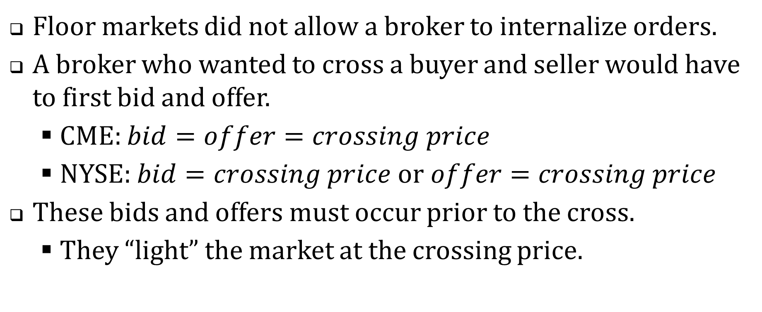
Summary
Floor markets did not allow a broker to internalize orders.
A broker who wanted to cross a buyer and seller would have to first bid and offer.
  CME: $bid=offer=crossing price$
  NYSE: $bid=crossing price or offer=crossing price$
These bids and offers must occur prior to the cross.
  They “light” the market at the crossing price.

Slide 35
Regulatory notes
“Trade-at” rules
  A market can only trade at its visible bid or offer
  General exceptions for hidden orders, midpoint trades, …
Adopted in Canada and Australia
Considered (but not implemented) in the US

Slide 36
Notes on “internalization”
Our examples were drawn from US equity and futures exchanges.
  Reliable bids and asks from lit markets.
  Direct crossing of customer orders.
In other markets, an internalizer is a dealer/market maker who receives a customer order flow that is mostly balanced (buy/sell).
  The internalizer does not cross customers directly.
  Few reliable bid and ask prices.
  Prominent in foreign exchange (FX) markets

Slide 37
Dark trading: the opposing views
For
  By crossing at the midpoint, dark markets save investors money.
  Dark markets prevent other traders from learning about investor’s trading plans.
Against
  Dark markets “free ride” on bids and offers in the lit markets.
  As traders move to dark markets, the lit markets will have less volume: liquidity will be hurt.

Slide 38
Manipulations around continuous dark pools.
The buyer in a dark pool knows that any execution will be priced at the NBBO midpoint.
The buyer can lower the midpoint by submitting an aggressive sell limit order to a lit market.
After the dark pool execution, the sell limit order is cancelled.
This is one form of spoofing
  “bidding or offering with the intent to cancel the bid or offer before execution” (Dodd-Frank Act)
  It is illegal.

Slide 39
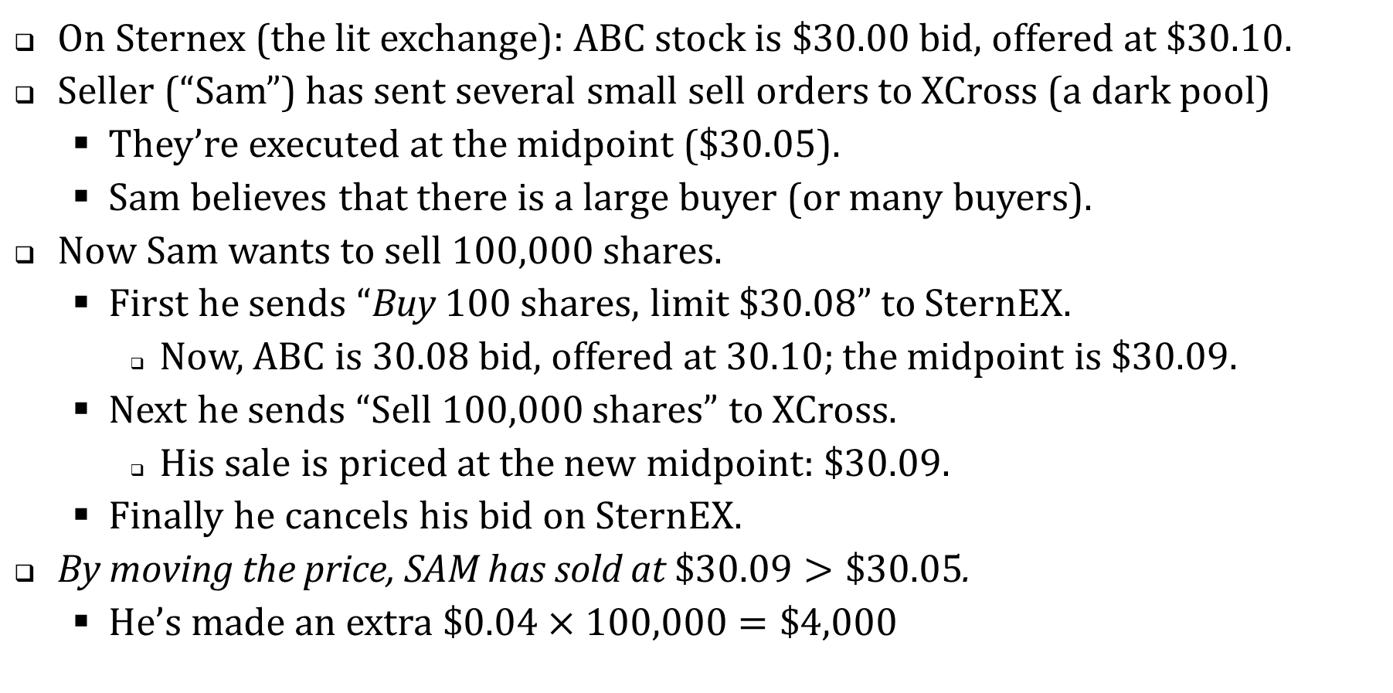
Spoofing: an example
On Sternex (the lit exchange): ABC stock is $30.00 bid, offered at $30.10.
Seller (“Sam”) has sent several small sell orders to XCross (a dark pool)
  They’re executed at the midpoint ($30.05).
  Sam believes that there is a large buyer (or many buyers).
Now Sam wants to sell 100,000 shares.
  First he sends “Buy 100 shares, limit $30.08” to SternEX.
    Now, ABC is 30.08 bid, offered at 30.10; the midpoint is $30.09.
  Next he sends “Sell 100,000 shares” to XCross.
    His sale is priced at the new midpoint: $30.09.
  Finally he cancels his bid on SternEX.
By moving the price, SAM has sold at $\$30.09>\$30.05$.
  He’s made an extra $\$0.04×100,000=\$4,000$

Slide 40
Countermeasures
When POSIT was a scheduled crossing …
  “Each scheduled cross [is] executed within a seven minute window selected randomly by the system.”
Now POSIT is a continuous dark pool.
  ITG and POSIT employ several measures, controls, and reviews to protect subscriber orders from potentially toxic order flow and gaming strategies. These tools include POSIT’s pre-and post-trade controls and Subscriber-requested counterparty restrictions. ITG uses these controls to monitor trading activity … for execution quality, potential regulatory violations, and inappropriate conduct.
  ITG employs anti-gaming technology - called Liquidity Guard - to help ensure quality executions for POSIT Subscribers. Liquidity Guard has two components: Prevention and Detection.

Slide 41
Note on Regulation
Posit is an Alternative Trading System (ATS)
The SEC has two kinds of markets
“National securities exchange” (NYSE, NASDAQ, etc.)
  Can trade (with no volume limits), list stocks, accept and regulate their members.
  Must allow open access to all traders.
Alternative Trading System (ATS)
  Subject to volume limits.
  Can discriminate (refuse to allow certain traders)
An ATS does not have to be “dark”, but most dark markets are registered as ATSs.

Slide 42
The SEC’s “Reg ATS”: An alternative trading system …
… with less than five percent of the trading volume in all securities it trades is required only to: (1) file with the Commission a notice of operation and quarterly reports; (2) maintain records, including an audit trail of transactions; and (3) refrain from using the words "exchange," "stock market," or similar terms in its name.
… that trade[s] five percent or more of the volume in national market system securities [must] be linked with a registered market in order to disseminate the best priced orders in those national market system securities displayed in their systems (including institutional orders) into the public quote stream.
… with twenty percent or more of the trading volume in any single security, whether equity or debt, [is also] required to: (1) grant or deny access based on objective standards established by the trading system and applied in a non-discriminatory manner; and (2) establish procedures to ensure adequate systems capacity, integrity, and contingency planning.

Slide 43
The dark pool universe
There are about 80 dark pools
  e.g. UBS, SIGMA X (Goldman), Crossfinder (Credit Suisse)
Users often try them sequentially.
A dark pool can decide whether or not to accept a particular client.
  An exchange (like the NYSE or NASDAQ) has to accept all orders.

Slide 44
Dark pool trading volumes
Most dark pools report trades to the FINRA TRF (Trade reporting facility, exchange symbol D)
  We don’t know which dark pool actually executed a trade.
FINRA reports weekly total volume executed by each dark pool. (ats.finra.org)
Next overhead: AAPL for week of 21 Sep 2020.

Slide 45
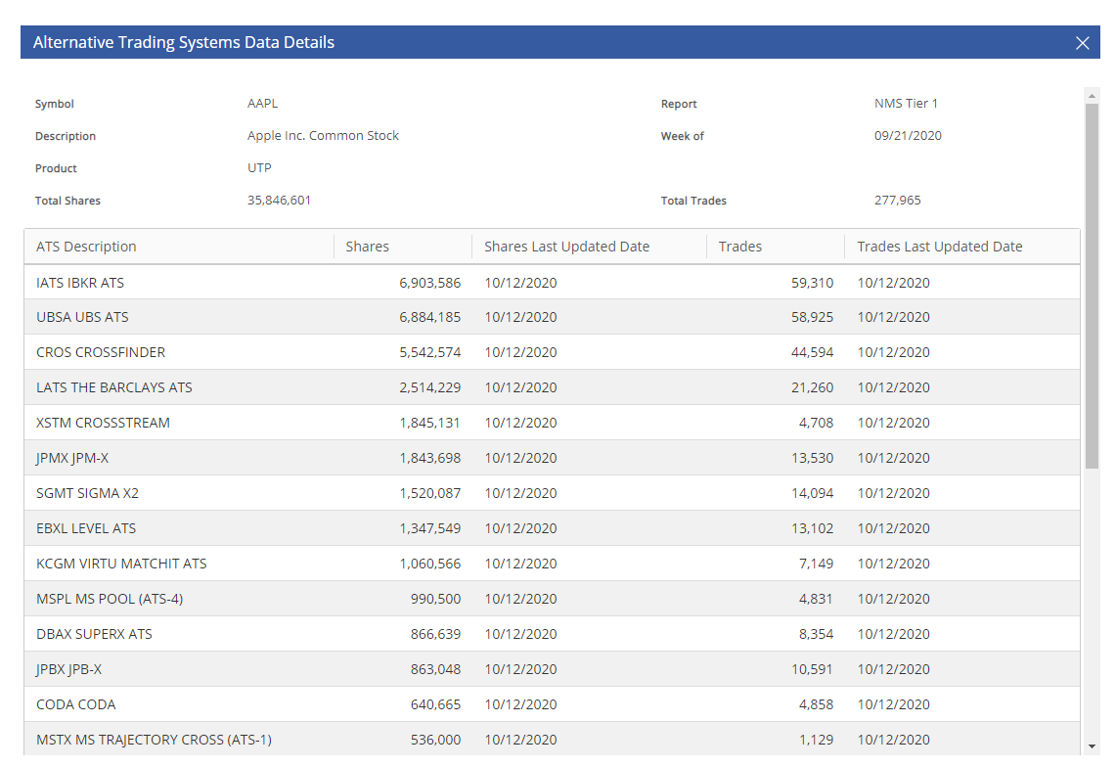

Slide 46
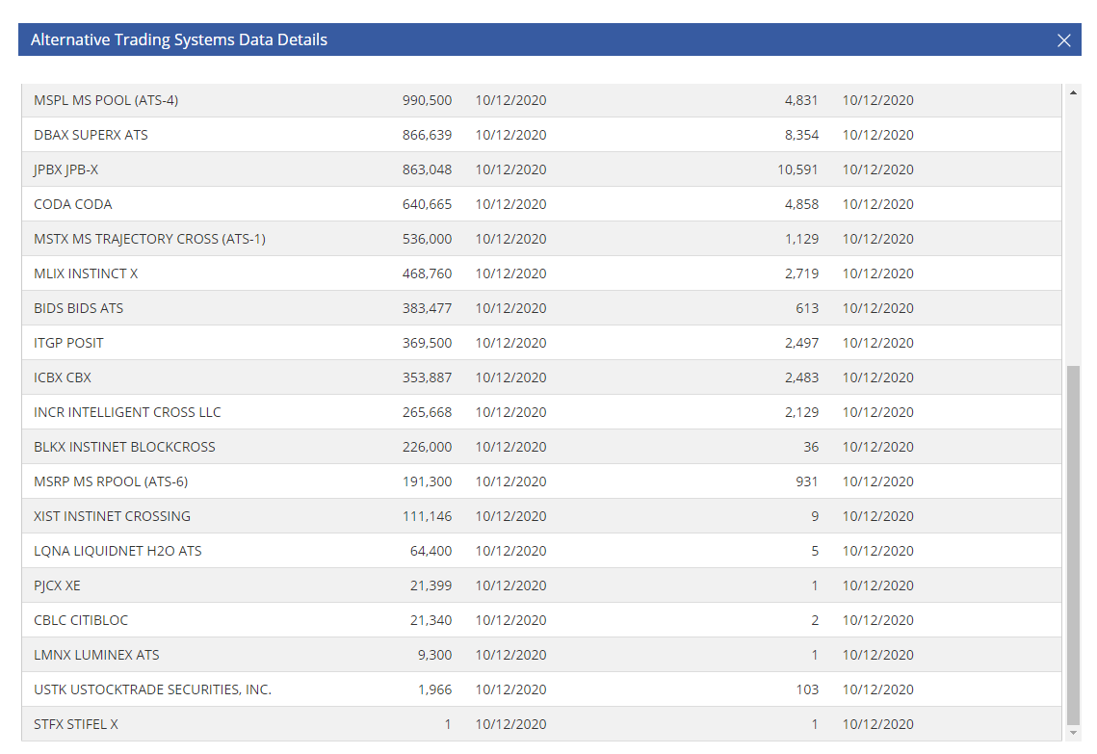

Slide 47
Concerns about dark pools.
Dark pools contribute to fragmentation.
  There are approximately 90 Alternative Trading Systems (most of which are dark pools)
Dark pools can discriminate, and refuse access. Is this fair?
Are dark pool trades subject to manipulation (by spoofing, for example)
Are dark pools really confidential?
Do dark pools hurt the lit markets?
  Shorter and Miller: do they hurt price discovery?
  Dark pools free ride on lit markets’ prices.
  When I post a limit buy order and a dark pool trade matches it, I’m deprived of an execution.
    Maybe next time I won’t use a visible order.
Dark pools are difficult to monitor and regulate
    Recent cases: Pipeline/Millstream; Barclays; UBS; POSIT

Slide 48
Pipeline/Millstream (SEC Cease and Desist Order, Oct 2011)
Pipeline was a dark pool.
  A dark pool is supposed to allow buyers and sellers to directly trade against each other anonymously.
Pipeline set up an affiliated proprietary trading group (“Millstream”) to trade against customers.
“Pipeline occasionally revealed to [Millstream], after the trades were consummated, order and trade data of other customers.”

Slide 49
Barclays (Allegations by NY State Attorney General, January 2015)
The .. complaint includes detailed e-mails between Barclays employees that the New York attorney general claims show a widespread pattern of deceiving clients.
The complaint says Barclays routed orders to its own dark pool first, regardless of whether the client could get a better price through another venue. Barclays assured investors they were protected from high-frequency trading strategies that it characterized as “‘toxic,’ ‘predatory,’ or ‘aggressive.’”
“Barclays was doing deals left and right with the high frequency firms to invite them into the pool to be trading partners for the buy side,” the complaint cited a former employee as saying. The employee added the pool was “mainly made up of high-frequency trading firms.”

Slide 50
UBS (SEC news release, Jan 15, 2015)
An SEC examination and investigation of UBS revealed that the firm failed to properly disclose to all subscribers the existence of an order type that it pitched almost exclusively to market makers and high frequency trading firms. The order type enabled users … to place subpenny-priced orders that jumped ahead of other orders submitted at legal, whole penny prices.
Furthermore, the SEC investigation found that UBS similarly failed to disclose to all subscribers a “natural only crossing restriction” developed to ensure that select orders would not execute against orders placed by market makers and high frequency trading firms. This shield was only available to benefit orders placed using UBS algorithms, which are automated trading strategies.
UBS did not disclose the existence of this feature to all subscribers until approximately 30 months after it was launched.
UBS Securities LLC agreed to settle the charges by paying more than $14.4 million, including a $12 million penalty that is the SEC’s largest against an alternative trading system (ATS).

Slide 51
POSIT / Project Omega (SEC settlement, August, 2015)
ITG (the operator of POSIT) set up a proprietary trading operation (“Project Omega”)
From April, 2010 to July, 2011, Project Omega traded against POSIT customers, using confidential information.
The SEC fined ITG $2 Million (the amount of Omega’s profits) plus an $18 Million penalty.

Slide 52
Some newer dark pools

Slide 53
IntelligentCross (IC)
A midpoint-match continuous dark pool (an ATS), but …
Matches are not instantaneous: “randomized matches milliseconds apart”
Minimum resting time: “orders have to rest on the book for a meaningful fraction of the match interval to participate”
After each trade, IC looks for “market impact”
  Thinner limit order books in the lit markets.
  If thinning happens, the IC waits longer before attempting next match.
Features 1 and 2 discourage spoofing.
  With the random delay and the minimum resting time, a bid/offer placed on a lit market must be exposed for a longer time.
Feature 3 delays matches when the market is moving to a new price level.

Slide 54
New Off-exchange trading at closing prices (Osipovich, Hoffman)
Recall: mutual funds need to trade at close. They can:
  Submit market on close (MOC) orders to NYSE, Nasdaq (high cost).
  Submit orders to an off-exchange dealer who guarantees the closing price (lower cost)
“The share of closing-price trades executed outside exchanges, by broker-dealers such as Goldman, doubled from mid-2015 through the end of last year, to 32% from 16%.”

Slide 55
Article is not clear about timing. My guess:
Goldman accepts orders for match on close until shortly before 3:50 PM.
Unmatched orders sent to the Exchange (MOC)
  For example, if Goldman has a buy imbalance, that imbalance will get sent to the exchange.
  Goldman pays closing exchange fees only on the imbalance, not its matched volume.
In an agreement that it asked one prospective client to sign, Goldman acknowledges that efforts to execute the trade while protecting itself from adverse price moves "may impact market prices" in ways that are unfavorable to its clients, according to a copy reviewed by The Wall Street Journal.

