Slide 1

Econometrics I
Professor William Greene
Stern School of Business
Department of Economics

Slide 2
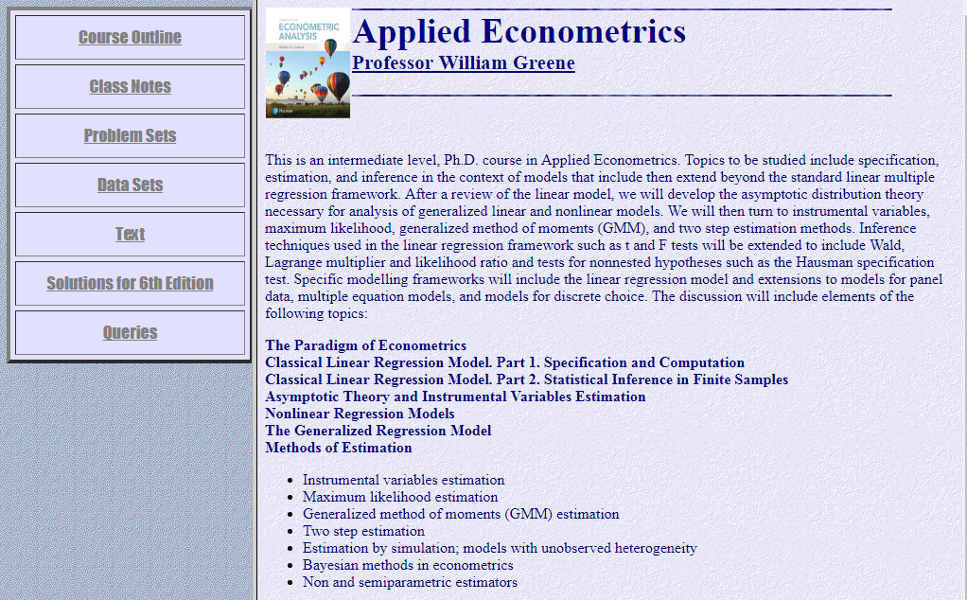
http://people.stern.nyu.edu/wgreene/Econometrics/Econometrics.htm

Slide 3
Abstract
Overview: This is an intermediate level, Ph.D. course in Applied Econometrics. Topics to be studied include specification, estimation, and inference in the context of models that include then extend beyond the standard linear multiple regression framework. After a review of the linear model, we will develop the theory necessary for analysis of generalized linear and nonlinear models.
Topics to be examined:
Regression modeling
Instrumental variables
Robust estimation and inference
Causal inference
Nonlinear modeling
Cross section, time series and panel data
Objective:
Preparation to read and carry out empirical social science
research using modern econometric methods.

Slide 4
Prerequisites
A previous course that used linear regression
Mathematical statistics
Matrix algebra

Slide 5
Readings
Main text: Greene, W.,
Econometric Analysis,
8th Edition,
Prentice Hall, 2017.
A few articles
Notes and materials on the course website:
http://people.stern.nyu.edu/wgreene/Econometrics/Econometrics.htm

Slide 6
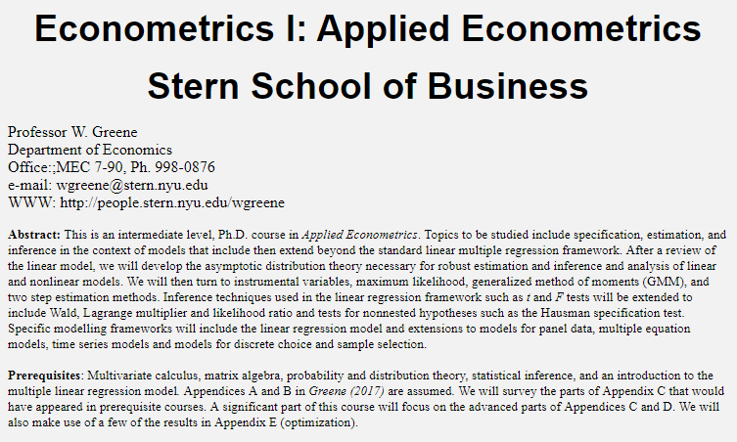
Course Schedule
No class on:
Thursday, September 21
*Tuesday, November 21
Thursday, November 23
*Tuesday, November 28
Added class on:
Tuesday, December 12
Midterm: October 24
Final: Take home; posted December 7,
due December 19

Slide 7
Practicals
Software
  NLOGIT provided, supported
  http://people.stern.nyu.edu/wgreene/Econometrics/NLsetup.exe
  SAS, Stata, EViews optional, your choice
  R, Matlab, Gauss, others
  Questions and review as requested
Problem Sets: (more details later)

Slide 8
Course Requirements
Problem sets: 5 (30%)
Midterm, in class (30%)
Final exam, take home (40%)

Slide 9
Econometrics I
Part 1 - Paradigm

Slide 10
Econometrics: Paradigm
Theoretical foundations
  Behavioral modeling: Optimization, labor supply, demand equations, etc.
  Microeconometrics and macroeconometrics
Mathematical Elements
Statistical foundations
‘Model’ building – the econometric model
  Mathematical elements
  The underlying truth – is there one?

Slide 11
Objectives
Understanding covariation:
  What is the income elasticity of the demand for health care in an economy?
Understanding a relationship:
  How will drivers respond to the availability of a new toll road?
Causal Inference: The search for “causal” effects
  Did an antitrust intervention that broke up a British boarding schools cartel have an impact on fees charged?
Prediction of an outcome of interest
  Does internet “buzz” help to predict movie success?

Slide 12
Trends in Econometrics
Small structural models
Pervasiveness of an econometrics paradigm
Non- and semiparametric methods vs. parametric
Robust methods / Estimation and inference
Nonlinear modeling (the role of software)
Behavioral and structural modeling vs. “reduced form,” “covariance analysis”
Identification and “causal” effects

Slide 13
Data Structures
Observation mechanisms
  Passive, nonexperimental (the usual)
  Randomly assigned experiment (wishful)
  Active, experimental (occasional)
  The ‘natural experiment’ (occasional, limited)
Data types
  Cross section
  Pure time series
  Panel –
    Longitudinal data – NLS
    Country macro data – Penn W.T.
  Financial data

Slide 14
Paradigm: Classical Inference
Population
Measurement
Econometrics
Characteristics
Behavior Patterns
Choices
Imprecise inference about the entire population – sampling theory and asymptotics

Slide 15
Paradigm: Bayesian Inference
Population
Measurement
Econometrics
Characteristics
Behavior Patterns
Choices
Sharp, ‘exact’ inference about only the sample – the ‘posterior’ density.

Slide 16
An Application:
Cornwell and Rupert Labor Market Data
Is Wage Related to Education?
Cornwell and Rupert Returns to Schooling Data, 595 Individuals, 7 Years
Variables in the file are
EXP = work experience
WKS = weeks worked
OCC = occupation, 1 if blue collar,
IND = 1 if manufacturing industry
SOUTH = 1 if resides in south
SMSA = 1 if resides in a city (SMSA)
MS = 1 if married
FEM = 1 if female
UNION = 1 if wage set by union contract
ED = years of education
LWAGE = log of wage = dependent variable in regressions
These data were analyzed in Cornwell, C. and Rupert, P., "Efficient Estimation with Panel Data: An Empirical Comparison of Instrumental Variable Estimators," Journal of Applied Econometrics, 3, 1988, pp. 149-155.
Notes:
16

Slide 17


Slide 18
Model Building in Econometrics
Role of the assumptions
Parameterizing the model
  Nonparametric analysis
  Semiparametric analysis
  Parametric analysis
Sharpness of inferences

Slide 19
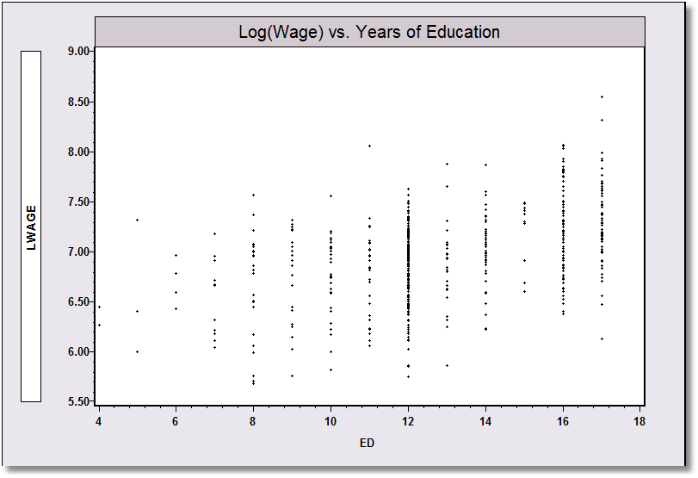
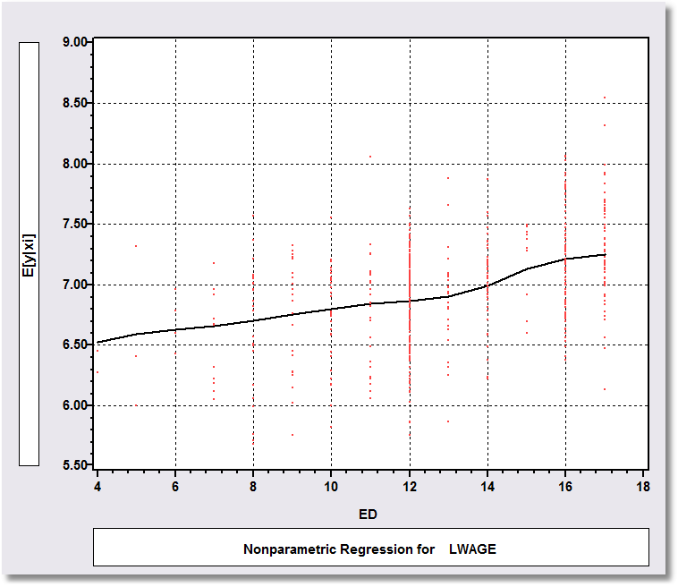
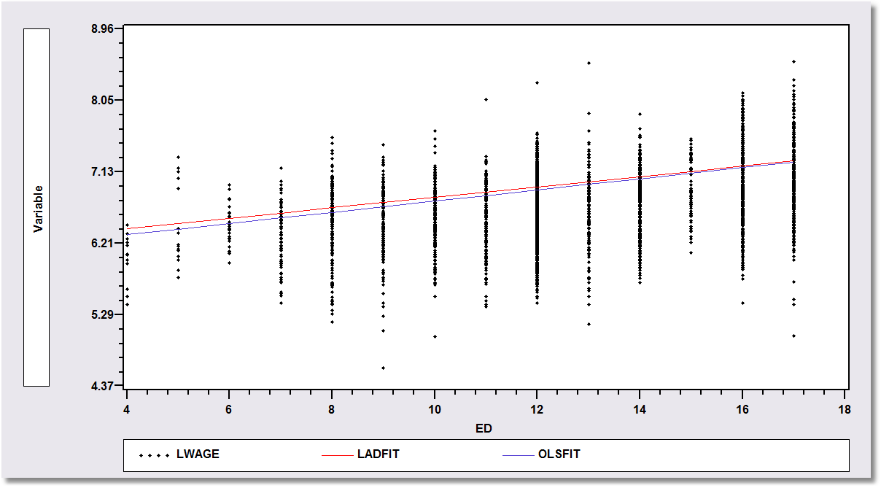
Application: Is there a relationship between (log) Wage and Education?
Nonparametric Regression
Kernel regression of log wage on education
Semiparametric Regression:
Least absolute deviations regression
Parametric Regression: Least squares – maximum likelihood – regression

Slide 20
A First Look at the Data
Descriptive Statistics
Basic Measures of Location and Dispersion
Graphical Devices
  Box Plots
  Histogram
  Kernel Density Estimator

Slide 21
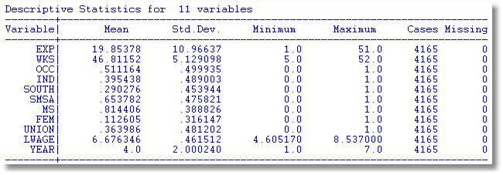
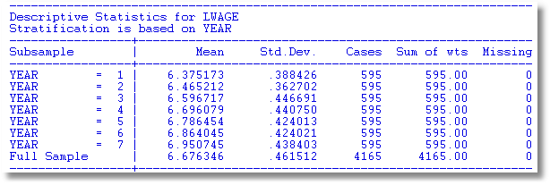

Slide 22
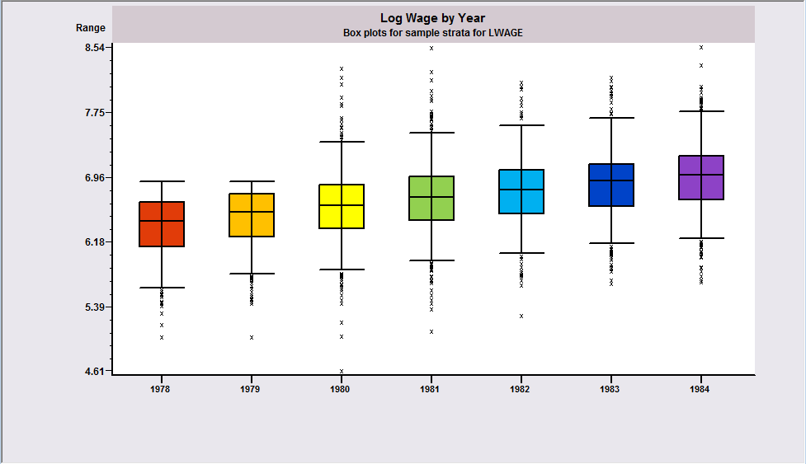
Box Plots
Shows upward trend in median log wage

Slide 23
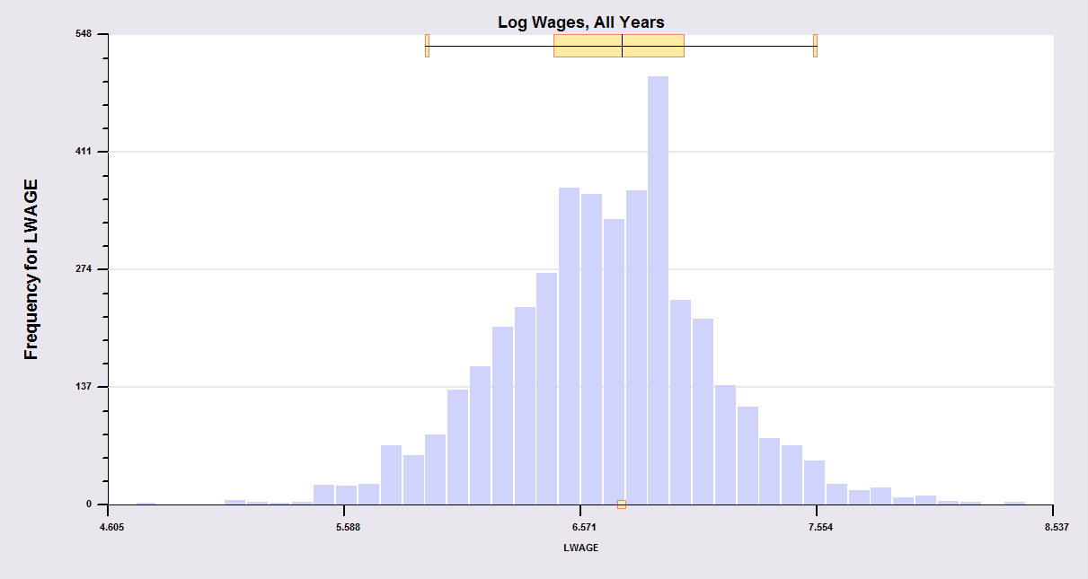
Histogram: Pooled data obscure within person variation
What is the source of the variance, variation across people or variation over time?

Slide 24
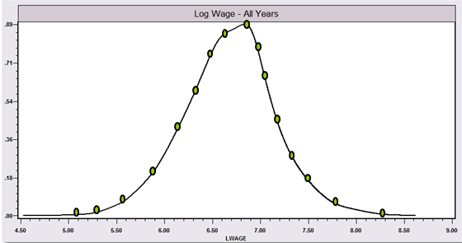
Kernel density estimator suggests the underlying distribution for a continuous variable

Slide 25
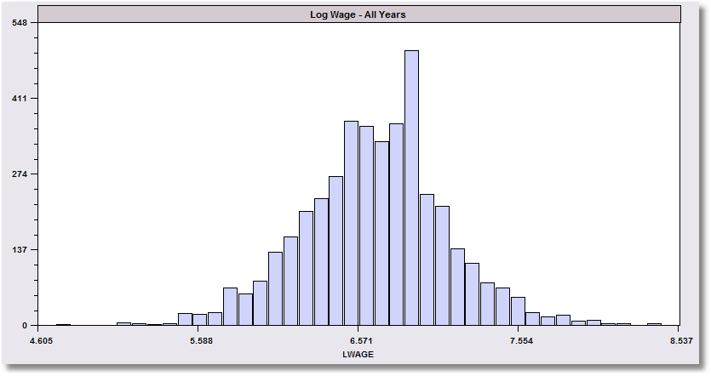
The kernel density estimator is a histogram (of sorts).

Slide 26
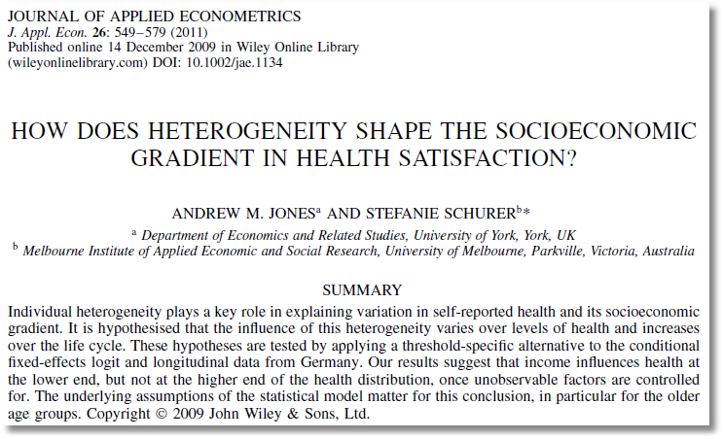

Slide 27
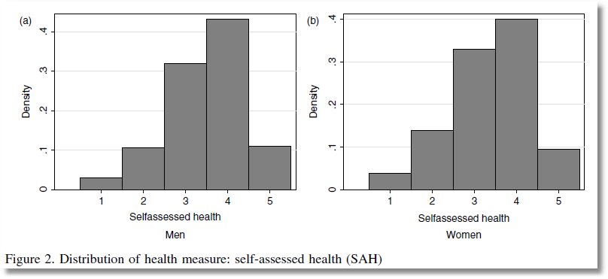

Slide 28
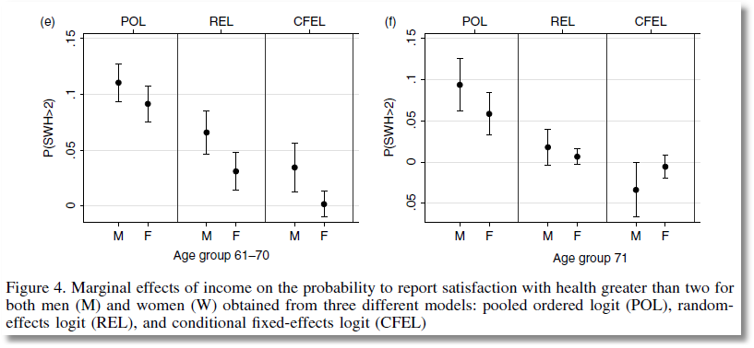

From Jones and Schurer (2011)
Stylized Box Plot

Slide 29
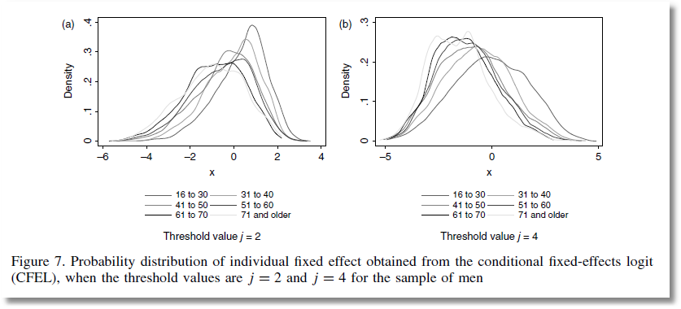
From Jones and Schurer (2011)

Slide 30
Objective: Impact of Education on (log) Wage
Specification: What is the right model to use to analyze this association?
Estimation
Inference
Analysis

Slide 31
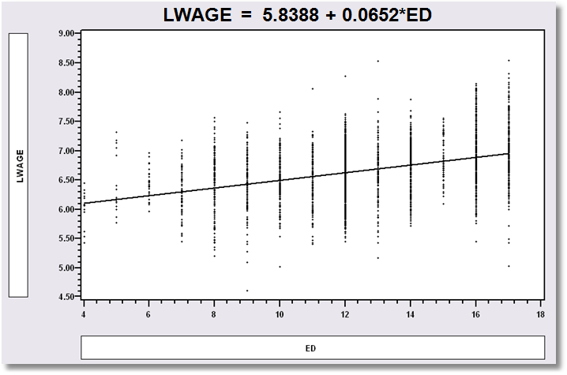
Simple Linear Regression
LWAGE = 5.8388 + 0.0652*ED

Slide 32
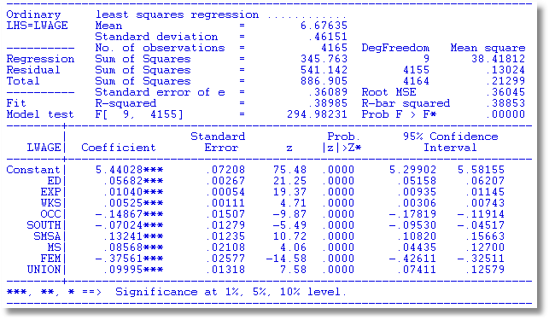
Multiple Regression

Slide 33

Nonlinear Specification:
Quadratic Effect of Experience

Slide 34
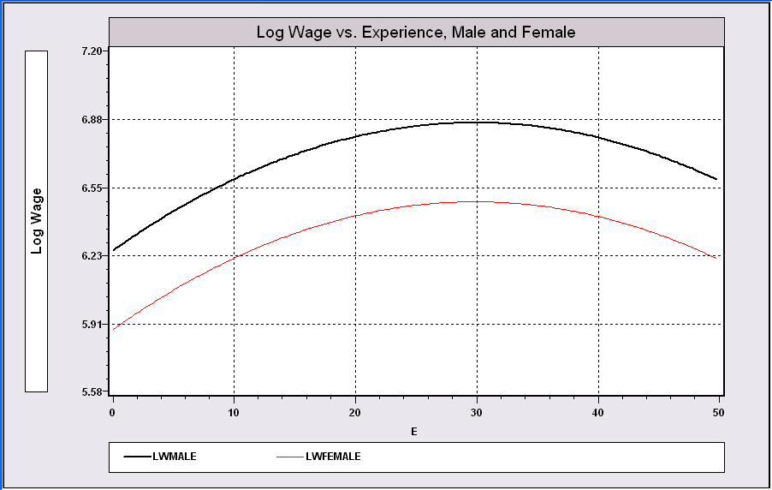
Model Building in Econometrics
A Model Relating (Log)Wage to Gender and Education & Experience

Slide 35
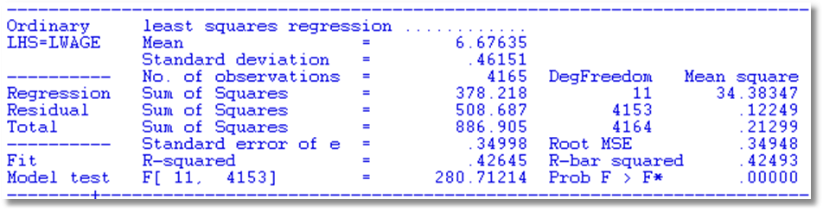
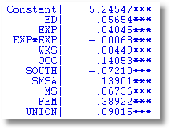
Partial Effects
Coefficients may not tell the story
Education .05654
Experience .04045 - 2*.00068*Exp
FEM -.38922

Slide 36
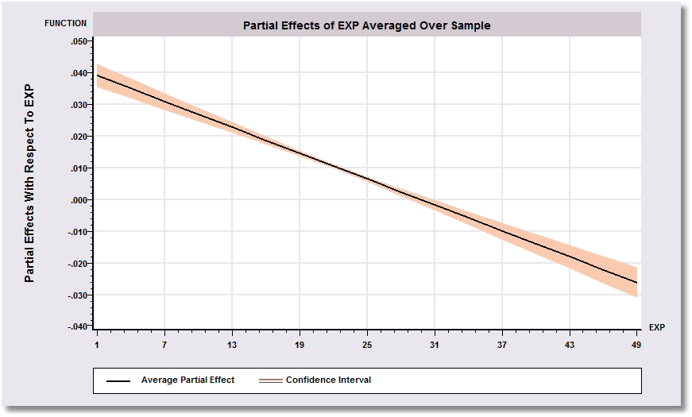
Effect of Experience = .04045 - 2*.00068*Exp
Positive from 1 to 30, negative after.

Slide 37
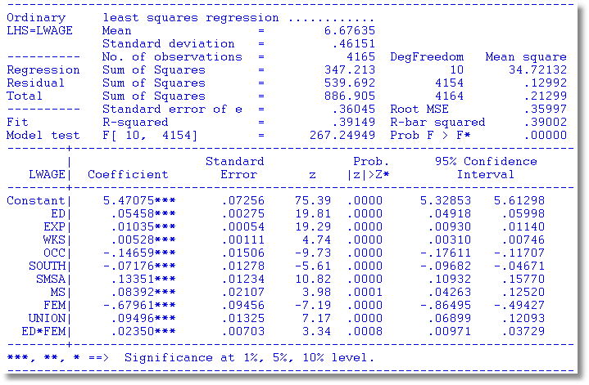
Interaction Effect
Gender Difference in Partial Effects

Slide 38
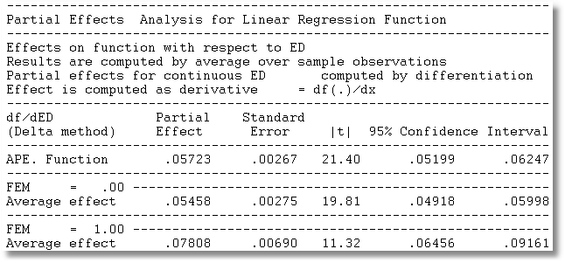
Partial Effect of a Year of Education
∂E[logWage]/∂ED = β_{ED} + β_{ED*FEM} *FEM
= 0.05458 + 0.02350*FEM
Note, the effect is positive.
The effect 43% is larger for women.

Slide 39
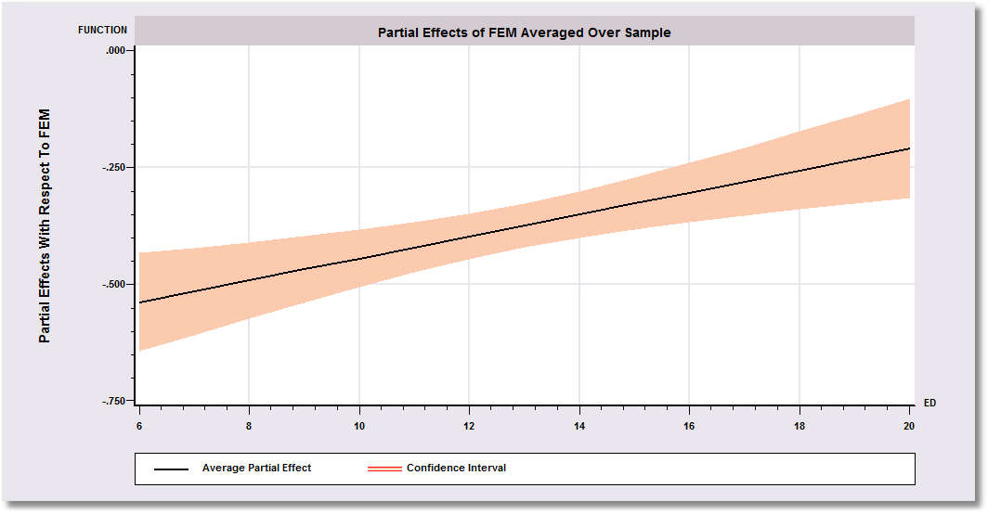
Gender Effect Varies by Years of Education
ΔE[logWage]/∇FEM = β_{FEM} + β_{ED*FEM} *ED
= -0.67961 + 0.0235*ED

Slide 40

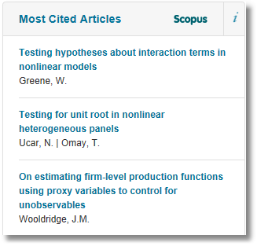
Analysts are interested in interaction effects in models.

