Slide 1

Econometrics I
Professor William Greene
Stern School of Business
Department of Economics

Slide 2
Econometrics I
Part 10 – Interval Estimation and Prediction

Slide 3
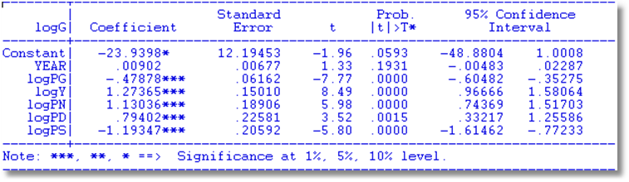
Interval Estimation
b = point estimator of β
We acknowledge the sampling variability.
  Estimated sampling variance
  b = β + sampling variability induced by ε

Slide 4
Point estimate is only the best single guess
Form an interval, or range of plausible values
Plausible ⬄ likely values with acceptable degree of probability.
To assign probabilities, we require a distribution for the variation of the estimator.
The role of the normality assumption for ε

Slide 5
Robust Inference:
Confidence Interval for β_{k}
b_{k} = the point estimate
Std.Err[b_{k}] = sqr{Estimated Asymptotic Variance of b_{k}} = v_{k}
The matrix may be any robust or appropriate covariance matrix.
  b_{k} ~ Asy.N[β_{k},v_{k}²]
  (b_{k}-β_{k})/v_{k} ~ Asy.N[0,1]
Consider a range of plausible values of β_{k} given the point estimate b_{k}. b_{k} ± sampling error.
  Measured in standard error units,
  |(b_{k} – β_{k})/ v_{k}| < z*
  Larger z* ➔ greater probability (“confidence”)
  Given normality, e.g., z* = 1.96 ➔ 95%, z*=1.645➔90%
  Plausible range for β_{k} then is b_{k} ± z* v_{k}

Slide 6
Critical Values for the Confidence Interval
Assume normality of ε:
  b_{k} ~ N[β_{k},v_{k}²] for the true β_{k}.
  (b_{k}-β_{k})/v_{k} ~ N[0,1]
v_{k} = [s²(X’X)⁻¹]_{kk} (b_{k}-β_{k})/Est.(v_{k}) ~ t[n-K].
Use critical values from t[n-K] distribution instead of standard normal. Will be the same as normal if n > 100.
Based on asymptotic results or any robust covariance matrix estimator, use N[0,1].

Slide 7
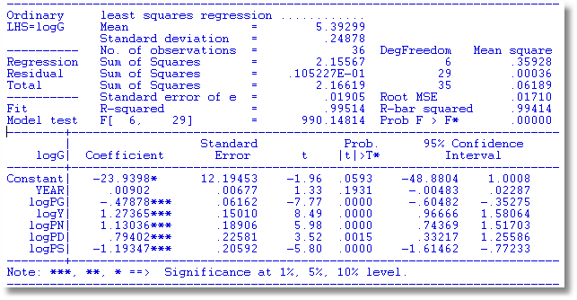
Confidence Interval
Critical t[.975,29] = 2.045
Confidence interval based on t: 1.27365 ± 2.045 * .1501
Confidence interval based on normal: 1.27365 ± 1.960 * .1501

Slide 8
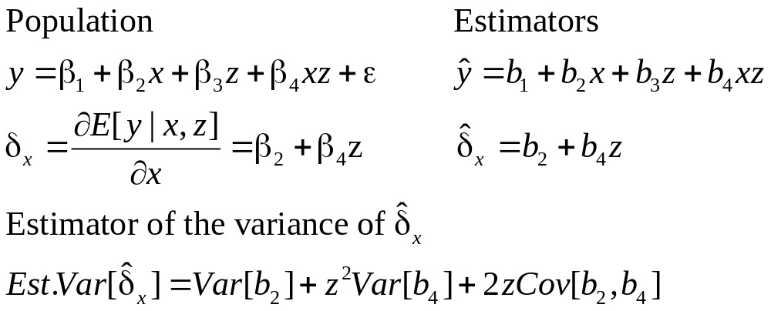
Specification and Functional Form:
Interaction Effects

Slide 9
Interaction Effect
----------------------------------------------------------------------
Ordinary least squares regression ............
LHS=LOGY Mean = -1.15746
Standard deviation = .49149
Number of observs. = 27322
Model size Parameters = 4
Degrees of freedom = 27318
Residuals Sum of squares = 6540.45988
Standard error of e = .48931
Fit R-squared = .00896
Adjusted R-squared = .00885
Model test F[ 3, 27318] (prob) = 82.4(.0000)
--------+-------------------------------------------------------------
Variable| Coefficient Standard Error b/St.Er. P[|Z|>z] Mean of X
--------+-------------------------------------------------------------
Constant| -1.22592*** .01605 -76.376 .0000
AGE| .00227*** .00036 6.240 .0000 43.5272
FEMALE| .21239*** .02363 8.987 .0000 .47881
AGE_FEM| -.00620*** .00052 -11.819 .0000 21.2960
--------+-------------------------------------------------------------
Do women earn more than men (in this sample?) The +.21239 coefficient on FEMALE would
suggest so. But, the female “difference” is +.21239 - .00620*Age. At average Age, the
effect is .21239 - .00620(43.5272) = -.05748.

Slide 10
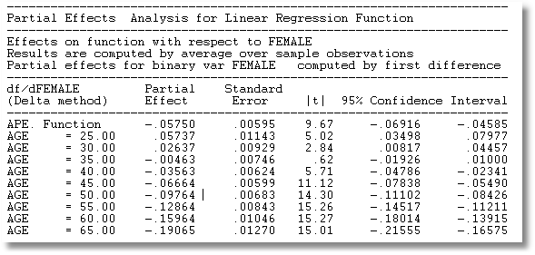

Slide 11
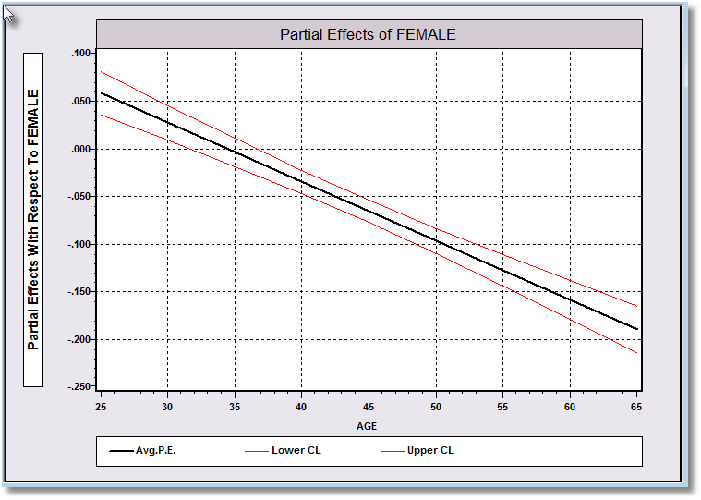

Slide 12
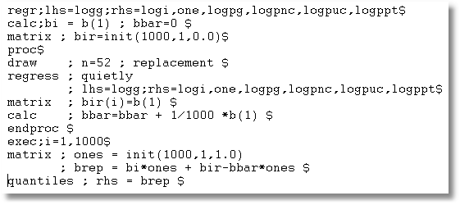
Bootstrap Confidence Interval
For a Coefficient

Slide 13
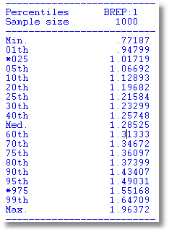
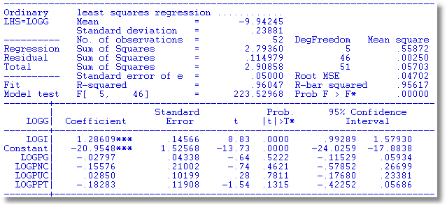
Bootstrap CI for Least Squares

Slide 14
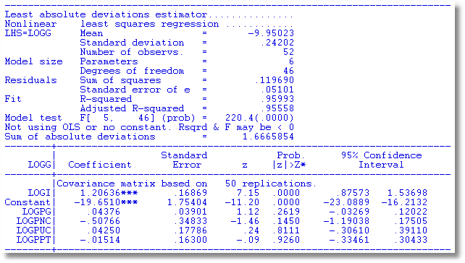
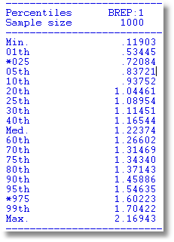
Bootstrap CI for Least Absolute Deviations

Slide 15
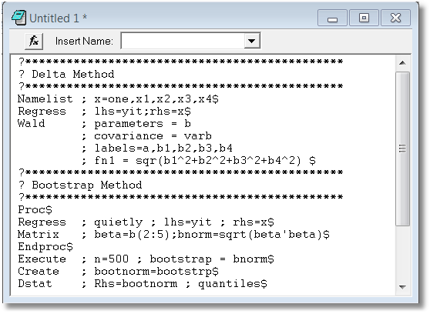
Bootstrapped Confidence Intervals
Estimate Norm(β)=(β₁² + β₂² + β₃² + β₄²)^{1/2}

Slide 16
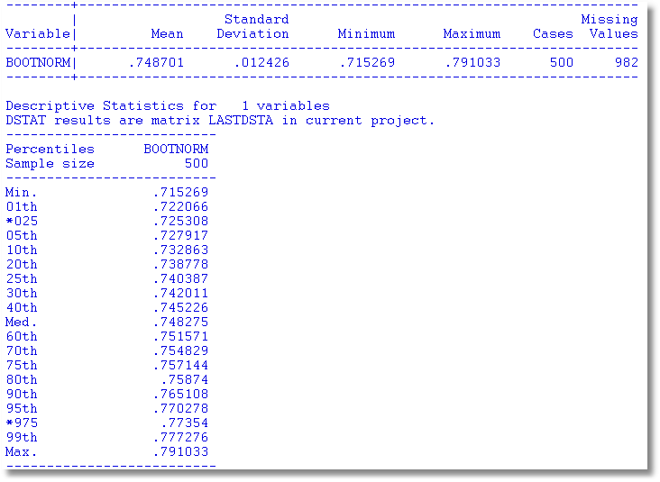
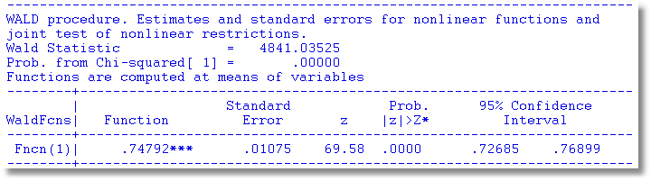

Slide 17
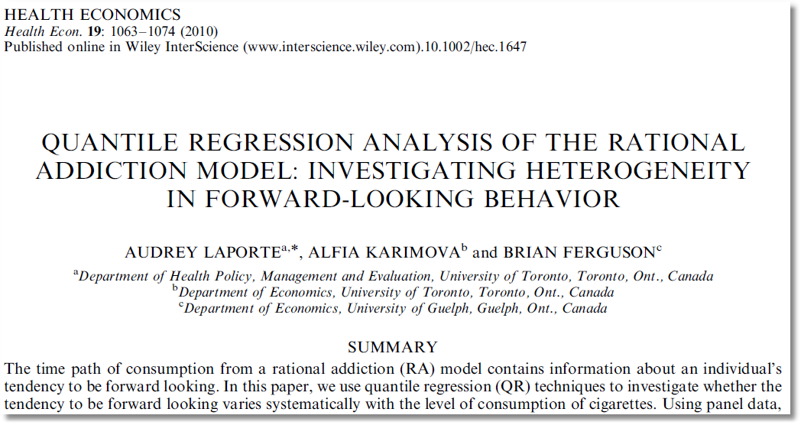

Slide 18
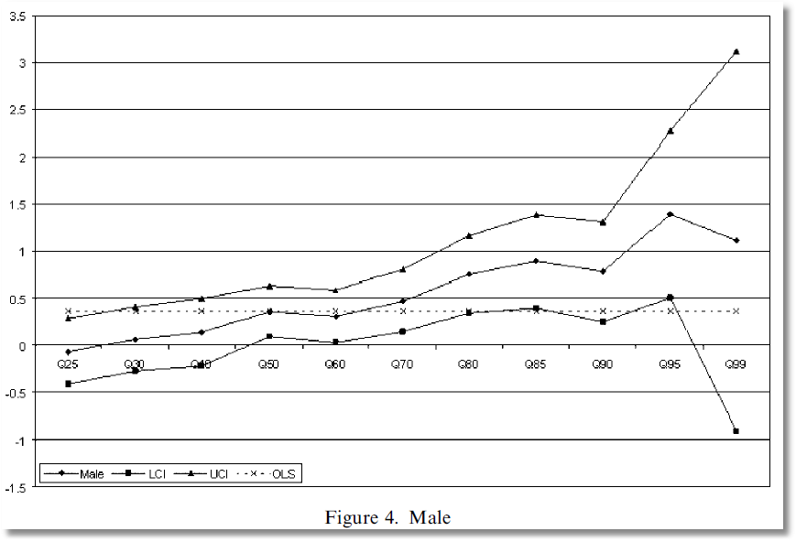
Coefficient on MALE dummy variable in quantile regressions

Slide 19
Forecasting
Objective: Forecast
Distinction: Ex post vs. Ex ante forecasting
  Ex post: RHS data are observed
  Ex ante: RHS data must be forecasted
Prediction vs. model validation.
  Within sample prediction
  “Hold out sample”

Slide 20
Prediction Intervals
Given x⁰ predict y⁰.
Two cases:
Estimate E[y|x⁰] = β′x⁰;
Predict y⁰ = β′x⁰ + ε⁰
Obvious predictor, b’x0 + estimate of ε⁰. Forecast ε⁰ as 0, but allow for variance.
Alternative: When we predict y⁰ with b′x⁰, what is the 'forecast error?'
Est.y⁰ - y⁰ = b′x⁰ - β′x⁰ - ε⁰, so the variance of the forecast error is
x⁰′Var[b - β]x⁰ + σ²
How do we estimate this? Form a confidence interval. Two cases:
If x⁰ is a vector of constants, the variance is just x⁰′ Var[b] x⁰. Form confidence interval as usual.
If x⁰ had to be estimated, then we use a random variable. What is the variance of the product? (Ouch!) One possibility: Use bootstrapping.

Slide 21
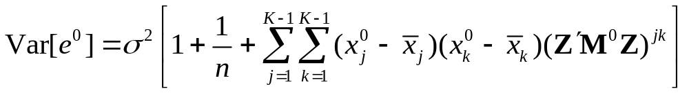
Forecast Variance
Variance of the forecast error is
σ² + x⁰’ Var[b]x⁰ = σ² + σ²[x⁰’(X’X)⁻¹x⁰]
If the model contains a constant term, this is
In terms squares and cross products of deviations from means. Interpretation: Forecast variance is smallest in the middle of our “experience” and increases as we move outside it.

Slide 22
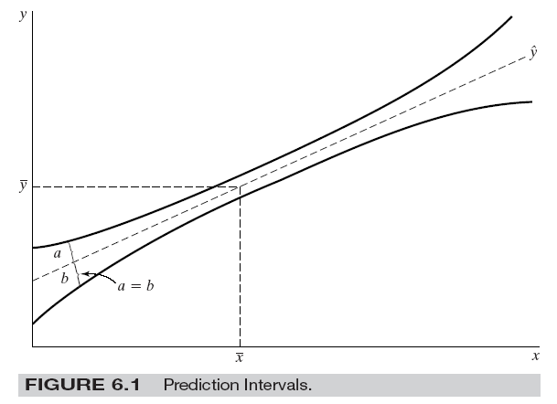
Butterfly Effect

Slide 23
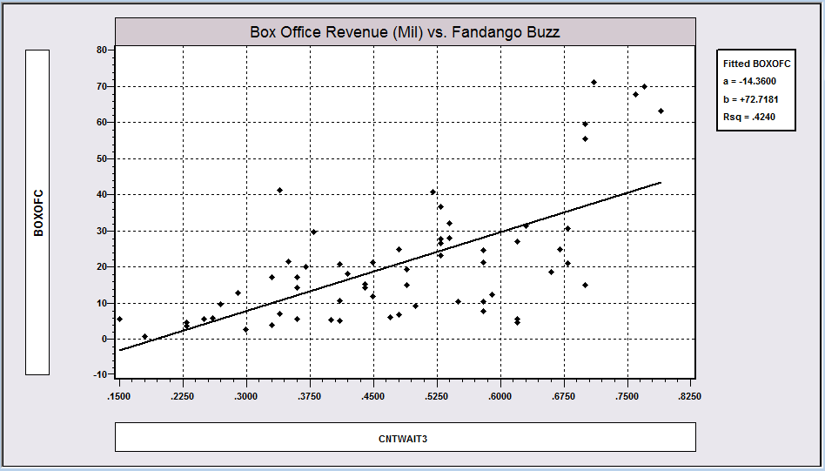
Internet Buzz Data

Slide 24
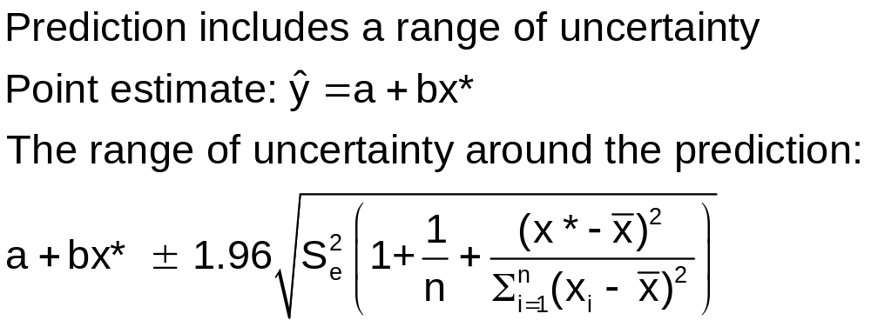
A Prediction Interval
The usual 95% Due to ε Due to estimating α and β with a and b

Slide 25
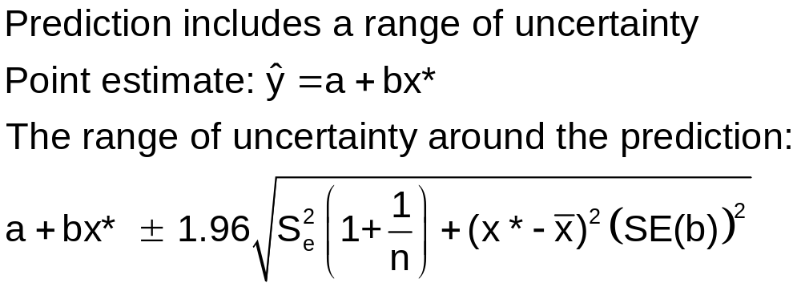
Slightly Simpler Formula for Prediction

Slide 26
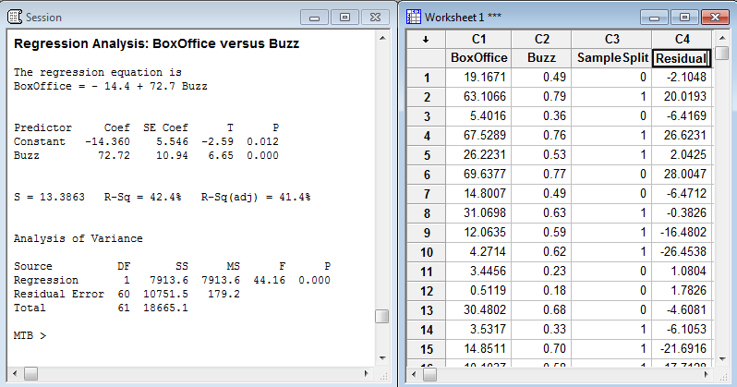
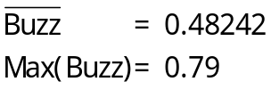
Prediction from Internet Buzz Regression

Slide 27
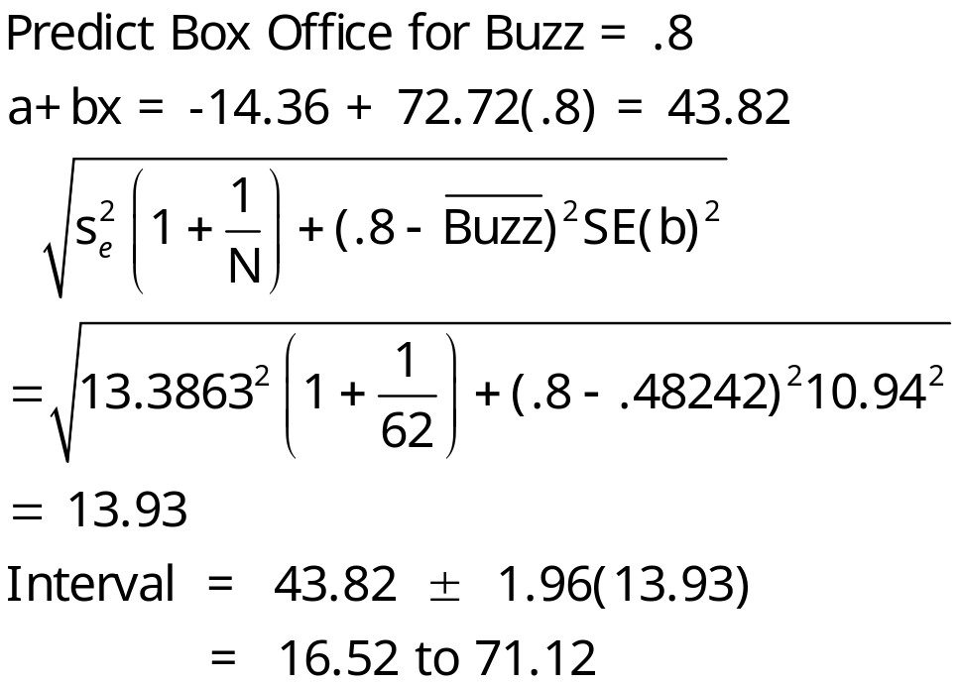
Prediction Interval for Buzz = .8

Slide 28
Semi- and Nonparametric Estimation

Slide 29
Application: Stochastic Frontier Model
Production Function Regression: logY = b’x + v - u
where u is “inefficiency.” u > 0. v is normally distributed.
e = N0,s_{v}²] - |N[0,s_{u}²]| has a “skew normal density
Save for the constant term, the model is consistently estimated by OLS.
If the theory is right, the OLS residuals will be skewed to the left, rather than symmetrically distributed if they were normally distributed.
Application: Spanish dairy data used in Assignment 2
yit = log of milk production
x1 = log cows, x2 = log land, x3 = log feed, x4 = log labor

Slide 30
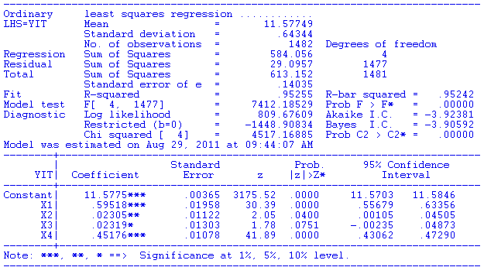
Regression Results

Slide 31
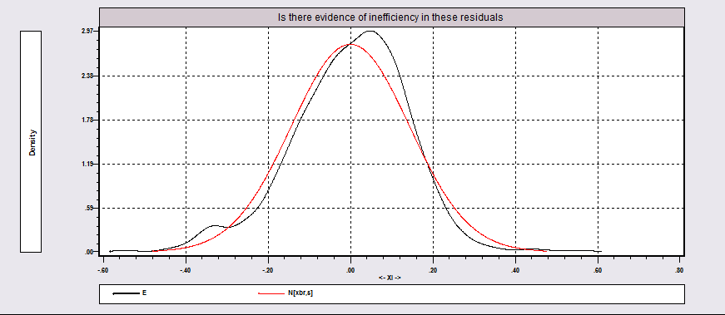
Distribution of OLS Residuals

Slide 32

A Nonparametric Regression
y = µ(x) +ε
Smoothing methods to approximate µ(x) at specific points, x*
For a particular x*, µ(x*) = ∑_{i} w_{i}(x*|x)y_{i}
  E.g., for ols, µ(x*) =a+bx*
  w_{i} = 1/n +
We look for weighting scheme, local differences in relationship. OLS assumes a fixed slope, b.

Slide 33
Nearest Neighbor Approach
Define a neighborhood of x*. Points near get high weight, points far away get a small or zero weight
Bandwidth, h defines the neighborhood:
e.g., Silverman h =.9Min[s,(IQR/1.349)]/n^{.2}
Neighborhood is + or – h/2
LOWESS weighting function: (tricube)
T_{i} = [1 – [Abs(x_{i} – x*)/h]³]³.
Weight is w_{i} = 1[Abs(x_{i} – x*)/h < .5] * T_{i} .

Slide 34
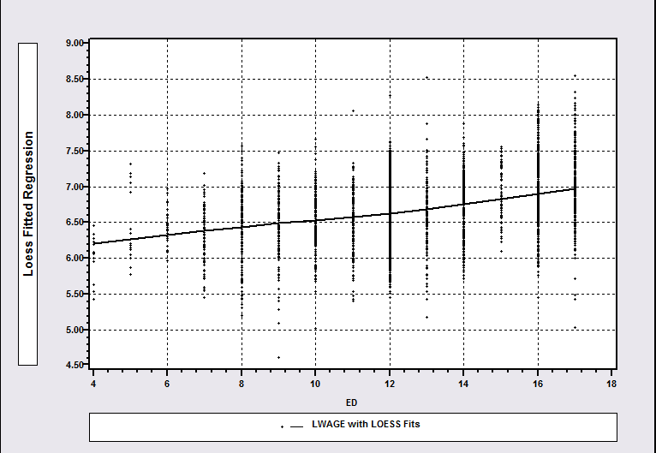
LOWESS Regression

Slide 35
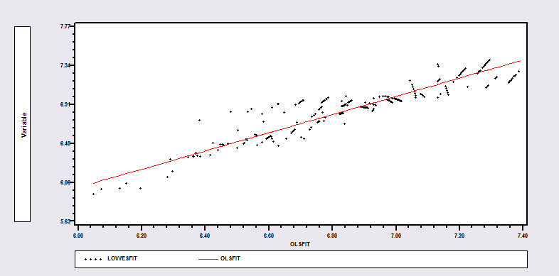
OLS Vs. Lowess

Slide 36
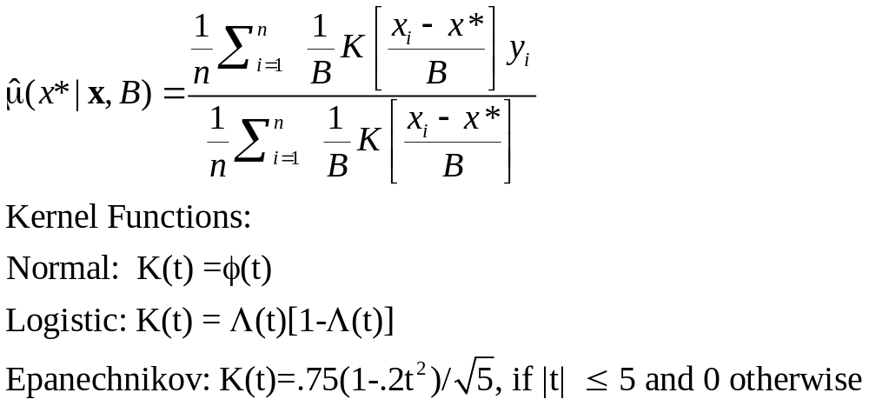
Smooth Function: Kernel Regression

Slide 37
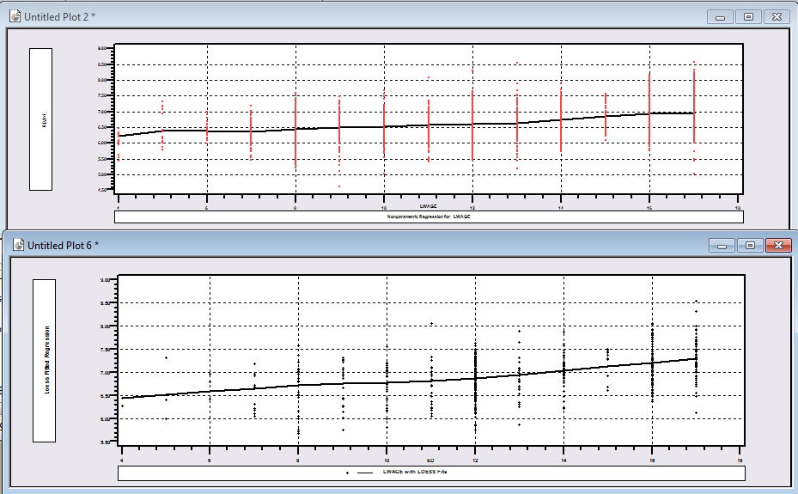
Kernel Regression vs. Lowess (Lwage vs. Educ)

Slide 38
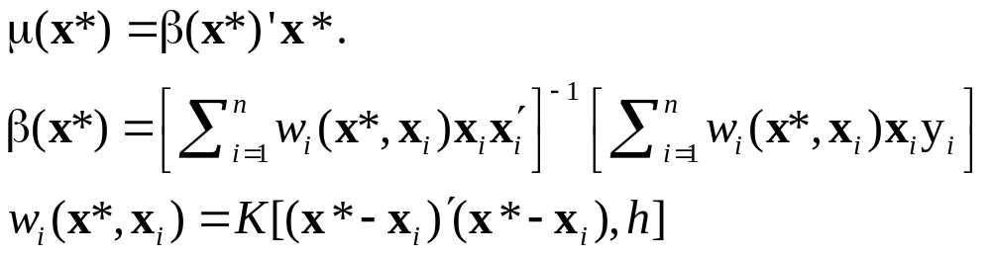
Locally Linear Regression

Slide 39
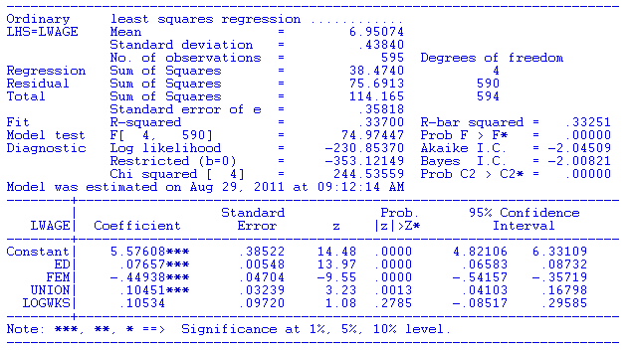
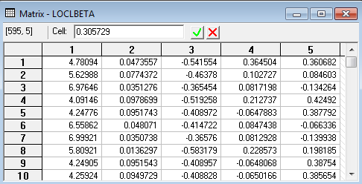
OLS vs. LOWESS

