Slide 1

Econometrics I
Professor William Greene
Stern School of Business
Department of Economics

Slide 2
Dear Colleagues,
We invite you to join us for a PRIISM seminar with Chuck Huber (Stata Corp.) on 10/18 from 10:30 AM - 12:00 PM in the Kimball Hall (246 Greene Street) 3rd floor conference room.
Talk Title: Introduction to Bayesian Analysis Using Stata
Talk Abstract: Bayesian analysis has become a popular tool for many statistical applications. Yet many data analysts have little training in the theory of Bayesian analysis and software used to fit Bayesian models. This talk will provide an intuitive introduction to the concepts of Bayesian analysis and demonstrate how to fit Bayesian models using Stata. No prior knowledge of Bayesian analysis is necessary and specific topics will include the relationship between likelihood functions, prior, and posterior distributions, Markov Chain Monte Carlo (MCMC) using the Metropolis-Hastings algorithm, and how to use Stata's Bayes prefix to fit Bayesian models.
Daphna Harel
Assistant Professor of Applied Statistics NYU Steinhardt

Slide 3
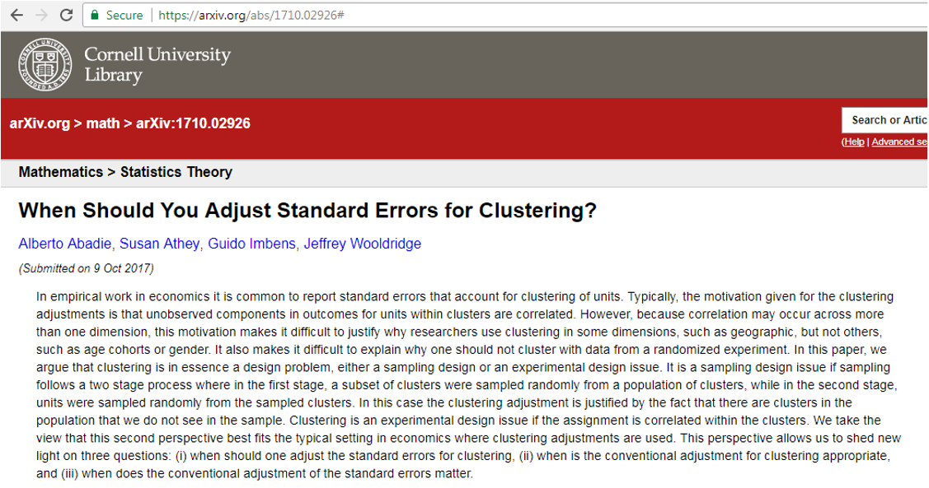
https://arxiv.org/abs/1710.02926# then download PDF

Slide 4
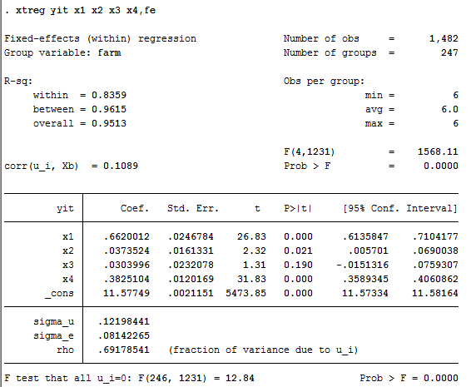
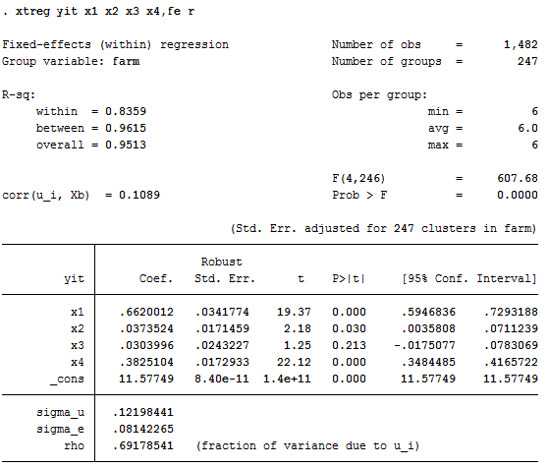
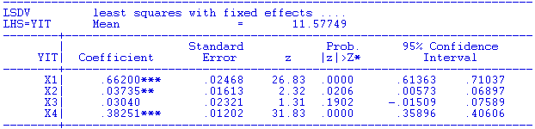
A Caution About Stata and Fixed Effects

Slide 5
Econometrics I
Part 11 – Hypothesis Testing

Slide 6
Classical Hypothesis Testing
We are interested in using the linear regression to support or cast doubt on the validity of a theory about the real world counterpart to our statistical model. The model is used to test hypotheses about the underlying data generating process.

Slide 7
Types of Tests
Nested Models: Restriction on the parameters of a particular model
y = β₁ + β₂x + β₃T + ε, β₃ = 0
(The “treatment” works; β₃ ≠ 0 .)
Nonnested models: E.g., different RHS variables
y_{t} = β₁ + β₂x_{t} + β₃x_{t-1} + ε_{t}
y_{t} = γ₁ + γ₂x_{t} + γ₃y_{t-1} + w_{t}
(Lagged effects occur immediately or spread over time.)
Specification tests:
ε ~ N[0,σ²] vs. some other distribution
(The “null” spec. is true or some other spec. is true.)

Slide 8
Hypothesis Testing
Nested vs. nonnested specifications
  y=b₁x+e vs. y=b₁x+b₂z+e: Nested
  y=bx+e vs. y=cz+u: Not nested
  y=bx+e vs. logy=clogx: Not nested
  y=bx+e; e ~ Normal vs. e ~ t[.]: Not nested
  Fixed vs. random effects: Not nested
  Logit vs. probit: Not nested
  x is (not) endogenous: Maybe nested. We’ll see …
Parametric restrictions
  Linear: Rβ-q = 0, R is JxK, J < K, full row rank
  General: r(β,q) = 0, r = a vector of J functions,
  R(β,q) = ∂r(β,q)/∂β’.
  Use r(β,q)=0 for linear and nonlinear cases

Slide 9
Broad Approaches
Bayesian: Does not reach a firm conclusion. Revises odds.
  Prior odds compares strength of prior beliefs in two states of the world
  Posterior odds compares revised beliefs
  Symmetrical treatment of competing ideas
  Not generally practical to carry out in meaningful situations
Classical: All or nothing; reject the theory or do not reject it.
  “Null” hypothesis given prominence
  Propose to “reject” toward favor of “alternative”
  Asymmetric treatment of null and alternative
  Huge gain in practical applicability

Slide 10
Inference in the Linear Model
Formulating hypotheses: linear restrictions as a general framework
Hypothesis Testing J linear restrictions
Analytical framework: y = Xβ + ε
Hypothesis: Rβ - q = 0,
Substantive restrictions: What is a "testable hypothesis?"
• Substantive restriction on parameters
• Reduces dimension of parameter space
• Imposition of restriction degrades estimation criterion

Slide 11
Testable Implications of a Theory
Investors care about nominal interest rates and
expected inflation:
I = β₁ + β₂r + β₃dp + e
Restriction is β₃ = - β₂.
Investors care only about real interest rates.
(1) Substantive restriction on parameters
(2) Parameter space is ℜ³. Restricted space
is a 2 dimensional subspace (not ℜ²).
(3) Restrictions must lead to increase in sum of
squared residuals

Slide 12
The General Linear Hypothesis: H₀: Rβ - q = 0
A unifying departure point: Regardless of the hypothesis, least squares is unbiased.
E[b] = β
The hypothesis makes a claim about the population
Rβ – q = 0. Then, if the hypothesis is true, E[Rb – q] = 0.
The sample statistic, Rb – q will not equal zero.
Two possibilities:
Rb – q is small enough to attribute to sampling variability
Rb – q is too large (by some measure) to be plausibly attributed to
sampling variability
Large Rb – q is the rejection region.

Slide 13
Neyman – Pearson Classical Methodology
Formulate null and alternative hypotheses
  Hypotheses are exclusive and exhaustive
  Null hypothesis is of particular interest
Define “Rejection” region = sample evidence that will lead to rejection of the null hypothesis.
Gather evidence
Assess whether evidence falls in rejection region or not.

Slide 14
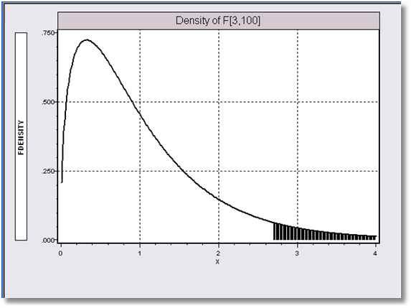
Testing Fundamentals - I
SIZE of a test = Probability it will incorrectly reject a “true” null hypothesis.
This is the probability of a Type I error.
Under the null hypothesis, F(3,100) has an F distribution with (3,100) degrees of freedom. Even if the null is true, F will be larger than the 5% critical value of 2.7 about 5% of the time.

Slide 15
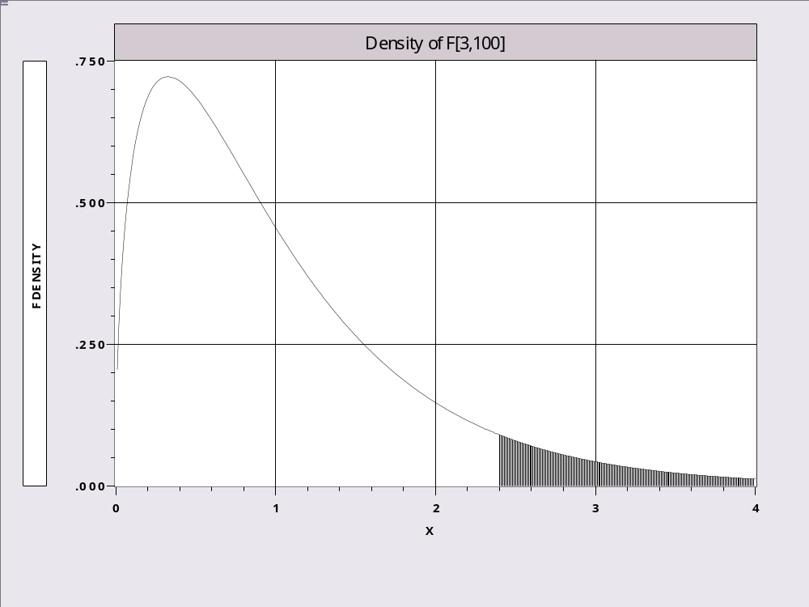
Distribution Under the Null

Slide 16
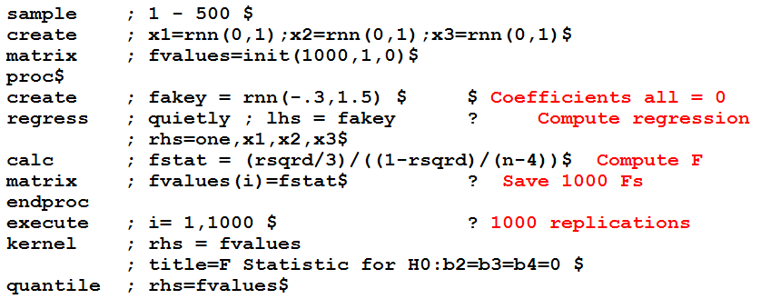
A Simulation Experiment

Slide 17
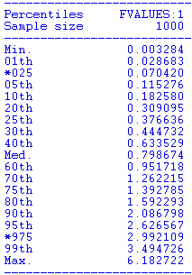
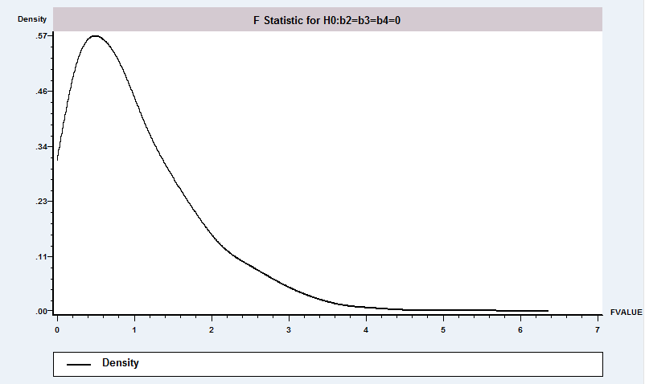
Simulation Results
About 5% of computed F values are in the rejection region, though β₁=β₂=β3=0 is true.

Slide 18
Testing Fundamentals - II
POWER of a test = the probability that it will correctly reject a “false null” hypothesis
This is 1 – the probability of a Type II error.
The power of a test depends on the specific alternative.

Slide 19
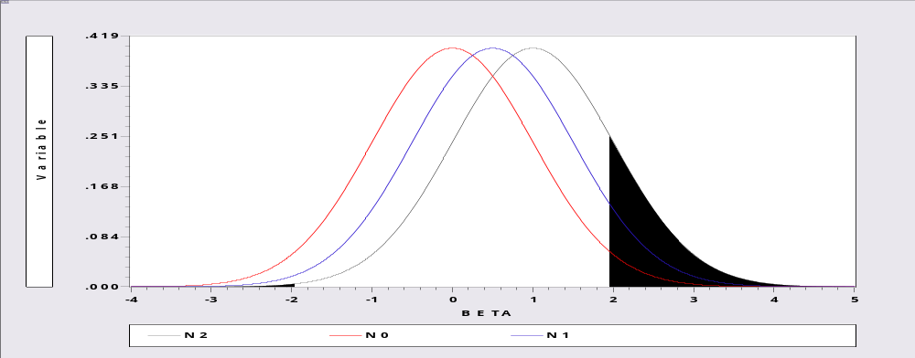
Power of a Test
Null: Mean = 0. Reject if observed mean < -1.96 or > +1.96.
Prob(Reject μ = 0 | μ = 0) = 0.05
Prob(Reject μ = 0 | μ =.5) = 0.07902
Prob(Reject μ = 0 | μ = 1) = 0.170066. Increases as the (alternative) μ rises.

Slide 20
3 Approaches to Defining the Rejection Region
(1) Imposing the restrictions leads to a loss of fit. Sum of squared
residuals must increase.
R² must go down. Does it go down “a lot?” (I.e., significantly?).
R_{u}² = unrestricted model, R_{r}² = restricted model fit. Test is based
on R_{u}² – R_{r}. Is this difference large?
(2) Is Rb - q close to 0? Basing the test on the discrepancy
vector: m = Rb - q.
Using the Wald criterion: m′(Var[m])⁻¹m. A distance measure
of how far m is from zero.
(3) Does the restricted model appear to satisfy the restrictions?
Examine the residuals from the restricted model. Do the
residuals appear to be random noise?

Slide 21
Testing Strategy
How to determine if the statistic is 'large.'
Need a 'null distribution.'
If the hypothesis is true, then the statistic will have a certain distribution. This tells you how likely certain values are, and in particular, if the hypothesis is true, then 'large values' will be unlikely.
If the observed statistic is too large, conclude that the assumed distribution must be incorrect and the hypothesis should be rejected.

Slide 22
Robust Tests
The Wald test generally will (when properly constructed) be more robust to failures of the narrow model assumptions than the t or F
Reason: Based on “robust” variance estimators and asymptotic results that hold in a wide range of circumstances.

Slide 23
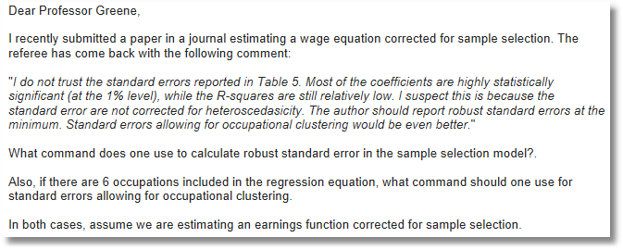

Slide 24
Robustness
Assumptions are narrower than necessary
  (1) Disturbances might be heteroscedastic
  (2) Disturbances might be correlated across observations – these are panel data
  (3) Normal distribution assumption is unnecessary
F, LM and LR tests rely on normality, no longer valid
Wald test relies on appropriate covariance matrix. (1) and (2) invalidate s²(X’X)⁻¹.

Slide 25
Robust Inference Strategy
(1) Use a robust estimator of the asymptotic covariance matrix. (Next class)
(2) The Wald statistic based on an appropriate covariance matrix is robust to distributional assumptions – it relies on the CLT.

Slide 26
The Nonrobust F Statistic
An application: (Familiar) Suppose b_{n} is the least squares estimator of β based on a sample of n observations. No assumption of normality of the disturbances or about nonstochastic regressors is made. The standard F statistic for testing the hypothesis H0: Rβ - q = 0 is
F[J, n-K] = [(e*’e* - e’e)/J] / [e’e / (n-K)]
where this is built of two sums of squared residuals. The statistic does not have an F distribution. How can we test the hypothesis?

Slide 27
Application - 1
Regression Model
LogG = β₁ + β₂logY + β₃logPG +
β₄logPNC + β₅logPUC + β₆logPPT +
β₇logPN + β₈logPD + β₉logPS + ε
Period = 1960 - 1995. Note that all coefficients
in the model are elasticities.

Slide 28
Full Model by Least Squares
----------------------------------------------------------------------
Ordinary least squares regression ............
LHS=LG Mean = 5.39299
Standard deviation = .24878
Number of observs. = 36
Model size Parameters = 9
Degrees of freedom = 27
Residuals Sum of squares = .00855
Standard error of e = .01780
Fit R-squared = .99605
Adjusted R-squared = .99488
--------+-------------------------------------------------------------
Variable| Coefficient Standard Error t-ratio P[|T|>t] Mean of X
--------+-------------------------------------------------------------
Constant| -6.95326*** 1.29811 -5.356 .0000
LY| 1.35721*** .14562 9.320 .0000 9.11093
LPG| -.50579*** .06200 -8.158 .0000 .67409
LPNC| -.01654 .19957 -.083 .9346 .44320
LPUC| -.12354* .06568 -1.881 .0708 .66361
LPPT| .11571 .07859 1.472 .1525 .77208
LPN| 1.10125*** .26840 4.103 .0003 .60539
LPD| .92018*** .27018 3.406 .0021 .43343
LPS| -1.09213*** .30812 -3.544 .0015 .68105
--------+-------------------------------------------------------------

Slide 29
Testing a Hypothesis Using a Confidence Interval
Given the range of plausible values
Testing the hypothesis that a coefficient equals zero or some other particular value:
Is the hypothesized value in the confidence interval?
Is the hypothesized value within the range of plausible values?
If not, reject the hypothesis.

Slide 30
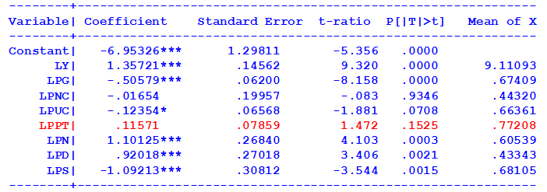
Test About One Parameter
Is the price of public transportation really ‘relevant?’ H₀ : β₆ = 0.
Confidence interval: b₆ ± t(.95,27) × Standard error
= .11571 ± 2.052(.07859)
= .11571 ± .16127 = (-.045557 ,.27698)
Contains 0.0. Do not reject hypothesis H₀ : β₆ = 0.

Slide 31
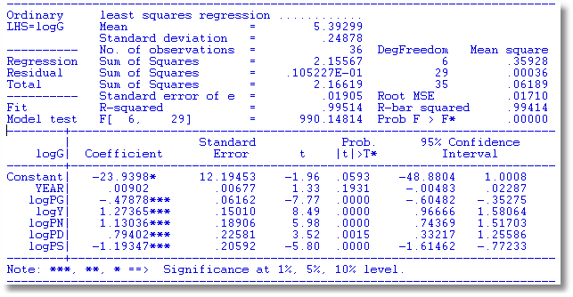
Test a Hypothesis About a Coefficient
Confidence intervals are often displayed in results
This model does not contain the micro price indices (PNC, PUC, PPT).

Slide 32
A Distance Measure
Testing more generally about a single parameter.
Sample estimate is b_{k} Sample estimated standard error is v_{k}.
Hypothesized value is β_{k}
How far is β_{k} from b_{k}? If too far, the hypothesis is inconsistent with the sample evidence.
Measure distance in standard error units
t = (b_{k} - β_{k})/Estimated v_{k}.
If t is “large” (larger than critical value), reject the hypothesis. The critical value is obtained in a table (computed) for the t distribution.

Slide 33
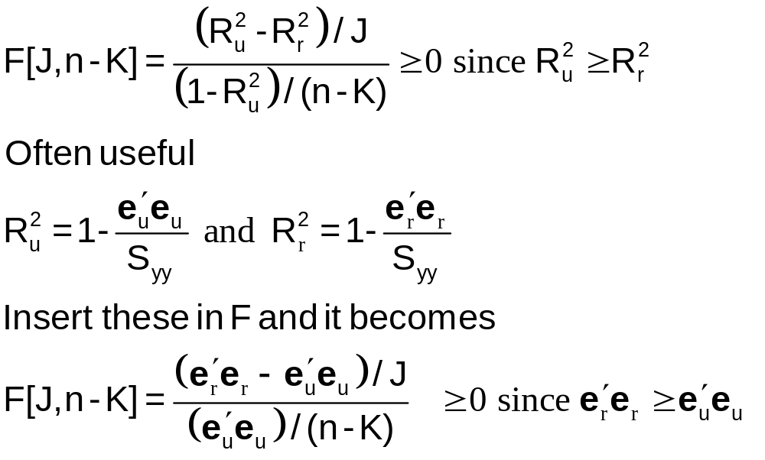
Test Statistic Based on Fit Measures
For the fit measures, use a normalized measure of the loss of fit:

Slide 34
Hypothesis Test: Sum of Coefficients = 0?
----------------------------------------------------------------------
Ordinary least squares regression ............
LHS=LG Mean = 5.39299
Standard deviation = .24878
Number of observs. = 36
Model size Parameters = 9
Degrees of freedom = 27
Residuals Sum of squares = .00855 <*******
Standard error of e = .01780
Fit R-squared = .99605 <*******
Adjusted R-squared = .99488
--------+-------------------------------------------------------------
Variable| Coefficient Standard Error t-ratio P[|T|>t] Mean of X
--------+-------------------------------------------------------------
Constant| -6.95326*** 1.29811 -5.356 .0000
LY| 1.35721*** .14562 9.320 .0000 9.11093
LPG| -.50579*** .06200 -8.158 .0000 .67409
LPNC| -.01654 .19957 -.083 .9346 .44320
LPUC| -.12354* .06568 -1.881 .0708 .66361
LPPT| .11571 .07859 1.472 .1525 .77208
LPN| 1.10125*** .26840 4.103 .0003 .60539
LPD| .92018*** .27018 3.406 .0021 .43343
LPS| -1.09213*** .30812 -3.544 .0015 .68105
--------+-------------------------------------------------------------
Sum = 0.9293. Significantly different from 0.0000?

Slide 35
Restricted Regression
----------------------------------------------------------------------
Linearly restricted regression
LHS=LG Mean = 5.392989
Standard deviation = .2487794
Number of observs. = 36
Model size Parameters = 8 <*** 9 – 1 restriction
Degrees of freedom = 28
Residuals Sum of squares = .0112599 <*** With the restriction
Residuals Sum of squares = .0085531 <*** Without the restriction
Fit R-squared = .9948020
Restrictns. F[ 1, 27] (prob) = 8.5(.01)
Not using OLS or no constant.R2 & F may be < 0
--------+-------------------------------------------------------------
Variable| Coefficient Standard Error t-ratio P[|T|>t] Mean of X
--------+-------------------------------------------------------------
Constant| -10.1507*** .78756 -12.889 .0000
LY| 1.71582*** .08839 19.412 .0000 9.11093
LPG| -.45826*** .06741 -6.798 .0000 .67409
LPNC| .46945*** .12439 3.774 .0008 .44320
LPUC| -.01566 .06122 -.256 .8000 .66361
LPPT| .24223*** .07391 3.277 .0029 .77208
LPN| 1.39620*** .28022 4.983 .0000 .60539
LPD| .23885 .15395 1.551 .1324 .43343
LPS| -1.63505*** .27700 -5.903 .0000 .68105
--------+-------------------------------------------------------------
F = [(.0112599 - .0085531)/1] / [.0085531/(36 – 9)] = 8.544691

Slide 36
Joint Hypotheses
Joint hypothesis: Income elasticity = +1, Own price elasticity = -1.
The hypothesis implies that b2 = 1 and b3 = -1.
logG = β₁ + logY – logPg + β₄ logPNC + ...
Strategy: Regress logG – logY + logPg on the other variables and compare the sums of squared residualss
With two restrictions imposed
Residuals Sum of squares = .0286877
Fit R-squared = .9979006
Unrestricted
Residuals Sum of squares = .0085531
Fit R-squared = .9960515
F = ((.0286877 - .0085531)/2) / (.0085531/(36-9)) = 31.779951
The critical F for 95% with (2,27) degrees of freedom is 3.354.
The hypothesis is rejected.

Slide 37
Basing the Test on R²
Based on R²s,
F = ((.9960515 - .997096)/2)/((1-.9960515)/(36-9))
= -3.571166 (!)
What's wrong? The unrestricted model used LHS = logG. The restricted one used logG - logY + logPG. The regressions have different LHS variables.
The calculation is always safe using the sums of squared residuals. The calculation is OK if the dependent variable is the same in the two regressions.

Slide 38
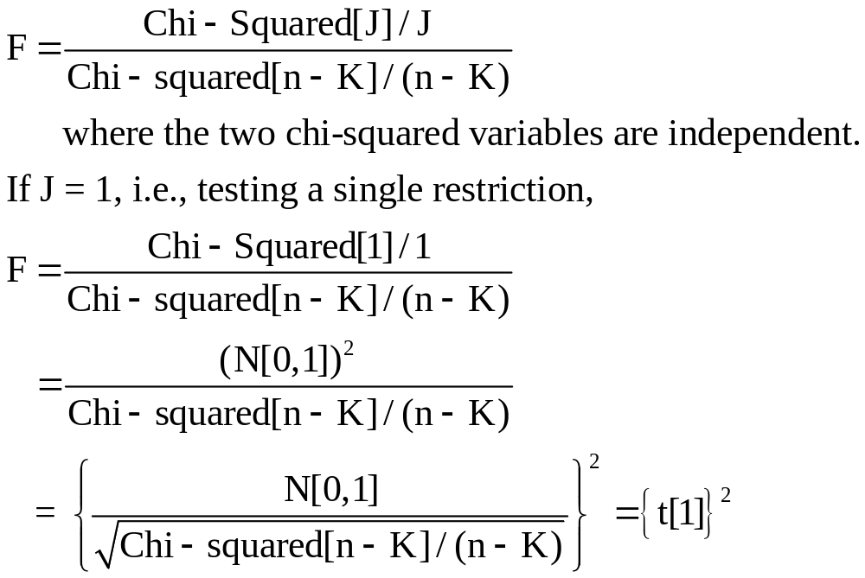
An important relationship between t and F
For a single restriction, F[1,n-K] is the square of the t ratio.

Slide 39
For one restriction, F = t²
----------------------------------------------------------------------
Ordinary least squares regression ............
LHS=LG Mean = 5.39299
Standard deviation = .24878
Number of observs. = 36
Residuals Sum of squares = .00855
Standard error of e = .01780
Fit R-squared = .99605
--------+-------------------------------------------------------------
Variable| Coefficient Standard Error t-ratio P[|T|>t] Mean of X
--------+-------------------------------------------------------------
Constant| -6.95326*** 1.29811 -5.356 .0000
LY| 1.35721*** .14562 9.320 .0000 9.11093
LPG| -.50579*** .06200 -8.158 .0000 .67409
LPNC| -.01654 .19957 -.083 .9346 .44320
LPUC| -.12354* .06568 -1.881 .0708 .66361
LPPT| .11571 .07859 1.472 .1525 .77208
LPN| 1.10125*** .26840 4.103 .0003 .60539
LPD| .92018*** .27018 3.406 .0021 .43343
LPS| -1.09213*** .30812 -3.544 .0015 .68105
--------+-------------------------------------------------------------
Regression fit if drop? Without LPPT, R-squared = 0.99573
Compare R², was 0.99605,
F(1,27) = [(.99605 - .99573)/1]/[(1-.99605)/(36-9)]
= 2.187
= 1.472² (with some rounding difference)

Slide 40
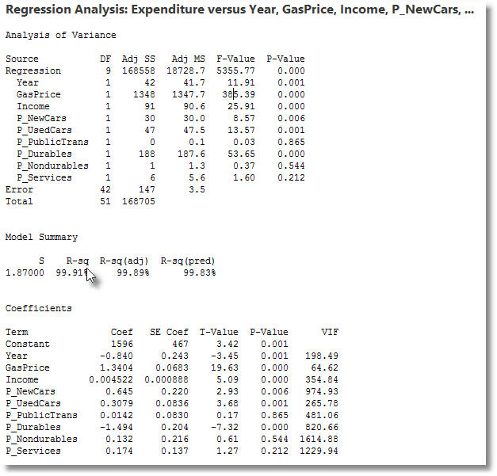
F-Value = T-Value²

Slide 41
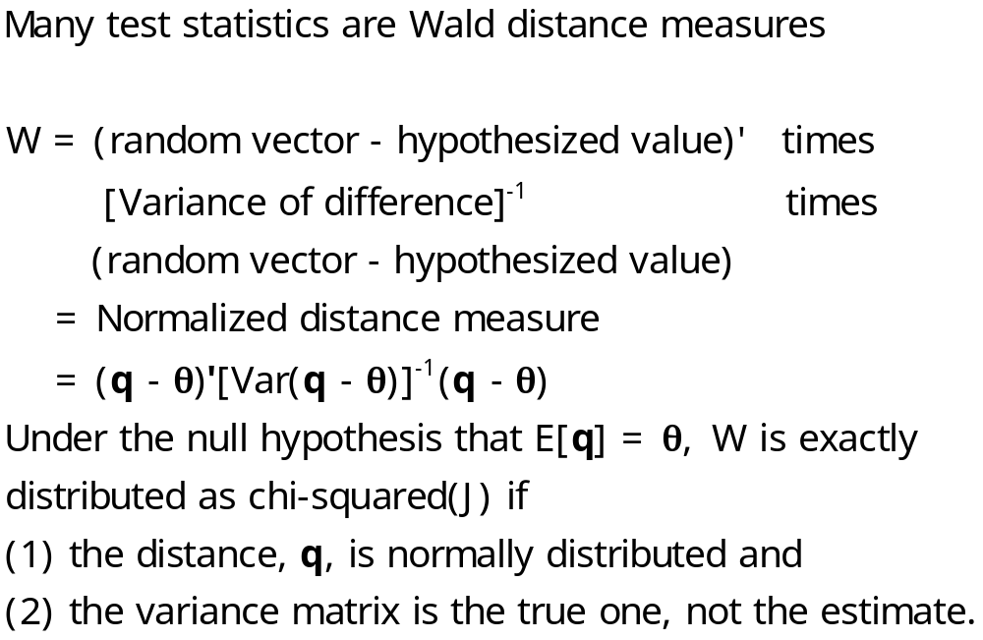
The Wald Statistic

Slide 42
Wald Test Statistics
W = m′[Est.Var(m)]⁻¹m
For a single restriction, m = r’b - q. The variance
is r’(Var[b])r
The distance measure is
(m / standard deviation of m)².
Example: The standard t test that bk = 0,
Wald = [(b_{k} – 0)/standard error]².
t² is the Wald statistic.

Slide 43
General Result for the Wald Statistic
Full Rank Quadratic Form
A crucial distributional result (exact): If the random vector x has a K-variate normal distribution with mean vector μ and covariance matrix Σ, then the random variable W = (x - μ)′Σ⁻¹(x - μ) has a chi-squared distribution with K degrees of freedom.
(See text, Appendix B11.6, Theorem B.11.)

Slide 44
Building the Wald Statistic-1
Suppose that the same normal distribution assumptions hold, but instead of the parameter matrix Σ we do the computation using a matrix S_{n} which has the property plim S_{n} = Σ. The exact chi-squared result no longer holds, but the limiting distribution is the same as if the true Σ were used.

Slide 45
Building the Wald Statistic-2
Suppose the statistic is computed not with an x that has an exact normal distribution, but with an x_{n} which has a limiting normal distribution, but whose finite sample distribution might be something else. Our earlier results for functions of random variables give us the result
(x_{n} - μ) ′S_{n}⁻¹(x_{n} - μ) → χ²[K]
(!!!)VVIR! Note that in fact, nothing in this relies on the normal distribution. What we used is consistency of a certain estimator (S_{n}) and the central limit theorem for x_{n}.

Slide 46
General Result for Wald Distance
The Wald distance measure: If plim x_{n} = μ, x_{n} is asymptotically normally distributed with a mean of μ and variance Σ, and if S_{n} is a consistent estimator of Σ, then the Wald statistic, which is a generalized distance measure between x_{n} converges to a chi-squared variate.
(x_{n} - μ) ′S_{n}⁻¹(x_{n} - μ) → χ²[K]

Slide 47
Test Statistics
We have established the asymptotic distribution of b. We now turn to the construction of test statistics. In particular,
F[J,n-K] = (1/J)(Rb - q)’[R s²(X′X)⁻¹R′]⁻¹(Rb - q)
This is the usual test statistic for testing linear hypotheses in the linear regression model, distributed exactly as F if the disturbances are normally distributed. We now obtain some general results that will let us construct test statistics in more general situations.

Slide 48
JF is a Wald Statistic
F[J,n-K] = (1/J) × (Rb_{n} - q)′[R s²(X′X)⁻¹ R’]⁻¹ (Rb_{n} - q).
Write m = (Rb_{n} - q). Under the hypothesis, plim m=0.
√n m → N[0, R(σ²/n)Q⁻¹R’]
Estimate the variance with R(s²/n)(X’X/n)⁻¹R’]
Then, (√n m )’ [Est.Var(√n m)]⁻¹ (√n m )
fits exactly into the apparatus developed earlier. If plim b_{n} = β, plim s² = σ², and the other asymptotic results we developed for least squares hold, then
JF[J,n-K] → χ²[J].

Slide 49
The Wald Statistic is Robust
Estimate the variance with R V R’ where V is any appropriate (conventional, heteroscedasticity robust, cluster corrected, etc.)
Then, (√n m )’ [Est.Var(√n m)]⁻¹ (√n m )
fits exactly into the apparatus developed earlier. If plim b_{n} = β, and the other asymptotic results we developed for least squares hold, then, specifically for the linear regression model,
JF[J,n-K] → χ²[J].
(Use JF and critical values for χ²[J] for tests.

Slide 50
A Caution About Stata and Fixed Effects

Slide 51
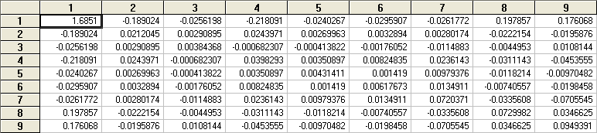
Hypothesis Test: Sum of Coefficients
Do the three aggregate price elasticities sum to zero?
H₀ :β₇ + β₈ + β₉ = 0
R = [0, 0, 0, 0, 0, 0, 1, 1, 1], q = [0]
Variable| Coefficient Standard Error t-ratio P[|T|>t] Mean of X
--------+-------------------------------------------------------------
LPN| 1.10125*** .26840 4.103 .0003 .60539
LPD| .92018*** .27018 3.406 .0021 .43343
LPS| -1.09213*** .30812 -3.544 .0015 .68105

Slide 52
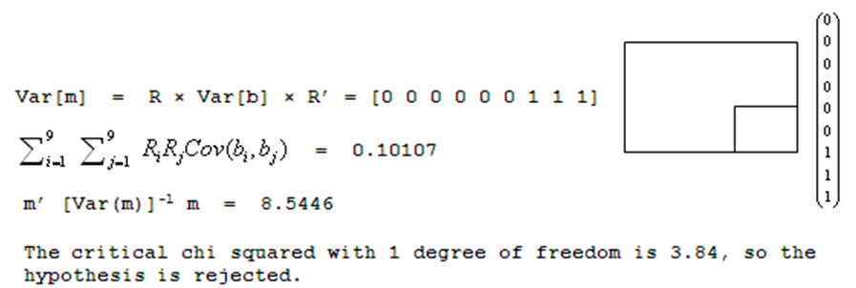
Wald Test
m = b7 + b8 + b9 = 0.9293.
(See slide 31)

Slide 53
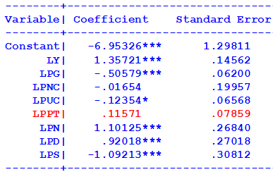
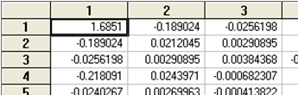
Wald Statistic for 2 Restrictions
Joint hypothesis:
b(LY) = 1
b(LPG) = -1
Matrix ; R = [0,1,0,0,0,0,0,0,0 /
0,0,1,0,0,0,0,0,0]$
Matrix ; q = [1/-1]$
Matrix ; list ; m = R*b - q $
Matrix m has 2 rows and 1 columns.
1
+-------------+
1| .35721
2| .49421
+-------------+
Matrix ; list ; vm = R*varb*R' $
Matrix VM has 2 rows and 2 columns.
1 2
+-------------+-------------+
1| .02120 .00291
2| .00291 .00384
+-------------+-------------+
Matrix ; list ; w = m'<vm>m $
Matrix W has 1 rows and 1 columns.
1
+-------------+
1| 63.55962
+-------------+

Slide 54
Example: Panel Data on Spanish Dairy Farms
N = 247 farms, T = 6 years (1993-1998)
 | Units | Mean | Std. Dev. | Minimum | Maximum
OutputMilk | Milk production (liters) | 131,107 | 92,584 | 14,410 | 727,281
Input Cows | # of milking cows | 22.12 | 11.27 | 4.5 | 82.3
Input Labor | # man-equivalent units | 1.67 | 0.55 | 1.0 | 4.0
Input Land | Hectares of land devoted to pasture and crops. | 12.99 | 6.17 | 2.0 | 45.1
Input Feed | Total amount of feedstuffs fed to dairy cows (Kg) | 57,941 | 47,981 | 3,924.14 | 376,732

Slide 55
Application
y = log output
x = Cobb douglas production: x = 1,x₁,x₂,x₃,x₄
= constant and logs of 4 inputs (5 terms)
z = Translog terms, x₁², x₂², etc. and all cross products,
x₁x₂, x₁x₃, x₁x₄, x₂x₃, etc. (10 terms)
w = (x,z) (all 15 terms)
Null hypothesis is Cobb Douglas, alternative is
translog = Cobb-Douglas plus second order terms.

Slide 56
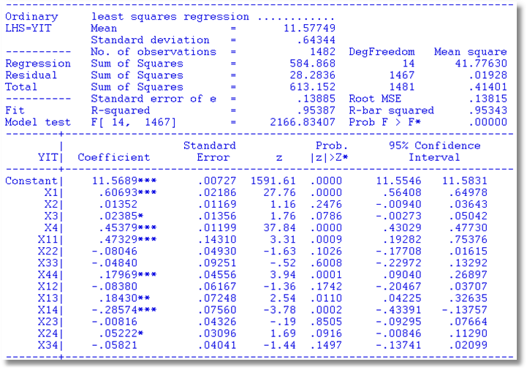
Translog Regression Model
β_{x}
H₀:β_{z}=0

Slide 57
Wald Tests
r(b,q)= close to zero?
Wald distance function:
r(b,q)’{Var[r(b,q)]}⁻¹ r(b,q) →χ²[J]
Use the delta method to estimate Var[r(b,q)]
  Est.Asy.Var[b]=s²(X’X)⁻¹
  Est.Asy.Var[r(b,q)]= R(b,q){s²(X’X)⁻¹}R’(b,q)
The standard F test is a Wald test; JF = χ²[J].

Slide 58

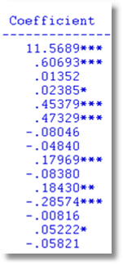
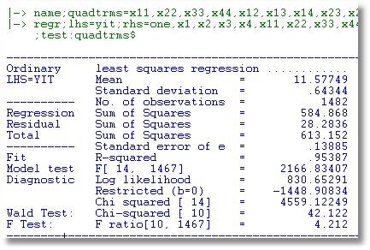
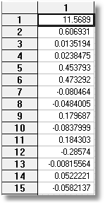
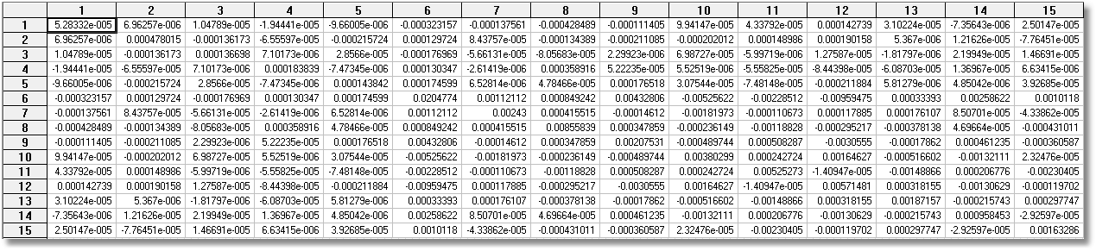
Close
to 0?
W=J*F

Slide 59

Need to establish that δ is not equal to 0.
SNAP = Xβ_{SNAP} + Zδ + ε
HEALTH = Xβ_{HEALTH} + ηSNAP + v

Slide 60
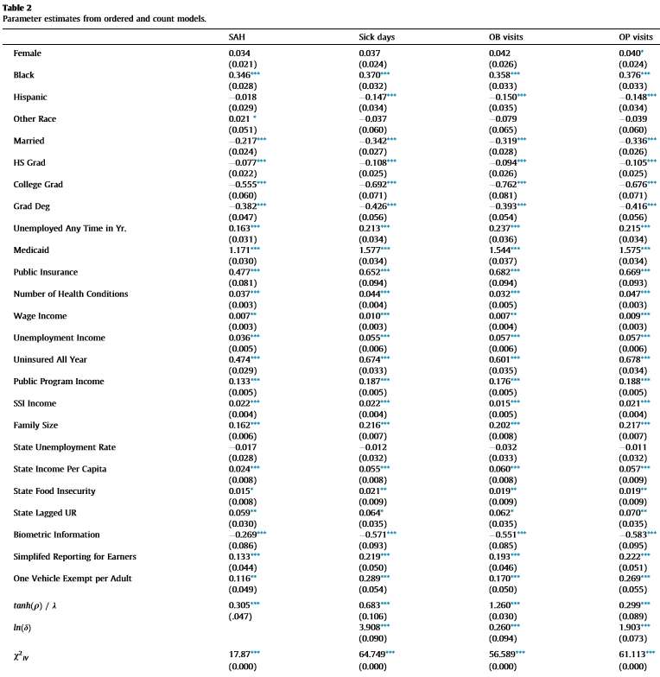

Slide 61
Score or LM Test: General
Maximum Likelihood (ML) Estimation, Adapted to LS.
A hypothesis test
  H₀: Restrictions on parameters are true
  H₁: Restrictions on parameters are not true
Basis for the test: b₀ = parameter estimate under H₀ (i.e., restricted), b₁ = unrestricted
Derivative results: For the likelihood function under H₁,
  (∂logL₁/∂β | β=b₁) = 0 (derivatives = 0 exactly, by definition)
  (∂logL₁/∂β | β=b₀) ≠ 0. Is it close? If so, the restrictions look
  reasonable

Slide 62
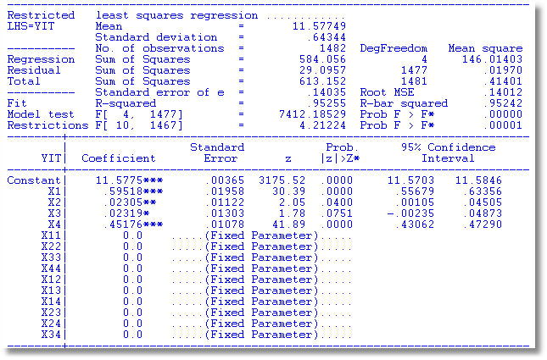
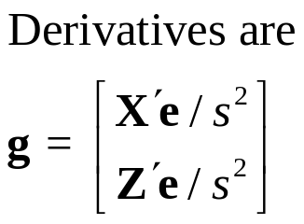
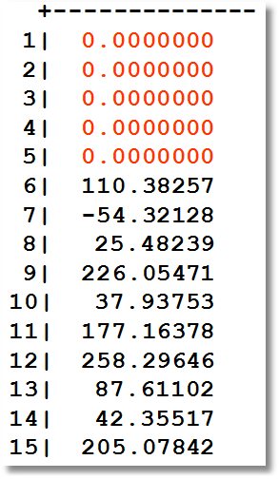
Restricted regression and derivatives for the LM Test
Are the residuals from regression of y on X alone uncorrelated with Z?

Slide 63
Computing the LM Statistic
Testing β_{z} = 0 in y=Xβ_{x}+Zβ_{z}+ε
Statistic computed from regression of y on X alone
1. Compute Restricted Regression (y on X alone) and compute
residuals, e₀
2. Regress e₀ on (X,Z). LM = NR² in this regression. (Regress
e₀ on the RHS of the unrestricted regression.

Slide 64
Application of the Score Test
Linear Model: Y = Xβ+Zδ+ε = Wθ + ε
  Test H₀: δ=0
  Restricted estimator is [b’,0’]’
NAMELIST ; X = a list… ; Z = a list … ; W = X,Z $
REGRESS ; Lhs = y ; Rhs = X ; Res = e $
CALC ; List ; LM = N * Rsq(W,e) $

Slide 65
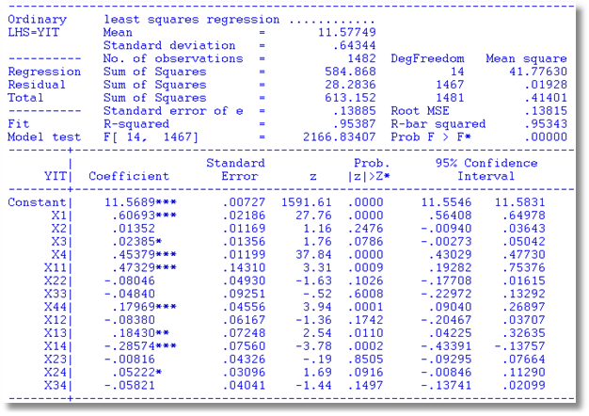
Regression Specification Tests
LM = 41.365
Wald Test: Chi-squared [ 10] = 42.122
F Test: F ratio[10, 1467] = 4.212

Slide 66
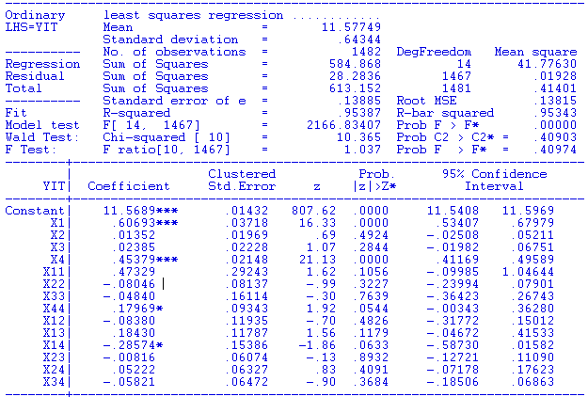
The Spanish dairy data are a 6 period panel. We robustify our test by using the cluster corrected covariance matrix. We were misled by the conventional covariance matrix! Use WALD with a robust covariance matrix for the test.
Wald test based on conventional standard errors: Chi-squared [ 10] = 42.122,
P = 0.00001
Wald statistic based on robust covariance matrix = 10.365.
P = 0.409!!

Slide 67
Structural Change Test

Slide 68
Application: Wald Tests
Year, G , Pg, Y , Pnc , Puc , Ppt , Pd , Pn , Ps $
1960 129.7 .925 6036 1.045 .836 .810 .444 .331 .302
1961 131.3 .914 6113 1.045 .869 .846 .448 .335 .307
1962 137.1 .919 6271 1.041 .948 .874 .457 .338 .314
1963 141.6 .918 6378 1.035 .960 .885 .463 .343 .320
1964 148.8 .914 6727 1.032 1.001 .901 .470 .347 .325
1965 155.9 .949 7027 1.009 .994 .919 .471 .353 .332
1966 164.9 .970 7280 .991 .970 .952 .475 .366 .342
1967 171.0 1.000 7513 1.000 1.000 1.000 .483 .375 .353
1968 183.4 1.014 7728 1.028 1.028 1.046 .501 .390 .368
1969 195.8 1.047 7891 1.044 1.031 1.127 .514 .409 .386
1970 207.4 1.056 8134 1.076 1.043 1.285 .527 .427 .407
1971 218.3 1.063 8322 1.120 1.102 1.377 .547 .442 .431
1972 226.8 1.076 8562 1.110 1.105 1.434 .555 .458 .451
1973 237.9 1.181 9042 1.111 1.176 1.448 .566 .497 .474
1974 225.8 1.599 8867 1.175 1.226 1.480 .604 .572 .513
1975 232.4 1.708 8944 1.276 1.464 1.586 .659 .615 .556
1976 241.7 1.779 9175 1.357 1.679 1.742 .695 .638 .598
1977 249.2 1.882 9381 1.429 1.828 1.824 .727 .671 .648
1978 261.3 1.963 9735 1.538 1.865 1.878 .769 .719 .698
1979 248.9 2.656 9829 1.660 2.010 2.003 .821 .800 .756
1980 226.8 3.691 9722 1.793 2.081 2.516 .892 .894 .839
1981 225.6 4.109 9769 1.902 2.569 3.120 .957 .969 .926
1982 228.8 3.894 9725 1.976 2.964 3.460 1.000 1.000 1.000
1983 239.6 3.764 9930 2.026 3.297 3.626 1.041 1.021 1.062
1984 244.7 3.707 10421 2.085 3.757 3.852 1.038 1.050 1.117
1985 245.8 3.738 10563 2.152 3.797 4.028 1.045 1.075 1.173
1986 269.4 2.921 10780 2.240 3.632 4.264 1.053 1.069 1.224

Slide 69
Regression Model
Based on the gasoline data: The regression equation is
g =β₁ + β₂y + β₃pg + β₄pnc + β₅puc +
β₆ppt + β₇pd + β₈pn + β₉ps + β₁₀t + ε
All variables are logs of the raw variables, so that coefficients are elasticities. The new variable, t, is a time trend, 0,1,…,26, so that β₁₀ is the autonomous yearly proportional growth in G.

Slide 70
Structural Change
Time series regression,
LogG = β₁ + β₂logY + β₃logPG
+ β₄logPNC + β₅logPUC + β₆logPPT
+ β₇logPN + β₈logPD + β₉logPS + ε
A significant event occurs in October 1973. We will be interested to know if the model 1960 to 1973 is the same as from 1974 to 1995.

Slide 71
Data Setup
Create;
G=log(G);
Pg=log(PG);
y=log(y);
pnc=log(pnc);
puc=log(puc);
ppt=log(ppt);
pd=log(pd);
pn=log(pn);
ps=log(ps);
t=year-1960$
Namelist;X=one,y,pg,pnc,puc,ppt,pd,pn,ps,t$
Regress;lhs=g;rhs=X$

Slide 72
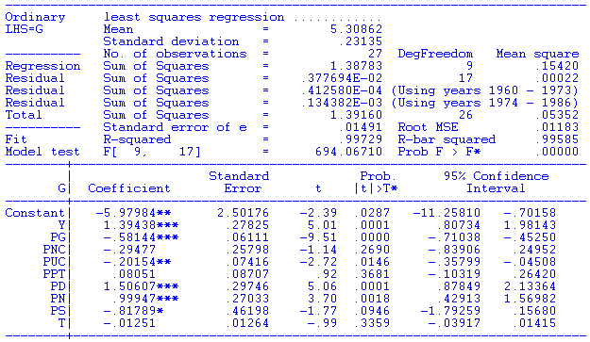
Least Squares Results

Slide 73
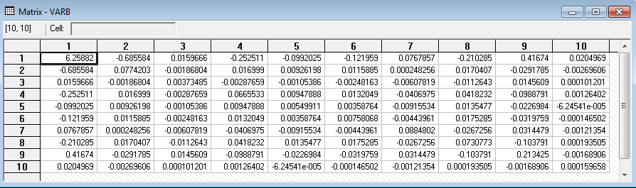
Covariance Matrix

Slide 74
Chow Test
Structural change test – The CHOW test. Is the regression model the same in the two subperiods, before and after 1973. Use 3 regressions to find out.
Pooled sum of squares = 0.0037769400 = ss01
1960-1973 = 0.0000412580 = ss0
1974-1986 = 0.0001343820 = ss1
F[10, 27 – 20] = [(ss01 – (ss0 + ss1))/K] / [(ss0 + ss1)/(n0 + n1 – 2K]
= 14.353
The critical value is 3.637. The hypothesis of no structural change is rejected.

Slide 75
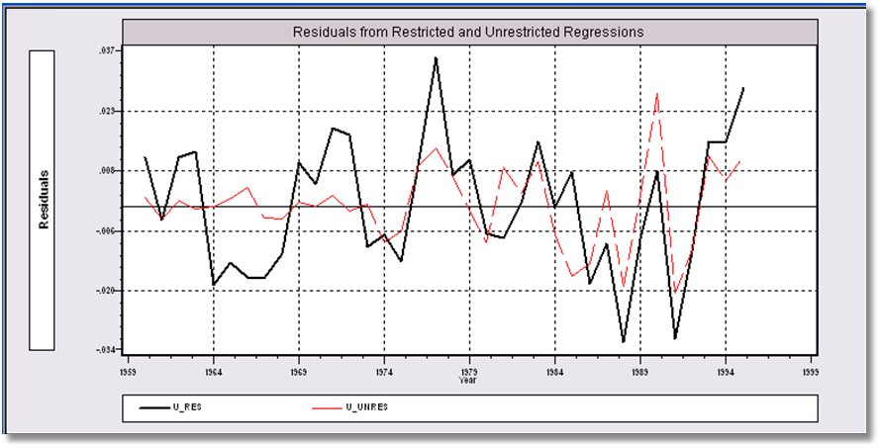
Residuals Show the Implication of the Restriction of Equal Coefficients. Loss of fit in the first period.

Slide 76
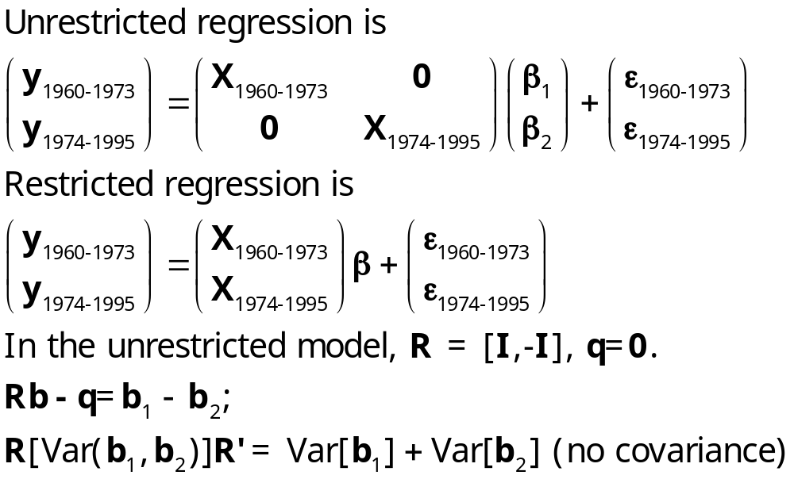
Algebra for the Chow Test

Slide 77
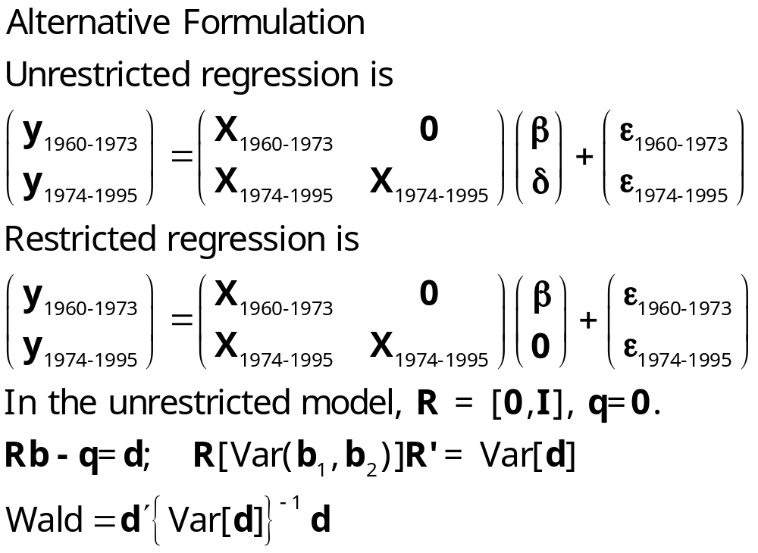
Structural Change Test

Slide 78
Application – Health and Income
German Health Care Usage Data, 7,293 Individuals, Varying Numbers of Periods
Variables in the file are
Data downloaded from Journal of Applied Econometrics Archive. This is an unbalanced panel with 7,293 individuals. There are altogether 27,326 observations. The number of observations ranges from 1 to 7 per family. (Frequencies are: 1=1525, 2=2158, 3=825, 4=926, 5=1051, 6=1000, 7=987). The dependent variable of interest is
DOCVIS = number of visits to the doctor in the observation period
HHNINC = household nominal monthly net income in German marks / 10000.
(4 observations with income=0 were dropped)
HHKIDS = children under age 16 in the household = 1; otherwise = 0
EDUC = years of schooling
AGE = age in years
MARRIED=marital status
WHITEC = 1 if has “white collar” job
Notes:
78

Slide 79
Men
+----------------------------------------------------+
| Ordinary least squares regression |
| LHS=HHNINC Mean = .3590541 |
| Standard deviation = .1735639 |
| Number of observs. = 14243 |
| Model size Parameters = 5 |
| Degrees of freedom = 14238 |
| Residuals Sum of squares = 379.8470 |
| Standard error of e = .1633352 |
| Fit R-squared = .1146423 |
| Adjusted R-squared = .1143936 |
+----------------------------------------------------+
+--------+--------------+----------------+--------+--------+----------+
|Variable| Coefficient | Standard Error |b/St.Er.|P[|Z|>z]| Mean of X|
+--------+--------------+----------------+--------+--------+----------+
|Constant| .04169*** .00894 4.662 .0000 |
|AGE | .00086*** .00013 6.654 .0000 42.6528|
|EDUC | .02044*** .00058 35.528 .0000 11.7287|
|MARRIED | .03825*** .00341 11.203 .0000 .76515|
|WHITEC | .03969*** .00305 13.002 .0000 .29994|
+--------+------------------------------------------------------------+

Slide 80
Women
+----------------------------------------------------+
| Ordinary least squares regression |
| LHS=HHNINC Mean = .3444951 |
| Standard deviation = .1801790 |
| Number of observs. = 13083 |
| Model size Parameters = 5 |
| Degrees of freedom = 13078 |
| Residuals Sum of squares = 363.8789 |
| Standard error of e = .1668045 |
| Fit R-squared = .1432098 |
| Adjusted R-squared = .1429477 |
+----------------------------------------------------+
+--------+--------------+----------------+--------+--------+----------+
|Variable| Coefficient | Standard Error |b/St.Er.|P[|Z|>z]| Mean of X|
+--------+--------------+----------------+--------+--------+----------+
|Constant| .01191 .01158 1.029 .3036 |
|AGE | .00026* .00014 1.875 .0608 44.4760|
|EDUC | .01941*** .00072 26.803 .0000 10.8764|
|MARRIED | .12081*** .00343 35.227 .0000 .75151|
|WHITEC | .06445*** .00334 19.310 .0000 .29924|
+--------+------------------------------------------------------------+

Slide 81
All
+----------------------------------------------------+
| Ordinary least squares regression |
| LHS=HHNINC Mean = .3520836 |
| Standard deviation = .1769083 |
| Number of observs. = 27326 |
| Model size Parameters = 5 |
| Degrees of freedom = 27321 |
| Residuals Sum of squares = 752.4767 | All
| Residuals Sum of squares = 379.8470 | Men
| Residuals Sum of squares = 363.8789 | Women
+----------------------------------------------------+
+--------+--------------+----------------+--------+--------+----------+
|Variable| Coefficient | Standard Error |b/St.Er.|P[|Z|>z]| Mean of X|
+--------+--------------+----------------+--------+--------+----------+
|Constant| .04186*** .00704 5.949 .0000 |
|AGE | .00030*** .919581D-04 3.209 .0013 43.5257|
|EDUC | .01967*** .00045 44.180 .0000 11.3206|
|MARRIED | .07947*** .00239 33.192 .0000 .75862|
|WHITEC | .04819*** .00225 21.465 .0000 .29960|
+--------+------------------------------------------------------------+

Slide 82
F Statistic for Chow Test
--> Calc ; k = col(x)
; List; dfd = (tm + tf - 2*k)
; Chowtest = ((sall - sm - sf)/k) /
((sm+sf)/dfd)
; FCrit = Ftb(.95,k,dfd) $
DFD = 27316.000000
CHOWTEST = 64.281630
FCRIT = 2.214100

Slide 83
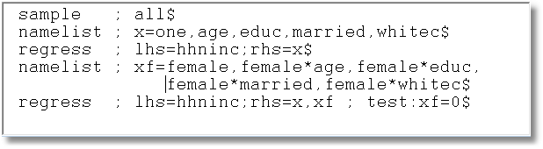
Use Dummy Variables (and Base the Test on a Robust Covariance Matrix)

Slide 84
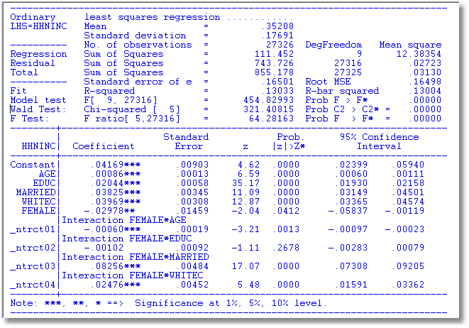
Wald Test for Difference

Slide 85
Specification Test: Normality of ε
Specification test for distribution
Standard tests:
  Kolmogorov-Smirnov: compare empirical cdf of X to normal with same mean and variance
  Bowman-Shenton: Compare third and fourth moments of X to normal, 0 (no skewness) and 3σ⁴ (meso kurtosis)
Bera-Jarque – adapted Bowman/Shenton to linear regression residuals

Slide 86
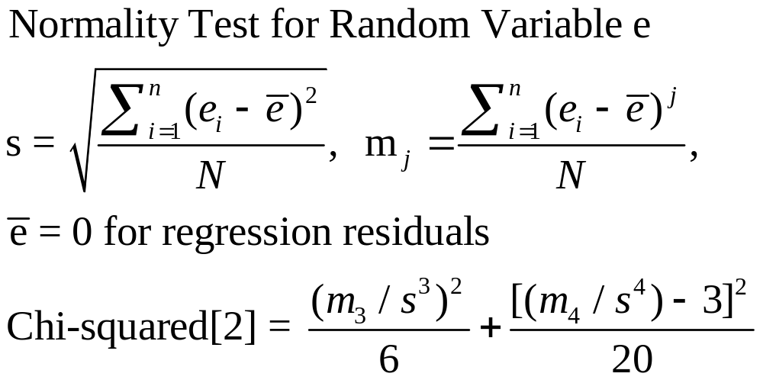
Testing for Normality

Slide 87
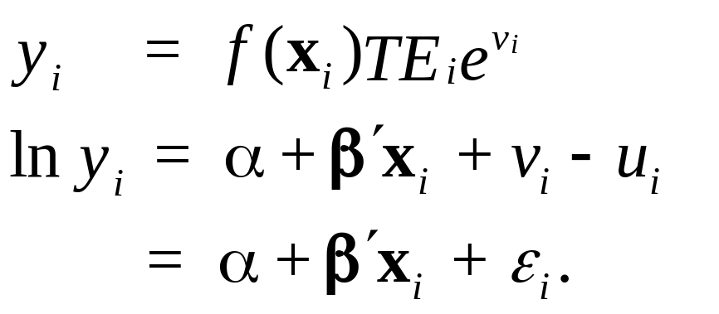
The Stochastic Frontier Model
u_{i} > 0, usually assumed to be |N[0,σ]|
v_{i} may take any value.
A symmetric distribution, such as the normal distribution, is usually assumed for v_{i}.

Slide 88
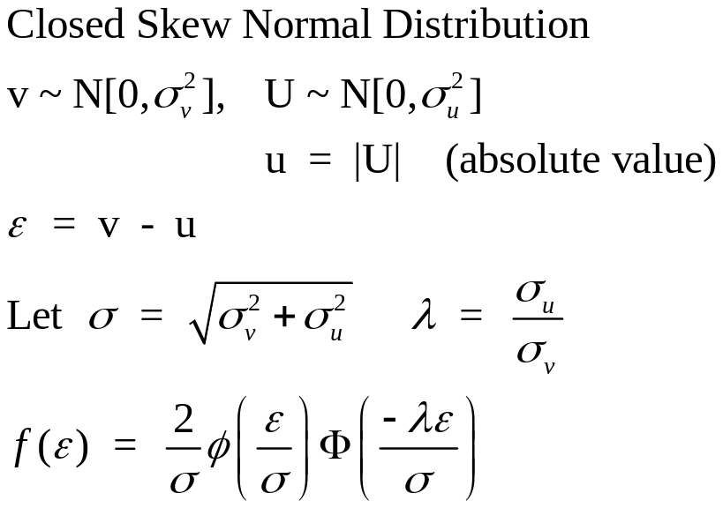
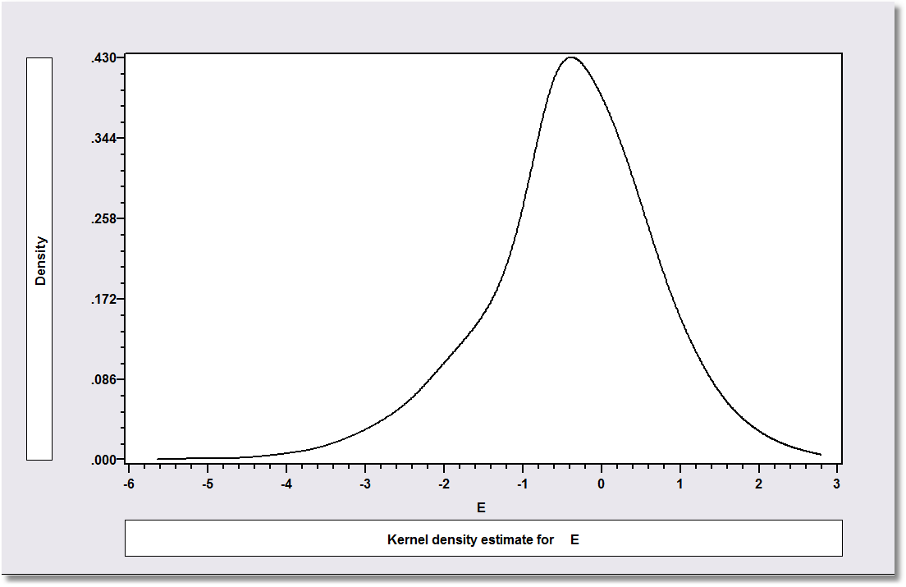
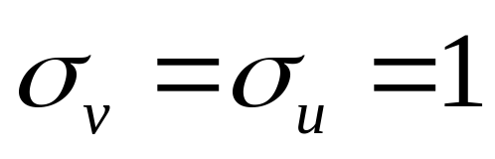

Slide 89
Application to Spanish Dairy Farms
N = 247 farms, T = 6 years (1993-1998)
Input | Units | Mean | Std. Dev. | Minimum | Maximum
Milk | Milk production (liters) | 131,108 | 92,539 | 14,110 | 727,281
Cows | # of milking cows | 2.12 | 11.27 | 4.5 | 82.3
Labor | # man-equivalent units | 1.67 | 0.55 | 1.0 | 4.0
Land | Hectares of land devoted to pasture and crops. | 12.99 | 6.17 | 2.0 | 45.1
Feed | Total amount of feedstuffs fed to dairy cows (tons) | 57,941 | 47,981 | 3,924.14 | 376,732

Slide 90
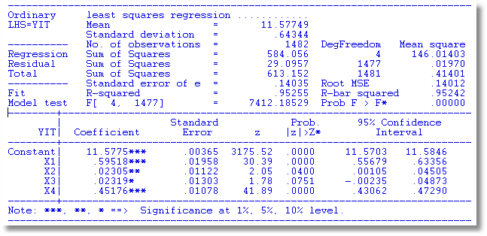
Stochastic Frontier Model

Slide 91
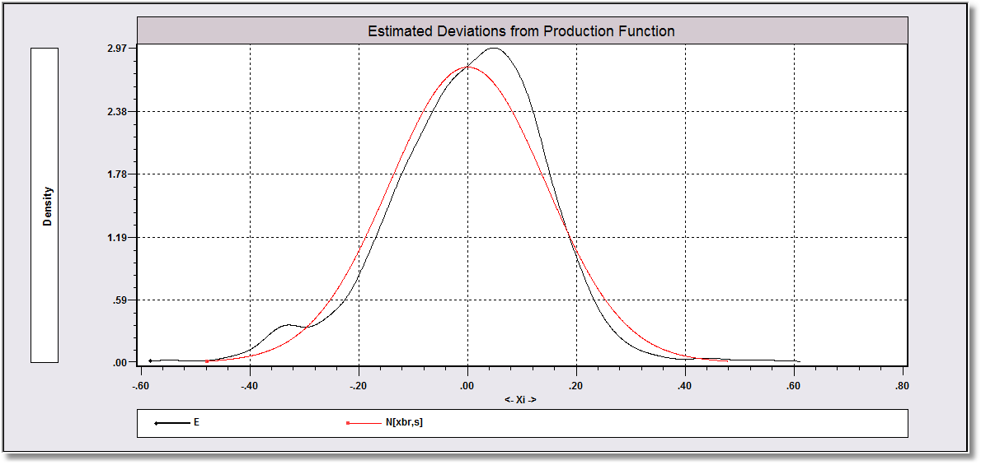

Slide 92
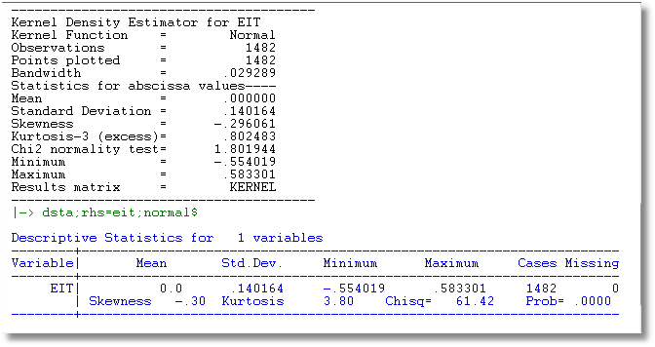

Slide 93
Appendix
Miscellaneous Results

Slide 94
Nonlinear Restrictions
I am interested in testing the hypothesis that certain ratios of elasticities are equal. In particular,
φ₁ = β₄/β₅ - β₇/β₈ = 0
φ₂ = β₄/β₅ - β₉/β₈ = 0

Slide 95
Setting Up the Wald Statistic
To do the Wald test, I first need to estimate the asymptotic covariance matrix for the sample estimates of φ₁ and φ₂. After estimating the regression by least squares, the estimates are
f₁ = b₄/b₅ - b₇/b₈
f₂ = b₄/b₅ - b₉/b₈.
Then, using the delta method, I will estimate the asymptotic variances of f₁ and f₂ and the asymptotic covariance of f₁ and f₂. For this, write f₁ = f₁(b), that is a function of the entire 10×1 coefficient vector. Then, I compute the 1×10 derivative vectors,
d₁ = ∂f₁(b)/∂b′ and d₂ = ∂f₂(b)/∂b′ These vectors are
1 2 3 4 5 6 7 8 9 10
d₁ = 0, 0, 0, 1/b₅, -b₄/b₅², 0, -1/b₈, b₇/b₈², 0, 0
d₂ = 0, 0, 0, 1/b₅, -b₄/b₅², 0, 0, b₉/b₈², -1/b₈, 0

Slide 96
Wald Statistics
Then, D = the 2×10 matrix with first row d₁ and second row d₂. The estimator of the asymptotic covariance matrix of [f₁,f₂]′ (a 2×1 column vector) is
V = D × s² (X′X)⁻¹ × D′. Finally, the Wald test of the hypothesis that φ = 0 is carried out by using the chi-squared statistic W = (f-0)′V⁻¹(f-0). This is a chi-squared statistic with 2 degrees of freedom. The critical value from the chi-squared table is 5.99, so if my sample chi-squared statistic is greater than 5.99, I reject the hypothesis.

Slide 97
Wald Test
In the example below, to make this a little simpler, I computed the 10 variable regression, then extracted the 5×1 subvector of the coefficient vector c = (b₄,b₅,b₇,b₈,b₉) and its associated part of the 10×10 covariance matrix. Then, I manipulated this smaller set of values.

Slide 98
Application of the Wald Statistic
? Extract subvector and submatrix for the test
matrix;list ; c =b(4:9)]$
matrix;list ; vc=varb(4:9,4:9)
? Compute derivatives
calc ;list
; g11=1/c(2); g12=-c(1)*g11*g11; g13=-1/c(4) ; g14=c(3)*g13*g13 ; g15=0
; g21= g11 ; g22=g12 ; g23=0 ; g24=c(5)/c(4)^2 ; g25=-1/c(4)$
? Move derivatives to matrix
matrix;list; dfdc=[g11,g12,g13,g14,g15 / g21,g22,g23,g24,g25]$
? Compute functions, then move to matrix and compute Wald statistic
calc;list ; f1=c(1)/c(2) - c(3)/c(4)
; f2=c(1)/c(2) - c(5)/c(4) $
matrix ; list; f = [f1/f2]$
matrix ; list; vf=dfdc * vc * dfdc' $
matrix ; list ; wald = f' * <vf> * f$

Slide 99
Computations
Matrix C is 5 rows by 1 columns.
1
1 -0.2948 -0.2015 1.506 0.9995 -0.8179
Matrix VC is 5 rows by 5 columns.
1 2 3 4 5
1 0.6655E-01 0.9479E-02 -0.4070E-01 0.4182E-01 -0.9888E-01
2 0.9479E-02 0.5499E-02 -0.9155E-02 0.1355E-01 -0.2270E-01
3 -0.4070E-01 -0.9155E-02 0.8848E-01 -0.2673E-01 0.3145E-01
4 0.4182E-01 0.1355E-01 -0.2673E-01 0.7308E-01 -0.1038
5 -0.9888E-01 -0.2270E-01 0.3145E-01 -0.1038 0.2134
G11 = -4.96184 G12 = 7.25755 G13= -1.00054 G14 = 1.50770 G15 = 0.000000
G21 = -4.96184 G22 = 7.25755 G23 = 0 G24 = -0.818753 G25 = -1.00054
DFDC=[G11,G12,G13,G14,G15/G21,G22,G23,G24,G25]
Matrix DFDC is 2 rows by 5 columns.
1 2 3 4 5
1 -4.962 7.258 -1.001 1.508 0.0000
2 -4.962 7.258 0.0000 -0.8188 -1.001
F1= -0.442126E-01
F2= 2.28098
F=[F1/F2]
VF=DFDC*VC*DFDC'
Matrix VF is 2 rows by 2 columns.
1 2
1 0.9804 0.7846
2 0.7846 0.8648
WALD Matrix Result is 1 rows by 1 columns.
1
1 22.65

Slide 100
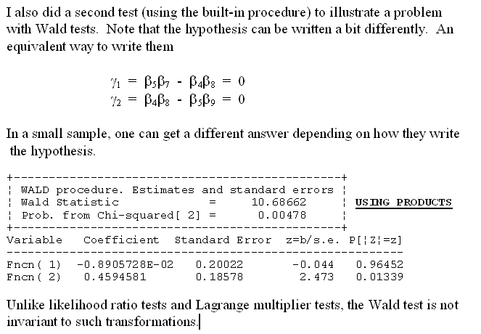
Noninvariance of the Wald Test

Slide 101
Nonnested Regression Models
Davidson and MacKinnon: If model A is correct, then predictions from model B will not add to the fit of model A to the data.
Vuong: If model A is correct, then the likelihood function will generally favor model A and not model B

Slide 102
Davidson and MacKinnon Strategy
Obtain predictions from model A = AFit
Obtain predictions from model B = Bfit
If A is correct, in the combined model (A,Bfit), Bfit should not be significant.
If B is correct, in the combined model (B,Afit), Afit should not be significant.
(Unfortunately), all four combinations of significance and not are possible.

Slide 103
Application
Model A
LogG(t) = β₁ + β₂logY(t) + β₃logPG(t)
+ β₄logPNC(t) + β₅logPUC(t) + β₆logPPT(t)
+ β₇logG(t-1) + ε
Model B
LogG(t) = α₁ + α₂logY(t) + α₃logPG(t)
+ α₄logPNC(t) + α₅logPUC(t) + α₆logPPT(t)
+ α₇logY(t-1) + w

Slide 104
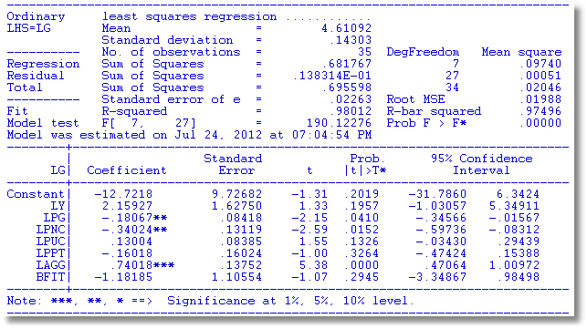
B does not add to Model A

Slide 105
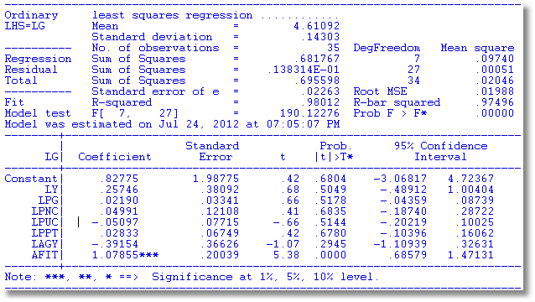
A Does Add to Model B

Slide 106
Voung
Log density for an observation is
L_{i} = -.5*[log(2π) + log(s²) + e_{i}²/s²]
Compute Li(A) and Li(B) for each observation
Compute D_{i} = L_{i}(A) – L_{i}(B)
Test hypothesis that mean of D_{i} equals zero using familiar “z” test.
Test statistic > +2 favors model A, < -2 favors model B, in between is inconclusive.

Slide 107



Slide 108
Oaxaca Decomposition
Two groups, two regression models: (Two time periods, men vs. women, two countries, etc.)
y₁ = X₁β₁ + ε₁ and y₂ = X₂β₂ + ε₂
Consider mean values,
y₁* = E[y₁|mean x₁] = x₁*′ β₁
y₂* = E[y₂|mean x₂] = x₂*′ β₂
Now, explain why y₁* is different from y₂*. (I.e., departing from y₂, why is y₁ different?) (Could reverse the roles of 1 and 2.)
y₁* - y₂* = x₁*′ β₁ - x₂*′ β₂
= x₁*′(β₁ - β₂) + (x₁* - x₂*)′ β₂
(change in model) (change in conditions)

Slide 109

The Oaxaca Decomposition

Slide 110
Application - Income
German Health Care Usage Data, 7,293 Individuals, Varying Numbers of Periods
Variables in the file are
Data downloaded from Journal of Applied Econometrics Archive. This is an unbalanced panel with 7,293 individuals. They can be used for regression, count models, binary choice, ordered choice, and bivariate binary choice. This is a large data set. There are altogether 27,326 observations. The number of observations ranges from 1 to 7. (Frequencies are: 1=1525, 2=2158, 3=825, 4=926, 5=1051, 6=1000, 7=987).
HHNINC = household nominal monthly net income in German marks / 10000.
(4 observations with income=0 were dropped)
HHKIDS = children under age 16 in the household = 1; otherwise = 0
EDUC = years of schooling
AGE = age in years
MARRIED = 1 if married, 0 if not
FEMALE = 1 if female, 0 if male

Slide 111

Regression: Female=0 (Men)

Slide 112

Regression Female=1 (Women)

Slide 113

Pooled Regression

Slide 114
Application
namelist ; X = one,age,educ,married,hhkids$
? Get results for females
include ; new ; female=1$ Subsample females
regr ; lhs=hhninc;rhs=x$ Regression
matrix ; bf=b ; vf = varb ; xbarf = mean(x) $ Coefficients, variance, mean X
calc ; meanincf = bf'xbarf $ Mean prediction for females
? Get results for males
include ; new ; female=0$ Subsample males
regr ; lhs=hhninc;rhs=x$ Regression
matrix ; bm=b ; vm = varb ; xbarm = mean(x) $ Coefficients, etc.
calc ; meanincm = bm'xbarm $ Mean prediction for males
? Examine difference in mean predicted income
calc ; list
; meanincm ; meanincf Display means
; diff = xbarm'bm - xbarf'bf $ Difference in means
matrix ; vdiff = xbarm'[vm]xbarm + xbarf'[vf]xbarf $ Variance of difference
calc ; list ; diffwald = diff^2 / vdiff $ Wald test of difference = 0
? “Discrimination” component of difference
matrix ; db = bm-bf ; discrim = xbarm'db Difference in coeffs., discrimination
; vdb = vm+vf ; vdiscrim = xbarm'[vdb]xbarm $ Variance of discrimination
calc ; list ; discrim ; dwald = discrim^2 / vdiscrim $ Walt test that D = 0.
? “Difference due difference in X”
matrix ; dx = xbarm - xbarf $ Difference in characteristics
matrix ; qual = dx'bf ; vqual = dx'[vf]dx $ Contribution to total difference
calc ; list ; qual ; qualwald = qual^2/vqual $ Wald test.

Slide 115
Results
+------------------------------------+
| Listed Calculator Results |
+------------------------------------+
MEANINCM = .359054
MEANINCF = .344495
DIFF = .014559
DIFFWALD = 52.006502
DISCRIM = -.005693
DWALD = 7.268757
QUAL = .020252
QUALWALD = 1071.053640

Slide 116

Decompositions

Slide 117

Likelihood Ratio Test
The normality assumption
Does it work ‘approximately?’
For any regression model y_{i} = h(x_{i},β)+ε_{i} where
ε_{i} ~N[0,σ²], (linear or nonlinear), at the linear (or nonlinear) least squares estimator, however computed, with or without restrictions,
This forms the basis for likelihood ratio tests.

Slide 118


Likelihood Ratio Test
LR = 2(830.653 – 809.676) = 41.954

