Slide 1

Econometrics I
Professor William Greene
Stern School of Business
Department of Economics

Slide 2
Econometrics I
Part 12 –Endogeneity
and IV Estimation

Slide 3
Sources of “Endogeneity”
Omitted Variables
Ignored “Heterogeneity”
Measurement Error
Endogenous “Treatment Effects”
Nonrandom Sampling (or Attrition)

Slide 4
In two of my projects, I was asked by reviewers to address the endogeneity concerns. In one project, I regress employee departure on project termination. Arguably project termination is not exogenous. In the other, I regress firms’ charitable giving in specific countries on their business activities in the local community. Again, business presence in countries are not exogenous. The problem is, both papers used non-linear models (Hazard model in one, and hurdle model in the other), which are required by the data I have. Are you aware of any econometric methods to deal with endogeneity in non-linear models? My search online did not go anywhere.
Hazard Model: Not a linear model.
Prob[event happens in time interval t to t+Δ| event happens after time t] =
a function of (x’β)

Slide 5
I have been asked this question (or ones like it) dozens of times. I think the issue is getting way overplayed. But, I'm not the majority voice, so you are going to have to deal with this.
Step 1: you or the referee need to figure out (make a case for) by what construction is "project termination" endogenous. What is correlated with what **in your hazard model** that makes the variable endogenous? There must be a second equation that implies that project termination is endogenous. What is it? What unobservable in that equation is correlated with what unobservable in the hazard model that makes it endogenous. Same questions for your hurdle model.
By what construction is SNAP endogenous in the HEALTH equation?
SNAP = Xβ_{SNAP} + Zδ + ε
HEALTH = Xβ_{HEALTH} + ηSNAP + v

Slide 6

Source of Endogeneity: Omitted Variable
Aggregate Data and Multinomial Choice:
The Model of Berry, Levinsohn and Pakes

Slide 7
Theoretical Foundation
Consumer market for J differentiated brands of a good
  j =1,…, J_{t} brands or types
  i = 1,…, N consumers
  t = i,…,T “markets” (like panel data)
Consumer i’s utility for brand j (in market t) depends on
  p = price
  x = observable attributes
  f = unobserved attributes
  w = unobserved heterogeneity across consumers
  ε = idiosyncratic aspects of consumer preferences
Observed data consist of aggregate choices, prices and features of the brands.

Slide 8
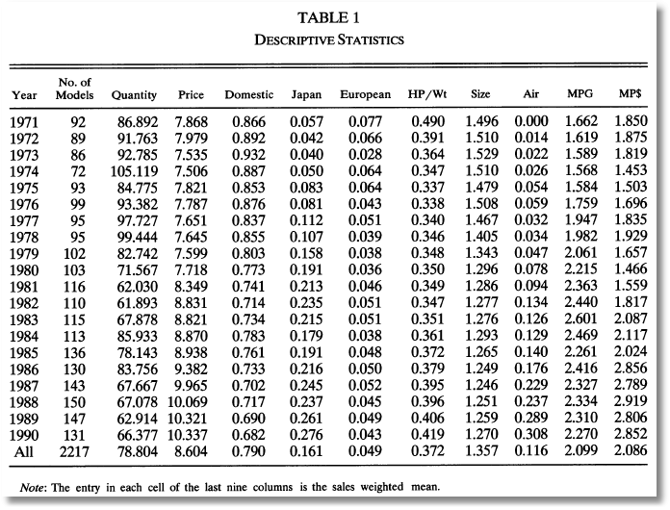
BLP Automobile Market
J_{t} N P X
t

Slide 9

Random Utility Model
Utility: U_{ijt}=U(w_{i},p_{jt},x_{jt},f_{jt},ε_{ijt} |θ), i = 1,…,(large) N, j=1,…,J
  w_{i} = individual heterogeneity; time (market) invariant. w has a continuous distribution across the population.
  p_{jt}, x_{jt}, f_{jt}, = price, observed attributes, unobserved features of brand j; all may vary through time (across markets)
Revealed Preference: Choice j provides maximum utility
Across the population, given market t, set of prices p_{t} and features (X_{t},f_{t}), there is a set of values of w_{i} that induces choice j, for each j=1,…,J_{t}; then, s_{j}(p_{t},X_{t},f_{t}|θ) is the market share of brand j in market t.
There is an outside good that attracts a nonnegligible market share, j=0. Therefore,

Slide 10
Endogenous Prices: Demand side
U_{ijt}=U(w_{i},p_{jt},x_{jt},f_{jt},ε_{ijt} |θ) = x_{jt}'β_{i} – αp_{j} + f_{jt} + ε_{ijt}
f_{jt} is unobserved features of model j
Utility responds to the unobserved f_{jt}
Price p_{jt} is partly determined by features f_{jt}.
In a choice model based on observables, price is correlated with the unobservables that determine the observed choices.

Slide 11
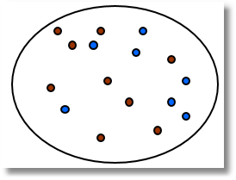
An Early Study of an Endogeneity Problem
(Snow, J., On the Mode of Communication of Cholera, 1855) http://www.ph.ucla.edu/epi/snow/snowbook3.html
London Cholera epidemic, ca 1853-4
Cholera = f(Water Purity,u) + ε.
  What is the ‘Causal’ effect of water purity on cholera?
  Purity=f(cholera prone environment (poor, garbage in streets, rodents, etc.). Regression does not work.
  Two London water companies
Lambeth Southwark & Vauxhall
^{Main sewage discharge}
River Thames
Paul Grootendorst: A Review of Instrumental Variables Estimation of Treatment Effects…
http://individual.utoronto.ca/grootendorst/pdf/IV_Paper_Sept6_2007.pdf
A review of instrumental variables estimation in the applied health sciences. Health Services and Outcomes Research Methodology 2007; 7(3-4):159-179.

Slide 12
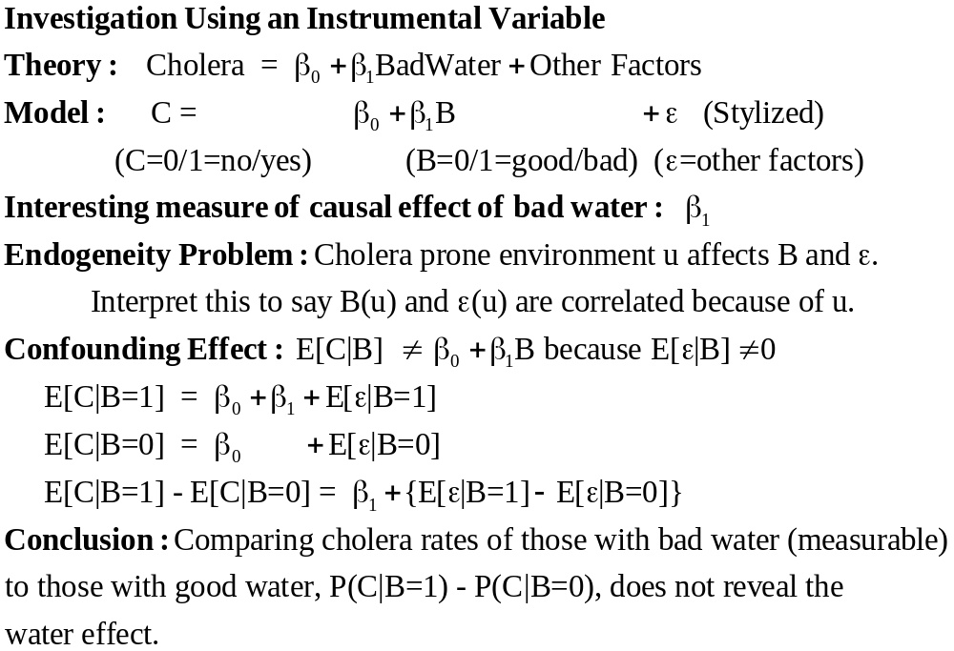

Slide 13
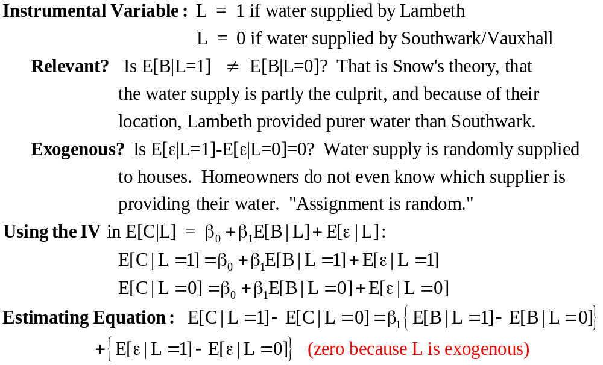

Slide 14
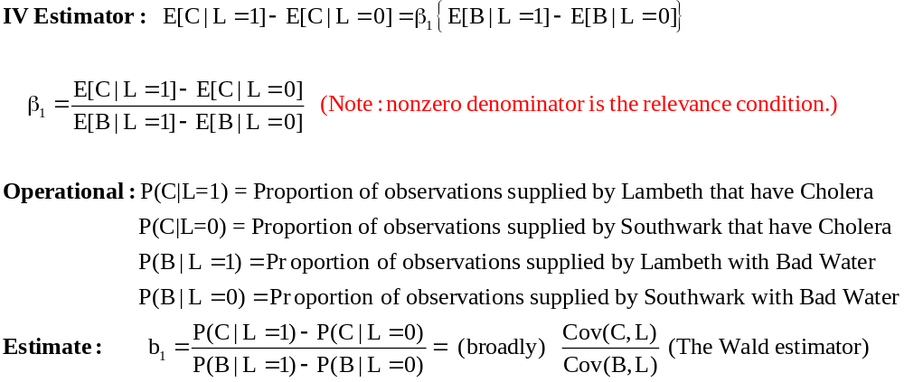

Slide 15
Cornwell and Rupert Data
Cornwell and Rupert Returns to Schooling Data, 595 Individuals, 7 Years
Variables in the file are
EXP = work experience
WKS = weeks worked
OCC = occupation, 1 if blue collar,
IND = 1 if manufacturing industry
SOUTH = 1 if resides in south
SMSA = 1 if resides in a city (SMSA)
MS = 1 if married
FEM = 1 if female
UNION = 1 if wage set by union contract
ED = years of education
LWAGE = log of wage = dependent variable in regressions
These data were analyzed in Cornwell, C. and Rupert, P., "Efficient Estimation with Panel Data: An Empirical Comparison of Instrumental Variable Estimators," Journal of Applied Econometrics, 3, 1988, pp. 149-155. See Baltagi, page 122 for further analysis. The data were downloaded from the website for Baltagi's text.
Notes:
15

Slide 16

Specification: Quadratic Effect of Experience

Slide 17
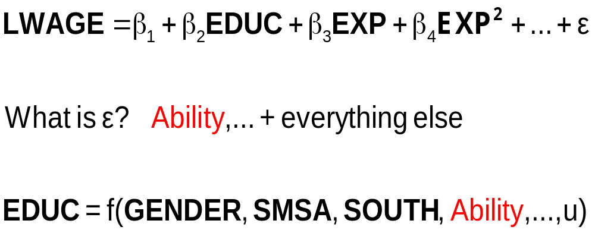
The Effect of Education on LWAGE

Slide 18
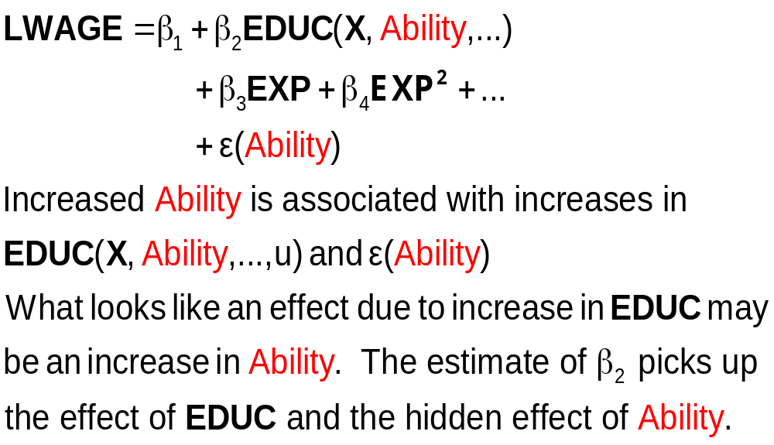
What Influences LWAGE?

Slide 19
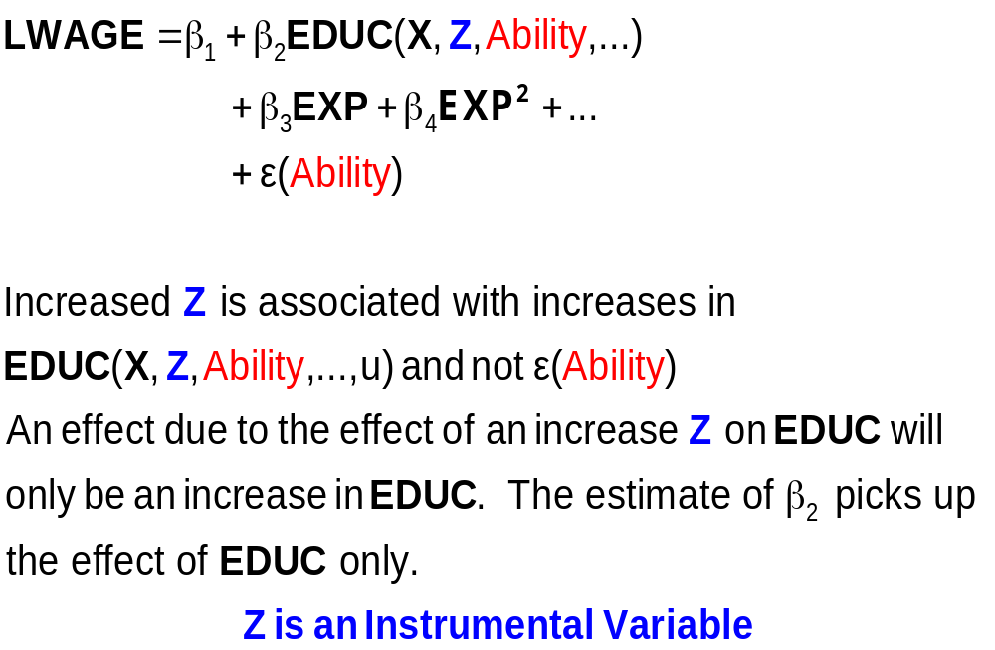
An Exogenous Influence

Slide 20
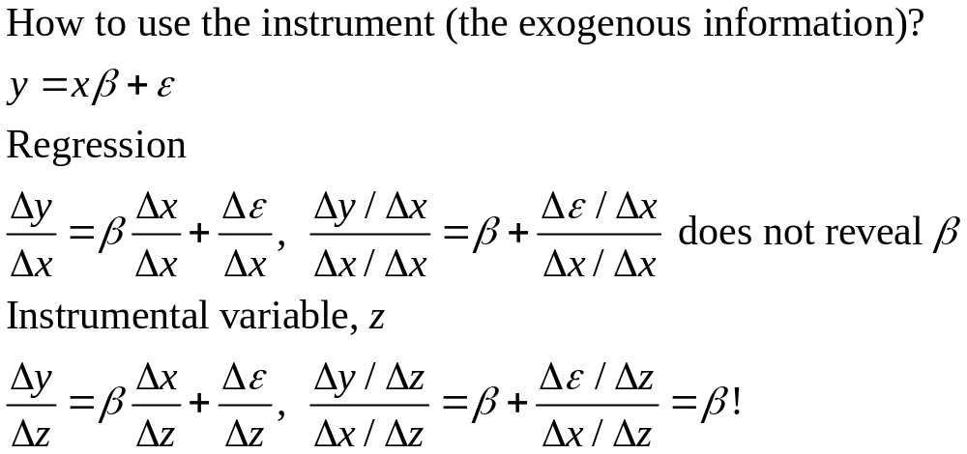
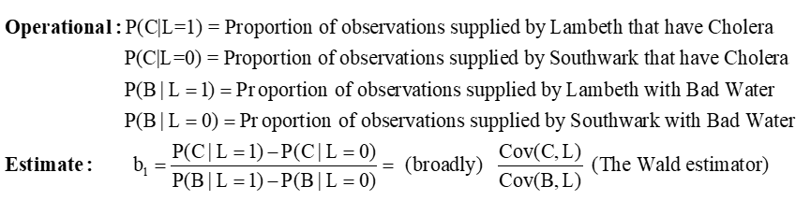
“y” is cholera prevalence (the outcome)
“x” is presence of bad water (the cause)
“z” is Lambeth is the water supplier (the instrument)

Slide 21
I have been asked this question (or ones like it) dozens of times. I think the issue is getting way overplayed. But, I'm not the majority voice, so you are going to have to deal with this.
Step 1: you or the referee need to figure out (make a case for) by what construction is "project termination" endogenous. What is correlated with what **in your hazard model** that makes the variable endogenous? There must be a second equation that implies that project termination is endogenous. What is it? What unobservable in that equation is correlated with what unobservable in the hazard model that makes it endogenous. Same questions for your hurdle model.
By what construction is SNAP endogenous in the HEALTH equation?
SNAP = Xβ_{SNAP} + Zδ + ε
HEALTH = Xβ_{HEALTH} + ηSNAP + v

Slide 22
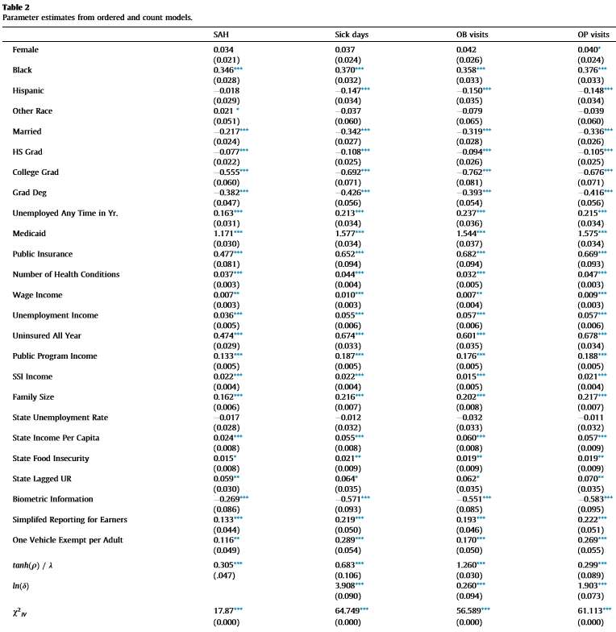
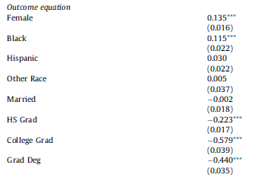
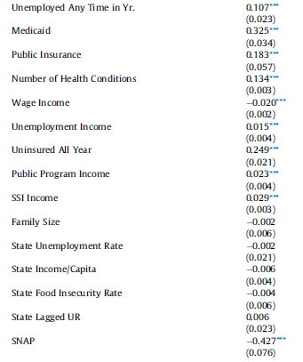
X
Z

Slide 23
Instrumental Variables
Structure
  LWAGE (ED,EXP,EXPSQ,WKS,OCC,
  SOUTH,SMSA,UNION)
  ED (MS, FEM)
  Reduced Form:
  LWAGE[ ED (MS, FEM),
  EXP,EXPSQ,WKS,OCC,
  SOUTH,SMSA,UNION ]

Slide 24
Two Stage Least Squares Strategy
  Reduced Form:
  LWAGE[ ED (MS, FEM,X),
  EXP,EXPSQ,WKS,OCC,
  SOUTH,SMSA,UNION ]
Strategy
  (1) Purge ED of the influence of everything but MS, FEM (and the other variables). Predict ED using all exogenous information in the sample (X and Z).
  (2) Regress LWAGE on this prediction of ED and everything else.
  Standard errors must be adjusted for the predicted ED

Slide 25
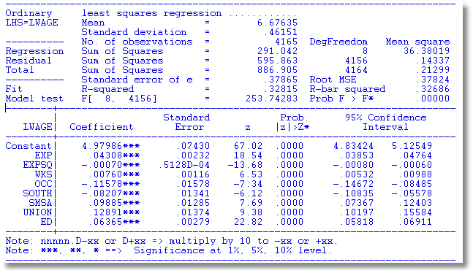
OLS

Slide 26
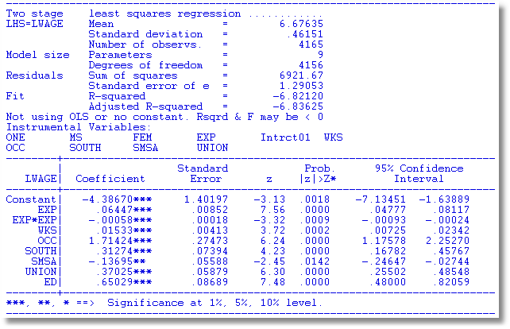
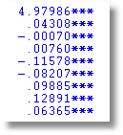
The weird results for the coefficient on ED happened because the instruments, MS and FEM are dummy variables. There is not enough variation in these variables.

Slide 27
The Ultimate Source of Endogeneity
  LWAGE = f(ED,
  EXP,EXPSQ,WKS,OCC,
  SOUTH,SMSA,UNION) + ε
  ED = f(MS,FEM,
  EXP,EXPSQ,WKS,OCC,
  SOUTH,SMSA,UNION) + u

Slide 28
Remove the Endogeneity
  LWAGE = f(ED,
  EXP,EXPSQ,WKS,OCC,
  SOUTH,SMSA,UNION) + u + ε
  Strategy
    Estimate u
    Add u to the equation. ED is uncorrelated with ε when u is in the equation.

Slide 29
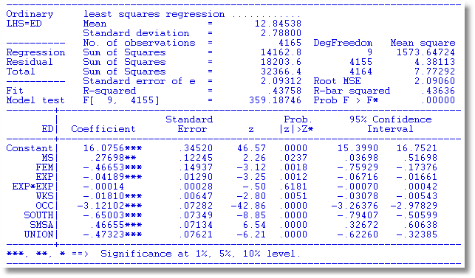
Auxiliary Regression for
ED to Obtain Residuals
IVs
Exog. Vars

Slide 30
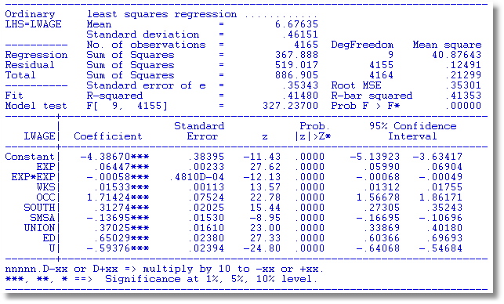
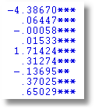
OLS with Residual (Control Function) Added
2SLS

Slide 31
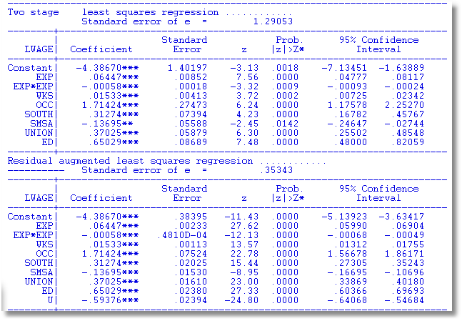

A Warning About Control Function Estimators:
The standard errors must be adjusted.

Slide 32
I am here to ask a little help for endogeneity. I have a main regression, in which the independent variabels are lagged 1 year (this is an unbalanced panel dataset); I use fixed effect, xtreg: Main Regression: Yt = Xt-1 + Qt-1 + Z3t-1 I suspect endogeneity: variable X may be itself determined by prior-year Y. As a solution, I read this strategy: regress the endogenous variable Xt-1 on the dependent variable (Yt-2) and other independent variables (i.e., Qt-2 and Zt-2); these Y Q and Z are all in year t-2, while X is in t-1. Then, from this regression, calculate the “predicted” values for X, and include them as a control-for-endogeneity (e.g., a variable named “Endogeneity-control”) in the main regression above. Question 1: in the Main Regression above, when including the control for endogeneity (i.e., the variable “Endogeneity-control”), do I have to lag its value? That is, do I have to include Endogeneity-control in t-1? or just the predicted values, without lagging?

Slide 33
The two stage LS strategy: (The two stage button in your software.) The software regresses EDUC on all independent variables plus the two instrumental variables (stage 1), then takes the predicted value on education and regresses lwage on that predicted value plus the original independent variables (stage 2). Is this correct?
Then the second method you showed is the same except the predicted residuals are included in the second stage OLS.
Is one method preferred over another? They produce the same results.

Slide 34
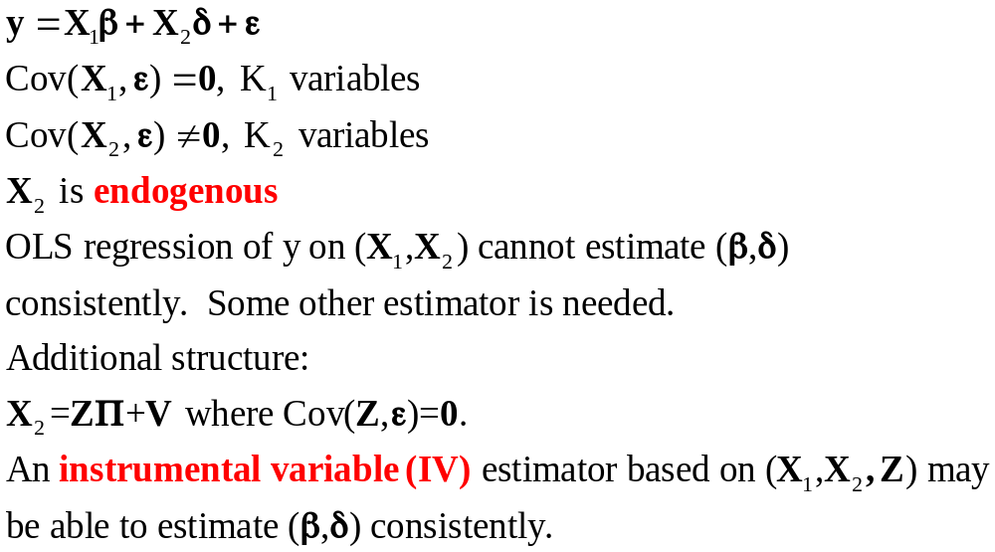
The General Problem

Slide 35
Instrumental Variables
Fully General Framework: y = Xβ + ε, K variables in X.
There exists a set of M=K variables, Z such that
plim(Z’X/n) ≠ 0 but plim(Z’ε/n) = 0
The variables in Z are called instrumental variables.
An alternative (to least squares) estimator of β is
b_{IV} = (Z’X)⁻¹Z’y
We consider the following:
  Why use this estimator?
  What are its properties compared to least squares?
We will also examine an important application

Slide 36
IV Estimators
Consistent
b_{IV} = (Z’X)⁻¹Z’y
= (Z’X/n)⁻¹ (Z’X/n)β+ (Z’X/n)⁻¹Z’ε/n
= β+ (Z’X/n)⁻¹Z’ε/n → β
Asymptotically normal (same approach to proof as for OLS)
Inefficient – to be shown.

Slide 37
The General Result
By construction, the IV estimator is consistent. So, we have an estimator that is consistent when least squares is not.

Slide 38
LS as an IV Estimator
The least squares estimator is
(X′X)⁻¹X′y = (X′X)⁻¹Σ_{i}x_{i}y_{i}
= β + (X′X)⁻¹Σ_{i}x_{i}ε_{i}
If plim(X’X/n) = Q nonzero
plim(X’ε/n) = 0
Under the usual assumptions LS is an IV estimator X is its own instrument.

Slide 39
IV Estimation
Why use an IV estimator? Suppose that X and ε are not uncorrelated. Then least squares is neither unbiased nor consistent.
Recall the proof of consistency of least squares:
b = β + (X’X/n)⁻¹(X’ε/n).
Plim b = β requires plim(X’ε/n) = 0. If this does not hold, the estimator is inconsistent.

Slide 40
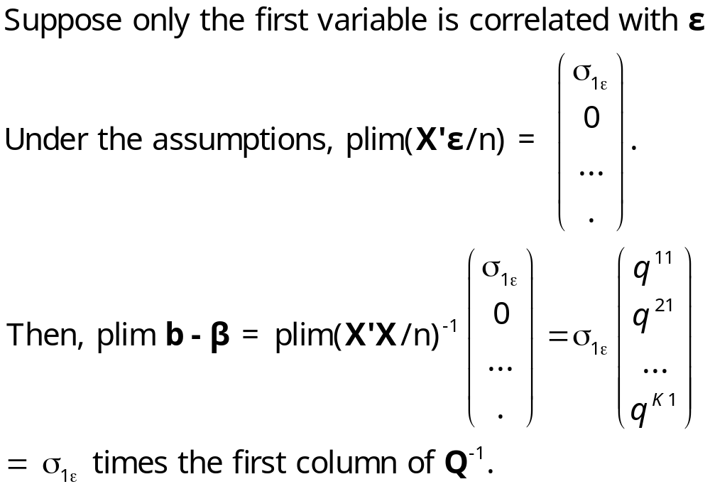
A Popular Misconception
A popular misconception. If only one variable in X is correlated with ε, the other coefficients are consistently estimated. False.
The problem is “smeared” over the other coefficients.

Slide 41
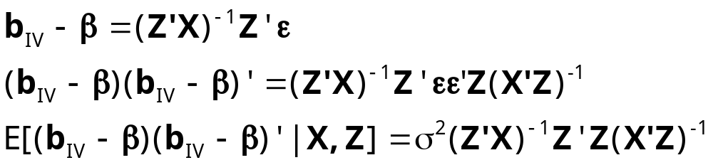
Asymptotic Covariance Matrix of b_{IV}

Slide 42
Asymptotic Efficiency
Asymptotic efficiency of the IV estimator. The variance is larger than that of LS. (A large sample type of Gauss-Markov result is at work.)
(1) It’s a moot point. LS is inconsistent.
(2) Mean squared error is uncertain:
MSE[estimator|β]=Variance + square of bias.
IV may be better or worse. Depends on the data

Slide 43
Two Stage Least Squares
How to use an “excess” of instrumental variables
(1) X is K variables. Some (at least one) of the K
variables in X are correlated with ε.
(2) Z is now M > K variables. Some of the variables in
Z are also in X, some are not. None of the
variables in Z are correlated with ε.
(3) Which K variables to use to compute Z’X and Z’y?

Slide 44
X
Z

Slide 45
Choosing the Instruments
Choose K randomly?
Choose the included Xs and the remainder randomly?
Use all of them? How?
A theorem: (Brundy and Jorgenson, ca. 1972) There is a most efficient way to construct the IV estimator from this subset:
  (1) For each column (variable) in X, compute the predictions of that variable using all the columns of Z.
  (2) Linearly regress y on these K predictions.
This is two stage least squares

Slide 46
Algebraic Equivalence
Two stage least squares is equivalent to
  (1) each variable in X that is also in Z is replaced by itself.
  (2) Variables in X that are not in Z are replaced by predictions of that X with all the variables in Z.
  Coefficients in augmented regression are added to
  match 2SLS. (They match if residuals are used
  instead of predictions.)

Slide 47

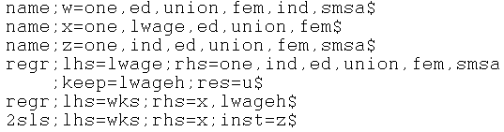
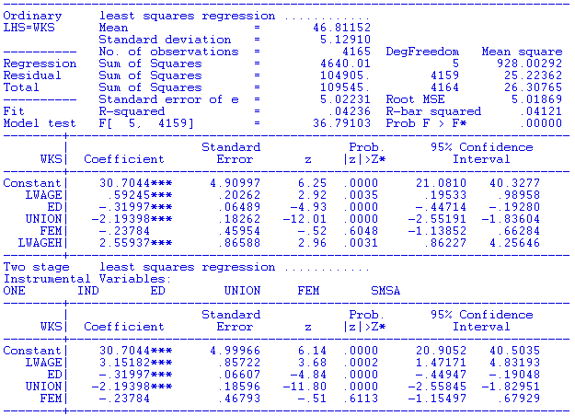
Sum=2sls

Slide 48
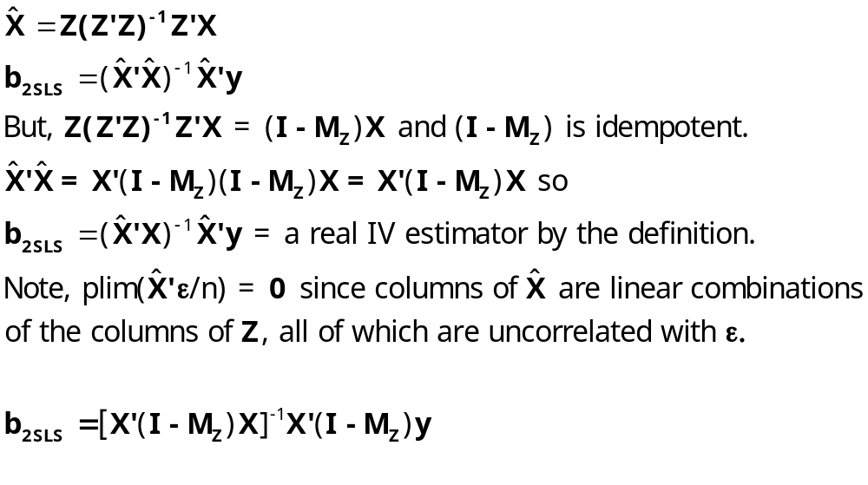
2SLS Algebra

Slide 49
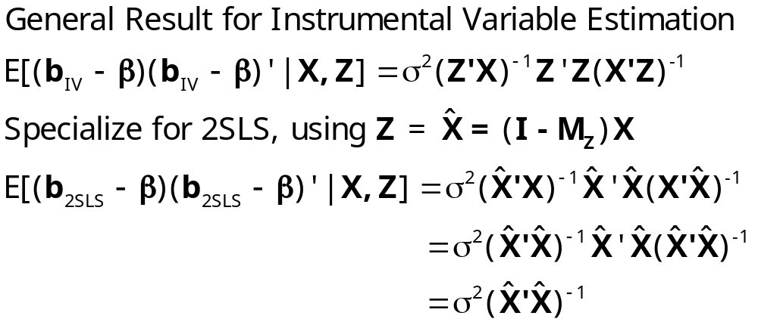
Asymptotic Covariance Matrix for 2SLS

Slide 50
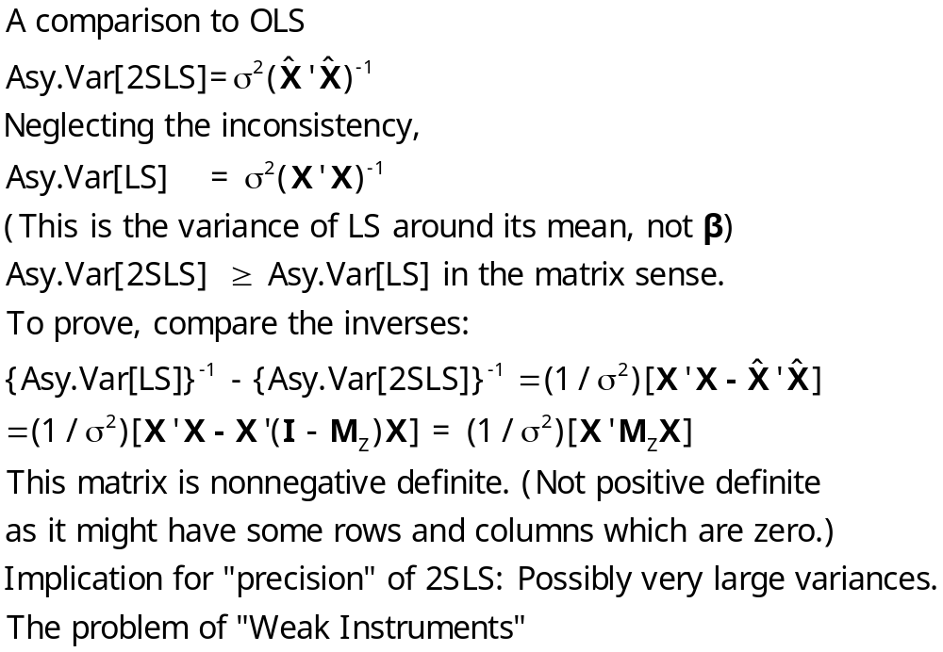
2SLS has larger variance (around its mean) than LS has around its mean.

Slide 51
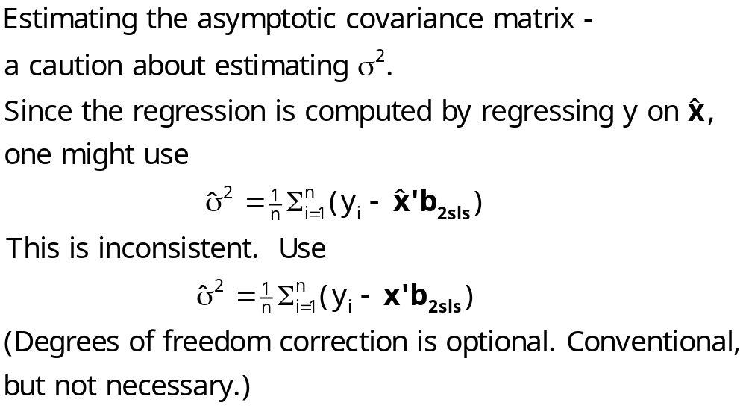
Estimating σ²

Slide 52

Two Problems with 2SLS
Z’X/n may not be sufficiently large. The covariance matrix for the IV estimator is Asy.Cov(b ) = σ²[(Z’X)(Z’Z)⁻¹(X’Z)]⁻¹
  If Z’X/n -> 0, the variance explodes.
  Additional problems:
    2SLS biased toward plim OLS
    Asymptotic results for inference fall apart.
When there are many instruments, is too close to x; 2SLS becomes OLS.

Slide 53
Weak Instruments
Symptom: The relevance condition, plim Z’X/n not zero, but is close to being violated.
Detection:
  Standard F test in the regression of x_{k} on Z. F < 10 suggests a problem. (Stock and Staiger)
  F statistic based on 2SLS – see text p. 274.
Remedy:
  Not much – most of the discussion is about the condition, not what to do about it.
  Use LIML? Requires a normality assumption. Probably not too restrictive.

Slide 54
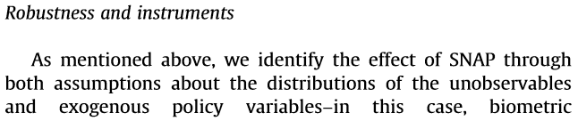
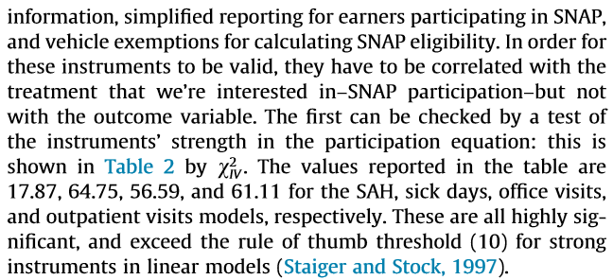

SNAP and Health

Slide 56
Cornwell and Rupert Data
Cornwell and Rupert Returns to Schooling Data, 595 Individuals, 7 Years
Variables in the file are
EXP = work experience
WKS = weeks worked
OCC = occupation, 1 if blue collar,
IND = 1 if manufacturing industry
SOUTH = 1 if resides in south
SMSA = 1 if resides in a city (SMSA)
MS = 1 if married
FEM = 1 if female
UNION = 1 if wage set by union contract
ED = years of education
LWAGE = log of wage = dependent variable in regressions
These data were analyzed in Cornwell, C. and Rupert, P., "Efficient Estimation with Panel Data: An Empirical Comparison of Instrumental Variable Estimators," Journal of Applied Econometrics, 3, 1988, pp. 149-155. See Baltagi, page 122 for further analysis. The data were downloaded from the website for Baltagi's text.
Notes:
56

Slide 57
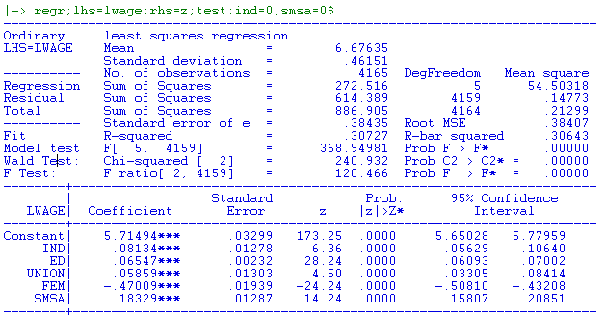
Endogenous Exogenous Instruments

Slide 58
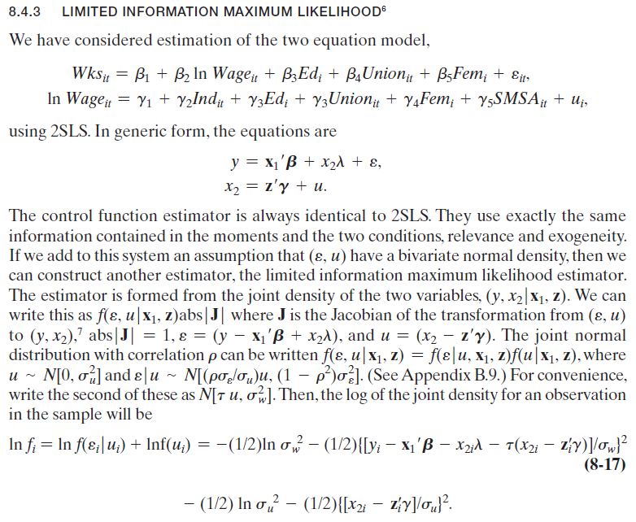
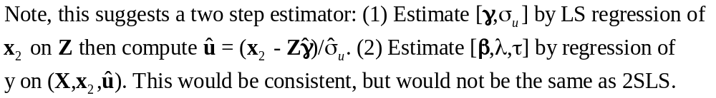
Two stage residual inclusion.

Slide 59
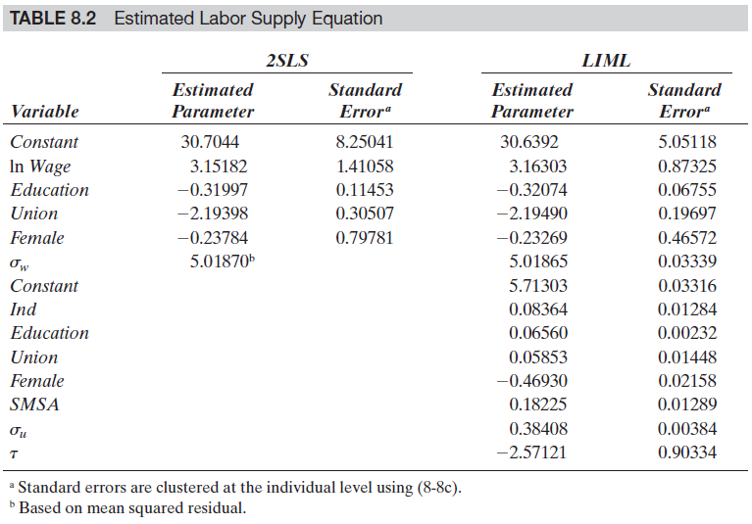
LIML appears to be much more efficient. That is the benefit of the additional normality assumption.

Slide 60
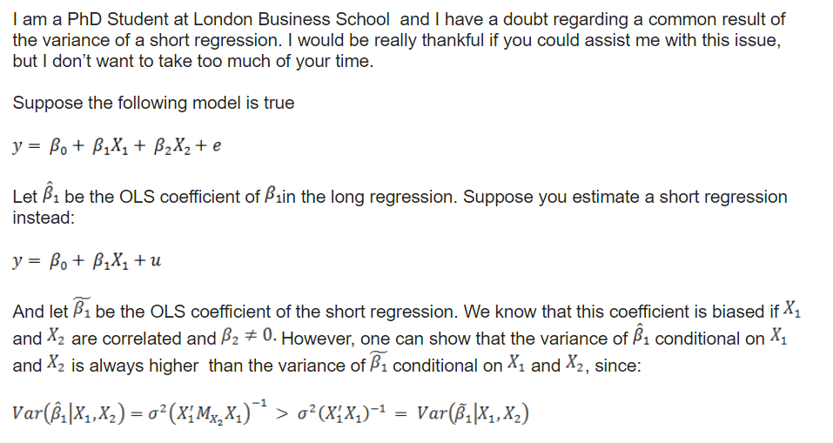

Slide 61
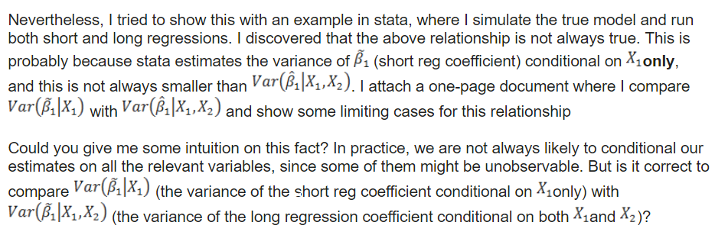

Slide 62
Weak Instruments
Symptom: The relevance condition, plim Z’X/n not zero, but is close to being violated.
Detection:
  Standard F test in the regression of x_{k} on Z. F < 10 suggests a problem. (Stock and Staiger)
  F statistic based on 2SLS – see text p. 274.
Remedy:
  Not much – most of the discussion is about the condition, not what to do about it.
  Use LIML? Requires a normality assumption. Probably not too restrictive.

Slide 63
SNAP and Health

Slide 65
Endogeneity Test? (Hausman)
Exogenous Endogenous
OLS Consistent, Efficient Inconsistent
2SLS Consistent, Inefficient Consistent
Base a test on d = b_{2SLS} - b_{OLS}
Use a Wald statistic, d’[Var(d)]⁻¹d
What to use for the variance matrix?
Hausman: V_{2SLS} - V_{OLS}

Slide 66
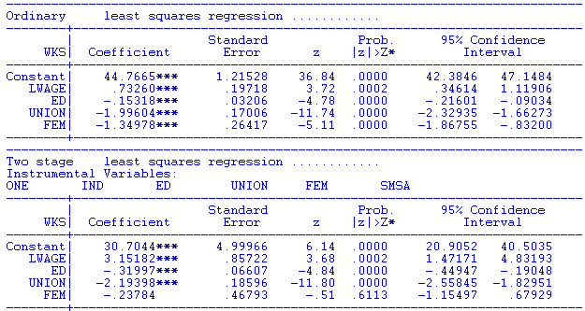

Slide 67
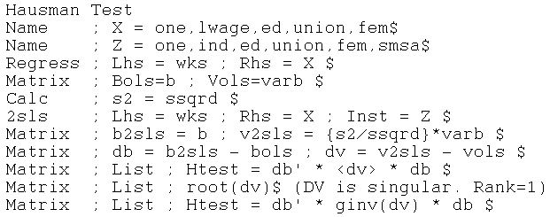
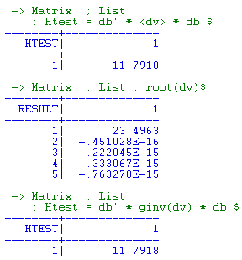
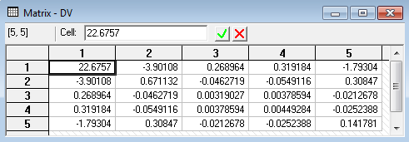
The matrix is not positive definite. It has a negative characteristic root. The matrix is indefinite. (Software such as Stata and NLOGIT find this problem and either use a generalized inverse or refuse to proceed.)
(Rank is not obvious by inspection.)
> 3.84

Slide 68
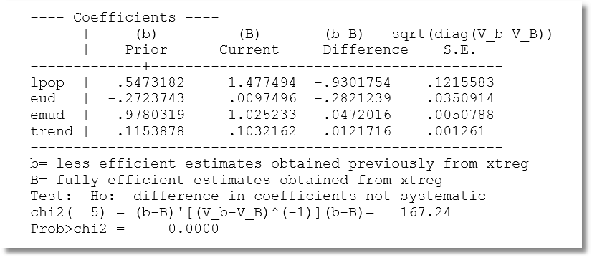
Hausman Test: One coefficient at a Time?
No, use the full vector.

Slide 69
Endogeneity Test: Wu
Considerable complication in Hausman test (text, pp. 275-276)
Simplification: Wu test.
Regress y on X and X^ estimated for the endogenous part of X. Then use an ordinary Wald test.

Slide 70
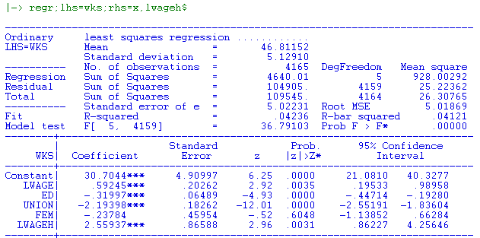
Wu Test

