Slide 1

Econometrics I
Professor William Greene
Stern School of Business
Department of Economics

Slide 2
Econometrics I
Part 13 – Endogeneity:
Applications

Slide 3
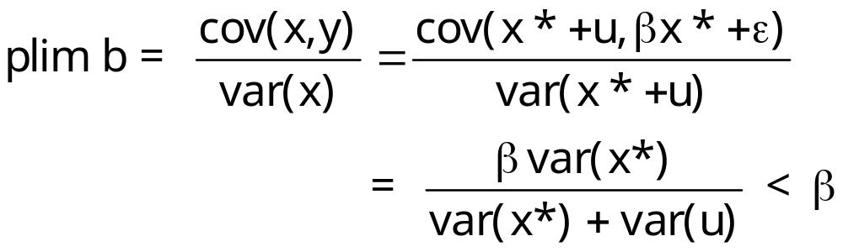
Measurement Error
y = βx* + ε all of the usual assumptions
x = x* + u the true x* is not observed (education vs. years of school)
What happens when y is regressed on x? Least squares attenutation:

Slide 4
Why Is Least Squares Attenuated?
y = βx* + ε
x = x* + u
y = βx + (ε - βu)
y = βx + v, cov(x,v) = - β var(u)
Some of the variation in x is not associated with variation in y. The effect of variation in x on y is dampened by the measurement error.

Slide 5
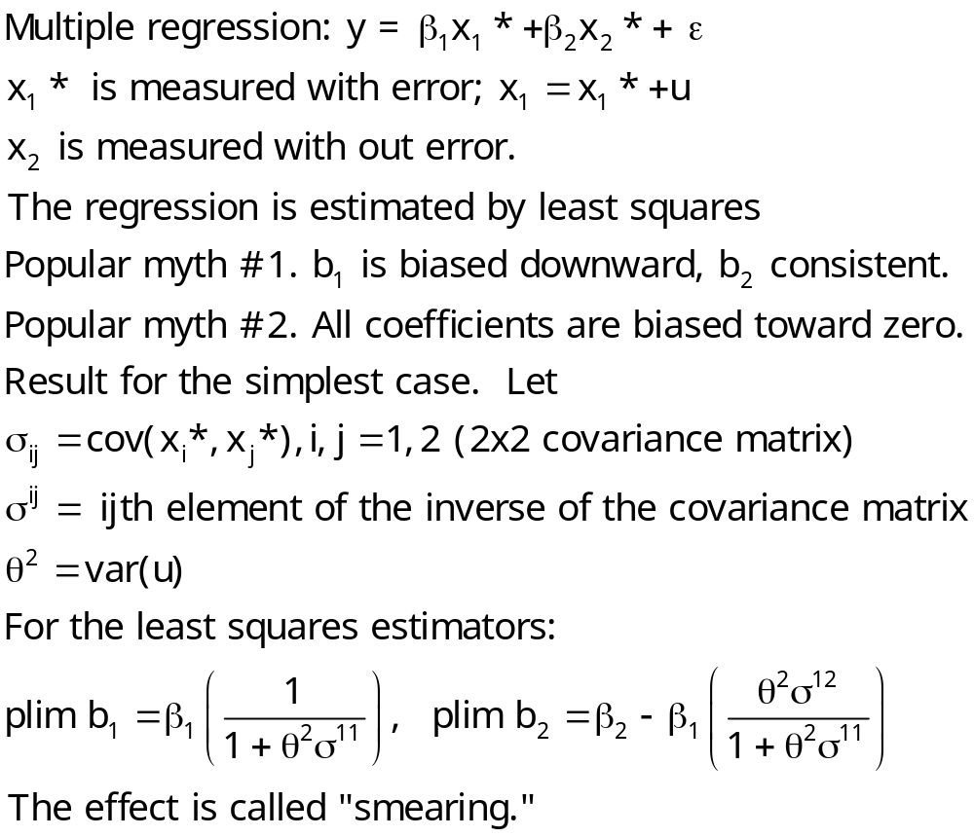
Measurement Error in Multiple Regression

Slide 6
Twins
Application from the literature: Ashenfelter/Krueger: A wage equation for twins that includes “schooling.”
y = earnings
x = education
z = education as reported by sibling

Slide 7
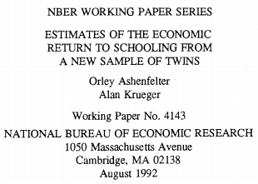
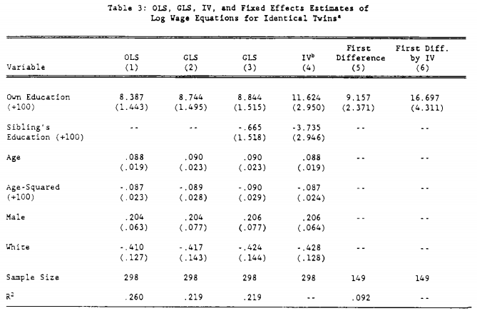

Slide 8
Orthodoxy
A proxy is not an instrumental variable
Instrument is a noun, not a verb
Are you sure that the instrument is really exogenous? The “natural experiment.”

Slide 9
Autism: Natural Experiment
Autism ←-----→ Television watching
Which way does the causation go?
We need an instrument: Rainfall
  Rainfall effects staying indoors which influences TV watching
  Rainfall is definitely absolutely truly exogenous, so it is a perfect instrument.
The correlation survives, so TV “causes” autism.

Slide 10
Treatment Effect
Earnings and Education: Effect of an additional year of schooling
Estimating Average and Local Average Treatment Effects of Education when Compulsory Schooling Laws Really Matter
  Philip Oreopoulos
  AER, 96,1, 2006, 152-175
  Also American Economic Journal, September, 2017

Slide 11
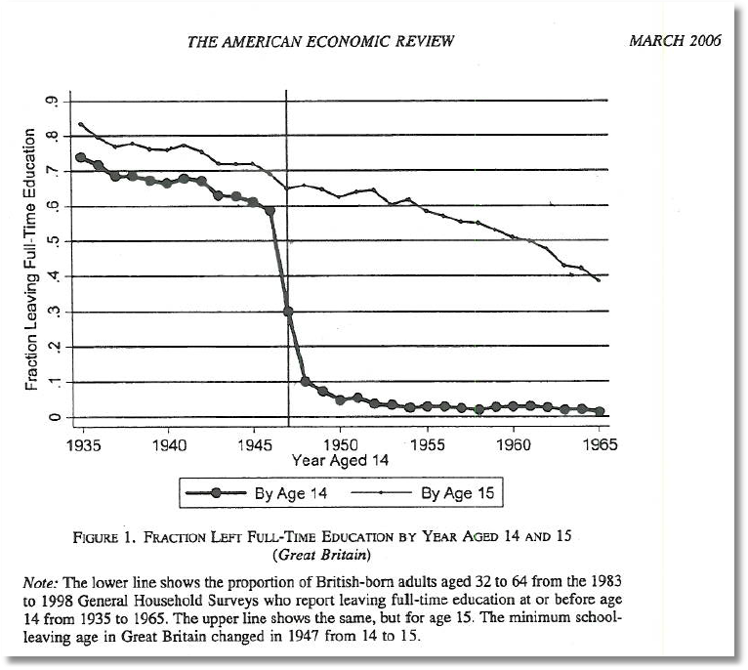
Treatment Effects and Natural Experiments

Slide 12
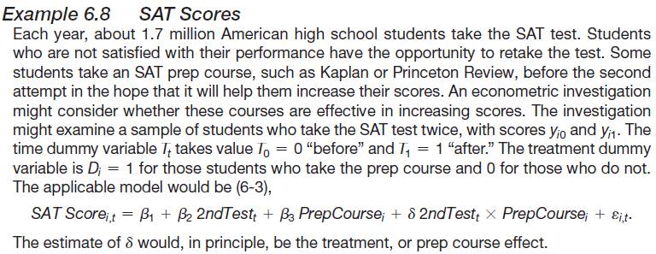
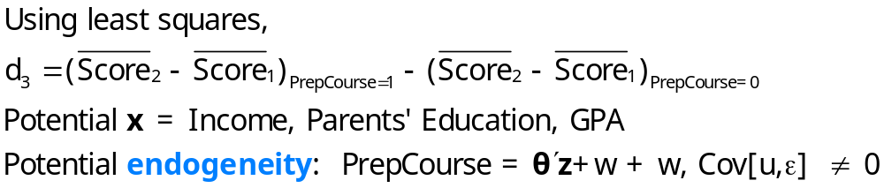
Endogenous Treatment in SAT Tests

Slide 13
A study of moral hazard
Riphahn, Wambach, Million: “Incentive Effects in the Demand for Healthcare”
Journal of Applied Econometrics, 2003
Did the presence of the ADDON insurance influence the demand for health care – doctor visits and hospital visits?
For a simple example, we examine the PUBLIC insurance (89%) instead of ADDON insurance (2%).
Some Conventional Approaches

Slide 14
Application: Health Care Panel Data
German Health Care Usage Data, 7,293 Individuals, Varying Numbers of Periods
Variables in the file are
Data downloaded from Journal of Applied Econometrics Archive. This is an unbalanced panel with 7,293 individuals. They can be used for regression, count models, binary choice, ordered choice, and bivariate binary choice. This is a large data set. There are altogether 27,326 observations. The number of observations ranges from 1 to 7. (Frequencies are: 1=1525, 2=2158, 3=825, 4=926, 5=1051, 6=1000, 7=987). Note, the variable NUMOBS below tells how many observations there are for each person. This variable is repeated in each row of the data for the person. (Downloaded from the JAE Archive)
DOCTOR = 1(Number of doctor visits > 0)
HOSPITAL = 1(Number of hospital visits > 0)
HSAT = health satisfaction, coded 0 (low) - 10 (high)
DOCVIS = number of doctor visits in last three months
HOSPVIS = number of hospital visits in last calendar year
PUBLIC = insured in public health insurance = 1; otherwise = 0
ADDON = insured by add-on insurance = 1; otherswise = 0
HHNINC = household nominal monthly net income in German marks / 10000.
(4 observations with income=0 were dropped)
HHKIDS = children under age 16 in the household = 1; otherwise = 0
EDUC = years of schooling
AGE = age in years
MARRIED = marital status
EDUC = years of education
Notes:
14

Slide 15
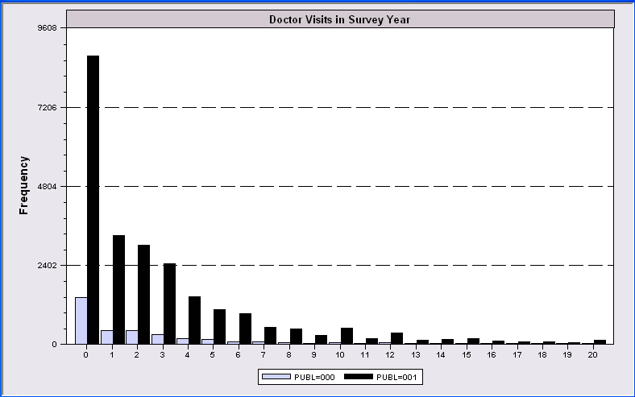
Evidence of Moral Hazard?

Slide 16
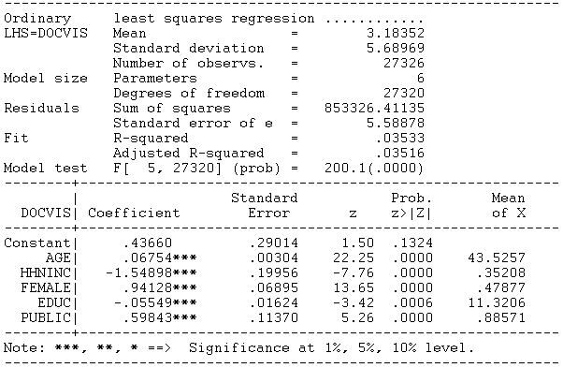
Regression Study

Slide 17
Endogenous Dummy Variable
Doctor Visits = f(Age, Educ, Health,
Presence of Insurance,
Other unobservables)
Insurance = f(Expected Doctor Visits,
Other unobservables)

Slide 18
Approaches
(Semiparametric) Instrumental Variable: Create an instrumental variable for the dummy variable (Barnow/Cain/ Goldberger, Angrist, Current generation of researchers)
(Parametric) Control Function: Build a structural model for the two variables (Heckman)
(?) Propensity Score Matching (Heckman et al., Becker/Ichino, Many recent researchers)

Slide 19
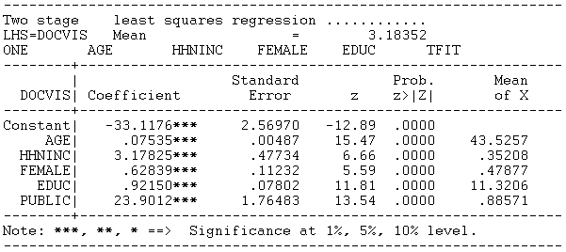
Instrumental Variable Approach
Construct a prediction for T using only the exogenous information
Use 2SLS using this instrumental variable.
Magnitude = 23.9012 is nonsensical in this context.

Slide 20
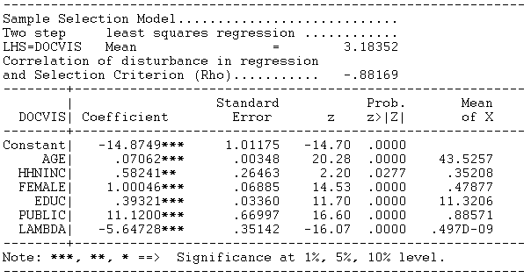
Heckman’s Control Function Approach
Y = xβ + δT + E[ε|T] + {ε - E[ε|T]}
λ = E[ε|T] , computed from a model for whether T = 0 or 1
Magnitude = 11.1200 is nonsensical in this context.

Slide 21
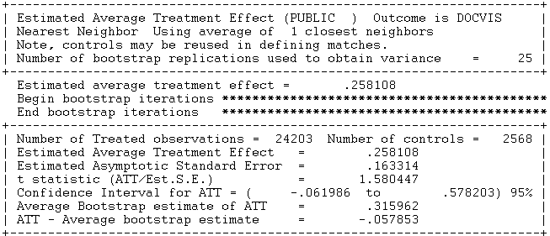
Propensity Score Matching
Create a model for T that produces probabilities for T=1: “Propensity Scores”
Find people with the same propensity score – some with T=1, some with T=0
Compare number of doctor visits of those with T=1 to those with T=0.

Slide 22
Application of a Two Period Model
“Hemoglobin and Quality of Life in Cancer Patients with Anemia,”
Finkelstein (MIT), Berndt (MIT), Greene (NYU), Cremieux (Univ. of Quebec)
1998
With Ortho Biotech – seeking to change labeling of already approved drug ‘erythropoetin.’
r-HuEPO

Slide 23


Slide 24
QOL Study
Quality of life study
  i = 1,… 1200+ clinically anemic cancer patients undergoing chemotherapy, treated with transfusions and/or r-HuEPO
  t = 0 at baseline, 1 at exit. (interperiod survey by some patients was not used)
y_{it} = self administered quality of life survey, scale = 0,…,100
x_{it} = hemoglobin level, other covariates
  Treatment effects model (hemoglobin level)
  Possibly Endogenous treatment – r-HuEPO treatment to affect Hg level: Actually not; treatment was not optional and all participated.
Important statistical issues
  Unobservable individual effects
  The placebo effect
  Attrition – sample selection
  FDA mistrust of “community based” – not clinical trial based statistical evidence
Objective – when to administer treatment for maximum marginal benefit

Slide 25
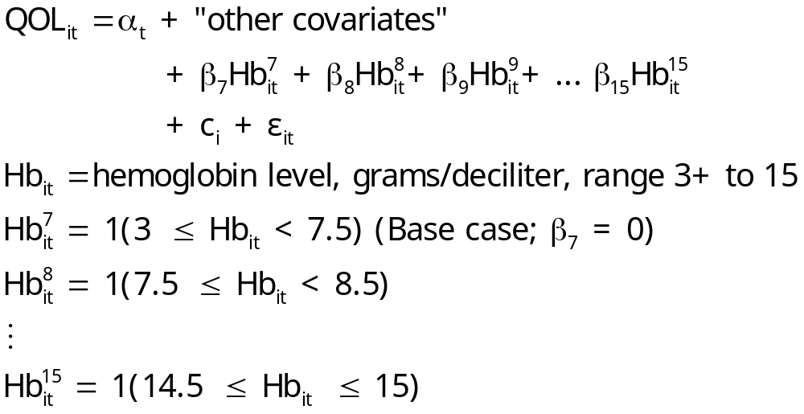
Regression-Treatment Effects Model

Slide 26
Effects and Covariates
Individual effects that would impact a self reported QOL: Depression, comorbidity factors (smoking), recent financial setback, recent loss of spouse, etc.
Covariates
  Change in tumor status
  Measured progressivity of disease
  Change in number of transfusions
  Presence of pain and nausea
  Change in number of chemotherapy cycles
  Change in radiotherapy types
  Elapsed days since chemotherapy treatment
  Amount of time between baseline and exit

Slide 27
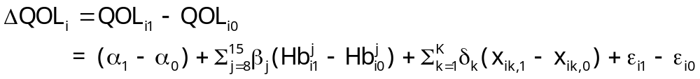
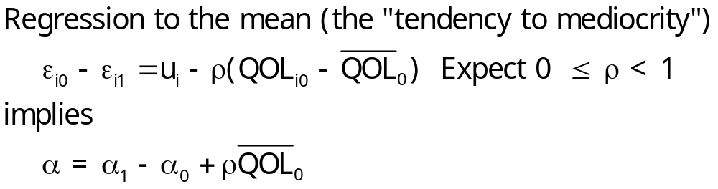
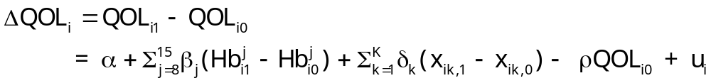
First Differences Model
Change in r-HuEPO definitely changes Hb
Does change in Hb change QOL?

Slide 28
Dealing with Attrition
The attrition issue: Appearance for the second interview was low for people with initial low QOL (death or depression) or with initial high QOL (don’t need the treatment). Thus, missing data at exit were clearly related to values of the dependent variable.
Solutions to the attrition problem
  Heckman selection model (used in the study)
    Prob[Present at exit|covariates] = Φ(z’θ) (Probit model)
    Additional variable added to difference model λ_{i} = Φ(z_{i}’θ)/Φ(z_{i}’θ)
  The FDA solution: fill with zeros. (!)

Slide 29
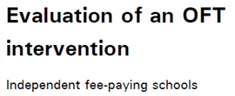

UK Office of Fair Trading, May 2012; Stephen Davies
http://dera.ioe.ac.uk/14610/1/oft1416.pdf

Slide 30


Outcome is the fees charged.
Activity is collusion on fees.

Slide 31
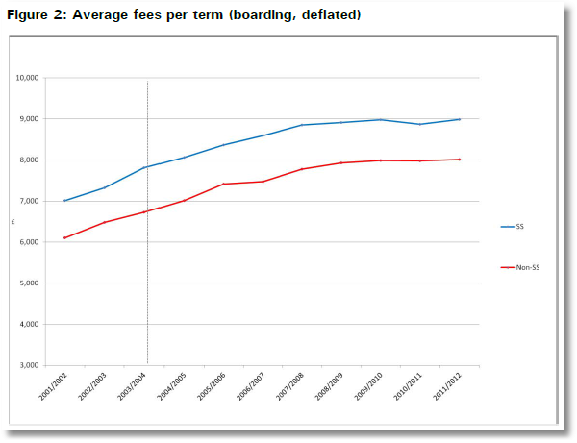
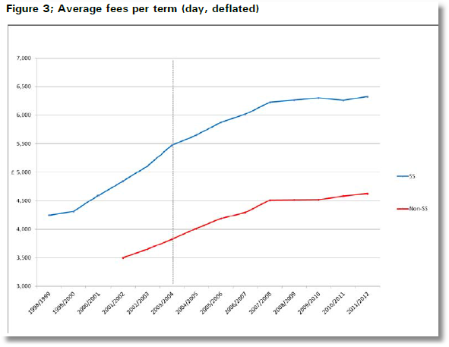
Treatment Schools: Treatment is an intervention by the Office of Fair Trading
Control Schools were not involved in the conspiracy
Treatment is not voluntary

Slide 32
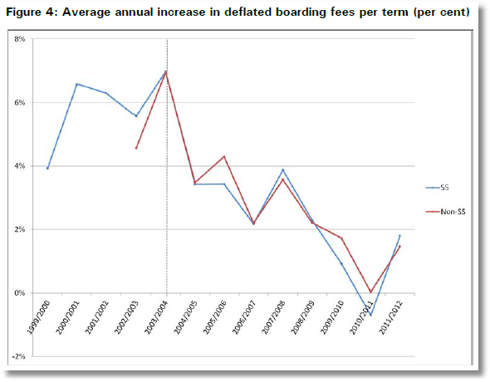
Apparent Impact of the Intervention

Slide 33
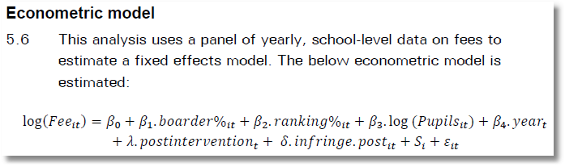

Slide 34

Treatment (Intervention) Effect = β₁ +
β₂ if SS school

Slide 35
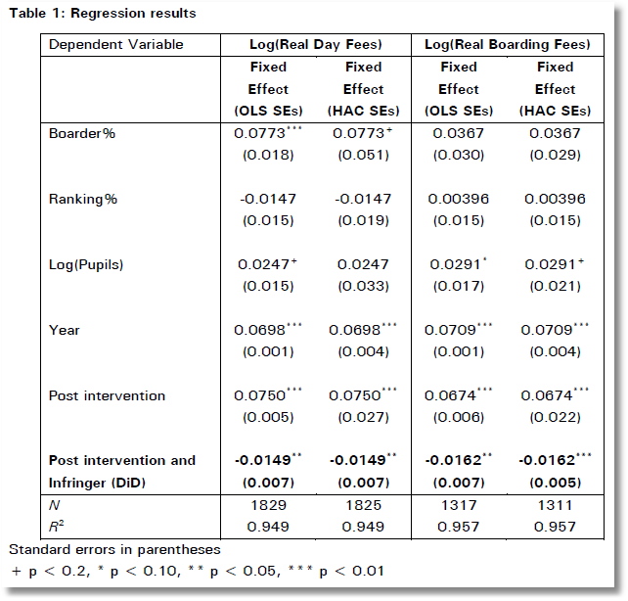
In order to test robustness two versions of the fixed effects model were run. The first is Ordinary Least Squares, and the second is heteroscedasticity and auto-correlation robust (HAC) standard errors in order to check for heteroscedasticity and autocorrelation.

Slide 36


Slide 37
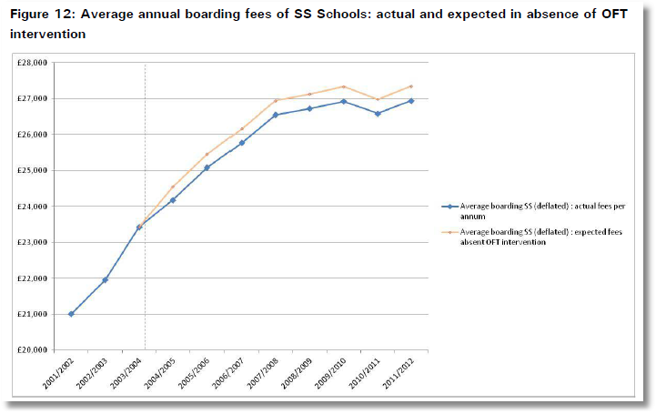
The cumulative impact of the intervention is the area between the two paths from intervention to time T.

Slide 38
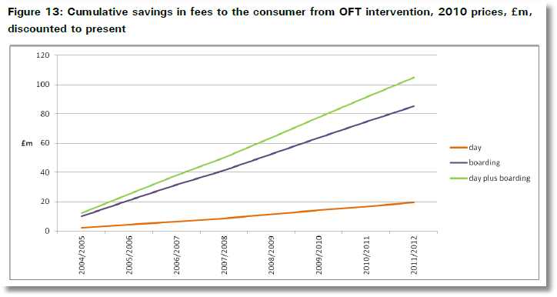

Slide 39
Endogenous Treatment in SAT Tests

Slide 40
Treatment Effect
Earnings and Education: Effect of an additional year of schooling
Estimating Average and Local Average Treatment Effects of Education when Compulsory Schooling Laws Really Matter
  Philip Oreopoulos
  AER, 96,1, 2006, 152-175

Slide 41
Treatment Effects and Natural Experiments

Slide 42
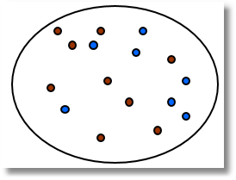
The First IV Study Was a Natural Experiment
(Snow, J., On the Mode of Communication of Cholera, 1855) http://www.ph.ucla.edu/epi/snow/snowbook3.html
London Cholera epidemic, ca 1853-4
Cholera = f(Water Purity,u) + ε.
  ‘Causal’ effect of water purity on cholera?
  Purity=f(cholera prone environment (poor, garbage in streets, rodents, etc.). Regression does not work.
  Two London water companies
Lambeth Southwark & Vauxhall
^{Main sewage discharge}
River Thames
Paul Grootendorst: A Review of Instrumental Variables Estimation of Treatment Effects…
http://individual.utoronto.ca/grootendorst/pdf/IV_Paper_Sept6_2007.pdf
A review of instrumental variables estimation in the applied health sciences. Health Services and Outcomes Research Methodology 2007; 7(3-4):159-179.

Slide 43
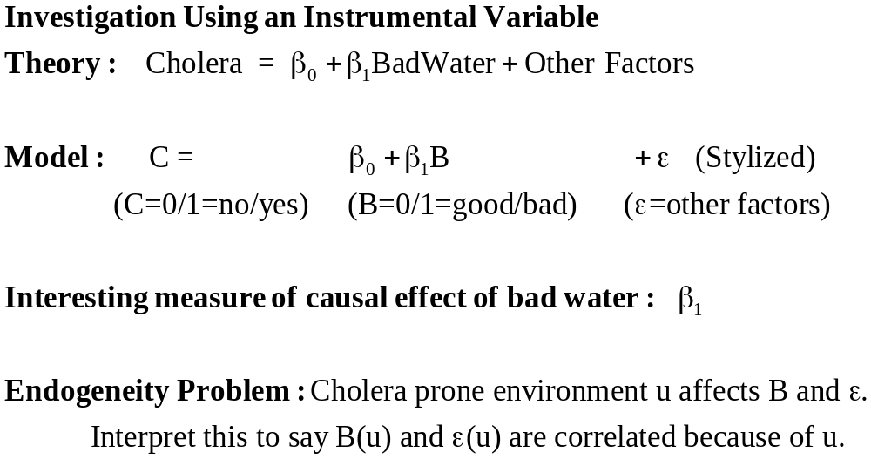

Slide 44
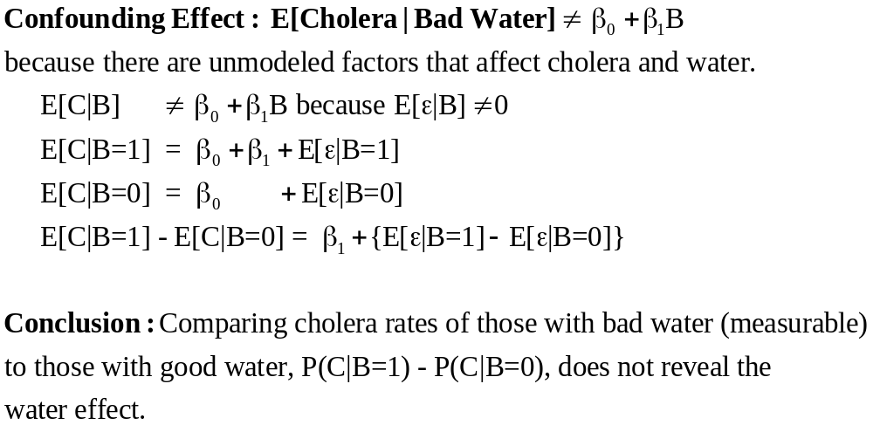

Slide 45
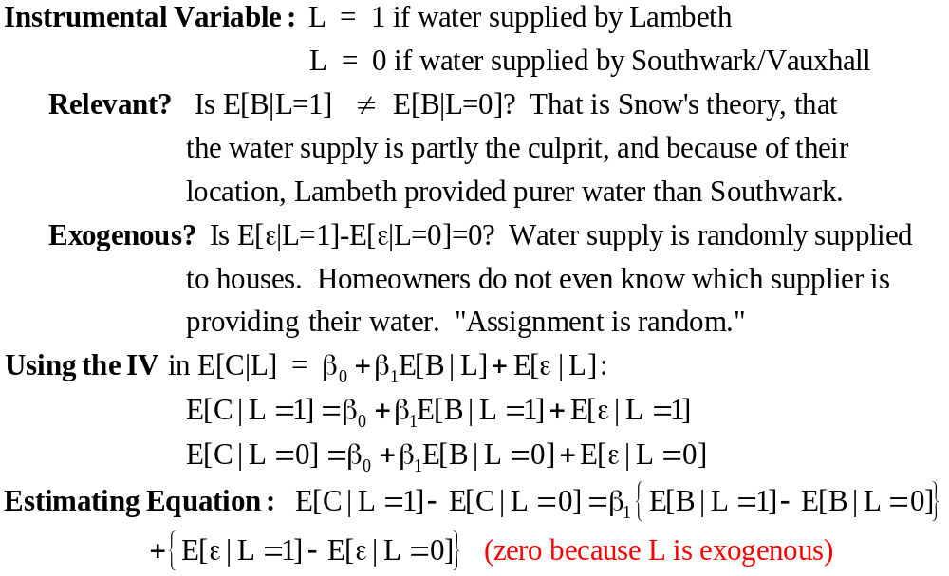

Slide 46
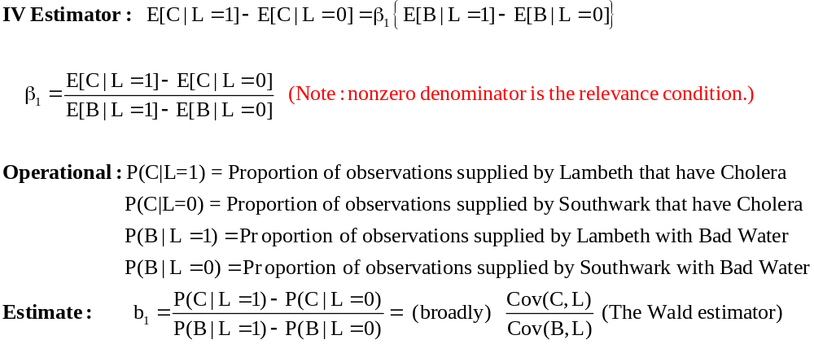

Slide 47
A Tale of Two Cities
A sharp change in policy can constitute a natural experiment
The Mariel boatlift from Cuba to Miami (May-September, 1980) increased the Miami labor force by 7%. Did it reduce wages or employment of non-immigrants?
Compare Miami to Los Angeles, a comparable (assumed) city.
Card, David, “The Impact of the Mariel Boatlift on the Miami Labor Market,” Industrial and Labor Relations Review, 43, 1990, pp. 245-257.

Slide 48
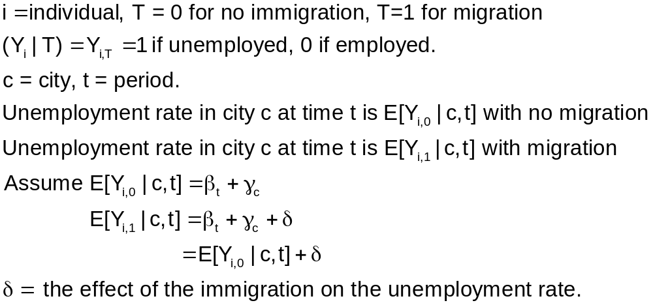
Difference in Differences

Slide 49
Applying the Model
c = M for Miami, L for Los Angeles
Immigration occurs in Miami, not Los Angeles
T = 1979, 1981 (pre- and post-)
Sample moment equations: E[Y_{i}|c,t,T]
  E[Y_{i}|M,79] = β₇₉ + γ_{M}
  E[Y_{i}|M,81] = β₈₁ + γ_{M} + δ
  E[Y_{i}|L,79] = β₇₉ + γ_{L}
  E[Y_{i}|M,79] = β₈₁ + γ_{L}
It is assumed that unemployment growth in the two cities would be the same if there were no immigration.

Slide 50
Implications for Differences
If neither city exposed to migration
  E[Y_{i,0}|M,81] - E[Y_{i,0}|M,79] = β₈₁ – β₇₉ (Miami)
  E[Y_{i,0}|L,81] - E[Y_{i,0}|L,79] = β₈₁ – β₇₉ (LA)
If both cities exposed to migration
  E[Y_{i,1}|M,81] - E[Y_{i,1}|M,79] = β₈₁ – β₇₉ + δ (Miami)
  E[Y_{i,1}|L,81] - E[Y_{i,1}|L,79] = β₈₁ – β₇₉ + δ (LA)
One city (Miami) exposed to migration: The difference in differences is.
  {E[Y_{i,1}|M,81] - E[Y_{i,1}|M,79]} – {E[Y_{i,0}|L,81] - E[Y_{i,0}|L,79]}
  = δ (Miami)

Slide 51
Autism: Natural Experiment
Autism ←-----→ Television watching
Which way does the causation go?
We need an instrument: Rainfall
  Rainfall effects staying indoors which influences TV watching
  Rainfall is definitely absolutely truly exogenous, so it is a perfect instrument.
The correlation survives, so TV “causes” autism.

