Slide 1

Econometrics I
Professor William Greene
Stern School of Business
Department of Economics

Slide 2
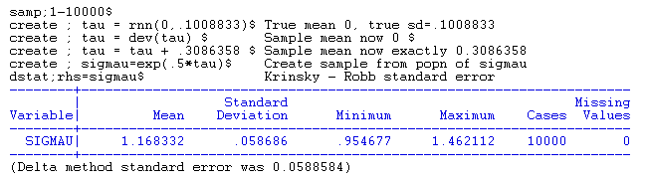
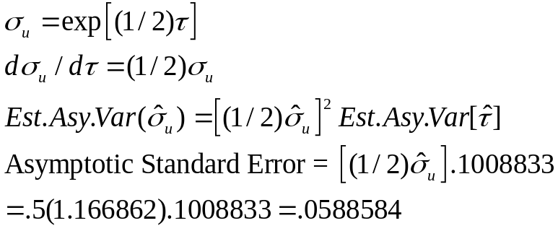
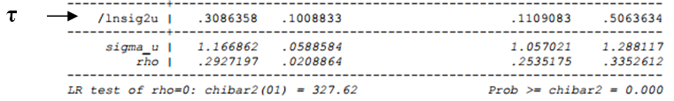
Krinsky and Robb standard error for a nonlinear function

Slide 3
Econometrics I
Part 14 – Generalized
Regression

Slide 4
Generalized Regression Model
Setting: The classical linear model assumes that E[εε′] = Var[ε] = σ²I. That is, observations are uncorrelated and all are drawn from a distribution with the same variance. The generalized regression (GR) model allows the variances to differ across observations and allows correlation across observations.

Slide 5
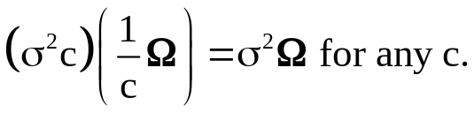
Generalized Regression Model
The generalized regression model:
y = Xβ + ε,
E[ε|X] = 0, Var[ε|X] = σ²Ω.
Regressors are well behaved.
Trace Ω = n.
This is a ‘normalization.’
Mimics tr(σ² I) = nσ². Needed since
Leading Cases
  Simple heteroscedasticity
  Autocorrelation
  Panel data and heterogeneity more generally.
  SUR Models for Production and Cost
  VAR models in Macroeconomics and Finance

Slide 6
Implications of GR Assumptions
The assumption that Var[ε] = σ²I is used to derive the result Var[b] = σ²(X′X)⁻¹. If it is not true, then the use of s²(X′X)⁻¹ to estimate Var[b] is inappropriate.
The assumption was also used to derive the t and F test statistics, so they must be revised as well.
Least squares gives each observation a weight of 1/n. But, if the variances are not equal, then some observations are more informative than others.
Least squares is based on simple sums, so the information that one observation might provide about another is never used.

Slide 7
Implications for Least Squares
Still unbiased. (Proof did not rely on Ω)
For consistency, we need the true variance of b,
Var[b|X] = E[(b-β)(b-β)’|X]
= (X’X)⁻¹ E[X’εε’X] (X’X)⁻¹
= σ² (X’X)⁻¹ X′ΩX (X’X)⁻¹ .
(Sandwich form of the covariance matrix.)
Divide all 4 terms by n. If the middle one converges to a finite matrix of constants, we have mean square consistency, so we need to examine
(1/n)X′ΩX = (1/n)Σ_{i}Σ_{j} ω_{ij} x_{i} x_{j}′.
This will be another assumption of the model.
Asymptotic normality? Easy for heteroscedasticity case, very difficult for autocorrelation case.

Slide 8
Robust Covariance Matrix
Robust estimation: Generality
How to estimate
Var[b|X] = (X’X)⁻¹ X′(σ² Ω)X(X’X)⁻¹ for the LS b?
The distinction between estimating
σ²Ω an n×n matrix
and estimating the K×K matrix
σ² X′ΩX = σ² Σ_{i}Σ_{j}ω_{ij} x_{i} x_{j}′
NOTE…… VVVIRs for modern applied econometrics.
  The White estimator
  Newey-West estimator.

Slide 9
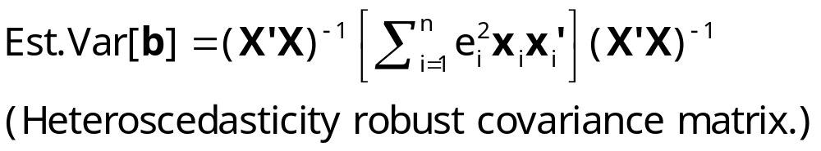
The White Estimator
Meaning of “robust” in this context
Robust standard errors; (b is not “robust”)
  Robust to: Heteroscedasticty
  Not robust to: (all considered later)
    Correlation across observations
    Individual unobserved heterogeneity
    Incorrect model specification
Robust inference means hypothesis tests and confidence intervals using robust covariance matrices

Slide 10
Inference Based on OLS
What about s²(X′X)⁻¹ ? Depends on X′ΩX - X′X. If they are nearly the same, the OLS covariance matrix is OK. When will they be nearly the same? Relates to an interesting property of weighted averages. Suppose ω_{i} is randomly drawn from a distribution with E[ω_{i}] = 1.
Then, (1/n)Σ_{i}x_{i}² → E[x²] and (1/n)Σ_{i}ω_{i}x_{i}² → E[x²].
This is the crux of the discussion in your text.

Slide 11
Inference Based on OLS
VIR: For the heteroscedasticity to be substantive wrt estimation and inference by LS, the weights must be correlated with x and/or x². (Text, page 305.)
If the heteroscedasticity is substantive. Then, b is inefficient.
The White estimator. ROBUST estimation of the variance of b.
Implication for testing hypotheses. We will use Wald tests.
(ROBUST TEST STATISTICS)

Slide 12
Finding Heteroscedasticity
The central issue is whether E[ε²] = σ²ω_{i} is related to the xs or their squares in the model.
Suggests an obvious strategy. Use residuals to estimate disturbances and look for relationships between e_{i}² and x_{i} and/or x_{i}². For example, regressions of squared residuals on xs and their squares.

Slide 13
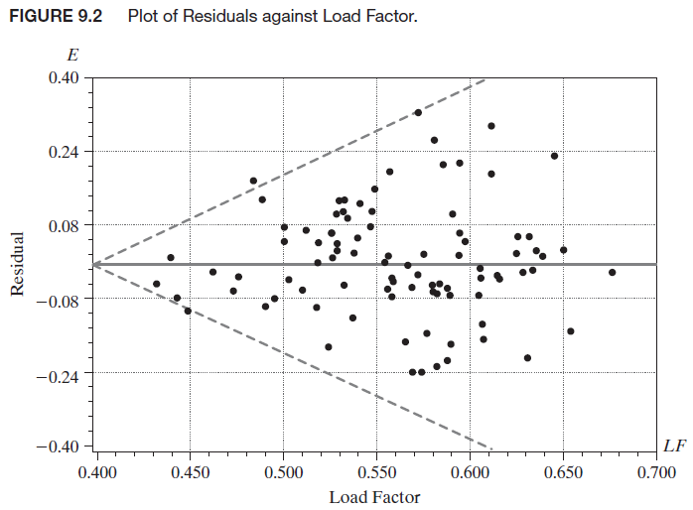
Procedures
White’s general test: nR² in the regression of e_{i}² on all unique xs, squares, and cross products. Chi-squared[P]
Breusch and Pagan’s Lagrange multiplier test. Regress
{[e_{i}² /(e′e/n)] – 1} on Z (may be X).
Chi-squared. Is nR² with degrees of freedom rank of Z.

Slide 14
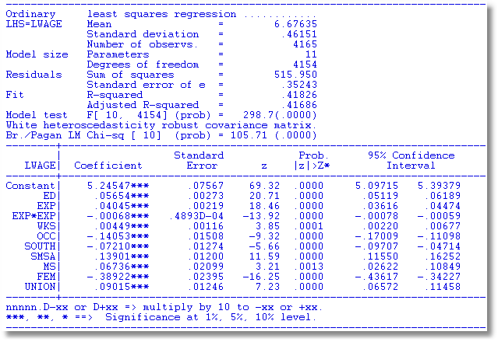
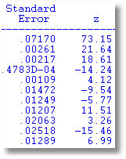
A Heteroscedasticity Robust Covariance Matrix
Uncorrected
Note the conflict: Test favors heteroscedasticity.
Robust VC matrix is essentially the same.

Slide 15
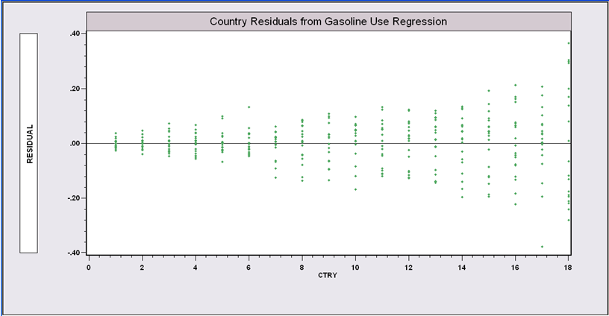
Groupwise Heteroscedasticity
Gasoline Demand Model
Countries are ordered by the standard deviation of their 19 residuals.
Regression of log of per capita gasoline use on log of per capita income, gasoline price and number of cars per capita for 18 OECD countries for 19 years. The standard deviation varies by country. The efficient estimator is “weighted least squares.”

Slide 16
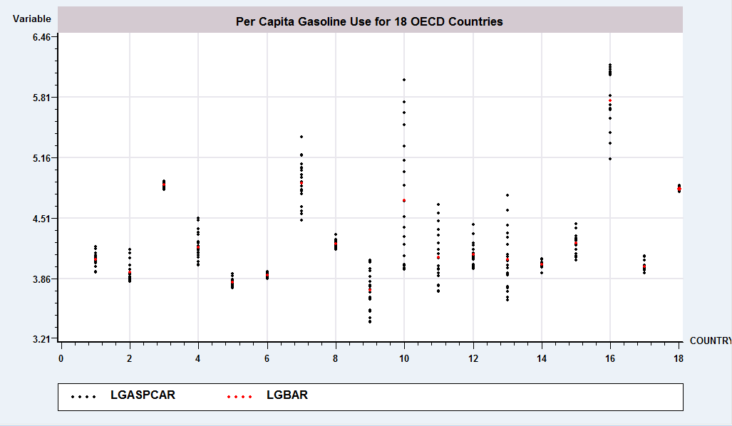
Analysis of Variance

Slide 17
White Estimator
(Not really appropriate for groupwise heteroscedasticity)
+--------+--------------+----------------+--------+--------+----------+
|Variable| Coefficient | Standard Error |t-ratio |P[|T|>t]| Mean of X|
+--------+--------------+----------------+--------+--------+----------+
Constant| 2.39132562 .11693429 20.450 .0000
LINCOMEP| .88996166 .03580581 24.855 .0000 -6.13942544
LRPMG | -.89179791 .03031474 -29.418 .0000 -.52310321
LCARPCAP| -.76337275 .01860830 -41.023 .0000 -9.04180473
-------------------------------------------------
White heteroscedasticity robust covariance matrix
-------------------------------------------------
Constant| 2.39132562 .11794828 20.274 .0000
LINCOMEP| .88996166 .04429158 20.093 .0000 -6.13942544
LRPMG | -.89179791 .03890922 -22.920 .0000 -.52310321
LCARPCAP| -.76337275 .02152888 -35.458 .0000 -9.04180473

Slide 18
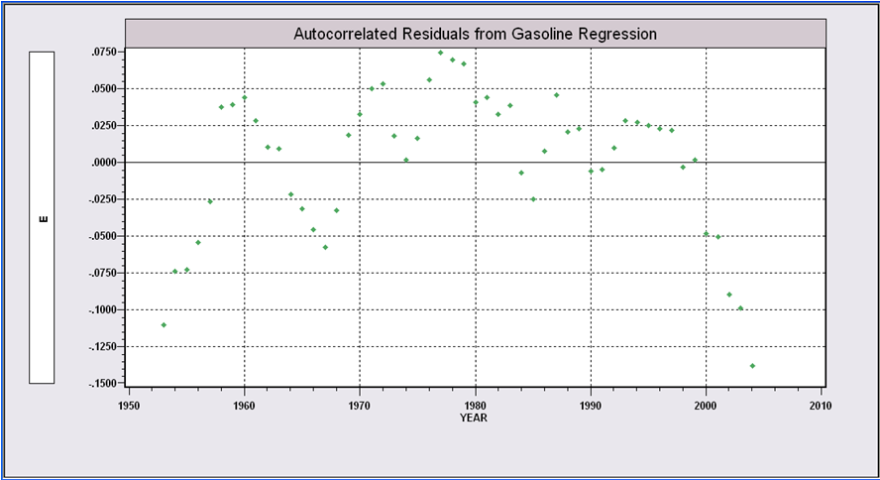
Autocorrelated Residuals logG=β₁ + β₂logPg + β₃logY + β₄logPnc + β₅logPuc + ε

Slide 19
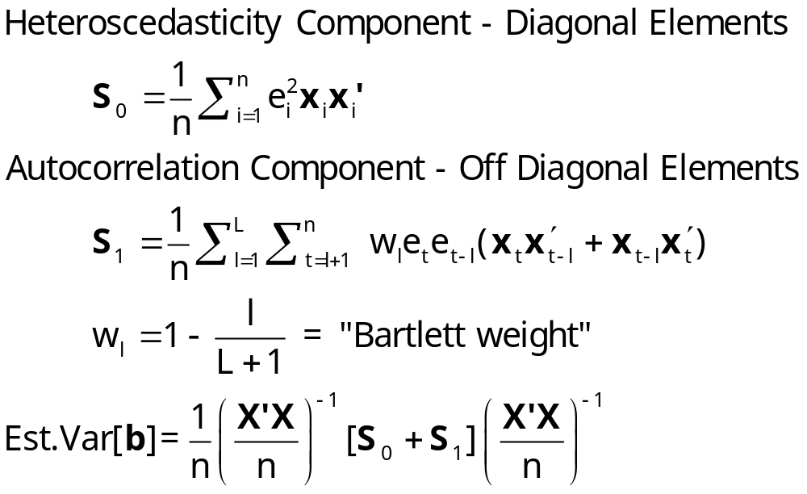
Newey-West Estimator

Slide 20
Newey-West Estimate
--------+-------------------------------------------------------------
Variable| Coefficient Standard Error t-ratio P[|T|>t] Mean of X
--------+-------------------------------------------------------------
Constant| -21.2111*** .75322 -28.160 .0000
LP| -.02121 .04377 -.485 .6303 3.72930
LY| 1.09587*** .07771 14.102 .0000 9.67215
LPNC| -.37361** .15707 -2.379 .0215 4.38037
LPUC| .02003 .10330 .194 .8471 4.10545
--------+-------------------------------------------------------------
--------+-------------------------------------------------------------
Variable| Coefficient Standard Error t-ratio P[|T|>t] Mean of X
Robust VC Newey-West, Periods = 10
--------+-------------------------------------------------------------
Constant| -21.2111*** 1.33095 -15.937 .0000
LP| -.02121 .06119 -.347 .7305 3.72930
LY| 1.09587*** .14234 7.699 .0000 9.67215
LPNC| -.37361** .16615 -2.249 .0293 4.38037
LPUC| .02003 .14176 .141 .8882 4.10545
--------+-------------------------------------------------------------

Slide 21
Generalized Least Squares Approach
Aitken theorem. The Generalized Least Squares estimator, GLS. Find P such that
Py = PXβ + Pε
y* = X*β + ε*.
E[ε*ε*’|X*]= σ²I
Use ordinary least squares in the transformed model. Satisfies the Gauss – Markov theorem.
b* = (X*’X*)⁻¹X*’y*

Slide 22
Generalized Least Squares – Finding P
A transformation of the model:
P = Ω^{-1/2}. P′P = Ω⁻¹
Py = PXβ + Pε or
y* = X*β + ε*.
We need a noninteger power of a matrix: Ω^{-1/2}.

Slide 23
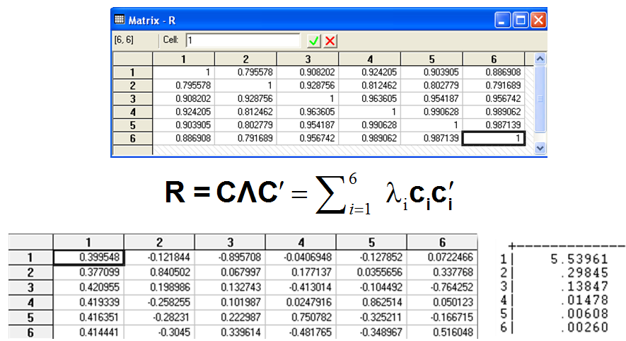
(Digression) Powers of a Matrix
(See slides 7:41-42)
Characteristic Roots and Vectors
  Ω = CΛC′
  C = Orthogonal matrix of
  characteristic vectors.
  Λ = Diagonal matrix of
  characteristic roots
For positive definite matrix, elements of Λ are all positive.
General result for a power of a matrix: Ωª = CΛªC′.
Characteristic roots are powers of elements of Λ. C is the same.
Important cases:
  Inverse: Ω⁻¹ = CΛ⁻¹C′
  Square root: Ω^{1/2} = CΛ^{1/2}C′
  Inverse of square root: Ω^{-1/2} = CΛ^{-1/2}C′
  Matrix to zero power: Ω⁰ = CΛ⁰C′ = CIC′ = I
λ

Slide 24
Generalized Least Squares – Finding P
(Using powers of the matrix)
E[ε*ε*’|X*] = PE[εε′ | X*]P′
= PE[εε′ |X]P′
= σ²PΩP′ = σ² Ω^{-1/2} Ω Ω^{-1/2} = σ² Ω⁰
= σ²I

Slide 25

Generalized Least Squares
Efficient estimation of β and, by implication, the inefficiency of least squares b.
= (X*’X*)⁻¹X*’y*
= (X’P’PX)⁻¹ X’P’Py
= (X’Ω⁻¹X)⁻¹ X’Ω⁻¹y
≠ b. is efficient, so by construction, b is not.

Slide 26
Asymptotics for GLS
Asymptotic distribution of GLS. (NOTE. We apply the full set of results of the classical model to the transformed model.)
Unbiasedness
Consistency - “well behaved data”
Asymptotic distribution
Test statistics

Slide 27
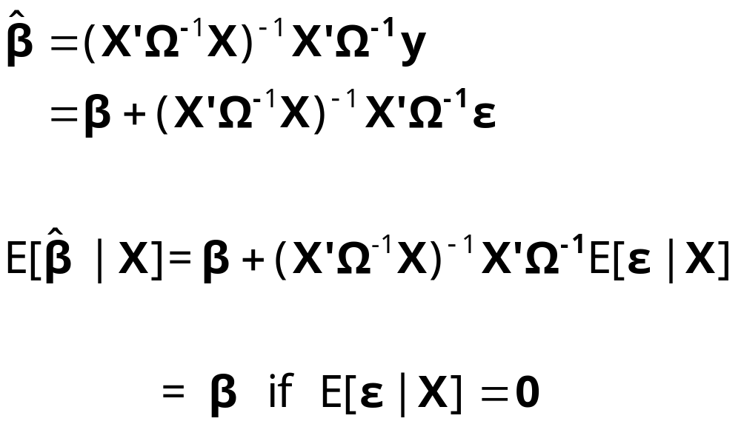
Unbiasedness

Slide 28
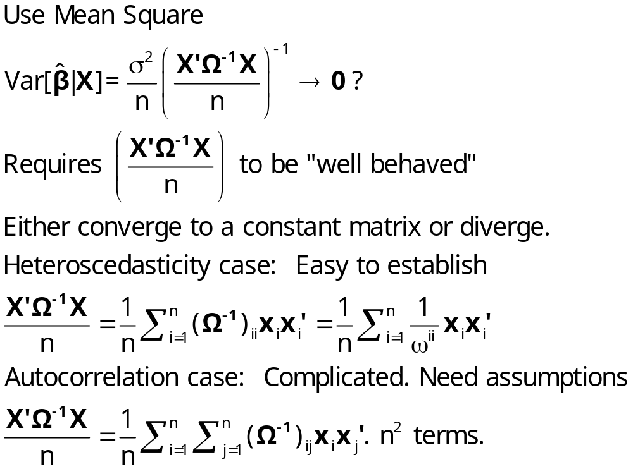
Consistency

Slide 29
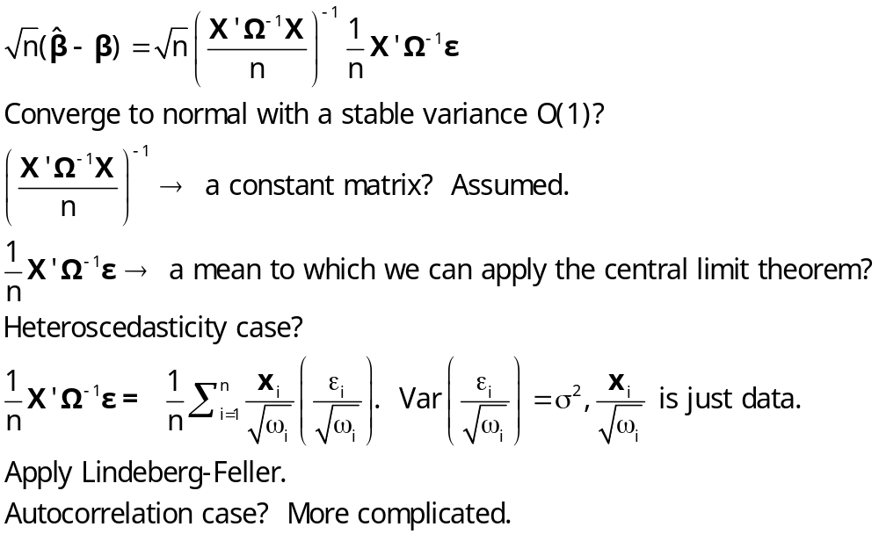
Asymptotic Normality

Slide 30
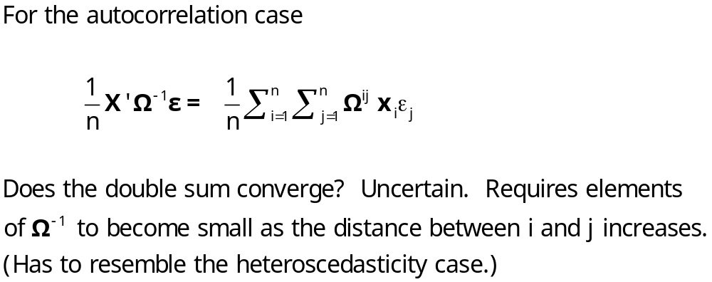
Asymptotic Normality (Cont.)

Slide 31
Test Statistics (Assuming Known Ω)
With known Ω, apply all familiar results to the transformed model:
With normality, t and F statistics apply to least squares based on Py and PX
With asymptotic normality, use Wald statistics and the chi-squared distribution, still based on the transformed model.

Slide 32
Unknown Ω
Ω would be known in narrow heteroscedasticity cases.
Ω is usually unknown. For now, we will consider two methods of estimation
  Two step, or feasible estimation. Estimate Ω first, then do GLS. Emphasize - same logic as White and Newey-West. We don’t need to estimate Ω. We need to find a matrix that behaves the same as (1/n)X′Ω⁻¹X.
  Full information estimation of β, σ², and Ω all at the same time. Joint estimation of all parameters. Fairly rare. Some generalities.
We will examine Harvey’s model of heteroscedasticity

Slide 33
Specification
Ω must be specified first.
A full unrestricted Ω contains n(n+1)/2 - 1 parameters. (Why minus 1? Remember, tr(Ω) = n, so one element is determined.)
Ω is generally specified in terms of a few parameters. Thus, Ω = Ω(θ) for some small parameter vector θ. It becomes a question of estimating θ.

Slide 34


Two Step Estimation
The general result for estimation when Ω is estimated.
GLS uses [X′Ω⁻¹X]X′ Ω⁻¹ y which converges in probability to β.
We seek a vector which converges to the same thing that this does. Call it “Feasible GLS” or FGLS, based on [X′ X]X′ y
The object is to find a set of parameters such that
[X′ X]X′ y - [X′Ω⁻¹X]X′Ω⁻¹y → 0

Slide 35
Two Step Estimation of the
Generalized Regression Model
Use the Aitken (Generalized Least Squares - GLS) estimator with an estimate of Ω
1. Ω is parameterized by a few estimable parameters.
Examples, the heteroscedastic model
2. Use least squares residuals to estimate the
variance functions
3. Use the estimated Ω in GLS - Feasible GLS, or FGLS
[4. Iterate? Generally no additional benefit.]

Slide 36
FGLS vs. Full GLS
VVIR (Theorem 9.5)
To achieve full efficiency, we do not need an efficient estimate of the parameters in Ω, only a consistent one.

Slide 37
Heteroscedasticity
Setting: The regression disturbances have unequal variances, but are still not correlated with each other:
Classical regression with hetero-(different) scedastic (variance) disturbances.
y_{i} = β′x_{i} + ε_{i}, E[ε_{i}] = 0, Var[ε_{i}] = σ² ω_{i}, ω_{i} > 0.
A normalization: Σ_{i} ω_{i} = n. The classical model arises if ω_{i} = 1.
A characterization of the heteroscedasticity: Well defined estimators and methods for testing hypotheses will be obtainable if the heteroscedasticity is “well behaved” in the sense that no single observation becomes dominant.

Slide 38
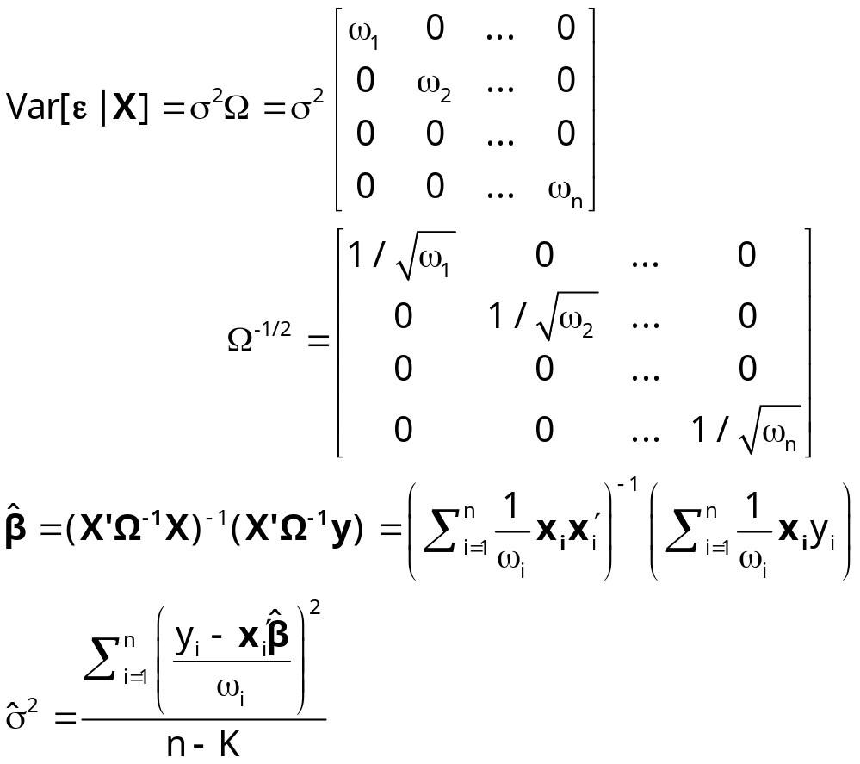
Generalized (Weighted) Least Squares
Heteroscedasticity Case

Slide 39
Estimation: WLS form of GLS
General result - mechanics of weighted least squares.
Generalized least squares - efficient estimation. Assuming weights are known.
Two step generalized least squares:
Step 1: Use least squares, then the residuals to estimate the weights.
Step 2: Weighted least squares using the estimated weights.
(Iteration: After step 2, recompute residuals and return to step 1. Exit when coefficient vector stops changing.)

Slide 40
FGLS – Harvey’s Model
Feasible GLS is based on finding an estimator which has the same properties as the true GLS.
Example Var[ε_{i}|z_{i}] = σ² [Exp(γ′z_{i})]².
True GLS would regress y_{i}/[σExp(γ′z_{i})] on the same transformation of x_{i}. With a consistent estimator of [σ,γ], say [s,c], we do the same computation with our estimates.
So long as plim [s,c] = [σ,γ], FGLS is as “good” as true GLS.
• Consistent
• Same Asymptotic Variance
• Same Asymptotic Normal Distribution

Slide 41
Harvey’s Model of Heteroscedasticity
Var[ε_{i} | X] = σ² exp(γ′z_{i})
Cov[ε_{i},ε_{j} | X] = 0
e.g.: z_{i} = firm size
e.g.: z_{i} = a set of dummy variables (e.g., countries) (The groupwise heteroscedasticity model.)
[σ² Ω] = diagonal [exp(θ + γ′z_{i})],
θ = log(σ²)

Slide 42
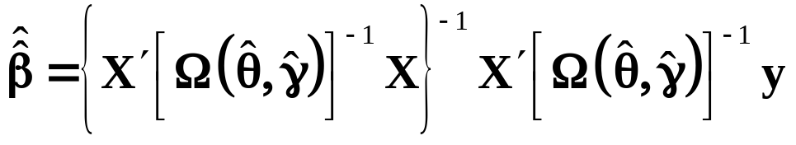
Harvey’s Model
Methods of estimation:
Two step FGLS: Use the least squares residuals to estimate (θ,γ), then use
Full maximum likelihood estimation. Estimate all parameters simultaneously.
A handy result due to Oberhofer and Kmenta - the “zig-zag” approach. Iterate back and forth between (θ,γ) and β.

Slide 43
Harvey’s Model for Groupwise Heteroscedasticity
Groupwise sample, y_{ig}, x_{ig},…
N groups, each with n_{g} observations.
Var[ε_{ig}] = σ_{g}²
Let d_{ig} = 1 if observation i,g is in group g, 0 else.
= group dummy variable. (Drop the first.)
Var[ε_{ig}] = σ_{g}² exp(θ₂d₂ + … θ_{G}d_{G})
Var₁ = σ_{g}² , Var₂ = σ_{g}² exp(θ₂) and so on.

Slide 44
Estimating Variance Components
OLS is still consistent:
Est.Var₁ = e₁’e₁/n₁ estimates σ_{g}²
Est.Var₂ = e₂’e₂/n₂ estimates σ_{g}² exp(θ₂), etc.
Estimator of θ₂ is ln[(e₂’e₂/n₂)/(e₁’e₁/n₁)]
(1) Now use FGLS – weighted least squares
Recompute residuals using WLS slopes
(2) Recompute variance estimators
Iterate to a solution… between (1) and (2)

Slide 45
Baltagi and Griffin’s Gasoline Data
World Gasoline Demand Data, 18 OECD Countries, 19 years
Variables in the file are
COUNTRY = name of country
YEAR = year, 1960-1978
LGASPCAR = log of consumption per car
LINCOMEP = log of per capita income
LRPMG = log of real price of gasoline
LCARPCAP = log of per capita number of cars
See Baltagi (2001, p. 24) for analysis of these data. The article on which the analysis is based is Baltagi, B. and Griffin, J., "Gasoline Demand in the OECD: An Application of Pooling and Testing Procedures," European Economic Review, 22, 1983, pp. 117-137. The data were downloaded from the website for Baltagi's text.

Slide 46
Least Squares First Step
----------------------------------------------------------------------
Multiplicative Heteroskedastic Regression Model...
Ordinary least squares regression ............
LHS=LGASPCAR Mean = 4.29624
Standard deviation = .54891
Number of observs. = 342
Model size Parameters = 4
Degrees of freedom = 338
Residuals Sum of squares = 14.90436
B/P LM statistic [17 d.f.] = 111.55 (.0000) (Large)
Cov matrix for b is sigma^2*inv(X'X)(X'WX)inv(X'X) (Robust)
--------+-------------------------------------------------------------
Variable| Coefficient Standard Error b/St.Er. P[|Z|>z] Mean of X
--------+-------------------------------------------------------------
Constant| 2.39133*** .20010 11.951 .0000
LINCOMEP| .88996*** .07358 12.094 .0000 -6.13943
LRPMG| -.89180*** .06119 -14.574 .0000 -.52310
LCARPCAP| -.76337*** .03030 -25.190 .0000 -9.04180
--------+-------------------------------------------------------------

Slide 47
Variance Estimates = ln[e(i)’e(i)/T]
Sigma| .48196*** .12281 3.924 .0001
D1| -2.60677*** .72073 -3.617 .0003 .05556
D2| -1.52919** .72073 -2.122 .0339 .05556
D3| .47152 .72073 .654 .5130 .05556
D4| -3.15102*** .72073 -4.372 .0000 .05556
D5| -3.26236*** .72073 -4.526 .0000 .05556
D6| -.09099 .72073 -.126 .8995 .05556
D7| -1.88962*** .72073 -2.622 .0087 .05556
D8| .60559 .72073 .840 .4008 .05556
D9| -1.56624** .72073 -2.173 .0298 .05556
D10| -1.53284** .72073 -2.127 .0334 .05556
D11| -2.62835*** .72073 -3.647 .0003 .05556
D12| -2.23638*** .72073 -3.103 .0019 .05556
D13| -.77641 .72073 -1.077 .2814 .05556
D14| -1.27341* .72073 -1.767 .0773 .05556
D15| -.57948 .72073 -.804 .4214 .05556
D16| -1.81723** .72073 -2.521 .0117 .05556
D17| -2.93529*** .72073 -4.073 .0000 .05556

Slide 48
OLS vs. Iterative FGLS
Looks like a substantial gain in reduced standard errors
--------+-------------------------------------------------------------
Variable| Coefficient Standard Error b/St.Er. P[|Z|>z] Mean of X
--------+-------------------------------------------------------------
|Ordinary Least Squares
|Robust Cov matrix for b is sigma^2*inv(X'X)(X'WX)inv(X'X)
Constant| 2.39133*** .20010 11.951 .0000
LINCOMEP| .88996*** .07358 12.094 .0000 -6.13943
LRPMG| -.89180*** .06119 -14.574 .0000 -.52310
LCARPCAP| -.76337*** .03030 -25.190 .0000 -9.04180
--------+-------------------------------------------------------------
|Regression (mean) function
Constant| 1.56909*** .06744 23.267 .0000
LINCOMEP| .60853*** .02097 29.019 .0000 -6.13943
LRPMG| -.61698*** .01902 -32.441 .0000 -.52310
LCARPCAP| -.66938*** .01116 -59.994 .0000 -9.04180

Slide 49
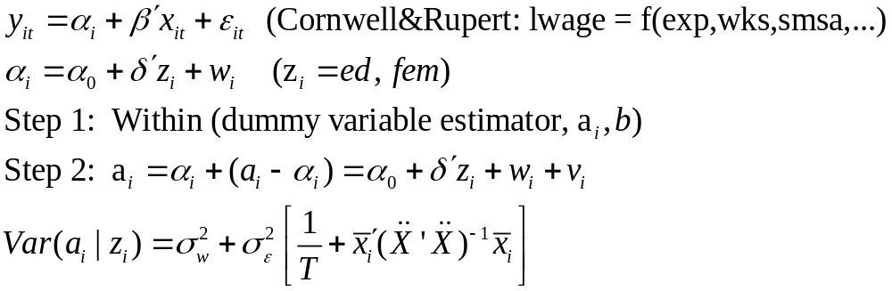
Methodology
In the possible presence of heteroscedasticity:
OLS with the White estimator
Weighted Least Squares

Slide 50
Seemingly Unrelated Regressions
The classical regression model, y_{i} = X_{i}β_{i} + ε_{i}. Applies to each of M equations and T observations. Familiar example: The capital asset pricing model:
(r_{m} - r_{f}) = α_{m}i + β_{m}( r_{market} – r_{f} ) + ε_{m}
Not quite the same as a panel data model. M is usually small - say 3 or 4. (The CAPM might have M in the thousands, but it is a special case for other reasons.)

Slide 51
Formulation
Consider an extension of the groupwise heteroscedastic model: We had
y_{i} = X_{i}β + ε_{i} with E[ε_{i}|X] = 0, Var[ε_{i}|X] = σ_{i}²I.
Now, allow two extensions:
Different coefficient vectors for each group,
Correlation across the observations at each specific point in time (think about the CAPM above. Variation in excess returns is affected both by firm specific factors and by the economy as a whole).
Stack the equations to obtain a GR model.

Slide 52
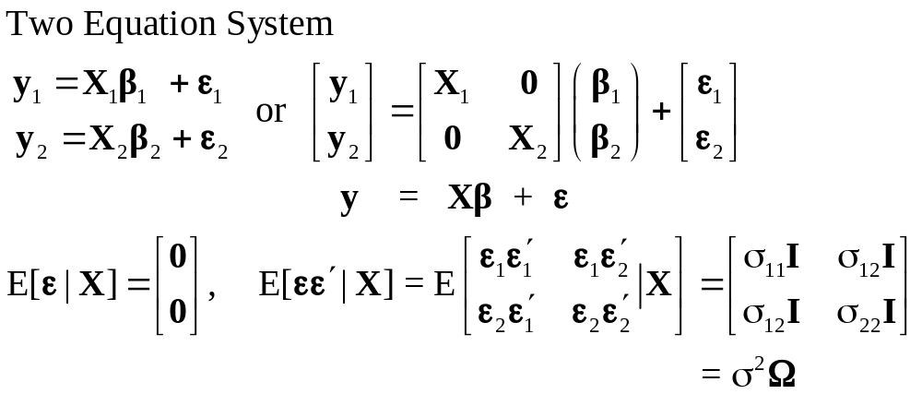
SUR Model

Slide 53
OLS and GLS
Each equation can be fit by OLS ignoring all others. Why do GLS? Efficiency improvement.
Gains to GLS:
None if identical regressors - NOTE THE CAPM ABOVE!
Implies that GLS is the same as OLS. This is an application of a strange special case of the GR model. “If the K columns of X are linear combinations of K characteristic vectors of Ω, in the GR model, then OLS is algebraically identical to GLS.” We will forego our opportunity to prove this theorem. This is our only application. (Kruskal’s Theorem)
Efficiency gains increase as the cross equation correlation increases (of course!).

Slide 54
The Identical X Case
Suppose the equations involve the same X matrices. (Not just the same variables, the same data. Then GLS is the same as equation by equation OLS.
Grunfeld’s investment data are not an example - each firm has its own data matrix. (Text, p. 371, Example 10.3, Table F10.4)
The 3 equation model on page 344 with Berndt and Wood’s data give an example. The three share equations all have the constant and logs of the price ratios on the RHS. Same variables, same years. The CAPM is also an example.
(Note, because of the constraint in the B&W system (the same δ parameters in more than one equation), the OLS result for identical Xs does not apply.)

Slide 55
Estimation by FGLS
Two step FGLS is essentially the same as the groupwise heteroscedastic model.
(1) OLS for each equation produces residuals e_{i}.
(2) S_{ij} = (1/n)e_{i}′e_{j} then do FGLS
Maximum likelihood estimation for normally distributed disturbances: Just iterate FLS.
(This is an application of the Oberhofer-Kmenta result.)

Slide 56
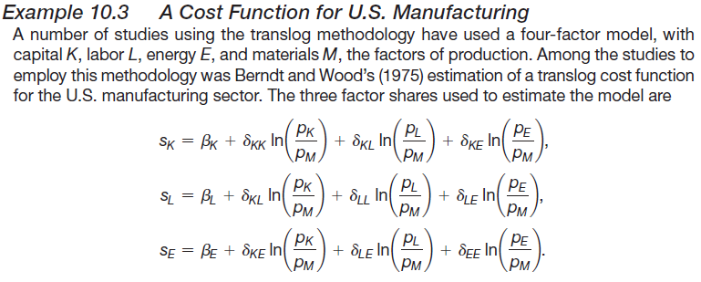
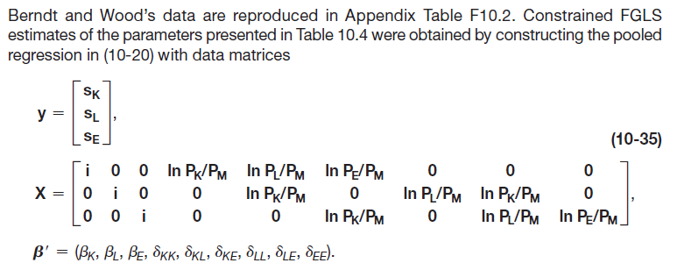
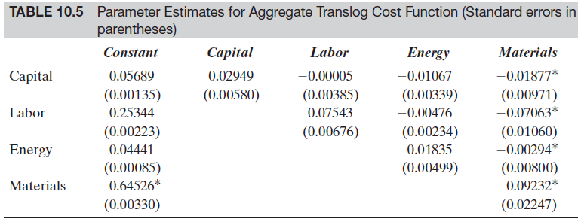

Slide 57
Vector Autoregression
The vector autoregression (VAR) model is one of the most successful, flexible,
and easy to use models for the analysis of multivariate time series. It is
a natural extension of the univariate autoregressive model to dynamic multivariate
time series. The VAR model has proven to be especially useful for
describing the dynamic behavior of economic and financial time series and
for forecasting. It often provides superior forecasts to those from univariate
time series models and elaborate theory-based simultaneous equations
models. Forecasts from VAR models are quite flexible because they can be
made conditional on the potential future paths of specified variables in the
model.
In addition to data description and forecasting, the VAR model is also
used for structural inference and policy analysis. In structural analysis, certain
assumptions about the causal structure of the data under investigation
are imposed, and the resulting causal impacts of unexpected shocks or
innovations to specified variables on the variables in the model are summarized.
These causal impacts are usually summarized with impulse response
functions and forecast error variance decompositions.
Eric Zivot: http://faculty.washington.edu/ezivot/econ584/notes/varModels.pdf

Slide 58
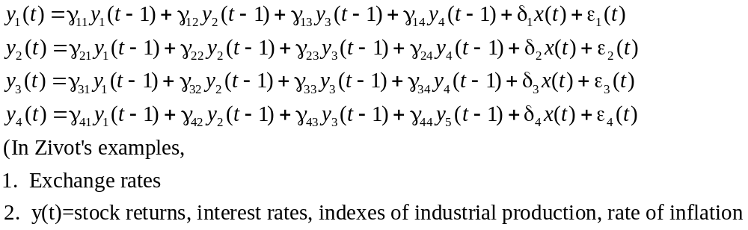
VAR

Slide 59
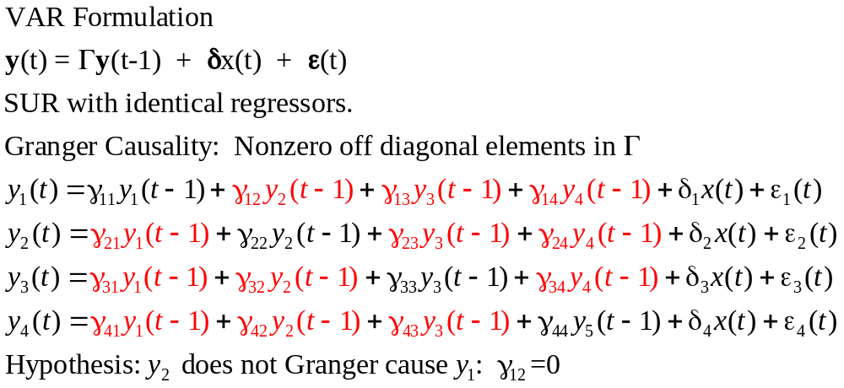

Slide 60
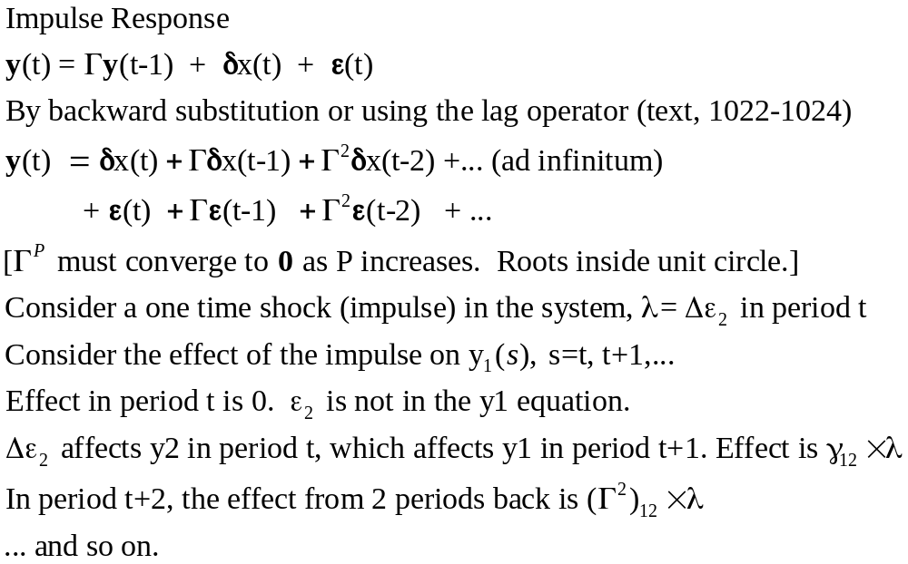

Slide 61
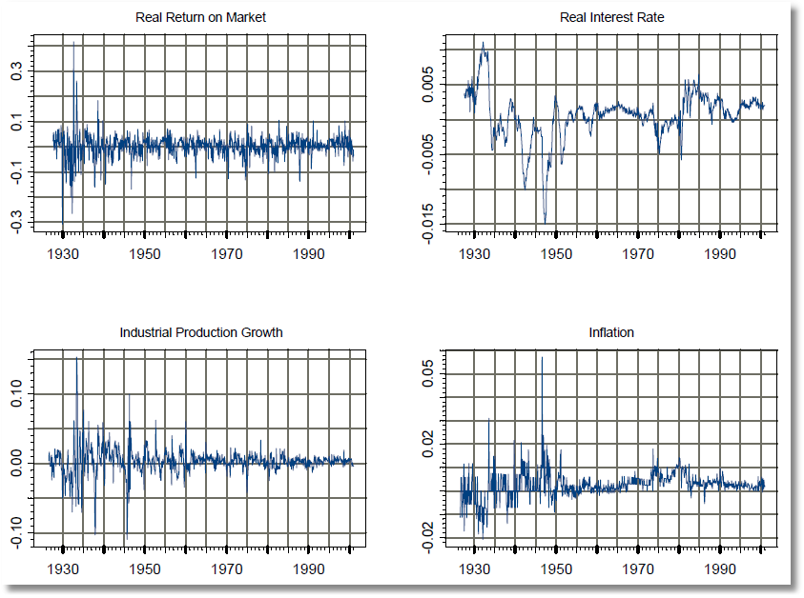
Zivot’s Data

Slide 62
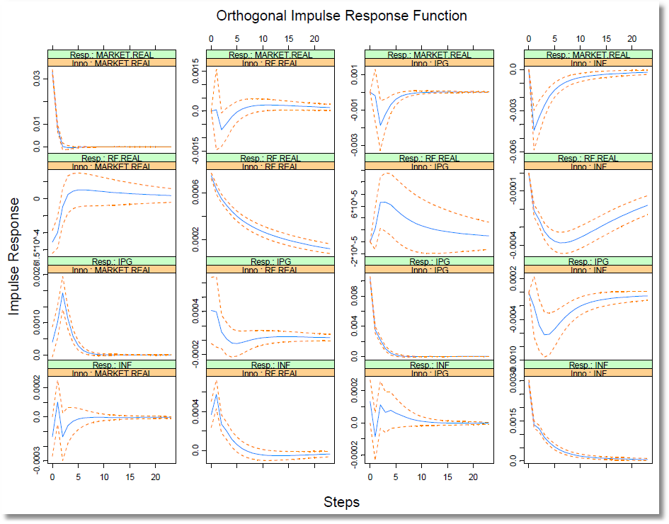
Impulse Responses

Slide 63
Appendix: Autocorrelation in Time Series

Slide 64
Autocorrelation
The analysis of “autocorrelation” in the narrow sense of correlation of the disturbances across time largely parallels the discussions we’ve already done for the GR model in general and for heteroscedasticity in particular. One difference is that the relatively crisp results for the model of heteroscedasticity are replaced with relatively fuzzy, somewhat imprecise results here. The reason is that it is much more difficult to characterize meaningfully “well behaved” data in a time series context. Thus, for example, in contrast to the sharp result that produces the White robust estimator, the theory underlying the Newey-West robust estimator is somewhat ambiguous in its requirement of a bland statement about “how far one must go back in time until correlation becomes unimportant.”

Slide 65
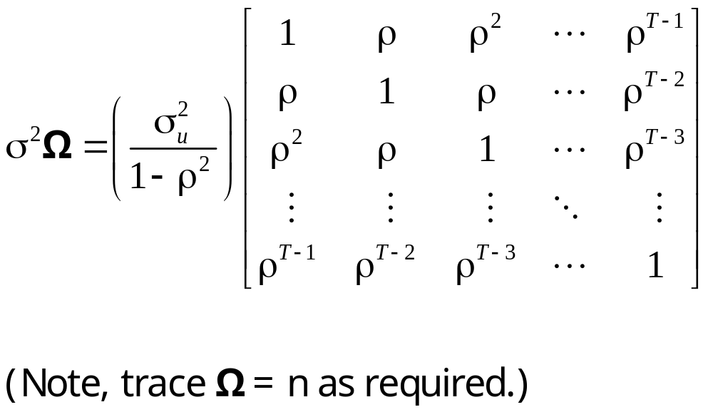
Autocorrelation Matrix

Slide 66
Autocorrelation
ε_{t} = ρε_{t-1} + u_{t}
(‘First order autocorrelation.’ How does this come about?)
Assume -1 < ρ < 1. Why?
u_{t} = ‘nonautocorrelated white noise’
ε_{t} = ρε_{t-1} + u_{t} (the autoregressive form)
= ρ(ρε_{t-2} + u_{t-1}) + u_{t}
= ... (continue to substitute)
= u_{t} + ρu_{t-1} + ρ²u_{t-2} + ρ³u_{t-3} + ...
= (the moving average form)

Slide 67
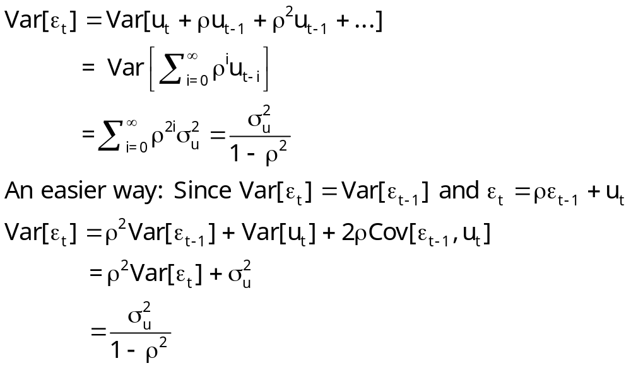
Autocorrelation

Slide 68
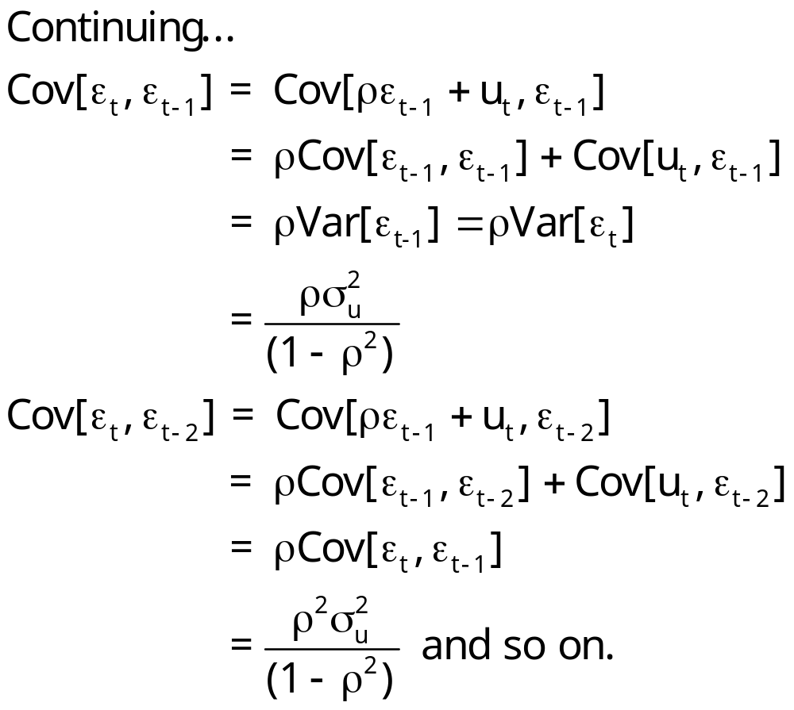
Autocovariances

Slide 69
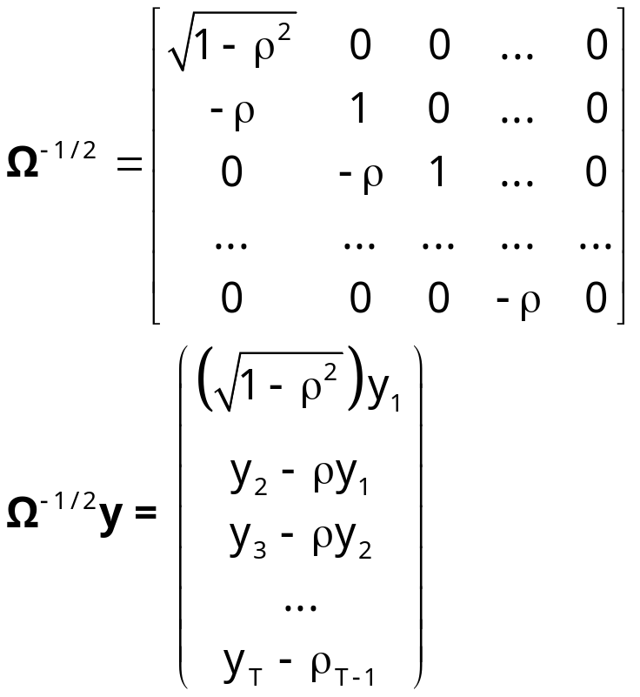
Generalized Least Squares

Slide 70
GLS and FGLS
Theoretical result for known Ω - i.e., known ρ. Prais-Winsten vs. Cochrane-Orcutt.
FGLS estimation: How to estimate ρ? OLS residuals as usual - first autocorrelation.
Many variations, all based on correlation of e_{t} and e_{t-1}

Slide 71
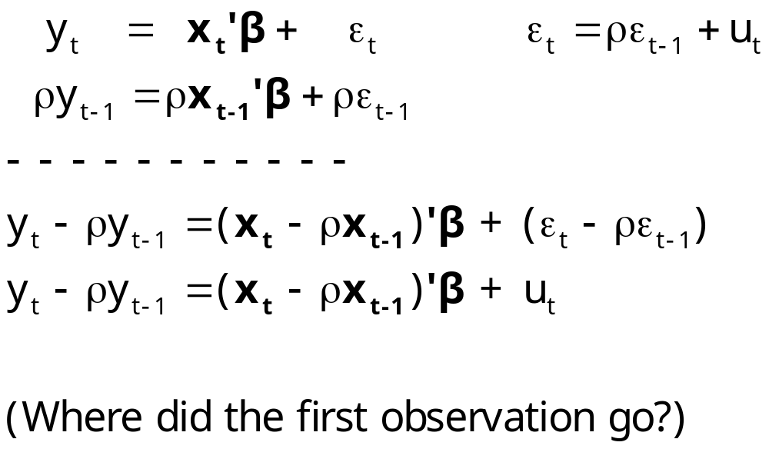
The Autoregressive Transformation

Slide 72
Estimated AR(1) Model
----------------------------------------------------------------------
AR(1) Model: e(t) = rho * e(t-1) + u(t)
Initial value of rho = .87566
Maximum iterations = 1
Method = Prais - Winsten
Iter= 1, SS= .022, Log-L= 127.593
Final value of Rho = .959411
Std. Deviation: e(t) = .076512
Std. Deviation: u(t) = .021577
Autocorrelation: u(t) = .253173
N[0,1] used for significance levels
--------+-------------------------------------------------------------
Variable| Coefficient Standard Error b/St.Er. P[|Z|>z] Mean of X
--------+-------------------------------------------------------------------------
Constant| -20.3373*** .69623 -29.211 .0000 FGLS
LP| -.11379*** .03296 -3.453 .0006 3.72930
LY| .87040*** .08827 9.860 .0000 9.67215
LPNC| .05426 .12392 .438 .6615 4.38037
LPUC| -.04028 .06193 -.650 .5154 4.10545
RHO| .95941*** .03949 24.295 .0000
--------+-------------------------------------------------------------------------
Constant| -21.2111*** .75322 -28.160 .0000 OLS
LP| -.02121 .04377 -.485 .6303 3.72930
LY| 1.09587*** .07771 14.102 .0000 9.67215
LPNC| -.37361** .15707 -2.379 .0215 4.38037
LPUC| .02003 .10330 .194 .8471 4.10545

Slide 73
The Familiar AR(1) Model
ε_{t} = ρε_{t-1} + u_{t}, |ρ| < 1.
This characterizes the disturbances, not the regressors.
• A general characterization of the mechanism producing ε
history + current innovations
• Analysis of this model in particular. The mean and variance and autocovariance
• Stationarity. Time series analysis.
• Implication: The form of σ²Ω; Var[ε] vs. Var[u].
• Other models for autocorrelation - less frequently used –
AR(1) is the workhorse.

Slide 74
Building the Model
Prior view: A feature of the data
  “Account for autocorrelation in the data.”
  Different models, different estimators
Contemporary view: Why is there autocorrelation?
  What is missing from the model?
  Build in appropriate dynamic structures
  Autocorrelation should be “built out” of the model
  Use robust procedures (Newey-West) instead of elaborate models specifically for the autocorrelation.

Slide 75
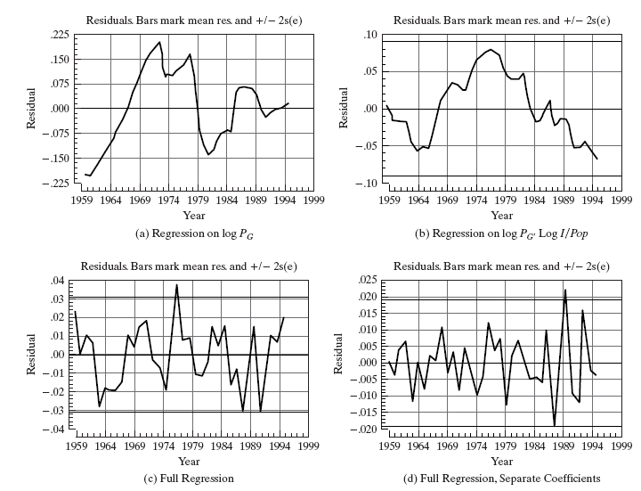
Model Misspecification

Slide 76
Implications for Least Squares
Familiar results: Consistent, unbiased, inefficient, asymptotic normality
The inefficiency of least squares:
• Difficult to characterize generally. It is worst in “low frequency”
i.e., long period (year) slowly evolving data.
• Can be extremely bad. GLS vs. OLS, the efficiency ratios can
be 3 or more.
A very important exception - the lagged dependent variable
y_{t} = βx_{t} + γy_{t-1} + ε_{t}. ε_{t} = ρε_{t-1} + u_{t},.
Obviously, Cov[y_{t-1} ,ε_{t} ] ≠ 0, because of the form of ε_{t}.
• How to estimate? IV
• Should the model be fit in this form? Is something missing?
Robust estimation of the covariance matrix - the Newey-West estimator.

Slide 77
Testing for Autocorrelation
A general proposition: There are several tests. All are functions of the simple autocorrelation of the least squares residuals. Two used generally, Durbin-Watson and Lagrange Multiplier
The Durbin - Watson test. d ≈ 2(1 - r). Small values of d lead to rejection of
NO AUTOCORRELATION: Why are the bounds necessary?
Godfrey’s LM test. Regression of e_{t} on e_{t-1} and x_{t}. Uses a “partial correlation.”

Slide 78
Consumption “Function”
Log real consumption vs. Log real disposable income
(Aggregate U.S. Data, 1950I – 2000IV. Table F5.2 from text)
----------------------------------------------------------------------
Ordinary least squares regression ............
LHS=LOGC Mean = 7.88005
Standard deviation = .51572
Number of observs. = 204
Model size Parameters = 2
Degrees of freedom = 202
Residuals Sum of squares = .09521
Standard error of e = .02171
Fit R-squared = .99824 <<<***
Adjusted R-squared = .99823
Model test F[ 1, 202] (prob) =114351.2(.0000)
--------+-------------------------------------------------------------
Variable| Coefficient Standard Error t-ratio P[|T|>t] Mean of X
--------+-------------------------------------------------------------
Constant| -.13526*** .02375 -5.695 .0000
LOGY| 1.00306*** .00297 338.159 .0000 7.99083
--------+-------------------------------------------------------------

Slide 79
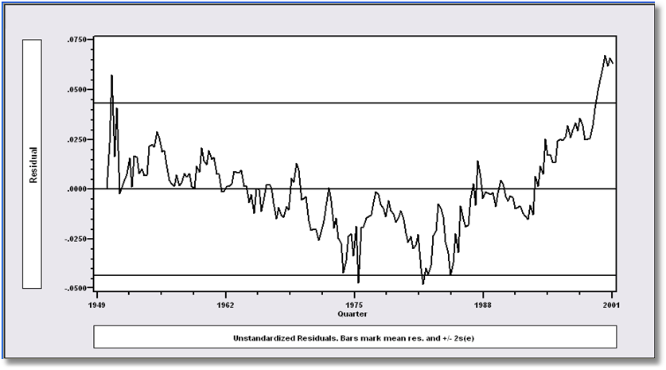
Least Squares Residuals: r = .91

Slide 80
Conventional vs. Newey-West
+---------+--------------+----------------+--------+---------+----------+
|Variable | Coefficient | Standard Error |t-ratio |P[|T|>t] | Mean of X|
+---------+--------------+----------------+--------+---------+----------+
Constant -.13525584 .02375149 -5.695 .0000
LOGY 1.00306313 .00296625 338.159 .0000 7.99083133
+---------+--------------+----------------+--------+---------+----------+
|Newey-West Robust Covariance Matrix
|Variable | Coefficient | Standard Error |t-ratio |P[|T|>t] | Mean of X|
+---------+--------------+----------------+--------+---------+----------+
Constant -.13525584 .07257279 -1.864 .0638
LOGY 1.00306313 .00938791 106.846 .0000 7.99083133

Slide 81
FGLS
+---------------------------------------------+
| AR(1) Model: e(t) = rho * e(t-1) + u(t) |
| Initial value of rho = .90693 | <<<***
| Maximum iterations = 100 |
| Method = Prais - Winsten |
| Iter= 1, SS= .017, Log-L= 666.519353 |
| Iter= 2, SS= .017, Log-L= 666.573544 |
| Final value of Rho = .910496 | <<<***
| Iter= 2, SS= .017, Log-L= 666.573544 |
| Durbin-Watson: e(t) = .179008 |
| Std. Deviation: e(t) = .022308 |
| Std. Deviation: u(t) = .009225 |
| Durbin-Watson: u(t) = 2.512611 |
| Autocorrelation: u(t) = -.256306 |
| N[0,1] used for significance levels |
+---------------------------------------------+
+---------+--------------+----------------+--------+---------+----------+
|Variable | Coefficient | Standard Error |b/St.Er.|P[|Z|>z] | Mean of X|
+---------+--------------+----------------+--------+---------+----------+
Constant -.08791441 .09678008 -.908 .3637
LOGY .99749200 .01208806 82.519 .0000 7.99083133
RHO .91049600 .02902326 31.371 .0000

Slide 82
Sorry to bother you again, but an important issue has come up. I am using LIMDEP to produce results for my testimony in a utility rate case. I have a time series sample of 40 years, and am doing simple OLS analysis using a primary independent variable and a dummy. There is serial correlation present. The issue is what is the BEST available AR1 procedure in LIMDEP for a sample of this type?? I have tried Cochrane-Orcott, Prais-Winsten, and the MLE procedure recommended by Beach-MacKinnon, with slight but meaningful differences.
By modern constructions, your best choice if you are comfortable with AR1 is Prais-Winsten. Noone has ever shown that iterating it is better or worse than not. Cochrance-Orcutt is inferior because it discards information (the first observation). Beach and MacKinnon would be best, but it assumes normality, and in contemporary treatments, fewer assumptions is better. If you are not comfortable with AR1, use OLS with Newey-West and 3 or 4 lags.

Slide 83
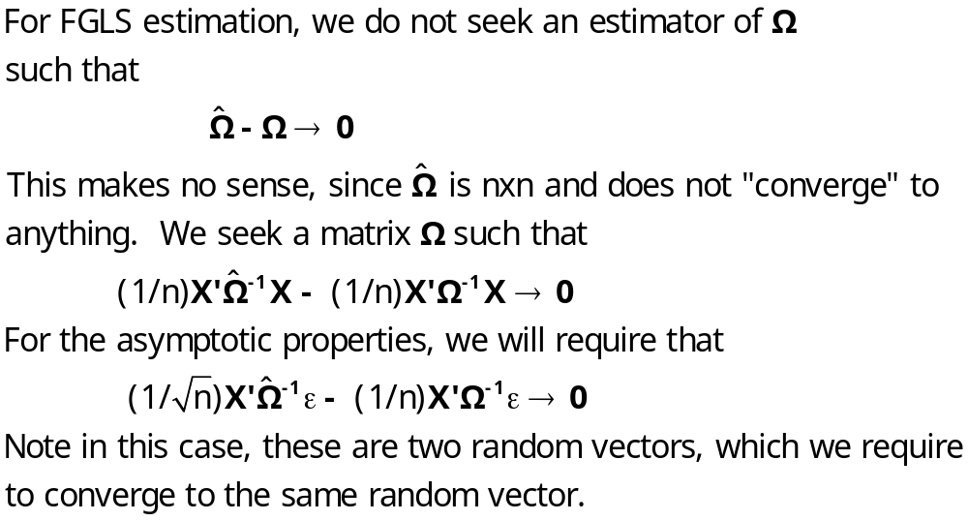
Feasible GLS

