Slide 1

Econometrics I
Professor William Greene
Stern School of Business
Department of Economics

Slide 2
Econometrics I
Part 15 – Panel Data-1

Slide 3
Panel Data Sets
Longitudinal data
  British household panel survey (BHPS)
  Panel Study of Income Dynamics (PSID)
  … many others
Cross section time series
  Penn world tables
Financial data by firm, by year
  r_{it} – r_{ft} = β_{i}(r_{mt} - r_{ft}) + ε_{it}, i = 1,…,many; t=1,…many
  Exchange rate data, essentially infinite T, large N

Slide 4
Benefits of Panel Data
Time and individual variation in behavior unobservable in cross sections or aggregate time series
Observable and unobservable individual heterogeneity
Rich hierarchical structures
More complicated models
Features that cannot be modeled with only cross section or aggregate time series data alone
Dynamics in economic behavior

Slide 5

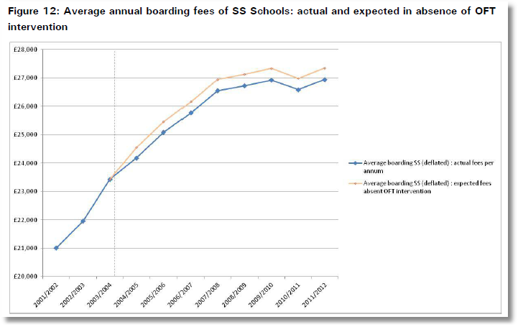
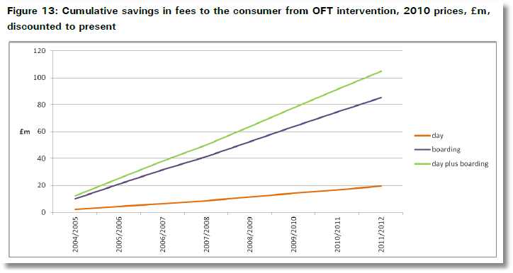

www.oft.gov.uk/shared_oft/reports/Evaluating-OFTs-work/oft1416.pdf

Slide 6


Slide 7


Slide 8



Slide 9


Slide 10


Slide 11


Slide 12


Slide 13


Slide 14


Slide 15


Slide 16


Slide 17


Slide 18


Slide 19
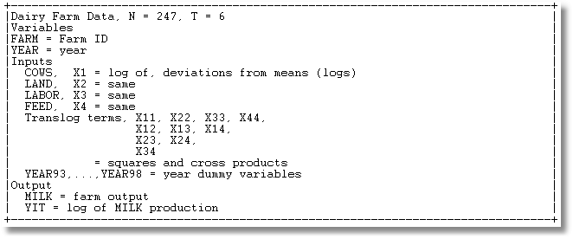
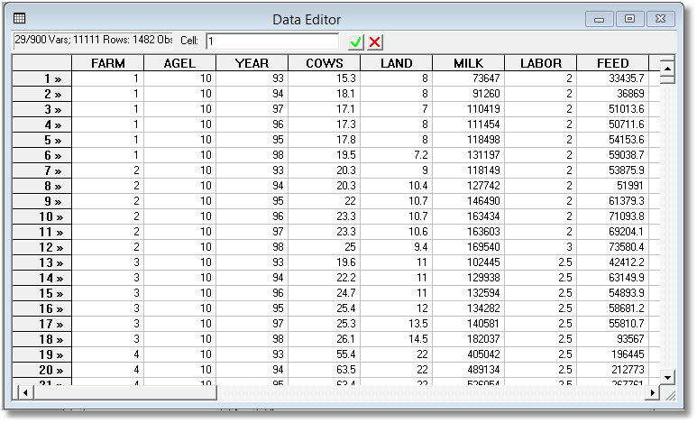
Panel Data on 247 Spanish Dairy Farms Over 6 Years

Slide 20
Cornwell and Rupert Data
Cornwell and Rupert Returns to Schooling Data, 595 Individuals, 7 Years
(Extracted from NLSY.) Variables in the file are
EXP = work experience
WKS = weeks worked
OCC = occupation, 1 if blue collar,
IND = 1 if manufacturing industry
SOUTH = 1 if resides in south
SMSA = 1 if resides in a city (SMSA)
MS = 1 if married
FEM = 1 if female
UNION = 1 if wage set by union contract
ED = years of education
LWAGE = log of wage = dependent variable in regressions
These data were analyzed in Cornwell, C. and Rupert, P., "Efficient Estimation with Panel Data: An Empirical Comparison of Instrumental Variable Estimators," Journal of Applied Econometrics, 3, 1988, pp. 149-155. See Baltagi, page 122 for further analysis. The data were downloaded from the website for Baltagi's text.
Notes:
20

Slide 21


Slide 22

Balanced and Unbalanced Panels
Distinction: Balanced vs. Unbalanced Panels
A notation to help with mechanics
  z_{i,t}, i = 1,…,N; t = 1,…,T_{i}
The role of the assumption
  Mathematical and notational convenience:
    Balanced, n=NT
    Unbalanced:
  Is the fixed T_{i} assumption ever necessary? Almost never.
Is unbalancedness due to nonrandom attrition from an otherwise balanced panel? This would require special considerations.

Slide 23
Application: Health Care Usage
German Health Care Usage Data, 7,293 Individuals, Varying Numbers of Periods
This is an unbalanced panel with 7,293 individuals. There are altogether 27,326 observations. The number of observations ranges from 1 to 7.
(Frequencies are: 1=1525, 2=2158, 3=825, 4=926, 5=1051, 6=1000, 7=987).
(Downloaded from the JAE Archive)
Variables in the file are
DOCTOR = 1(Number of doctor visits > 0)
HOSPITAL = 1(Number of hospital visits > 0)
HSAT = health satisfaction, coded 0 (low) - 10 (high)
DOCVIS = number of doctor visits in last three months
HOSPVIS = number of hospital visits in last calendar year
PUBLIC = insured in public health insurance = 1; otherwise = 0
ADDON = insured by add-on insurance = 1; otherswise = 0
HHNINC = household nominal monthly net income in German marks / 10000.
(4 observations with income=0 were dropped)
HHKIDS = children under age 16 in the household = 1; otherwise = 0
EDUC = years of schooling
AGE = age in years
MARRIED = marital status
Notes:
23

Slide 24
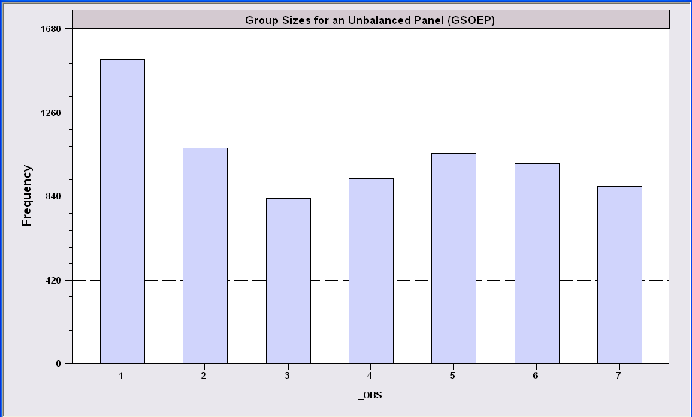
An Unbalanced Panel:
RWM’s GSOEP Data on Health Care
N = 7,293 Households

Slide 25
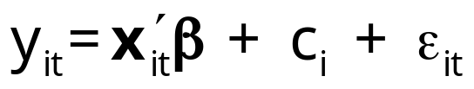
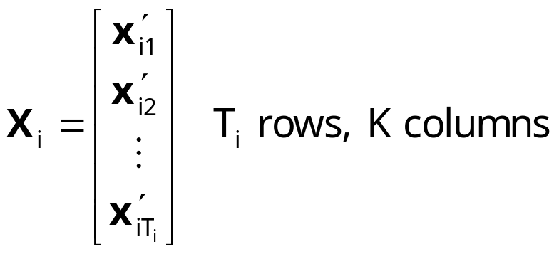
A Basic Model for Panel Data
Unobserved individual effects in regression: E[y_{it} | x_{it}, c_{i}]
  Notation:
Linear specification:
  Fixed Effects: E[c_{i} | X_{i} ] = g(X_{i}). Cov[x_{it},c_{i}] ≠0
  effects are correlated with included variables.
  Random Effects: E[c_{i} | X_{i} ] = 0. Cov[x_{it},c_{i}] = 0

Slide 26
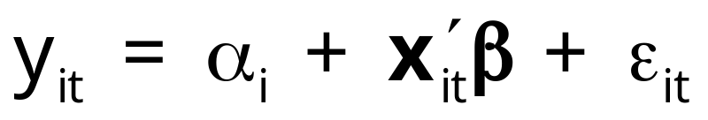
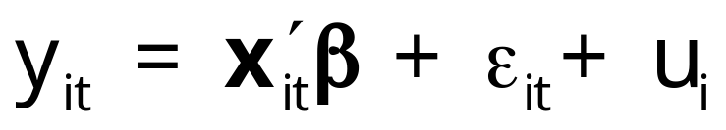
Convenient Notation
Fixed Effects – the ‘dummy variable model’
Random Effects – the ‘error components model’
Individual specific constant terms.
Compound (“composed”) disturbance

Slide 27
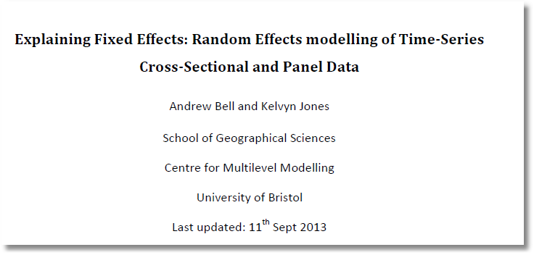
http://people.stern.nyu.edu/wgreene/Econometrics/Bell-Jones-Fixed-vs-Random-Sept-2013.pdf

Slide 28
Estimating β
β is the partial effect of interest
Can it be estimated (consistently) in the presence of (unmeasured) c_{i}?
  Does pooled least squares “work?”
  Strategies for “controlling for c_{i}” using the sample data

Slide 29
Assumptions for Asymptotics
Convergence of moments involving cross section X_{i}.
N increasing, T or T_{i} assumed fixed.
  “Fixed T asymptotics” (see text, p. 348)
  Time series characteristics are not relevant (may be nonstationary – relevant in Penn World Tables)
  If T is also growing, need to treat as multivariate time series.
Ranks of matrices. X must have full column rank. (X_{i} may not, if T_{i} < K.)
Strict exogeneity and dynamics. If x_{it} contains y_{i,t-1} then x_{it} cannot be strictly exogenous. X_{it} will be correlated with the unobservables in period t-1. (To be revisited later.)
Empirical characteristics of microeconomic data

Slide 30
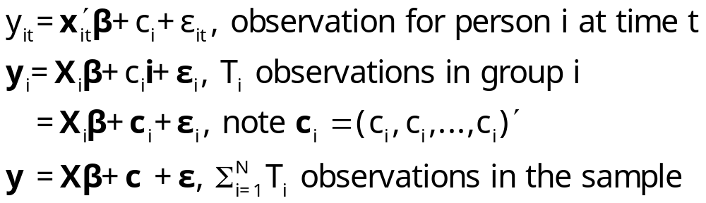
The Pooled Regression
Presence of omitted effects
Potential bias/inconsistency of OLS – depends on ‘fixed’ or ‘random’

Slide 31
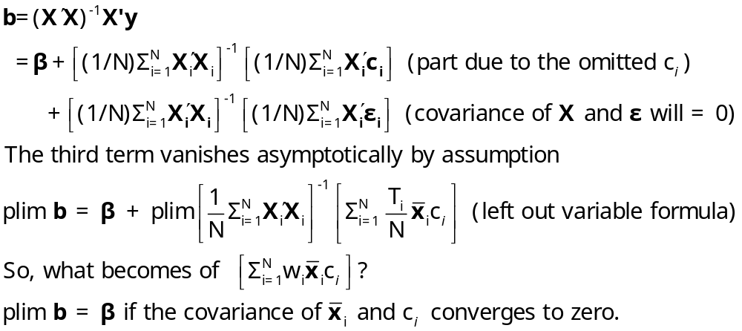
OLS in the Presence of Individual Effects

Slide 32
Estimating the Sampling Variance of b
s²(X ́X)⁻¹? Inappropriate because
  Correlation across observations (certainly)
  Heteroscedasticity (possibly)
A ‘robust’ covariance matrix
  Robust estimation (in general)
  The White estimator
  A Robust estimator for OLS.

Slide 33
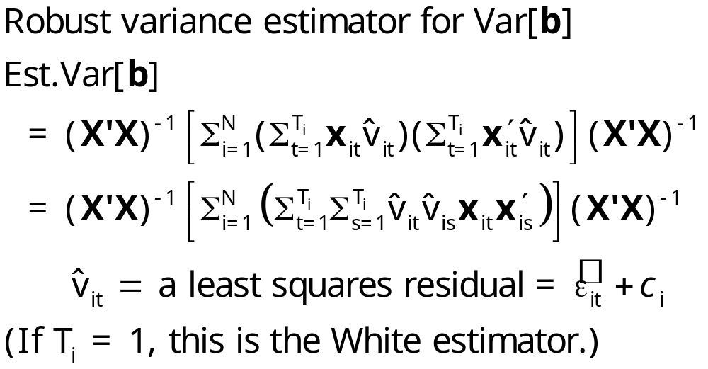
Cluster Estimator

Slide 34
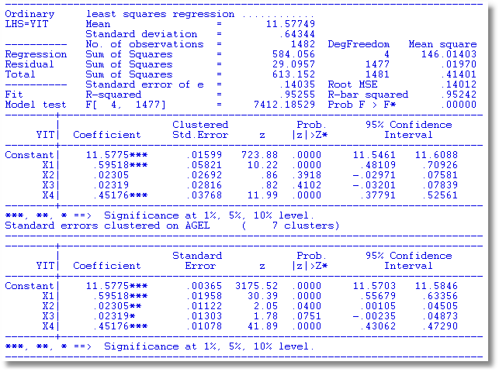

Slide 35

Alternative OLS Variance Estimators
Cluster correction increases SEs
+---------+--------------+----------------+--------+---------+
|Variable | Coefficient | Standard Error |b/St.Er.|P[|Z|>z] |
+---------+--------------+----------------+--------+---------+
Constant 5.40159723 .04838934 111.628 .0000
EXP .04084968 .00218534 18.693 .0000
EXPSQ -.00068788 .480428D-04 -14.318 .0000
OCC -.13830480 .01480107 -9.344 .0000
SMSA .14856267 .01206772 12.311 .0000
MS .06798358 .02074599 3.277 .0010
FEM -.40020215 .02526118 -15.843 .0000
UNION .09409925 .01253203 7.509 .0000
ED .05812166 .00260039 22.351 .0000
Robust
Constant 5.40159723 .10156038 53.186 .0000
EXP .04084968 .00432272 9.450 .0000
EXPSQ -.00068788 .983981D-04 -6.991 .0000
OCC -.13830480 .02772631 -4.988 .0000
SMSA .14856267 .02423668 6.130 .0000
MS .06798358 .04382220 1.551 .1208
FEM -.40020215 .04961926 -8.065 .0000
UNION .09409925 .02422669 3.884 .0001
ED .05812166 .00555697 10.459 .0000

Slide 36
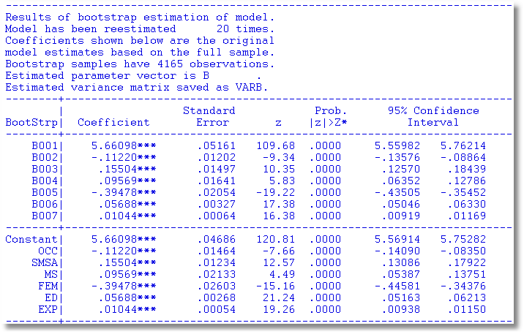
Results of Bootstrap Estimation

Slide 37
Bootstrap variance for a panel data estimator
Panel Bootstrap =
Block Bootstrap
Data set is N groups of size T_{i}
Bootstrap sample is N groups of size T_{i} drawn with replacement.

Slide 38
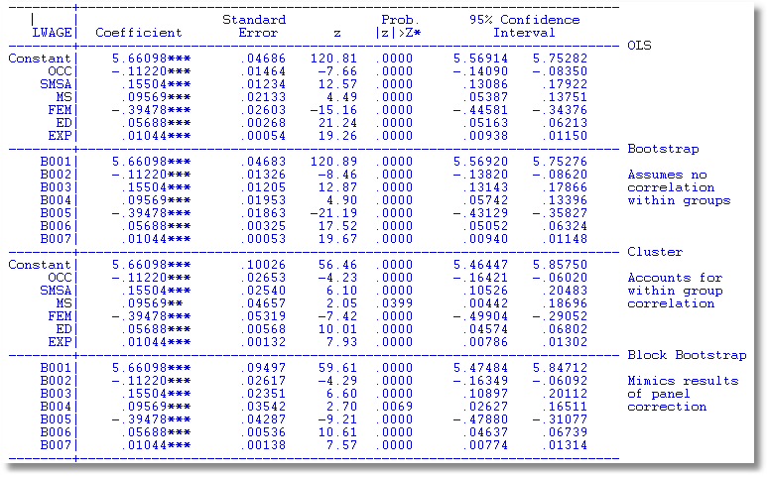

Slide 39
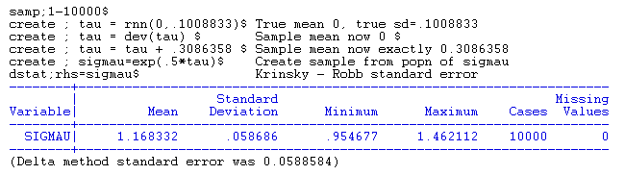
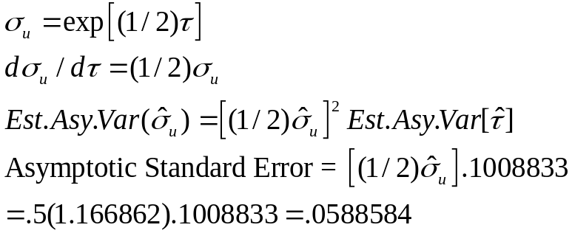
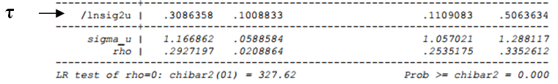
Krinsky and Robb standard error for a nonlinear function

Slide 40
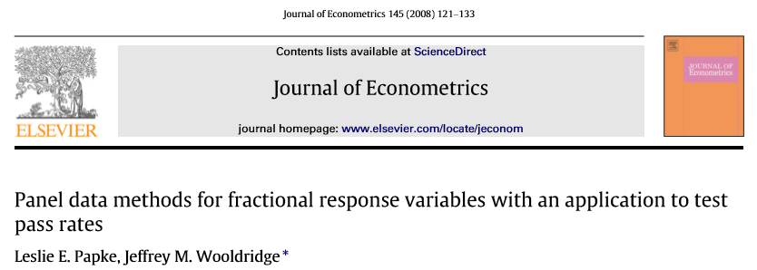
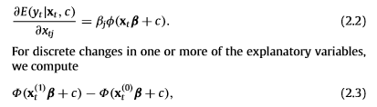

Slide 41
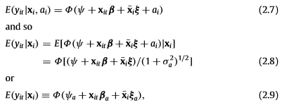

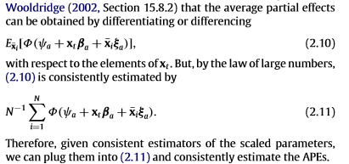

Slide 42
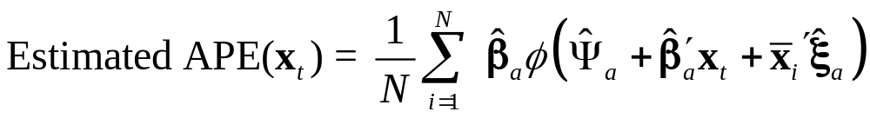
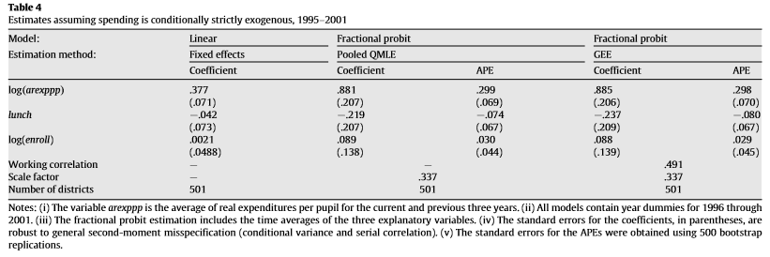

Slide 43
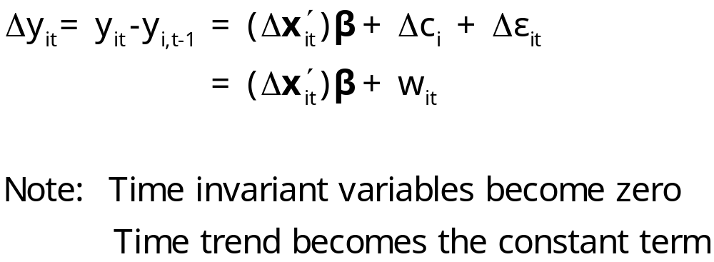
Using First Differences
Eliminating the heterogeneity

Slide 44
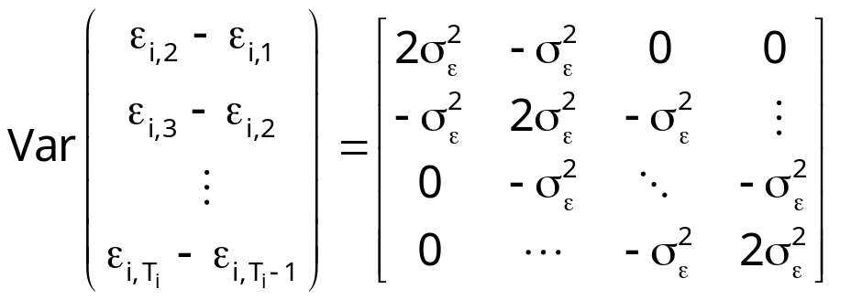
OLS with First Differences
With strict exogeneity of (X_{i},c_{i}), OLS regression of Δy_{it} on Δx_{it} is unbiased and consistent but inefficient.
GLS is unpleasantly complicated. Use OLS in first differences and use Newey-West with one lag.

Slide 45
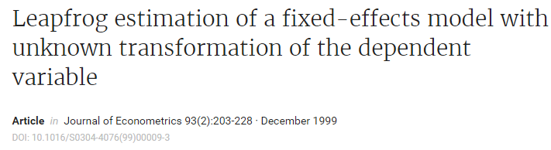
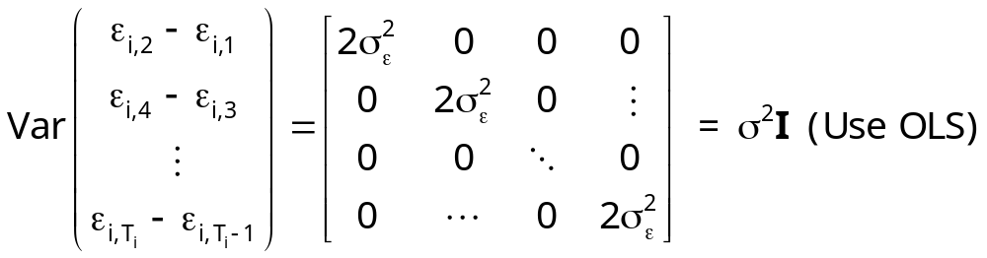
Leapfrog Estimator
Jason Abrevaya

Slide 46
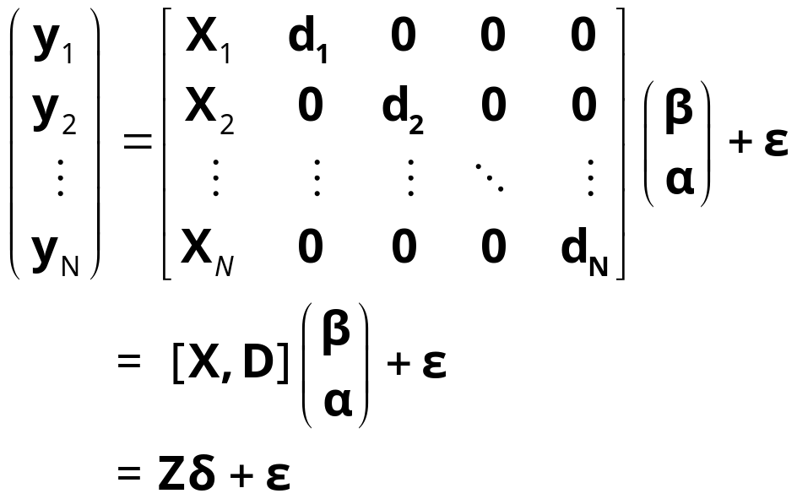
The Fixed Effects Model
y_{i} = X_{i}β + d_{i}α_{i} + ε_{i}, for each individual
  E[c_{i} | X_{i} ] = g(X_{i}); Effects are correlated with included variables.
  Cov[x_{it},c_{i}] ≠0

Slide 47
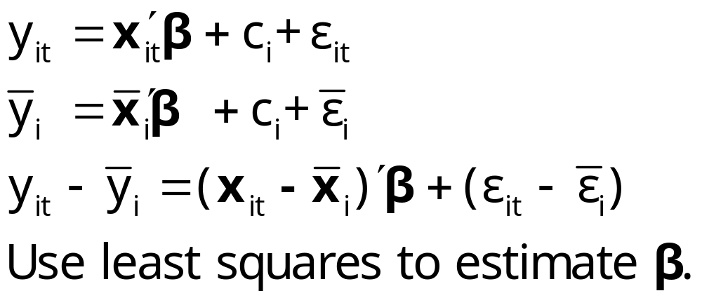
The Within Groups Transformation Removes the Effects

Slide 48
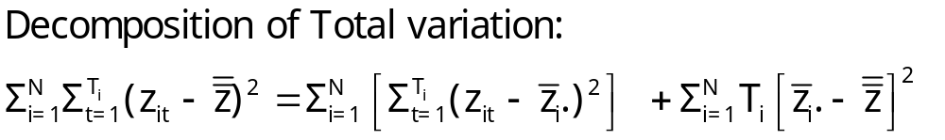
Useful Analysis of Variance Notation
Total variation = Within groups variation
+ Between groups variation
Within groups variation is crucial to the analysis. Without the within groups variation, the sample becomes just a cross section sample of the group means.

Slide 49
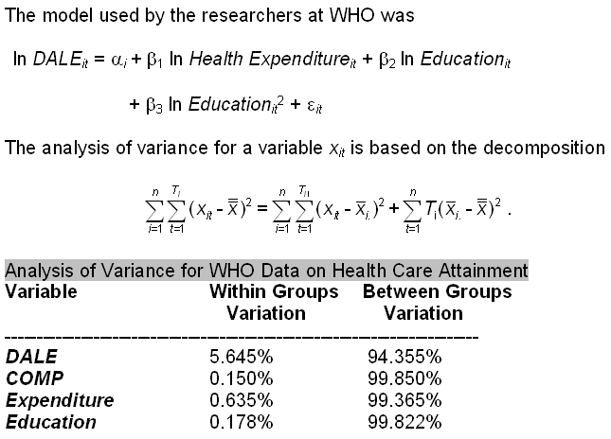

WHO Data

Slide 50
Baltagi and Griffin’s Gasoline Data
World Gasoline Demand Data, 18 OECD Countries, 19 years
Variables in the file are
COUNTRY = name of country
YEAR = year, 1960-1978
LGASPCAR = log of consumption per car
LINCOMEP = log of per capita income
LRPMG = log of real price of gasoline
LCARPCAP = log of per capita number of cars
See Baltagi (2001, p. 24) for analysis of these data. The article on which the analysis is based is Baltagi, B. and Griffin, J., "Gasolne Demand in the OECD: An Application of Pooling and Testing Procedures," European Economic Review, 22, 1983, pp. 117-137. The data were downloaded from the website for Baltagi's text.

Slide 51
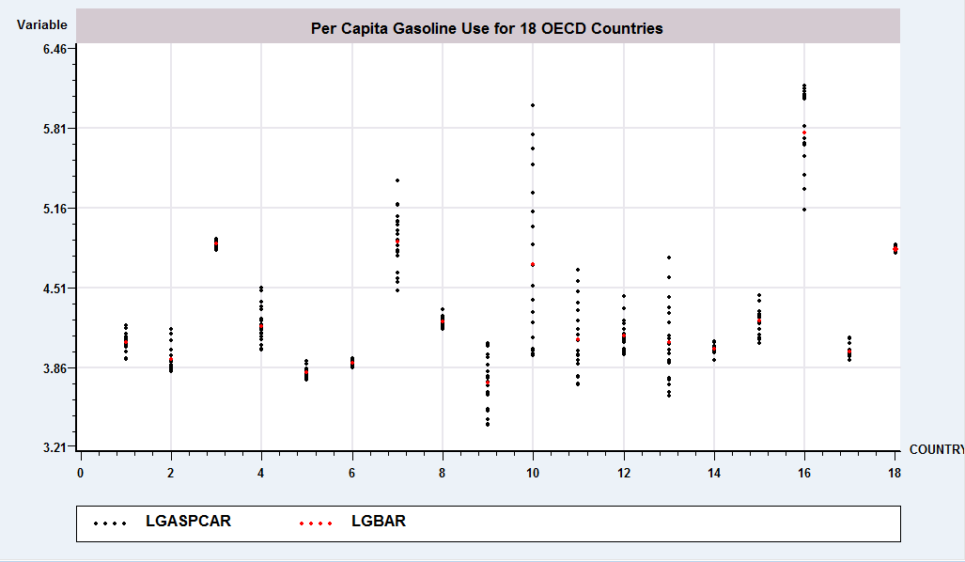
Analysis of Variance

Slide 52
Analysis of Variance
+--------------------------------------------------------------------------+
| Analysis of Variance for LGASPCAR |
| Stratification Variable _STRATUM |
| Observations weighted by ONE |
| Total Sample Size 342 |
| Number of Groups 18 |
| Number of groups with no data 0 |
| Overall Sample Mean 4.2962420 |
| Sample Standard Deviation .5489071 |
| Total Sample Variance .3012990 |
| |
| Source of Variation Variation Deg.Fr. Mean Square |
| Between Groups 85.68228007 17 5.04013 |
| Within Groups 17.06068428 324 .05266 |
| Total 102.74296435 341 .30130 |
| Residual S.D. .22946990 |
| R-squared .83394791 MSB/MSW 21.96425 |
| F ratio 95.71734806 P value .00000 |
+--------------------------------------------------------------------------+

Slide 53
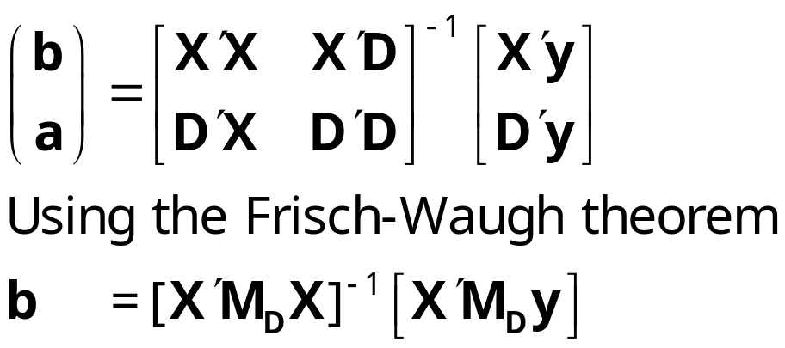
Estimating the Fixed Effects Model
The FEM is a plain vanilla regression model but with many independent variables
Least squares is unbiased, consistent, efficient, but inconvenient if N is large.

Slide 54
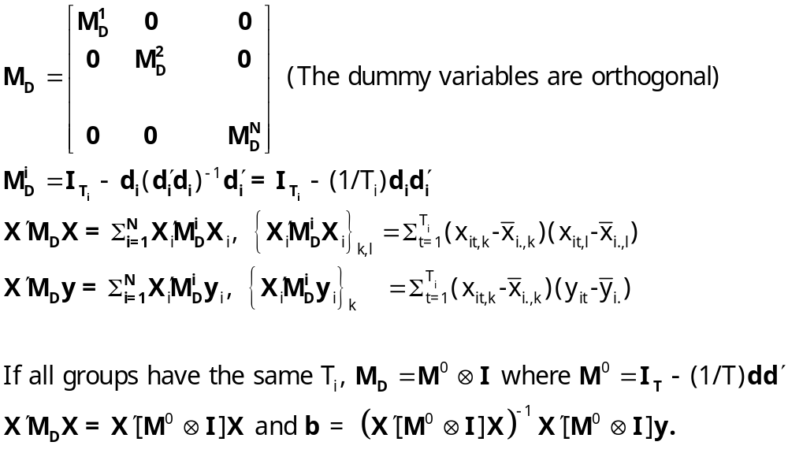
Fixed Effects Estimator (cont.)

Slide 55
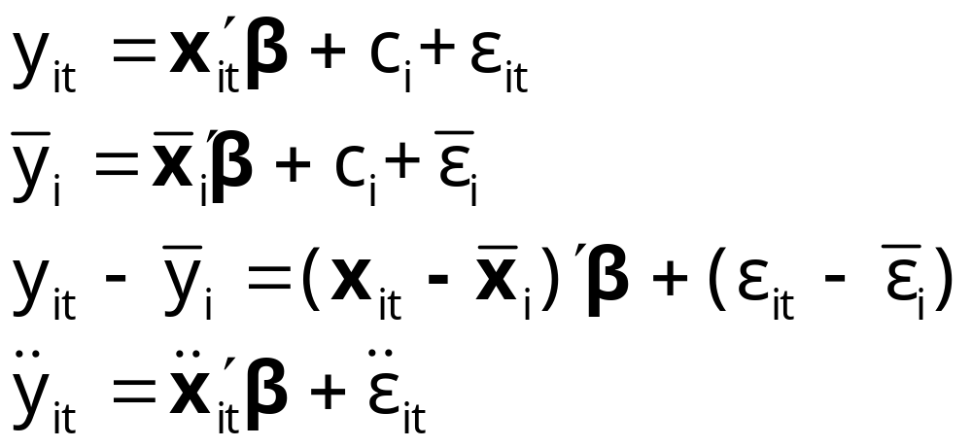
The Within Transformation Removes the Effects
Wooldridge notation for data in deviations from group means

Slide 56
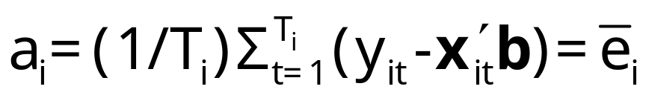
Least Squares Dummy Variable Estimator
b is obtained by ‘within’ groups least squares (group mean deviations)
a is estimated using the normal equations:
D’Xb+D’Da=D’y
a = (D’D)⁻¹D’(y – Xb)

Slide 57
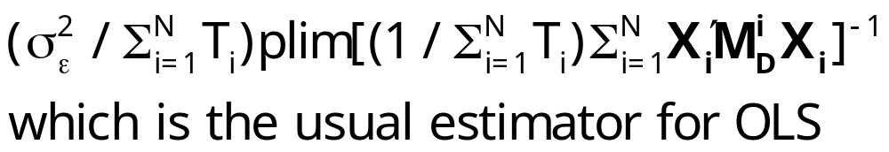
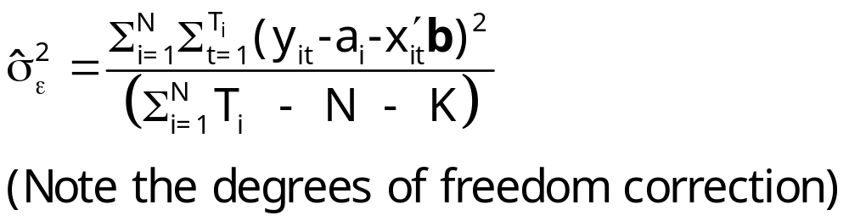
Inference About LSDV
Assume strict exogeneity: Cov[ε_{it},(x_{js},c_{j})]=0. Every disturbance in every period for each person is uncorrelated with variables and effects for every person and across periods.
Now, it’s just least squares in a classical linear regression model.
Asy.Var[b] =

Slide 58
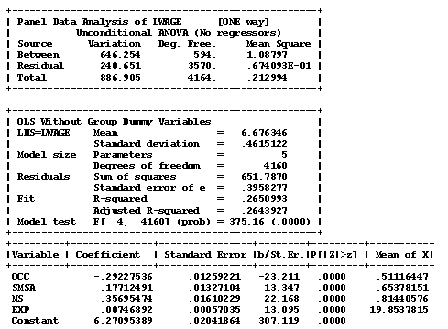
Application Cornwell and Rupert

Slide 59
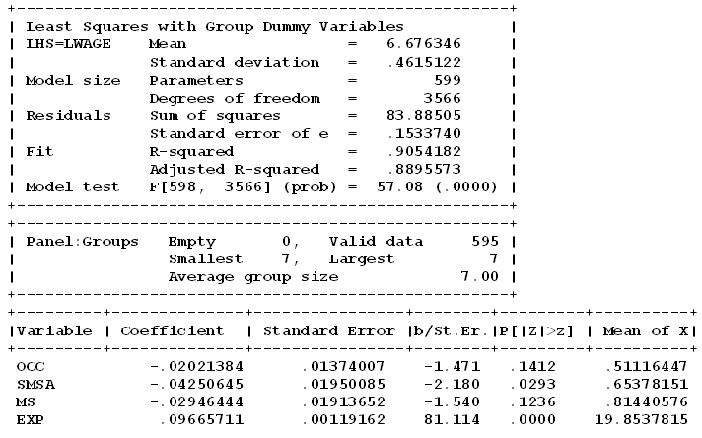

LSDV Results
Note huge changes in the coefficients. SMSA and MS change signs. Significance changes completely!
Pooled OLS

Slide 60
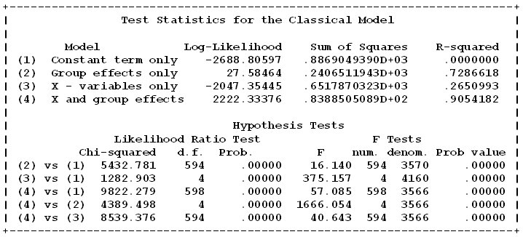
The Effect of the Effects

Slide 61
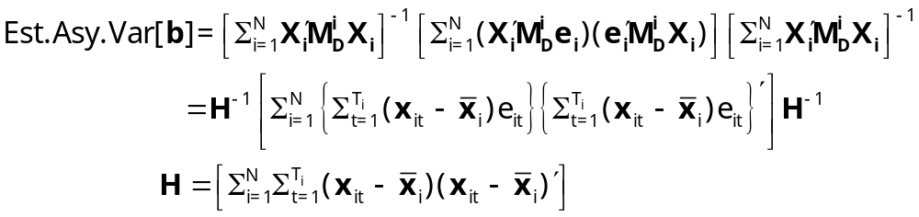
Robust Counterpart to White Estimator?
Assumes Var[ε_{i}] = Ω_{i} ≠σ²I_{Ti}
e_{i} = y_{i} – a_{i}i_{Ti} - X_{i}b = M_{D}y_{i} – M_{D}X_{i}b
(T_{i} x 1 vector of group residuals)
Resembles (and is based on) White, but treats a full vector of disturbances at a time. Robust to heteroscedasticity and autocorrelation (within the groups).

Slide 62
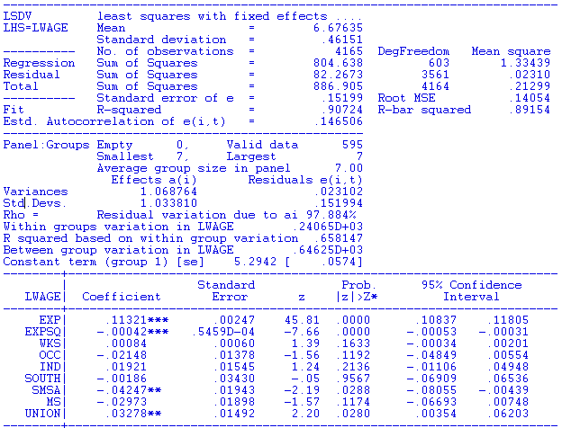


Slide 63
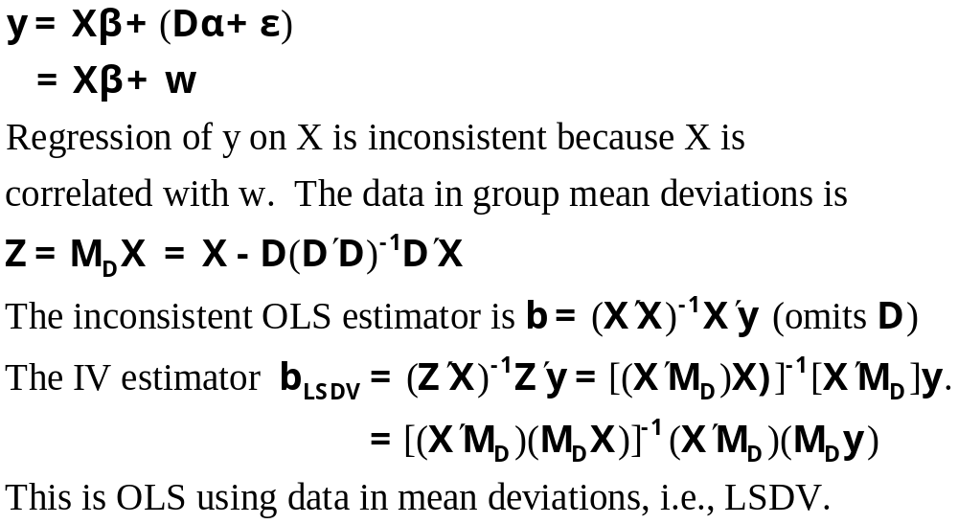
The Within (LSDV) Estimator is an IV Estimator

Slide 64
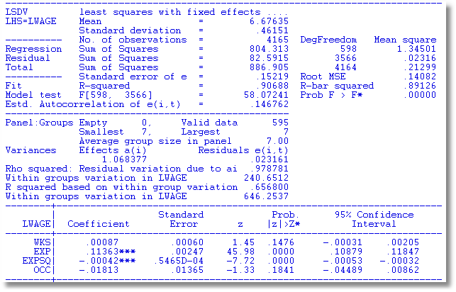
LSDV – As Usual

Slide 65
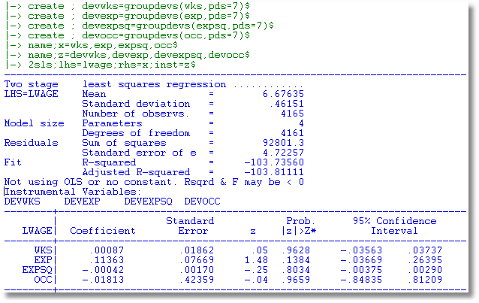
2SLS Using Z=M_{D}X as Instruments

Slide 66
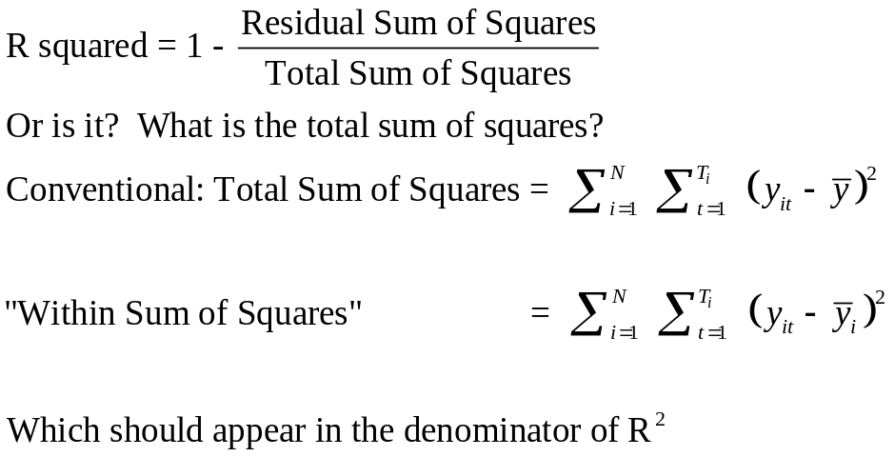
A Caution About Stata and R²
For the FE model above,
R² = 0.90542
R² = 0.65142
The coefficient estimates and standard errors are the same. The calculation of the R² is different. In the areg procedure, you are estimating coefficients for each of your covariates plus each dummy variable for your groups. In the xtreg, fe procedure the R² reported is obtained by only fitting a mean deviated model where the effects of the groups (all of the dummy variables) are assumed to be fixed quantities. So, all of the effects for the groups are simply subtracted out of the model and no attempt is made to quantify their overall effect on the fit of the model.
Since the SSE is the same, the R²=1−SSE/SST is very different. The difference is real in that we are making different assumptions with the two approaches. In the xtreg, fe approach, the effects of the groups are fixed and unestimated quantities are subtracted out of the model before the fit is performed. In the areg approach, the group effects are estimated and affect the total sum of squares of the model under consideration.

Slide 67
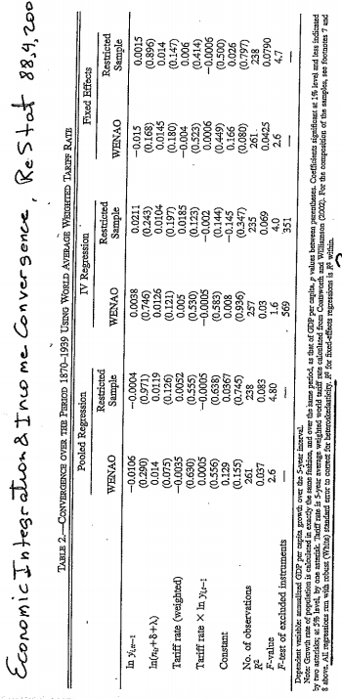
“R² for fixed-effects regression is R² within”

Slide 68
Robust Covariance Matrix for LSDV
Cluster Estimator for Within Estimator
+--------+--------------+----------------+--------+--------+----------+
|Variable| Coefficient | Standard Error |b/St.Er.|P[|Z|>z]| Mean of X|
+--------+--------------+----------------+--------+--------+----------+
|OCC | -.02021 .01374007 -1.471 .1412 .5111645|
|SMSA | -.04251** .01950085 -2.180 .0293 .6537815|
|MS | -.02946 .01913652 -1.540 .1236 .8144058|
|EXP | .09666*** .00119162 81.114 .0000 19.853782|
+--------+------------------------------------------------------------+
+---------------------------------------------------------------------+
| Covariance matrix for the model is adjusted for data clustering. |
| Sample of 4165 observations contained 595 clusters defined by |
| 7 observations (fixed number) in each cluster. |
+---------------------------------------------------------------------+
+--------+--------------+----------------+--------+--------+----------+
|Variable| Coefficient | Standard Error |b/St.Er.|P[|Z|>z]| Mean of X|
+--------+--------------+----------------+--------+--------+----------+
|DOCC | -.02021 .01982162 -1.020 .3078 .00000|
|DSMSA | -.04251 .03091685 -1.375 .1692 .00000|
|DMS | -.02946 .02635035 -1.118 .2635 .00000|
|DEXP | .09666*** .00176599 54.732 .0000 .00000|
+--------+------------------------------------------------------------+

Slide 69



A Caution About Stata and Fixed Effects

Slide 70
Time Invariant Regressors
Time invariant x_{it} is defined as invariant for all i. E.g., sex dummy variable, FEM and ED (education in the Cornwell/Rupert data).
If x_{it,k} is invariant for all t, then the group mean deviations are all 0.

Slide 71
FE With Time Invariant Variables
+----------------------------------------------------+
| There are 2 vars. with no within group variation. |
| FEM ED |
+----------------------------------------------------+
+--------+--------------+----------------+--------+--------+----------+
|Variable| Coefficient | Standard Error |b/St.Er.|P[|Z|>z]| Mean of X|
+--------+--------------+----------------+--------+--------+----------+
EXP | .09671227 .00119137 81.177 .0000 19.8537815
WKS | .00118483 .00060357 1.963 .0496 46.8115246
OCC | -.02145609 .01375327 -1.560 .1187 .51116447
SMSA | -.04454343 .01946544 -2.288 .0221 .65378151
FEM | .000000 ......(Fixed Parameter).......
ED | .000000 ......(Fixed Parameter).......
+--------------------------------------------------------------------+
| Test Statistics for the Classical Model |
+--------------------------------------------------------------------+
| Model Log-Likelihood Sum of Squares R-squared |
|(1) Constant term only -2688.80597 886.90494 .00000 |
|(2) Group effects only 27.58464 240.65119 .72866 |
|(3) X - variables only -1688.12010 548.51596 .38154 |
|(4) X and group effects 2223.20087 83.85013 .90546 |
+--------------------------------------------------------------------+

Slide 72
Drop The Time Invariant Variables
Same Results
+--------+--------------+----------------+--------+--------+----------+
|Variable| Coefficient | Standard Error |b/St.Er.|P[|Z|>z]| Mean of X|
+--------+--------------+----------------+--------+--------+----------+
EXP | .09671227 .00119087 81.211 .0000 19.8537815
WKS | .00118483 .00060332 1.964 .0495 46.8115246
OCC | -.02145609 .01374749 -1.561 .1186 .51116447
SMSA | -.04454343 .01945725 -2.289 .0221 .65378151
+--------------------------------------------------------------------+
| Test Statistics for the Classical Model |
+--------------------------------------------------------------------+
| Model Log-Likelihood Sum of Squares R-squared |
|(1) Constant term only -2688.80597 886.90494 .00000 |
|(2) Group effects only 27.58464 240.65119 .72866 |
|(3) X - variables only -1688.12010 548.51596 .38154 |
|(4) X and group effects 2223.20087 83.85013 .90546 |
+--------------------------------------------------------------------+
No change in the sum of squared residuals

Slide 73

Difference in Differences

Slide 74
http://dera.ioe.ac.uk/14610/1/oft1416.pdf

Slide 75


Outcome is the fees charged.
Activity is collusion on fees.

Slide 76


Treatment Schools: Treatment is an intervention by the Office of Fair Trading
Control Schools were not involved in the conspiracy
Treatment is not voluntary

Slide 77


Slide 78


Slide 79

Treatment (Intervention) Effect = δ

Slide 80

In order to test robustness two versions of the fixed effects model were run. The first is Ordinary Least Squares, and the second is heteroscedasticity and auto-correlation robust (HAC) standard errors in order to check for heteroscedasticity and autocorrelation.

Slide 81


Slide 84
Appendix

Slide 85
Fixed Effects Vector Decomposition
Efficient Estimation of Time Invariant and Rarely Changing Variables in Finite Sample Panel Analyses with Unit Fixed Effects
Thomas Plümper and Vera Troeger
Political Analysis, 2007

Slide 86
Introduction
[T]he FE model … does not allow the estimation of time invariant variables. A second drawback of the FE model … results from its inefficiency in estimating the effect of variables that have very little within variance.
This article discusses a remedy to the related problems of estimating time invariant and rarely changing variables in FE models with unit effects

Slide 87

The Model

Slide 88

Fixed Effects Vector Decomposition
Step 1: Compute the fixed effects regression to get the “estimated unit effects.” “We run this FE model with the sole intention to obtain estimates of the unit effects, α_{i}.”

Slide 89


Step 2
Regress a_{i} on z_{i} and compute residuals

Slide 90

Step 3
Regress y_{it} on a constant, X, Z and h using ordinary least squares to estimate α, β, γ, δ.

Slide 91
Step 1 (Based on full sample)
These 2 variables have no within group variation.
FEM ED
F.E. estimates are based on a generalized inverse.
--------+---------------------------------------------------------
| Standard Prob. Mean
LWAGE| Coefficient Error z z>|Z| of X
--------+---------------------------------------------------------
EXP| .09663*** .00119 81.13 .0000 19.8538
WKS| .00114* .00060 1.88 .0600 46.8115
OCC| -.02496* .01390 -1.80 .0724 .51116
IND| .02042 .01558 1.31 .1899 .39544
SOUTH| -.00091 .03457 -.03 .9791 .29028
SMSA| -.04581** .01955 -2.34 .0191 .65378
UNION| .03411** .01505 2.27 .0234 .36399
FEM| .000 .....(Fixed Parameter)..... .11261
ED| .000 .....(Fixed Parameter)..... 12.8454
--------+---------------------------------------------------------

Slide 92
Step 2 (Based on 595 observations)
--------+---------------------------------------------------------
| Standard Prob. Mean
UHI| Coefficient Error z z>|Z| of X
--------+---------------------------------------------------------
Constant| 2.88090*** .07172 40.17 .0000
FEM| -.09963** .04842 -2.06 .0396 .11261
ED| .14616*** .00541 27.02 .0000 12.8454
--------+---------------------------------------------------------

Slide 93
Step 3!
--------+---------------------------------------------------------
| Standard Prob. Mean
LWAGE| Coefficient Error z z>|Z| of X
--------+---------------------------------------------------------
Constant| 2.88090*** .03282 87.78 .0000
EXP| .09663*** .00061 157.53 .0000 19.8538
WKS| .00114*** .00044 2.58 .0098 46.8115
OCC| -.02496*** .00601 -4.16 .0000 .51116
IND| .02042*** .00479 4.26 .0000 .39544
SOUTH| -.00091 .00510 -.18 .8590 .29028
SMSA| -.04581*** .00506 -9.06 .0000 .65378
UNION| .03411*** .00521 6.55 .0000 .36399
FEM| -.09963*** .00767 -13.00 .0000 .11261
ED| .14616*** .00122 120.19 .0000 12.8454
HI| 1.00000*** .00670 149.26 .0000 -.103D-13
--------+---------------------------------------------------------

Slide 94


Slide 95

What happened here?

Slide 96

http://davegiles.blogspot.com/2012/06/fixed-effects-vector-decomposition.html

Slide 97


