Slide 1

Econometrics I
Professor William Greene
Stern School of Business
Department of Economics

Slide 2
Econometrics I
Part 16 – Panel Data-2

Slide 3
The Random Effects Model
The random effects model
c_{i} is uncorrelated with x_{it} for all t;
  E[c_{i} |X_{i}] = 0
  E[ε_{it}|X_{i},c_{i}]=0

Slide 4
Notation

Slide 5
Error Components Model
A Generalized Regression Model

Slide 6
Notation

Slide 7
Convergence of Moments

Slide 8
Random vs. Fixed Effects
Random Effects
  Small number of parameters
  Efficient estimation
  Objectionable orthogonality assumption (c_{i} ⊥ X_{i})
Fixed Effects
  Robust – generally consistent
  Large number of parameters

Slide 9
Ordinary Least Squares
Standard results for OLS in a GR model
  Consistent
  Unbiased
  Inefficient
True variance of the least squares estimator

Slide 10
Estimating the Variance for OLS

Slide 11
OLS Results for Cornwell and Rupert
+----------------------------------------------------+
| Residuals Sum of squares = 522.2008 |
| Standard error of e = .3544712 |
| Fit R-squared = .4112099 |
| Adjusted R-squared = .4100766 |
+----------------------------------------------------+
+---------+--------------+----------------+--------+---------+----------+
|Variable | Coefficient | Standard Error |b/St.Er.|P[|Z|>z] | Mean of X|
+---------+--------------+----------------+--------+---------+----------+
Constant 5.40159723 .04838934 111.628 .0000
EXP .04084968 .00218534 18.693 .0000 19.8537815
EXPSQ -.00068788 .480428D-04 -14.318 .0000 514.405042
OCC -.13830480 .01480107 -9.344 .0000 .51116447
SMSA .14856267 .01206772 12.311 .0000 .65378151
MS .06798358 .02074599 3.277 .0010 .81440576
FEM -.40020215 .02526118 -15.843 .0000 .11260504
UNION .09409925 .01253203 7.509 .0000 .36398559
ED .05812166 .00260039 22.351 .0000 12.8453782

Slide 12
Alternative Variance Estimators
+---------+--------------+----------------+--------+---------+
|Variable | Coefficient | Standard Error |b/St.Er.|P[|Z|>z] |
+---------+--------------+----------------+--------+---------+
Constant 5.40159723 .04838934 111.628 .0000
EXP .04084968 .00218534 18.693 .0000
EXPSQ -.00068788 .480428D-04 -14.318 .0000
OCC -.13830480 .01480107 -9.344 .0000
SMSA .14856267 .01206772 12.311 .0000
MS .06798358 .02074599 3.277 .0010
FEM -.40020215 .02526118 -15.843 .0000
UNION .09409925 .01253203 7.509 .0000
ED .05812166 .00260039 22.351 .0000
Robust – Cluster___________________________________________
Constant 5.40159723 .10156038 53.186 .0000
EXP .04084968 .00432272 9.450 .0000
EXPSQ -.00068788 .983981D-04 -6.991 .0000
OCC -.13830480 .02772631 -4.988 .0000
SMSA .14856267 .02423668 6.130 .0000
MS .06798358 .04382220 1.551 .1208
FEM -.40020215 .04961926 -8.065 .0000
UNION .09409925 .02422669 3.884 .0001
ED .05812166 .00555697 10.459 .0000

Slide 13
Generalized Least Squares

Slide 14
Generalized Least Squares

Slide 15
Estimators for the Variances

Slide 16
Practical Problems with FGLS

Slide 17
Stata Variance Estimators

Slide 18
Other Variance Estimators
x´ does not contain a constant term in the preceding.

Slide 19
Fixed Effects Estimates
----------------------------------------------------------------------
Least Squares with Group Dummy Variables..........
LHS=LWAGE Mean = 6.67635
Residuals Sum of squares = 82.34912
Standard error of e = .15205
These 2 variables have no within group variation.
FEM ED
F.E. estimates are based on a generalized inverse.
--------+-------------------------------------------------------------
Variable| Coefficient Standard Error b/St.Er. P[|Z|>z] Mean of X
--------+-------------------------------------------------------------
EXP| .11346*** .00247 45.982 .0000 19.8538
EXPSQ| -.00042*** .544864D-04 -7.789 .0000 514.405
OCC| -.02106 .01373 -1.534 .1251 .51116
SMSA| -.04209** .01934 -2.177 .0295 .65378
MS| -.02915 .01897 -1.536 .1245 .81441
FEM| .000 ......(Fixed Parameter).......
UNION| .03413** .01491 2.290 .0220 .36399
ED| .000 ......(Fixed Parameter).......
--------+-------------------------------------------------------------

Slide 20
Computing Variance Estimators

Slide 21
Application
----------------------------------------------------------------------
Random Effects Model: v(i,t) = e(i,t) + u(i)
Estimates: Var[e] = .023119
Var[u] = .102531
Corr[v(i,t),v(i,s)] = .816006
Lagrange Multiplier Test vs. Model (3) =3713.07
( 1 degrees of freedom, prob. value = .000000)
(High values of LM favor FEM/REM over CR model)
Fixed vs. Random Effects (Hausman) = .00 (Cannot be computed)
( 8 degrees of freedom, prob. value = 1.000000)
(High (low) values of H favor F.E.(R.E.) model)
Sum of Squares 1411.241136
R-squared -.591198
+---------+--------------+----------------+--------+---------+----------+
|Variable | Coefficient | Standard Error |b/St.Er.|P[|Z|>z] | Mean of X|
+---------+--------------+----------------+--------+---------+----------+
EXP .08819204 .00224823 39.227 .0000 19.8537815
EXPSQ -.00076604 .496074D-04 -15.442 .0000 514.405042
OCC -.04243576 .01298466 -3.268 .0011 .51116447
SMSA -.03404260 .01620508 -2.101 .0357 .65378151
MS -.06708159 .01794516 -3.738 .0002 .81440576
FEM -.34346104 .04536453 -7.571 .0000 .11260504
UNION .05752770 .01350031 4.261 .0000 .36398559
ED .11028379 .00510008 21.624 .0000 12.8453782
Constant 4.01913257 .07724830 52.029 .0000

Slide 22
Testing for Effects: An LM Test

Slide 23
Application: Cornwell-Rupert

Slide 24
Testing for Effects
Regress; lhs=lwage;rhs=fixedx,varyingx;res=e$
Matrix ; tebar=7*gxbr(e,person)$
Calc ; list;lm=595*7/(2*(7-1))*
(tebar'tebar/sumsqdev - 1)^2$
LM = 3797.06757

Slide 25
A Hausman Test for FE vs. RE
Estimator | Random Effects E[c_{i}|X_{i}] = 0 | Fixed Effects E[c_{i}|X_{i}] ≠ 0
FGLS (Random Effects) | Consistent and Efficient | Inconsistent
LSDV (Fixed Effects) | Consistent Inefficient | Consistent Possibly Efficient

Slide 26
Computing the Hausman Statistic
β does not contain the constant term in the preceding.

Slide 27
Hausman Test
+--------------------------------------------------+
| Random Effects Model: v(i,t) = e(i,t) + u(i) |
| Estimates: Var[e] = .235368D-01 |
| Var[u] = .110254D+00 |
| Corr[v(i,t),v(i,s)] = .824078 |
| Lagrange Multiplier Test vs. Model (3) = 3797.07 |
| ( 1 df, prob value = .000000) |
| (High values of LM favor FEM/REM over CR model.) |
| Fixed vs. Random Effects (Hausman) = 2632.34 |
| ( 4 df, prob value = .000000) |
| (High (low) values of H favor FEM (REM).) |
+--------------------------------------------------+

Slide 28
Fixed Effects
+----------------------------------------------------+
| Panel:Groups Empty 0, Valid data 595 |
| Smallest 7, Largest 7 |
| Average group size 7.00 |
| There are 2 vars. with no within group variation. |
| ED FEM |
| Look for huge standard errors and fixed parameters.|
| F.E. results are based on a generalized inverse. |
| They will be highly erratic. (Problematic model.) |
| Unable to compute std.errors for dummy var. coeffs.|
+----------------------------------------------------+
+--------+--------------+----------------+--------+--------+----------+
|Variable| Coefficient | Standard Error |b/St.Er.|P[|Z|>z]| Mean of X|
+--------+--------------+----------------+--------+--------+----------+
|WKS | .00083 .00060003 1.381 .1672 46.811525|
|OCC | -.02157 .01379216 -1.564 .1178 .5111645|
|IND | .01888 .01545450 1.221 .2219 .3954382|
|SOUTH | .00039 .03429053 .011 .9909 .2902761|
|SMSA | -.04451** .01939659 -2.295 .0217 .6537815|
|UNION | .03274** .01493217 2.192 .0283 .3639856|
|EXP | .11327*** .00247221 45.819 .0000 19.853782|
|EXPSQ | -.00042*** .546283D-04 -7.664 .0000 514.40504|
|ED | .000 ......(Fixed Parameter)....... |
|FEM | .000 ......(Fixed Parameter)....... |
+--------+------------------------------------------------------------+

Slide 29
Random Effects
+--------------------------------------------------+
| Random Effects Model: v(i,t) = e(i,t) + u(i) |
| Estimates: Var[e] = .235368D-01 |
| Var[u] = .110254D+00 |
| Corr[v(i,t),v(i,s)] = .824078 |
| Lagrange Multiplier Test vs. Model (3) = 3797.07 |
| ( 1 df, prob value = .000000) |
| (High values of LM favor FEM/REM over CR model.) |
+--------------------------------------------------+
+--------+--------------+----------------+--------+--------+----------+
|Variable| Coefficient | Standard Error |b/St.Er.|P[|Z|>z]| Mean of X|
+--------+--------------+----------------+--------+--------+----------+
|WKS | .00094 .00059308 1.586 .1128 46.811525|
|OCC | -.04367*** .01299206 -3.361 .0008 .5111645|
|IND | .00271 .01373256 .197 .8434 .3954382|
|SOUTH | -.00664 .02246416 -.295 .7677 .2902761|
|SMSA | -.03117* .01615455 -1.930 .0536 .6537815|
|UNION | .05802*** .01349982 4.298 .0000 .3639856|
|EXP | .08744*** .00224705 38.913 .0000 19.853782|
|EXPSQ | -.00076*** .495876D-04 -15.411 .0000 514.40504|
|ED | .10724*** .00511463 20.967 .0000 12.845378|
|FEM | -.24786*** .04283536 -5.786 .0000 .1126050|
|Constant| 3.97756*** .08178139 48.637 .0000 |
+--------+------------------------------------------------------------+

Slide 30
The Hausman Test, by Hand
--> matrix; br=b(1:8) ; vr=varb(1:8,1:8)$
--> matrix ; db = bf - br ; dv = vf - vr $
--> matrix ; list ; h =db'<dv>db$
Matrix H has 1 rows and 1 columns.
1
+--------------
1| 2523.64910
--> calc;list;ctb(.95,8)$
+------------------------------------+
| Listed Calculator Results |
+------------------------------------+
Result = 15.507313

Slide 31
Hello, professor greene.
I’ve taken the liberty of attaching some LIMDEP output in order to ask your view on whether my Hausman test stat is “large,” requiring the FEM, or not, allowing me to use the (much better for my research) REM.
Specifically, my test statistic, corrected for heteroscedasticity, is about 34 and significant with 6 df.
I considered this a large value until I found your “assignment 2” on the internet which shows a value of 2554 with 4 df. Now, I’d like to assert that 34/6 is a small value.

Slide 32
Variable Addition

Slide 33
A Variable Addition Test
Asymptotic equivalent to Hausman
Also equivalent to Mundlak formulation
In the random effects model, using FGLS
  Only applies to time varying variables
  Add expanded group means to the regression (i.e., observation i,t gets same group means for all t.
  Use Wald test to test for coefficients on means equal to 0. Large chi-squared weighs against random effects specification.

Slide 34
Means Added to REM - Mundlak
+--------+--------------+----------------+--------+--------+----------+
|Variable| Coefficient | Standard Error |b/St.Er.|P[|Z|>z]| Mean of X|
+--------+--------------+----------------+--------+--------+----------+
|WKS | .00083 .00060070 1.380 .1677 46.811525|
|OCC | -.02157 .01380769 -1.562 .1182 .5111645|
|IND | .01888 .01547189 1.220 .2224 .3954382|
|SOUTH | .00039 .03432914 .011 .9909 .2902761|
|SMSA | -.04451** .01941842 -2.292 .0219 .6537815|
|UNION | .03274** .01494898 2.190 .0285 .3639856|
|EXP | .11327*** .00247500 45.768 .0000 19.853782|
|EXPSQ | -.00042*** .546898D-04 -7.655 .0000 514.40504|
|ED | .05199*** .00552893 9.404 .0000 12.845378|
|FEM | -.41306*** .03732204 -11.067 .0000 .1126050|
|WKSB | .00863** .00363907 2.371 .0177 46.811525|
|OCCB | -.14656*** .03640885 -4.025 .0001 .5111645|
|INDB | .04142 .02976363 1.392 .1640 .3954382|
|SOUTHB | -.05551 .04297816 -1.292 .1965 .2902761|
|SMSAB | .21607*** .03213205 6.724 .0000 .6537815|
|UNIONB | .08152** .03266438 2.496 .0126 .3639856|
|EXPB | -.08005*** .00533603 -15.002 .0000 19.853782|
|EXPSQB | -.00017 .00011763 -1.416 .1567 514.40504|
|Constant| 5.19036*** .20147201 25.762 .0000 |
+--------+------------------------------------------------------------+

Slide 35
Wu (Variable Addition) Test
--> matrix ; bm=b(12:19);vm=varb(12:19,12:19)$
--> matrix ; list ; wu = bm'<vm>bm $
Matrix WU has 1 rows and 1 columns.
1
+--------------
1| 3004.38076

Slide 36
LSDV is a Control Function Estimator

Slide 37
LSDV is a Control Function Estimator

Slide 38
LSDV is a Control Function Estimator

Slide 39
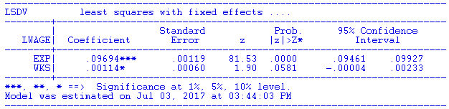
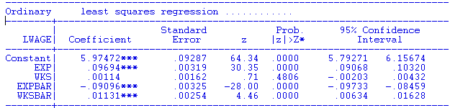
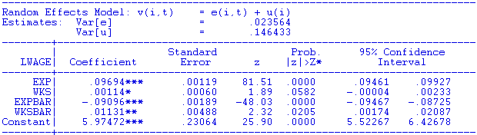

Slide 40
A Hierarchical Linear Model
Interpretation of the FE Model

Slide 41
Hierarchical Linear Model as REM
+--------------------------------------------------+
| Random Effects Model: v(i,t) = e(i,t) + u(i) |
| Estimates: Var[e] = .235368D-01 |
| Var[u] = .110254D+00 |
| Corr[v(i,t),v(i,s)] = .824078 |
| Sigma(u) = 0.3303 |
+--------------------------------------------------+
+--------+--------------+----------------+--------+--------+----------+
|Variable| Coefficient | Standard Error |b/St.Er.|P[|Z|>z]| Mean of X|
+--------+--------------+----------------+--------+--------+----------+
OCC | -.03908144 .01298962 -3.009 .0026 .51116447
SMSA | -.03881553 .01645862 -2.358 .0184 .65378151
MS | -.06557030 .01815465 -3.612 .0003 .81440576
EXP | .05737298 .00088467 64.852 .0000 19.8537815
FEM | -.34715010 .04681514 -7.415 .0000 .11260504
ED | .11120152 .00525209 21.173 .0000 12.8453782
Constant| 4.24669585 .07763394 54.702 .0000

Slide 42
Evolution: Correlated Random Effects

Slide 43
Mundlak’s Estimator
Mundlak, Y., “On the Pooling of Time Series and Cross Section Data, Econometrica, 46, 1978, pp. 69-85.

Slide 44
Mundlak’s Approach for an FE Model with Time Invariant Variables

Slide 45
Mundlak Form of FE Model
+--------+--------------+----------------+--------+--------+----------+
|Variable| Coefficient | Standard Error |b/St.Er.|P[|Z|>z]| Mean of X|
+--------+--------------+----------------+--------+--------+----------+
x(i,t)=================================================================
OCC | -.02021384 .01375165 -1.470 .1416 .51116447
SMSA | -.04250645 .01951727 -2.178 .0294 .65378151
MS | -.02946444 .01915264 -1.538 .1240 .81440576
EXP | .09665711 .00119262 81.046 .0000 19.8537815
z(i)===================================================================
FEM | -.34322129 .05725632 -5.994 .0000 .11260504
ED | .05099781 .00575551 8.861 .0000 12.8453782
Means of x(i,t) and constant===========================================
Constant| 5.72655261 .10300460 55.595 .0000
OCCB | -.10850252 .03635921 -2.984 .0028 .51116447
SMSAB | .22934020 .03282197 6.987 .0000 .65378151
MSB | .20453332 .05329948 3.837 .0001 .81440576
EXPB | -.08988632 .00165025 -54.468 .0000 19.8537815
Variance Estimates=====================================================
Var[e]| .0235632
Var[u]| .0773825

Slide 46
Panel Data Extensions
Dynamic models: lagged effects of the dependent variable
Endogenous RHS variables
Cross country comparisons– large T
More general parameter heterogeneity – not only the constant term
Nonlinear models such as binary choice

Slide 47
The Hausman and Taylor Model

Slide 48
H&T’s 4 Step FGLS Estimator

Slide 49
H&T’s 4 STEP IV Estimator

Slide 51
Arellano/Bond/Bover’s Formulation Builds on Hausman and Taylor

Slide 52
Arellano/Bond/Bover’s Formulation Adds a Lagged DV to H&T
This formulation is the same as H&T with y_{i,t-1} contained in x2_{it} .

Slide 53
Dynamic (Linear) Panel
Data (DPD) Models
Application
Bias in Conventional Estimation
Development of Consistent Estimators
Efficient GMM Estimators

Slide 54
Dynamic Linear Model

Slide 55
A General DPD model

Slide 56
Arellano and Bond Estimator

Slide 57
Arellano and Bond Estimator

Slide 58
Arellano and Bond Estimator

Slide 59
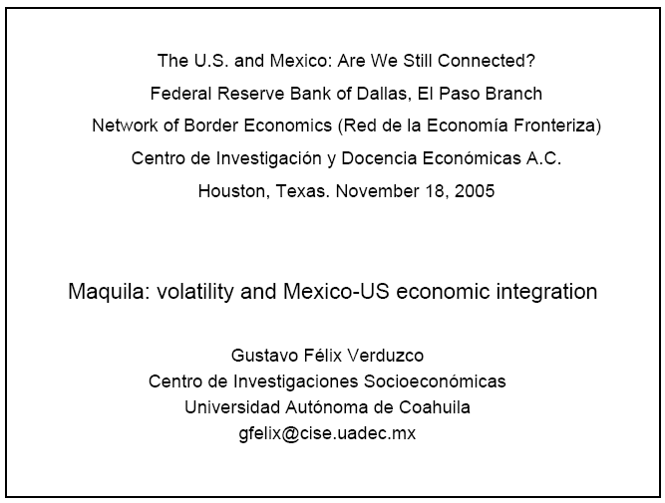
Application: Maquiladora
http://www.dallasfed.org/news/research/2005/05us-mexico_felix.pdf

Slide 60
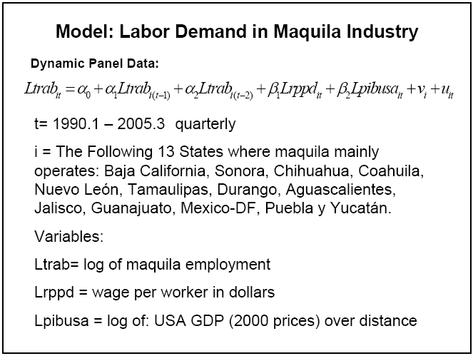
Maquiladora

Slide 61
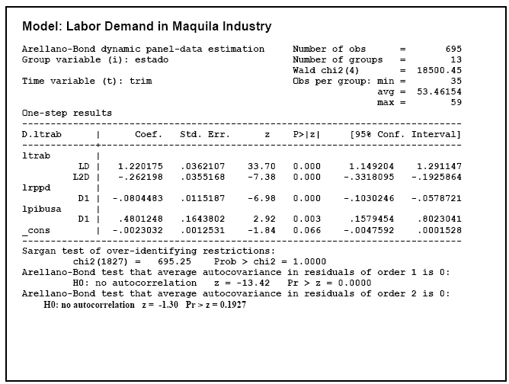
Estimates

