Slide 1

Econometrics I
Professor William Greene
Stern School of Business
Department of Economics

Slide 2
Econometrics I
Part 17 – Nonlinear
Regression

Slide 3
Nonlinear Regression
Nonlinearity and Nonlinear Models
Estimation Criterion
Iterative Algorithm

Slide 4
Nonlinear Regression
What makes a regression model “nonlinear?”
Nonlinear functional form?
Regression model: y_{i} = f(x_{i},β) + ε_{i}
Not necessarily: y_{i} = exp(α) + β₂*log(x_{i})+ ε_{i}
β₁ = exp(α)
y_{i} = exp(α)x_{i}^{β2}exp(ε_{i}) is “loglinear”
Models can be nonlinear in the functional form of the relationship between y and x, and not be nonlinear for purposes here.
We will redefine “nonlinear” shortly, as we proceed.

Slide 5
Least Squares
Least squares: Minimize wrt β
S(β) = ½ Σ_{i} {y_{i} - E[y_{i}|x_{i},β]}²
= ½ Σ_{i} [y_{i} - f(x_{i},β)]²
= ½ Σ_{i} e_{i}²
First order conditions: ∂S(β)/∂β = 0
∂{½Σ_{i}[y_{i}- f(x_{i},β)]²}/∂β
= ½Σ_{i}(-2)[y_{i}- f(x_{i},β)] ∂f(x_{i},β)/∂β
= -Σ_{i} e_{i}x_{i}⁰ = 0 (familiar?)
There is no explicit solution, b = f(data) like LS.
(Nonlinearity of the FOC defines nonlinear model)

Slide 6
Example
How to solve this kind of set of equations: Example,
y_{i} = β0 + β1x_{i}^{β2} + ε_{i}.
∂[ ½Σ_{i} e_{i}²]/∂β0 = Σ_{i} (-1) (y_{i} - β0 - β1x_{i}^{β2}) 1 = 0
∂[ ½Σ_{i} e_{i}²]/∂β1 = Σ_{i} (-1) (y_{i} - β0 - β1 x_{i}^{β2}) x_{i}^{β2} = 0
∂[ ½Σ_{i} e_{i}²]/∂β2 = Σ_{i} (-1) (y_{i} - β0 - β1 x_{i}^{β2}) β1 x_{i}^{β2}lnx_{i} = 0
Nonlinear equations require a nonlinear solution.
This defines a nonlinear regression model.
I.e., when the first order conditions are not linear in β.
(!!!) Check your understanding. What does this produce if
f(x_{i},β) = x_{i}′β? (I.e., a linear model)

Slide 7
The Linearized Regression Model
Linear Taylor series: y = f(x_{i},β) + ε.
Expand the regression around some point, β*.
f(x_{i},β) ≈ f(x_{i},β*) + Σ_{k}[∂f(x_{i},β*)/∂β_{k}*]( β_{k} - β_{k}*)
= f(x_{i},β*) + Σ_{k} x_{ik}⁰(β_{k} - β_{k}*)
= [f(x_{i},β*) - Σ_{k} x_{ik}⁰β_{k}*] + Σ_{k} x_{i}⁰β_{k}
= f⁰ + Σ_{k} x_{ik}⁰β_{k} which looks linear.
x_{ik}⁰ = the derivative wrt β_{k} evaluated at β*
The ‘pseudo-regressors’ are the derivative functions in the linearized model.

Slide 8
Estimating Asy.Var[b]
Computing the asymptotic covariance matrix for the nonlinear least squares estimator using the pseudo regressors and the sum of squares.

Slide 9
Gauss-Marquardt Algorithm
Given a coefficient vector b(m), at step m, find the vector for step m+1 by
b(m+1) = b(m) + [X⁰(m)′X⁰(m)]⁻¹X⁰(m)′e⁰(m)
Columns of X⁰(m) are the derivatives, ∂f(x_{i},b(m))/∂b(m)′
e⁰ = vector of residuals, y - f[x,b(m)]
“Update” vector is the slopes in the regression of the residuals on the pseudo-regressors. Update is zero when they are orthogonal. (Just like LS)

Slide 10
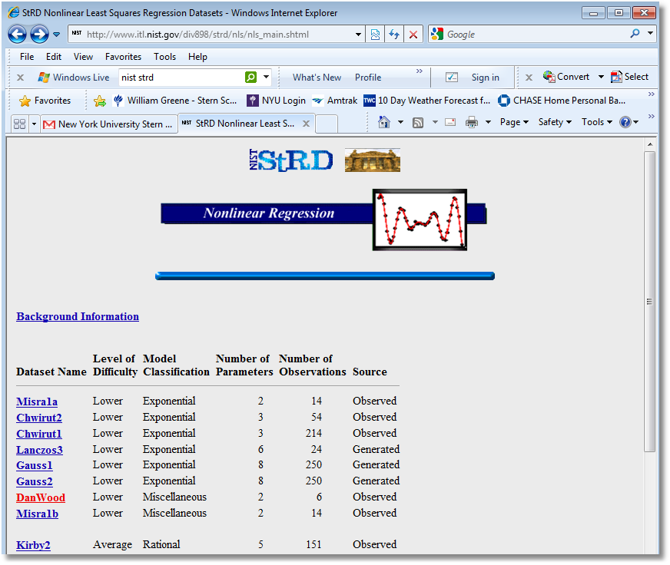

Slide 11
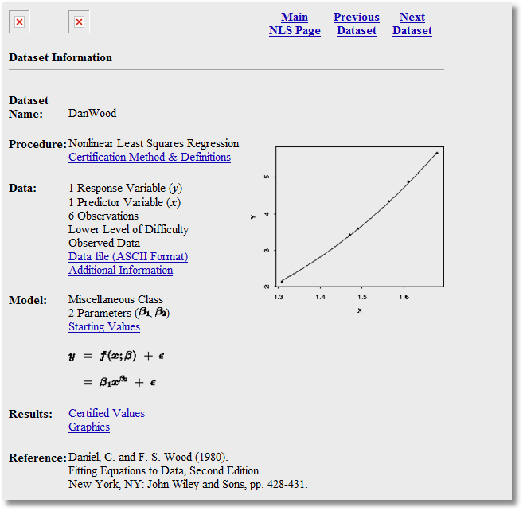

Slide 12
The NIST Dan Wood Application
Y X
2.138 1.309
3.421 1.471
3.597 1.490 y = β₁x^{β2} + ε.
4.340 1.565
4.882 1.611 x_{i}⁰ = [x^{β2}, β₁x^{β2}logx ]
5.660 1.680

Slide 13
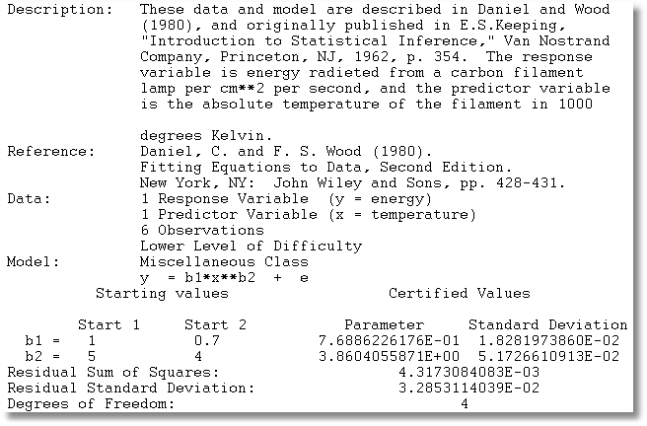
Dan Wood Solution

Slide 14
Iterations
NLSQ;LHS=Y ;FCN=B1*X^B2 ;LABELS=B1,B2
;MAXIT=500;TLF;TLB;OUTPUT=1;DFC ;START=1,5 $
Begin NLSQ iterations. Linearized regression.
Iteration= 1; Sum of squares= 149.719219 ; Gradient = 149.717729
Iteration= 2; Sum of squares= 4.61087813 ; Gradient = 4.60758767
Iteration= 3; Sum of squares= .316841645E-01; Gradient = .273915086E-01
Iteration= 4; Sum of squares= .432059390E-02; Gradient = .328593114E-05
Iteration= 5; Sum of squares= .431730841E-02; Gradient = .383744563E-11
Iteration= 6; Sum of squares= .431730841E-02; Gradient = .225037906E-15
Iteration= 7; Sum of squares= .431730841E-02; Gradient = .140146409E-19
Iteration= 8; Sum of squares= .431730841E-02; Gradient = .162996996E-23
Convergence achieved

Slide 15
Results
-----------------------------------------------------------------------------
User Defined Optimization.........................
Nonlinear least squares regression ............
LHS=Y Mean = 4.00633
Standard deviation = 1.23398
Number of observs. = 6
Model size Parameters = 2
Degrees of freedom = 4
Residuals Sum of squares = .431731E-02
Standard error of e = .03285
Fit R-squared = .99943
Adjusted R-squared = .99929
Model test F[ 1, 4] (prob) = 7050.0(.0000)
Not using OLS or no constant. Rsqrd & F may be < 0
--------+--------------------------------------------------------------------
| Standard Prob. 95% Confidence
UserFunc| Coefficient Error z |z|>Z* Interval
--------+--------------------------------------------------------------------
B1| .76886*** .01828 42.06 .0000 .73303 .80469
B2| 3.86041*** .05173 74.63 .0000 3.75902 3.96179
--------+--------------------------------------------------------------------
Note: ***, **, * ==> Significance at 1%, 5%, 10% level.
-----------------------------------------------------------------------------

Slide 16
NLS Solution
The pseudo regressors and residuals at the solution are:
X10 X20 X30
1 x^{β2} β₁x^{β2} lnx e0
1 2.47983 0.721624 .0036
1 3.67566 1.5331 -.0058
1 3.83826 1.65415 -.0055
1 4.52972 2.19255 -.0097
1 4.99466 2.57397 .0298
1 5.75358 3.22585 -.0124
X0′e0 = .3375078D-13
.3167466D-12
.1283528D-10

Slide 17
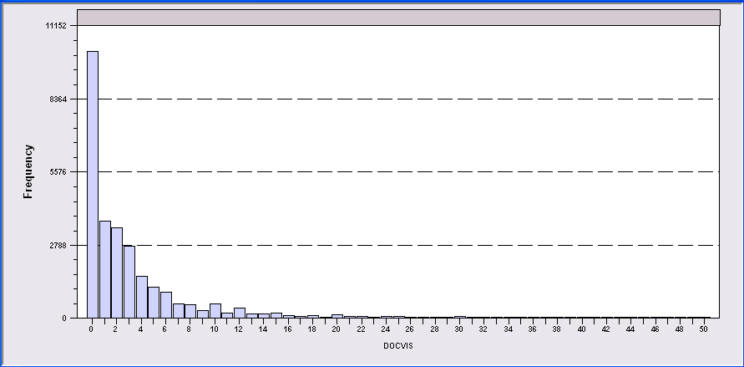
Application: Doctor Visits
German Individual Health Care data: N=27,236
Model for number of visits to the doctor

Slide 18
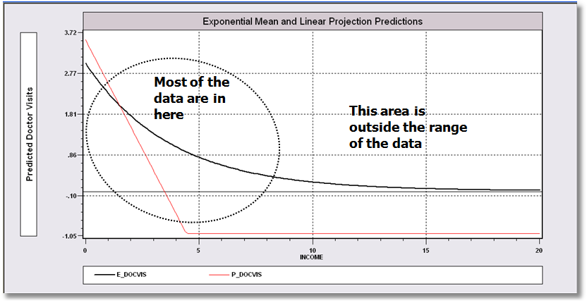
Conditional Mean and Projection
Notice the problem with the linear approach. Negative predictions.

Slide 19
Nonlinear Model Specification
Nonlinear Regression Model y=exp(β’x) + ε
X =one,age,health_status, married,
education, household_income, kids

Slide 20
NLS Iterations
--> nlsq;lhs=docvis;start=0,0,0,0,0,0,0;labels=k_b;fcn=exp(b1'x);maxit=25;out...
Begin NLSQ iterations. Linearized regression.
Iteration= 1; Sum of squares= 1014865.00 ; Gradient= 257025.070
Iteration= 2; Sum of squares= .130154610E+11 ; Gradient= .130145942E+11
Iteration= 3; Sum of squares= .175441482E+10 ; Gradient= .175354986E+10
Iteration= 4; Sum of squares= 235369144. ; Gradient= 234509185.
Iteration= 5; Sum of squares= 31610466.6 ; Gradient= 30763872.3
Iteration= 6; Sum of squares= 4684627.59 ; Gradient= 3871393.70
Iteration= 7; Sum of squares= 1224759.31 ; Gradient= 467169.410
Iteration= 8; Sum of squares= 778596.192 ; Gradient= 33500.2809
Iteration= 9; Sum of squares= 746343.830 ; Gradient= 450.321350
Iteration= 10; Sum of squares= 745898.272 ; Gradient= .287180441
Iteration= 11; Sum of squares= 745897.985 ; Gradient= .929823308E-03
Iteration= 12; Sum of squares= 745897.984 ; Gradient= .839914514E-05
Iteration= 13; Sum of squares= 745897.984 ; Gradient= .991471058E-07
Iteration= 14; Sum of squares= 745897.984 ; Gradient= .132954206E-08
Iteration= 15; Sum of squares= 745897.984 ; Gradient= .188041512E-10
(The blue iterations take place within the ‘hidden digits.’)

Slide 21
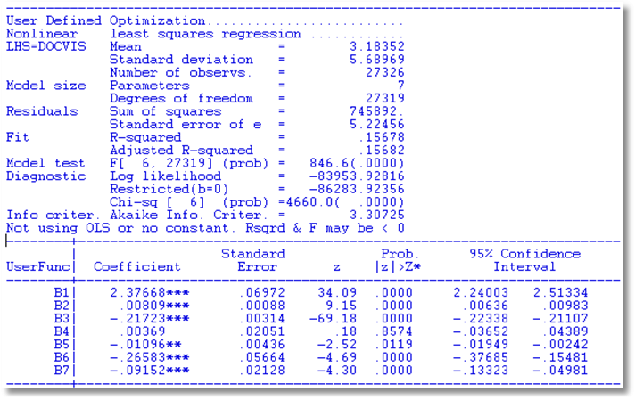
Nonlinear Regression Results

Slide 22
Partial Effects in the Nonlinear Model

Slide 23
Delta Method for Asymptotic Variance of the Slope Estimator

Slide 24
Computing the Slopes
Namelist;x=one,age,hsat,married,educ,hhninc,hhkids$
Calc ; k=col(x)$
Nlsq ; lhs=docvis;start=0,0,0,0,0,0,0
; labels=k_b;fcn=exp(b1'x)$
Partials ; function=exp(b1'x)
; parameters=b
; covariance = varb
; labels=k_b
; effects : x ; summary [; means] $

Slide 25
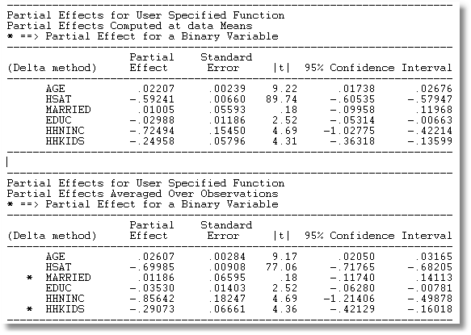
Partial Effects: PEA vs. APE

Slide 26
What About Just Using LS?
+---------+--------------+----------------+--------+---------+----------+
|Variable | Coefficient | Standard Error |b/St.Er.|P[|Z|>z] | Mean of X|
+---------+--------------+----------------+--------+---------+----------+
Least Squares Coefficient Estimates
AGE .02385640 .00327769 7.278 .0000 43.5256898
NEWHSAT -.86828751 .01441043 -60.254 .0000 6.78566201
MARRIED -.02458941 .08364976 -.294 .7688 .75861817
EDUC -.04909154 .01455653 -3.372 .0007 11.3206310
HHNINC -1.02174923 .19087197 -5.353 .0000 .35208362
HHKIDS -.38033746 .07513138 -5.062 .0000 .40273000
Estimated Partial Effects
ME_2 .02207102 .00239484 9.216 .0000
ME_3 -.59237330 .00660118 -89.737 .0000
ME_4 .01012122 .05593616 .181 .8564
ME_5 -.02989567 .01186495 -2.520 .0117
ME_6 -.72498339 .15449817 -4.693 .0000
ME_7 -.24959690 .05796000 -4.306 .0000

