Slide 1

Econometrics I
Professor William Greene
Stern School of Business
Department of Economics

Slide 2
Econometrics I
Part 18 – Maximum
Likelihood

Slide 3
Maximum Likelihood Estimation
This defines a class of estimators based on the particular distribution assumed to have generated the observed random variable.
Not estimating a mean – least squares is not available
Estimating a mean (possibly), but also using information about the distribution

Slide 4
Setting Up the MLE
The distribution of the observed random variable is written as a function of the parameters to be estimated
P(y_{i}|data,β) = Probability density | parameters.
The likelihood function is constructed from the density
Construction: Joint probability density function of the observed sample of data – generally the product when the data are a random sample.

Slide 5
(Log) Likelihood Function
f(y_{i}|β,x_{i}) = probability density of observed y_{i} given parameter(s) and possibly data, x_{i}.
Observations are independent
Joint density = Π_{i} f(y_{i}|β,x_{i}) = L(β|y,X)
f(y_{i}|β,x_{i}) is the contribution of observation i to the likelihood.
The MLE of β maximizes L(β|y,X)
In practice it is usually easier to maximize
logL(β|y,X) = Σ_{i} logf(y_{i}|β,x_{i})

Slide 6
Average Time Until Failure
Estimating the average time until failure, θ, of light bulbs.
y_{i} = observed life until failure.
f(y_{i}|θ) = (1/θ)exp(-y_{i}/θ)
L(θ) = Π_{i} f(y_{i}|θ)= θ^{-n} exp(-Σy_{i}/θ)
logL(θ) = -nlog (θ) - Σy_{i}/θ
Likelihood equation: ∂logL(θ)/∂θ = -n/θ + Σy_{i}/θ² =0
Solution: θ_{MLE} = Σy_{i} /n. Note: E[y_{i}]= θ
Note, ∂logf(y_{i}|θ)/∂θ = -1/θ + y_{i}/θ²
Since E[y_{i}] = θ, E[∂logf(θ)/∂θ]=0.
Extension: Loglinear Model: θ_{i} = exp(x_{i}’β) = E[y_{i}|x_{i}]

Slide 7
The MLE
The log-likelihood function: logL(β|data)
The likelihood equation(s):
First derivatives of logL equal zero at the MLE.
(1/n)Σ_{i} ∂logf(y_{i}|β,x_{i})/∂β_{MLE} = 0.
(Sample statistic.) (The 1/n is irrelevant.)
“First order conditions” for maximization
Usually a nonlinear estimator.
A moment condition - its counterpart is the fundamental theoretical result E[∂logL/∂β] = 0.

Slide 8
Properties of the MLE
Consistent: Not necessarily unbiased, however
Asymptotically normally distributed: Proof based on central limit theorems
Asymptotically efficient: Among the possible estimators that are consistent and asymptotically normally distributed – counterpart to Gauss-Markov for linear regression
Invariant: The MLE of g(θ) is g(the MLE of θ)

Slide 9
The Linear (Normal) Model
Definition of the likelihood function - joint density of the observed data, written as a function of the parameters we wish to estimate.
Definition of the maximum likelihood estimator as that function of the observed data that maximizes the likelihood function, or its logarithm.
For the model: y_{i} = β′x_{i} + ε_{i}, where ε_{i} ~ N[0,σ²],
the maximum likelihood estimators of β and σ² are
b = (X′X)⁻¹X′y and s² = e′e/n.
That is, least squares is ML for the slopes, but the variance estimator makes no degrees of freedom correction, so the MLE is biased.

Slide 10
Normal Linear Model
The log-likelihood function
= Σ_{i} log f(y_{i}|θ)
= sum of logs of densities.
For the linear regression model with normally distributed disturbances
logL = Σ_{i} [ -½log 2π - ½log σ² - ½(y_{i} – x_{i}′β)²/σ² ].
= -n/2[log2π + logσ² + v²/σ²]
v² = ε′ε/n

Slide 11
Likelihood Equations
The estimator is defined by the function of the data that equates
∂log-L/∂θ to 0. (Likelihood equation)
The derivative vector of the log-likelihood function is the score function. For the regression model,
g = [∂logL/∂β , ∂logL/∂σ²]’
= ∂logL/∂β = Σ_{i} [(1/σ²)x_{i}(y_{i} - x_{i}′β) ] = X′ε/σ² .
∂logL/∂σ² = Σ_{i} [-1/(2σ²) + (y_{i} - x_{i}′β)²/(2σ⁴)] = -n/2σ² [1 – s²/σ²]
For the linear regression model, the first derivative vector of logL is
(1/σ²)X′(y - Xβ) and (1/2σ²) Σ_{i} [(y_{i} - x_{i}′β^{)2/}σ² - 1]
(K×1) (1×1)
Note that we could compute these functions at any β and σ². If we compute them at b and e′e/n, the functions will be identically zero.

Slide 12
Maximizer of the log likelihood?
Use the Information Matrix
The negative of the second derivatives matrix of the log-likelihood,
-H =
For a maximizer, -H is positive definite.
-H forms the basis for estimating the variance of the MLE.
It is usually a random matrix. –H is the information matrix.

Slide 13
Hessian for the Linear Model
Note that the off diagonal elements have expectation zero.

Slide 14
Information Matrix
This can be computed at any vector β and scalar σ². You can take expected values of the parts of the matrix to get
(which should look familiar). The off diagonal terms go to zero (one of the assumptions of the linear model).

Slide 15
Asymptotic Variance
The asymptotic variance is {–E[H]}⁻¹ i.e., the inverse of the information matrix.
There are several ways to estimate this matrix
  Inverse of negative of expected second derivatives
  Inverse of negative of actual second derivatives
  Inverse of sum of squares of first derivatives
  Robust matrix for some special cases

Slide 16
Computing the Asymptotic Variance
We want to estimate {-E[H]}⁻¹ Three ways:
(1) Just compute the negative of the actual second derivatives matrix and invert it.
(2) Insert the maximum likelihood estimates into the known expected values of the second derivatives matrix. Sometimes (1) and (2) give the same answer (for example, in the linear regression model).
(3) Since E[H] is the variance of the first derivatives, estimate this with the sample variance (i.e., mean square) of the first derivatives, then invert the result. This will almost always be different from (1) and (2).
Since they are estimating the same thing, in large samples, all three will give the same answer. Current practice in econometrics often favors (3). Stata rarely uses (3). Others do.

Slide 17

Model for a Binary Dependent Variable
Binary outcome.
  Event occurs or doesn’t (e.g., the person adopts green technology, the person enters the labor force, etc.)
  Model the probability of the event. P(x)=Prob(y=1|x)
  Probability responds to independent variables
Requirements for a probability
  0 < Probability < 1
  P(x) should be monotonic in x – it’s a CDF

Slide 18
Behavioral Utility Based Approach
Observed outcomes partially reveal underlying preferences
There exists an underlying preference scale defined over alternatives, U*(choices)
Revelation of preferences between two choices labeled 0 and 1 reveals the ranking of the underlying utility
  U*(choice 1) > U*(choice 0) Choose 1
  U*(choice 1) < U*(choice 0) Choose 0
Net utility = U = U*(choice 1) - U*(choice 0). U > 0 => choice 1

Slide 19
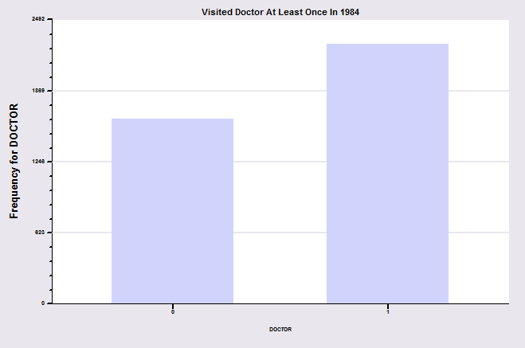
Binary Outcome: Visit Doctor
In the 1984 year of the GSOEP, 2265 of 3874 individuals visited the doctor at least once.

Slide 20
A Random Utility Model for the Binary Choice
Yes or No decision | Visit or not visit the doctor
Model: Net utility of visit at least once
Net utility depends on observables and unobservables
U_{doctor} = Net utility = U*_{visit} – U*_{not visit}
U_{doctor} = α + β₁Age + β₂Income + β₃Sex + ε
Choose to visit at least once if net utility is positive
Observed Data: X = Age, Income, Sex
y = 1 if choose visit, ⬄ U_{doctor} > 0, 0 if not.
Random Utility

Slide 21
Modeling the Binary Choice Between
the Two Alternatives
Net Utility U_{doctor} = U*_{visit} – U*_{not} _{visit}
U_{doctor} = α + β₁ Age + β₂ Income + β₃ Sex + ε
Chooses to visit: U_{doctor} > 0
α + β₁ Age + β₂ Income + β₃ Sex + ε > 0
Choosing to visit is a random outcome because of ε
ε > -(α + β₁ Age + β₂ Income + β₃ Sex)

Slide 22
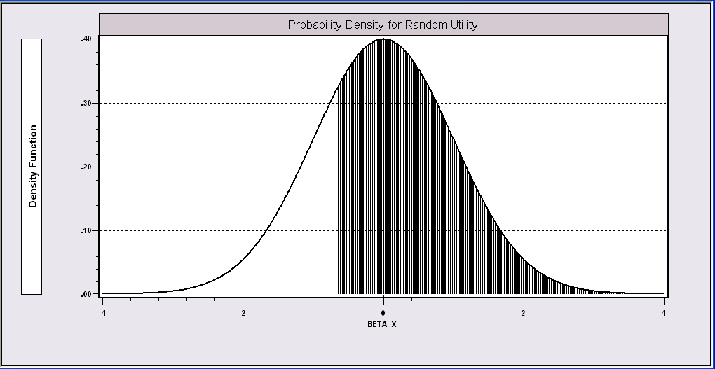
Probability Model for Choice Between Two Alternatives
People with the same (Age,Income,Sex) will make different choices because ε is random. We can model the probability that the random event “visits the doctor”will occur.
Probability is governed by ε, the random part of the utility function.
Event DOCTOR=1 occurs if ε > -(α + β₁Age + β₂Income + β₃Sex)
We model the probability of this event.

Slide 23
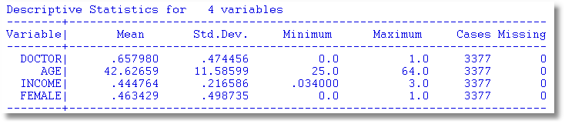
An Application
27,326 Observations in GSOEP Sample
  1 to 7 years, panel
  7,293 households observed
  We use the 1994 year; 3,337 household observations

Slide 24
An Econometric Model
Choose to visit iff U_{doctor} > 0
  Udoctor = α + β₁ Age + β₂ Income + β₃ Sex + ε
  Udoctor > 0 ⇔ ε > -(α + β₁ Age + β₂ Income + β₃ Sex)
  ε < α + β₁ Age + β₂ Income + β₃ Sex)
Probability model: For any person observed by the analyst,
Prob(doctor=1) = Prob(ε < α + β₁ Age + β₂ Income + β₃ Sex)
Note the relationship between the unobserved ε and the observed outcome DOCTOR.

Slide 25
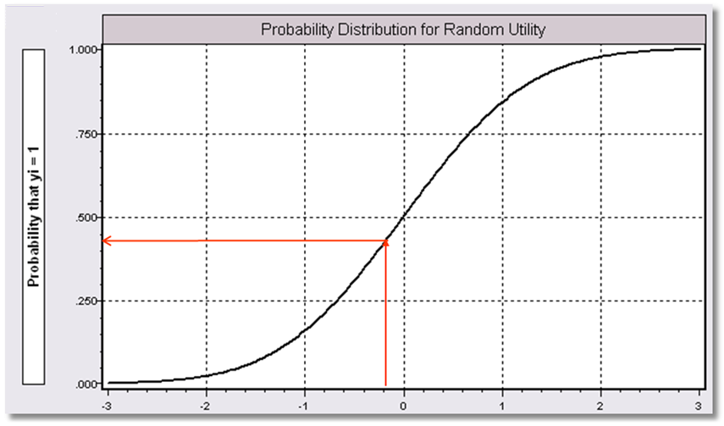
Index = α+β₁Age + β₂ Income + β3 Sex
Probability = a function of the Index.
P(Doctor = 1) = f(Index)
Internally consistent probabilities:
(1) (Coherence) 0 < Probability < 1
(2) (Monotonicity) Probability increases with Index.

Slide 26
A Fully Parametric Model
Index Function: U = β’x + ε
Observation Mechanism: y = 1[U > 0]
Distribution: ε ~ f(ε); Normal, Logistic, …
Maximum Likelihood Estimation:
Max(β) logL = Σ_{i} log Prob(Y_{i} = y_{i}|x_{i})

Slide 27
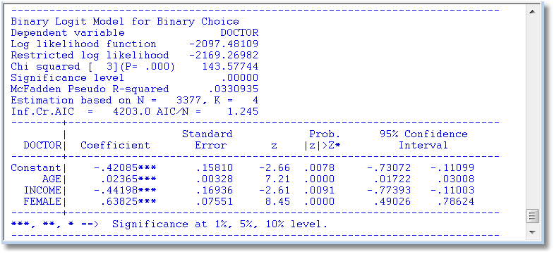
A Parametric Logit Model
We examine the model components.

Slide 28
Parametric Model Estimation
How to estimate α, β₁, β₂, β₃?
  The technique of maximum likelihood
  Prob[doctor=1] = Prob[ε > -(α + β₁ Age + β₂ Income + β₃ Sex)]
  Prob[doctor=0] = 1 – Prob[doctor=1]
Requires a model for the probability

Slide 29
Completing the Model: F(ε)
The distribution
  Normal: PROBIT, natural for behavior
  Logistic: LOGIT, allows “thicker tails”
  Gompertz: EXTREME VALUE, asymmetric
  Others…
Does it matter?
  Yes, large difference in estimates
  Not much, quantities of interest are more stable.

Slide 30
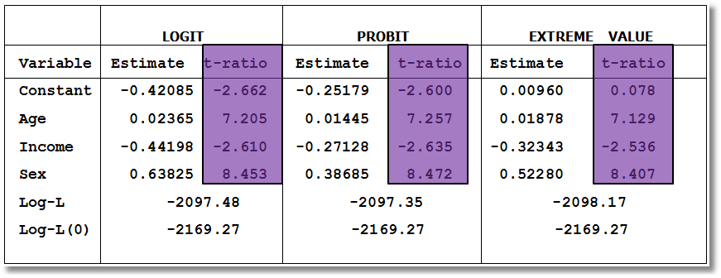
Estimated Binary Choice Models for Three Distributions
Log-L(0) = log likelihood for a model that has only a constant term.
Ignore the t ratios for now.

Slide 31
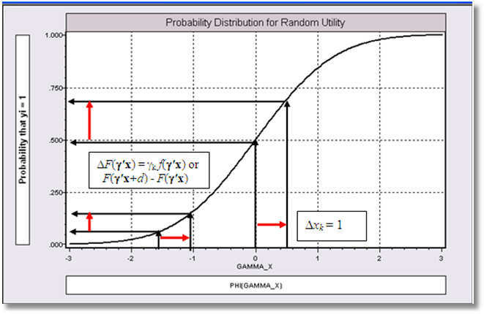
Effect on Predicted Probability of an Increase in Age
α + β₁ (Age+1) + β₂ (Income) + β₃ Sex (β₁ is positive)

Slide 32
Partial Effects in Probability Models
Prob[Outcome] = some F(α+β₁Income…)
“Partial effect” = ∂F(α+β₁Income…) / ∂”x” (derivative)
  Partial effects are derivatives
  Result varies with model
    Logit: ∂F(α+β₁Income…) /∂x = Prob * (1-Prob) × β
    Probit: ∂ F(α+β₁Income…)/∂x = Normal density × β
    Extreme Value: ∂ F(α+β₁Income…)/∂x = Prob * (-log Prob) × β
  Scaling usually erases model differences

Slide 34
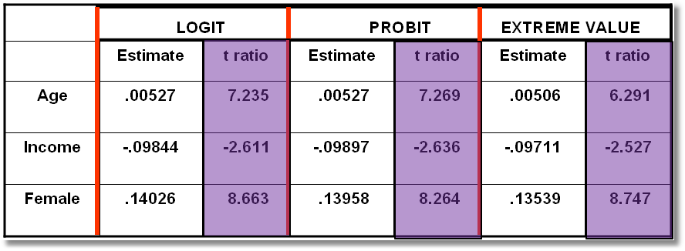
Estimated Partial Effects for Three Models
(Standard errors to be considered later)

Slide 35
Partial Effect for a Dummy Variable Computed
Using Means of Other Variables
Prob[y_{i} = 1|x_{i},d_{i}] = F(β’x_{i}+γd_{i}) where d is a dummy variable such as Sex in our doctor model.
For the probit model, Prob[y_{i} = 1|x_{i},d_{i}] = Φ(β′x+γd), Φ = the normal CDF.
Partial effect of d
Prob[y_{i} = 1|x_{i}, d_{i}=1] - Prob[y_{i} = 1|x_{i}, d_{i}=0]
=

Slide 36
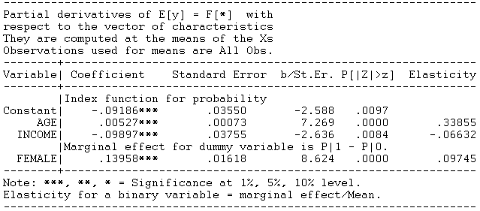
Partial Effect – Dummy Variable

Slide 37
Computing Partial Effects
Compute at the data means (PEA)
  Simple
  Inference is well defined.
  Not realistic for some variables, such as Sex
Average the individual effects (APE)
  More appropriate
  Asymptotic standard errors are slightly more complicated.

Slide 38
Partial Effects

Slide 39
Average Partial Partial Effects
Effects at Data Means
Age 0.00512 0.00527
Income -0.09609 -0.09871
Female 0.13792 0.13958
The two approaches usually give similar answers, though sometimes the results differ substantially.

Slide 40
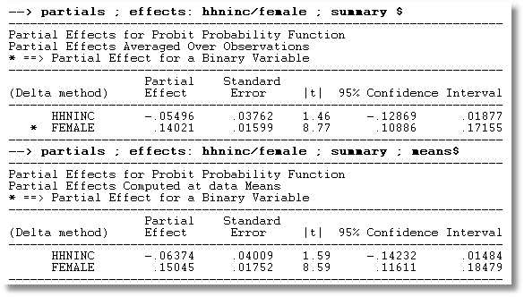
APE vs. Partial Effects at the Mean

Slide 41


Slide 42
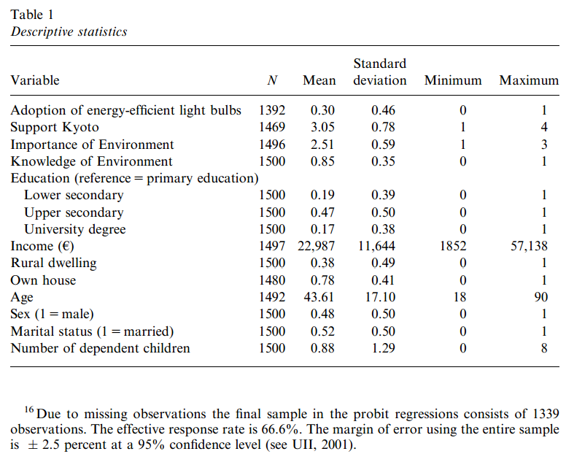
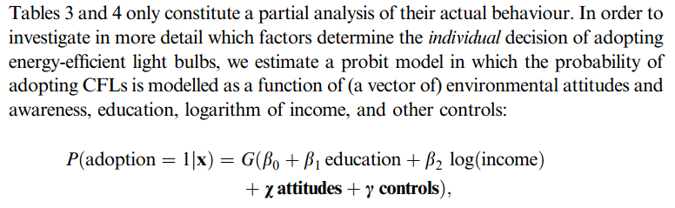

Slide 43
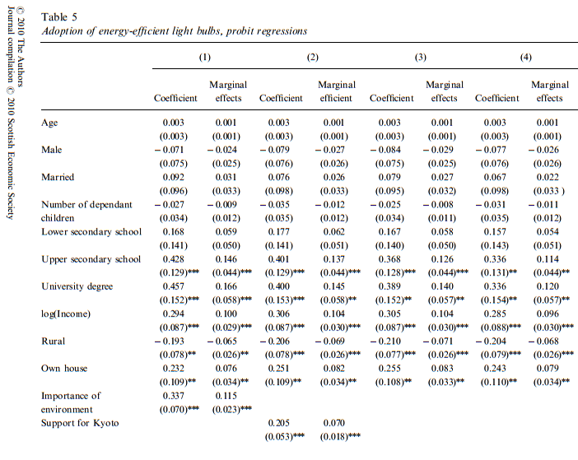

Slide 44
How Well Does the Model Fit the Data?
There is no R squared for a probability model.
  Least squares for linear models is computed to maximize R²
  There are no residuals or sums of squares in a binary choice model
  The model is not computed to optimize the fit of the model to the data
How can we measure the “fit” of the model to the data?
  “Fit measures” computed from the log likelihood
    Pseudo R squared = 1 – logL/logL0
    Also called the “likelihood ratio index”
  Direct assessment of the effectiveness of the model at predicting the outcome

Slide 45
Pseudo R² = Likelihood Ratio Index

Slide 46
The Likelihood Ratio Index
Bounded by 0 and a number < 1
Rises when the model is expanded
Specific values between 0 and 1 have no meaning
Can be strikingly low even in a great model
Should not be used to compare models
  Use logL
  Use information criteria to compare nonnested models
Can be negative if the model is not a discrete choice model. For linear regression,
logL=-n/2(1+log2π+log(e’e/n)]; Positive if e’e/n < 0.058497
Notes:
46

Slide 47
Fit Measures Based on LogL
----------------------------------------------------------------------
Binary Logit Model for Binary Choice
Dependent variable DOCTOR
Log likelihood function -2085.92452 Full model LogL
Restricted log likelihood -2169.26982 Constant term only LogL0
Chi squared [ 5 d.f.] 166.69058
Significance level .00000
McFadden Pseudo R-squared .0384209 1 – LogL/logL0
Estimation based on N = 3377, K = 6
Information Criteria: Normalization=1/N
Normalized Unnormalized
AIC 1.23892 4183.84905 -2LogL + 2K
Fin.Smpl.AIC 1.23893 4183.87398 -2LogL + 2K + 2K(K+1)/(N-K-1)
Bayes IC 1.24981 4220.59751 -2LogL + KlnN
Hannan Quinn 1.24282 4196.98802 -2LogL + 2Kln(lnN)
--------+-------------------------------------------------------------
Variable| Coefficient Standard Error b/St.Er. P[|Z|>z] Mean of X
--------+-------------------------------------------------------------
|Characteristics in numerator of Prob[Y = 1]
Constant| 1.86428*** .67793 2.750 .0060
AGE| -.10209*** .03056 -3.341 .0008 42.6266
AGESQ| .00154*** .00034 4.556 .0000 1951.22
INCOME| .51206 .74600 .686 .4925 .44476
AGE_INC| -.01843 .01691 -1.090 .2756 19.0288
FEMALE| .65366*** .07588 8.615 .0000 .46343
--------+-------------------------------------------------------------

Slide 48
Fit Measures Based on Predictions
Computation
  Use the model to compute predicted probabilities
  P = F(a + b₁Age + b₂Income + b₃Female+…)
  Use a rule to compute predicted y = 0 or 1
  Predict y=1 if P is “large” enough
  Generally use 0.5 for “large” (more likely than not)
Fit measure compares predictions to actuals
Count successes and failures

Slide 49
Computing test statistics requires the log likelihood and/or standard errors based on the Hessian of LogL

Slide 50
Robust Covariance Matrix
(Robust to the model specification? Latent heterogeneity? Correlation across observations? Not always clear)

Slide 51
Robust Covariance Matrix for Logit Model
Doesn’t change much. The model is well specified.
--------+--------------------------------------------------------------------
| Standard Prob. 95% Confidence
DOCTOR| Coefficient Error z |z|>Z* Interval
--------+--------------------------------------------------------------------
Conventional Standard Errors
Constant| 1.86428*** .67793 2.75 .0060 .53557 3.19299
AGE| -.10209*** .03056 -3.34 .0008 -.16199 -.04219
AGE^2.0| .00154*** .00034 4.56 .0000 .00088 .00220
INCOME| .51206 .74600 .69 .4925 -.95008 1.97420
|Interaction AGE*INCOME
_ntrct02| -.01843 .01691 -1.09 .2756 -.05157 .01470
FEMALE| .65366*** .07588 8.61 .0000 .50494 .80237
--------+--------------------------------------------------------------------
Robust Standard Errors
Constant| 1.86428*** .68518 2.72 .0065 .52135 3.20721
AGE| -.10209*** .03118 -3.27 .0011 -.16321 -.04098
AGE^2.0| .00154*** .00035 4.44 .0000 .00086 .00222
INCOME| .51206 .75171 .68 .4958 -.96127 1.98539
|Interaction AGE*INCOME
_ntrct02| -.01843 .01705 -1.08 .2796 -.05185 .01498
FEMALE| .65366*** .07594 8.61 .0000 .50483 .80249

Slide 52
The Effect of Clustering
Y_{it} must be correlated with Y_{is} across periods
Pooled estimator ignores correlation
Broadly, y_{it} = E[y_{it}|x_{it}] + w_{it},
  E[y_{it}|x_{it}] = Prob(y_{it} = 1|x_{it})
  w_{it} is correlated across periods
Assuming the marginal probability is the same, the pooled estimator is consistent. (We just saw that it might not be.)
Ignoring the correlation across periods generally leads to underestimating standard errors.

Slide 53
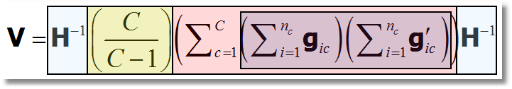
‘Cluster’ Corrected Covariance Matrix

Slide 54
Cluster Correction: Doctor
----------------------------------------------------------------------
Binomial Probit Model
Dependent variable DOCTOR
Log likelihood function -17457.21899
--------+-------------------------------------------------------------
Variable| Coefficient Standard Error b/St.Er. P[|Z|>z] Mean of X
--------+-------------------------------------------------------------
| Conventional Standard Errors
Constant| -.25597*** .05481 -4.670 .0000
AGE| .01469*** .00071 20.686 .0000 43.5257
EDUC| -.01523*** .00355 -4.289 .0000 11.3206
HHNINC| -.10914** .04569 -2.389 .0169 .35208
FEMALE| .35209*** .01598 22.027 .0000 .47877
--------+-------------------------------------------------------------
| Corrected Standard Errors
Constant| -.25597*** .07744 -3.305 .0009
AGE| .01469*** .00098 15.065 .0000 43.5257
EDUC| -.01523*** .00504 -3.023 .0025 11.3206
HHNINC| -.10914* .05645 -1.933 .0532 .35208
FEMALE| .35209*** .02290 15.372 .0000 .47877
--------+-------------------------------------------------------------

Slide 55
Hypothesis Tests
We consider “nested” models and parametric tests
Test statistics based on the usual 3 strategies
  Wald statistics: Use the unrestricted model
  Likelihood ratio statistics: Based on comparing the two models
  Lagrange multiplier: Based on the restricted model.
Test statistics require the log likelihood and/or the first and second derivatives of logL

Slide 56
Base Model for Hypothesis Tests
----------------------------------------------------------------------
Binary Logit Model for Binary Choice
Dependent variable DOCTOR
Log likelihood function -2085.92452
Restricted log likelihood -2169.26982
Chi squared [ 5 d.f.] 166.69058
Significance level .00000
McFadden Pseudo R-squared .0384209
Estimation based on N = 3377, K = 6
Information Criteria: Normalization=1/N
Normalized Unnormalized
AIC 1.23892 4183.84905
--------+-------------------------------------------------------------
Variable| Coefficient Standard Error b/St.Er. P[|Z|>z] Mean of X
--------+-------------------------------------------------------------
|Characteristics in numerator of Prob[Y = 1]
Constant| 1.86428*** .67793 2.750 .0060
AGE| -.10209*** .03056 -3.341 .0008 42.6266
AGESQ| .00154*** .00034 4.556 .0000 1951.22
INCOME| .51206 .74600 .686 .4925 .44476
AGE_INC| -.01843 .01691 -1.090 .2756 19.0288
FEMALE| .65366*** .07588 8.615 .0000 .46343
--------+-------------------------------------------------------------
H₀: Age is not a significant
determinant of
Prob(Doctor = 1)
H₀: β₂ = β₃ = β₅ = 0

Slide 57
Likelihood Ratio Test
Null hypothesis restricts the parameter vector
Alternative relaxes the restriction
Test statistic: Chi-squared =
2 (LogL|Unrestricted model – LogL|Restrictions) > 0
Degrees of freedom = number of restrictions

Slide 58
LR Test of H₀: β₂ = β₃ = β₅ = 0
UNRESTRICTED MODEL
Binary Logit Model for Binary Choice
Dependent variable DOCTOR
Log likelihood function -2085.92452
Restricted log likelihood -2169.26982
Chi squared [ 5 d.f.] 166.69058
Significance level .00000
McFadden Pseudo R-squared .0384209
Estimation based on N = 3377, K = 6
Information Criteria: Normalization=1/N
Normalized Unnormalized
AIC 1.23892 4183.84905
RESTRICTED MODEL
Binary Logit Model for Binary Choice
Dependent variable DOCTOR
Log likelihood function -2124.06568
Restricted log likelihood -2169.26982
Chi squared [ 2 d.f.] 90.40827
Significance level .00000
McFadden Pseudo R-squared .0208384
Estimation based on N = 3377, K = 3
Information Criteria: Normalization=1/N
Normalized Unnormalized
AIC 1.25974 4254.13136
Chi squared[3] = 2[-2085.92452 - (-2124.06568)] = 77.46456

Slide 59
Wald Test of H₀: β₂ = β₃ = β₅ = 0
Unrestricted parameter vector is estimated
Discrepancy: q= Rb – m is computed
(or r(b,m) if nonlinear)
Variance of discrepancy is estimated:
Var[q] = R V R’
Wald Statistic is q’[Var(q)]⁻¹q = q’[RVR’]⁻¹q

Slide 60
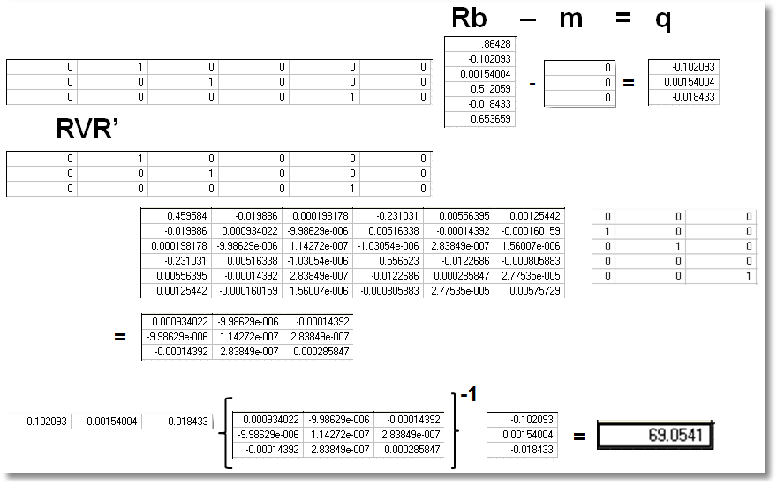
Wald Test
Chi squared[3] = 69.0541

Slide 61
Lagrange Multiplier Test of H₀: β₂ = β₃ = β₅ = 0
Restricted model is estimated
Derivatives of unrestricted model and variances of derivatives are computed at restricted estimates
Wald test of whether derivatives are zero tests the restrictions
Usually hard to compute – difficult to program the derivatives and their variances.

Slide 62
LM Test for a Logit Model
Compute b₀ (subject to restictions)
(e.g., with zeros in appropriate positions.
Compute P_{i}(b₀) for each observation.
Compute e_{i}(b₀) = [y_{i} – P_{i}(b₀)]
Compute g_{i}(b₀) = x_{i}e_{i} using full x_{i} vector
LM = [Σ_{i}g_{i}(b₀)]’[Σ_{i}g_{i}(b₀)g_{i}(b₀)’]⁻¹[Σ_{i}g_{i}(b₀)]

Slide 63
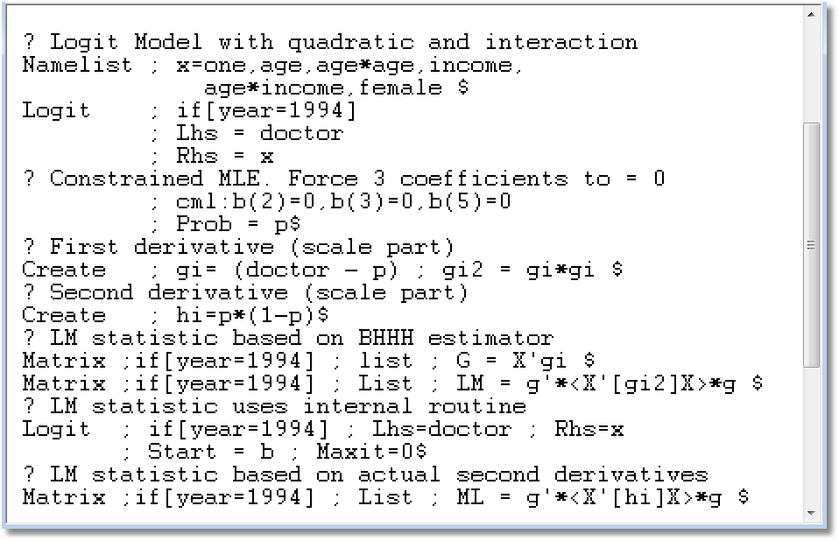
(There is a built in function for this computation.)

Slide 64
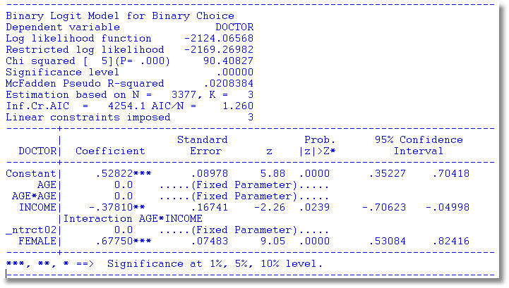
Restricted Model

Slide 65
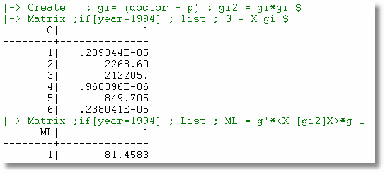
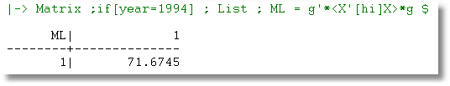
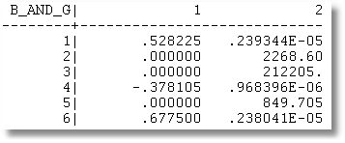

Slide 66
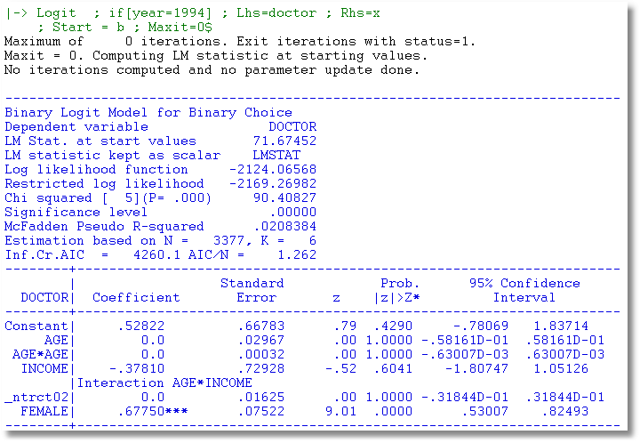

Slide 67
I have a question. The question is as follows. We have a probit model. We used LM tests to test for the hetercodeaticiy in this model and found that there is heterocedasticity in this model...
How do we proceed now? What do we do to get rid of heterescedasticiy?
Testing for heteroscedasticity in a probit model and then getting rid of heteroscedasticit in this model is not a common procedure. In fact I do not remember seen an applied (or theoretical also) works which tests for heteroscedasticiy and then uses a method to get rid of it???
See Econometric Analysis, 7th ed. pages 714-714

Slide 68
Appendix

Slide 69
Properties of the
Maximum Likelihood Estimator
We will sketch formal proofs of these results:
The log-likelihood function, again
The likelihood equation and the information matrix.
A linear Taylor series approximation to the first order conditions:
g(θ_{ML}) = 0 ≈ g(θ) + H(θ) (θ_{ML} - θ)
(under regularity, higher order terms will vanish in large samples.)
Our usual approach. Large sample behavior of the left and right hand sides is the same.
A Proof of consistency. (Property 1)
The limiting variance of √n(θ_{ML} - θ). We are using the central limit theorem here.
Leads to asymptotic normality (Property 2). We will derive the asymptotic variance of the MLE.
Estimating the variance of the maximum likelihood estimator.
Efficiency (we have not developed the tools to prove this.) The Cramer-Rao lower bound for efficient estimation (an asymptotic version of Gauss-Markov).
Invariance. (A VERY handy result.) Coupled with the Slutsky theorem and the delta method, the invariance property makes estimation of nonlinear functions of parameters very easy.

Slide 70
Regularity Conditions
Deriving the theory for the MLE relies on certain “regularity” conditions for the density.
What they are
  1. logf(.) has three continuous derivatives wrt parameters
  2. Conditions needed to obtain expectations of derivatives are met. (E.g., range of the variable is not a function of the parameters.)
  3. Third derivative has finite expectation.
What they mean
  Moment conditions and convergence. We need to obtain expectations of derivatives.
  We need to be able to truncate Taylor series.
  We will use central limit theorems

Slide 71
The MLE

Slide 72
Consistency of the MLE

Slide 73
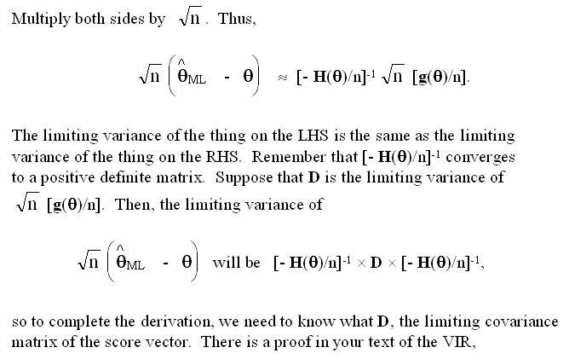
Asymptotic Variance

Slide 74
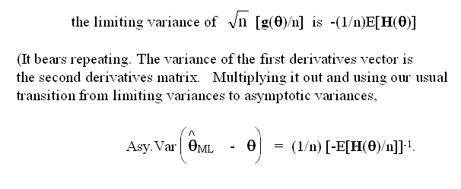
Asymptotic Variance

Slide 77
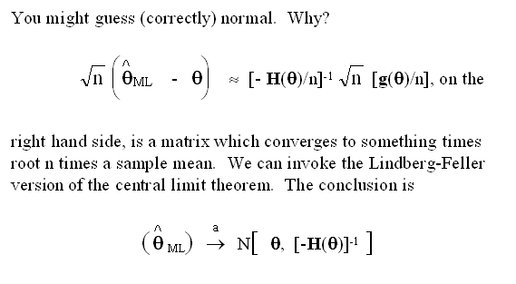
Asymptotic Distribution

Slide 78
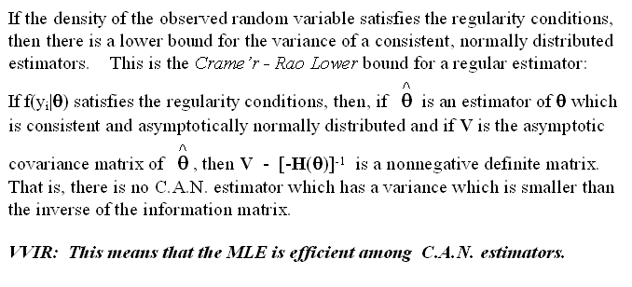
Efficiency: Variance Bound

Slide 79
Invariance
The maximum likelihood estimator of a function of θ, say h(θ) is h(MLE). This is not always true of other kinds of estimators. To get the variance of this function, we would use the delta method. E.g., the MLE of θ=(β/σ) is b/(e′e/n)

Slide 80

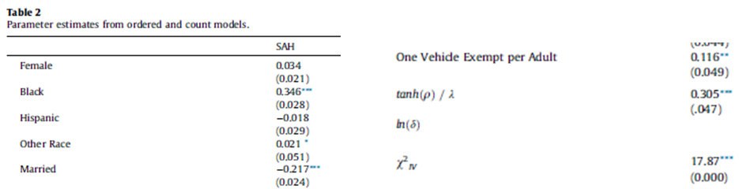

Slide 81

The Linear Probability “Model”

Slide 82
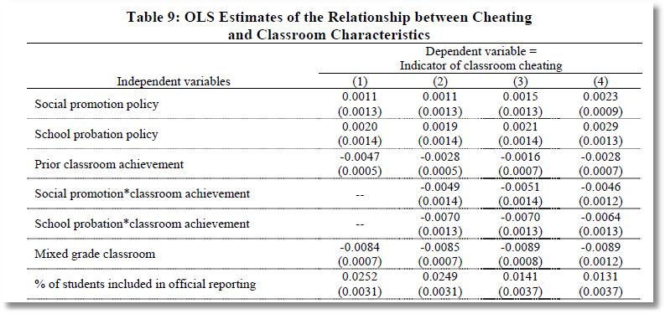
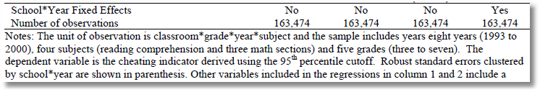
The Dependent Variable equals zero for 99.1% of the observations. In the sample of 163,474 observations, the LHS variable equals 1 about 1,500 times.

Slide 83
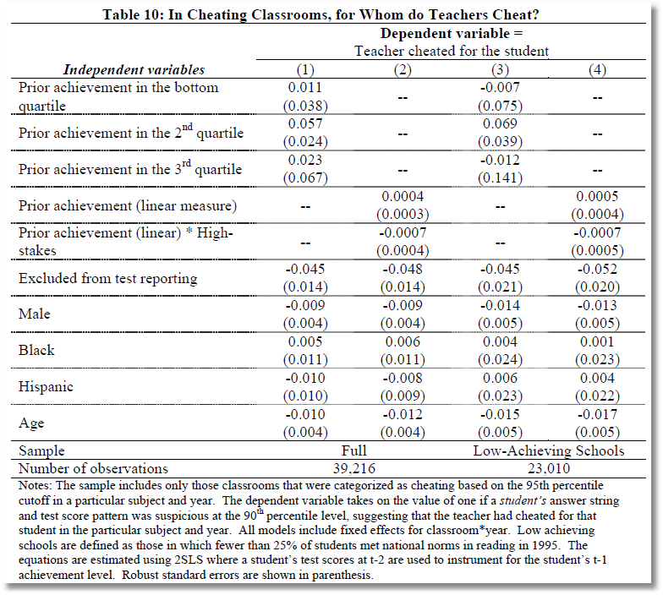
2SLS for a binary dependent variable.

Slide 84
Modeling a Binary Outcome
Did firm i produce a product or process innovation in year t ? y_{it} : 1=Yes/0=No
Observed N=1270 firms for T=5 years, 1984-1988
Observed covariates: x_{it} = Industry, competitive pressures, size, productivity, etc.
How to model?
  Binary outcome
  Correlation across time
  Heterogeneity across firms

Slide 85
Application

Slide 86
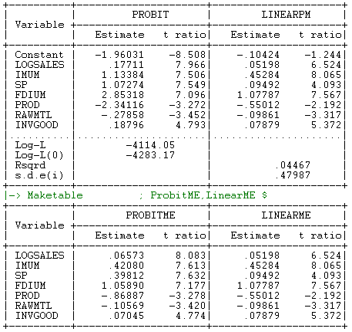
Probit and LPM

Slide 87
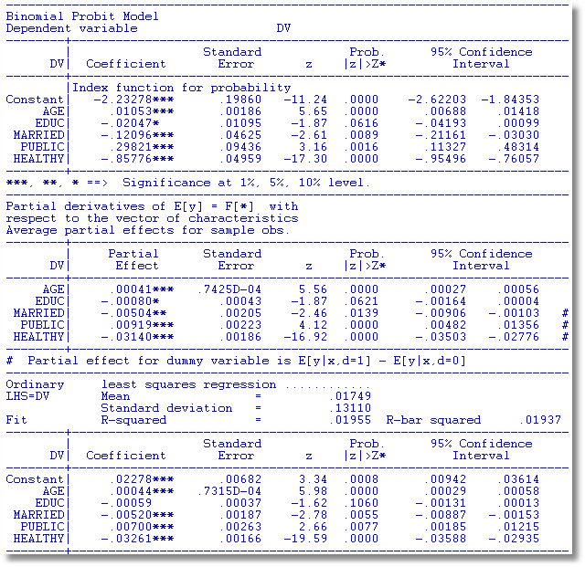
OLS approximates the partial effects, “directly,” without bothering with coefficients.
MLE
Average Partial Effects
OLS Coefficients

Slide 88
Odds Ratios
This calculation is not meaningful if the model is not a binary logit model

Slide 89
Odds Ratio
Exp(γ) = multiplicative change in the odds ratio when z changes by 1 unit.
dOR(x,z)/dx = OR(x,z)*β, not exp(β)
The “odds ratio” is not a partial effect – it is not a derivative.
It is only meaningful when the odds ratio is itself of interest and the change of the variable by a whole unit is meaningful.
“Odds ratios” might be interesting for dummy variables

Slide 90
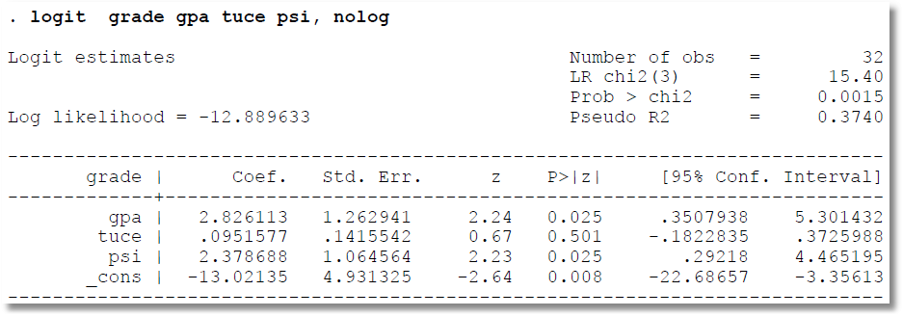
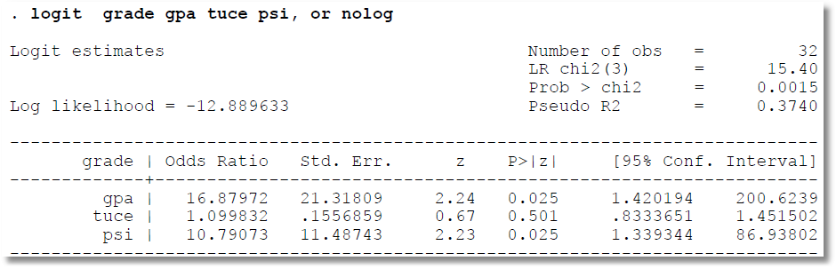
Cautions About reported Odds Ratios

Slide 91
Model for a Binary Dependent Variable
Binary outcome.
  Event occurs or doesn’t (e.g., the democrat wins, the person enters the labor force,…
  Model the probability of the event. P(x)=Prob(y=1|x)
  Probability responds to independent variables
Requirements
  0 < Probability < 1
  P(x) should be monotonic in x – it’s a CDF

Slide 92
Two Standard Models
Based on the normal distribution:
  Prob[y=1|x] = Φ(β’x) = CDF of normal distribution
  The “probit” model
Based on the logistic distribution
  Prob[y=1|x] = exp(β’x)/[1+ exp(β’x)]
  The “logit” model
Log likelihood
  P(y|x) = (1-F)^{(1-y)} F^{y} where F = the cdf
  LogL = Σ_{i} (1-y_{i})log(1-F_{i}) + y_{i}logF_{i}
    = Σ_{i} F[(2y_{i}-1)β’x] since F(-t)=1-F(t) for both.

Slide 93
Coefficients in the Binary Choice Models
E[y|x] = 0*(1-F_{i}) + 1*F_{i} = P(y=1|x)
= F(β’x)
The coefficients are not the slopes, as usual
in a nonlinear model
∂E[y|x]/∂x= f(β’x)β
These will look similar for probit and logit

Slide 94
Application: Female Labor Supply
1975 Survey Data: Mroz (Econometrica) 753 Observations
Descriptive Statistics
Variable Mean Std.Dev. Minimum Maximum Cases Missing
==============================================================================
All observations in current sample
--------+---------------------------------------------------------------------
LFP | .568393 .495630 .000000 1.00000 753 0
WHRS | 740.576 871.314 .000000 4950.00 753 0
KL6 | .237716 .523959 .000000 3.00000 753 0
K618 | 1.35325 1.31987 .000000 8.00000 753 0
WA | 42.5378 8.07257 30.0000 60.0000 753 0
WE | 12.2869 2.28025 5.00000 17.0000 753 0
WW | 2.37457 3.24183 .000000 25.0000 753 0
RPWG | 1.84973 2.41989 .000000 9.98000 753 0
HHRS | 2267.27 595.567 175.000 5010.00 753 0
HA | 45.1208 8.05879 30.0000 60.0000 753 0
HE | 12.4914 3.02080 3.00000 17.0000 753 0
HW | 7.48218 4.23056 .412100 40.5090 753 0
FAMINC | 23080.6 12190.2 1500.00 96000.0 753 0
KIDS | .695883 .460338 .000000 1.00000 753 0

Slide 95
Estimated Choice Models for Labor Force Participation
----------------------------------------------------------------------
Binomial Probit Model
Dependent variable LFP
Log likelihood function -488.26476 (Probit)
Log likelihood function -488.17640 (Logit)
--------+-------------------------------------------------------------
Variable| Coefficient Standard Error b/St.Er. P[|Z|>z] Mean of X
--------+-------------------------------------------------------------
|Index function for probability
Constant| .77143 .52381 1.473 .1408
WA| -.02008 .01305 -1.538 .1241 42.5378
WE| .13881*** .02710 5.122 .0000 12.2869
HHRS| -.00019** .801461D-04 -2.359 .0183 2267.27
HA| -.00526 .01285 -.410 .6821 45.1208
HE| -.06136*** .02058 -2.982 .0029 12.4914
FAMINC| .00997** .00435 2.289 .0221 23.0806
KIDS| -.34017*** .12556 -2.709 .0067 .69588
--------+-------------------------------------------------------------
Binary Logit Model for Binary Choice
--------+-------------------------------------------------------------
|Characteristics in numerator of Prob[Y = 1]
Constant| 1.24556 .84987 1.466 .1428
WA| -.03289 .02134 -1.542 .1232 42.5378
WE| .22584*** .04504 5.014 .0000 12.2869
HHRS| -.00030** .00013 -2.326 .0200 2267.27
HA| -.00856 .02098 -.408 .6834 45.1208
HE| -.10096*** .03381 -2.986 .0028 12.4914
FAMINC| .01727** .00752 2.298 .0215 23.0806
KIDS| -.54990*** .20416 -2.693 .0071 .69588
--------+-------------------------------------------------------------

Slide 96
Partial Effects
----------------------------------------------------------------------
Partial derivatives of probabilities with
respect to the vector of characteristics.
They are computed at the means of the Xs.
Observations used are All Obs.
--------+-------------------------------------------------------------
Variable| Coefficient Standard Error b/St.Er. P[|Z|>z] Elasticity
--------+-------------------------------------------------------------
|PROBIT: Index function for probability
WA| -.00788 .00512 -1.538 .1240 -.58479
WE| .05445*** .01062 5.127 .0000 1.16790
HHRS|-.74164D-04** .314375D-04 -2.359 .0183 -.29353
HA| -.00206 .00504 -.410 .6821 -.16263
HE| -.02407*** .00807 -2.983 .0029 -.52488
FAMINC| .00391** .00171 2.289 .0221 .15753
|Marginal effect for dummy variable is P|1 - P|0.
KIDS| -.13093*** .04708 -2.781 .0054 -.15905
Variable| Coefficient Standard Error b/St.Er. P[|Z|>z] Elasticity
--------+-------------------------------------------------------------
|LOGIT: Marginal effect for variable in probability
WA| -.00804 .00521 -1.542 .1231 -.59546
WE| .05521*** .01099 5.023 .0000 1.18097
HHRS|-.74419D-04** .319831D-04 -2.327 .0200 -.29375
HA| -.00209 .00513 -.408 .6834 -.16434
HE| -.02468*** .00826 -2.988 .0028 -.53673
FAMINC| .00422** .00184 2.301 .0214 .16966
|Marginal effect for dummy variable is P|1 - P|0.
KIDS| -.13120*** .04709 -2.786 .0053 -.15894
--------+-------------------------------------------------------------

Slide 97
Testing Hypotheses – A Trinity of Tests
The likelihood ratio test:
Based on the proposition (Greene’s) that restrictions always “make life worse”
Is the reduction in the criterion (log-likelihood) large? Leads to the LR test.
The Wald test: The usual.
The Lagrange multiplier test:
Underlying basis: Reexamine the first order conditions.
Form a test of whether the gradient is significantly “nonzero” at the restricted estimator.

Slide 98
Testing Hypotheses
Wald tests, using the familiar distance measure
Likelihood ratio tests:
LogL_{U} = log likelihood without restrictions
LogL_{R} = log likelihood with restrictions
LogL_{U} > logL_{R} for any nested restrictions
2(LogL_{U} – logL_{R}) → chi-squared [J]

Slide 99
Estimating the Tobit Model

