Slide 1

Econometrics I
Professor William Greene
Stern School of Business
Department of Economics

Slide 2
Econometrics I
Part 19 – Sample Selection
Two Step Estimation

Slide 3
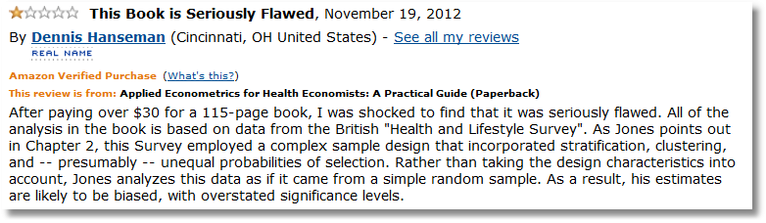

Slide 4
Dueling Selection Biases –
From two emails, same day.
“I am trying to find methods which can deal with data that is non-randomised and suffers from selection bias.”
“I explain the probability of answering questions using, among other independent variables, a variable which measures knowledge breadth. Knowledge breadth can be constructed only for those individuals that fill in a skill description in the company intranet. This is where the selection bias comes from.

Slide 5
Samples and Populations
Consistent estimation
  The sample is randomly drawn from the population
  Sample statistics converge to their population counterparts
A presumption: The ‘population’ is the population of interest.
Implication: If the sample is randomly drawn from a specific subpopulation, statistics converge to the characteristics of that subpopulation

Slide 6
Nonrandom Sampling
Simple nonrandom samples: Average incomes of airport travelers → mean income in the population as a whole?
Survivorship: Time series of returns on business performance. Mutual fund performance. (Past performance is no guarantee of future success.)
Attrition: Drug trials. Effect of erythropoetin on quality of life survey.
Self-selection:
  Labor supply models
  Shere Hite’s (1976) “The Hite Report” ‘survey’ of sexual habits of Americans. “While her books are ground-breaking and important, they are based on flawed statistical methods and one must view their results with skepticism.”

Slide 7
The Crucial Element
Selection on the unobservables
  Selection into the sample is based on both observables and unobservables.
  All the observables are accounted for.
  Unobservables in the selection rule also appear in the model of interest (or are correlated with unobservables in the model of interest).
“Selection Bias” = the bias due to not accounting for the unobservables that link the equations.

Slide 8
Heckman’s Canonical Model

Slide 9
Standard Sample Selection Model

Slide 10
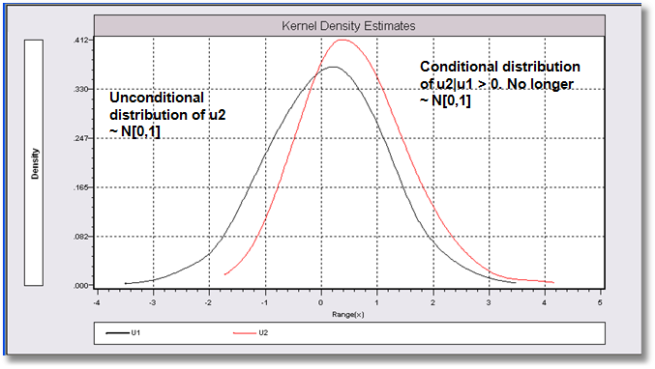
Incidental Truncation u1,u2~N[(0,0),(1,.71,1)

Slide 11
Selection as a Specification Error
E[y_{i}|x_{i},y_{i} observed] = β’x_{i} + θλ_{i}
Regression of y_{i} on x_{i} omits λ_{i}.
  λ_{i} will generally be correlated with x_{i} if z_{i} is.
  z_{i} and x_{i} often have variables in common.
  There is no specification error if θ = 0 <=> ρ = 0
“Selection Bias” is plim (b – β)
What is “selection bias…”

Slide 12
Control Function

Slide 13
Estimation of the Selection Model
Two step least squares
  Inefficient
  Simple – exists in current software
  Simple to understand and widely used
Full information maximum likelihood
  Efficient
  Simple – exists in current software
  Not so simple to understand – widely misunderstood

Slide 14
Estimation
Heckman’s two step procedure
  (1) Estimate the probit model and compute λ_{i} for each observation using the estimated parameters.
  (2) a. Linearly regress y_{i} on x_{i} and λ_{i} using the
  observed data
  b. Correct the estimated asymptotic covariance
  matrix for the use of the estimated λ_{i}. (An
  application of Murphy and Topel (1984)
  – Heckman was 1979) See text, pp. 953-955.

Slide 15
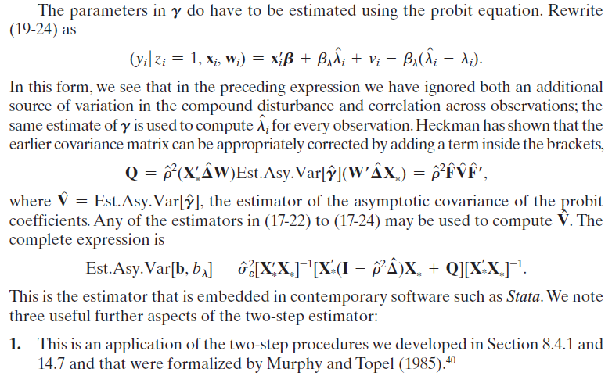
Variance of a Heckman’s Two Step Estimator

Slide 16
Application – Labor Supply
MROZ labor supply data. Cross section, 753 observations
Use LFP for binary choice, KIDS for count models.
LFP = labor force participation, 0 if no, 1 if yes.
WHRS = wife's hours worked. 0 if LFP=0
KL6 = number of kids less than 6
K618 = kids 6 to 18
WA = wife's age
WE = wife's education
WW = wife's wage, 0 if LFP=0.
RPWG = Wife's reported wage at the time of the interview
HHRS = husband's hours
HA = husband's age
HE = husband's education
HW = husband's wage
FAMINC = family income
MTR = marginal tax rate
WMED = wife's mother's education
WFED = wife's father's education
UN = unemployment rate in county of residence
CIT = dummy for urban residence
AX = actual years of wife's previous labor market experience
AGE = Age
AGESQ = Age squared
EARNINGS= WW * WHRS
LOGE = Log of EARNINGS
KIDS = 1 if kids < 18 in the home.

Slide 17
Labor Supply Model
NAMELIST ; Z = One,KL6,K618,WA,WE,HA,HE $
NAMELIST ; X = One,KL6,K618,Age,Agesq,WE,Faminc $
PROBIT ; Lhs = LFP ; Rhs = Z ; Hold(IMR=Lambda) $
SELECT ; Lhs = WHRS ; Rhs = X $
REGRESS ; If [ LFP = 1] ; Lhs = WHRS ; Rhs = X $
REGRESS ; If [ LFP = 1] ; Lhs = WHRS ; Rhs = X,Lambda $
REGRESS ; If [ LFP = 1] ; Lhs = WHRS ; Rhs = X,Lambda
; Cluster = 1 $

Slide 18
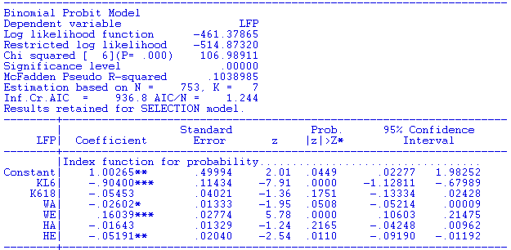
Participation Equation

Slide 19
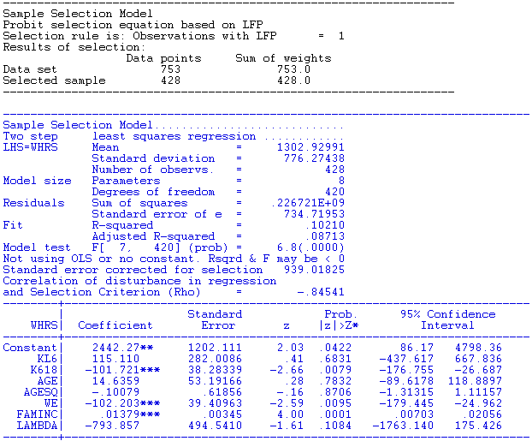
Hours Equation

Slide 20
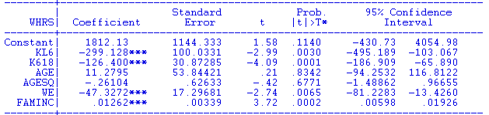
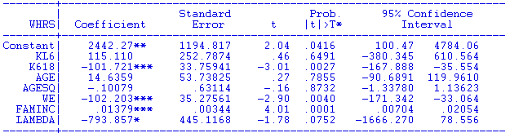
Selection “Bias”

Slide 21
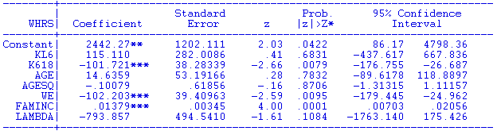
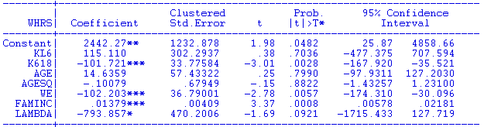
Heckman’s corrected standard errors
Uncorrected standard errors - OLS
Heteroscedasticity robust standard errors (cluster = 1)

Slide 22
Maximum Likelihood Estimation

Slide 23
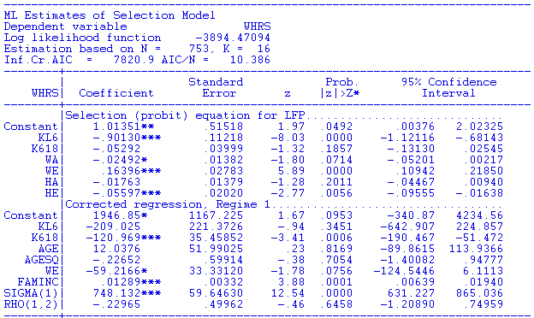
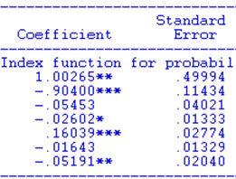
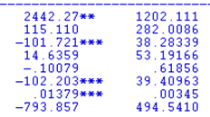

MLE
Two Step Estimates

Slide 24
How to Handle Selectivity
The ‘Mills Ratio’ approach – just add a ‘lambda’ to whatever model is being estimated?
  The Heckman model applies to a probit model with a linear regression.
  The conditional mean in a nonlinear model is not something “+lambda”
The model can sometimes be built up from first principles

Slide 25
Received Sunday, April 27, 2014
I have a paper regarding strategic alliances between firms, and their impact on firm risk. While observing how a firm’s strategic alliance formation impacts its risk, I need to correct for two types of selection biases. The reviews at Journal of Marketing asked us to correct for the propensity of firms to enter into alliances, and also the propensity to select a specific partner, before we examine how the partnership itself impacts risk.
Our approach involved conducting a probit of alliance formation propensity, take the inverse mills and include it in the second selection equation which is also a probit of partner selection. Then, we include inverse mills from the second selection into the main model. The review team states that this is not correct, and we need an MLE estimation in order to correctly model the set of three equations. The Associate Editor’s point is given below. Can you please provide any guidance on whether this is a valid criticism of our approach. Is there a procedure in LIMDEP that can handle this set of three equations with two selection probit models?
AE’s comment:
“Please note that the procedure of using an inverse mills ratio is only consistent when the main equation where the ratio is being used is linear. In non-linear cases (like the second probit used by the authors), this is not correct. Please see any standard econometric treatment like Greene or Wooldridge. A MLE estimator is needed which will be far from trivial to specify and estimate given error correlations between all three equations.”

Slide 26
A Bivariate Probit Model

Slide 27
FT/PT Selection Model
+---------------------------------------------+
| FIML Estimates of Bivariate Probit Model |
| Dependent variable FULLFP |
| Weighting variable None |
| Number of observations 753 |
| Log likelihood function -723.9798 |
| Number of parameters 16 |
| Selection model based on LFP |
+---------------------------------------------+
+---------+--------------+----------------+--------+---------+----------+
|Variable | Coefficient | Standard Error |b/St.Er.|P[|Z|>z] | Mean of X|
+---------+--------------+----------------+--------+---------+----------+
Index equation for FULLTIME
Constant .94532822 1.61674948 .585 .5587
WW -.02764944 .01941006 -1.424 .1543 4.17768154
KL6 .04098432 .26250878 .156 .8759 .14018692
K618 -.13640024 .05930081 -2.300 .0214 1.35046729
AGE .03543435 .07530788 .471 .6380 41.9719626
AGESQ -.00043848 .00088406 -.496 .6199 1821.12150
WE -.08622974 .02808185 -3.071 .0021 12.6588785
FAMINC .210971D-04 .503746D-05 4.188 .0000 24130.4229
Index equation for LFP
Constant .98337341 .50679582 1.940 .0523
KL6 -.88485756 .11251971 -7.864 .0000 .23771580
K618 -.04101187 .04020437 -1.020 .3077 1.35325365
WA -.02462108 .01308154 -1.882 .0598 42.5378486
WE .16636047 .02738447 6.075 .0000 12.2868526
HA -.01652335 .01287662 -1.283 .1994 45.1208499
HE -.06276470 .01912877 -3.281 .0010 12.4913679
Disturbance correlation
RHO(1,2) -.84102682 .25122229 -3.348 .0008
Full Time = Hours > 1000

Slide 28
Building a Likelihood for a Poisson Regression Model with Selection

Slide 29
Building the Likelihood

Slide 30
Dear Professor Greene,
I am very sorry to bother you considering this is my first time emailing you. I am ****************, lecturer in Finance at &&&&&&&&&&& University (Scotland).
I am doing a project investigating the impact of hedge fund manager's co-investment on the survival probability of the fund. As fund managers' co-investment decision is self-selection which might cause endogeneity issue, I jointly estimate the co-investment decision (Probit model) and the survival probability (Hazard model) to account for endogeneity of co-investment decision. I received one comment saying that I should use Heckman's two procedure to correct for endogeneity. My understanding is the Heckman's approach applies to a Probit and a LINEAR model. Since hazard model is nonlinear, simply adding inverse Mill's ration in the hazard model is wrong.
What I am asking is if my understanding of this is correct? If so, why can we not simply add Mill's ratio in a nonlinear model?

Slide 31
Conditional Likelihood

Slide 32
Poisson Model with Selection
Strategy:
  Hermite quadrature or maximum simulated likelihood.
  Not by throwing a ‘lambda’ into the unconditional likelihood
Could this be done without joint normality?
  How robust is the model?
  Is there any other approach available?
  Not easily. The subject of ongoing research

Slide 33
Nonnormality Issue
How robust is the Heckman model to nonnormality of the unobserved effects?
Are there other techniques
  Parametric: Copula methods
  Semiparametric: Klein/Spady and Series methods
Other forms of the selection equation – e.g., multinomial logit
Other forms of the primary model: e.g., as above.

Slide 34
Application: Health Care Usage
German Health Care Usage Data, 7,293 Individuals, Varying Numbers of Periods
This is an unbalanced panel with 7,293 individuals. There are altogether 27,326 observations. The number of observations ranges from 1 to 7.
(Frequencies are: 1=1525, 2=2158, 3=825, 4=926, 5=1051, 6=1000, 7=987).
(Downloaded from the JAE Archive)
Variables in the file are
DOCTOR = 1(Number of doctor visits > 0)
HOSPITAL = 1(Number of hospital visits > 0)
HSAT = health satisfaction, coded 0 (low) - 10 (high)
DOCVIS = number of doctor visits in last three months
HOSPVIS = number of hospital visits in last calendar year
PUBLIC = insured in public health insurance = 1; otherwise = 0
ADDON = insured by add-on insurance = 1; otherswise = 0
HHNINC = household nominal monthly net income in German marks / 10000.
(4 observations with income=0 were dropped)
HHKIDS = children under age 16 in the household = 1; otherwise = 0
EDUC = years of schooling
AGE = age in years
MARRIED = marital status
Notes:
34

Slide 35
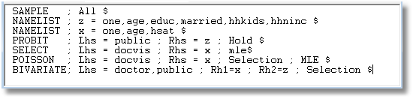

Slide 36
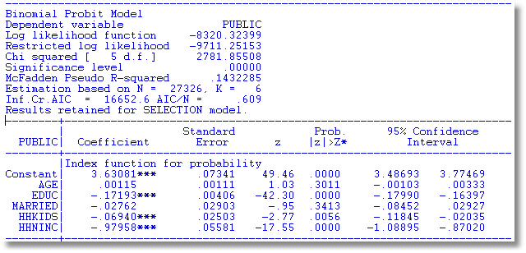

Slide 37
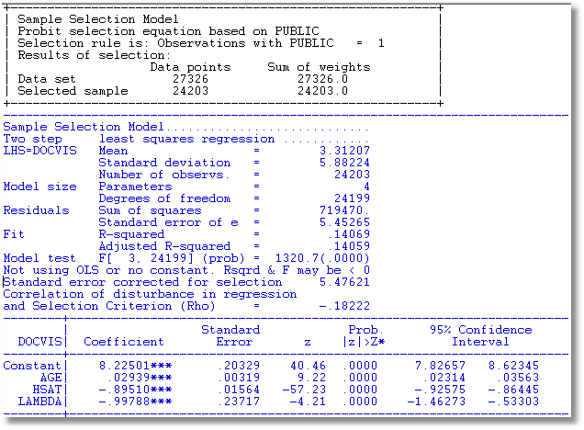

Slide 38
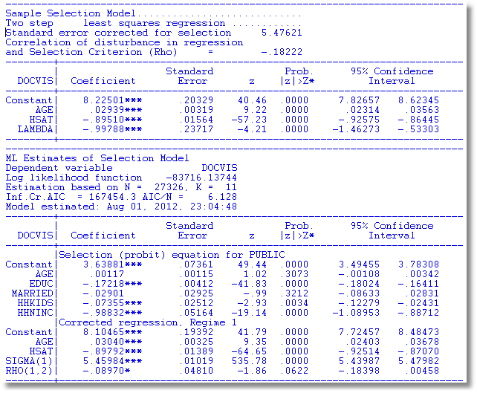

Slide 39
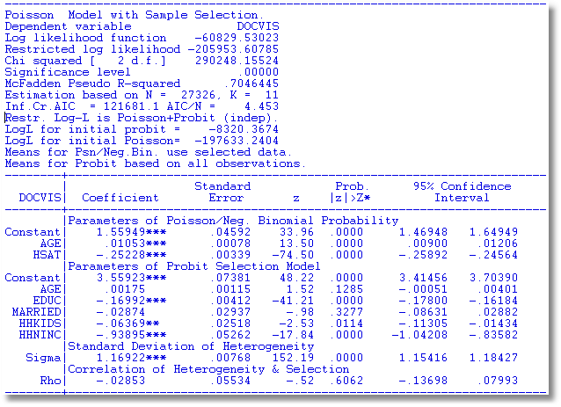

Slide 40
