Slide 1

Econometrics I
Professor William Greene
Stern School of Business
Department of Economics

Slide 2
Econometrics I
Part 2 – Projection and
Regression

Slide 3
Statistical Relationship
Objective: Characterize the ‘relationship’ between a variable of interest and a set of 'related' variables
Context: An inverse demand equation,
  P = α + βQ + γY, Y = income. P and Q are two random variables with a joint distribution, f(P,Q). We are interested in studying the ‘relationship’ between
  P and Q.
  By ‘relationship’ we mean (usually) covariation.

Slide 4
Bivariate Distribution - Model for a Relationship Between Two Variables
We might posit a bivariate distribution for P and Q, f(P,Q)
How does variation in P arise?
  With variation in Q, and
  Random variation in its distribution.
There exists a conditional distribution f(P|Q) and a conditional mean function, E[P|Q]. Variation in P arises because of
  Variation in the conditional mean,
  Variation around the conditional mean,
  (Possibly) variation in a covariate, Y which shifts the conditional distribution

Slide 5
Conditional Moments
The conditional mean function is the regression function.
  P = E[P|Q] + (P - E[P|Q]) = E[P|Q] + ε
  E[ε|Q] = 0 = E[ε]. Proof: (The Law of iterated expectations)
Variance of the conditional random variable = conditional variance, or the scedastic function.
A “trivial relationship” may be written as P = h(Q) + ε, where the random variable ε = P-h(Q) has zero mean by construction. Looks like a regression “model” of sorts.
An extension: Can we carry Y as a parameter in the bivariate distribution? Examine E[P|Q,Y]

Slide 6
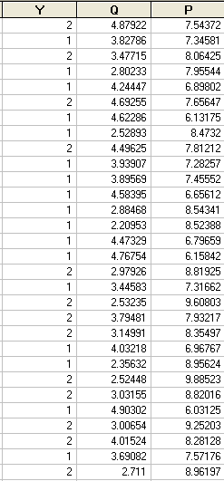
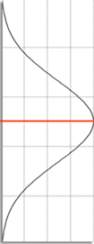
Sample Data (Experiment)
5.0 7.5 10.0
Distribution of P

Slide 7
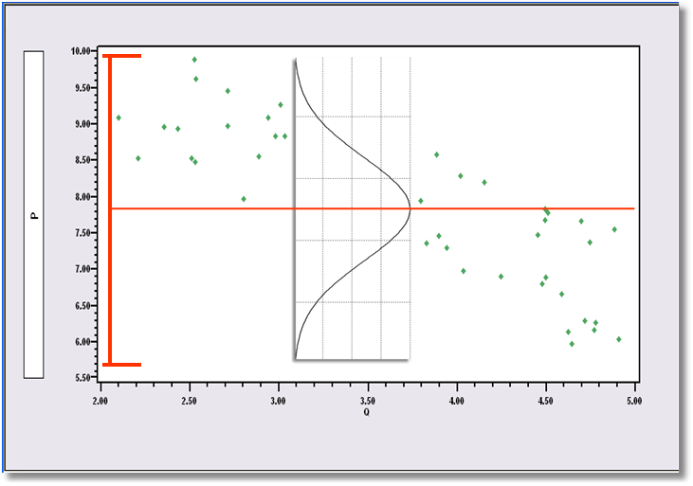
50 Observations on P and Q
Showing Variation of P Around E[P]

Slide 8
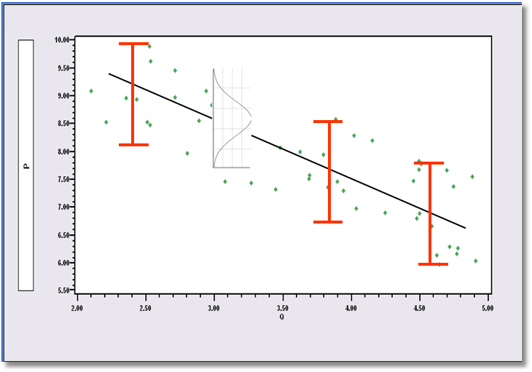
Variation Around E[P|Q]
(Conditioning Reduces Variation)

Slide 9
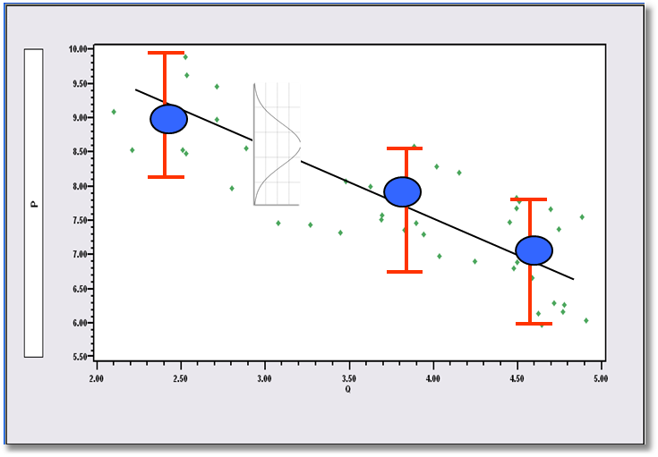
Means of P for Given Group Means of Q

Slide 10
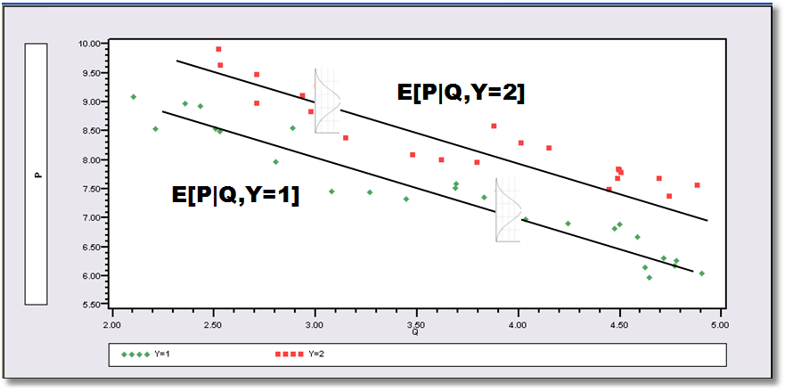
Another Conditioning Variable

Slide 11
Conditional Mean Functions
No requirement that they be "linear" (we will discuss what we mean by linear)
Conditional Mean function: h(X) is the function that minimizes E_{X,Y}[Y – h(X)]²
No restrictions on conditional variances at this point.

Slide 12
Projections and Regressions
We explore the difference between the linear projection and the conditional mean function
y and x are two random variables that have a bivariate distribution, f(x,y).
Suppose there exists a linear function such that
y = α + βx + ε where E(ε|x) = 0 => Cov(x,ε) = 0
Then,
Cov(x,y) = Cov(x,α) + βCov(x,x) + Cov(x,ε)
= 0 + β Var(x) + 0
so, β = Cov(x,y) / Var(x)
and E(y) = α + βE(x) + E(ε)
but E(ε) = E(ε|x) = E(0) = 0 (Law of iterated expectations)
so E(y) = α + βE(x) + 0
so, α = E[y] - βE[x].

Slide 13
Regression and Projection
Does this mean E[y|x] = α + βx?
  No. This is the linear projection of y on x
  It is true in every bivariate distribution, whether or not E[y|x] is linear in x.
  y can generally be written y = α + βx + ε
  where ε ⊥ x, β = Cov(x,y) / Var(x) etc.
  The conditional mean function is h(x) such that
  y = h(x) + v where E[v|h(x)] = 0. But, h(x) does not have to be linear.
  The implication: What is the result of “linearly regressing y on ,” for example using least squares?

Slide 14
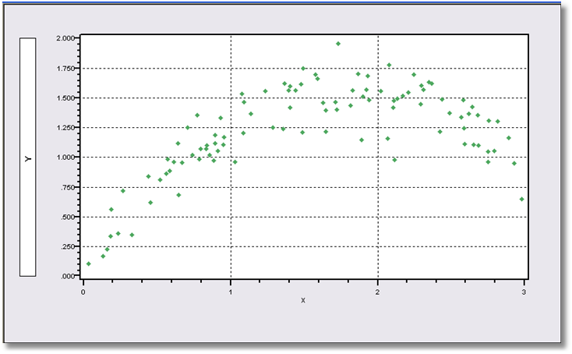
Data from a Bivariate Population

Slide 15
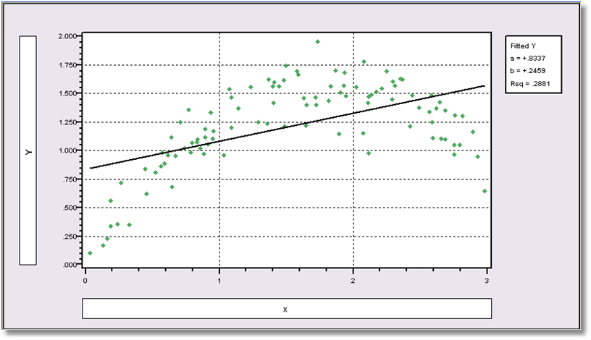
The Linear Projection Computed by Least Squares

Slide 16
Linear Least Squares Projection
----------------------------------------------------------------------
Ordinary least squares regression ............
LHS=Y Mean = 1.21632
Standard deviation = .37592
Number of observs. = 100
Model size Parameters = 2
Degrees of freedom = 98
Residuals Sum of squares = 9.95949
Standard error of e = .31879
Fit R-squared = .28812
Adjusted R-squared = .28086
--------+-------------------------------------------------------------
Variable| Coefficient Standard Error t-ratio P[|T|>t] Mean of X
--------+-------------------------------------------------------------
Constant| .83368*** .06861 12.150 .0000
X| .24591*** .03905 6.298 .0000 1.55603
--------+-------------------------------------------------------------

Slide 17
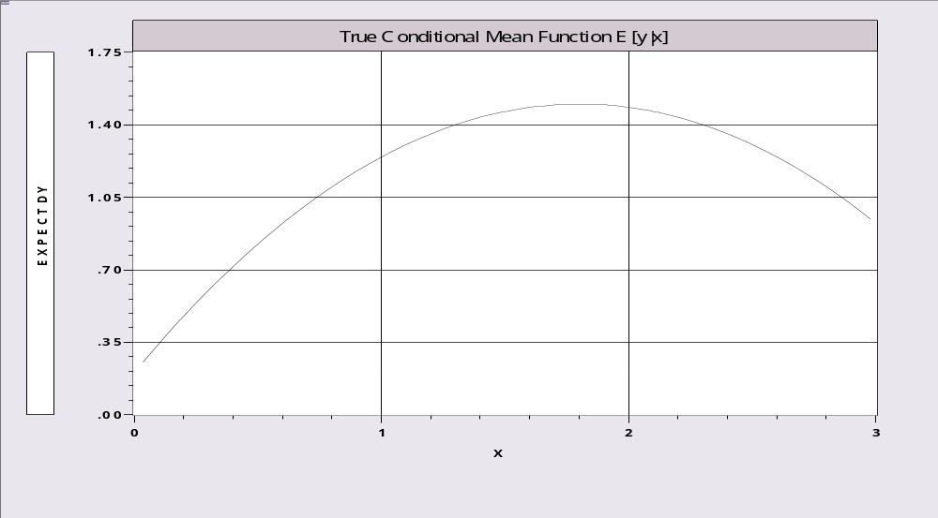
The True Conditional Mean Function

Slide 18
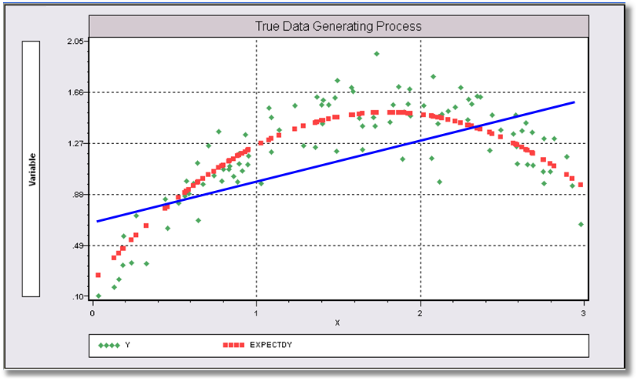
The True Data Generating Mechanism
What does least squares “estimate?”

Slide 19


Slide 20
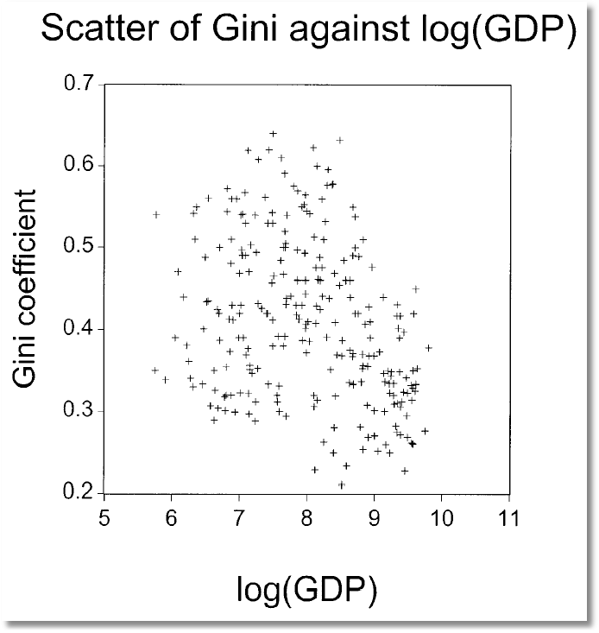
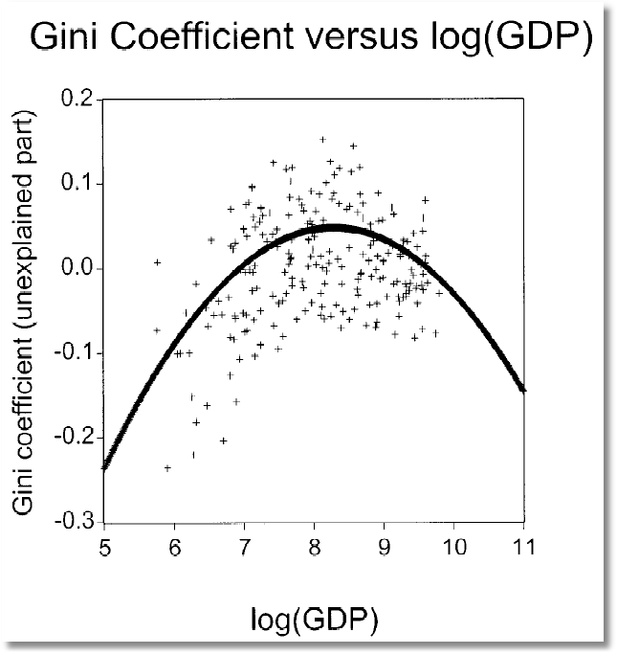

Slide 21
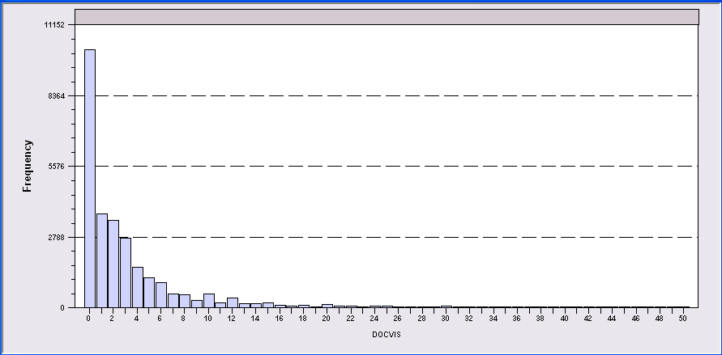
Application: Doctor Visits
German Individual Health Care data: n=27,236
A model for number of visits to the doctor:
  True E[v|income] = exp(1.413 - .747*income)
  Linear regression: g*(income)=3.918 – 2.087*income

Slide 22
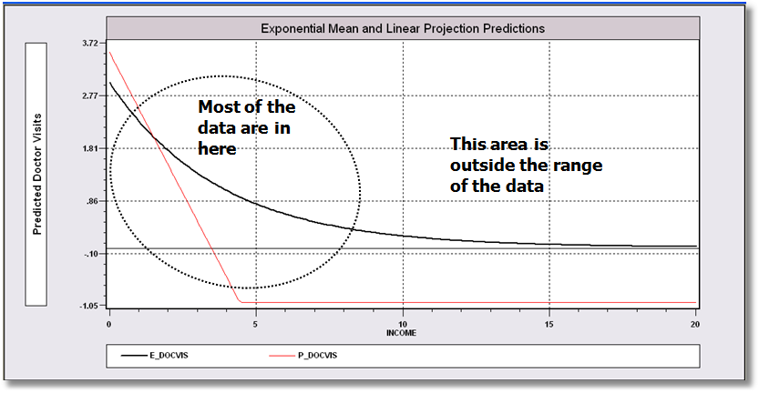
Conditional Mean and Projection
The linear projection somewhat resembles the conditional mean.
Notice the problem with the linear approach. Negative predictions.

Slide 23
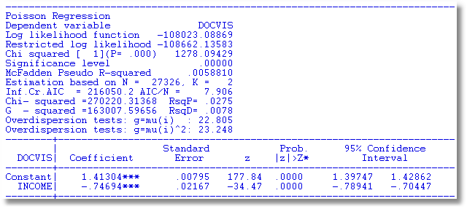

Slide 24
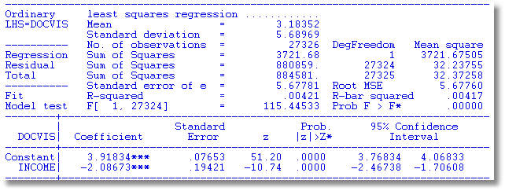
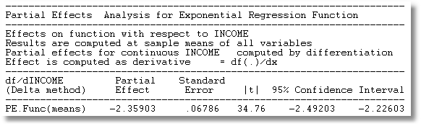

Slide 25
Representing the Relationship
Conditional mean function is : E[y | x] = g(x)
The linear projection (linear regression?)
Linear approximation to the nonlinear conditional mean function: Linear Taylor series evaluated at x⁰
We will use the projection very often. We will rarely use the Taylor series.

Slide 26
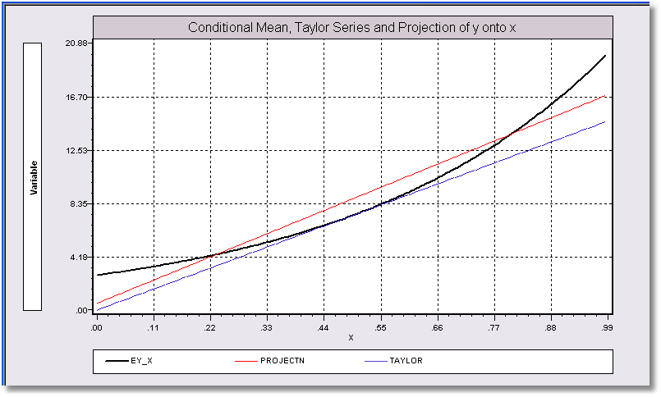
Representations of y
Does y = β₀ + β₁x + ε?
Slopes of the 3 functions are roughly equal.

Slide 27
Summary
Regression function: E[y|x] = g(x)
Projection: g*(y|x) = a + bx where
b = Cov(x,y)/Var(x) and a = E[y]-bE[x]
Projection will equal E[y|x] if E[y|x] is linear.
y = E[y|x] + e
y = a + bx + u

Slide 28
The Linear Regression Model
The model is y = f(x₁,x₂,…,x_{K},β₁,β₂,…β_{K}) + ε
= a multiple regression model (multiple as opposed to multivariate). Emphasis on the “multiple” aspect of multiple regression. Important examples:
Form of the model – E[y|x] = a linear function of x.
(Regressand vs. regressors)
Note the presumption that there exists a relationship defined by the model.
‘Dependent’ and ‘independent’ variables.
  Independent of what? Think in terms of autonomous variation.
  Can y just ‘change?’ What ‘causes’ the change?
  Very careful on the issue of causality. Cause vs. association. Modeling causality in econometrics…

Slide 29
Model Assumptions: Generalities
Linearity means linear in the parameters. We’ll return to this issue shortly.
Identifiability. It is not possible in the context of the model for two different sets of parameters to produce the same value of E[y|x] for all x vectors. (It is possible for some x.)
Conditional expected value of the deviation of an observation from the conditional mean function is zero
Form of the variance of the random variable around the conditional mean is specified
Nature of the process by which x is observed is not specified. The assumptions are conditioned on the observed x.
Assumptions about a specific probability distribution to be made later.

Slide 30
Linearity of the Model
f(x₁,x₂,…,x_{K},β₁,β₂,…β_{K}) = x₁β₁ + x₂β₂ + … + x_{K}β_{K}
Notation: x₁β₁ + x₂β₂ + … + x_{K}β_{K} = x′β.
  Boldface letter indicates a column vector. “x” denotes a variable, a function of a variable, or a function of a set of variables.
  There are K “variables” on the right hand side of the conditional mean “function.”
  The first “variable” is usually a constant term. (Wisdom: Models should have a constant term unless the theory says they should not.)
E[y|x] = β₁*1 + β₂*x₂ + … + β_{K}*x_{K}.
(β₁*1 = the intercept term).

Slide 31
Linearity
Simple linear model, E[y|x] =x’β
Quadratic model: E[y|x] = α + β₁x + β₂x²
Loglinear model, E[lny|lnx] = α + Σ_{k} lnx_{k}β_{k}
Semilog, E[y|x] = α + Σ_{k} lnx_{k}β_{k}
Translog: E[lny|lnx] = α + Σ_{k} lnx_{k}β_{k}
+ Σ_{k} Σ_{l} δ_{kl} lnx_{k} lnx_{l}
All are “linear.” An infinite number of variations.

Slide 32
Linearity
Linearity means linear in the parameters, not in the variables
E[y|x] = β₁ f₁(…) + β₂ f₂(…) + … + β_{K} f_{K}(…).
f_{k}() may be any function of data.
Examples:
  Logs and levels in economics
  Time trends, and time trends in loglinear models – rates of growth
  Dummy variables
  Quadratics, power functions, log-quadratic, trig functions, interactions and so on.

Slide 33
Uniqueness of the Conditional Mean
The conditional mean relationship must hold for any set of N observations, i = 1,…,n. Assume, that n ≥ K (justified later)
E[y₁|x] = x₁′β
E[y₂|x] = x₂′β
…
E[y_{n}|x] = x_{n}′β
All n observations at once: E[y|X] = Xβ = E_{β}.

Slide 34
Uniqueness of E[y|X]
Now, suppose there is a γ ≠ β that produces the same expected value,
E[y|X] = Xγ = E_{γ}.
Let δ = β - γ. Then,
Xδ = Xβ - Xγ = E_{β} - E_{γ} = 0.
Is this possible? X is an n×K matrix (n rows, K columns). What does Xδ = 0 mean? We assume this is not possible. This is the ‘full rank’ assumption – it is an ‘identifiability’ assumption. Ultimately, it will imply that we can ‘estimate’ β. (We have yet to develop this.) This requires n ≥ K .
Without uniqueness, neither Xβ or Xγ are E[y|X]

Slide 35
Linear Dependence
Example: (2.5) from your text:
x = [1 , Nonlabor income, Labor income, Total income]
More formal statement of the uniqueness condition:
No linear dependencies: No variable x_{k} may be written as a linear function of the other variables in the model. An identification condition. Theory does not rule it out, but it makes estimation impossible. E.g.,
y = β₁ + β₂NI + β₃S + β₄T + ε, where T = NI+S.
y = β₁ + (β₂+a)NI + (β₃+a)S + (β₄-a)T + ε for any a,
= γ₁ + γ₂NI + γ₃S + γ₄T + ε.
What do we estimate if we ‘regress’ y on (1,NI,S,T)?
Note, the model does not rule out nonlinear dependence. Having x and x² in the same equation is no problem.

Slide 36

An Enduring Art Mystery
3/49
Graphics show relative sizes of the two works.
The Persistence of Econometrics
Greene, 2017
Why do larger paintings command higher prices?
The Persistence of Memory. Salvador Dali, 1931

Slide 37

An Unidentified (But Valid)
Theory of Art Appreciation
Enhanced Monet Area Effect Model: Height and Width Effects
Log(Price) = α + β₁ log Area +
β₂ log Aspect Ratio +
β₃ log Height +
β₄ Signature + ε
= α + β₁x₁ + β₂x₂ + β₃x₃ + β₄x₄ + ε
(Aspect Ratio = Width/Height). This is a perfectly respectable theory of art prices. However, it is not possible to learn about the parameters from data on prices, areas, aspect ratios, heights and signatures.
x₃ = (1/2)(x₁-x₂)
(Not a Monet)

Slide 38
Notation
Define column vectors of N observations on y and the K variables.
= Xβ + ε
The assumption means that the rank of the matrix X is K.
No linear dependencies => FULL COLUMN RANK of the matrix X.

Slide 39
Expected Values of Deviations from the Conditional Mean
Observed y will equal E[y|x] + random variation.
y = E[y|x] + ε (disturbance)
  Is there any information about ε in x? That is, does movement in x provide useful information about movement in ε? If so, then we have not fully specified the conditional mean, and this function we are calling ‘E[y|x]’ is not the conditional mean (regression)
  There may be information about ε in other variables. But, not in x. If E[ε|x] ≠ 0 then it follows that Cov[ε,x] ≠ 0. This violates the (as yet still not fully defined) ‘independence’ assumption

Slide 40
Zero Conditional Mean of ε
E[ε|all data in X] = 0
E[ε|X] = 0 is stronger than E[ε_{i} | x_{i}] = 0
  The second says that knowledge of x_{i} provides no information about the mean of ε_{i}. The first says that no x_{j} provides information about the expected value of ε_{i}, not the i^{th} observation and not any other observation either.
  “No information” is the same as no correlation. Proof: Cov[X,ε] = Cov[X,E[ε|X]] = 0

Slide 41
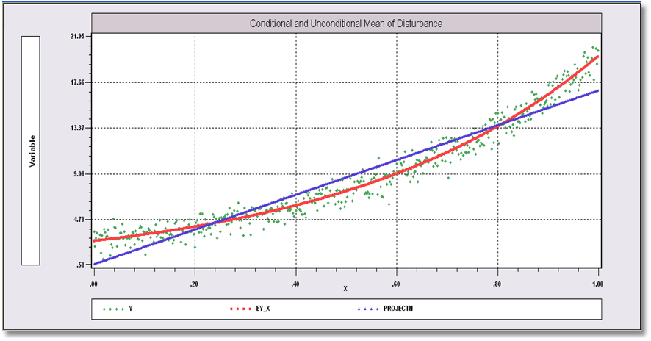
The Difference Between E[ε |x]=0 and E[ε]=0
With respect to , E[ε|x] ≠ 0, but E_{x}[E[ε|x]] = E[ε] = 0

Slide 42
Conditional Homoscedasticity and Nonautocorrelation
Disturbances provide no information about each other, whether in the presence of X or not.
  Var[ε|X] = σ²I.
  Does this imply that Var[ε] = σ²I? Yes:
  Proof: Var[ε] = E[Var[ε|X]] + Var[E[ε|X]].
  Insert the pieces above. What does this mean? It is an additional assumption, part of the model. We’ll change it later. For now, it is a useful simplification

Slide 43
Normal Distribution of ε
Used to facilitate finite sample derivations of certain test statistics.
Temporary. We’ll return to this later. For now, we only assume ε are i.i.d. with zero conditional mean and constant conditional variance.

Slide 44
The Linear Model
y = Xβ+ε, n observations, K columns in X, including a column of ones.
  Standard assumptions about X
  Standard assumptions about ε|X
  E[ε|X]=0, E[ε]=0 and Cov[ε,x]=0
Regression?
  If E[y|X] = Xβ then E[y|x] is also the projection.

Slide 45
Cornwell and Rupert Panel Data
Cornwell and Rupert Returns to Schooling Data, 595 Individuals, 7 Years
Variables in the file are
EXP = work experience
WKS = weeks worked
OCC = occupation, 1 if blue collar,
IND = 1 if manufacturing industry
SOUTH = 1 if resides in south
SMSA = 1 if resides in a city (SMSA)
MS = 1 if married
FEM = 1 if female
UNION = 1 if wage set by union contract
ED = years of education
LWAGE = log of wage = dependent variable in regressions
These data were analyzed in Cornwell, C. and Rupert, P., "Efficient Estimation with Panel Data: An Empirical Comparison of Instrumental Variable Estimators," Journal of Applied Econometrics, 3, 1988, pp. 149-155. See Baltagi, page 122 for further analysis. The data were downloaded from the website for Baltagi's text.
Notes:
45

Slide 46

Regression Specification: Quadratic Effect of Experience

Slide 47
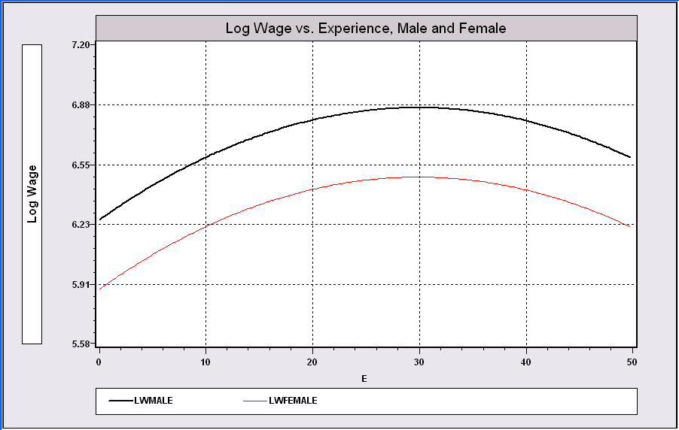
Model Implication:
Effect of Experience and Male vs. Female

