Slide 1

Econometrics I
Professor William Greene
Stern School of Business
Department of Economics

Slide 2
Econometrics I
Part 20 –MLE Applications and a Two Step Estimator

Slide 3
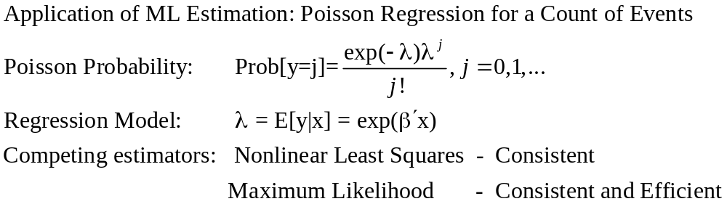
Poisson Regression Model

Slide 4
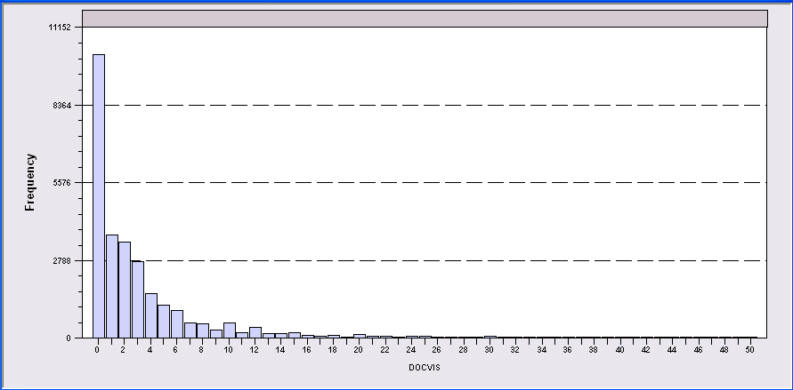
Application: Doctor Visits
German Individual Health Care data: n=27,236
Model for number of visits to the doctor:
  Poisson regression (fit by maximum likelihood)
  Income, Education, Gender

Slide 5
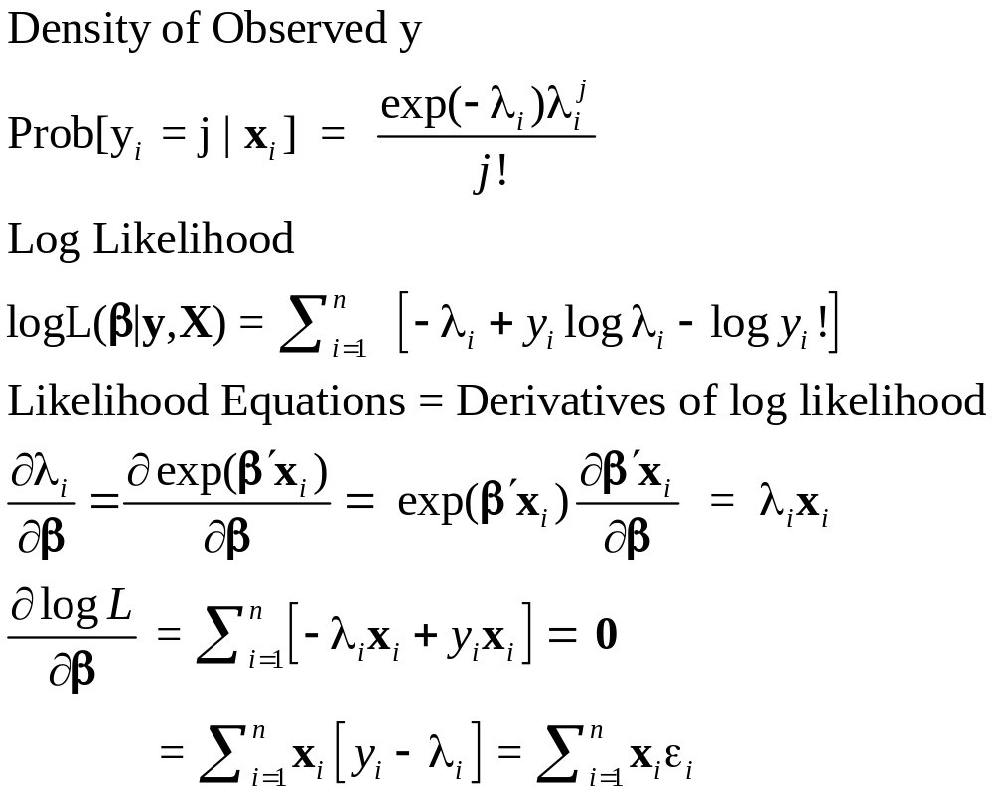
Poisson Model

Slide 6
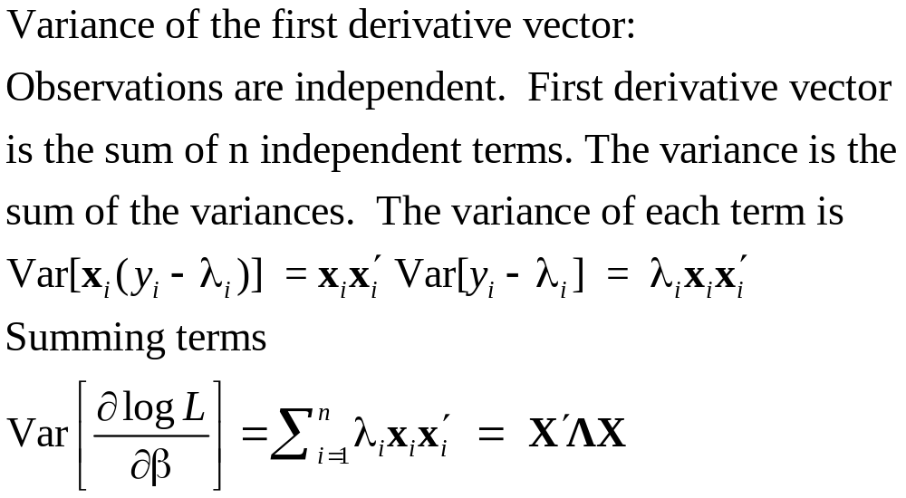
Asymptotic Variance of the MLE

Slide 7
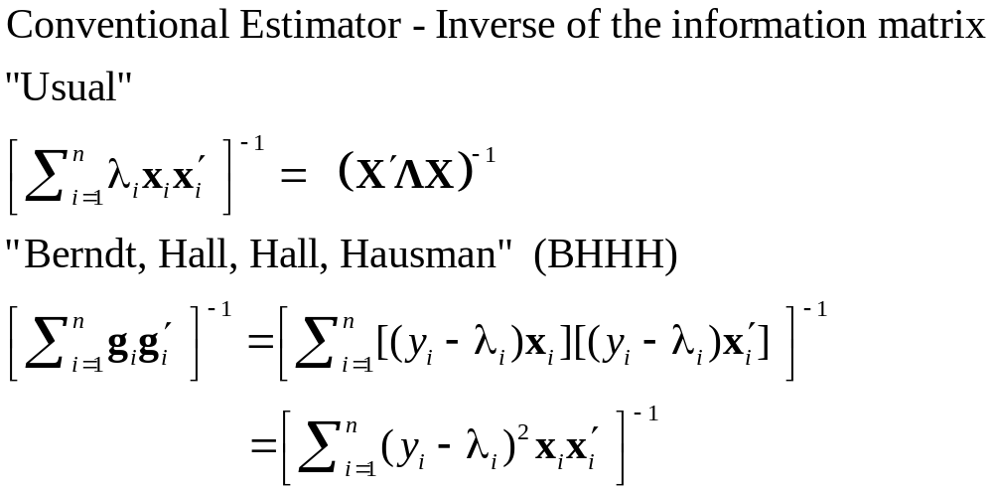
Estimators of the Asymptotic Covariance Asymptotic Covariance Matrix

Slide 8
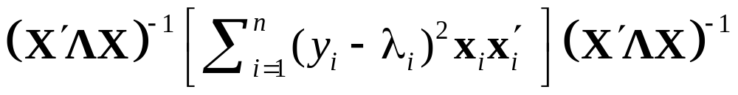
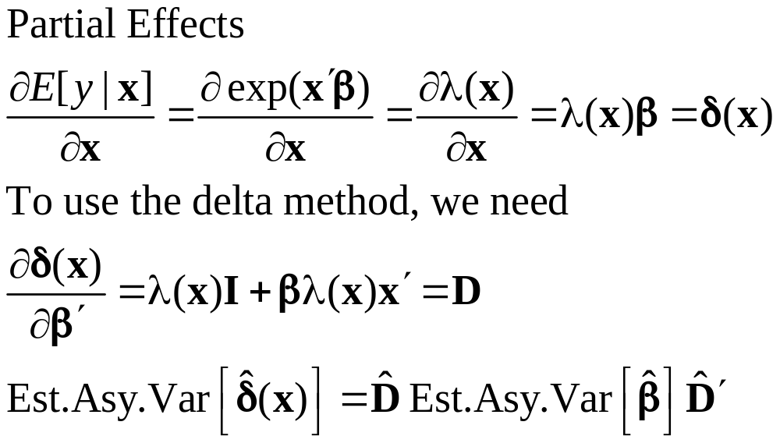
Robust Estimation
Robust (Sandwich) Estimator
H⁻¹ (G′G) H⁻¹

Slide 9
Regression and Partial Effects
+--------+--------------+----------------+--------+--------+----------+
|Variable| Coefficient | Standard Error |b/St.Er.|P[|Z|>z]| Mean of X|
+--------+--------------+----------------+--------+--------+----------+
Constant| 1.72492985 .02000568 86.222 .0000
FEMALE | .31954440 .00696870 45.854 .0000 .47877479
HHNINC | -.52475878 .02197021 -23.885 .0000 .35208362
EDUC | -.04986696 .00172872 -28.846 .0000 11.3206310
+-------------------------------------------+
| Partial derivatives of expected val. with |
| respect to the vector of characteristics. |
| Effects are averaged over individuals. |
| Observations used for means are All Obs. |
| Conditional Mean at Sample Point 3.1835 |
| Scale Factor for Marginal Effects 3.1835 |
+-------------------------------------------+
+--------+--------------+----------------+--------+--------+----------+
|Variable| Coefficient | Standard Error |b/St.Er.|P[|Z|>z]| Mean of X|
+--------+--------------+----------------+--------+--------+----------+
FEMALE | 1.01727755 .02427607 41.905 .0000 .47877479
HHNINC | -1.67058263 .07312900 -22.844 .0000 .35208362
EDUC | -.15875271 .00579668 -27.387 .0000 11.3206310

Slide 10
Comparison of Standard Errors
Negative Inverse of Second Derivatives
+--------+--------------+----------------+--------+--------+----------+
|Variable| Coefficient | Standard Error |b/St.Er.|P[|Z|>z]| Mean of X|
+--------+--------------+----------------+--------+--------+----------+
Constant| 1.72492985 .02000568 86.222 .0000
FEMALE | .31954440 .00696870 45.854 .0000 .47877479
HHNINC | -.52475878 .02197021 -23.885 .0000 .35208362
EDUC | -.04986696 .00172872 -28.846 .0000 11.3206310
BHHH
+--------+--------------+----------------+--------+--------+
|Variable| Coefficient | Standard Error |b/St.Er.|P[|Z|>z]|
+--------+--------------+----------------+--------+--------+
Constant| 1.72492985 .00677787 254.495 .0000
FEMALE | .31954440 .00217499 146.918 .0000
HHNINC | -.52475878 .00733328 -71.559 .0000
EDUC | -.04986696 .00062283 -80.065 .0000
Why are they so different? Model failure. This is a panel. There is autocorrelation.

Slide 11
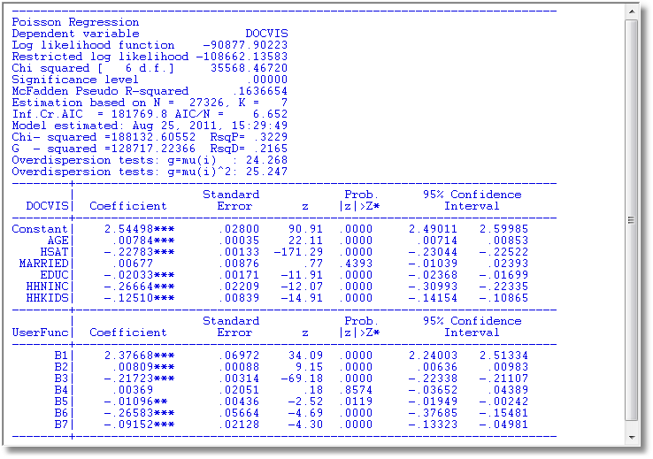
MLE vs. Nonlinear LS

Slide 12
Poisson Model Specification Issues
Equi-Dispersion: Var[y_{i}|x_{i}] = E[y_{i}|x_{i}].
Overdispersion: If λ_{i} = exp[β’x_{i} + ε_{i}],
  E[y_{i}|x_{i}] = γexp[β’x_{i}]
  Var[y_{i}] > E[y_{i}] (overdispersed)
  ε_{i} ~ log-Gamma ➔ Negative binomial model
  ε_{i} ~ Normal[0,σ²] ➔ Normal-mixture model
  ε_{i} is viewed as unobserved heterogeneity (“frailty”).
    Normal model may be more natural.
    Estimation is a bit more complicated.

Slide 13
Negative Binomial Specification
Prob(Y_{i}=j|x_{i}) has greater mass to the right and left
of the mean
Conditional mean function is the same as the
Poisson: E[y_{i}|x_{i}] = λ_{i}=Exp(β’x_{i}), so marginal
effects have the same form.
Variance is Var[y_{i}|x_{i}] = λ_{i}(1 + α λ_{i}), α is the
overdispersion parameter; α = 0 reverts
to the Poisson.
Poisson is consistent when NegBin is appropriate.
Therefore, this is a case for the ROBUST
covariance matrix estimator. (Neglected
heterogeneity that is uncorrelated with x_{i}.)

Slide 14
NegBin Model for Doctor Visits
----------------------------------------------------------------------
Negative Binomial Regression
Dependent variable DOCVIS
Log likelihood function -60134.50735 NegBin LogL
Restricted log likelihood -103727.29625 Poisson LogL
Chi squared [ 1 d.f.] 87185.57782 Reject Poisson model
Significance level .00000
McFadden Pseudo R-squared .4202634
Estimation based on N = 27326, K = 8
Information Criteria: Normalization=1/N
Normalized Unnormalized
AIC 4.40185 120285.01469
NegBin form 2; Psi(i) = theta
--------+-------------------------------------------------------------
Variable| Coefficient Standard Error b/St.Er. P[|Z|>z] Mean of X
--------+-------------------------------------------------------------
Constant| .80825*** .05955 13.572 .0000
AGE| .01806*** .00079 22.780 .0000 43.5257
EDUC| -.03717*** .00386 -9.622 .0000 11.3206
FEMALE| .32596*** .01586 20.556 .0000 .47877
MARRIED| -.00605 .01880 -.322 .7477 .75862
HHNINC| -.46768*** .04663 -10.029 .0000 .35208
HHKIDS| -.15274*** .01729 -8.832 .0000 .40273
|Dispersion parameter for count data model
Alpha| 1.89679*** .01981 95.747 .0000
--------+-------------------------------------------------------------

Slide 15
Zero Inflation – ZIP Models
Two regimes: (Recreation site visits)
  Zero (with probability 1). (Never visit site)
  Poisson with Pr(0) = exp[- β’x_{i}]. (Number of visits, including zero visits this season.)
Unconditional:
  Pr[0] = P(regime 0) + P(regime 1)*Pr[0|regime 1]
  Pr[j | j >0] = P(regime 1)*Pr[j|regime 1]
“Two inflation” – Number of children
These are “latent class models”

Slide 16
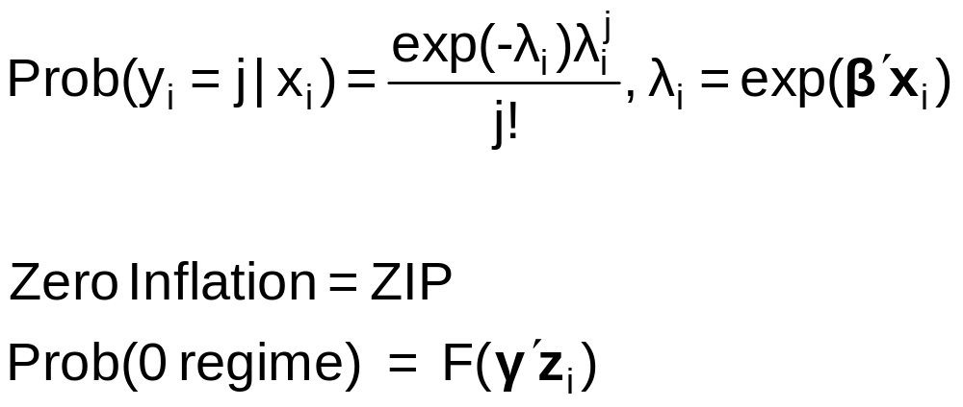
Zero Inflation Models

Slide 17
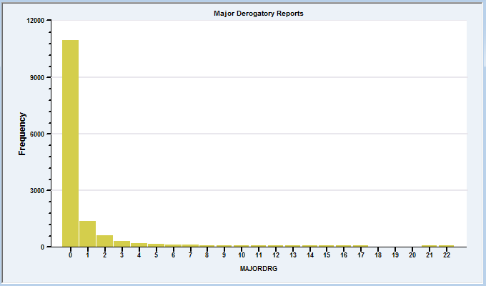
A Zip Model for Major Derogatory Reports
AmEx Credit Card Holders
N = 13,444
Number of major derogatory reports in 1 year
Issues:
Nonrandom selection
Excess zeros

Slide 18
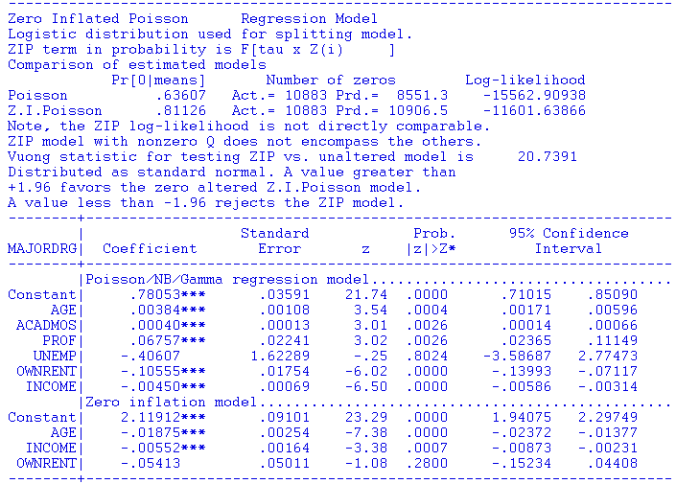

Slide 19
A Hurdle Model
Two part model:
  Model 1: Probability model for more than zero occurrences
  Model 2: Model for number of occurrences given that the number is greater than zero.
Applications common in health economics
  Usage of health care facilities
  Use of drugs, alcohol, etc.

Slide 20


Slide 21
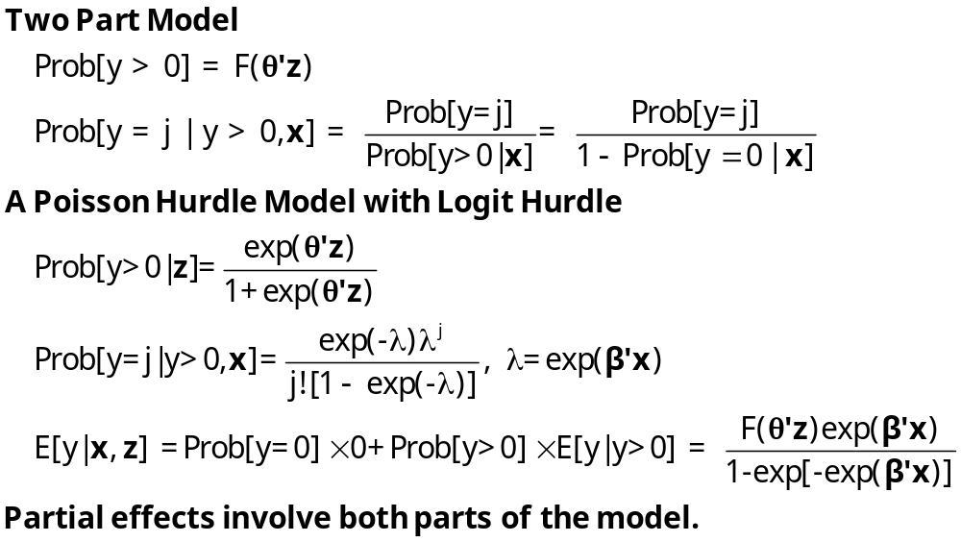
Hurdle Model

Slide 22

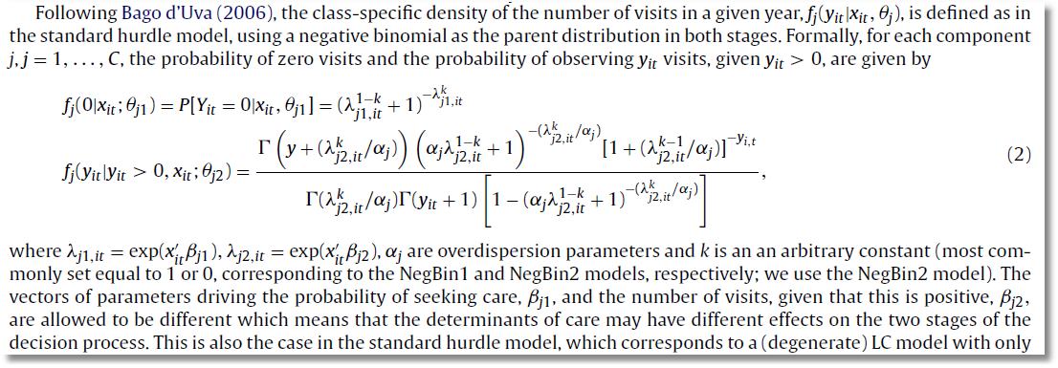
Negative Binomial Model with Hurdle

Slide 23


Slide 24

Application of Several of the Models
Discussed in this Section

Slide 25
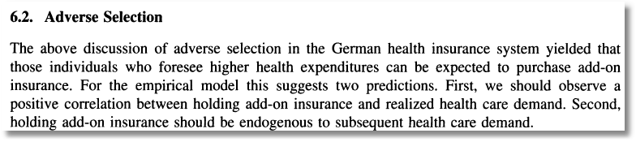
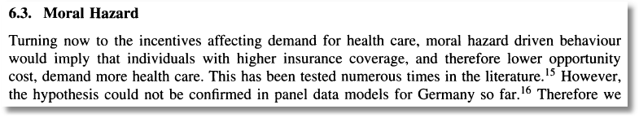

Slide 26

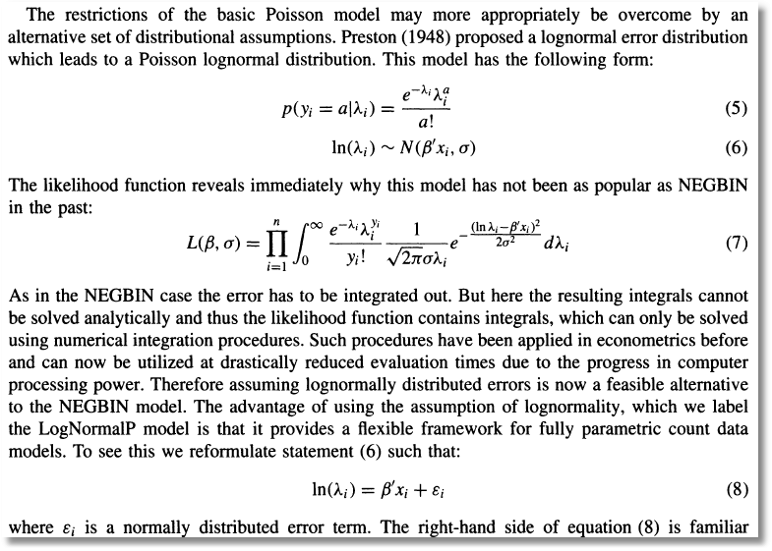
Poisson (log)Normal Mixture

Slide 27
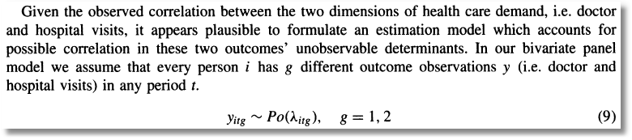
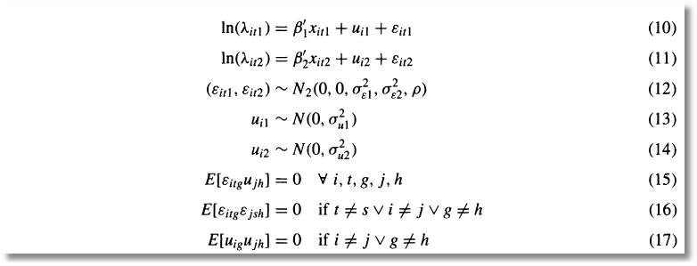
Bivariate Random Effects

Slide 28
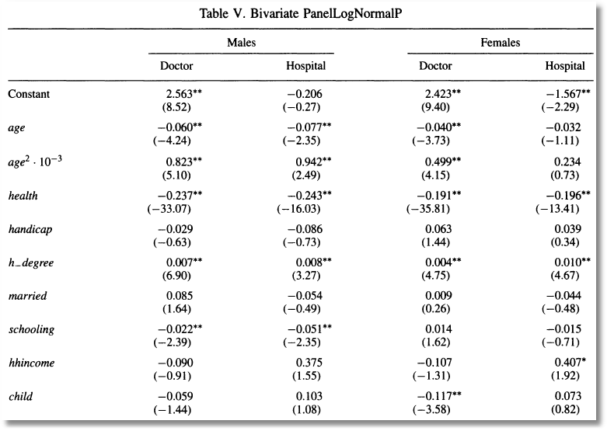
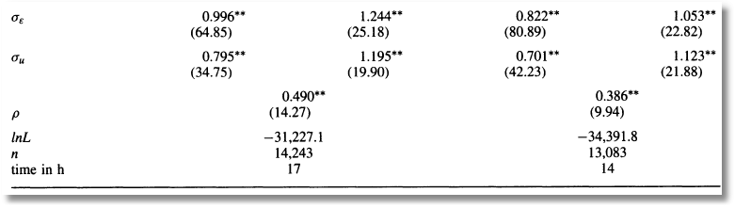

Slide 29
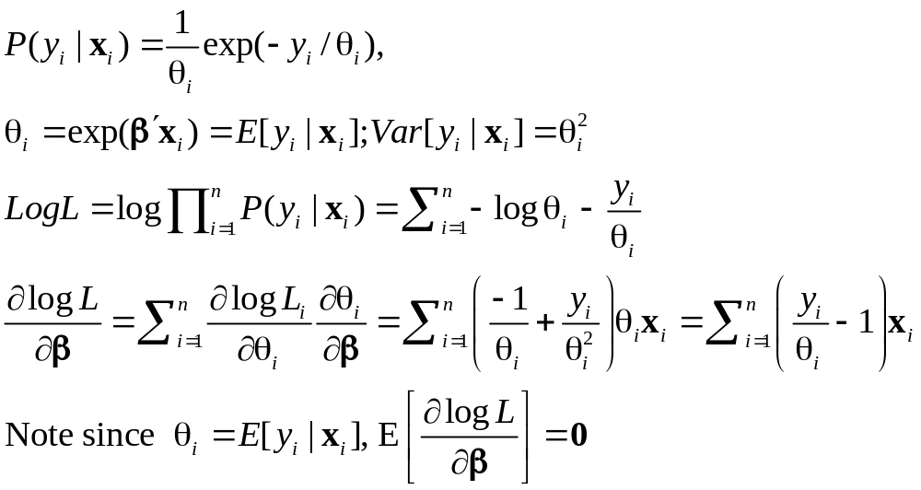
Exponential Regression Model

Slide 30
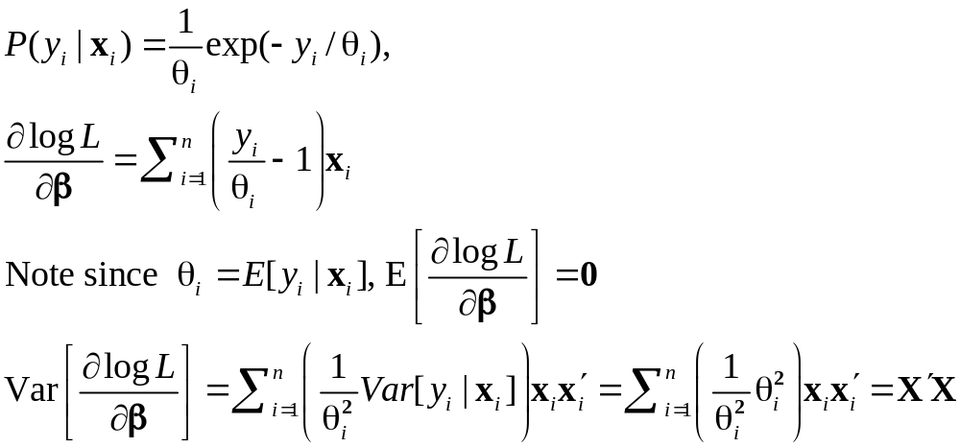
Variance of the First Derivative

Slide 31
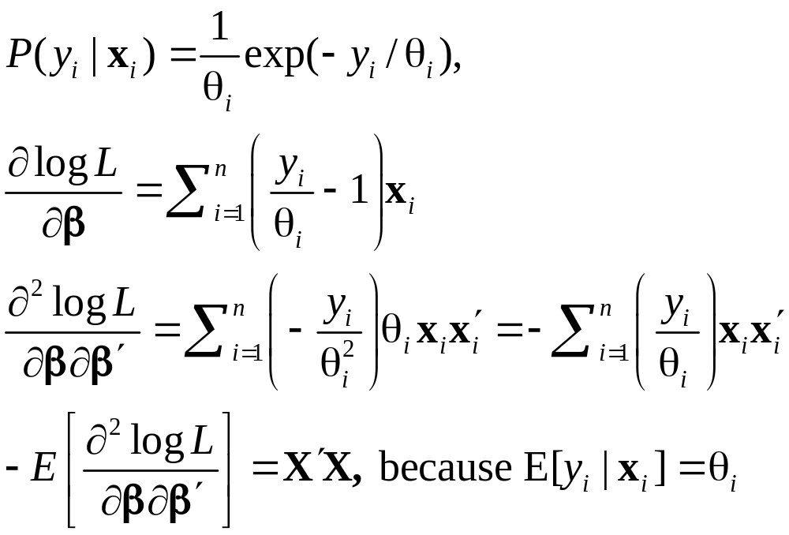
Hessian

Slide 32
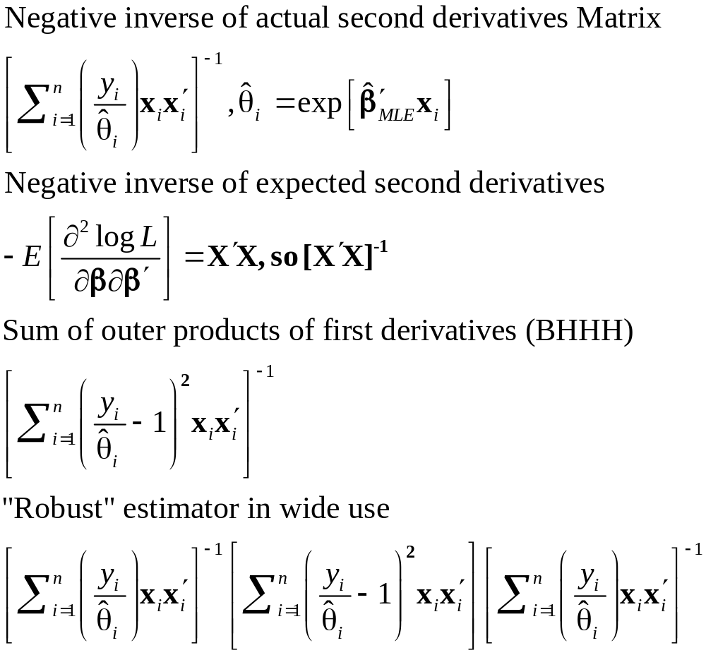
Variance Estimators

Slide 33
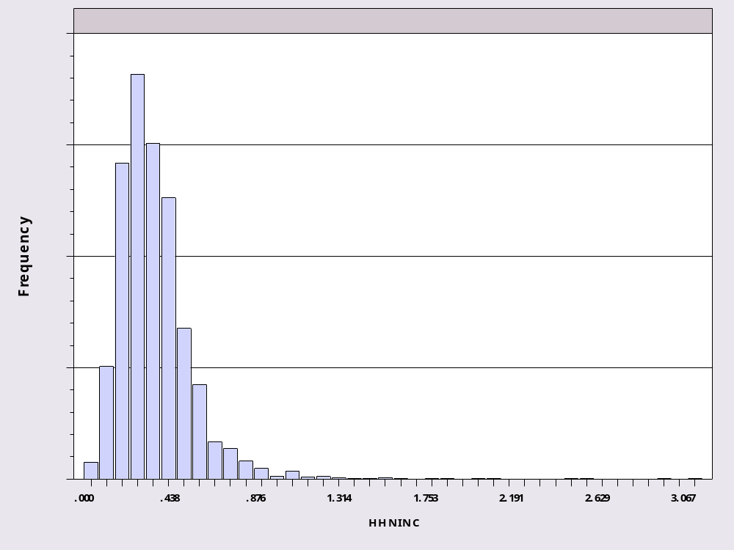
Income Data

Slide 34
Exponential Regression
--> logl ; lhs=hhninc ; rhs = x ; model=exp $
Normal exit: 11 iterations. Status=0. F= -1550.075
----------------------------------------------------------------------
Exponential (Loglinear) Regression Model
Dependent variable HHNINC
Log likelihood function 1550.07536
Restricted log likelihood 1195.06953
Chi squared [ 5 d.f.] 710.01166
Significance level .00000
McFadden Pseudo R-squared -.2970587
Estimation based on N = 27322, K = 6
--------+-------------------------------------------------------------
Variable| Coefficient Standard Error b/St.Er. P[|Z|>z] Mean of X
--------+-------------------------------------------------------------
|Parameters in conditional mean function
Constant| 1.77430*** .04501 39.418 .0000
AGE| .00205*** .00063 3.274 .0011 43.5272
EDUC| -.05572*** .00271 -20.539 .0000 11.3202
MARRIED| -.26341*** .01568 -16.804 .0000 .75869
HHKIDS| .06512*** .01399 4.657 .0000 .40272
FEMALE| -.00542 .01234 -.439 .6603 .47881
--------+-------------------------------------------------------------
Note: ***, **, * = Significance at 1%, 5%, 10% level.
----------------------------------------------------------------------

Slide 35
Variance Estimators
histogram;rhs=hhninc$
reject ; hhninc=0$
namelist ; X = one, age,educ,married,hhkids,female $
loglinear ; lhs=hhninc ; rhs = x ; model=exp $
create ; thetai = exp(b'x) $
create ; gi = (hhninc/thetai - 1) ; gi2 = gi^2 $$
create ; hi = (hhninc/thetai) $
matrix ; Expected = <X'X> ; Stat(b,Expected,X)$
matrix ; Actual = <X'[hi]X> ; Stat(b,Actual,X) $
matrix ; BHHH = <X'[gi2]X> ; Stat(b,BHHH,X) $
matrix ; Robust = Actual * X'[gi2]X * Actual
; Stat(b,Robust,X) $

Slide 36
Estimates
--------+--------------------------------------------------
Variable| Coefficient Standard Error b/St.Er. P[|Z|>z]
--------+--------------------------------------------------
--> matrix ; Expected = <X'X> ; Stat(b,Expected,X)$
Constant| 1.77430*** .04548 39.010 .0000
AGE| .00205*** .00061 3.361 .0008
EDUC| -.05572*** .00269 -20.739 .0000
MARRIED| -.26341*** .01558 -16.902 .0000
HHKIDS| .06512*** .01425 4.571 .0000
FEMALE| -.00542 .01235 -.439 .6605
--> matrix ; Actual = <X'[hi]X> ; Stat(b,Actual,X) $
Constant| 1.77430*** .11922 14.883 .0000
AGE| .00205 .00181 1.137 .2553
EDUC| -.05572*** .00631 -8.837 .0000
MARRIED| -.26341*** .04954 -5.318 .0000
HHKIDS| .06512* .03920 1.661 .0967
FEMALE| -.00542 .03471 -.156 .8759
--> matrix ; BHHH = <X'[gi2]X> ; Stat(b,BHHH,X) $
Constant| 1.77430*** .05409 32.802 .0000
AGE| .00205*** .00069 2.973 .0029
EDUC| -.05572*** .00331 -16.815 .0000
MARRIED| -.26341*** .01737 -15.165 .0000
HHKIDS| .06512*** .01637 3.978 .0001
FEMALE| -.00542 .01410 -.385 .7004
--> matrix ; Robust = Actual * X'[gi2]X * Actual $
Constant| 1.77430*** .28500 6.226 .0000
AGE| .00205 .00481 .427 .6691
EDUC| -.05572*** .01306 -4.268 .0000
MARRIED| -.26341* .14581 -1.806 .0708
HHKIDS| .06512 .09459 .689 .4911
FEMALE| -.00542 .08580 -.063 .9496

Slide 37
Testing Hypotheses
Wald tests, using the familiar distance measure
Likelihood ratio tests:
LogL_{U} = log likelihood without restrictions
LogL_{R} = log likelihood with restrictions
LogL_{U} > logL_{R} for any nested restrictions
2(LogL_{U} – logL_{R}) → chi-squared [J]

Slide 38
Testing the Model
+---------------------------------------------+
| Poisson Regression |
| Maximum Likelihood Estimates |
| Dependent variable DOCVIS |
| Number of observations 27326 |
| Iterations completed 7 |
| Log likelihood function -106215.1 | Log likelihood
| Number of parameters 4 |
| Restricted log likelihood -108662.1 | Log Likelihood with only a
| McFadden Pseudo R-squared .0225193 | constant term.
| Chi squared 4893.983 | 2*[logL – logL(0)]
| Degrees of freedom 3 |
| Prob[ChiSqd > value] = .0000000 |
+---------------------------------------------+
Likelihood ratio test that all three slopes are zero.
NOTE: -2logL reported by some computer programs is meaningless.

Slide 39
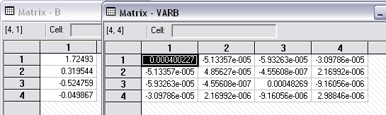
Wald Test
--> MATRIX ; List ; b1 = b(2:4) ; v11 = varb(2:4,2:4) ; B1'<V11>B1$
Matrix B1 Matrix V11
has 3 rows and 1 columns. has 3 rows and 3 columns
1 1 2 3
+-------------- +------------------------------------------
1| .31954 1| .4856275D-04 -.4556076D-06 .2169925D-05
2| -.52476 2| -.4556076D-06 .00048 -.9160558D-05
3| -.04987 3| .2169925D-05 -.9160558D-05 .2988465D-05
Matrix Result has 1 rows and 1 columns.
1
+--------------
1| 4682.38779 LR statistic was 4893.983

Slide 40
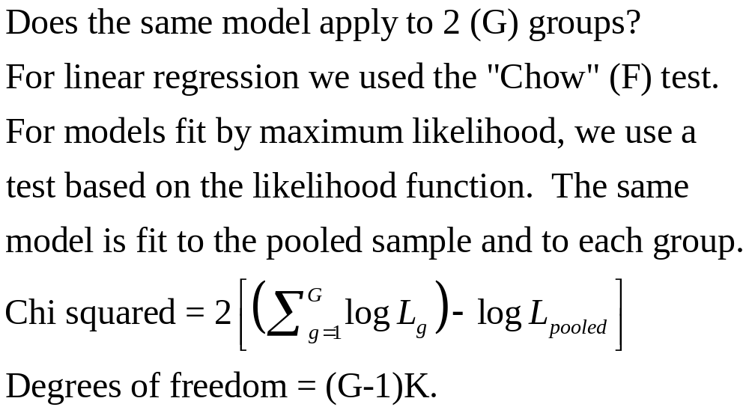
Chow Style Test for Structural Change

Slide 41
Poisson Regressions
----------------------------------------------------------------------
Poisson Regression
Dependent variable DOCVIS
Log likelihood function -90878.20153 (Pooled, N = 27326)
Log likelihood function -43286.40271 (Male, N = 14243)
Log likelihood function -46587.29002 (Female, N = 13083)
--------+-------------------------------------------------------------
Variable| Coefficient Standard Error b/St.Er. P[|Z|>z] Mean of X
--------+-------------------------------------------------------------
Pooled
Constant| 2.54579*** .02797 91.015 .0000
AGE| .00791*** .00034 23.306 .0000 43.5257
EDUC| -.02047*** .00170 -12.056 .0000 11.3206
HSAT| -.22780*** .00133 -171.350 .0000 6.78543
HHNINC| -.26255*** .02143 -12.254 .0000 .35208
HHKIDS| -.12304*** .00796 -15.464 .0000 .40273
--------+-------------------------------------------------------------
Males
Constant| 2.38138*** .04053 58.763 .0000
AGE| .01232*** .00050 24.738 .0000 42.6528
EDUC| -.02962*** .00253 -11.728 .0000 11.7287
HSAT| -.23754*** .00202 -117.337 .0000 6.92436
HHNINC| -.33562*** .03357 -9.998 .0000 .35905
HHKIDS| -.10728*** .01166 -9.204 .0000 .41297
--------+-------------------------------------------------------------
Females
Constant| 2.48647*** .03988 62.344 .0000
AGE| .00379*** .00048 7.940 .0000 44.4760
EDUC| .00893*** .00234 3.821 .0001 10.8764
HSAT| -.21724*** .00177 -123.029 .0000 6.63417
HHNINC| -.22371*** .02767 -8.084 .0000 .34450
HHKIDS| -.14906*** .01107 -13.463 .0000 .39158
--------+-------------------------------------------------------------

Slide 42
Chi Squared Test
Namelist; X = one,age,educ,hsat,hhninc,hhkids$
Sample ; All $
Poisson ; Lhs = Docvis ; Rhs = X $
Calc ; Lpool = logl $
Poisson ; For [female = 0] ; Lhs = Docvis ; Rhs = X $
Calc ; Lmale = logl $
Poisson ; For [female = 1] ; Lhs = Docvis ; Rhs = X $
Calc ; Lfemale = logl $
Calc ; K = Col(X) $
Calc ; List
; Chisq = 2*(Lmale + Lfemale - Lpool)
; Ctb(.95,k) $
+------------------------------------+
| Listed Calculator Results |
+------------------------------------+
CHISQ = 2009.017601
*Result*= 12.591587
The hypothesis that the same model applies to men and
women is rejected.

Slide 43
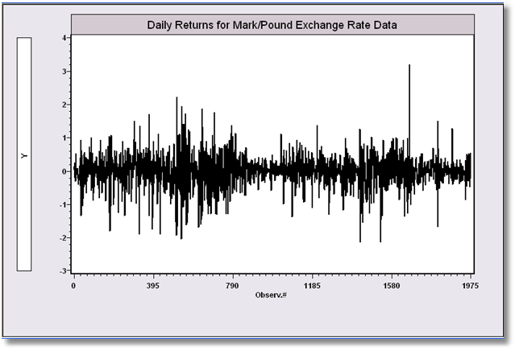
GARCH Models: A Model for Time Series with Latent Heteroscedasticity
Bollerslev/Ghysel, 1974

Slide 44
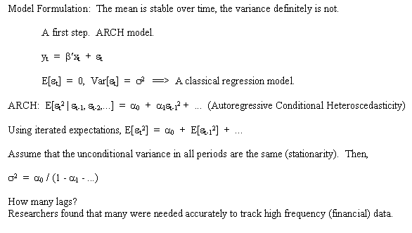
ARCH Model

Slide 45
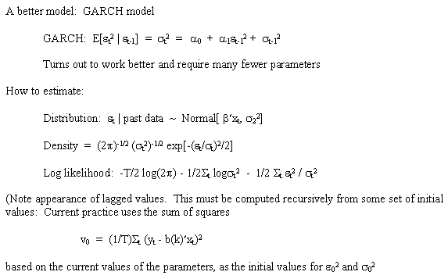
GARCH Model

Slide 46
Estimated GARCH Model
----------------------------------------------------------------------
GARCH MODEL
Dependent variable Y
Log likelihood function -1106.60788
Restricted log likelihood -1311.09637
Chi squared [ 2 d.f.] 408.97699
Significance level .00000
McFadden Pseudo R-squared .1559676
Estimation based on N = 1974, K = 4
GARCH Model, P = 1, Q = 1
Wald statistic for GARCH = 3727.503
--------+-------------------------------------------------------------
Variable| Coefficient Standard Error b/St.Er. P[|Z|>z] Mean of X
--------+-------------------------------------------------------------
|Regression parameters
Constant| -.00619 .00873 -.709 .4783
|Unconditional Variance
Alpha(0)| .01076*** .00312 3.445 .0006
|Lagged Variance Terms
Delta(1)| .80597*** .03015 26.731 .0000
|Lagged Squared Disturbance Terms
Alpha(1)| .15313*** .02732 5.605 .0000
|Equilibrium variance, a0/[1-D(1)-A(1)]
EquilVar| .26316 .59402 .443 .6577
--------+-------------------------------------------------------------

Slide 47
2 Step Estimation (Murphy-Topel)
Setting, fitting a model which contains parameter estimates from another model.
Typical application, inserting a prediction from one model into another.
A. Procedures: How it's done.
B. Asymptotic results:
1. Consistency
2. Getting an appropriate estimator of the
asymptotic covariance matrix
The Murphy - Topel result
Application: Equation 1: Number of children
Equation 2: Labor force participation

Slide 48
Setting
Two equation model:
  Model for y₁ = f(y₁ | x₁, θ₁)
  Model for y₂ = f(y₂ | x₂, θ₂, x₁, θ₁)
  (Note, not ‘simultaneous’ or even ‘recursive.’)
Procedure:
  Estimate θ₁ by ML, with covariance matrix (1/n)V₁
  Estimate θ₂ by ML treating θ₁ as if it were known.
  Correct the estimated asymptotic covariance matrix, (1/n)V₂ for the estimator of θ₂

Slide 49
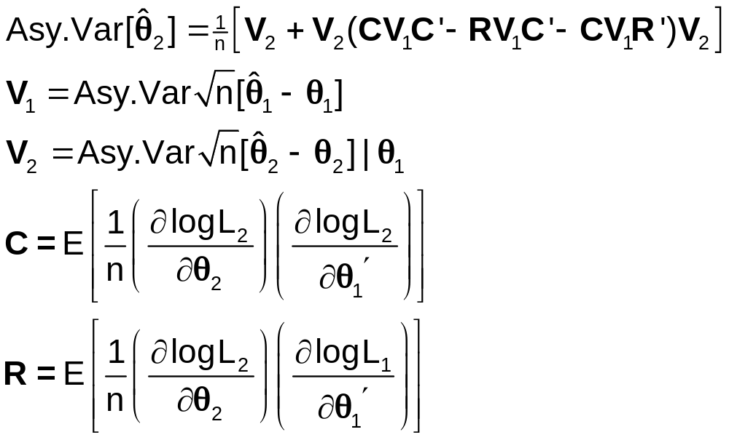
Murphy and Topel (1984,2002) Results
Both MLEs are consistent

Slide 50
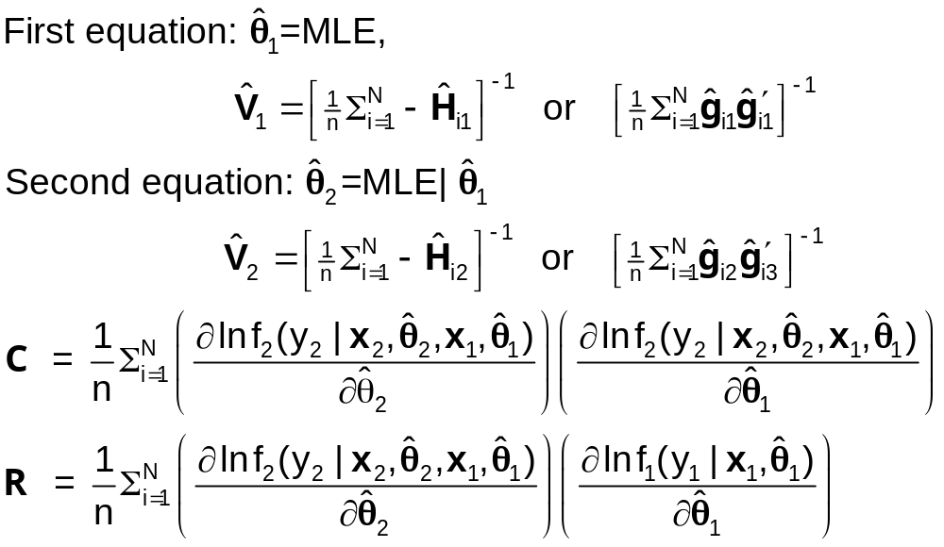
M&T Computations

Slide 51
Example
Equation 1: Number of Kids –
Poisson Regression
  p(y_{i1}|x_{i1}, β)=exp(-λ_{i})λ_{i}^{yi1}/y_{i1}!
  λ_{i} = exp(x_{i1}’β)
  g_{i1} = x_{i1}(y_{i1} – λ_{i})
  V₁ = [(1/n)Σ(-λ_{i})x_{i1}x_{i1}’]⁻¹

Slide 52
Example - Continued
Equation 2: Labor Force Participation – Logit
p(y_{i2}|x_{i2},δ,α,x_{i1},β)=exp(d_{i2})/[1+exp(d_{i2})]=P_{i2}
d_{i2} = (2y_{i2}-1)[δ′x_{i2} + αλ_{i}]
λ_{i} = exp(β′x_{i1})
Let z_{i2} = (x_{i2}, λ_{i}), θ₂ = (δ, α)
d_{i2} = (2y_{i2}-1)[θ₂′z_{i2}]
g_{i2} = (y_{i2}-P_{i2})z_{i2}
V₂ = [(1/n)Σ{-P_{i2}(1-P_{i2})}z_{i2}z_{i2}’]⁻¹

Slide 53
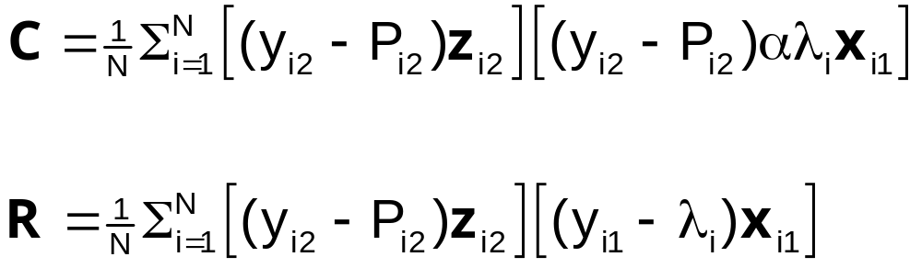
Murphy and Topel Correction

Slide 54
Two Step Estimation of LFP Model
? Data transformations. Number of kids, scale income variables
Create ; Kids = kl6 + k618
; income = faminc/10000 ; Wifeinc = ww*whrs/1000 $
? Equation 1, number of kids. Standard Poisson fertility model.
? Fit equation, collect parameters BETA and covariance matrix V1
? Then compute fitted values and derivatives
Namelist ; X1 = one,wa,we,income,wifeinc$
Poisson ; Lhs = kids ; Rhs = X1 $
Matrix ; Beta = b ; V1 = N*VARB $
Create ; Lambda = Exp(X1'Beta); gi1 = Kids - Lambda $
? Set up logit labor force participation model
? Compute probit model and collect results. Delta=Coefficients on X2
? Alpha = coefficient on fitted number of kids.
Namelist ; X2 = one,wa,we,ha,he,income ; Z2 = X2,Lambda $
Logit ; Lhs = lfp ; Rhs = Z2 $
Calc ; alpha = b(kreg) ; K2 = Col(X2) $
Matrix ; delta=b(1:K2) ; Theta2 = b ; V2 = N*VARB $
? Poisson derivative of with respect to beta is (kidsi - lambda)´X1
Create ; di = delta'X2 + alpha*Lambda
; pi2= exp(di)/(1+exp(di))
; gi2 = LFP - Pi2
? These are the terms that are used to compute R and C.
; ci = gi2*gi2*alpha*lambda
; ri = gi2*gi1$
MATRIX ; C = 1/n*Z2'[ci]X1
; R = 1/n*Z2'[ri]X1
; A = C*V1*C' - R*V1*C' - C*V1*R'
; V2S = V2+V2*A*V2 ; V2s = 1/N*V2S $
? Compute matrix products and report results
Matrix ; Stat(Theta2,V2s,Z2)$

Slide 55
Estimated Equation 1: E[Kids]
+---------------------------------------------+
| Poisson Regression |
| Dependent variable KIDS |
| Number of observations 753 |
| Log likelihood function -1123.627 |
+---------------------------------------------+
+---------+--------------+----------------+--------+---------+----------+
|Variable | Coefficient | Standard Error |b/St.Er.|P[|Z|>z] | Mean of X|
+---------+--------------+----------------+--------+---------+----------+
Constant 3.34216852 .24375192 13.711 .0000
WA -.06334700 .00401543 -15.776 .0000 42.5378486
WE -.02572915 .01449538 -1.775 .0759 12.2868526
INCOME .06024922 .02432043 2.477 .0132 2.30805950
WIFEINC -.04922310 .00856067 -5.750 .0000 2.95163126

Slide 56
Two Step Estimator
+---------------------------------------------+
| Multinomial Logit Model |
| Dependent variable LFP |
| Number of observations 753 |
| Log likelihood function -351.5765 |
| Number of parameters 7 |
+---------------------------------------------+
+---------+--------------+----------------+--------+---------+----------+
|Variable | Coefficient | Standard Error |b/St.Er.|P[|Z|>z] | Mean of X|
+---------+--------------+----------------+--------+---------+----------+
Characteristics in numerator of Prob[Y = 1]
Constant 33.1506089 2.88435238 11.493 .0000
WA -.54875880 .05079250 -10.804 .0000 42.5378486
WE -.02856207 .05754362 -.496 .6196 12.2868526
HA -.01197824 .02528962 -.474 .6358 45.1208499
HE -.02290480 .04210979 -.544 .5865 12.4913679
INCOME .39093149 .09669418 4.043 .0001 2.30805950
LAMBDA -5.63267225 .46165315 -12.201 .0000 1.59096946
With Corrected Covariance Matrix
+---------+--------------+----------------+--------+---------+
|Variable | Coefficient | Standard Error |b/St.Er.|P[|Z|>z] |
+---------+--------------+----------------+--------+---------+
Constant 33.1506089 5.41964589 6.117 .0000
WA -.54875880 .07780642 -7.053 .0000
WE -.02856207 .12508144 -.228 .8194
HA -.01197824 .02549883 -.470 .6385
HE -.02290480 .04862978 -.471 .6376
INCOME .39093149 .27444304 1.424 .1543
LAMBDA -5.63267225 1.07381248 -5.245 .0000

Slide 57
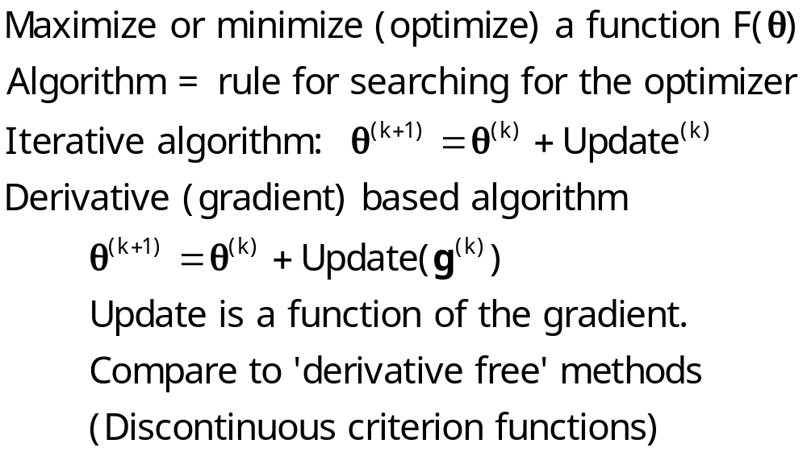
Optimization - Algorithms

Slide 58
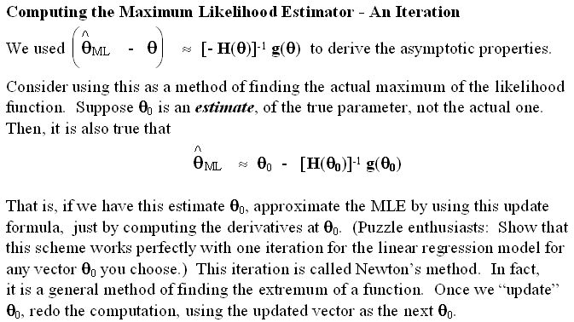
Newton’s Method

Slide 59
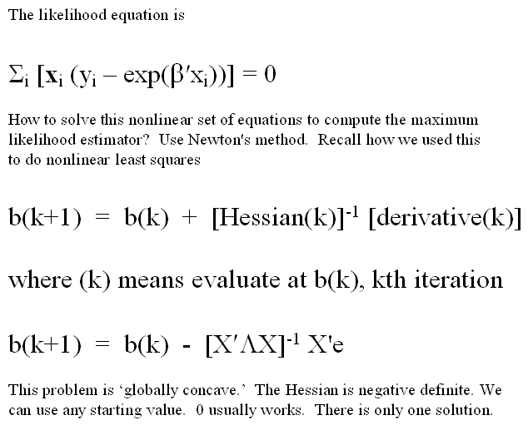
Newton’s Method for Poisson Regression

Slide 60
Poisson Regression Iterations
Poisson ; lhs = doctor ; rhs = one,female,hhninc,educ;mar;output=3$
Method=Newton; Maximum iterations=100
Convergence criteria: gtHg .1000D-05 chg.F .0000D+00 max|db| .0000D+00
Start values: .00000D+00 .00000D+00 .00000D+00 .00000D+00
1st derivs. -.13214D+06 -.61899D+05 -.43338D+05 -.14596D+07
Parameters: .28002D+01 .72374D-01 -.65451D+00 -.47608D-01
Itr 2 F= -.1587D+06 gtHg= .2832D+03 chg.F= .1587D+06 max|db|= .1346D+01
1st derivs. -.33055D+05 -.14401D+05 -.10804D+05 -.36592D+06
Parameters: .21404D+01 .16980D+00 -.60181D+00 -.48527D-01
Itr 3 F= -.1115D+06 gtHg= .9725D+02 chg.F= .4716D+05 max|db|= .6348D+00
1st derivs. -.42953D+04 -.15074D+04 -.13927D+04 -.47823D+05
Parameters: .17997D+01 .27758D+00 -.54519D+00 -.49513D-01
Itr 4 F= -.1063D+06 gtHg= .1545D+02 chg.F= .5162D+04 max|db|= .1437D+00
1st derivs. -.11692D+03 -.22248D+02 -.37525D+02 -.13159D+04
Parameters: .17276D+01 .31746D+00 -.52565D+00 -.49852D-01
Itr 5 F= -.1062D+06 gtHg= .5006D+00 chg.F= .1218D+03 max|db|= .6542D-02
1st derivs. -.12522D+00 -.54690D-02 -.40254D-01 -.14232D+01
Parameters: .17249D+01 .31954D+00 -.52476D+00 -.49867D-01
Itr 6 F= -.1062D+06 gtHg= .6215D-03 chg.F= .1254D+00 max|db|= .9678D-05
1st derivs. -.19317D-06 -.94936D-09 -.62872D-07 -.22029D-05
Parameters: .17249D+01 .31954D+00 -.52476D+00 -.49867D-01
Itr 7 F= -.1062D+06 gtHg= .9957D-09 chg.F= .1941D-06 max|db|= .1602D-10
* Converged

Slide 61
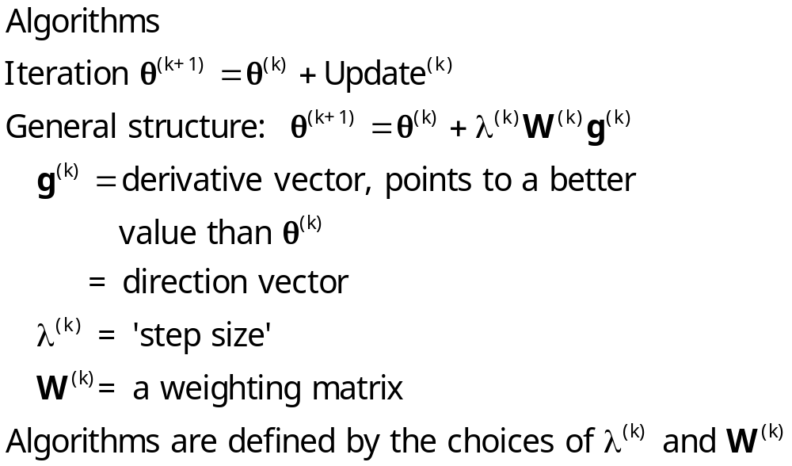
Optimization

Slide 62
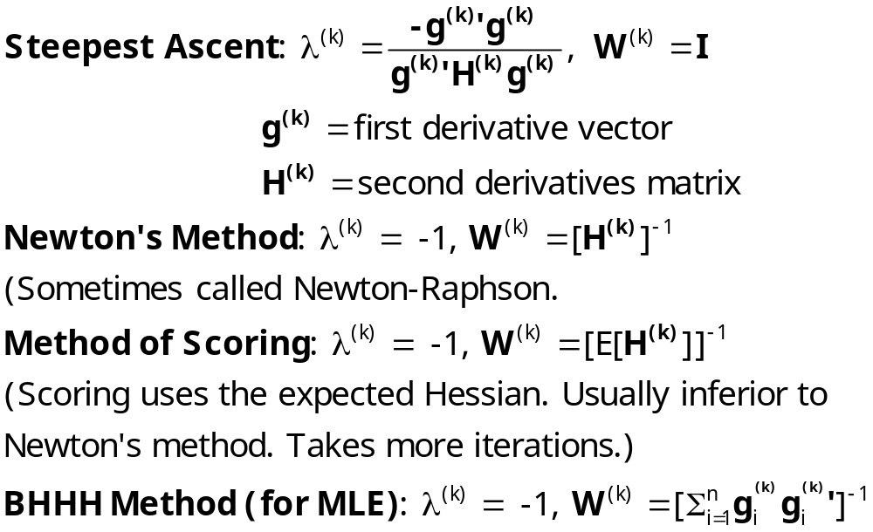
Algorithms

Slide 63
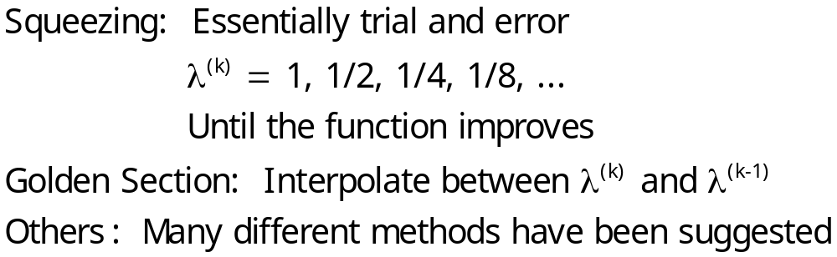
Line Search Methods

Slide 64
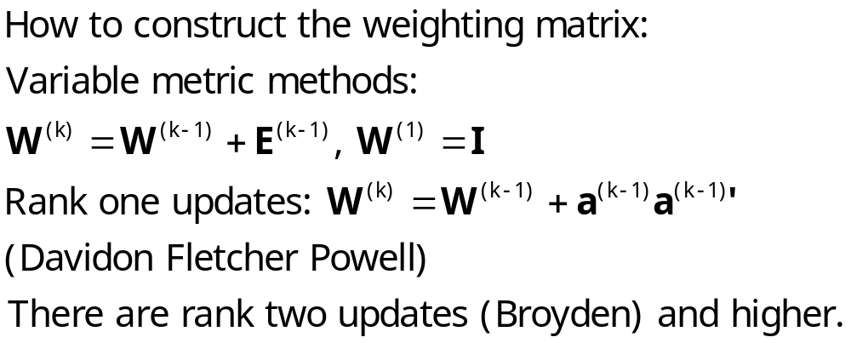
Quasi-Newton Methods

Slide 65
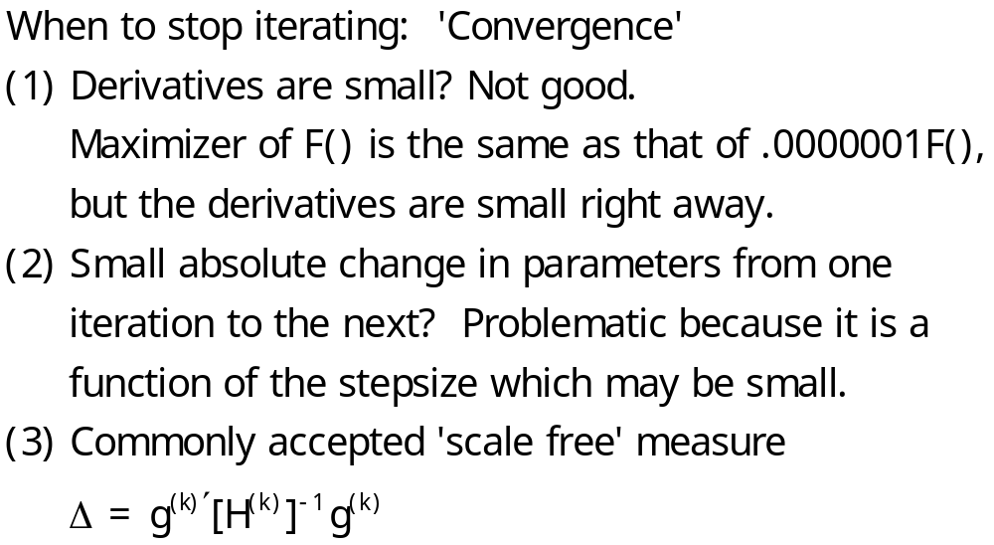
Stopping Rule

Slide 66
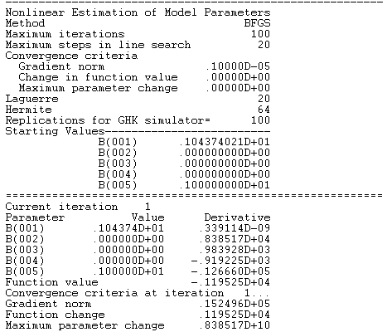
Start value for constant is log (mean HHNINC)
Start value for P is 1 => exponential model.

Slide 67
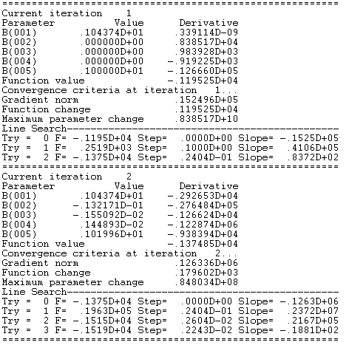

Slide 68
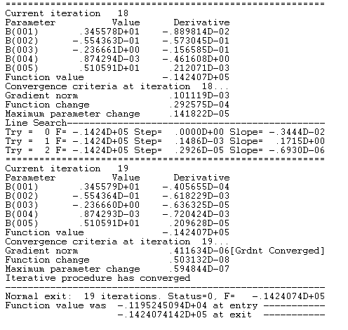

Slide 69
