Slide 1

Econometrics I
Professor William Greene
Stern School of Business
Department of Economics

Slide 2
Econometrics I
Part 21 – Generalized
Method of Moments

Slide 3
I also have a questions about nonlinear GMM - which is more or less nonlinear IV technique I suppose.
I am running a panel non-linear regression (non-linear in the parameters) and I have L parameters and K exogenous variables with L>K.
In particular my model looks kind of like this: Y = b₁*X^b₂ + e, and so I am trying to estimate the extra b₂ that don't usually appear in a regression.
From what I am reading, to run nonlinear GMM I can use the K exogenous variables to construct the orthogonality conditions but what should I use for the extra, b₂ coefficients?
Just some more possible IVs (like lags) of the exogenous variables?
I agree that by adding more IVs you will get a more efficient estimation, but isn't it only the case when you believe the IVs are truly uncorrelated with the error term?
So by adding more "instruments" you are more or less imposing more and more restrictive assumptions about the model (which might not actually be true).
I am asking because I have not found sources comparing nonlinear GMM/IV to nonlinear least squares. If there is no homoscadesticity/serial correlation what is more efficient/give tighter estimates?

Slide 4
I’m trying to minimize a nonlinear program with the least square under nonlinear constraints. It’s first introduced by Ané & Geman (2000). It consisted on the minimization of the sum of squared difference between the moment generating function and the theoretical moment generating function (The method was suggested by Quandt and Ramsey in the 1970s.)

Slide 5
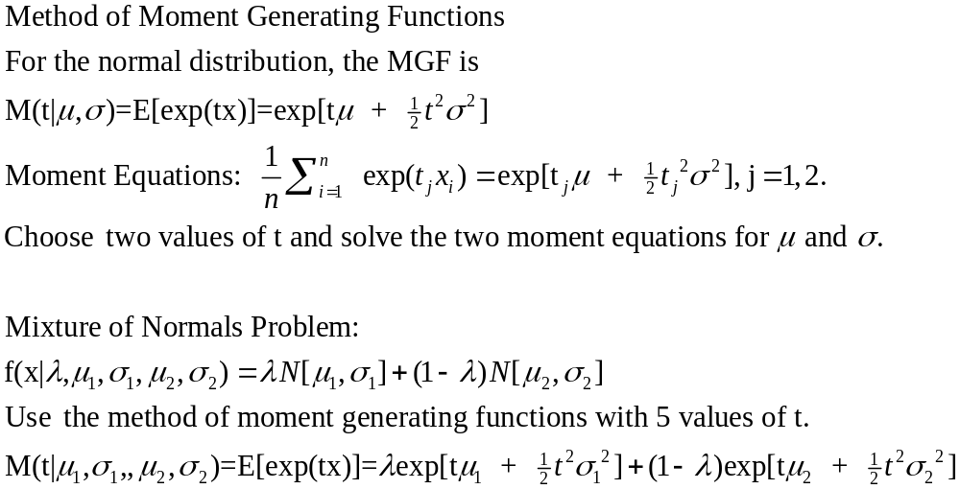

Slide 6
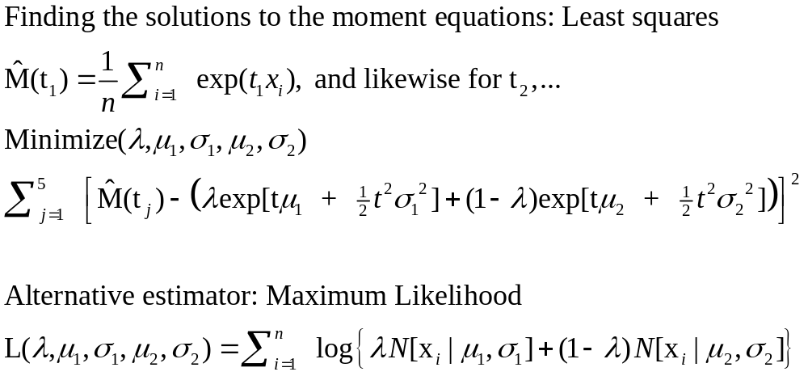

Slide 7
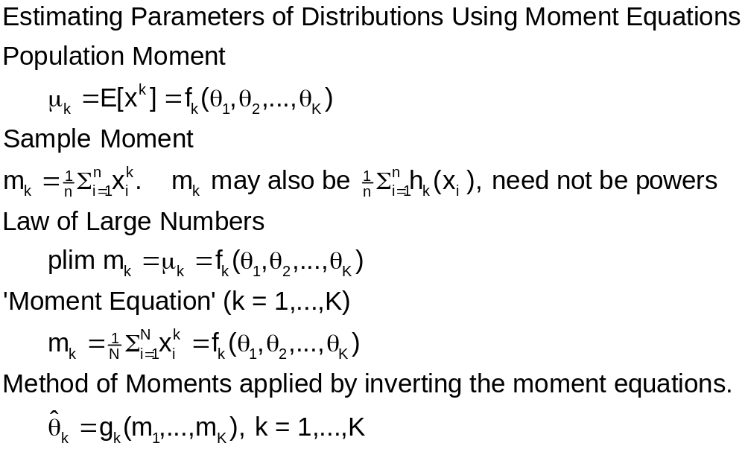
The Method of Moments

Slide 8
Estimating a Parameter
Mean of Poisson
  p(y)=exp(-λ) λ^{y} / y!
  E[y]= λ.
  plim (1/n)Σ_{i}y_{i} = λ.
  This is the estimator
Mean of Exponential
  p(y) = α exp(- α y)
  E[y] = 1/ α.
  plim (1/n)Σ_{i}y_{i} = 1/ α

Slide 9
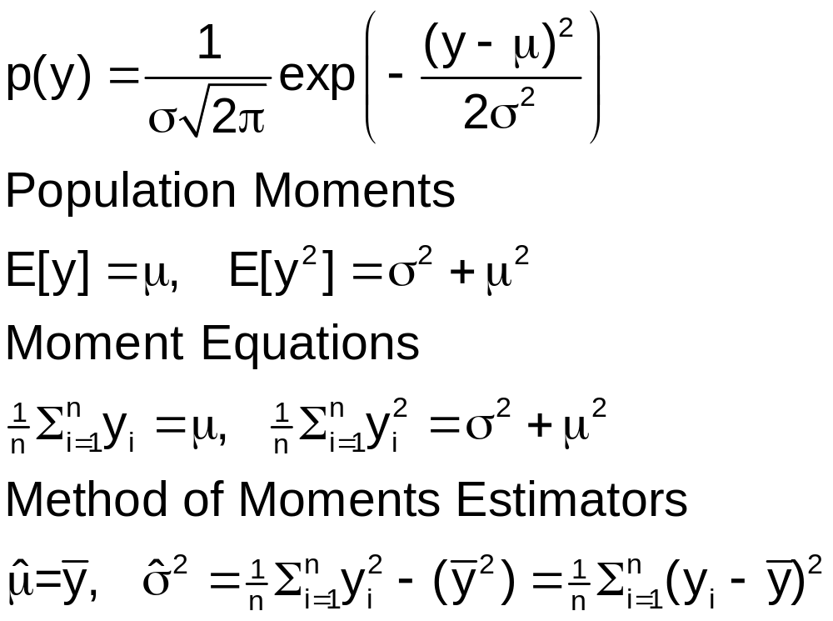
Mean and Variance of a
Normal Distribution

Slide 10
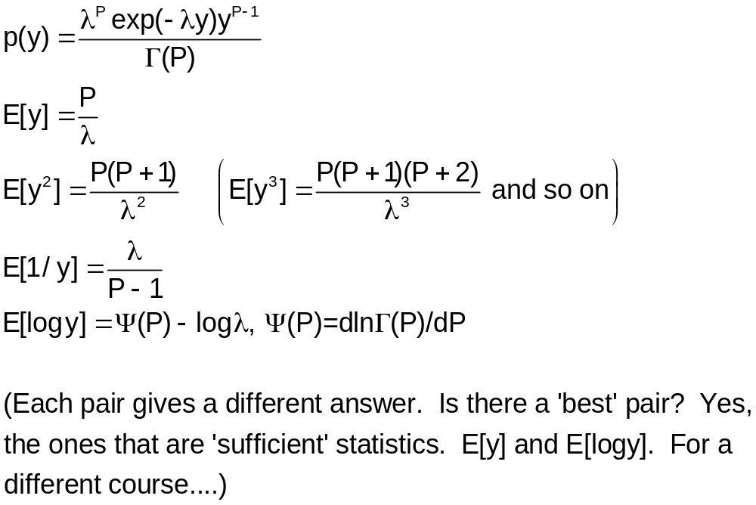
Gamma Distribution

Slide 11
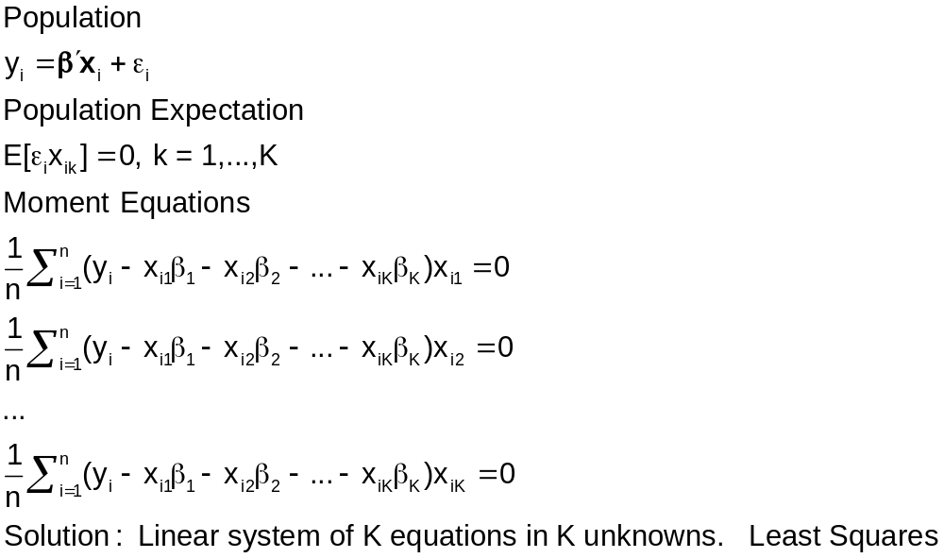
The Linear Regression Model

Slide 12
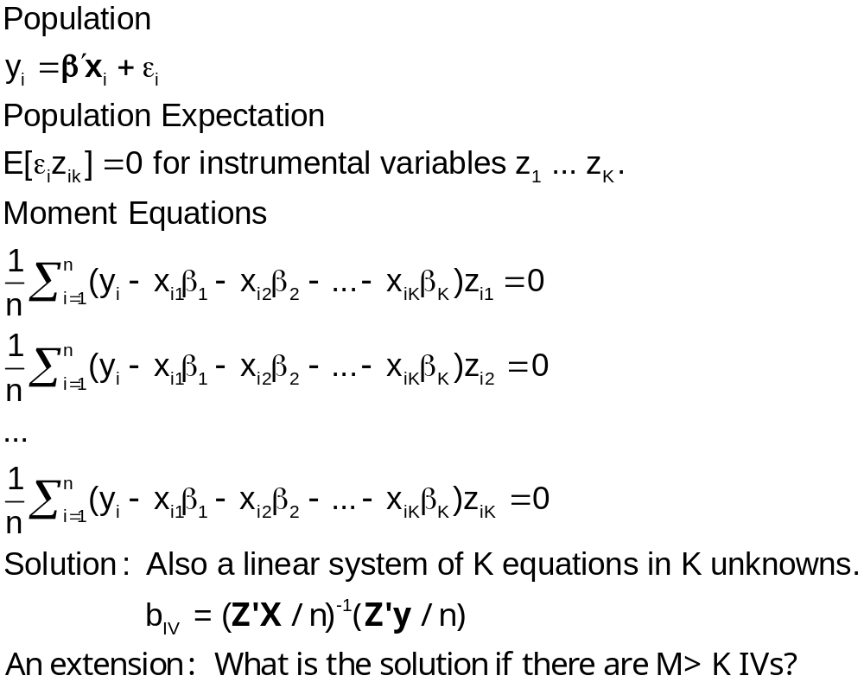
Instrumental Variables

Slide 13
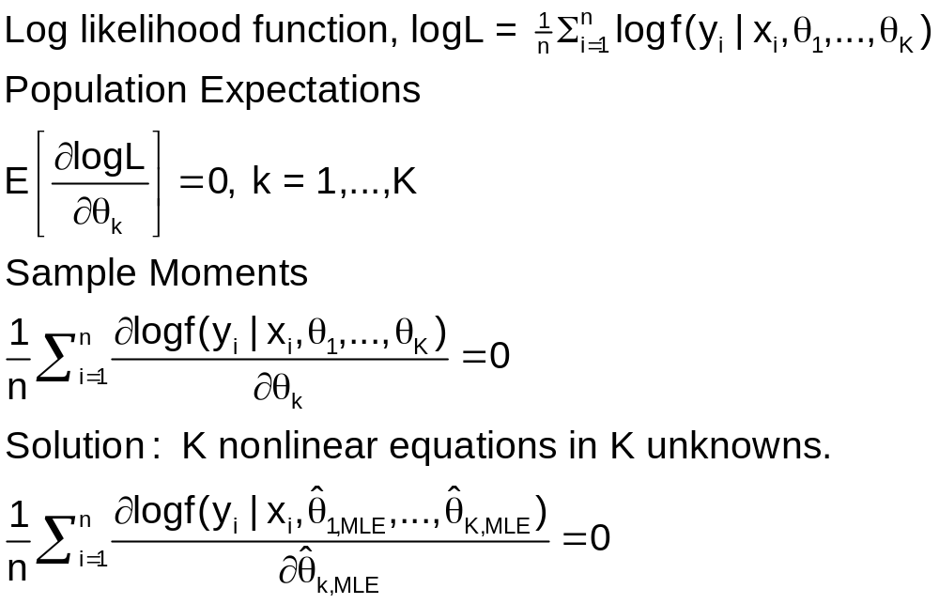
Maximum Likelihood

Slide 14
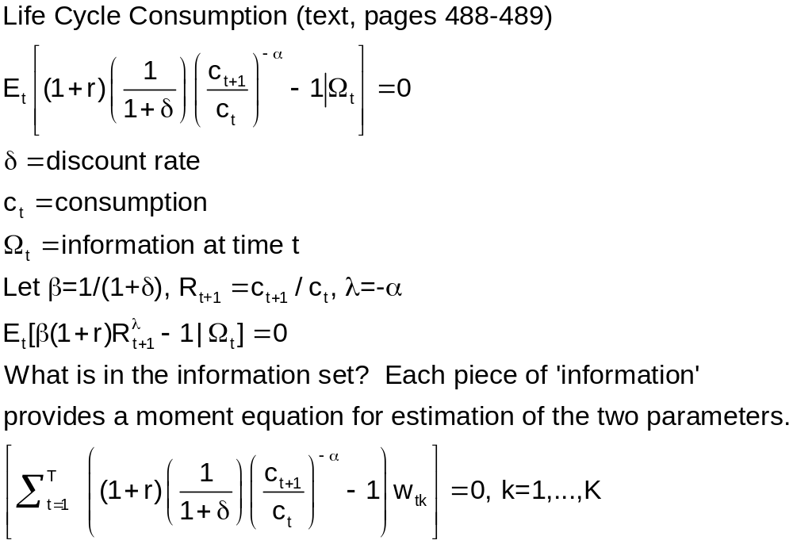
Behavioral Application

Slide 15
Identification
Can the parameters be estimated?
Not a sample ‘property’
Assume an infinite sample
  Is there sufficient information in a sample to reveal consistent estimators of the parameters
  Can the ‘moment equations’ be solved for the population parameters?

Slide 16
Identification
Exactly Identified Case: K population moment equations in K unknown parameters.
  Our familiar cases, OLS, IV, ML, the MOM estimators
  Is the counting rule sufficient?
  What else is needed?
Overidentified Case
  Instrumental Variables
Underidentified Case
  Multicollinearity
  Variance parameter in a probit model
  Shape parameter in a loglinear model

Slide 17
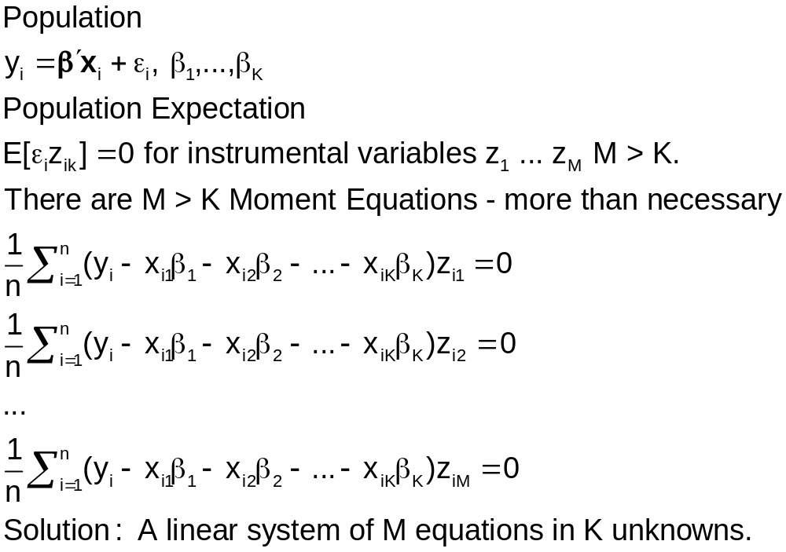
Overidentification

Slide 18
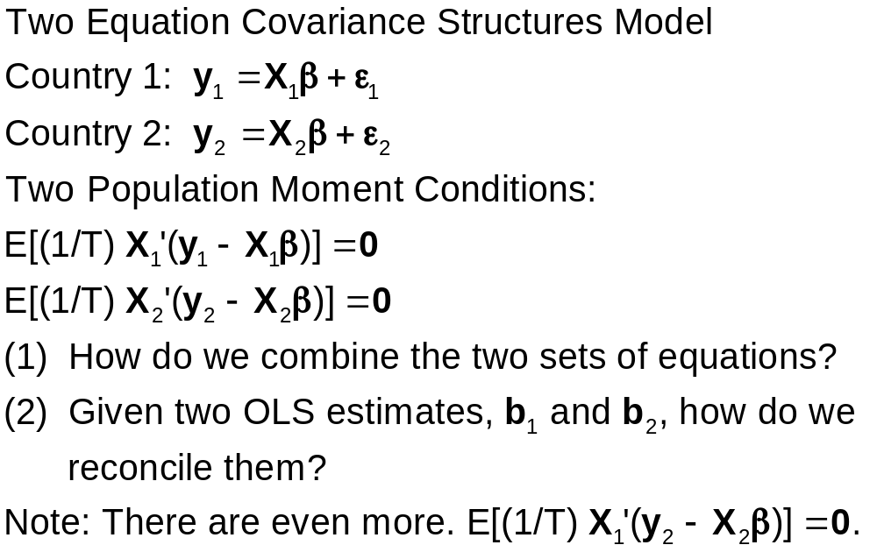
Overidentification

Slide 19
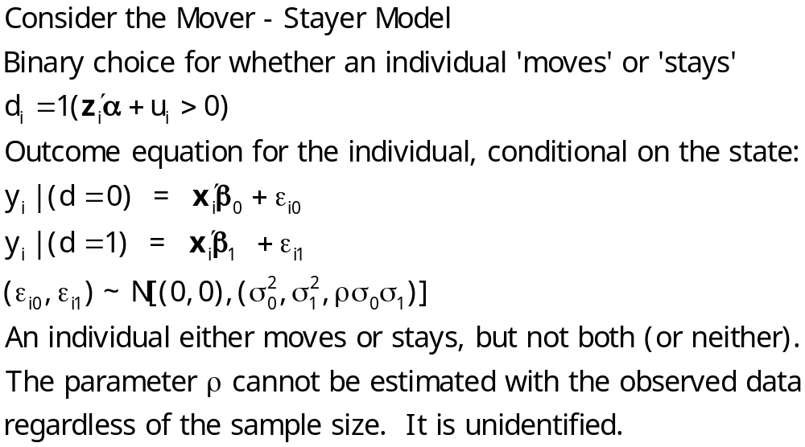
Underidentification – Model/Data

Slide 20
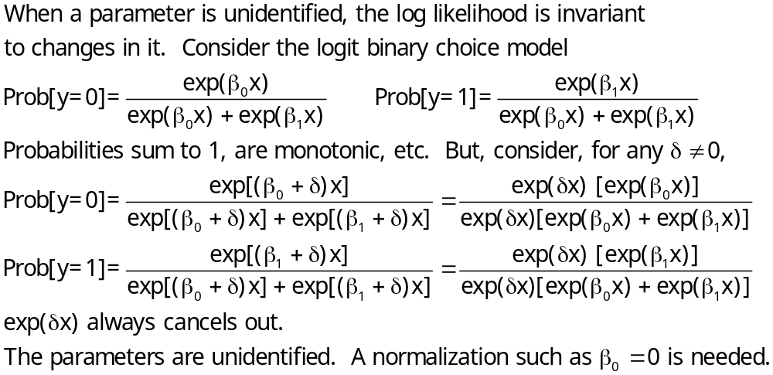
Underidentification - Normalization

Slide 21
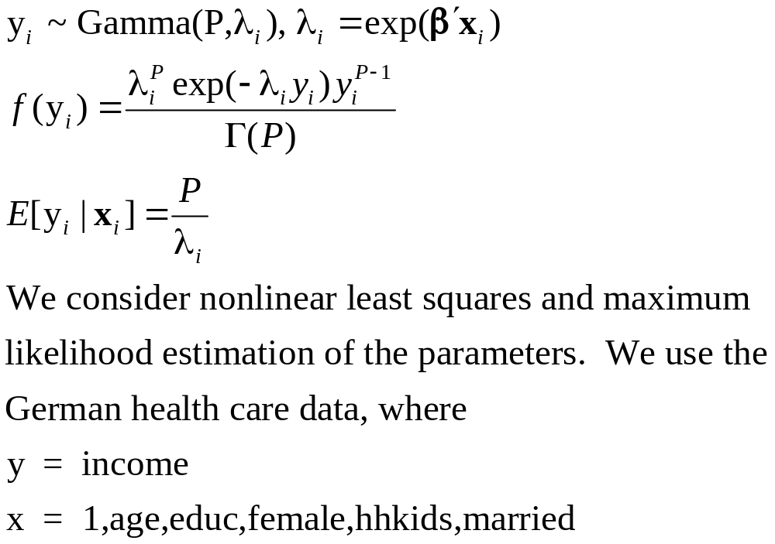
Underidentification: Moments
Nonlinear LS vs. MLE

Slide 22
Nonlinear Least Squares
--> NAMELIST ; x = one,age,educ,female,hhkids,married $
--> Calc ; k=col(x) $
--> NLSQ ; Lhs = hhninc ; Fcn = p / exp(b1'x)
; labels = k_b,p ; start = k_0,1 ; maxit = 20$
Moment matrix has become nonpositive definite.
Switching to BFGS algorithm
Normal exit: 16 iterations. Status=0. F= 381.1028
-----------------------------------------------------------
User Defined Optimization.........................
Nonlinear least squares regression ............
LHS=HHNINC Mean = .35208
Standard deviation = .17691
Number of observs. = 27326
Model size Parameters = 7
Degrees of freedom = 27319
Residuals Sum of squares = 762.20551
Standard error of e = .16701
--------+--------------------------------------------------
Variable| Coefficient Standard Error b/St.Er. P[|Z|>z]
--------+--------------------------------------------------
B1| 1.39905 14319.39 .000 .9999 <======
B2| .00029 .00029 .986 .3242
B3| -.05527*** .00105 -52.809 .0000
B4| -.01843*** .00580 -3.180 .0015
B5| .05445*** .00665 8.184 .0000
B6| -.26424*** .00823 -32.109 .0000
P| .63239 9055.493 .000 .9999 <=======
--------+--------------------------------------------------
Nonlinear least squares did not work. That is the implication of the
infinite standard errors for B1 (the constant) and P.

Slide 23
Maximum Likelihood
----------------------------------------------------------------------
Gamma (Loglinear) Regression Model
Dependent variable HHNINC
Log likelihood function 14293.00214
Restricted log likelihood 1195.06953
Chi squared [ 6 d.f.] 26195.86522
Significance level .00000
McFadden Pseudo R-squared -10.9599753 (4 observations with income = 0
Estimation based on N = 27322, K = 7 were deleted so logL was computable.)
--------+-------------------------------------------------------------
Variable| Coefficient Standard Error b/St.Er. P[|Z|>z] Mean of X
--------+-------------------------------------------------------------
|Parameters in conditional mean function
Constant| 3.40841*** .02154 158.213 .0000
AGE| .00205*** .00028 7.413 .0000 43.5272
EDUC| -.05572*** .00120 -46.496 .0000 11.3202
FEMALE| -.00542 .00545 -.995 .3198 .47881
HHKIDS| .06512*** .00618 10.542 .0000 .40272
MARRIED| -.26341*** .00692 -38.041 .0000 .75869
|Scale parameter for gamma model
P_scale| 5.12486*** .04250 120.594 .0000
--------+-------------------------------------------------------------
MLE apparently worked fine. Why did one method (nls) fail and another consistent estimator work without difficulty?

Slide 24
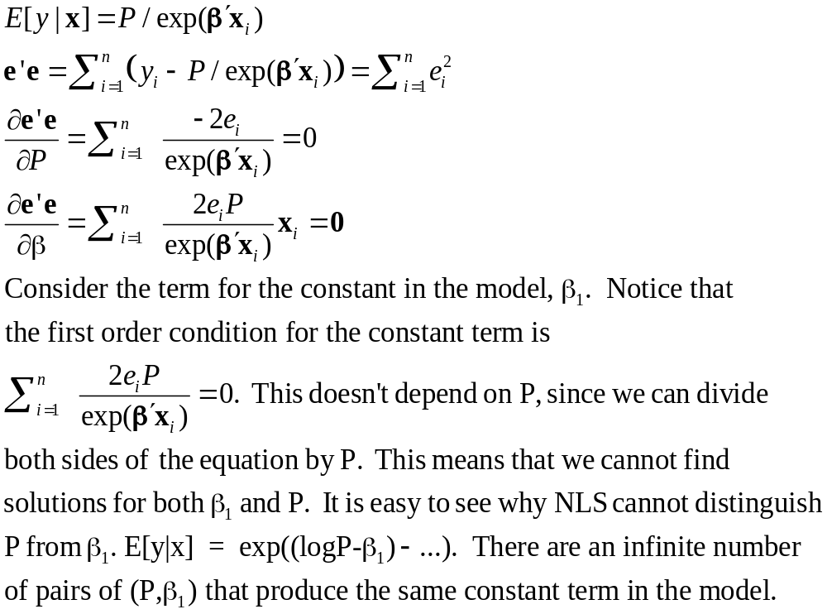
Moment Equations: NLS

Slide 25
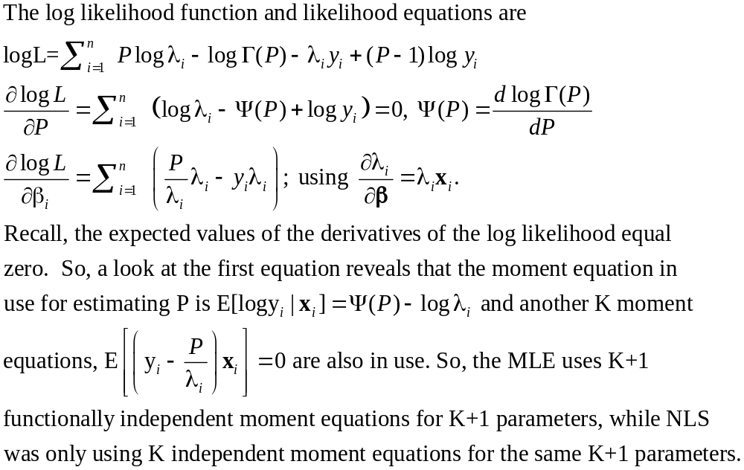
Moment Equations MLE

Slide 26
GMM Agenda
The Method of Moments. Solving the moment equations
Exactly identified cases
Overidentified cases
Consistency. How do we know the method of moments is
consistent?
Asymptotic covariance matrix.
Consistent vs. Efficient estimation
A weighting matrix
The minimum distance estimator
What is the efficient weighting matrix?
Estimating the weighting matrix.
The Generalized method of moments estimator - how it is computed.
Computing the appropriate asymptotic covariance matrix

Slide 27
The Method of Moments
Moment Equation: Defines a sample statistic that mimics a population expectation:
The population expectation – orthogonality condition:
E[ m_{i} (β) ] = 0. Subscript i indicates it depends on data vector indexed by 'i' (or 't' for a time series setting)

Slide 28
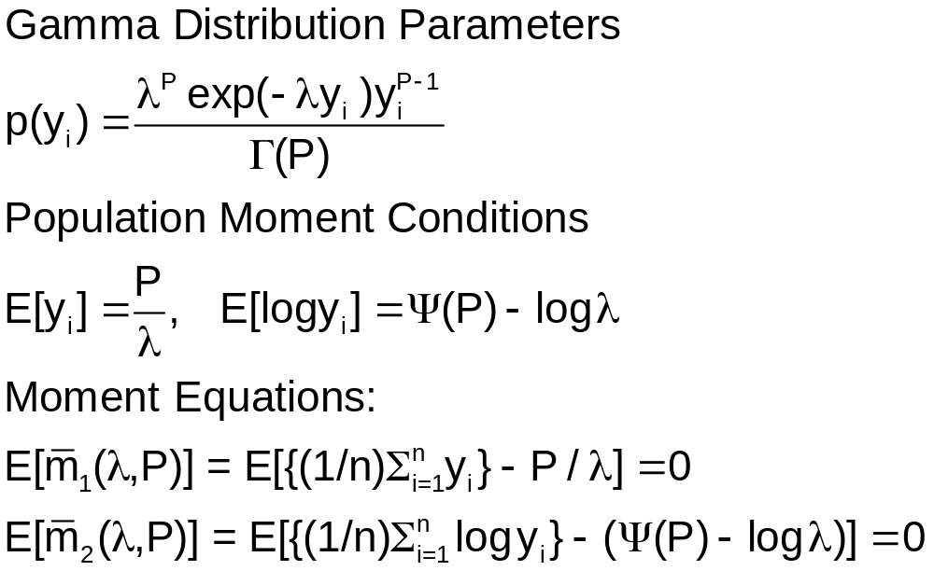
The Method of Moments - Example

Slide 29
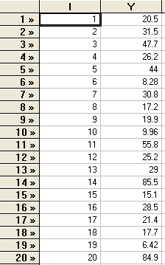
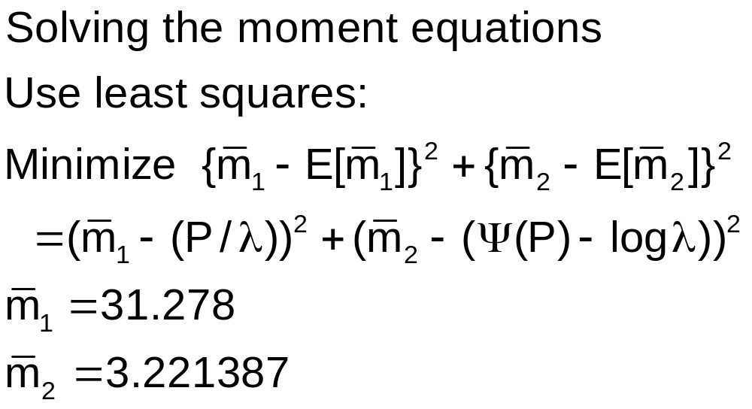
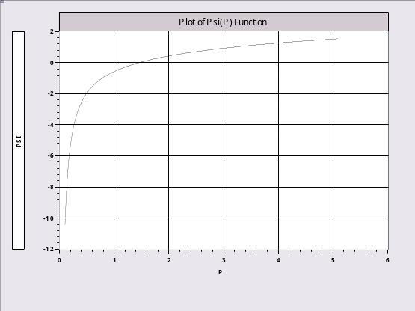
Application

Slide 30
Method of Moments Solution
create ; y1=y ; y2=log(y)$
calc ; m1=xbr(y1) ; ms=xbr(y2)$
minimize; start = 2.0, .06 ; labels = p,l
; fcn = (l*m1-p)^2
+ (ms - psi(p)+log(l)) ^2 $
+---------------------------------------------+
| User Defined Optimization |
| Dependent variable Function |
| Number of observations 1 |
| Iterations completed 6 |
| Log likelihood function .5062979E-13 |
+---------------------------------------------+
+---------+--------------+
|Variable | Coefficient |
+---------+--------------+
P 2.41060361
L .07707026

Slide 31

Nonlinear Instrumental Variables
There are K parameters, β
y_{i} = f(x_{i},β) + ε_{i}.
There exists a set of K instrumental variables, z_{i} such that E[z_{i} ε_{i}] = 0.
The sample counterpart is the moment equation
(1/n)Σ_{i} z_{i} ε_{i} = (1/n)Σ_{i} z_{i} [y_{i} - f(x_{i},β)]
= (1/n)Σ_{i} m_{i} (β) = (β) = 0.
The method of moments estimator is the solution to the moment equation(s).
(How the solution is obtained is not always obvious, and varies from problem to problem.)

Slide 32
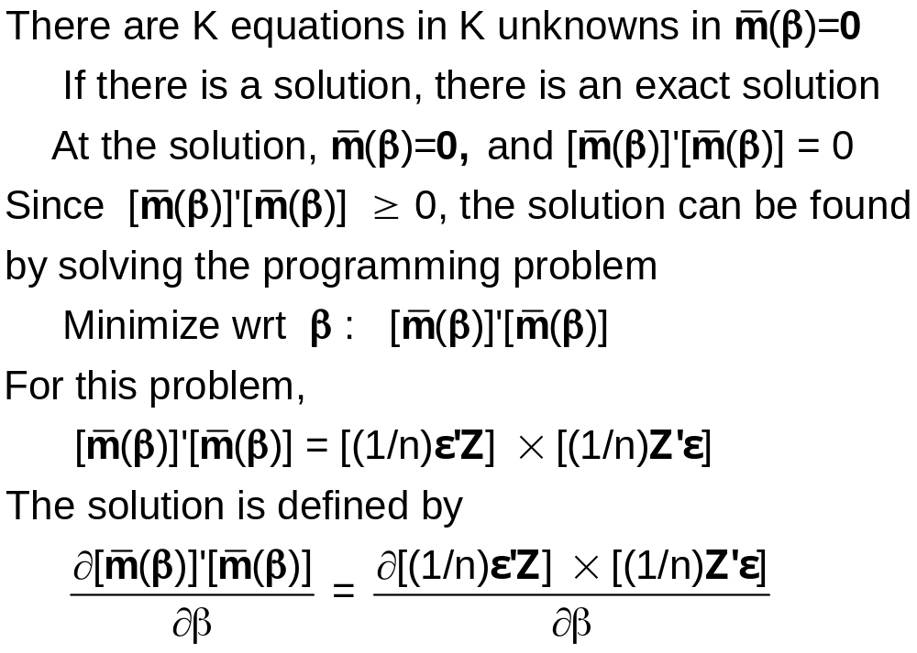
The MOM Solution

Slide 33
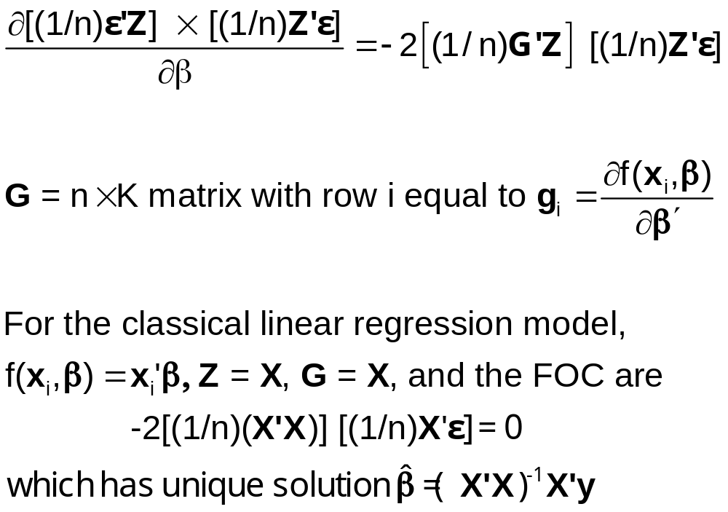
MOM Solution

Slide 34
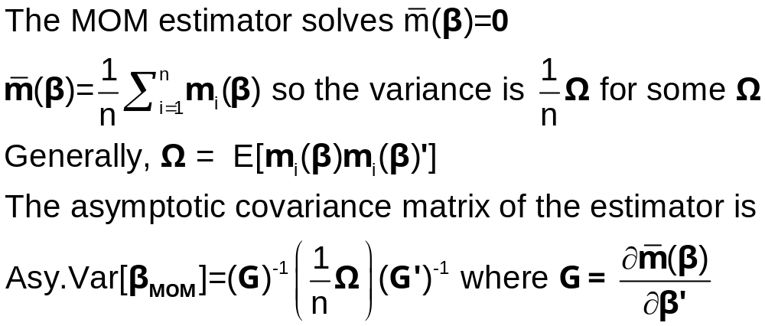
Variance of the Method of Moments Estimator

Slide 35
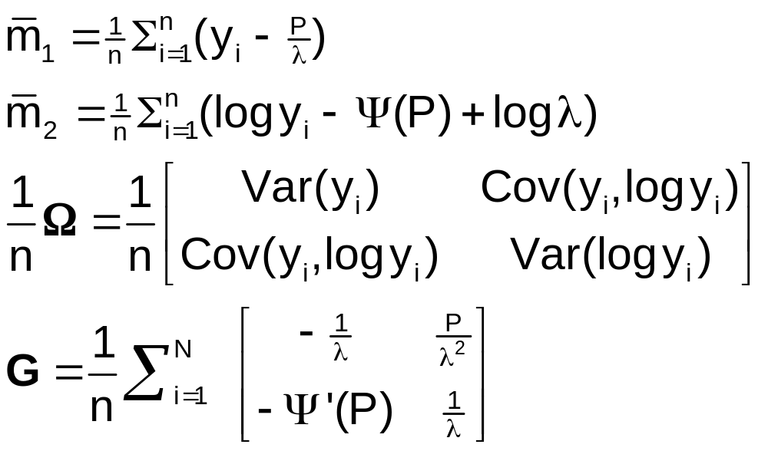
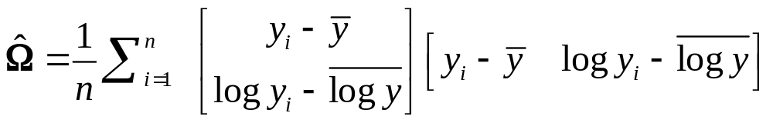
Example 1: Gamma Distribution

Slide 36
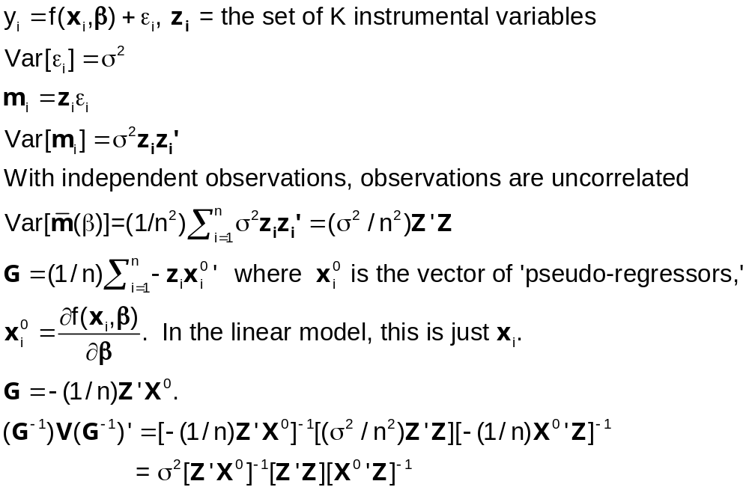
Example 2: Nonlinear IV Least Squares

Slide 37
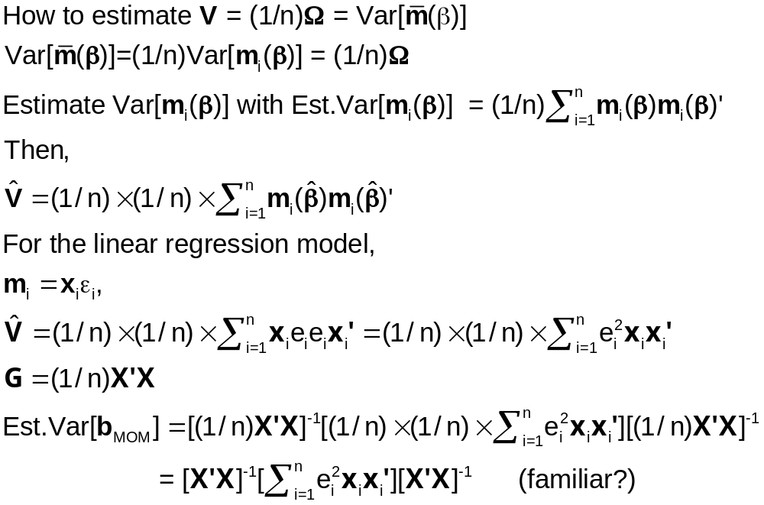
Variance of the Moments

Slide 38
Properties of the MOM Estimator
Consistent?
  The LLN implies that the moments are consistent estimators of their population counterparts (zero)
  Use the Slutsky theorem to assert consistency of the functions of the moments
Asymptotically normal? The moments are sample means. Invoke a central limit theorem.
Efficient? Not necessarily
  Sometimes yes. (Gamma example)
  Perhaps not. Depends on the model and the available information (and how much of it is used).

Slide 39
Generalizing the Method of Moments Estimator
More moments than parameters – the overidentified case
Example: Instrumental variable case, M > K instruments

Slide 40
Two Stage Least Squares
How to use an “excess” of instrumental variables
(1) X is K variables. Some (at least one) of the K
variables in X are correlated with ε.
(2) Z is M > K variables. Some of the variables in
Z are also in X, some are not. None of the
variables in Z are correlated with ε.
(3) Which K variables to use to compute Z’X and
Z’y?

Slide 41
Choosing the Instruments
Choose K randomly?
Choose the included Xs and the remainder randomly?
Use all of them? How?
A theorem: (Brundy and Jorgenson, ca. 1972) There is a most efficient way to construct the IV estimator from this subset:
  (1) For each column (variable) in X, compute the predictions of that variable using all the columns of Z.
  (2) Linearly regress y on these K predictions.
This is two stage least squares

Slide 42
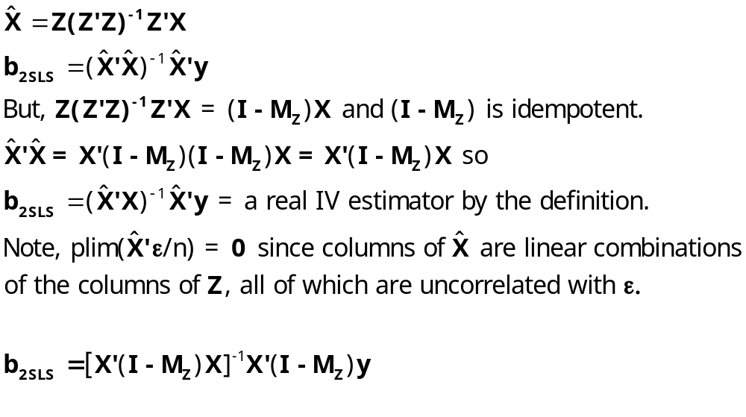
2SLS Algebra

Slide 43
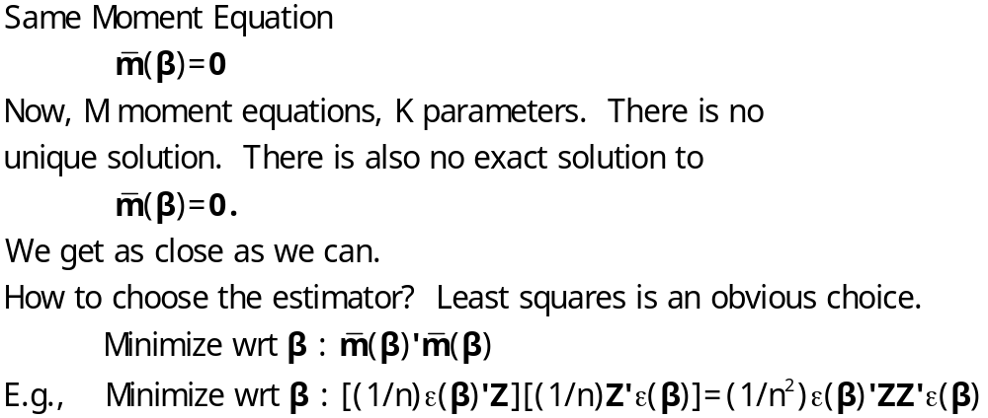
Method of Moments Estimation

Slide 44
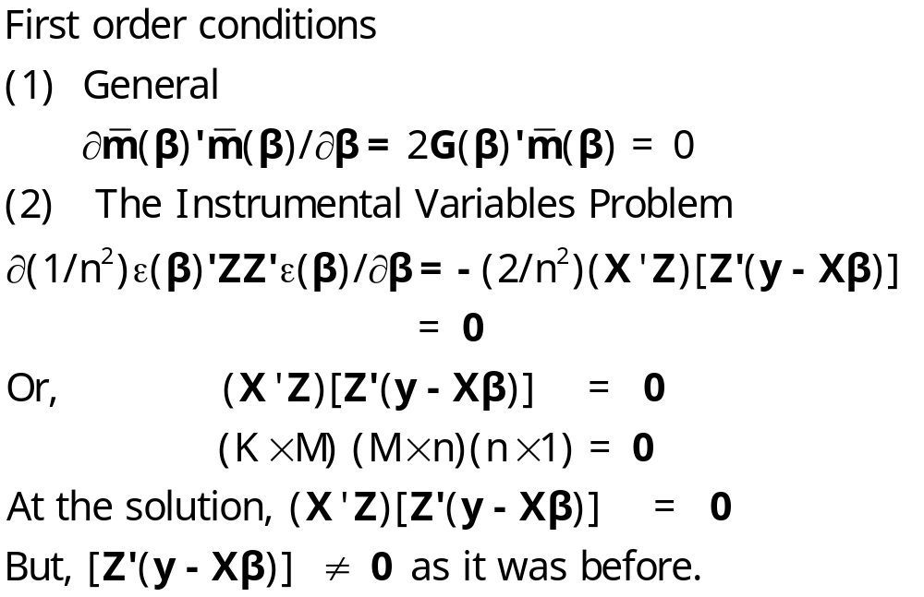
FOC for MOM

Slide 45
Computing the Estimator
Programming Program
No all purpose solution
Nonlinear optimization problem – solution varies from setting to setting.

Slide 46
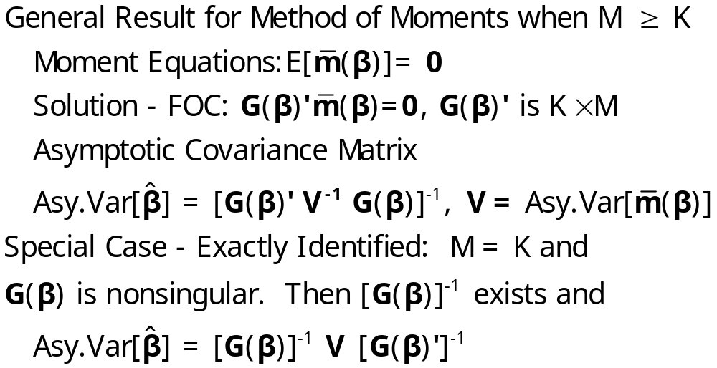
Asymptotic Covariance Matrix

Slide 47
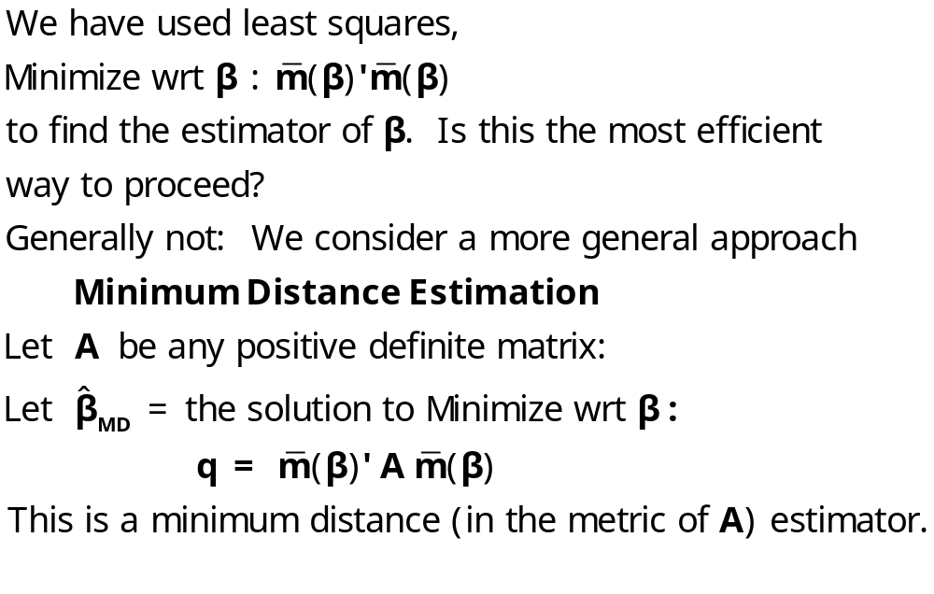
More Efficient Estimation

Slide 48
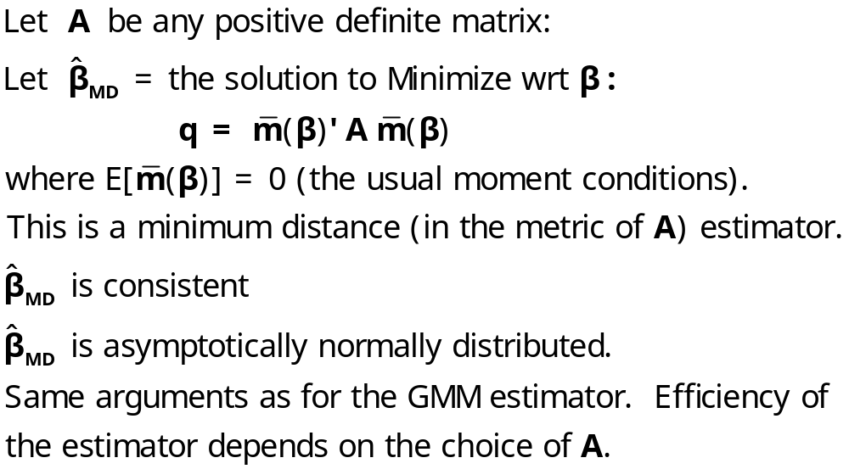
Minimum Distance Estimation

Slide 49
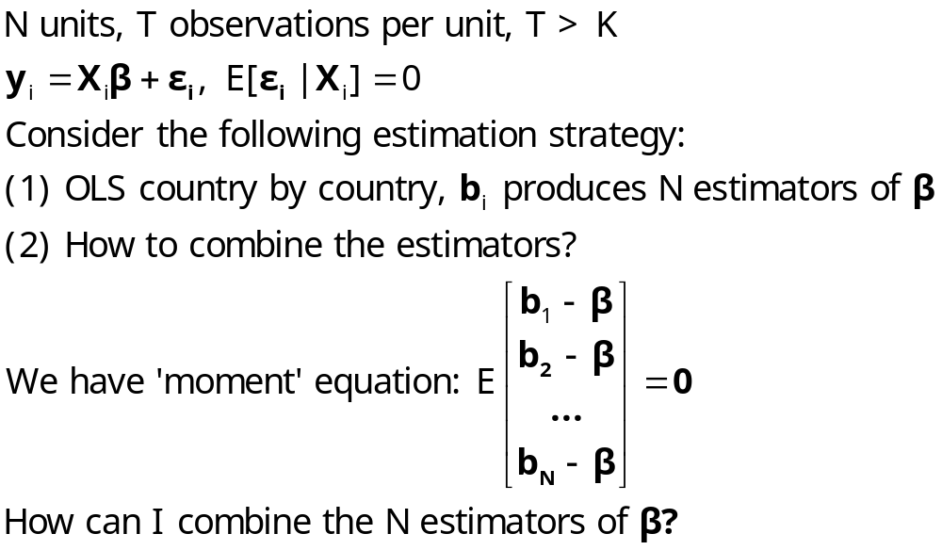
MDE Estimation: Application

Slide 50
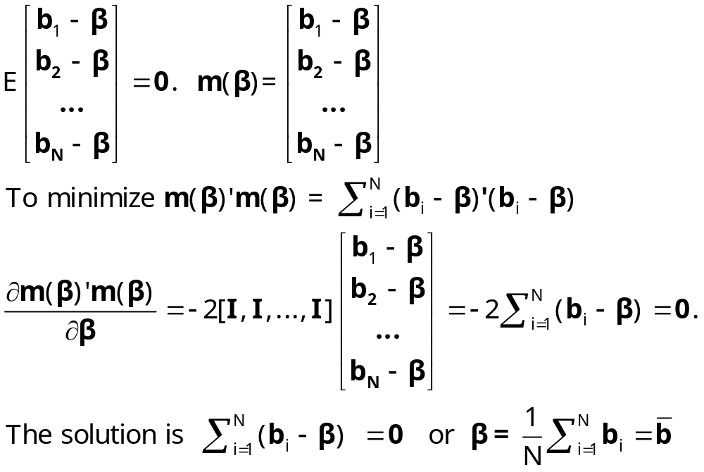
Least Squares

Slide 51
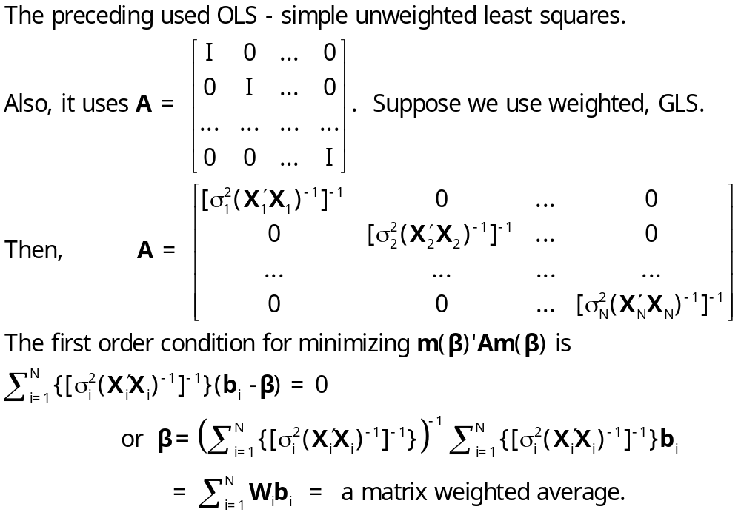
Generalized Least Squares

Slide 52
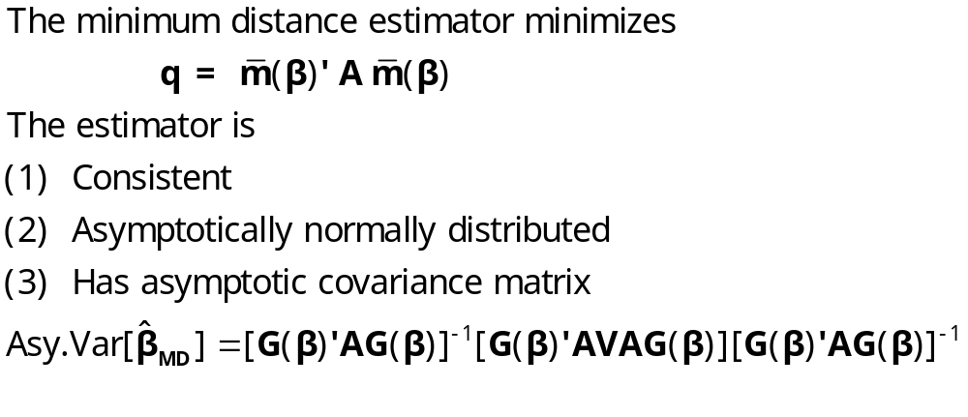
Minimum Distance Estimation

Slide 53
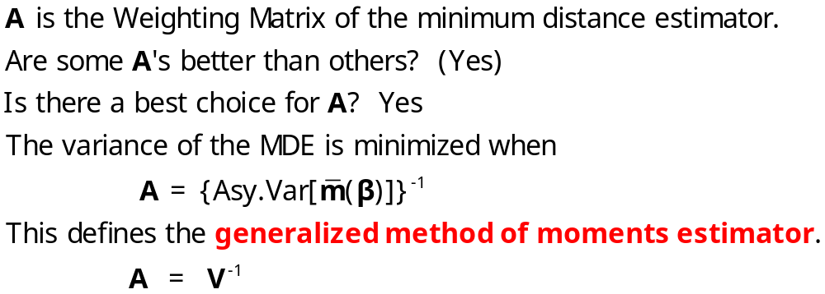
Optimal Weighting Matrix

Slide 54
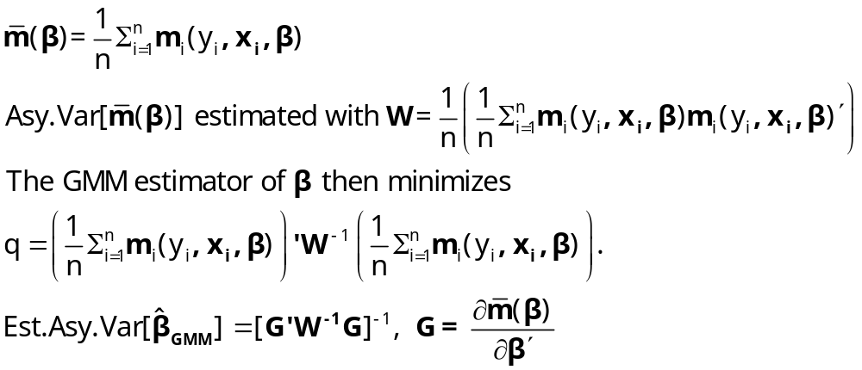
GMM Estimation

Slide 55
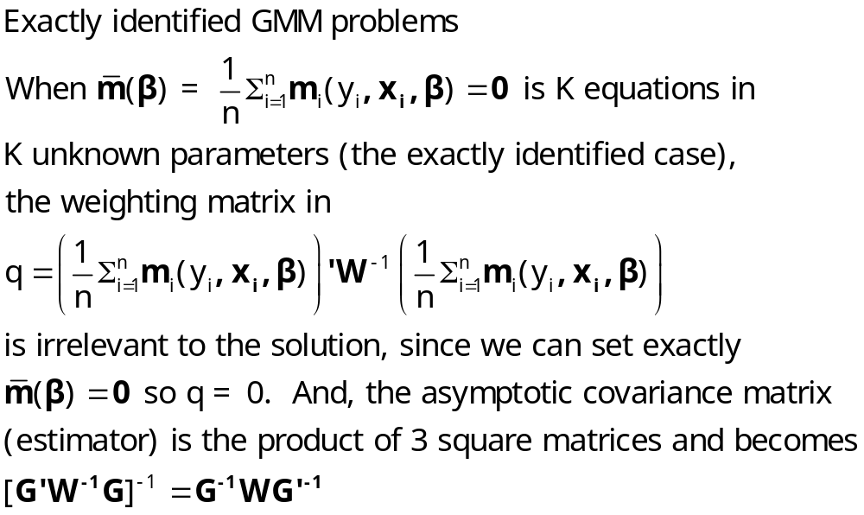
GMM Estimation

Slide 56
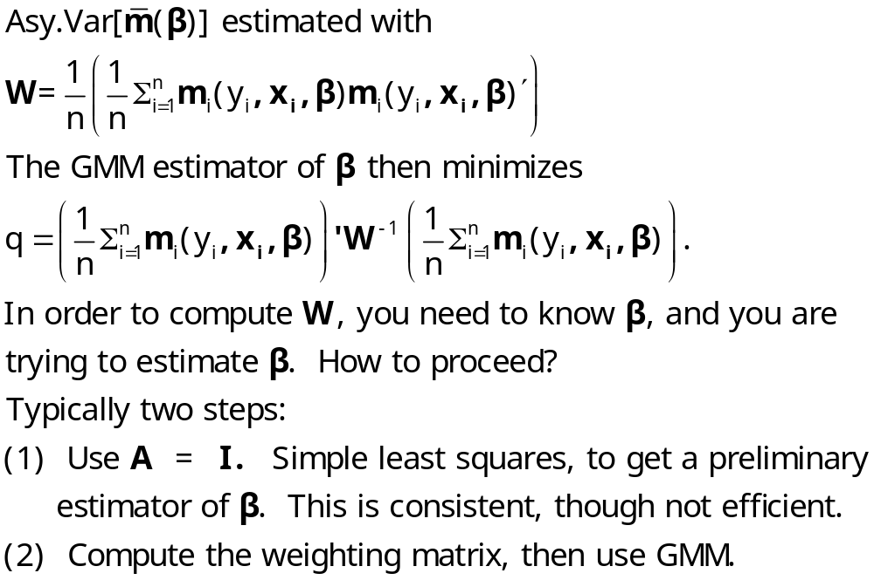
A Practical Problem

Slide 57
Inference
Testing hypotheses about the parameters:
Wald test
A counterpart to the likelihood ratio test
Testing the overidentifying restrictions

Slide 58
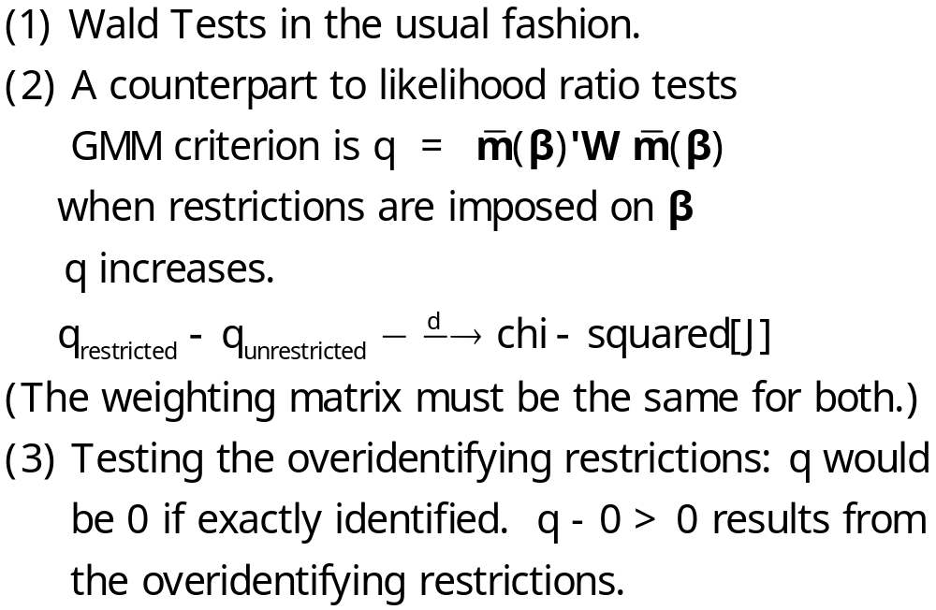
Testing Hypotheses

Slide 59
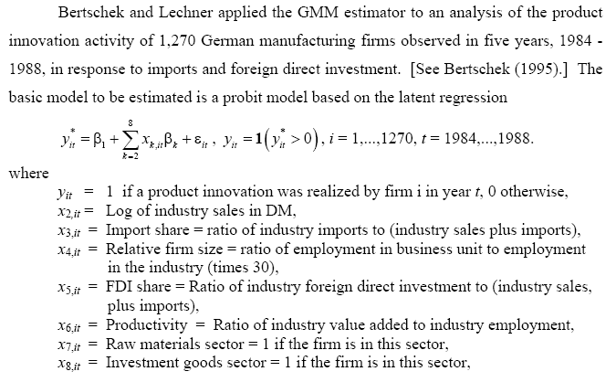
Application: Innovation

Slide 60
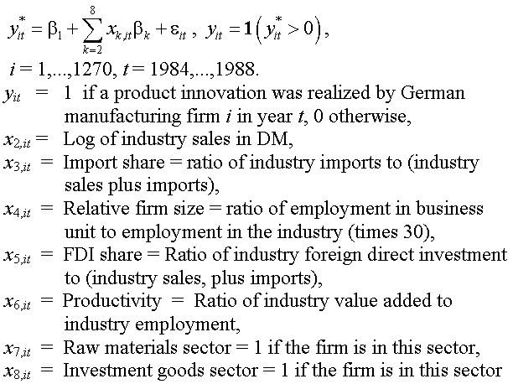
Application: Innovation

Slide 61
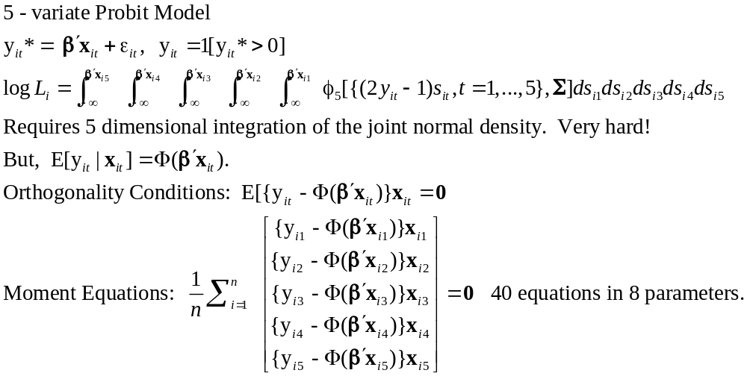
Application: Multivariate Probit Model

Slide 62
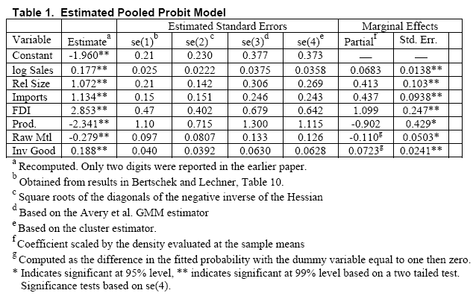
Pooled Probit – Ignoring Correlation

Slide 63
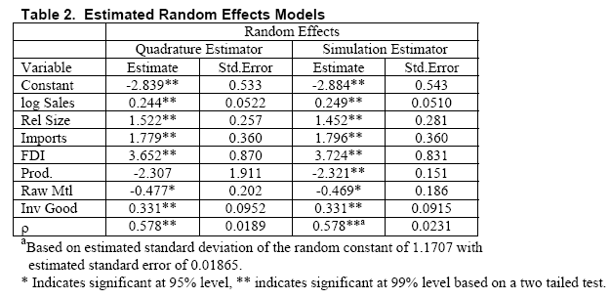
Random Effects: Σ=(1- ρ)I+ρii’

Slide 64
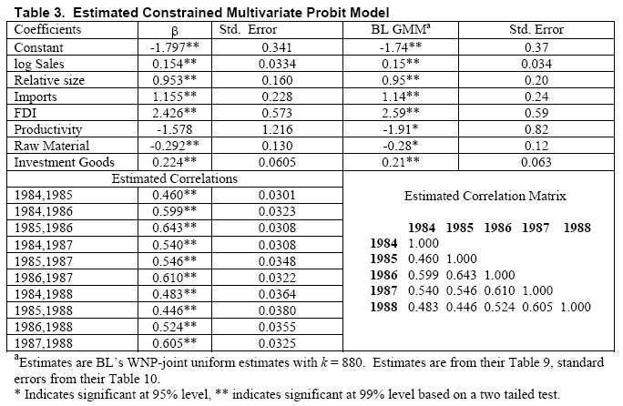
Unrestricted Correlation Matrix

