Slide 1
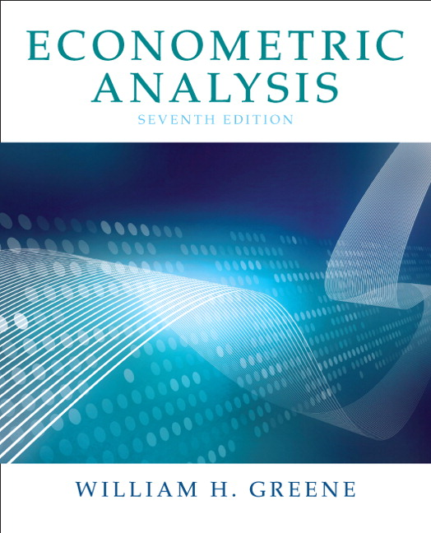
Econometrics I
Professor William Greene
Stern School of Business
Department of Economics

Slide 2
Econometrics I
Part 22 – Semi- and Nonparametric Estimation

Slide 3
Cornwell and Rupert Data
Cornwell and Rupert Returns to Schooling Data, 595 Individuals, 7 Years
Variables in the file are
EXP = work experience
WKS = weeks worked
OCC = occupation, 1 if blue collar,
IND = 1 if manufacturing industry
SOUTH = 1 if resides in south
SMSA = 1 if resides in a city (SMSA)
MS = 1 if married
FEM = 1 if female
UNION = 1 if wage set by union contract
ED = years of education
LWAGE = log of wage = dependent variable in regressions
These data were analyzed in Cornwell, C. and Rupert, P., "Efficient Estimation with Panel Data: An Empirical Comparison of Instrumental Variable Estimators," Journal of Applied Econometrics, 3, 1988, pp. 149-155. See Baltagi, page 122 for further analysis. The data were downloaded from the website for Baltagi's text.
Notes:
3

Slide 4
A First Look at the Data
Descriptive Statistics
Basic Measures of Location and Dispersion
Graphical Devices
  Histogram
  Kernel Density Estimator

Slide 5
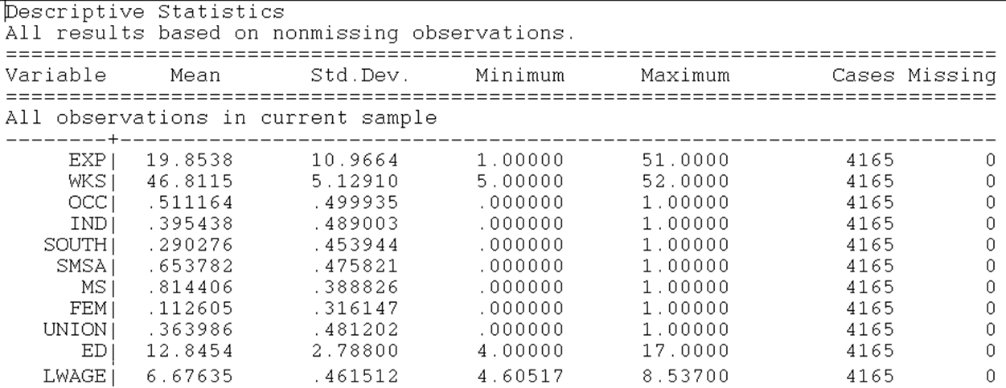

Slide 6
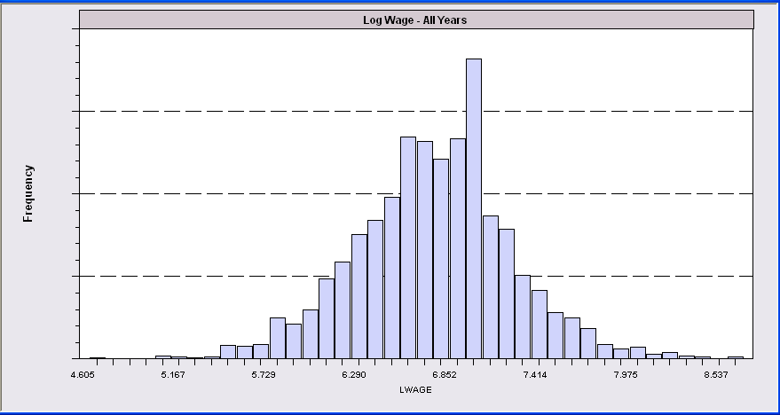
Histogram for LWAGE

Slide 7
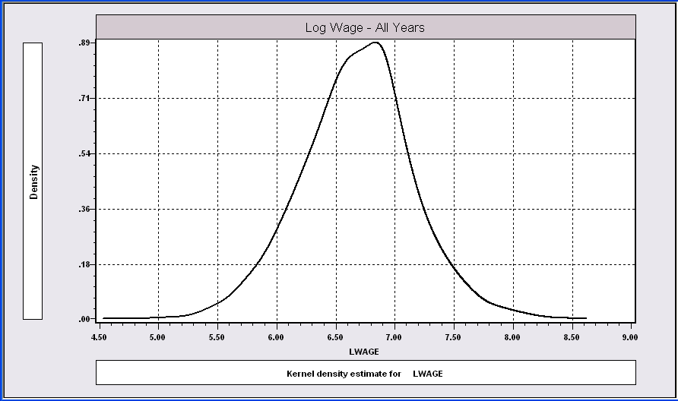
The kernel density estimator is a histogram (of sorts).

Slide 8
Computing the KDE

Slide 9
Kernel Density Estimator

Slide 10
Kernel Estimator for LWAGE

Slide 11
Application: Stochastic Frontier Model
Production Function Regression: logY = b’x + v - u
where u is “inefficiency.” u > 0. v is normally distributed.
Save for the constant term, the model is consistently estimated by OLS.
If the theory is right, the OLS residuals will be skewed to the left, rather than symmetrically distributed if they were normally distributed.
Application: Spanish dairy data used in Assignment 2
yit = log of milk production
x1 = log cows, x2 = log land, x3 = log feed, x4 = log labor

Slide 12
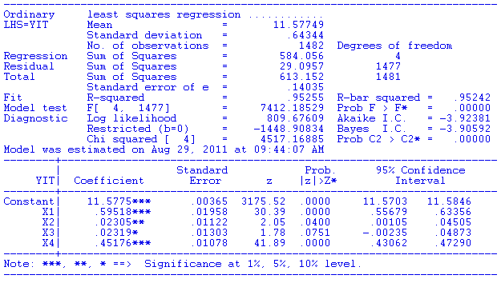
Regression Results

Slide 13
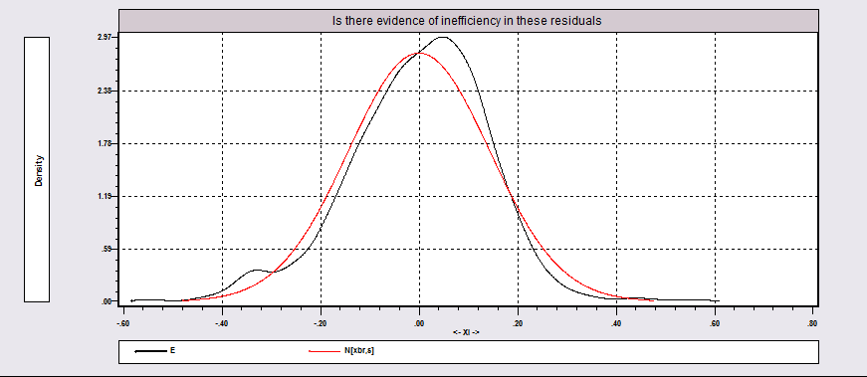
Distribution of OLS Residuals

Slide 14
A Nonparametric Regression
y = µ(x) +ε
Smoothing methods to approximate µ(x) at specific points, x*
For a particular x*, µ(x*) = ∑_{i} w_{i}(x*|x)y_{i}
  E.g., for ols, µ(x*) =a+bx*
  w_{i} = 1/n +
We look for weighting scheme, local differences in relationship. OLS assumes a fixed slope, b.

Slide 15
Nearest Neighbor Approach
Define a neighborhood of x*. Points near get high weight, points far away get a small or zero weight
Bandwidth, h defines the neighborhood:
e.g., Silverman h =.9Min[s,(IQR/1.349)]/n^{.2}
Neighborhood is + or – h/2
LOWESS weighting function: (tricube)
T_{i} = [1 – [Abs(x_{i} – x*)/h]³]³.
Weight is w_{i} = 1[Abs(x_{i} – x*)/h < .5] * T_{i} .

Slide 16
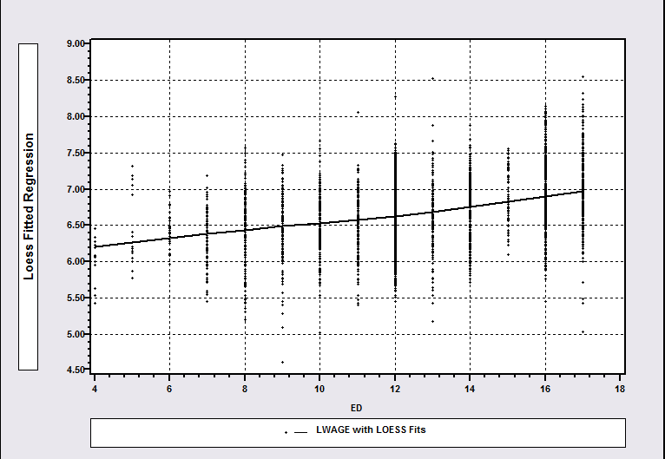
LOWESS Regression

Slide 17
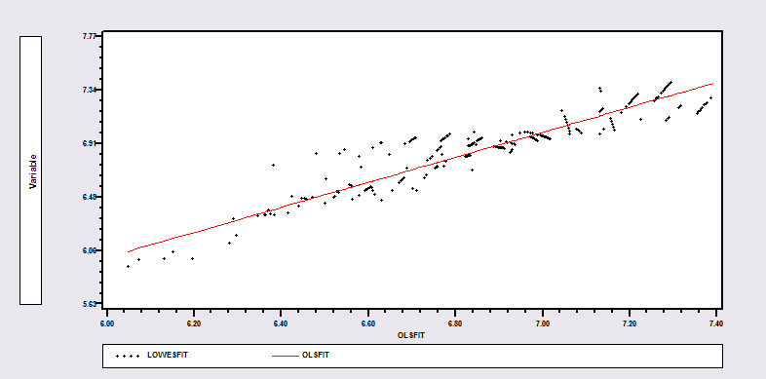
OLS Vs. Lowess

Slide 18
Smooth Function: Kernel Regression

Slide 19
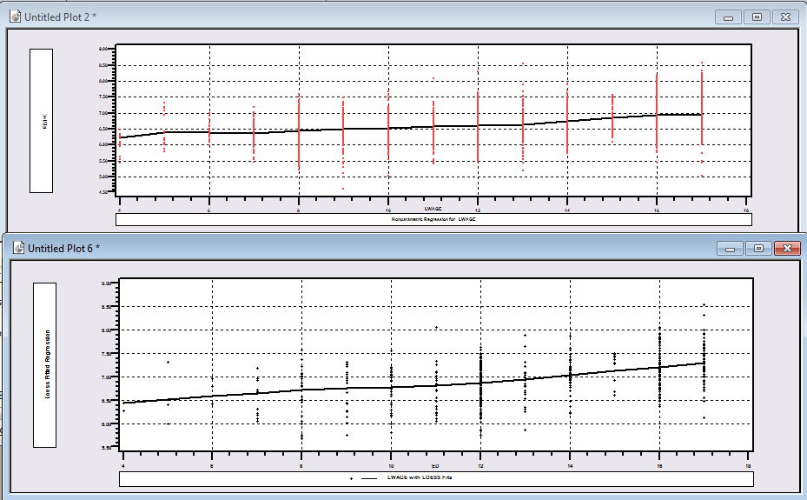
Kernel Regression vs. Lowess (Lwage vs. Educ)

Slide 20
Locally Linear Regression

Slide 21
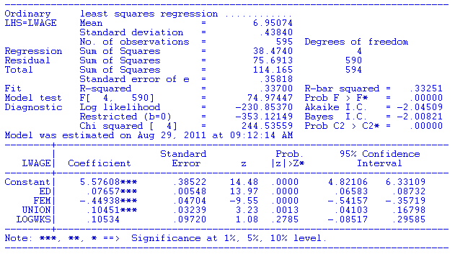
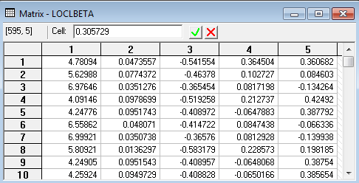
OLS vs. LOWESS

Slide 22
Quantile Regression
Least squares based on: E[y|x]=ẞ’x
LAD based on: Median[y|x]=ẞ(.5)’x
Quantile regression: Q(y|x,q)=ẞ(q)’x
Does this just shift the constant?

Slide 23
OLS vs. Least Absolute Deviations
----------------------------------------------------------------------
Least absolute deviations estimator...............
Residuals Sum of squares = 1537.58603
Standard error of e = 6.82594
Fit R-squared = .98284
Adjusted R-squared = .98180
Sum of absolute deviations = 189.3973484
--------+-------------------------------------------------------------
Variable| Coefficient Standard Error b/St.Er. P[|Z|>z] Mean of X
--------+-------------------------------------------------------------
|Covariance matrix based on 50 replications.
Constant| -84.0258*** 16.08614 -5.223 .0000
Y| .03784*** .00271 13.952 .0000 9232.86
PG| -17.0990*** 4.37160 -3.911 .0001 2.31661
--------+-------------------------------------------------------------
Ordinary least squares regression ............
Residuals Sum of squares = 1472.79834
Standard error of e = 6.68059 Standard errors are based on
Fit R-squared = .98356 50 bootstrap replications
Adjusted R-squared = .98256
--------+-------------------------------------------------------------
Variable| Coefficient Standard Error t-ratio P[|T|>t] Mean of X
--------+-------------------------------------------------------------
Constant| -79.7535*** 8.67255 -9.196 .0000
Y| .03692*** .00132 28.022 .0000 9232.86
PG| -15.1224*** 1.88034 -8.042 .0000 2.31661
--------+-------------------------------------------------------------

Slide 24
Quantile Regression
Q(y|x,α) = β′x, α = quantile
Estimated by linear programming
Q(y|x,.50) = β′x, .50 ➔ median regression
Median regression estimated by LAD (estimates same parameters as mean regression if symmetric conditional distribution)
Why use quantile (median) regression?
  Semiparametric
  Robust to some extensions (heteroscedasticity?)
  Complete characterization of conditional distribution

Slide 25
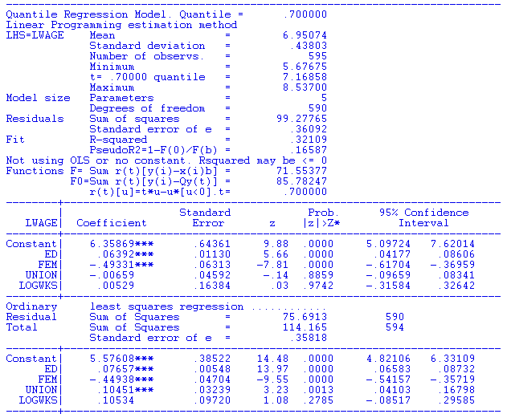
Quantile Regression

Slide 26
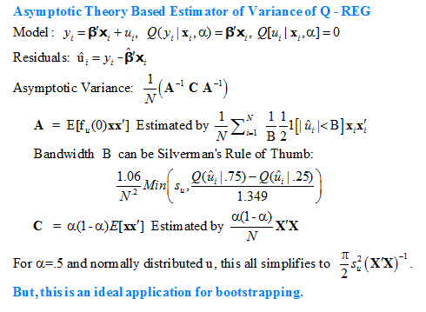

Slide 27
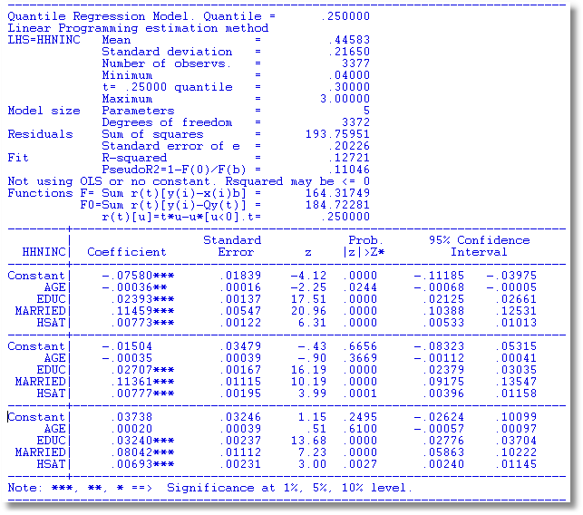
α = .25
α = .50
α = .75

Slide 28
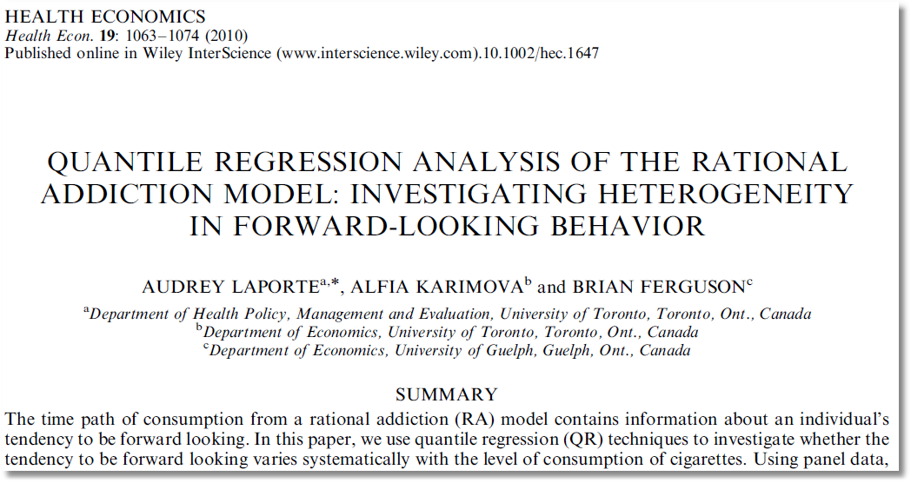

Slide 29
