Slide 1

Econometrics I
Professor William Greene
Stern School of Business
Department of Economics

Slide 2
Econometrics I
Part 23 – Simulation Based Estimation

Slide 3
Settings
Conditional and unconditional log likelihoods
  Likelihood function to be maximized contains unobservables
  Integration techniques
Bayesian estimation
  Prior times likelihood is intractible
  How to obtain posterior means, which are open form integrals
The problem in both cases is “…how to do the integration?”

Slide 4
A Conditional Log Likelihood

Slide 5
Application - Innovation
Sample = 1,270 German Manufacturing Firms
Panel, 5 years, 1984-1988
Response: Process or product innovation in the survey year? (yes or no)
Inputs:
  Imports of products in the industry
  Pressure from foreign direct investment
  Other covariates
Model: Probit with common firm effects
(Irene Bertschuk, doctoral thesis, Journal of Econometrics, 1998)

Slide 6
Likelihood Function for Random Effects
Joint conditional (on u_{i}=σv_{i}) density for obs. i.
Unconditional likelihood for observation i
How do we do the integration to get rid of the heterogeneity in the conditional likelihood?

Slide 7
Obtaining the Unconditional Likelihood
The Butler and Moffitt (1982) method is used by most current software
  Quadrature (Stata –GLAMM)
  Works only for normally distributed heterogeneity

Slide 8
Hermite Quadrature

Slide 9
Example: 8 Point Quadrature
Nodes for 8 point Hermite Quadrature
Use both signs, + and -
0.381186990207322000,
1.15719371244677990
1.98165675669584300
2.93063742025714410
Weights for 8 point Hermite Quadrature
0.661147012558199960,
0.20780232581489999,
0.0170779830074100010,
0.000199604072211400010

Slide 10
Butler and Moffitt’s Approach
Random Effects Log Likelihood Function

Slide 11
The Simulated Log Likelihood

Slide 12
Monte Carlo Integration

Slide 13
Generating Random Draws

Slide 14
Drawing Uniform Random Numbers

Slide 15
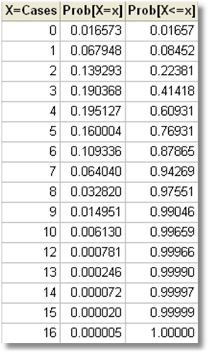
Poisson with mean = 4.1
Table
Uniform Draw = .72159
Poisson Draw = 4

Slide 16
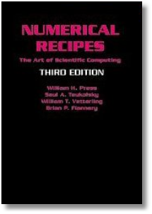

Slide 17
Quasi-Monte Carlo Integration Based on Halton Sequences
For example, using base p=5, the integer r=37 has b₀ = 2, b₁ = 2, and b₂ = 1; (37=1x5² + 2x5¹ + 2x5⁰). Then
H(37|5) = 2×5⁻¹ + 2×5⁻² + 1×5⁻³ = 0.448.

Slide 18
Halton Sequences vs. Random Draws
Requires far fewer draws – for one dimension, about 1/10. Accelerates estimation by a factor of 5 to 10.

Slide 19
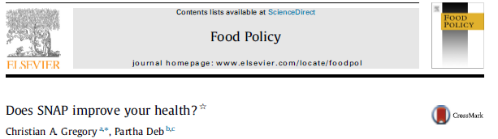
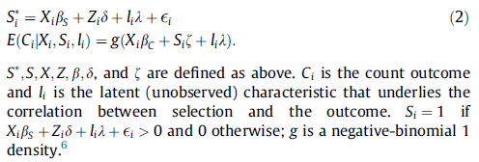

Slide 21
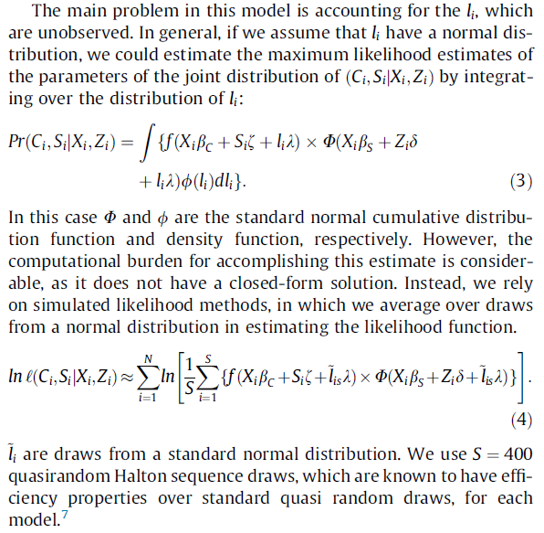
NegBin(count|SNAP)
Probit(SNAP)

Slide 23
Panel Data Estimation
A Random Effects Probit Model

Slide 24
Log Likelihood

Slide 25
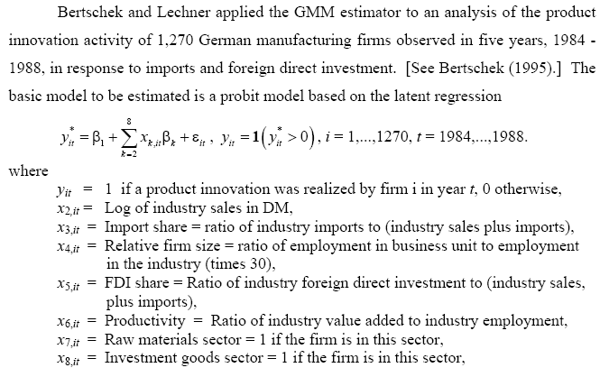
Application: Innovation

Slide 26
Application: Innovation

Slide 27
(1.1707² / (1 + 1.1707²) = 0.578)

Slide 28
Quadrature vs. Simulation
Computationally, comparably difficult
Numerically, essentially the same answer. MSL is consistent in R
Advantages of simulation
  Can integrate over any distribution, not just normal
  Can integrate over multiple random variables. Quadrature is largely unable to do this.
  Models based on simulation are being extended in many directions.
  Simulation based estimator allows estimation of conditional means → essentially the same as Bayesian posterior means

Slide 29
A Random Parameters Model

Slide 31
Estimates of a Random Parameters Model
----------------------------------------------------------------------
Probit Regression Start Values for IP
Dependent variable IP
Log likelihood function -4134.84707
Estimation based on N = 6350, K = 6
Information Criteria: Normalization=1/N
Normalized Unnormalized
AIC 1.30420 8281.69414
--------+-------------------------------------------------------------
Variable| Coefficient Standard Error b/St.Er. P[|Z|>z] Mean of X
--------+-------------------------------------------------------------
Constant| -2.34719*** .21381 -10.978 .0000
FDIUM| 3.39290*** .39359 8.620 .0000 .04581
IMUM| .90941*** .14333 6.345 .0000 .25275
LOGSALES| .24292*** .01937 12.538 .0000 10.5401
SP| 1.16687*** .14072 8.292 .0000 .07428
PROD| -4.71078*** .55278 -8.522 .0000 .08962
--------+-------------------------------------------------------------

Slide 32
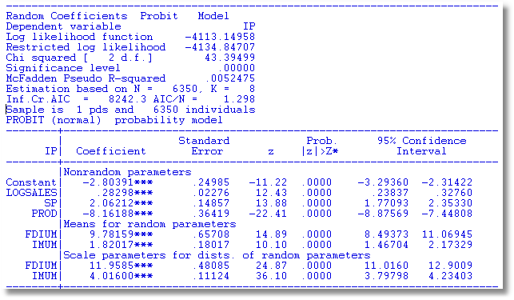
RPM

Slide 33
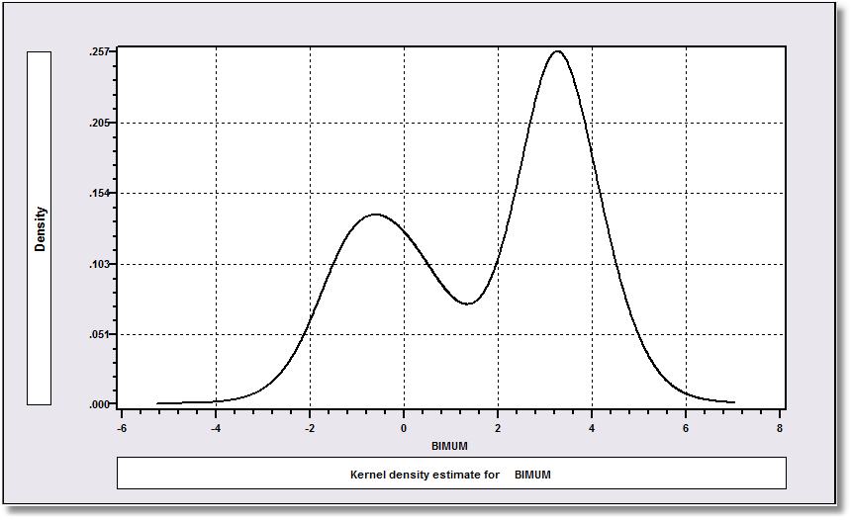

Slide 34
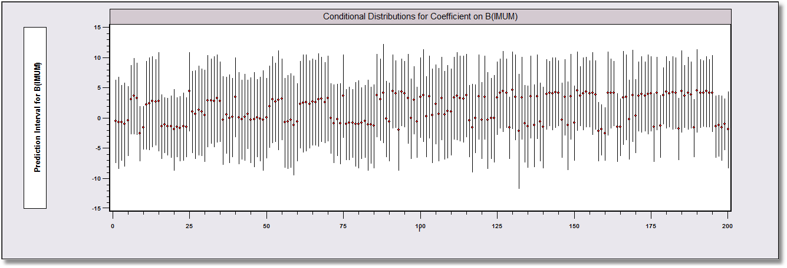
Parameter Heterogeneity

Slide 36
Movie Model

