Slide 1

Econometrics I
Professor William Greene
Stern School of Business
Department of Economics

Slide 2
Econometrics I
Part 24 – Bayesian Estimation

Slide 3
Bayesian Estimators
“Random Parameters” vs. Randomly Distributed Parameters
Models of Individual Heterogeneity
  Random Effects: Consumer Brand Choice
  Fixed Effects: Hospital Costs

Slide 4
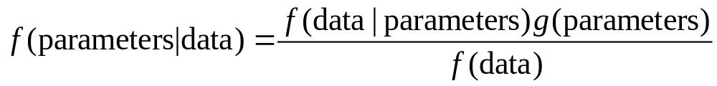
Bayesian Estimation
Specification of conditional likelihood:
f(data | parameters)
Specification of priors: g(parameters)
Posterior density of parameters:
Posterior mean = E[parameters|data]

Slide 5
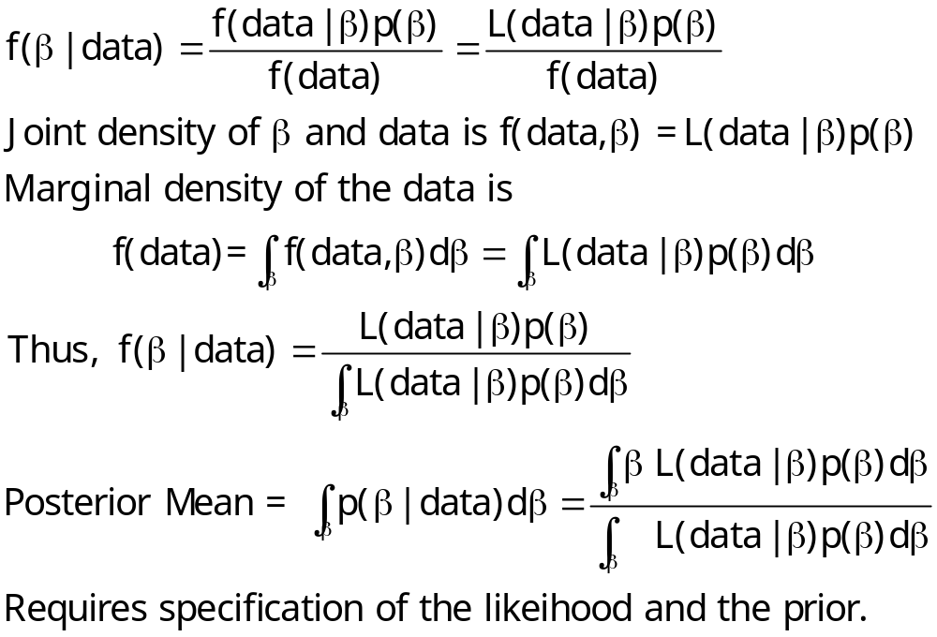
The Marginal Density for the Data is Irrelevant

Slide 6
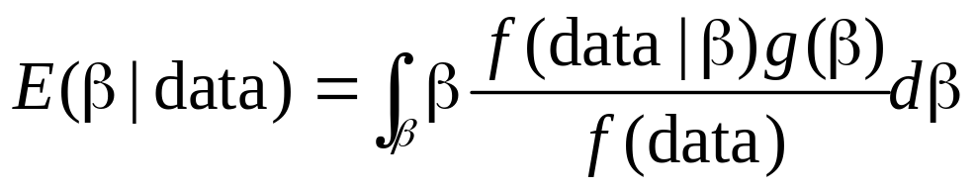
Computing Bayesian Estimators
First generation: Do the integration (math)
Contemporary - Simulation:
  (1) Deduce the posterior
  (2) Draw random samples of draws from the posterior and compute the sample means and variances of the samples. (Relies on the law of large numbers.)

Slide 7
Modeling Issues
As n →∞, the likelihood dominates and the prior disappears ➔ Bayesian and Classical MLE converge. (Needs the mode of the posterior to converge to the mean.)
Priors
  Diffuse → large variances imply little prior information. (NONINFORMATIVE)
  INFORMATIVE priors – finite variances that appear in the posterior. “Taints” any final results.

Slide 8
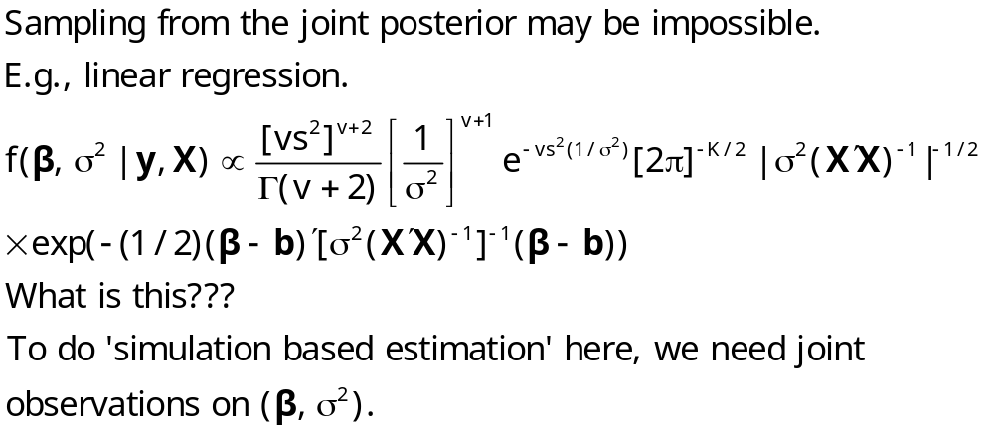
A Practical Problem

Slide 9
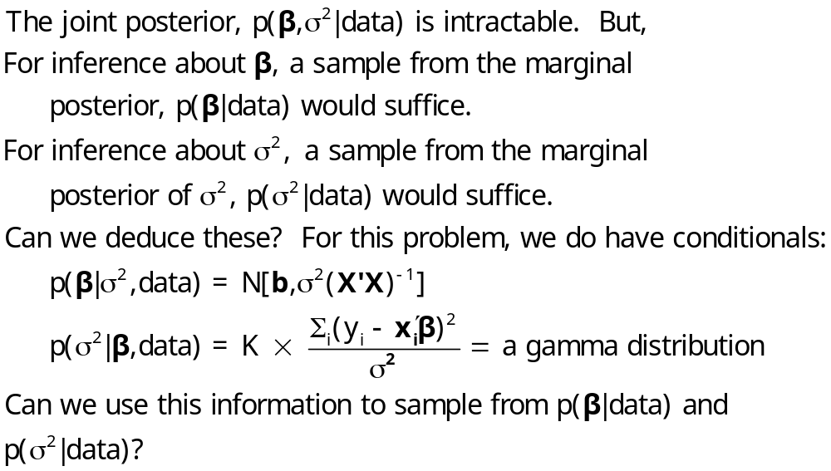
A Solution to the Sampling Problem

Slide 10
The Gibbs Sampler
Target: Sample from marginals of f(x₁, x₂) = joint distribution
Joint distribution is unknown or it is not possible to sample from the joint distribution.
Assumed: f(x₁|x₂) and f(x₂|x₁) both known and samples can be drawn from both.
Gibbs sampling: Obtain one draw from x₁,x₂ by many cycles between x₁|x₂ and x₂|x₁.
  Start x_{1,0} anywhere in the right range.
  Draw x_{2,0} from x₂|x_{1,0}.
  Return to x_{1,1} from x₁|x_{2,0} and so on.
  Several thousand cycles produces the draws
  Discard the first several thousand to avoid initial conditions. (Burn in)
Average the draws to estimate the marginal means.

Slide 11
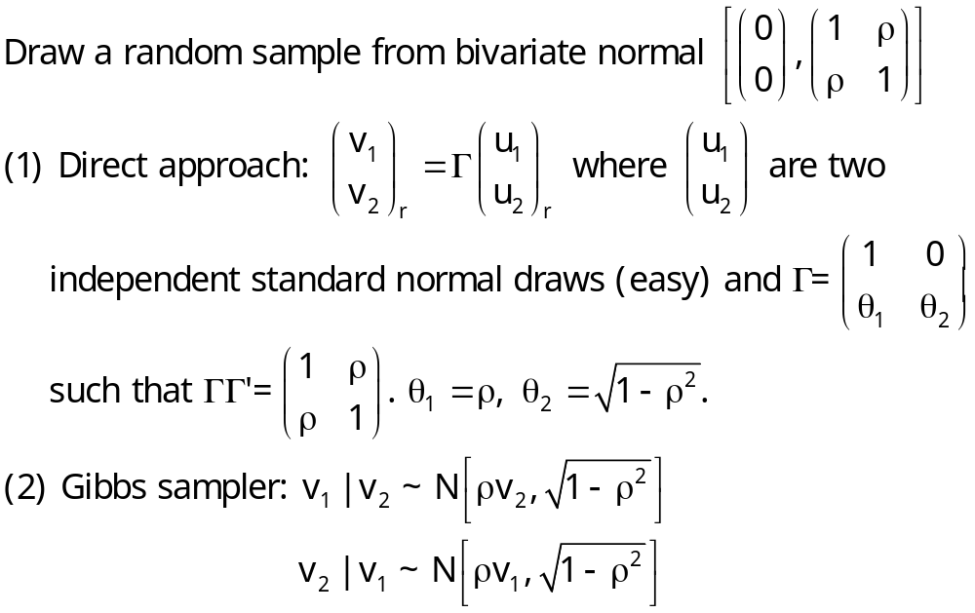
Bivariate Normal Sampling

Slide 12
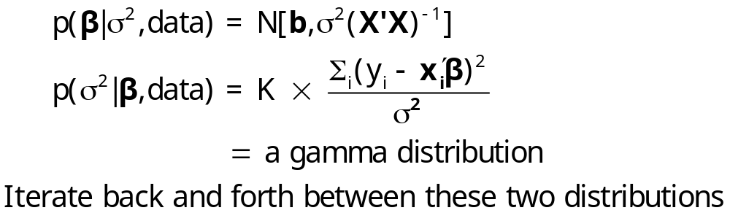
Gibbs Sampling for the Linear Regression Model

Slide 13
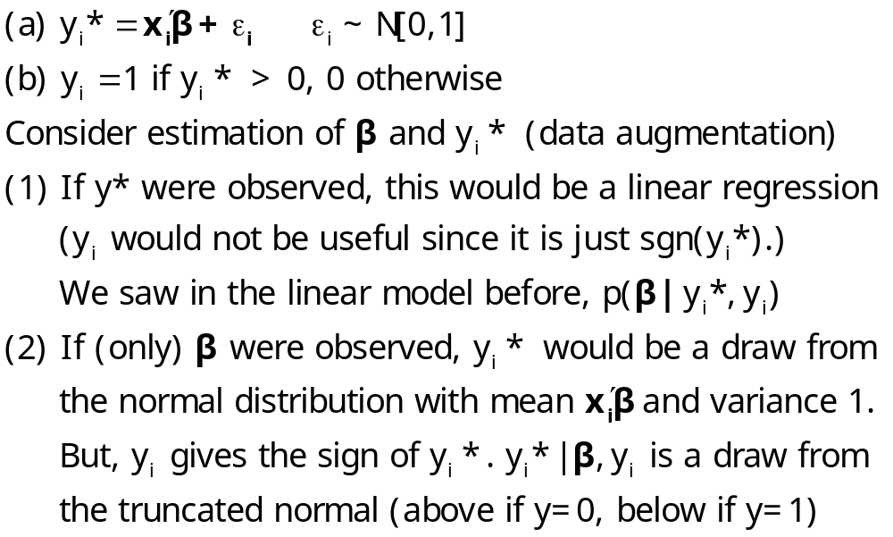
Application – the Probit Model

Slide 14
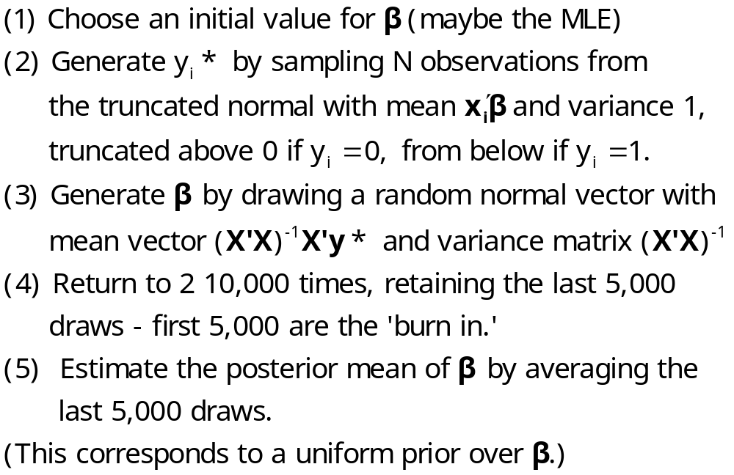
Gibbs Sampling for the Probit Model

Slide 15
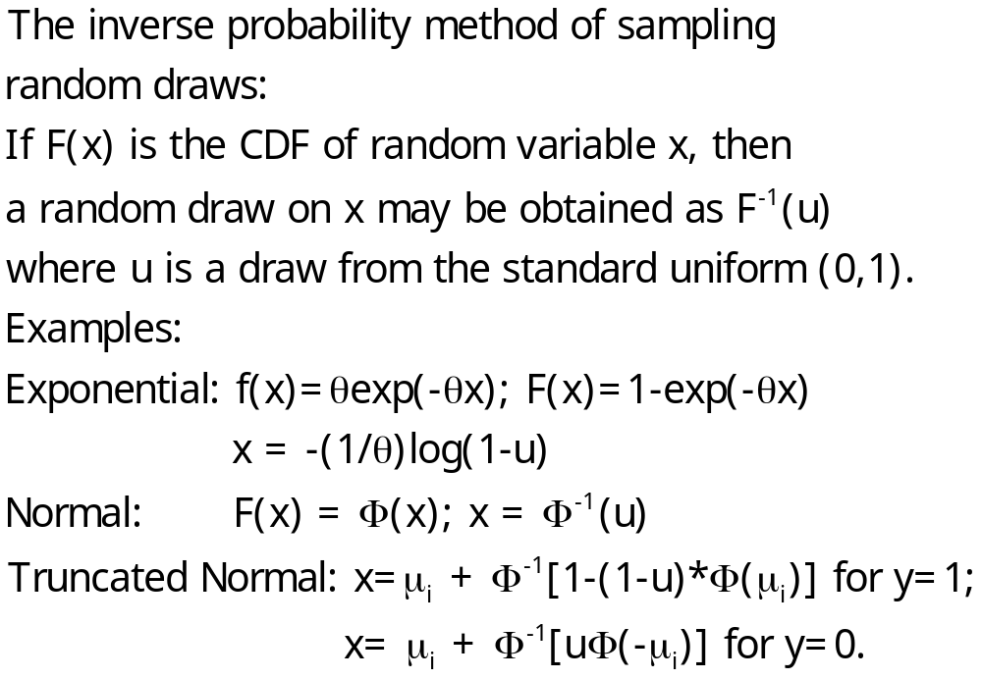
Generating Random Draws from f(X)

Slide 16
? Generate raw data
Calc ; Ran(13579) $
Sample ; 1 - 250 $
Create ; x1 = rnn(0,1) ; x2 = rnn(0,1) $
Create ; ys = .2 + .5*x1 - .5*x2 + rnn(0,1) ; y = ys > 0 $
Namelist; x = one,x1,x2$
Matrix ; xxi = <x’x> $
Calc ; Rep = 200 ; Ri = 1/(Rep-25)$
? Starting values and accumulate mean and variance matrices
Matrix ; beta=[0/0/0] ; bbar=init(3,1,0);bv=init(3,3,0)$$
Proc = gibbs $ Markov Chain – Monte Carlo iterations
Do for ; simulate ; r =1,Rep $
? ------- [ Sample y* | beta ] --------------------------
Create ; mui = x'beta ; f = rnu(0,1)
; if(y=1) ysg = mui + inp(1-(1-f)*phi( mui));
(else) ysg = mui + inp( f *phi(-mui)) $
? ------- [ Sample beta | y*] ---------------------------
Matrix ; mb = xxi*x'ysg ; beta = rndm(mb,xxi) $
? ------- [ Sum posterior mean and variance. Discard burn in. ]
Matrix ; if[r > 25] ; bbar=bbar+beta ; bv=bv+beta*beta'$
Enddo ; simulate $
Endproc $
Execute ; Proc = Gibbs $
Matrix ; bbar=ri*bbar ; bv=ri*bv-bbar*bbar' $
Probit ; lhs = y ; rhs = x $
Matrix ; Stat(bbar,bv,x) $

Slide 17
Example: Probit MLE vs. Gibbs
--> Matrix ; Stat(bbar,bv); Stat(b,varb) $
+---------------------------------------------------+
|Number of observations in current sample = 1000 |
|Number of parameters computed here = 3 |
|Number of degrees of freedom = 997 |
+---------------------------------------------------+
+---------+--------------+----------------+--------+---------+
|Variable | Coefficient | Standard Error |b/St.Er.|P[|Z|>z] |
+---------+--------------+----------------+--------+---------+
BBAR_1 .21483281 .05076663 4.232 .0000
BBAR_2 .40815611 .04779292 8.540 .0000
BBAR_3 -.49692480 .04508507 -11.022 .0000
+---------+--------------+----------------+--------+---------+
|Variable | Coefficient | Standard Error |b/St.Er.|P[|Z|>z] |
+---------+--------------+----------------+--------+---------+
B_1 .22696546 .04276520 5.307 .0000
B_2 .40038880 .04671773 8.570 .0000
B_3 -.50012787 .04705345 -10.629 .0000

Slide 18
A Random Effects Approach
Allenby and Rossi, “Marketing Models of Consumer Heterogeneity”
  Discrete Choice Model – Brand Choice
  “Hierarchical Bayes”
  Multinomial Probit
Panel Data: Purchases of 4 brands of Ketchup

Slide 19
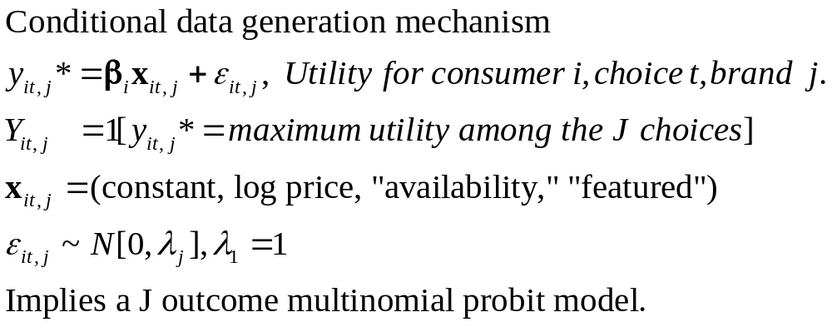
Structure

Slide 20
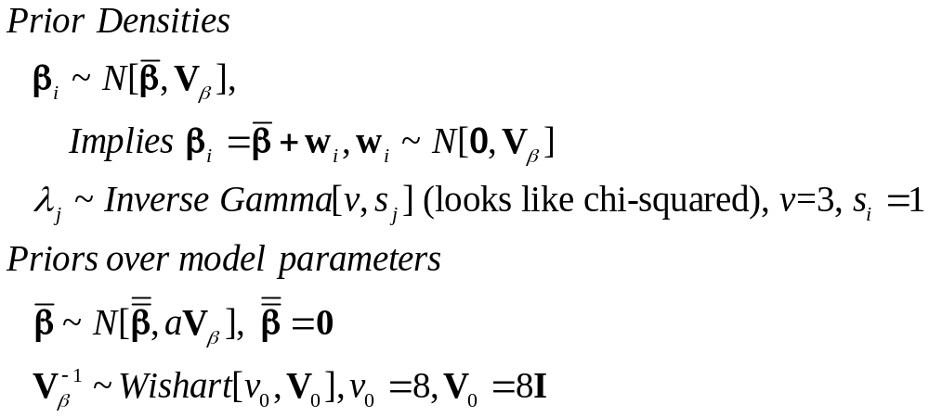
Bayesian Priors

Slide 21
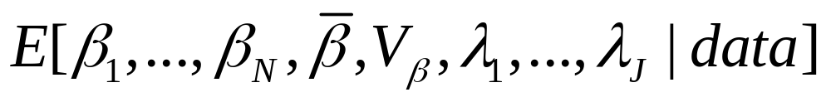
Bayesian Estimator
Joint Posterior=
Integral does not exist in closed form.
Estimate by random samples from the joint posterior.
Full joint posterior is not known, so not possible to sample from the joint posterior.

Slide 22
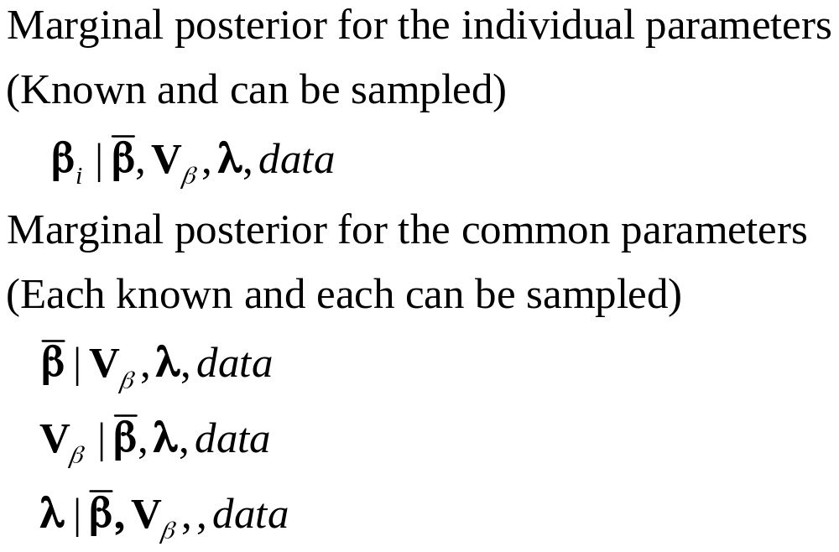
Gibbs Cycles for the MNP Model
Samples from the marginal posteriors

Slide 23
Results
Individual parameter vectors and disturbance variances
Individual estimates of choice probabilities
The same as the “random parameters model” with slightly different weights.
Allenby and Rossi call the classical method an “approximate Bayesian” approach.
  (Greene calls the Bayesian estimator an “approximate random parameters model”)
  Who’s right?
    Bayesian layers on implausible uninformative priors and calls the maximum likelihood results “exact” Bayesian estimators
    Classical is strongly parametric and a slave to the distributional assumptions.
    Bayesian is even more strongly parametric than classical.
    Neither is right – Both are right.

Slide 24
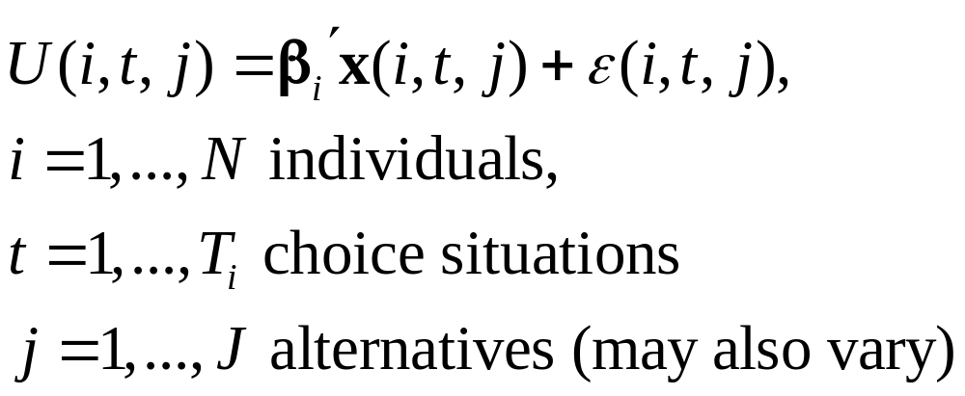
Comparison of Maximum Simulated Likelihood and Hierarchical Bayes
Ken Train: “A Comparison of Hierarchical Bayes and Maximum Simulated Likelihood for Mixed Logit”
Mixed Logit

Slide 25
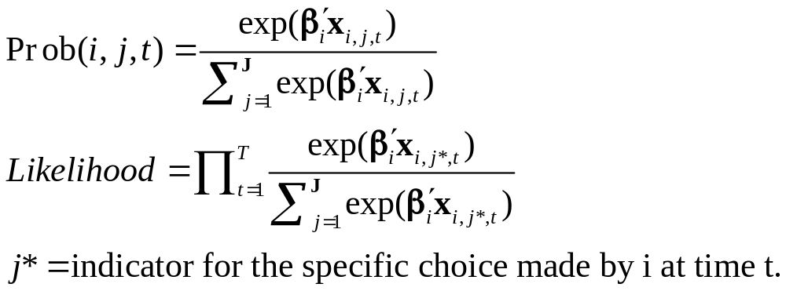
Stochastic Structure – Conditional Likelihood
Note individual specific parameter vector, β_{i}

Slide 26
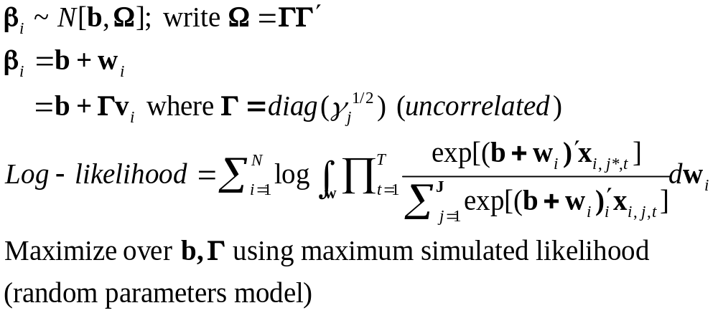
Classical Approach

Slide 27
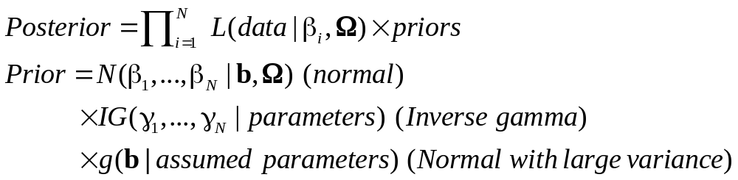
Bayesian Approach – Gibbs Sampling and Metropolis-Hastings

Slide 28
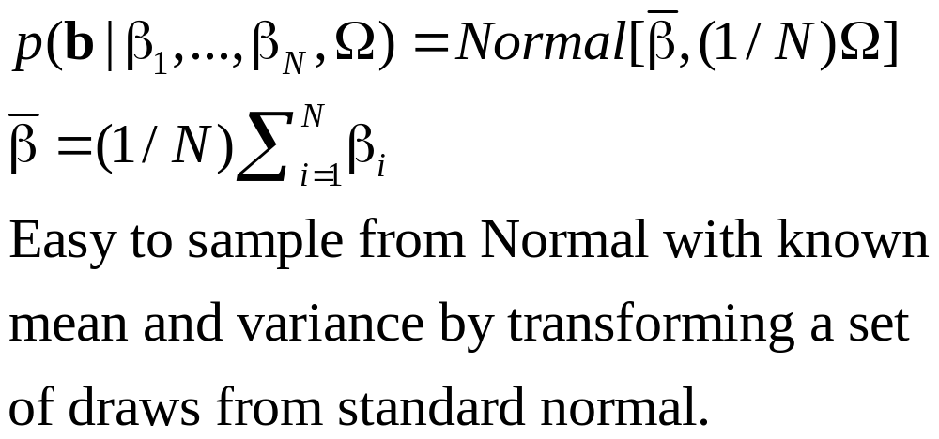
Gibbs Sampling from Posteriors: b

Slide 29
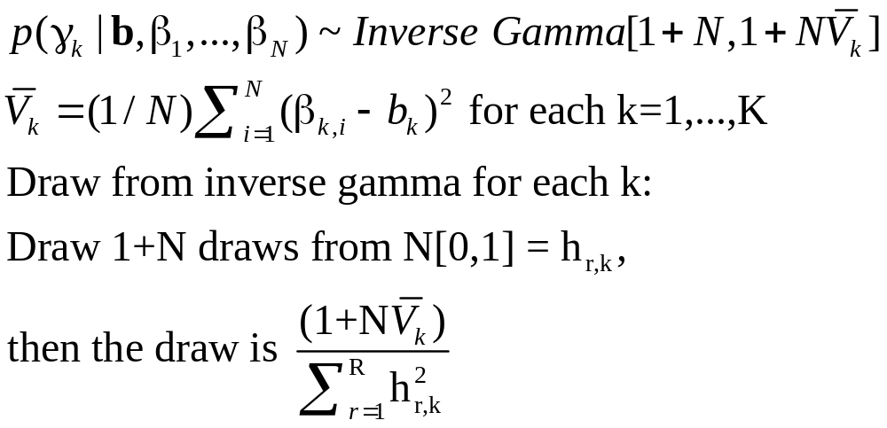
Gibbs Sampling from Posteriors: Ω

Slide 30
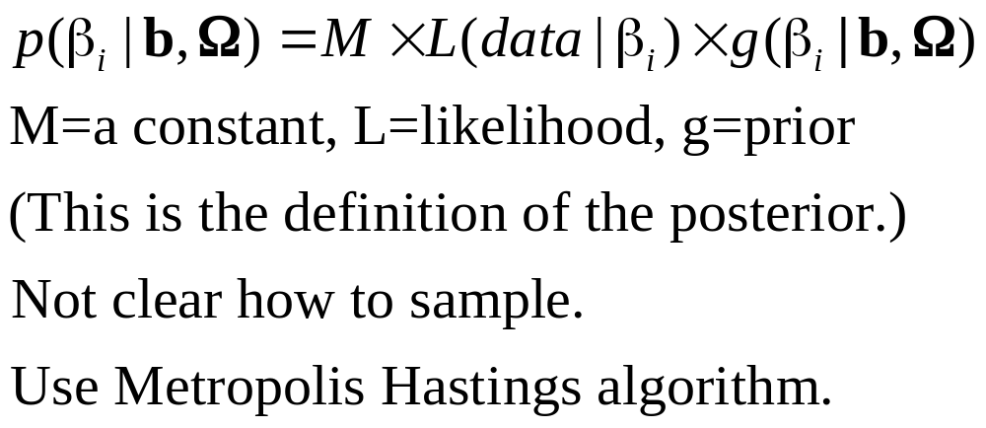
Gibbs Sampling from Posteriors: β_{i}

Slide 31
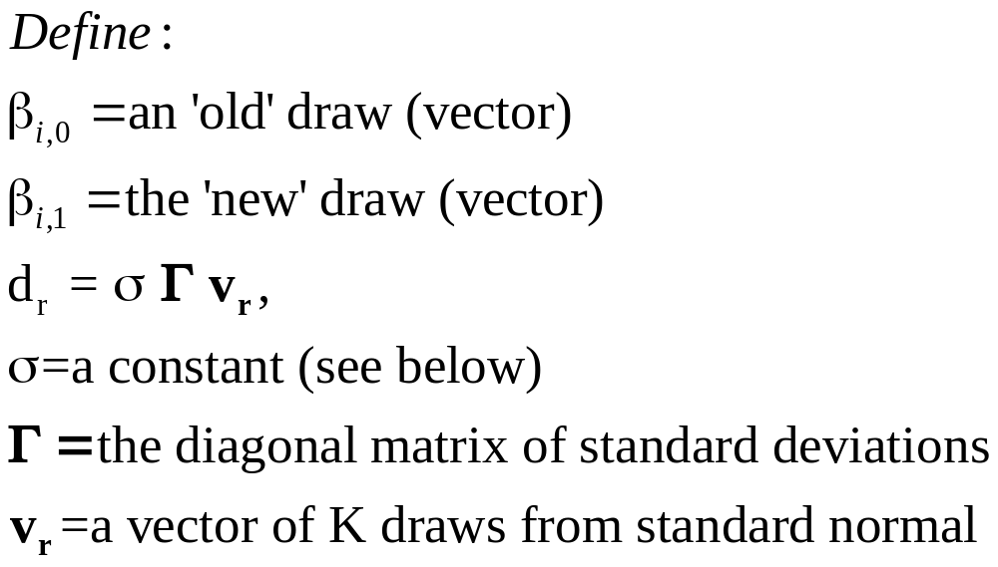
Metropolis – Hastings Method

Slide 32
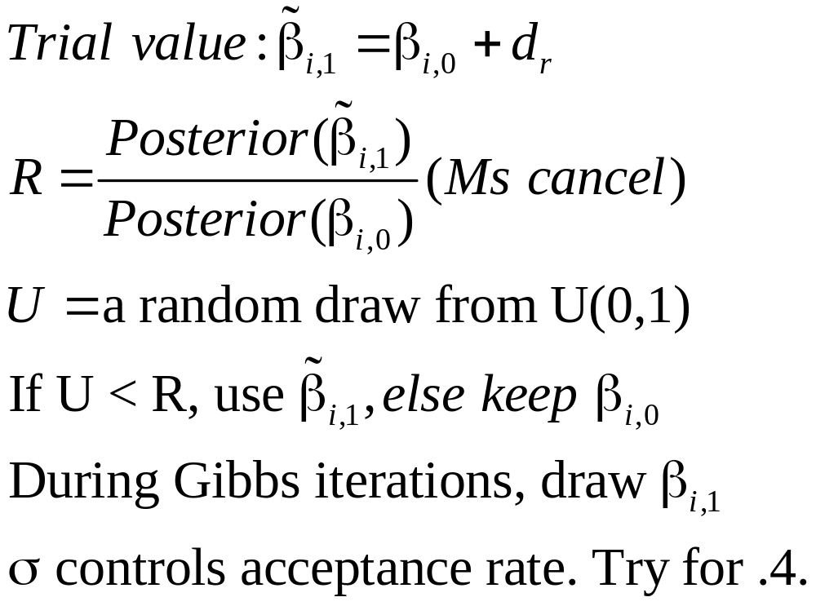
Metropolis Hastings: A Draw of β_{i}

Slide 33
Application: Energy Suppliers
N=361 individuals, 2 to 12 hypothetical suppliers
X= (1) fixed rates,
(2) contract length,
(3) local (0,1),
(4) well known company (0,1),
(5) offer TOD rates (0,1),
(6) offer seasonal rates (0,1).

Slide 34
Estimates: Mean of Individual β_{i}
 | MSL Estimate | Bayes Posterior Mean
Price | -1.04 (0.396) | -1.04 (0.0374)
Contract | -0.208 (0.0240) | -0.194 (0.0224)
Local | 2.40 (0.127) | 2.41 (0.140)
Well Known | 1.74 (0.0927) | 1.71 (0.100)
TOD | -9.94 (0.337) | -10.0 (0.315)
Seasonal | -10.2 (0.333) | -10.2 (0.310)

Slide 35
Reconciliation: A Theorem (Bernstein-Von Mises)
The posterior distribution converges to normal with covariance matrix equal to 1/n times the information matrix (same as classical MLE). (The distribution that is converging is the posterior, not the sampling distribution of the estimator of the posterior mean.)
The posterior mean (empirical) converges to the mode of the likelihood function. Same as the MLE. A proper prior disappears asymptotically.
Asymptotic sampling distribution of the posterior mean is the same as that of the MLE.

