Slide 1
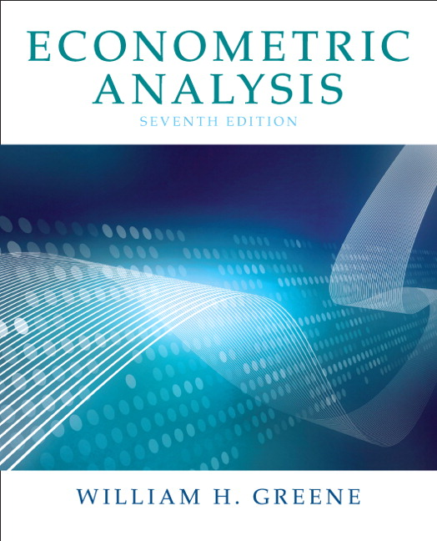
Econometrics I
Professor William Greene
Stern School of Business
Department of Economics

Slide 2
Econometrics I
Part 25 – Time Series

Slide 3
Modeling an Economic Time Series
Observed y₀, y₁, …, y_{t},…
What is the “sample”
Random sampling?
The “observation window”

Slide 4
Estimators
Functions of sums of observations
Law of large numbers?
  Nonindependent observations
  What does “increasing sample size” mean?
Asymptotic properties? (There are no finite sample properties.)

Slide 5
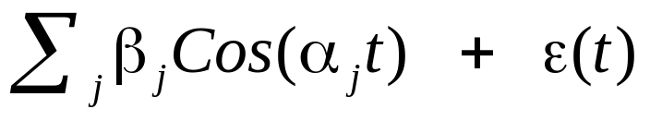
Interpreting a Time Series
Time domain: A “process”
  y(t) = ax(t) + by(t-1) + …
  Regression like approach/interpretation
Frequency domain: A sum of terms
  y(t) =
  Contribution of different frequencies to the observed series.
(“High frequency data and financial econometrics – “frequency” is used slightly differently here.)

Slide 6
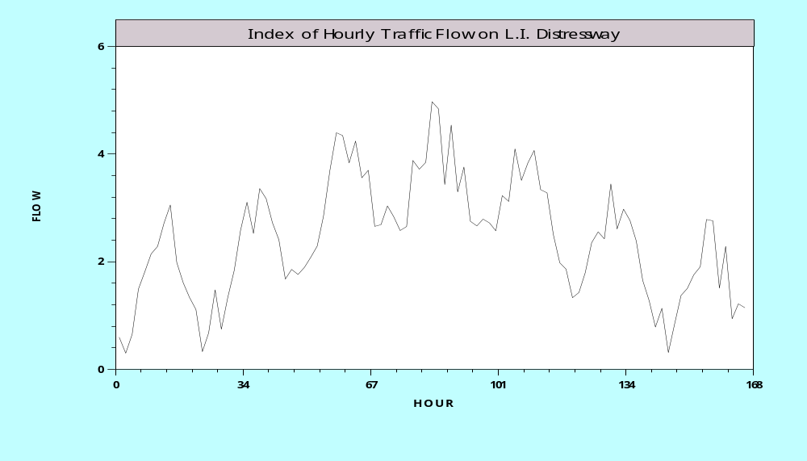
For example,…

Slide 7
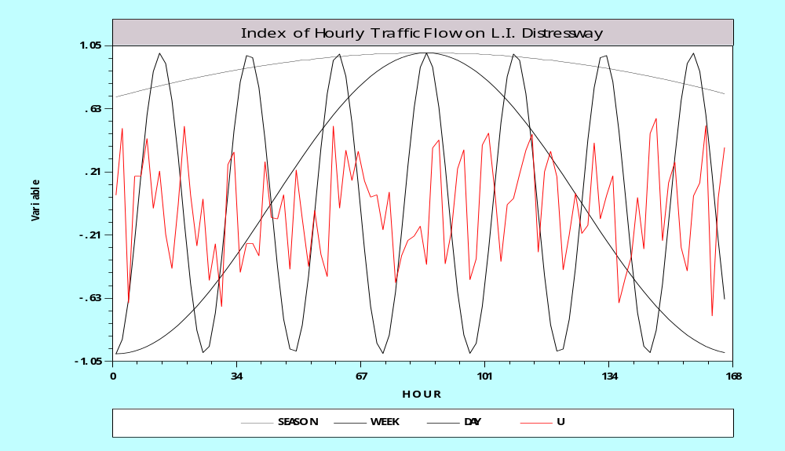
In parts…

Slide 8
Studying the Frequency Domain
Cannot identify the number of terms
Cannot identify frequencies from the time series
Deconstructing the variance, autocovariances and autocorrelations
  Contributions at different frequencies
  Apparent large weights at different frequencies
  Using Fourier transforms of the data
  Does this provide “new” information about the series?

Slide 9
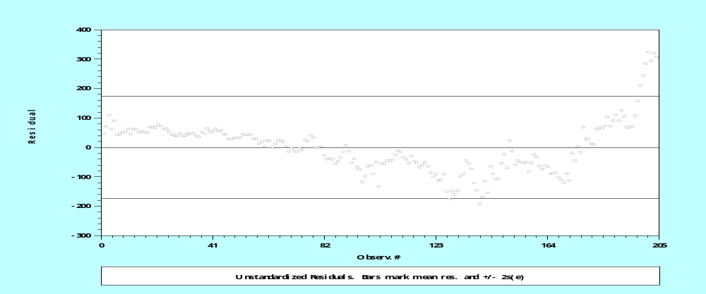
Autocorrelation in Regression
Y_{t} = b’x_{t} + ε_{t}
Cov(ε_{t}, ε_{t-1}) ≠ 0
Ex. RealCons_{t} = a + bRealIncome + ε_{t} U.S. Data, quarterly, 1950-2000

Slide 10
Autocorrelation
How does it arise?
What does it mean?
Modeling approaches
  Classical – direct: corrective
    Estimation that accounts for autocorrelation
    Inference in the presence of autocorrelation
  Contemporary – structural
    Model the source
    Incorporate the time series aspect in the model

Slide 11
Stationary Time Series
z_{t} = b₁y_{t-1} + b₂y_{t-2} + … + b_{P}y_{t-P} + e_{t}
Autocovariance: γ_{k} = Cov[y_{t},y_{t-k}]
Autocorrelation: ρ_{k} = γ_{k} / γ₀
Stationary series: γ_{k} depends only on k, not on t
  Weak stationarity: E[y_{t}] is not a function of t, E[y_{t} * y_{t-s}] is not a function of t or s, only of |t-s|
  Strong stationarity: The joint distribution of [y_{t},y_{t-1},…,y_{t-s}] for any window of length s periods, is not a function of t or s.
A condition for weak stationarity: The smallest root of the characteristic polynomial: 1 - b₁z¹ - b₂z² - … - b_{P}z^{P} = 0, is greater than one.
  The unit circle
  Complex roots
  Example: y_{t} = ρy_{t-1} + e_{e}, 1 - ρz = 0 has root z = 1/ ρ, | z | > 1 => | ρ | < 1.

Slide 12
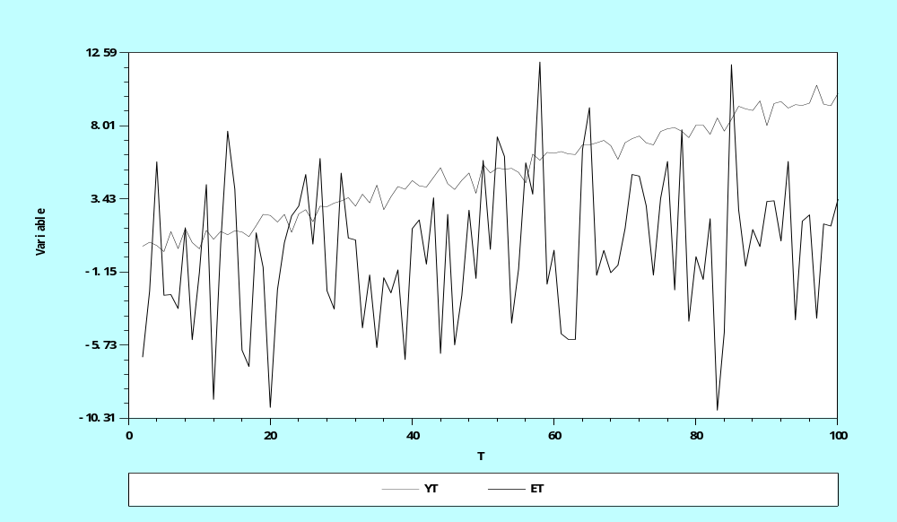
Stationary vs. Nonstationary Series

Slide 13
The Lag Operator
Lx_{t} = x_{t-1}
L² x_{t} = x_{t-2}
L^{P}x_{t} + L^{Q}x_{t} = x_{t-P} + x_{t-Q}
Polynomials in L: y_{t} = B(L)y_{t} + e_{t}
A(L) y_{t} = e_{t}
Invertibility: y_{t} = [A(L)]⁻¹ e_{t}

Slide 14
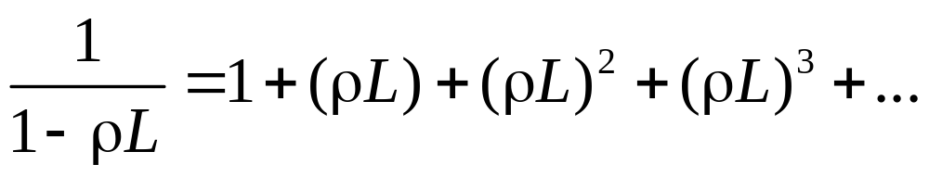
Inverting a Stationary Series
y_{t}= ρy_{t-1} + e_{t} ➔ (1- ρL)y_{t} = e_{t}
y_{t} = [1- ρL]⁻¹ e_{t} = e_{t} + ρe_{t-1} + ρ²e_{t-2} + …
  Stationary series can be inverted
  Autoregressive vs. moving average form of series

Slide 15
Regression with Autocorrelation
y_{t} = x_{t}’b + e_{t}, e_{t} = ρe_{t-1} + u_{t}
(1- ρL)e_{t} = u_{t} ➔ e_{t} = (1- ρL)⁻¹u_{t}
  E[e_{t}] = E[ (1- ρL)⁻¹u_{t}] = (1- ρL)⁻¹E[u_{t}] = 0
  Var[e_{t}] = (1- ρL)⁻²Var[u_{t}] = 1+ ρ²σ_{u}² + … = σ_{u}²/(1- ρ²)
  Cov[e_{t},e_{t-1}] = Cov[ρe_{t-1} + u_{t}, e_{t-1}] =
  =ρCov[e_{t-1},e_{t-1}]+Cov[u_{t},e_{t-1}] = ρ σ_{u}²/(1- ρ²)

Slide 16
OLS vs. GLS
OLS
  Unbiased?
  Consistent: (Except in the presence of a lagged dependent variable)
  Inefficient
GLS
  Consistent and efficient

Slide 17
+----------------------------------------------------+
| Ordinary least squares regression |
| LHS=REALCONS Mean = 2999.436 |
| Autocorrel Durbin-Watson Stat. = .0920480 |
| Rho = cor[e,e(-1)] = .9539760 |
+----------------------------------------------------+
+---------+--------------+----------------+--------+---------+----------+
|Variable | Coefficient | Standard Error |t-ratio |P[|T|>t] | Mean of X|
+---------+--------------+----------------+--------+---------+----------+
Constant -80.3547488 14.3058515 -5.617 .0000
REALDPI .92168567 .00387175 238.054 .0000 3341.47598
| Robust VC Newey-West, Periods = 10 |
Constant -80.3547488 41.7239214 -1.926 .0555
REALDPI .92168567 .01503516 61.302 .0000 3341.47598
+---------------------------------------------+
| AR(1) Model: e(t) = rho * e(t-1) + u(t) |
| Final value of Rho = .998782 |
| Iter= 6, SS= 118367.007, Log-L=-941.371914 |
| Durbin-Watson: e(t) = .002436 |
| Std. Deviation: e(t) = 490.567910 |
| Std. Deviation: u(t) = 24.206926 |
| Durbin-Watson: u(t) = 1.994957 |
| Autocorrelation: u(t) = .002521 |
| N[0,1] used for significance levels |
+---------------------------------------------+
+---------+--------------+----------------+--------+---------+----------+
|Variable | Coefficient | Standard Error |b/St.Er.|P[|Z|>z] | Mean of X|
+---------+--------------+----------------+--------+---------+----------+
Constant 1019.32680 411.177156 2.479 .0132
REALDPI .67342731 .03972593 16.952 .0000 3341.47598
RHO .99878181 .00346332 288.389 .0000

Slide 18
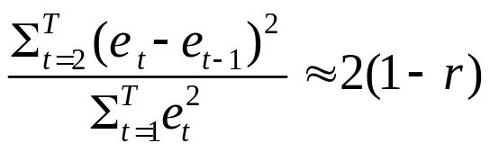
Detecting Autocorrelation
Use residuals
  Durbin-Watson d=
  Assumes normally distributed disturbances strictly exogenous regressors
Variable addition (Godfrey)
  y_{t} = β’x_{t} + ρε_{t-1} + u_{t}
  Use regression residuals e_{t} and test ρ = 0
  Assumes consistency of b.

Slide 19
A Unit Root?
How to test for ρ = 1?
By construction: ε_{t} – ε_{t-1} = (ρ - 1)ε_{t-1} + u_{t}
  Test for γ = (ρ - 1) = 0 using regression?
  Variance goes to 0 faster than 1/T. Need a new table; can’t use standard t tables.
  Dickey – Fuller tests
Unit roots in economic data. (Are there?)
  Nonstationary series
  Implications for conventional analysis

Slide 20
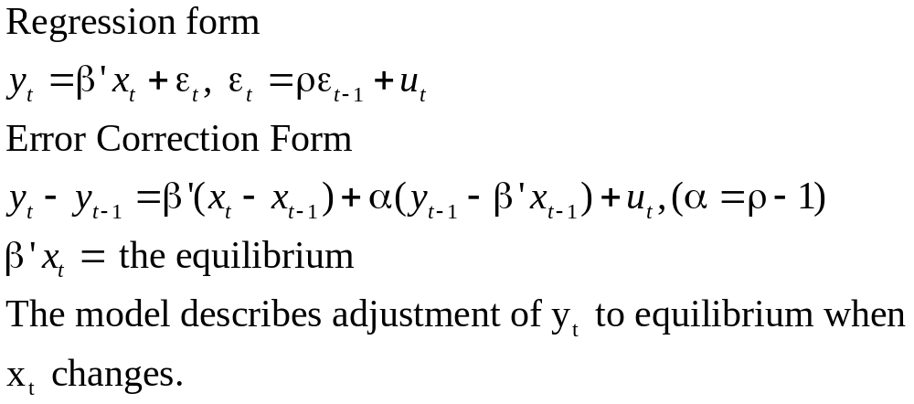
Reinterpreting Autocorrelation

Slide 21
Integrated Processes
Integration of order (P) when the P’th differenced series is stationary
Stationary series are I(0)
Trending series are often I(1). Then y_{t} – y_{t-1} = Δy_{t} is I(0). [Most macroeconomic data series.]
Accelerating series might be I(2). Then (y_{t} – y_{t-1})- (y_{t} – y_{t-1}) = Δ²y_{t} is I(0) [Money stock in hyperinflationary economies. Difficult to find many applications in economics]

Slide 22
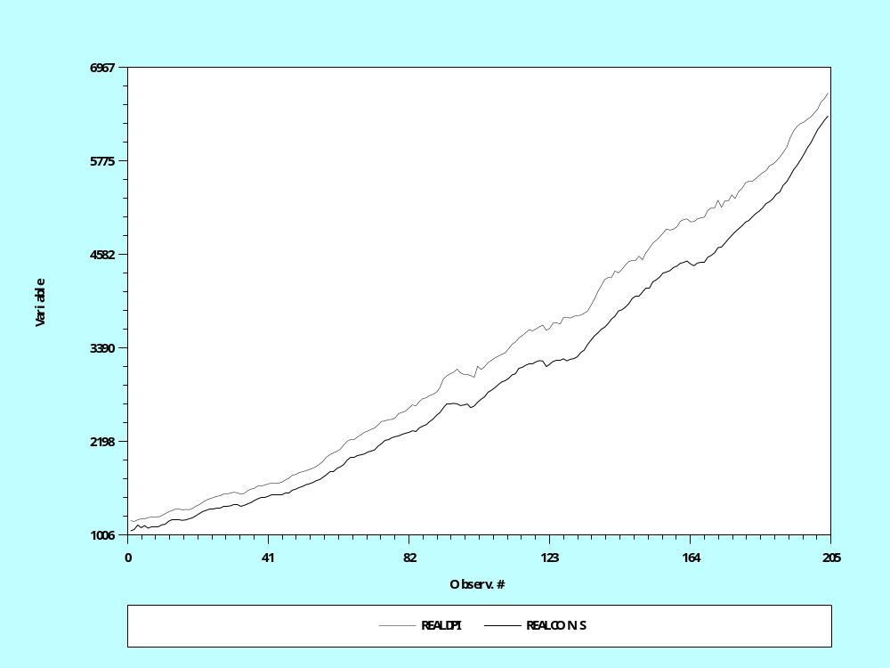
Cointegration: Real DPI and Real Consumption

Slide 23
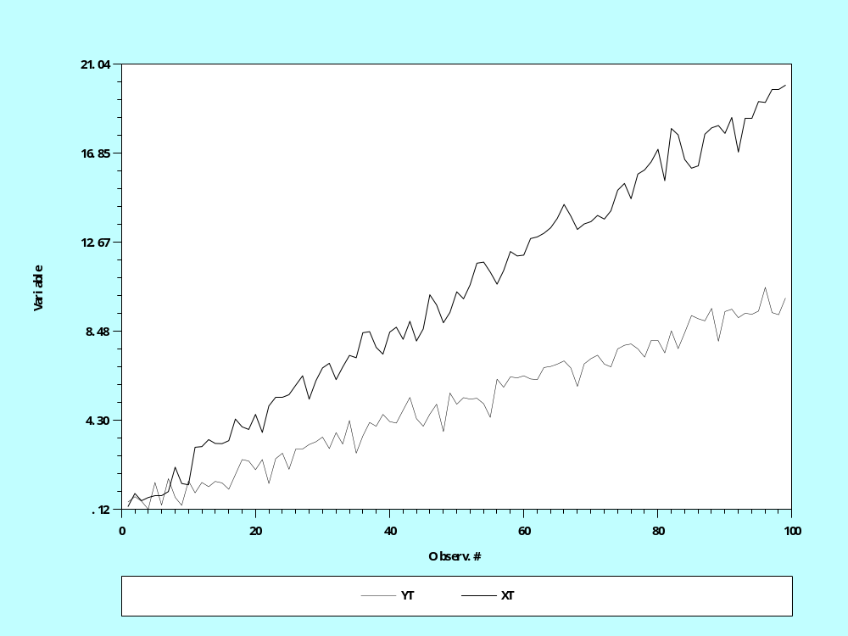
Cointegration – Divergent Series?

Slide 24
Cointegration
X(t) and y(t) are obviously I(1)
Looks like any linear combination of x(t) and y(t) will also be I(1)
Does a model y(t) = bx(t) + u(u) where u(t) is I(0) make any sense? How can u(t) be I(0)?
In fact, there is a linear combination, [1,-β] that is I(0).
y(t) = .1*t + noise, x(t) = .2*t + noise
y(t) and x(t) have a common trend
y(t) and x(t) are cointegrated.

Slide 25
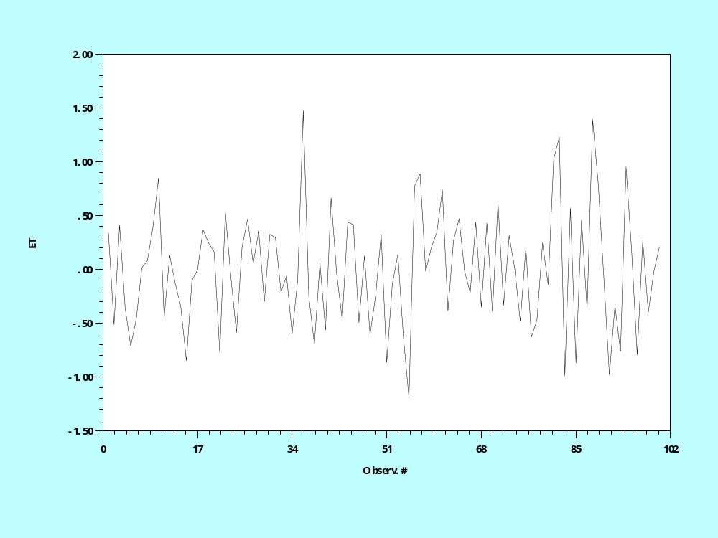
Cointegration and I(0) Residuals

