Slide 1

Econometrics I
Professor William Greene
Stern School of Business
Department of Economics

Slide 2
Econometrics I
Part 3 – Least Squares Algebra

Slide 3
Vocabulary
Some terms to be used in the discussion.
  Population characteristics and entities vs.
  sample quantities and analogs
  Residuals and disturbances
  Population regression line and sample regression
Objective: Learn about the conditional mean function. ‘Estimate’ β and σ²
First step: Mechanics of fitting a line (hyperplane) to a set of data

Slide 4
Fitting Criteria
The set of points in the sample
Fitting criteria - what are they:
  LAD: Minimize_{b} Σ |y – x’b_{LAD}|
  Least squares: Minimize_{b} Σ (y – x’b_{LS})²
  and so on
Why least squares?
A fundamental result:
Sample moments are “good” estimators of
their population counterparts
We will examine this principle and apply it to least squares computation.

Slide 5
An Analogy Principle for Estimating β
In the population E[y | X ] = Xβ so
E[y - Xβ |X] = 0
Continuing (assumed) E[x_{i} ε_{i}] = 0 for every i
Summing, Σ_{i} E[x_{i} ε_{i}] = Σ_{i} 0 = 0
Exchange Σ_{i} and E[] E[Σ_{i} x_{i} ε_{i}] = E[ X′ε ] = 0
E[X′(y - Xβ) ] = 0
So, if Xβ is the conditional mean, then E[X’ε] = 0.
We choose b, the estimator of β, to mimic this population result: i.e., mimic the population mean with the sample mean
Find b such that
As we will see, the solution is the least squares coefficient vector.

Slide 6
Population Moments
We assumed that E[ε_{i}|x_{i}] = 0. (Slide 2:40)
It follows that Cov[x_{i},ε_{i}] = 0.
Proof: Cov(x_{i},ε_{i}) = Cov(x_{i},E[ε_{i} |x_{i}]) = Cov(x_{i},0) = 0.
(Theorem B.2). If E[y_{i}|x_{i}] = x_{i}’β, then
β = (Var[x_{i}])⁻¹ Cov[x_{i},y_{i}].
Proof: Cov[x_{i},y_{i}] = Cov[x_{i},E[y_{i}|x_{i}]]=Cov[x_{i},x_{i}’β]
This will provide a population analog to the statistics we compute with the data.

Slide 7
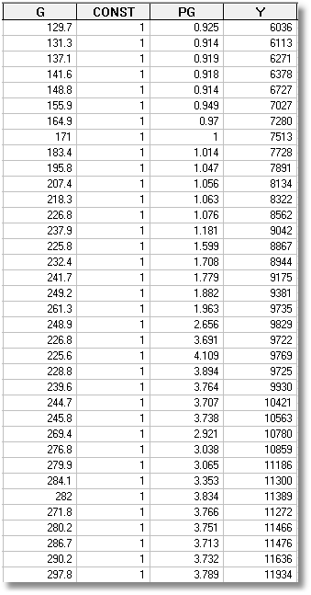
U.S. Gasoline Market, 1960-1995

Slide 8
Least Squares
Example will be, G_{i} regressed on
x_{i} = [1, PG_{i} , Y_{i}]
Fitting criterion: Fitted equation will be
y_{i} = b₁x_{i1} + b₂x_{i2} + ... + b_{K}x_{iK}.
Criterion is based on residuals:
e_{i} = y_{i} - b₁x_{i1} + b₂x_{i2} + ... + b_{K}x_{iK}
Make e_{i} as small as possible.
Form a criterion and minimize it.

Slide 9
Fitting Criteria
Sum of residuals:
Sum of squares:
Sum of absolute values of residuals:
Absolute value of sum of residuals
We focus on now and later

Slide 10
Least Squares Algebra

Slide 11
Least Squares Normal Equations

Slide 12
Least Squares Normal Equations

Slide 13
Least Squares Solution

Slide 14
Second Order Conditions

Slide 15
Side Result: Sample Moments

Slide 16
Does b Minimize e’e?

Slide 17
A Positive Definite Matrix

Slide 18
Algebraic Results - 1

Slide 19
Residuals vs. Disturbances

Slide 20
Algebraic Results - 2
A “residual maker” M = (I - X(X’X)⁻¹X’)
e = y - Xb= y - X(X’X)⁻¹X’y = My
My = The residuals that result when y is regressed on X
MX = 0 (This result is fundamental!)
How do we interpret this result in terms of residuals?
When a column of X is regressed on all of X, we get a
perfect fit and zero residuals.
(Therefore) My = MXb + Me = Me = e
(You should be able to prove this.
y = Py + My, P = X(X’X)⁻¹X’ = (I - M).
PM = MP = 0.
Py is the projection of y into the column space of X.

Slide 21
The M Matrix
M = I- X(X’X)⁻¹X’ is an nxn matrix
M is symmetric – M = M’
M is idempotent – M*M = M
(just multiply it out)
M is singular; M⁻¹ does not exist.
(We will prove this later as a side result in another derivation.)

Slide 22
Results when X Contains a Constant Term
X = [1,x₂,…,x_{K}]
The first column of X is a column of ones
Since X’e = 0, x₁’e = 0 – the residuals sum to zero.

Slide 23
U.S. Gasoline Market, 1960-1995

Slide 24
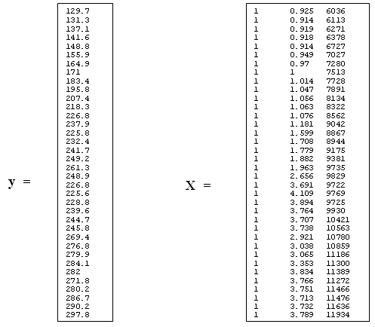
Least Squares Algebra

Slide 25
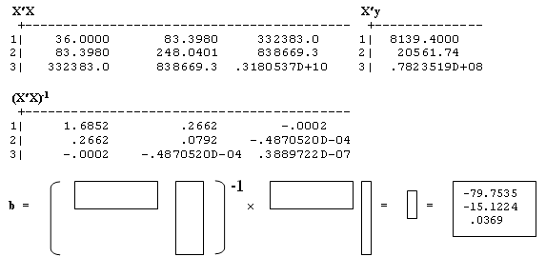
Least Squares

Slide 26
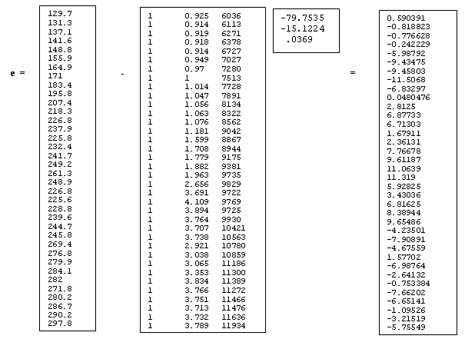
Residuals

Slide 27
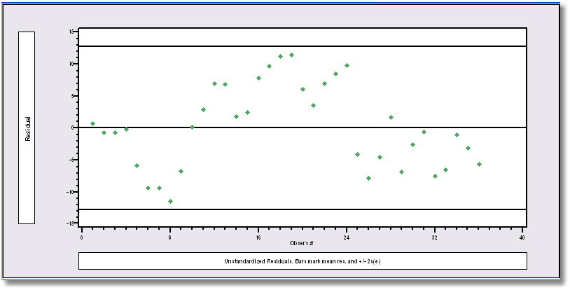
Least Squares Residuals (autocorrelated)

Slide 28
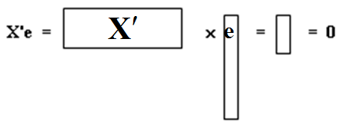
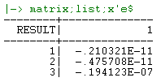
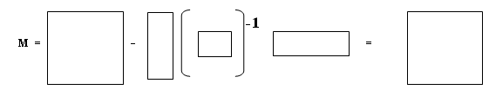
Least Squares Algebra-3
M is n × n potentially huge

Slide 29
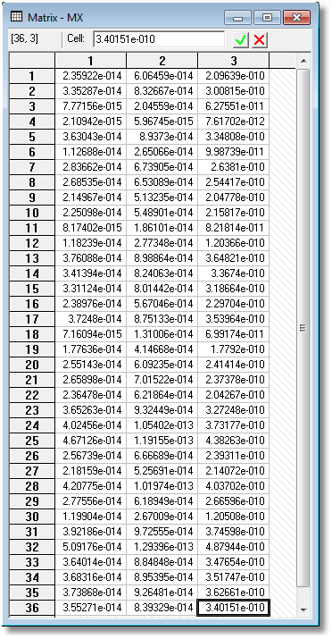
Least Squares Algebra-4
MX =

