Slide 1

Econometrics I
Professor William Greene
Stern School of Business
Department of Economics

Slide 2
Econometrics I
Part 4 – Partial Regression
and Partial Correlation

Slide 3
Frisch-Waugh (1933) ‘Theorem’
Context: Model contains two sets of variables:
X = [ (1,time) : (other variables)]
= [X₁ X₂]
Regression model:
y = X₁β₁ + X₂β₂ + ε (population)
= X₁b₁ + X₂b₂ + e (sample)
Problem: Algebraic expression for the second set of least squares coefficients, b₂

Slide 4
Partitioned Solution
Method of solution (Why did F&W care? In 1933, matrix computation was not trivial!)
Direct manipulation of normal equations produces

Slide 5
Partitioned Solution
Direct manipulation of normal equations produces
b₂ = (X₂′X₂)⁻¹X₂′(y - X₁b₁)
What is this? Regression of (y - X₁b₁) on X₂
If we knew b₁, this is the solution for b₂.
Important result (perhaps not fundamental). Note the result if X₂′X₁ = 0.
Useful in theory: Probably
Likely in practice? Not at all.
Notes:
5

Slide 6
Partitioned Inverse
Use of the partitioned inverse result produces a fundamental result: What is the southeast element in the inverse of the moment matrix?

Slide 7
Partitioned Inverse
The algebraic result is:
[ ]⁻¹_{(2,2)} = {[X₂’X₂] - X₂’X₁(X₁’X₁)⁻¹ X₁’X₂}⁻¹
= [X₂’(I - X₁(X₁’X₁)⁻¹X₁’)X₂]⁻¹
= [X₂’M₁X₂]⁻¹
Note the appearance of an “M” matrix. How do we interpret this result?
Note the implication for the case in which X₁ is a single variable. (Theorem, p. 37)
Note the implication for the case in which X₁ is the constant term. (p. 38)

Slide 8
Frisch-Waugh (1933) Basic Result
Lovell (JASA, 1963) did the matrix algebra.
Continuing the algebraic manipulation:
b₂ = [X₂’M₁X₂]⁻¹[X₂’M₁y].
This is Frisch and Waugh’s famous result - the “double residual regression.”
How do we interpret this? A regression of residuals on residuals.
“We get the same result whether we (1) detrend the other variables by using the residuals from a regression of them on a constant and a time trend and use the detrended data in the regression or (2) just include a constant and a time trend in the regression and not detrend the data”
“Detrend the data” means compute the residuals from the regressions of the variables on a constant and a time trend.

Slide 9
Important Implications
Isolating a single coefficient in a regression. (Corollary 3.2.1, p. 37). The double residual regression.
Regression of residuals on residuals – ‘partialling’ out the effect of the other variables.
It is not necessary to ‘partial’ the other Xs out of y because M₁ is idempotent. (This is a very useful result.) (i.e., X₂′M₁’M₁y = X₂′M₁y)
(Orthogonal regression) Suppose X₁ and X₂ are orthogonal; X₁′X₂ = 0. What is M₁X₂?

Slide 10
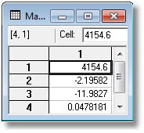
Applying Frisch-Waugh
Using gasoline data from Notes 3.
X = [1, year, PG, Y], y = G as before.
Full least squares regression of y on X.
Partitioned regression strategy:
1. Regress PG and Y on (1,Year) (detrend them) and compute
residuals PG* and Y*
2. Regress G on (1,Year) and compute residuals G*. (This step
is not actually necessary.)
3. Regress G* on PG* and Y*. (Should produce -11.9827 and
0.0478181.

Slide 11
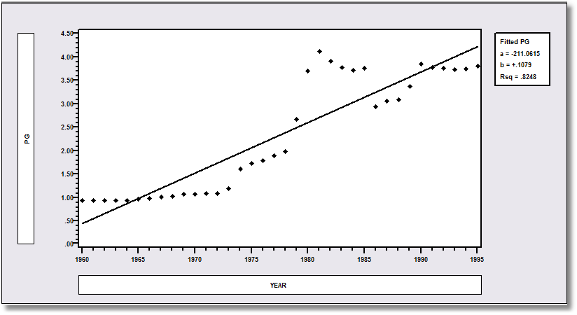
Detrending the Variables – Pg
Pg* are the residuals from this regression

Slide 12
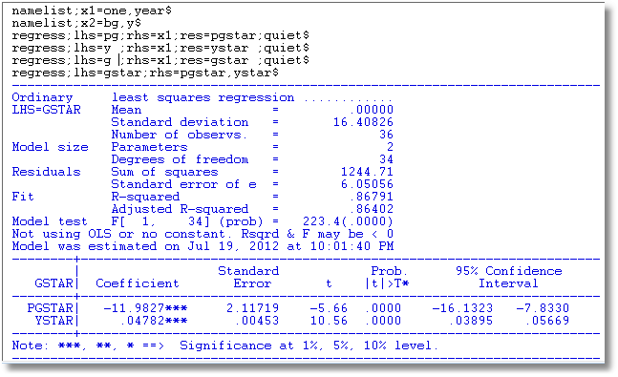
Regression of detrended G on detrended Pg and detrended Y

Slide 13
Partial Regression
Important terms in this context:
Partialing out the effect of X₁.
Netting out the effect …
“Partial regression coefficients.”
To continue belaboring the point: Note the interpretation of partial
regression as “net of the effect of …”
This is the (very powerful) Frisch – Waugh Theorem. This is what is
meant by “controlling for the effect of X₁.”
Now, follow this through for the case in which X₁ is just a constant term, column of ones.
What are the residuals in a regression on a constant. What is M₁?
Note that this produces the result that we can do linear regression on data in mean deviation form.
'Partial regression coefficients' are the same as 'multiple regression coefficients.' It follows from the Frisch-Waugh theorem.

Slide 14
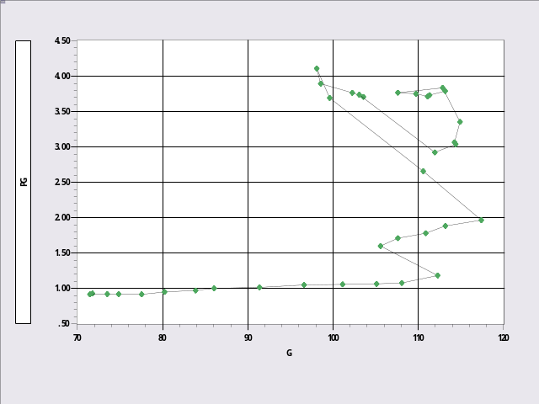
Partial Correlation
Working definition. Correlation between sets of residuals.
Some results on computation: Based on the M matrices.
Some important considerations:
Partial correlations and coefficients can have signs and
magnitudes that differ greatly from gross correlations and
simple regression coefficients.
Compare the simple (gross) correlation of G and PG with the partial correlation, net of the time effect. (Could you have predicted the negative partial correlation?)
CALC;list;Cor(g,pg)$
Result = .7696572
CALC;list;cor(gstar,pgstar)$
Result = -.6589938

Slide 15
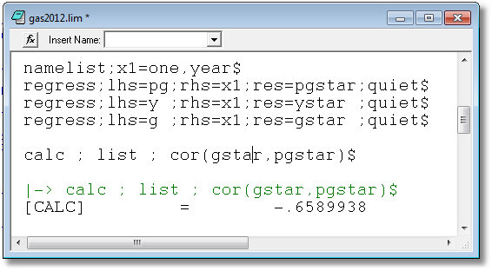
Partial Correlation

Slide 16
THE Most Famous Application of
Frisch-Waugh: The Fixed Effects Model
A regression model with a dummy variable for
each individual in the sample, each observed T_{i} times.
There is a constant term for each individual.
y_{i} = X_{i}β + d_{i}α_{i} + ε_{i}, for each individual
N columns
N may be thousands. I.e., the regression has thousands of variables (coefficients).

Slide 17
Application – Health and Income
German Health Care Usage Data, 7,293 Individuals,
Varying Numbers of Periods
Variables in the file are
Data downloaded from Journal of Applied Econometrics Archive. This is an unbalanced panel with N = 7,293 individuals. There are altogether n = 27,326 observations. The number of observations ranges from 1 to 7 per family.
(Frequencies are: 1=1525, 2=2158, 3=825, 4=926, 5=1051, 6=1000, 7=987).
The dependent variable of interest is
DOCVIS = number of visits to the doctor in the observation period
HHNINC = household nominal monthly net income in German marks / 10000.
(4 observations with income=0 were dropped)
HHKIDS = children under age 16 in the household = 1; otherwise = 0
EDUC = years of schooling
AGE = age in years
We desire also to include a separate family effect (7293 of them) for each family. This requires 7293 dummy variables in addition to the four regressors.

Slide 18
Estimating the Fixed Effects Model
The FE model is a linear regression model with many independent variables

Slide 19
Fixed Effects Estimator (cont.)

Slide 20
Fixed Effects Estimator (cont.)

Slide 21
‘Within’ Transformations

Slide 22
Least Squares Dummy Variable Estimator
b is obtained by ‘within’ groups least squares (group mean deviations)
Normal equations for a are D’Xb+D’Da=D’y
a = (D’D)⁻¹D’(y – Xb) (see slide 5)

Slide 23
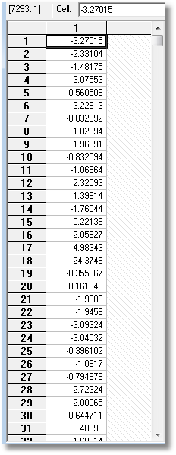
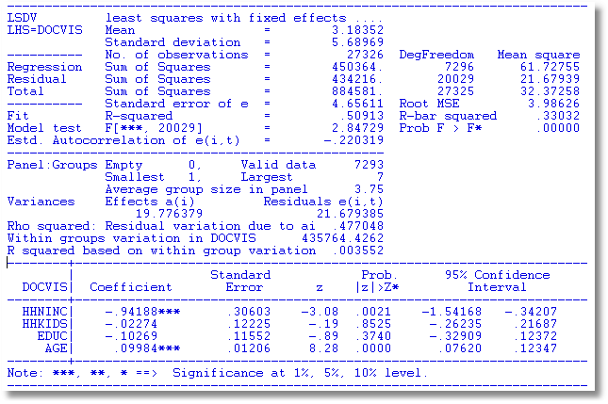
A Fixed Effects Regression
Constant terms

Slide 24
What happens to a time invariant variable such as gender?

Slide 25
