Slide 1

Econometrics I
Professor William Greene
Stern School of Business
Department of Economics

Slide 2
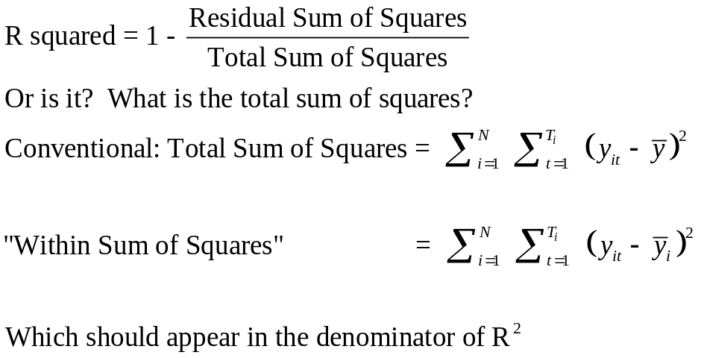
A Caution About Stata and R²
For the FE model above,
R² = 0.90542
R² = 0.65142
The coefficient estimates and standard errors are the same. The calculation of the R² is different. In the areg procedure, you are estimating coefficients for each of your covariates plus each dummy variable for your groups. In the xtreg, fe procedure the R² reported is obtained by only fitting a mean deviated model where the effects of the groups (all of the dummy variables) are assumed to be fixed quantities. So, all of the effects for the groups are simply subtracted out of the model and no attempt is made to quantify their overall effect on the fit of the model.
Since the SSE is the same, the R²=1−SSE/SST is very different. The difference is real in that we are making different assumptions with the two approaches. In the xtreg, fe approach, the effects of the groups are fixed and unestimated quantities are subtracted out of the model before the fit is performed. In the areg approach, the group effects are estimated and affect the total sum of squares of the model under consideration.

Slide 3
Econometrics I
Part 5 – Regression
Algebra and Fit;
Restricted Least Squares

Slide 4
Minimizing e′e
b minimizes e′e = (y - Xb)′(y - Xb).
Any other coefficient vector has a larger sum of squared residuals.
Proof:
d = the vector, not equal to b; u = Xd
u = y – Xd = y – Xb + Xb – Xd
= e - X(d - b).
Then, u′u = (y - Xd)′(y-Xd) = sum of squares using d
= [(y – Xb) - X(d - b)]′[(y – Xb) - X(d - b)]
= [e - X(d - b)]′[e - X(d - b)]
Expand to find u′u = e′e + (d-b)′X′X(d-b)
(The cross product term is 2e′X(d-b)=0 as X’e = 0.)
= e’e + v’v > e′e

Slide 5
Dropping a Variable
An important special case. Suppose
b_{X,z} = [b,c]
= the regression coefficients in a regression of y on [X,z]
b_{X} = [d,0]
= is the same, but computed to force the coefficient on z
to equal 0. This removes z from the regression.
We are comparing the results that we get with and without the variable z in the equation. Results which we can show:
• Dropping a variable(s) cannot improve the fit - that is, it cannot reduce the sum of squared residuals.
• Adding a variable(s) cannot degrade the fit - that is, it cannot increase the sum of squared residuals.

Slide 6
Adding a Variable Never Increases the Sum of Squares
Theorem 3.5 on text page 40.
u = the residual in the regression of y on [X,z]
e = the residual in the regression of y on X alone,
u′u = e′e – c²(z*′z*) ≤ e′e
where z* = M_{X}z and c is the coefficient on
z in the regression of y on [X,z].

Slide 7
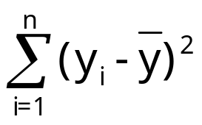
The Fit of the Regression
“Variation:” In the context of the “model” we speak of covariation of a variable as movement of the variable, usually associated with (not necessarily caused by) movement of another variable.
Total variation = = y′M⁰y.
M⁰ = I – i(i’i)⁻¹i’
= the M matrix for
X = a column of ones.

Slide 8
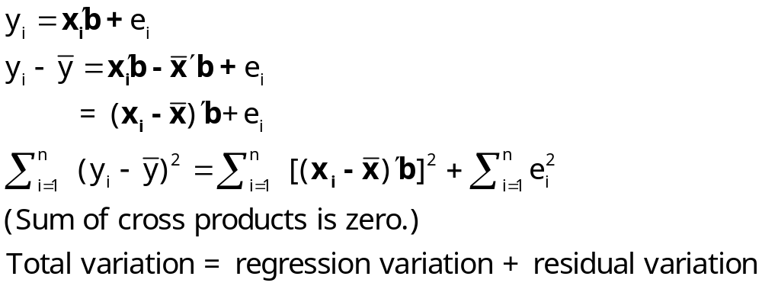
Decomposing the Variation
Recall the decomposition:
Var[y] = Var [E[y|x]] + E[Var [ y | x ]]
= Variation of the conditional mean around the overall mean
+ Variation around the conditional mean function.

Slide 9
Decomposing the Variation of Vector y
Decomposition: (This all assumes the model contains a constant term. one of the columns in X is i.)
y = Xb + e so
M⁰y = M⁰Xb + M⁰e = M⁰Xb + e.
(Deviations from means.)
y′M⁰y = b′(X’ M⁰)(M⁰X)b + e′e
= b′X′M⁰Xb + e′e.
(M⁰ is idempotent and e’ M⁰X = e’X = 0.)
Total sum of squares = Regression Sum of Squares (SSR)+
Residual Sum of Squares (SSE)

Slide 10
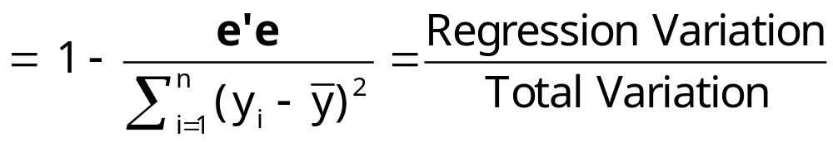
A Fit Measure
R² = b′X′M⁰Xb/y′M⁰y
(Very Important Result.) R² is bounded by zero and one only if:
  (a) There is a constant term in X and
  (b) The line is computed by linear least squares.

Slide 11
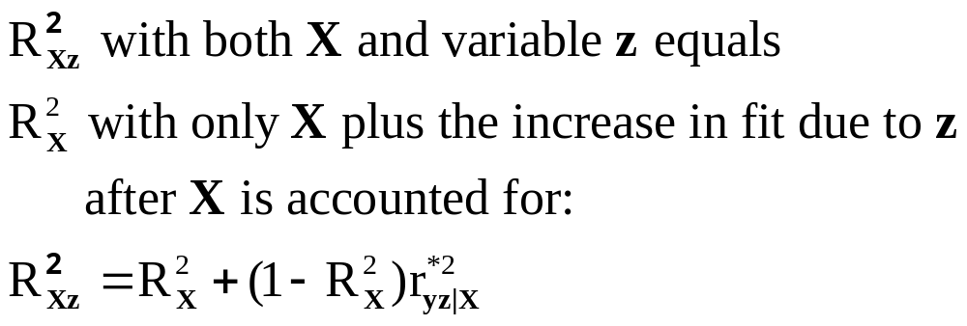
Adding Variables
R² never falls when a variable z is added to the regression.
A useful general result for adding a variable
Useful practical wisdom: It is not possible meaningfully to accumulate R² by adding variables in sequence. The incremental fit added by each variable depends on the order. The increase in R² that occurs from x₃ in (x₁ then x₂ then x₃) is different from that in
(x₁ then x₃ then x₂).

Slide 12
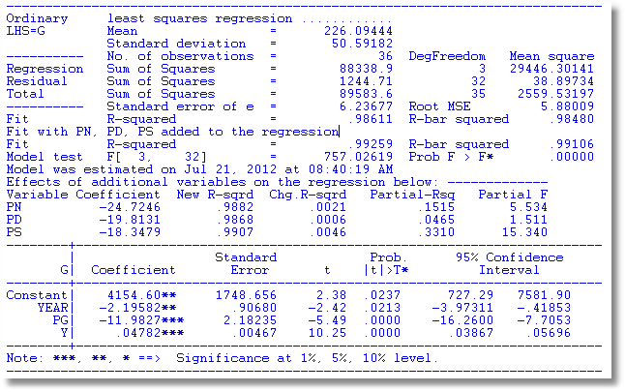
Adding Variables to a Model
What is the effect of adding PN, PD, PS?

Slide 13

A Useful Result
Squared partial correlation of an x in X with y is
We will define the 't-ratio' and 'degrees of freedom' later. Note how it enters:

Slide 14
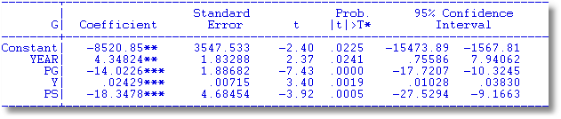
Partial Correlation
Partial correlation is a difference in R²s.
For PS in the example above,
R² without PS = .9861, R² with PS = .9907
(.9907 - .9861) / (1 - .9861) = .331
3.92² / (3.92² + (36-5)) = .331

Slide 15
Comparing fits of regressions
Make sure the denominator in R² is the same - i.e., same left hand side variable. Example, linear vs. loglinear. Loglinear will almost always appear to fit better because taking logs reduces variation.

Slide 16
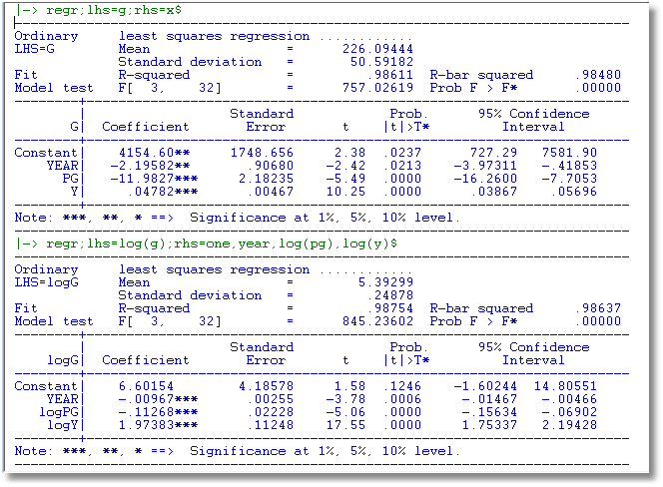

Slide 17
(Linearly) Transformed Data
How does linear transformation affect the results of least squares? Z = XP for K×K nonsingular P
Based on X, b = (X′X)⁻¹X’y.
Based on Z, c = (Z′Z)⁻¹Z’y = (P’X′XP)⁻¹P’X’y
= P⁻¹(X’X)⁻¹P’⁻¹P’X’y = P⁻¹b
  “Fitted value” is Zc = (XP)(P⁻¹b) = Xb. The same!!
Residuals from using Z are y - Zc = y - Xb (we just proved this.). The same!!
  Sum of squared residuals must be identical, as y-Xb = e = y-Zc.
  R² must also be identical, as R² = 1 - e′e/y’M⁰y (!!).

Slide 18
Linear Transformation
What are the practical implications of this result?
  (1) Transformation does not affect the fit of a model to a body of data.
  (2) Transformation does affect the “estimates.” If b is an estimate of something (β), then c cannot be an estimate of β - it must be an estimate of P⁻¹β, which might have no meaning at all.
  Xb is the projection of y into the column space of X. Zc is the projection of y into the column space of Z. But, since the columns of Z are just linear combinations of those of X, the column space of Z must be identical to that of X. Therefore, the projection of y into the former must be the same as the latter, which now produces the other results.)

Slide 19
Principal Components
Z = XC
  Fewer columns than X
  Includes as much ‘variation’ of X as possible
  Columns of Z are orthogonal
Why do we do this?
  Collinearity
  Combine variables of ambiguous identity such as test scores as measures of ‘ability’

Slide 20
What is a Principal Component?
X = a data matrix (deviations from means)
z = Xp = a linear combination of the columns of X.
Choose p to maximize the variation of z.
How? p = eigenvector that corresponds to the largest eigenvalue of X’X. (Notes 7:41-44.)

Slide 21


Slide 22
+----------------------------------------------------+
| Movie Regression. Opening Week Box for 62 Films |
| Ordinary least squares regression |
| LHS=LOGBOX Mean = 16.47993 |
| Standard deviation = .9429722 |
| Number of observs. = 62 |
| Residuals Sum of squares = 20.54972 |
| Standard error of e = .6475971 |
| Fit R-squared = .6211405 |
| Adjusted R-squared = .5283586 |
+----------------------------------------------------+
+--------+--------------+----------------+--------+--------+----------+
|Variable| Coefficient | Standard Error |t-ratio |P[|T|>t]| Mean of X|
+--------+--------------+----------------+--------+--------+----------+
|Constant| 12.5388*** .98766 12.695 .0000 |
|LOGBUDGT| .23193 .18346 1.264 .2122 3.71468|
|STARPOWR| .00175 .01303 .135 .8935 18.0316|
|SEQUEL | .43480 .29668 1.466 .1492 .14516|
|MPRATING| -.26265* .14179 -1.852 .0700 2.96774|
|ACTION | -.83091*** .29297 -2.836 .0066 .22581|
|COMEDY | -.03344 .23626 -.142 .8880 .32258|
|ANIMATED| -.82655** .38407 -2.152 .0363 .09677|
|HORROR | .33094 .36318 .911 .3666 .09677|
|4 INTERNET BUZZ VARIABLES
|LOGADCT | .29451** .13146 2.240 .0296 8.16947|
|LOGCMSON| .05950 .12633 .471 .6397 3.60648|
|LOGFNDGO| .02322 .11460 .203 .8403 5.95764|
|CNTWAIT3| 2.59489*** .90981 2.852 .0063 .48242|
+--------+------------------------------------------------------------+

Slide 23
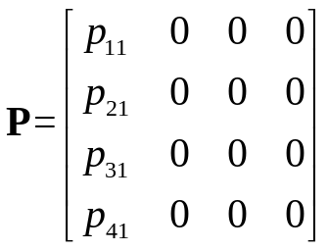
The fit goes down when the 4 buzz variables are reduced to a single linear combination of the 4.
+----------------------------------------------------+
| Ordinary least squares regression |
| LHS=LOGBOX Mean = 16.47993 |
| Standard deviation = .9429722 |
| Number of observs. = 62 |
| Residuals Sum of squares = 25.36721 |
| Standard error of e = .6984489 |
| Fit R-squared = .5323241 |
| Adjusted R-squared = .4513802 |
+----------------------------------------------------+
+--------+--------------+----------------+--------+--------+----------+
|Variable| Coefficient | Standard Error |t-ratio |P[|T|>t]| Mean of X|
+--------+--------------+----------------+--------+--------+----------+
|Constant| 11.9602*** .91818 13.026 .0000 |
|LOGBUDGT| .38159** .18711 2.039 .0465 3.71468|
|STARPOWR| .01303 .01315 .991 .3263 18.0316|
|SEQUEL | .33147 .28492 1.163 .2500 .14516|
|MPRATING| -.21185 .13975 -1.516 .1356 2.96774|
|ACTION | -.81404** .30760 -2.646 .0107 .22581|
|COMEDY | .04048 .25367 .160 .8738 .32258|
|ANIMATED| -.80183* .40776 -1.966 .0546 .09677|
|HORROR | .47454 .38629 1.228 .2248 .09677|
|PCBUZZ | .39704*** .08575 4.630 .0000 9.19362|
+--------+------------------------------------------------------------+

Slide 24
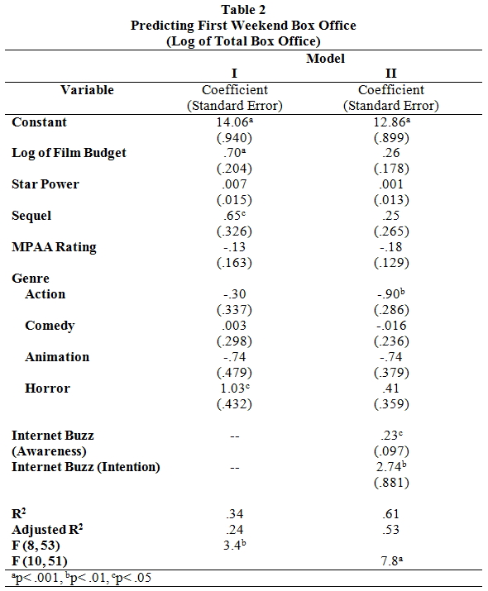


Slide 25
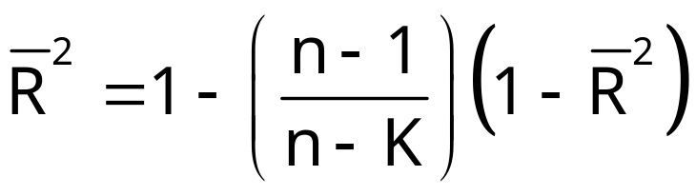
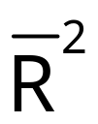
Adjusted R Squared
Adjusted R² (adjusted for degrees of freedom)
Degrees of freedom” adjustment.
includes a penalty for variables that don’t add much fit. Can fall when a variable is added to the equation.

Slide 26
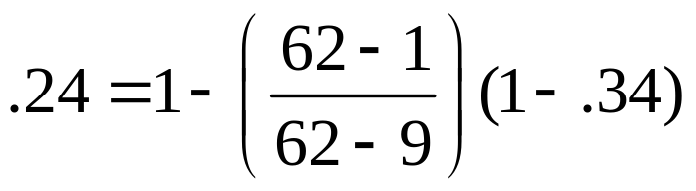

Slide 27


Adjusted R²
What is being adjusted?
The penalty for using up degrees of freedom.
= 1 - [e′e/(n – K)]/[y′M⁰y/(n-1)]
= 1 – [(n-1)/(n-K)(1 – R²)]
Will rise when a variable is added to the regression?
is higher with z than without z if and only if the t ratio on z is in the regression when it is added is larger than one in absolute value. (See p. 46 in text.)

Slide 28
Full Regression (Without PD)
----------------------------------------------------------------------
Ordinary least squares regression ............
LHS=G Mean = 226.09444
Standard deviation = 50.59182
Number of observs. = 36
Model size Parameters = 9
Degrees of freedom = 27
Residuals Sum of squares = 596.68995
Standard error of e = 4.70102
Fit R-squared = .99334 <**********
Adjusted R-squared = .99137 <**********
Info criter. LogAmemiya Prd. Crt. = 3.31870 <**********
Akaike Info. Criter. = 3.30788 <**********
Model test F[ 8, 27] (prob) = 503.3(.0000)
--------+-------------------------------------------------------------
Variable| Coefficient Standard Error t-ratio P[|T|>t] Mean of X
--------+-------------------------------------------------------------
Constant| -8220.38** 3629.309 -2.265 .0317
PG| -26.8313*** 5.76403 -4.655 .0001 2.31661
Y| .02214*** .00711 3.116 .0043 9232.86
PNC| 36.2027 21.54563 1.680 .1044 1.67078
PUC| -6.23235 5.01098 -1.244 .2243 2.34364
PPT| 9.35681 8.94549 1.046 .3048 2.74486
PN| 53.5879* 30.61384 1.750 .0914 2.08511
PS| -65.4897*** 23.58819 -2.776 .0099 2.36898
YEAR| 4.18510** 1.87283 2.235 .0339 1977.50
--------+-------------------------------------------------------------

Slide 29
PD added to the model. R² rises, Adjusted R² falls
----------------------------------------------------------------------
Ordinary least squares regression ............
LHS=G Mean = 226.09444
Standard deviation = 50.59182
Number of observs. = 36
Model size Parameters = 10
Degrees of freedom = 26
Residuals Sum of squares = 594.54206
Standard error of e = 4.78195
Fit R-squared = .99336 Was 0.99334
Adjusted R-squared = .99107 Was 0.99137
--------+-------------------------------------------------------------
Variable| Coefficient Standard Error t-ratio P[|T|>t] Mean of X
--------+-------------------------------------------------------------
Constant| -7916.51** 3822.602 -2.071 .0484
PG| -26.8077*** 5.86376 -4.572 .0001 2.31661
Y| .02231*** .00725 3.077 .0049 9232.86
PNC| 30.0618 29.69543 1.012 .3207 1.67078
PUC| -7.44699 6.45668 -1.153 .2592 2.34364
PPT| 9.05542 9.15246 .989 .3316 2.74486
PD| 11.8023 38.50913 .306 .7617 1.65056 (NOTE LOW t ratio)
PN| 47.3306 37.23680 1.271 .2150 2.08511
PS| -60.6202** 28.77798 -2.106 .0450 2.36898
YEAR| 4.02861* 1.97231 2.043 .0514 1977.50
--------+-------------------------------------------------------------

Slide 30
Linear Least Squares Subject to Restrictions
Restrictions: Theory imposes certain restrictions on parameters.
Some common applications
• Dropping variables from the equation = certain coefficients in b forced to equal 0. (Probably the most common testing situation. “Is a certain variable significant?”)
• Adding up conditions: Sums of certain coefficients must equal fixed values. Adding up conditions in demand systems. Constant returns to scale in production functions.
• Equality restrictions: Certain coefficients must equal other coefficients. Using real vs. nominal variables in equations.
General formulation for linear restrictions:
Minimize the sum of squares, e′e, subject to the linear constraint
Rb = q.

Slide 31
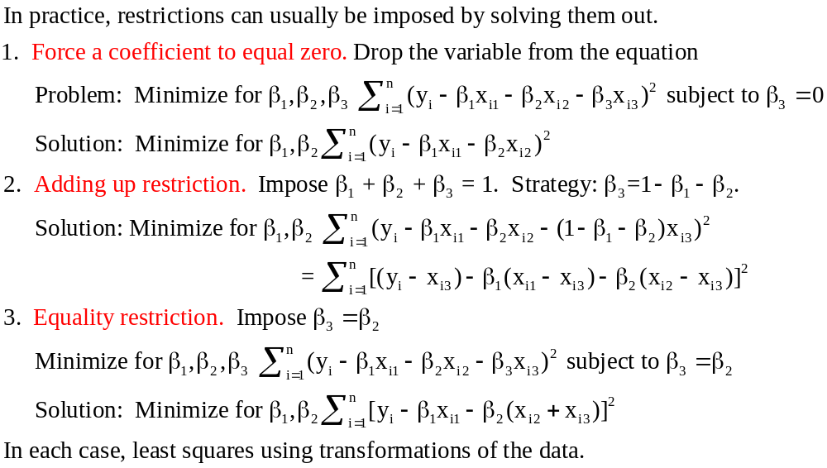
Restricted Least Squares

Slide 32
Restricted Least Squares Solution
General Approach: Programming Problem
Minimize for β L = (y - Xβ)′(y - Xβ)
subject to Rβ = q
Each row of R is the K coefficients in a restriction.
There are J restrictions: J rows
β₃ = 0: R = [0,0,1,0,…] q = (0). J=1
β₂ = β₃: R = [0,1,-1,0,…] q = (0). J=1
β₂ = 0, β₃ = 0: R = 0,1,0,0,… q = 0 J=2
0,0,1,0,… 0

Slide 33
Solution Strategy
Quadratic program: Minimize quadratic criterion subject to linear restrictions
All restrictions are binding
Solve using Lagrangean formulation
Minimize over (β,λ)
L* = (y - Xβ)′(y - Xβ) + 2λ′(Rβ-q)
(The 2 is for convenience – see below.)

Slide 34
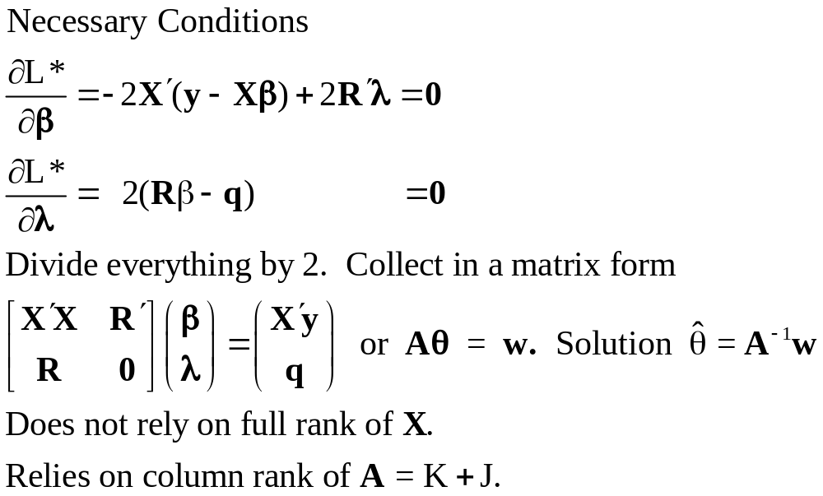
Restricted LS Solution

Slide 35
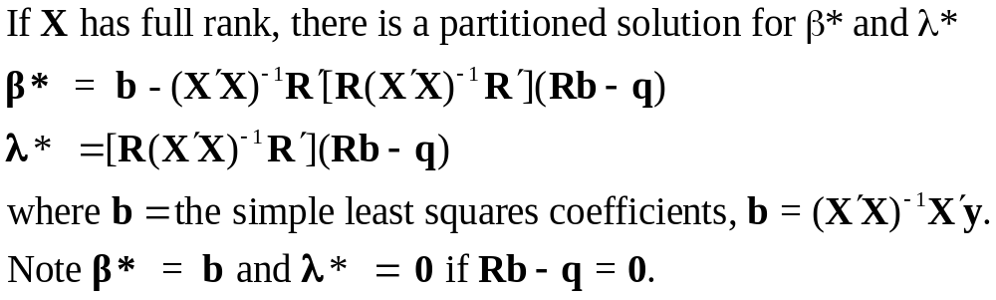
Restricted Least Squares

Slide 36
Aspects of Restricted LS
1. b* = b - Cm where
m = the “discrepancy vector” Rb - q.
Note what happens if m = 0.
What does m = 0 mean?
2. λ=[R(X′X)⁻¹R′]⁻¹(Rb - q) = [R(X′X)⁻¹R′]⁻¹m.
When does λ = 0. What does this mean?
3. Combining results: b* = b - (X′X)⁻¹R′λ.
How could b* = b?

Slide 37
