Slide 1

Econometrics I
Professor William Greene
Stern School of Business
Department of Economics

Slide 2
Econometrics I
Part 6 – Dummy Variables
and Functional Form

Slide 3
Agenda
Dummy variables
Interaction
Categorical variables and transition tables
Nonlinear functional form
Differences
Difference in differences
Regression discontinuity
Kinked regression

Slide 4
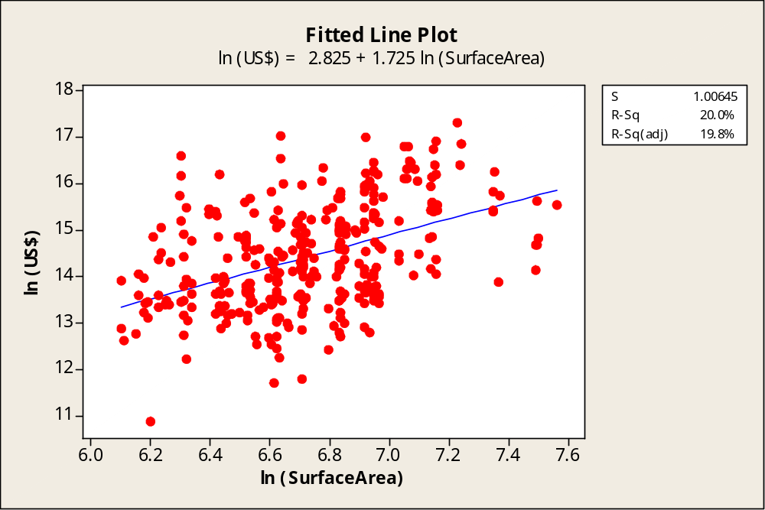

Monet in Large and Small
Sale prices of 328 signed Monet paintings
Log of $price = a + b log surface area + e

Slide 5
How Much for the Signature?
The sample also contains 102 unsigned paintings
Average Sale Price
Signed $3,364,248
Not signed $1,832,712
Average price of a signed Monet is almost twice that of an unsigned one.

Slide 6
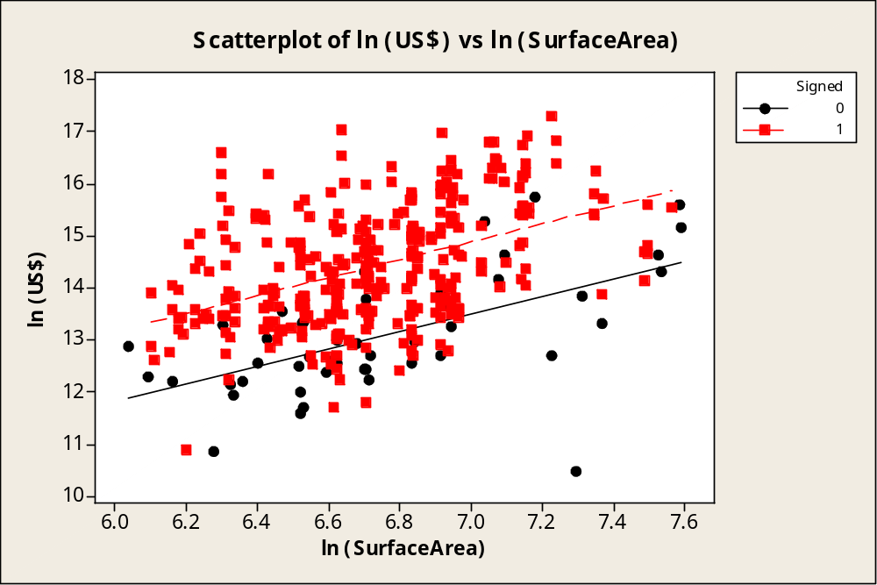
A Multiple Regression
d
Ln Price = a + b × ln Area + d × (0 if unsigned, 1 if signed) + e

Slide 7
Monet Multiple Regression
Regression Analysis: ln (US$) versus ln (SurfaceArea), Signed
The regression equation is
ln (US$) = 4.12 + 1.35 ln (SurfaceArea) + 1.26 Signed
Predictor Coef SE Coef T P
Constant 4.1222 0.5585 7.38 0.000
ln (SurfaceArea) 1.3458 0.08151 16.51 0.000
Signed 1.2618 0.1249 10.11 0.000
S = 0.992509 R-Sq = 46.2% R-Sq(adj) = 46.0%
Interpretation:
(1) Elasticity of price with respect to surface area is 1.3458 – very large
(2) The signature multiplies the price of a painting by exp(1.2618) (about
3.5), for any given size.

Slide 8
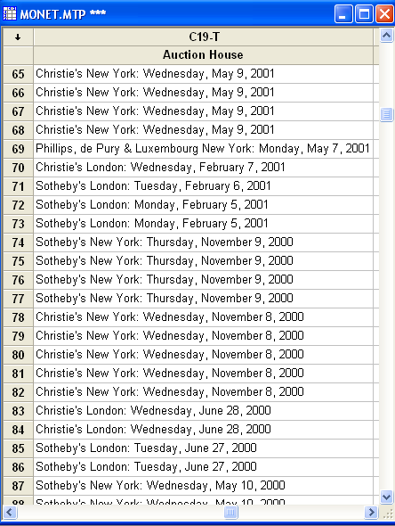
A Conspiracy Theory for Art Sales at Auction
Sotheby’s and Christies, 1995 to about 2000 conspired on commission rates.

Slide 9
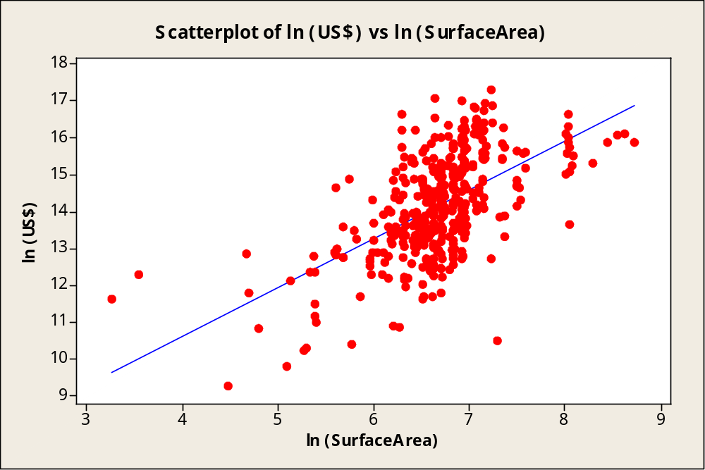
If the Theory is Correct…
Sold from 1995 to 2000
Sold before 1995 or after 2000

Slide 10
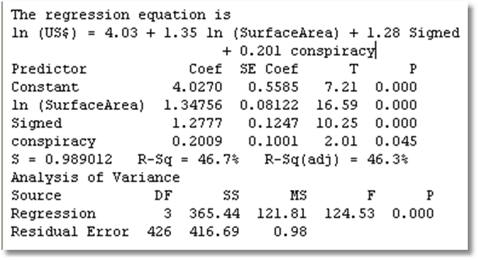
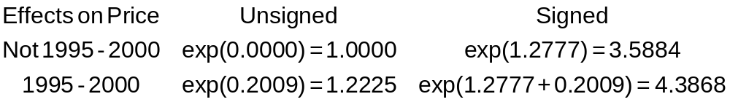
Evidence
The statistical evidence seems to be consistent with the theory.

Slide 11
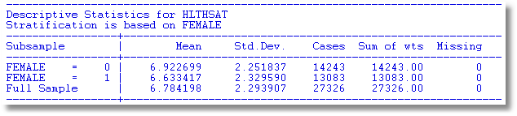
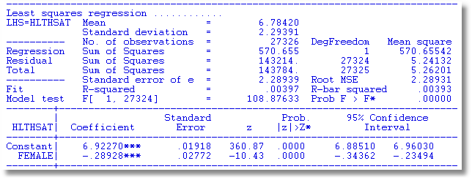
Women appear to assess health satisfaction differently from men.

Slide 12
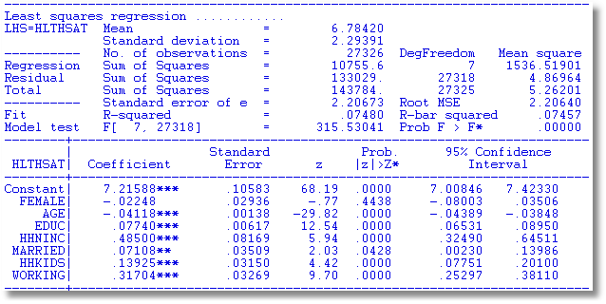
Or do they? Not when other things are held constant

Slide 13
Dummy Variable for One Observation
A dummy variable that isolates a single observation. What does this do?
Define d to be the dummy variable in question.
Z = all other regressors. X = [Z,d]
Multiple regression of y on X. We know that
X'e = 0 where e = the column vector of
residuals. That means d'e = 0, which says that e_{j} = 0 for that particular residual. The observation will be predicted perfectly.
Fairly important result. Important to know.

Slide 14
I have a simple question for you. Yesterday, I was estimating a regional production function with yearly dummies. The coefficients of the dummies are usually interpreted as a measure of technical change with respect to the base year (excluded dummy variable). However, I felt that it could be more interesting to redefine the dummy variables in such a way that the coefficient could measure technical change from one year to the next. You could get the same result by subtracting two coefficients in the original regression but you would have to compute the standard error of the difference if you want to do inference.
Is this a well known procedure? YES

Slide 15
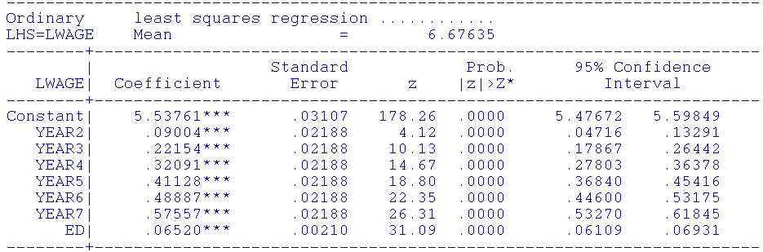
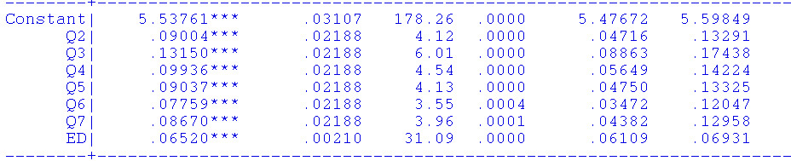

Slide 16
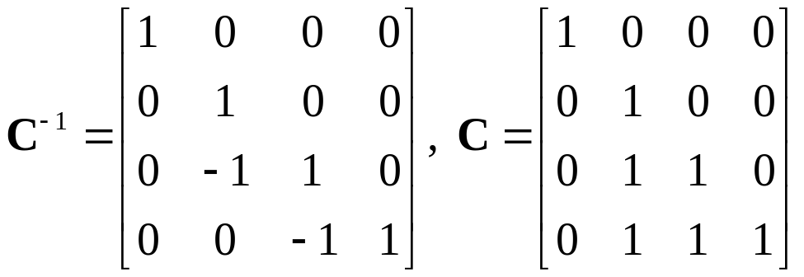
Example with 4 Periods
The estimated model with time dummies is
y = a +b₂*d₂+ b₃*d₃ + b₄*d₄ + e (possibly some other variables, not needed now).
Estimated least squares coefficients are
b = a, b₂, b₃, b₄
Desired coefficients are
c = a, b₂, b₃ – b₂, b₄ – b₃
The original model is y = Xb + e.
The new model would be y = (XC)(C⁻¹b) + e = Qc + e
The transformation of the data is Q = XC. c = C⁻¹b
The transformed X is [1,d₂+d₃+d₄, d₃+d₄.d₄]

Slide 17
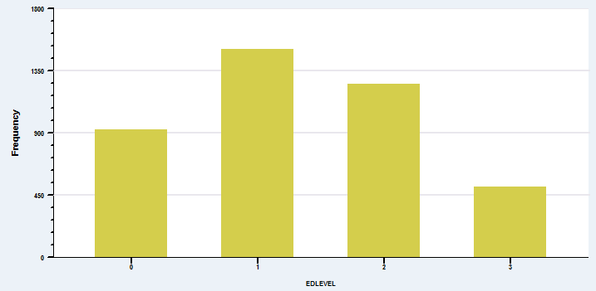
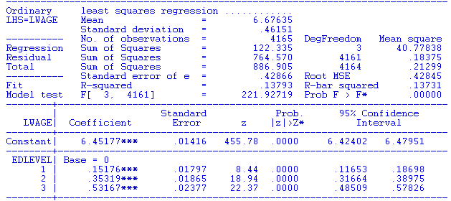
A Categorical Variable

Slide 18
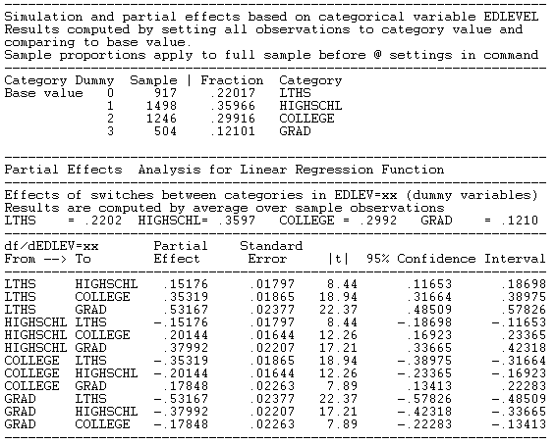

Slide 19

Nonlinear Specification:
Quadratic Effect of Experience

Slide 20
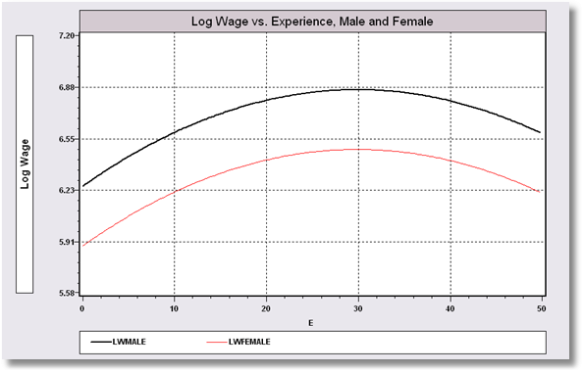
Model Implication: Effect of Experience and Male vs. Female

Slide 21
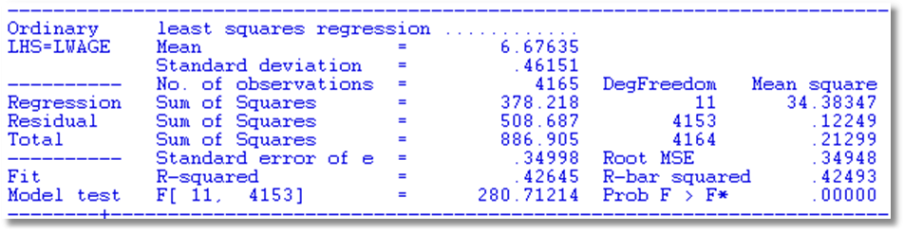
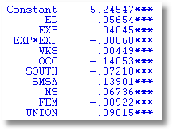
Partial Effect of Experience:
Coefficients do not tell the story
Education: .05654
Experience: .04045 - 2*.00068*Exp
FEM: -.38922

Slide 22
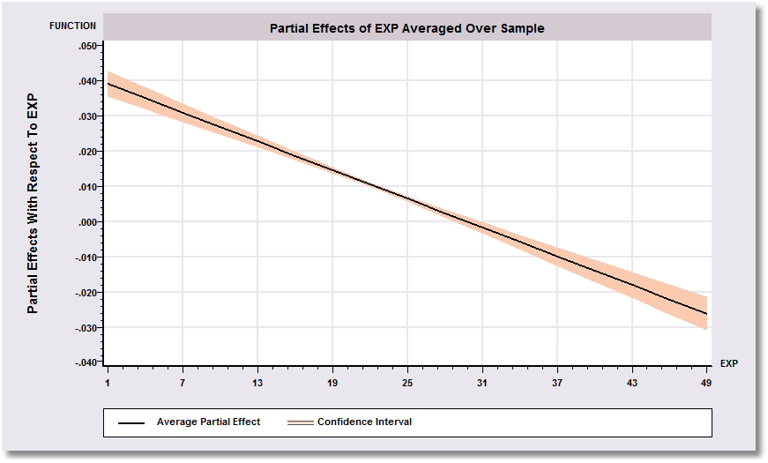
Effect of Experience = .04045 - 2 * 0.00068*Exp
Positive from 1 to 30, negative after.

Slide 23
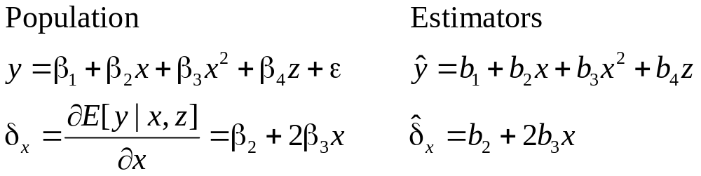
Specification and Functional Form: Nonlinearity

Slide 24

Log Income Equation
----------------------------------------------------------------------
Ordinary least squares regression ............
LHS=LOGY Mean = -1.15746 Estimated Cov[b1,b2]
Standard deviation = .49149
Number of observs. = 27322
Model size Parameters = 7
Degrees of freedom = 27315
Residuals Sum of squares = 5462.03686
Standard error of e = .44717
Fit R-squared = .17237
--------+-------------------------------------------------------------
Variable| Coefficient Standard Error b/St.Er. P[|Z|>z] Mean of X
--------+-------------------------------------------------------------
AGE| .06225*** .00213 29.189 .0000 43.5272
AGESQ| -.00074*** .242482D-04 -30.576 .0000 2022.99
Constant| -3.19130*** .04567 -69.884 .0000
MARRIED| .32153*** .00703 45.767 .0000 .75869
HHKIDS| -.11134*** .00655 -17.002 .0000 .40272
FEMALE| -.00491 .00552 -.889 .3739 .47881
EDUC| .05542*** .00120 46.050 .0000 11.3202
--------+-------------------------------------------------------------
Average Age = 43.5272. Estimated Partial effect = .066225 – 2(.00074)43.5272 = .00018.
Estimated Variance 4.54799e-6 + 4(43.5272)²(5.87973e-10) + 4(43.5272)(-5.1285e-8)
= 7.4755086e-08. Estimated standard error = .00027341.

Slide 25
Objective: Impact of Education on (log) Wage
Specification: What is the right model to use to analyze this association?
Estimation
Inference
Analysis

Slide 26
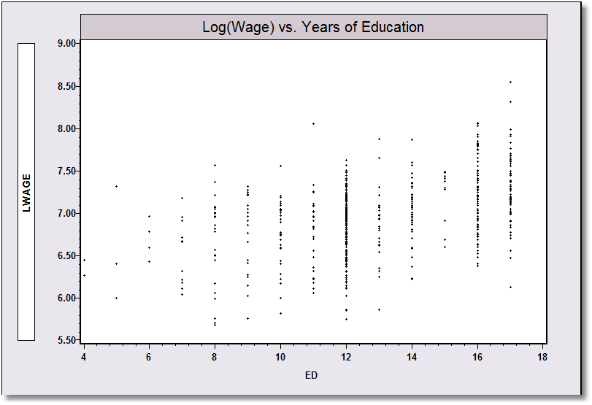
Application: Is there a relationship between (log) Wage and Education?

Slide 27
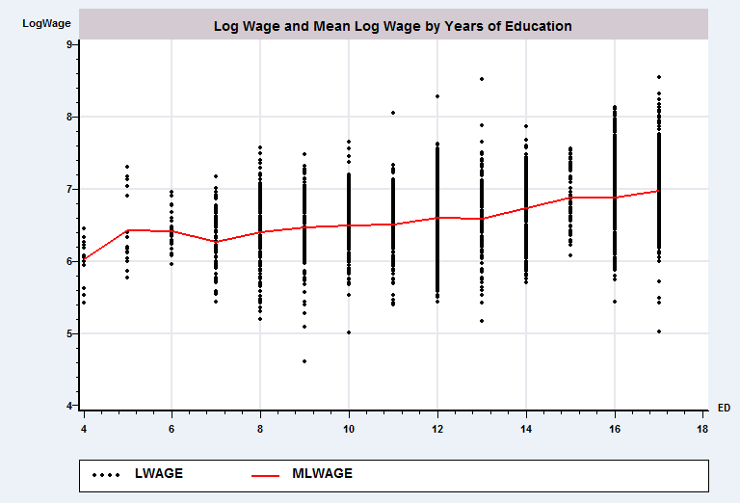
Group (Conditional) Means (Nonparametric)

Slide 28
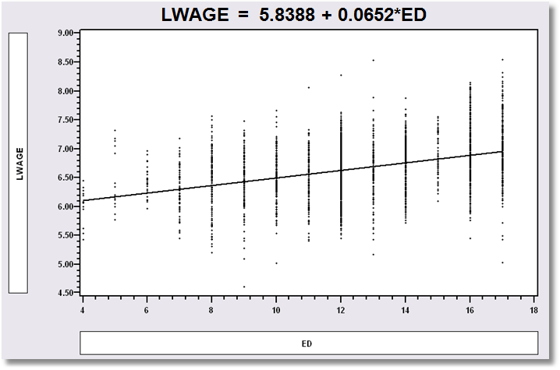
Simple Linear Regression (semiparametric)
LWAGE = 5.8388 + 0.0652*ED

Slide 29
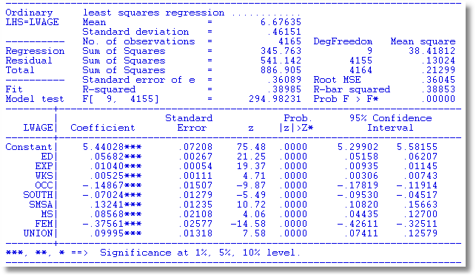
Multiple Regression

Slide 30
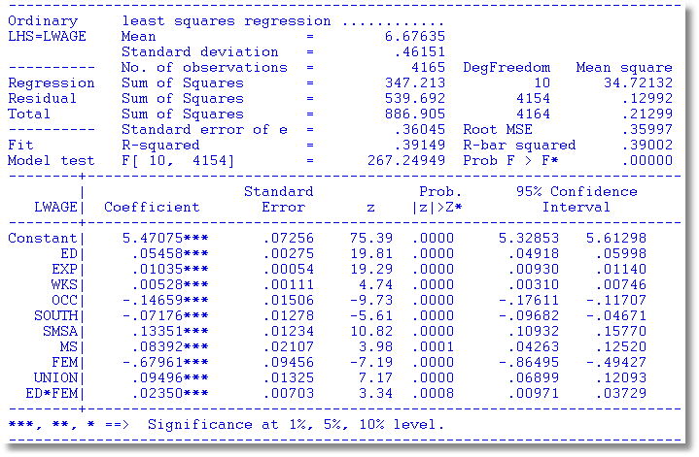
Interaction Effect
Gender Difference in Partial Effects

Slide 31
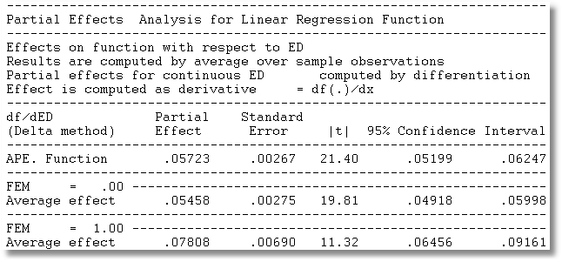
Partial Effect of a Year of Education
∂E[logWage]/∂ED=β_{ED} + β_{ED*FEM} *FEM
Note, the effect is positive.
Effect is larger for women.

Slide 32
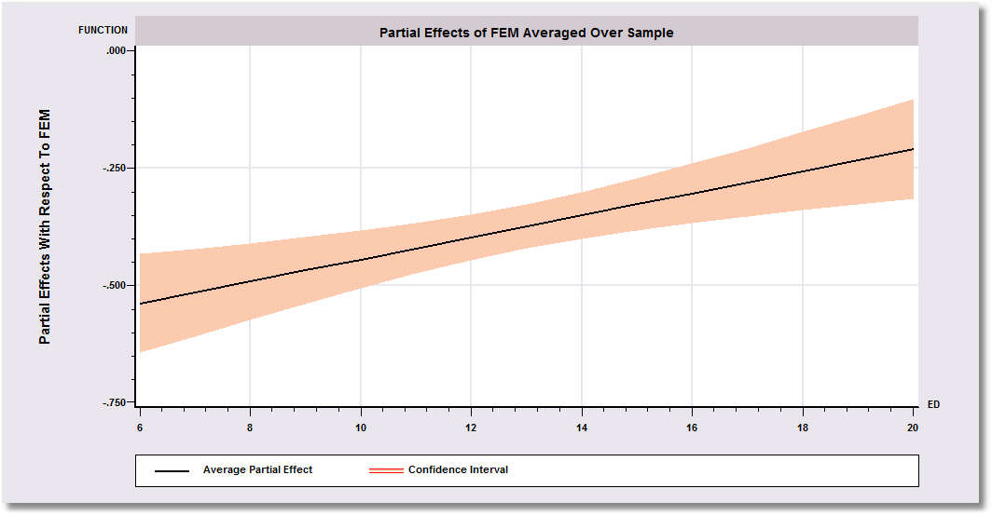
Gender Effect Varies by Years of Education
-0.67961 is misleading

Slide 33
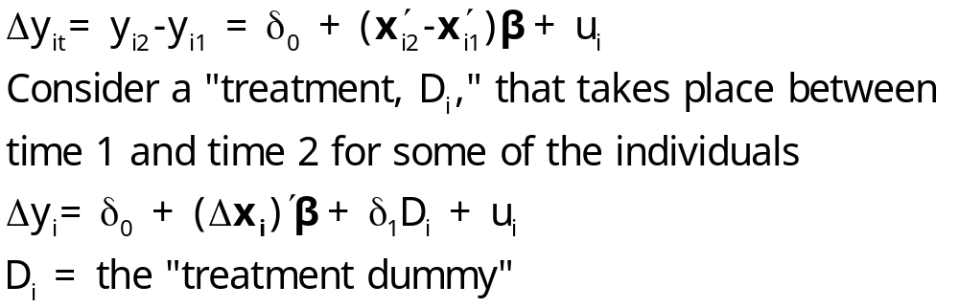
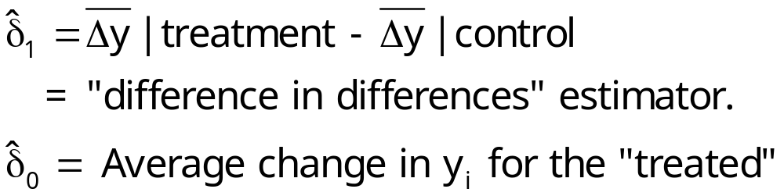
Difference in Differences
With two periods,
This is a linear regression model. If there are no regressors,

Slide 34
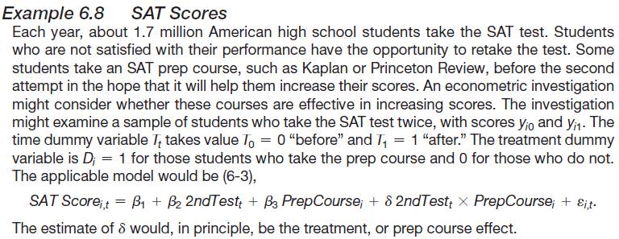
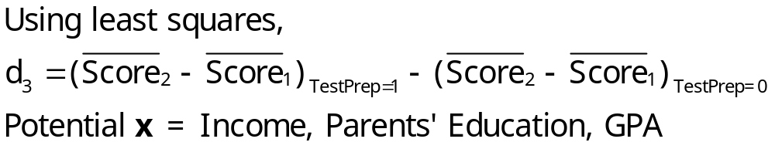
SAT Tests

Slide 35
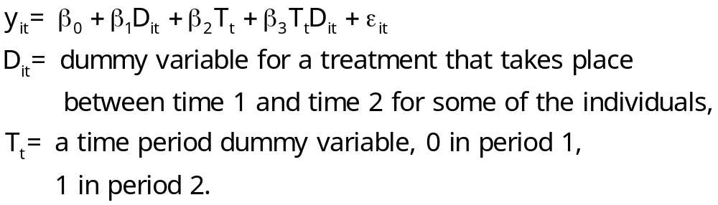
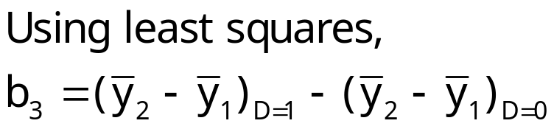
Difference-in-Differences Model
With two periods and strict exogeneity of D and T,
This is a linear regression model. If there are no regressors,

Slide 36
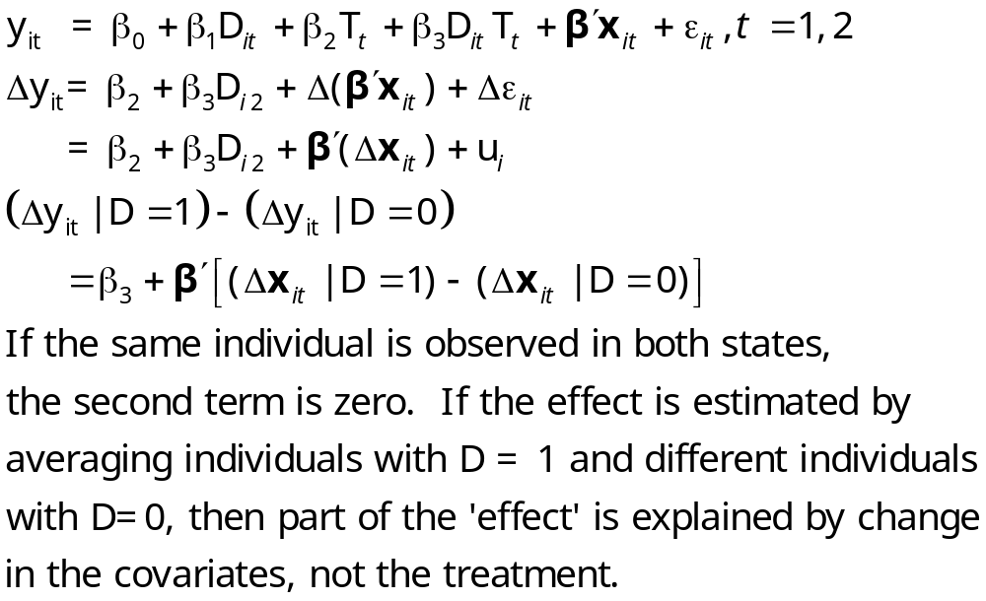
Difference in Differences

Slide 37
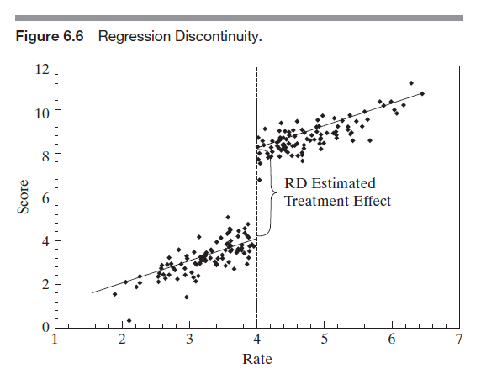
Abrupt Effect on Regression at a Specific Level of x

Slide 38
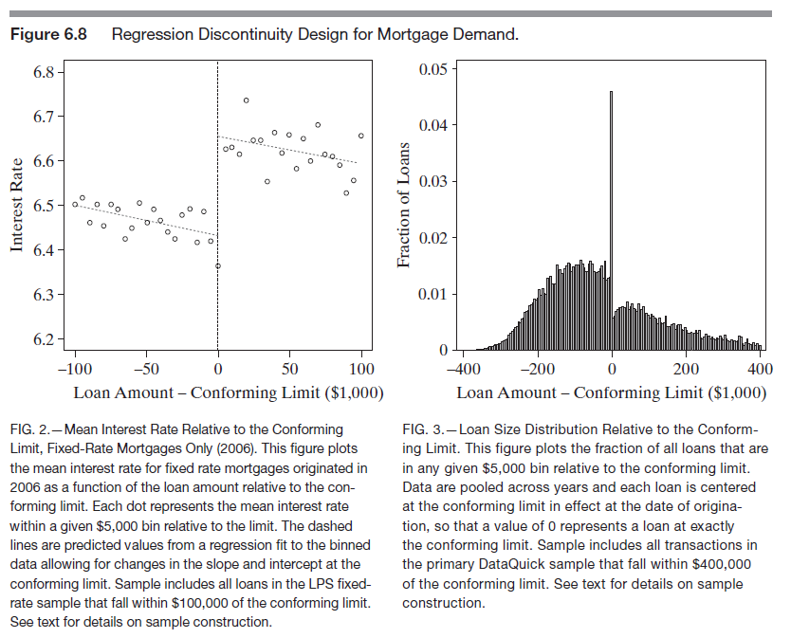

Slide 39
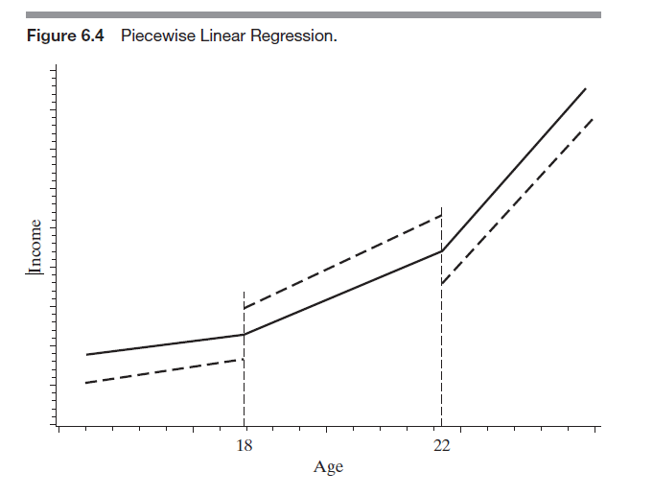
Useful Functional Form: Kinked Regression

Slide 40
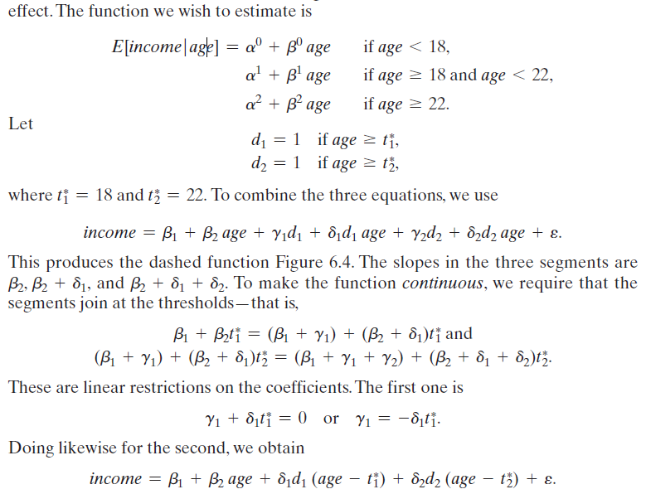
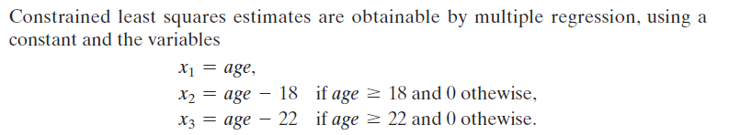

Slide 41
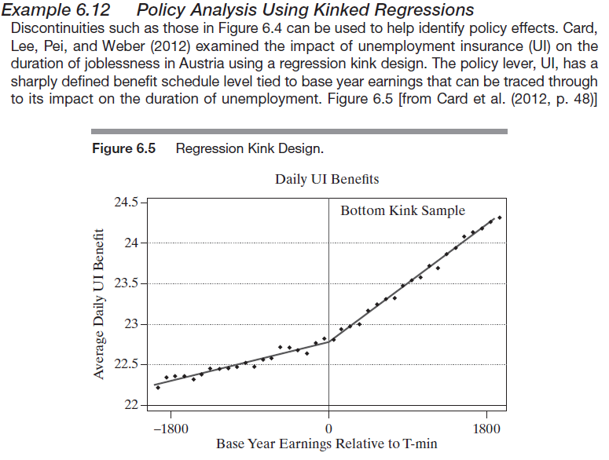
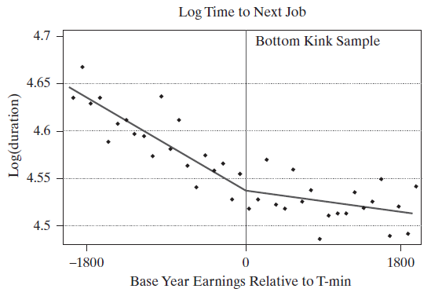
Kinked Regression and Policy Analysis: Unemployment Insurance

