Slide 1

Econometrics I
Professor William Greene
Stern School of Business
Department of Economics

Slide 2
Econometrics I
Part 7 – Finite Sample Properties of Least Squares; Multicollinearity

Slide 3
Terms of Art
Estimates and estimators
Properties of an estimator - the sampling distribution
“Finite sample” properties as opposed to “asymptotic” or “large sample” properties
Scientific principles behind sampling distributions and ‘repeated sampling’

Slide 4
Application: Health Care Panel Data
German Health Care Usage Data, 7,293 Individuals, Varying Numbers of Periods
Data downloaded from Journal of Applied Econometrics Archive. There are altogether 27,326 observations. The number of observations per household ranges from 1 to 7.
(Frequencies are: 1=1525, 2=2158, 3=825, 4=926, 5=1051, 6=1000, 7=987).
Variables in the file are
DOCVIS = number of doctor visits in last three months
HOSPVIS = number of hospital visits in last calendar year
DOCTOR = 1(Number of doctor visits > 0)
HOSPITAL = 1(Number of hospital visits > 0)
HSAT = health satisfaction, coded 0 (low) - 10 (high)
PUBLIC = insured in public health insurance = 1; otherwise = 0
ADDON = insured by add-on insurance = 1; otherswise = 0
HHNINC = household nominal monthly net income in German marks / 10000.
(4 observations with income=0 were dropped)
HHKIDS = children under age 16 in the household = 1; otherwise = 0
EDUC = years of schooling
AGE = age in years
MARRIED = marital status
For now, treat this sample as if it were a cross section, and as if it were the full population.
Notes:
4

Slide 5
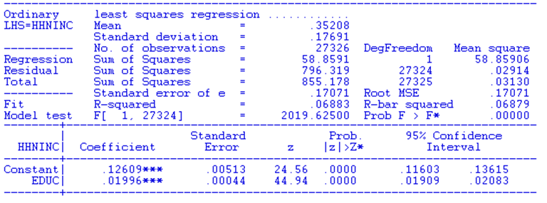
Population Regression of
Household Income on Education
The population value of β is +0.020

Slide 6
Sampling Distribution
A sampling experiment: Draw 25 observations at random from the population. Compute the regression. Repeat 100 times. Display estimated slopes in a histogram.
Resampling y and x. Sampling variability over y, x, ε
matrix ; beduc=init(100,1,0)$
proc$
draw ; n=25 $
regress; quietly ; lhs=hhninc ; rhs = one,educ $
matrix ; beduc(i)=b(2) $
sample;all$
endproc$
execute ; i=1,100 $
histogram;rhs=beduc; boxplot $

Slide 7
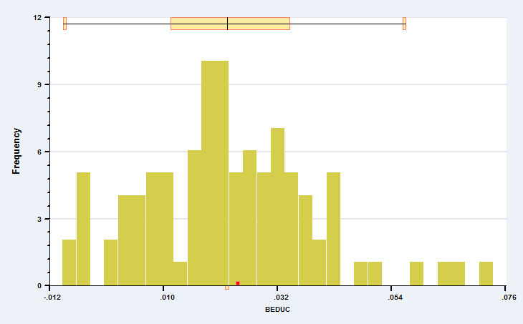
The least squares estimator is random. In repeated random samples, it varies randomly above and below β.
Sample mean = 0.022
How should we interpret this variation in the regression slope?

Slide 8
The Statistical Context of Least Squares Estimation
The sample of data from the population:
Data generating process is y = x′β + ε
The stochastic specification of the regression model: Assumptions about the random ε.
Endowment of the stochastic properties of the model upon the least squares estimator. The estimator is a function of the observed (realized) data.

Slide 9
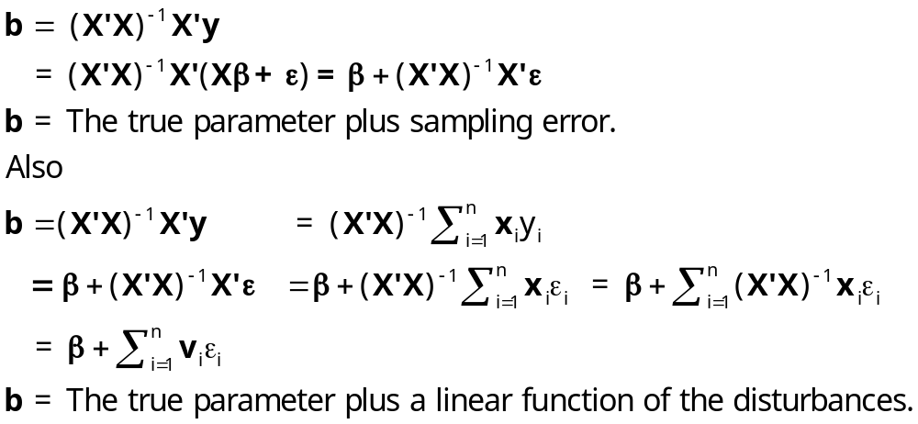
Least Squares as a Random Variable

Slide 10
Deriving the Properties of b
b = a parameter vector + a linear combination of the disturbances, each times a vector.
Therefore, b is a vector of random variables.
We do the analysis conditional on an X, then show that results do not depend on the particular X in hand, so the result must be general – i.e., independent of X.

Slide 11
Properties of the LS Estimator:
(1) b is unbiased
Expected value and the property of unbiasedness.
E[b|X] = E[β + (X′X)⁻¹X′ε|X]
= β + (X′X)⁻¹X′E[ε|X]
= β + 0
= β
E[b] = E_{X}{E[b|X]} (The law of iterated expectations.)
= E_{X}{β}
= β.

Slide 12
A Sampling Experiment: Unbiasedness
X is fixed in repeated samples
Holding X fixed. Resampling over ε
draw;n=25 $ Draw a particular sample of 25 observations
matrix ; beduc = init(1000,1,0)$
proc$
? Reuse X, resample epsilon each time, 1000 samples.
create ; inc = .12609+.01996*educ + r nn(0,.17071) $
regress; quietly ; lhs=inc ; rhs = one,educ $
matrix ; beduc(i)=b(2) $
endproc$
execute ; i=1,1000 $
histogram;rhs=beduc ;boxplot$

Slide 13
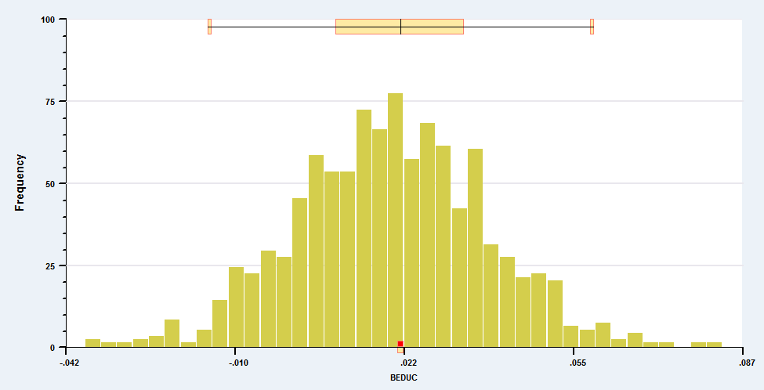
1000 Repetitions of b|x

Slide 14
Using the Expected Value of b
Partitioned Regression
A Crucial Result About Specification:
y = X₁β₁ + X₂β₂ + ε
Two sets of variables. What if the regression is computed without the second set of variables?
What is the expectation of the "short" regression estimator? E[b₁|(y = X₁β₁ + X₂β₂ + ε)]
b₁ = (X₁′X₁)⁻¹X₁′y

Slide 15
The Left Out Variable Formula
“Short” regression means we regress y on X₁ when
y = X₁β₁ + X₂β₂ + ε and β₂ is not 0
(This is a VVIR!)
b₁ = (X₁′X₁)⁻¹X₁′y
= (X₁′X₁)⁻¹X₁′(X₁β₁ + X₂β₂ + ε)
= (X₁′X₁)⁻¹X₁′X₁β₁ + (X₁′X₁)⁻¹X₁′ X₂β₂
+ (X₁′X₁)⁻¹X₁′ε)
E[b₁] = β₁ + (X₁′X₁)⁻¹X₁′X₂β₂
Omitting relevant variables causes LS to be “biased.”
This result educates our general understanding about regression.

Slide 16
Application
The (truly) short regression estimator is biased.
Application:
Quantity = β₁Price + β₂Income + ε
If you regress Quantity only on Price and leave out Income. What do you get?

Slide 17
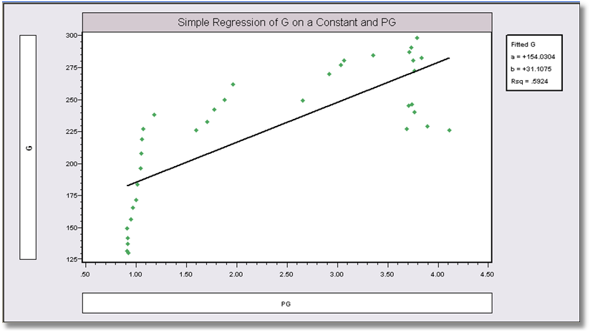
Estimated ‘Demand’ Equation
Shouldn’t the Price Coefficient be Negative?

Slide 18
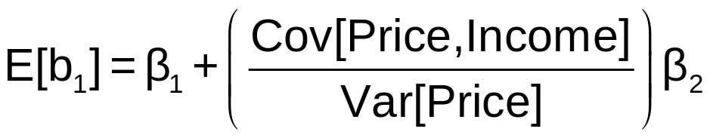
Application: Left out Variable
Leave out Income. What do you get?
In time series data, β₁ < 0, β₂ > 0 (usually)
Cov[Price,Income] > 0 in time series data.
So, the short regression will overestimate the price coefficient. It will be pulled toward and even past zero.
Simple Regression of G on a constant and PG
Price Coefficient should be negative.

Slide 19
Multiple Regression of G on Y and PG.
The Theory Works!
----------------------------------------------------------------------
Ordinary least squares regression ............
LHS=G Mean = 226.09444
Standard deviation = 50.59182
Number of observs. = 36
Model size Parameters = 3
Degrees of freedom = 33
Residuals Sum of squares = 1472.79834
Standard error of e = 6.68059
Fit R-squared = .98356
Adjusted R-squared = .98256
Model test F[ 2, 33] (prob) = 987.1(.0000)
--------+-------------------------------------------------------------
Variable| Coefficient Standard Error t-ratio P[|T|>t] Mean of X
--------+-------------------------------------------------------------
Constant| -79.7535*** 8.67255 -9.196 .0000
Y| .03692*** .00132 28.022 .0000 9232.86
PG| -15.1224*** 1.88034 -8.042 .0000 2.31661
--------+-------------------------------------------------------------

Slide 20
The Extra Variable Formula
A Second Crucial Result About Specification:
y = X₁β₁ + X₂β₂ + ε but β₂ really is 0.
Two sets of variables. One is superfluous. What if the regression is computed with it anyway?
The Extra Variable Formula: (This is a VIR!)
E[b_{1.2}| β₂ = 0] = β₁
The long regression estimator in a short regression is unbiased.)
Extra variables in a model do not induce biases. Why not just include them? We will develop this result.

Slide 21
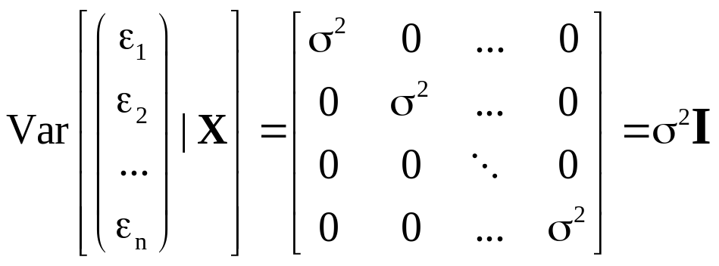
(2) The Sampling Variance of b
Assumption about disturbances:
  ε_{i} has zero mean and is uncorrelated with every other ε_{j}
  Var[ε_{i}|X] = σ². The variance of ε_{i} does not depend on any data in the sample.

Slide 22
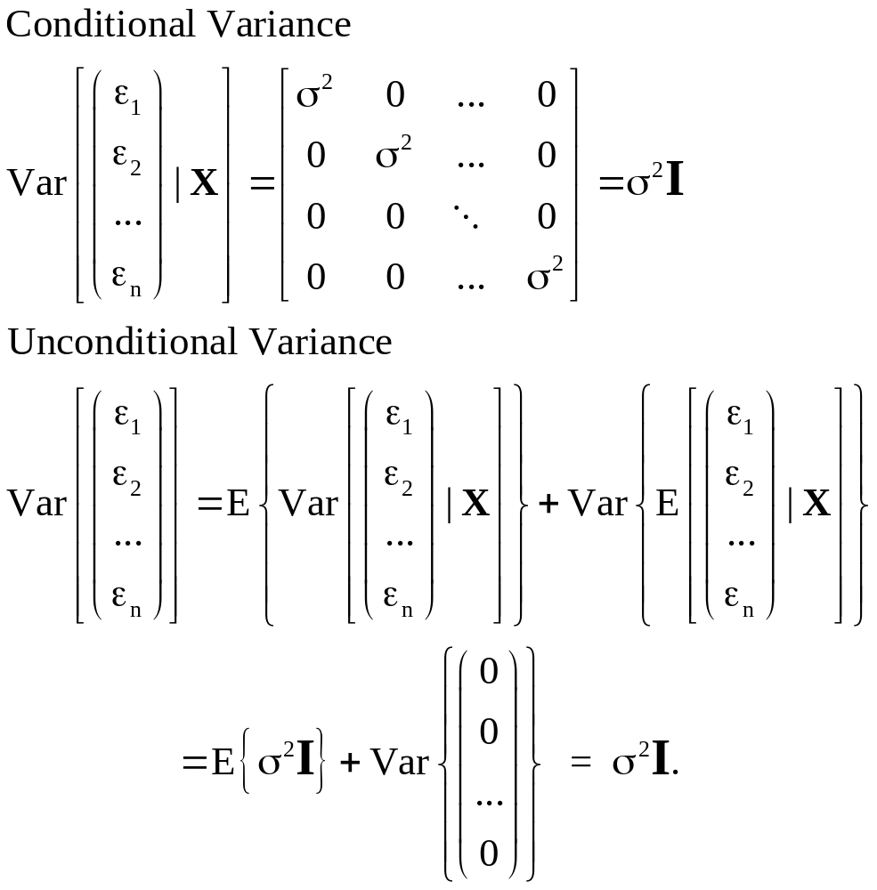

Slide 23
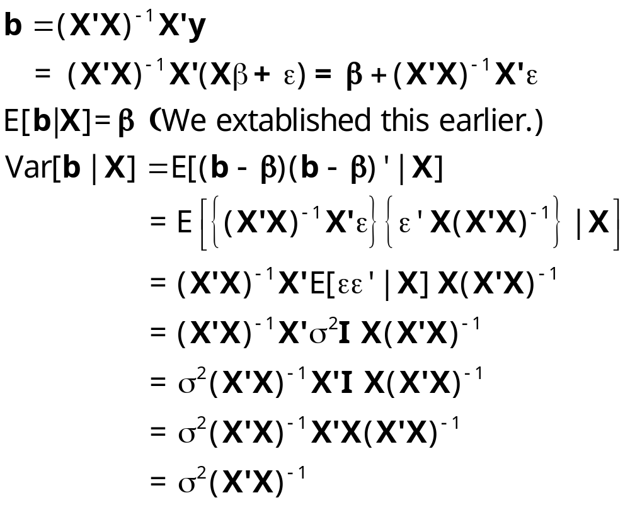
Conditional Variance of the Least Squares Estimator

Slide 24
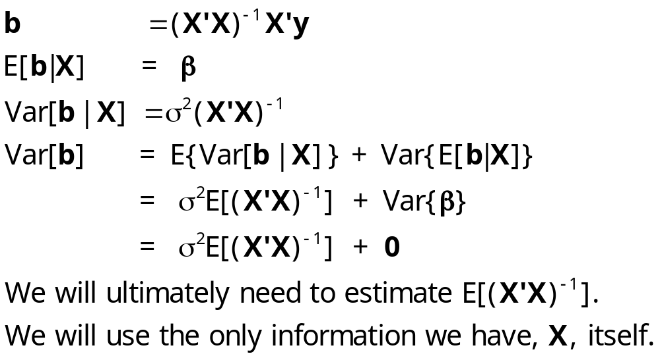
Unconditional Variance of the Least Squares Estimator

Slide 25
Variance Implications of
Specification Errors: Omitted Variables
Suppose the correct model is
y = X₁β₁ + X₂β₂ + ε. I.e., two sets of variables.
Compute least squares omitting X₂. Some easily
proved results:
Var[b₁] is smaller than Var[b_{1.2}]. Proof: Var[b₁] = σ²(X₁’X₁)⁻¹.
Var[b_{1.2}] = σ²(X₁’M₂X₁)⁻¹. To compare the matrices, we can ignore σ². To show that Var[b₁] is smaller than Var[b_{1.2}], we show that its inverse is bigger. So, is
[(X₁’X₁)⁻¹]⁻¹ larger than [(X₁’M₂X₁)⁻¹]⁻¹?
Is X₁’X₁ larger than X₁’X₁ – X₁’X₂(X₂’X₂)⁻¹X₂’X₁? Obviously.

Slide 26
Variance Implications of
Specification Errors: Omitted Variables
I.e., you get a smaller variance when you omit X₂.
Omitting X₂ amounts to using extra information (β₂ = 0). Even if the information is wrong (see the next result), it reduces the variance. (This is an important result.) It may induce a bias, but either way, it reduces variance.
b₁ may be more “precise.”
Precision = Mean squared error
= variance + squared bias.
Smaller variance but positive bias. If bias is small, may still favor the short regression.

Slide 27
Specification Errors-2
Including superfluous variables: Just reverse the results.
Including superfluous variables increases variance. (The cost of not using information.)
Does not cause a bias, because if the variables in X₂ are truly superfluous, then β₂ = 0,
so E[b_{1.2}] = β₁+Cβ₂ = β₁

Slide 28
Linear Restrictions
Context: How do linear restrictions affect the properties of the least squares estimator?
Model: y = Xβ + ε
Theory (information) Rβ - q = 0
Restricted least squares estimator:
b* = b - (X′X)⁻¹R′[R(X′X)⁻¹R′]⁻¹(Rb - q)
Expected value: E[b*] = β - (X′X)⁻¹R′[R(X′X)⁻¹R′]⁻¹(Rβ - q)
Variance: σ²(X′X)⁻¹ - σ² (X′X)⁻¹R′[R(X′X)⁻¹R′]⁻¹ R(X′X)⁻¹
= Var[b] – a nonnegative definite matrix < Var[b]
Implication: (As before) nonsample information reduces the variance of the estimator.

Slide 29
Interpretation
Case 1: Theory is correct: Rβ - q = 0
(the restrictions do hold).
b* is unbiased
Var[b*] is smaller than Var[b]
Case 2: Theory is incorrect: Rβ - q ≠ 0
(the restrictions do not hold).
b* is biased – what does this mean?
Var[b*] is still smaller than Var[b]

Slide 30
Restrictions and Information
How do we interpret this important result?
• The theory is "information"
• Bad information leads us away from "the truth"
• Any information, good or bad, makes us more certain
of our answer. In this context, any information reduces
variance.
What about ignoring the information?
• Not using the correct information does not lead us
away from "the truth"
• Not using the information foregoes the variance
reduction - i.e., does not use the ability to reduce
"uncertainty."

Slide 31
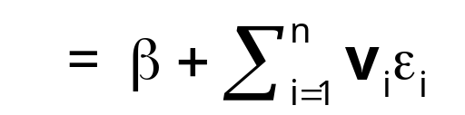
(3) Gauss-Markov Theorem
A theorem of Gauss and Markov: Least Squares is the minimum variance linear unbiased estimator (MVLUE)
1. Linear estimator
2. Unbiased: E[b|X] = β
Theorem: Var[b*|X] – Var[b|X] is nonnegative definite for any other linear and unbiased estimator b* that is not equal to b.
Definition: b is efficient in this class of estimators.

Slide 32
Implications of Gauss-Markov
Theorem: Var[b*|X] – Var[b|X] is nonnegative definite for any other linear and unbiased estimator b* that is not equal to b. Implies:
b_{k} = the kth particular element of b.
Var[b_{k}|X] = the kth diagonal element of Var[b|X]
Var[b_{k}|X] < Var[b_{k}*|X] for each coefficient.
c′b = any linear combination of the elements of b. Var[c′b|X] < Var[c′b*|X] for any nonzero c and b* that is not equal to b.

Slide 33
Aspects of the Gauss-Markov Theorem
Indirect proof: Any other linear unbiased estimator has a larger covariance matrix.
Direct proof: Find the minimum variance linear unbiased estimator. It will be least squares.
Other estimators
Biased estimation – a minimum mean squared error estimator. Is there a biased estimator with a smaller ‘dispersion’? Yes, always
Normally distributed disturbances – the Rao-Blackwell result. (General observation – for normally distributed disturbances, ‘linear’ is superfluous.)
Nonnormal disturbances - Least Absolute Deviations and other nonparametric approaches may be better in small samples

Slide 34
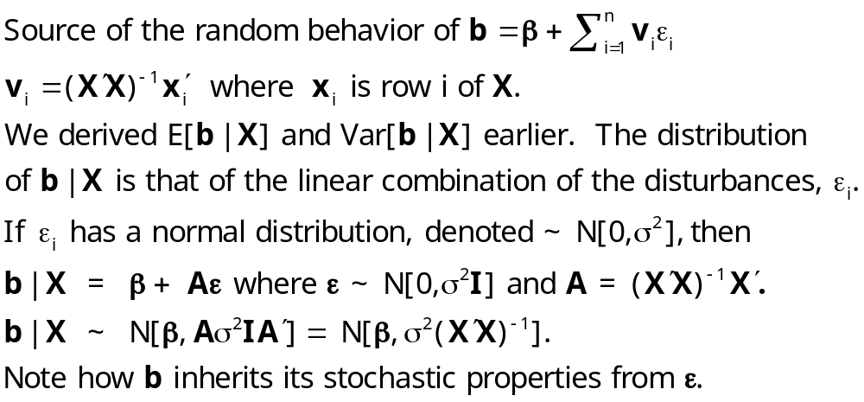
(4) Distribution

Slide 35
Summary: Finite Sample Properties of b
(1) Unbiased: E[b]=β
(2) Variance: Var[b|X] = σ²(X′X)⁻¹
(3) Efficiency: Gauss-Markov Theorem with all implications
(4) Distribution: Under normality,
b|X ~ Normal[β, σ²(X′X)⁻¹ ]
(Without normality, the distribution is generally
unknown.)

Slide 36
Estimating the Variance of b
The true variance of b|X is σ²(X′X)⁻¹ . We consider how to use the sample data to estimate this matrix. The ultimate objectives are to form interval estimates for regression slopes and to test hypotheses about them. Both require estimates of the variability of the distribution. We then examine a factor which affects how "large" this variance is, multicollinearity.

Slide 37
Estimating σ²
Using the residuals instead of the disturbances:
The natural estimator: e′e/n as a sample
surrogate for E[ε′ε/n]
Imperfect observation of ε_{i}, e_{i} = ε_{i} - (β - b)′x_{i}
Downward bias of e′e/n.
We obtain the result E[e′e|X] = (n-K)σ²

Slide 38
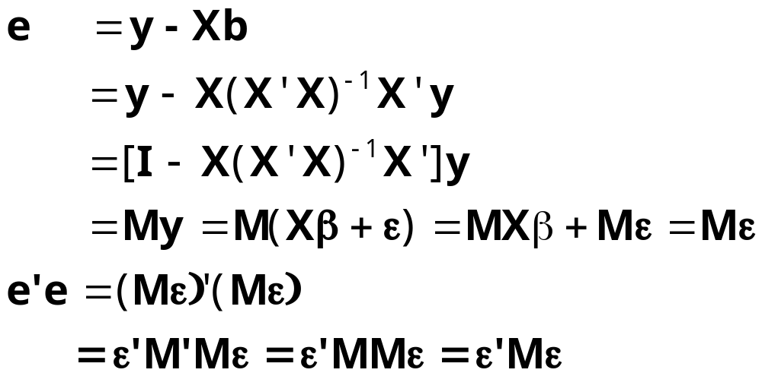
Expectation of e′e

Slide 39
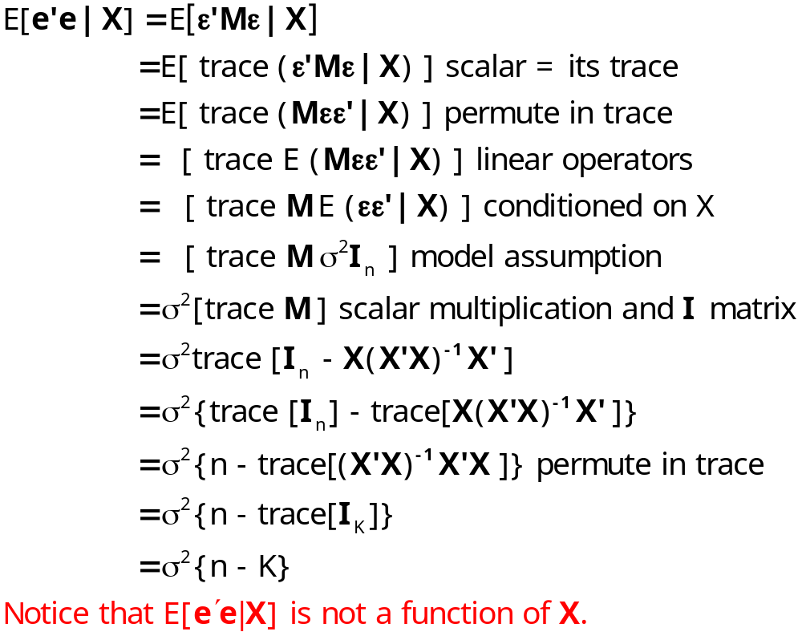
Method 1:

Slide 40
Estimating σ²
The unbiased estimator is s² = e′e/(n-K).
(n-K) is a “degrees of freedom correction”
Therefore, the unbiased estimator of σ² is
s² = e′e/(n-K)

Slide 41
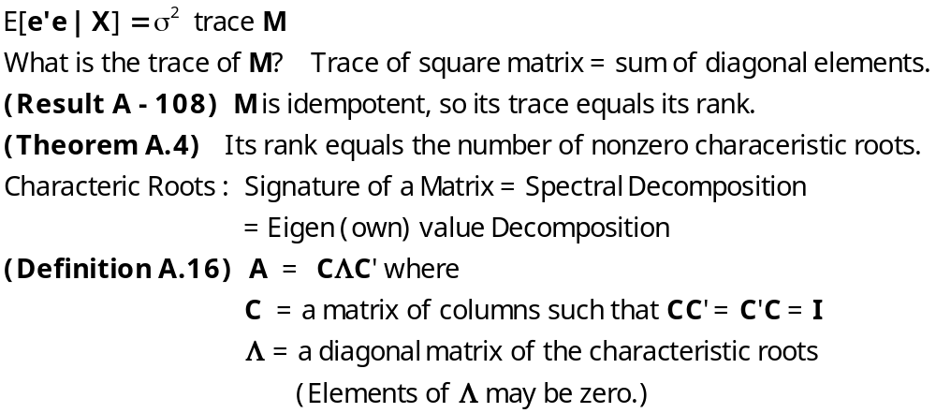
Method 2: Some Matrix Algebra

Slide 42
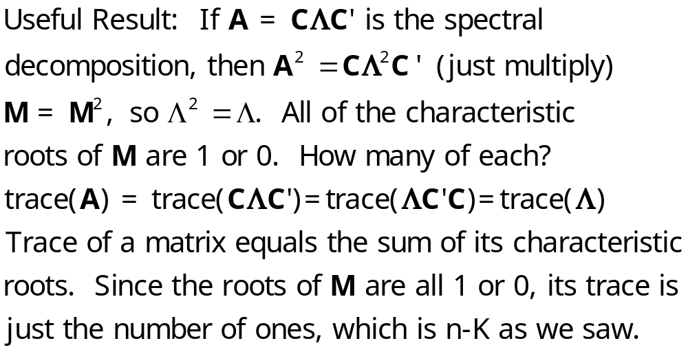
Decomposing M

Slide 43
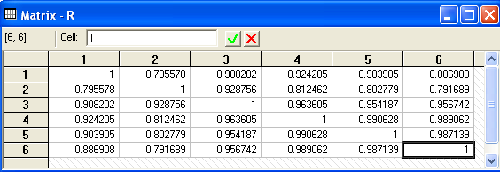
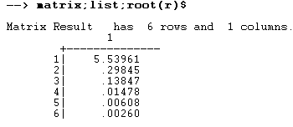
Example: Characteristic Roots of a Correlation Matrix
Note sum = trace = 6.

Slide 44

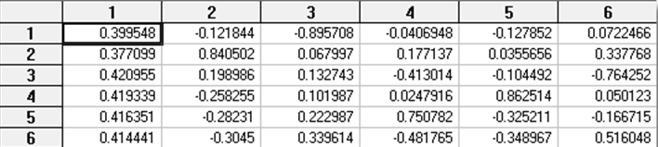
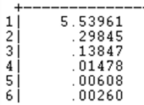

Slide 45
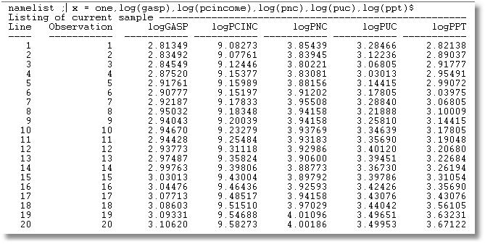
Gasoline Data (first 20 of 52 observations)

Slide 46
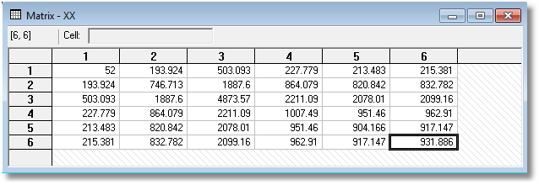
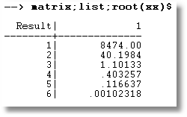
X’X and its Roots

Slide 47
Var[b|X]
Estimating the Covariance Matrix for b|X
The true covariance matrix is σ² (X’X)⁻¹
The natural estimator is s²(X’X)⁻¹
“Standard errors” of the individual coefficients are the square roots of the diagonal elements.

Slide 48
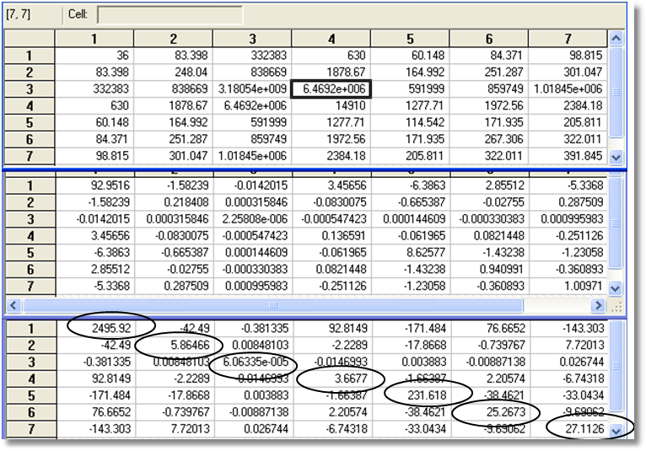
X’X
(X’X)⁻¹
s²(X’X)⁻¹

Slide 49
Standard Regression Results
----------------------------------------------------------------------
Ordinary least squares regression ........
LHS=G Mean = 226.09444
Standard deviation = 50.59182
Number of observs. = 36
Model size Parameters = 7
Degrees of freedom = 29
Residuals Sum of squares = 778.70227
Standard error of e = 5.18187 <= sqr[778.70227/(36 – 7)]
Fit R-squared = .99131
Adjusted R-squared = .98951
--------+-------------------------------------------------------------
Variable| Coefficient Standard Error t-ratio P[|T|>t] Mean of X
--------+-------------------------------------------------------------
Constant| -7.73975 49.95915 -.155 .8780
PG| -15.3008*** 2.42171 -6.318 .0000 2.31661
Y| .02365*** .00779 3.037 .0050 9232.86
TREND| 4.14359** 1.91513 2.164 .0389 17.5000
PNC| 15.4387 15.21899 1.014 .3188 1.67078
PUC| -5.63438 5.02666 -1.121 .2715 2.34364
PPT| -12.4378** 5.20697 -2.389 .0236 2.74486
--------+-------------------------------------------------------------

Slide 50
Multicollinearity

Slide 51

Multicollinearity: Short Rank of X
Enhanced Monet Area Effect Model: Height and Width Effects
Log(Price) = α + β₁ log Area +
β₂ log Aspect Ratio +
β₃ log Height +
β₄ Signature + ε
= α + β₁x₁ + β₂x₂ + β₃x₃ + β₄x₄ + ε
(Aspect Ratio = Width/Height). This is a perfectly respectable theory of art prices. However, it is not possible to learn about the parameters from data on prices, areas, aspect ratios, heights and signatures.
x₃ = (1/2)(x₁-x₂)
(Not a Monet)

Slide 52
Multicollinearity: Correlation of Regressors
Not “short rank,” which is a deficiency in the model.
Full rank, but columns of X are highly correlated.
A characteristic of the data set which affects the covariance matrix.
Regardless, β is unbiased.
Consider one of the unbiased coefficient estimators of β_{k}. E[b_{k}] = β_{k}
Var[b] = σ²(X’X)⁻¹ . The variance of b_{k} is the kth diagonal element of σ²(X’X)⁻¹ .
We can isolate this with the result Theorem 3.4, page 39
Let [X,z] be [Other xs, x_{k}] = [X₁,x₂]
The general result is that the diagonal element we seek is [z′M_{X}z]⁻¹ ,
the reciprocal of the sum of squared residuals in the regression of z on X.

Slide 53
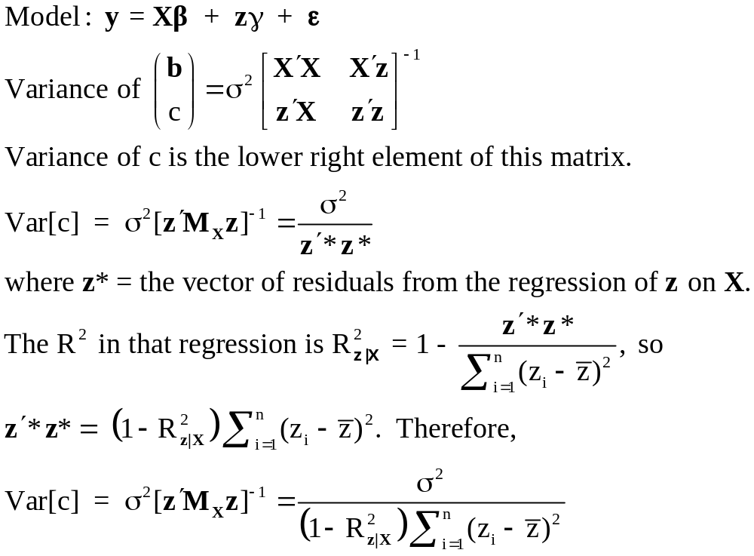
Variances of Least Squares Coefficients

Slide 54
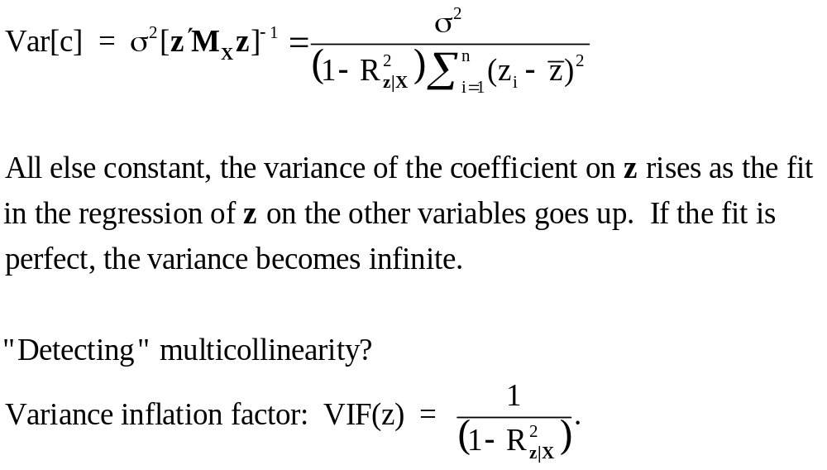
Multicollinearity

Slide 55
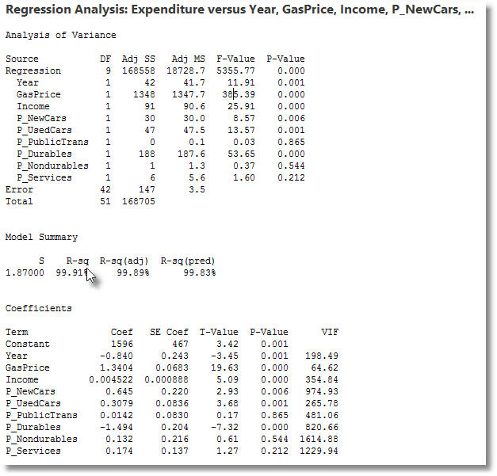

Slide 56
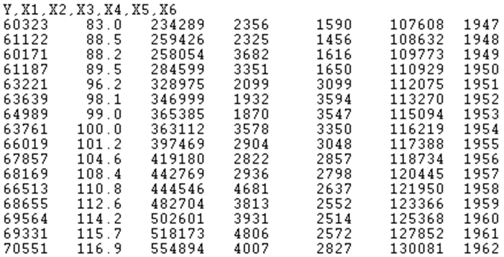
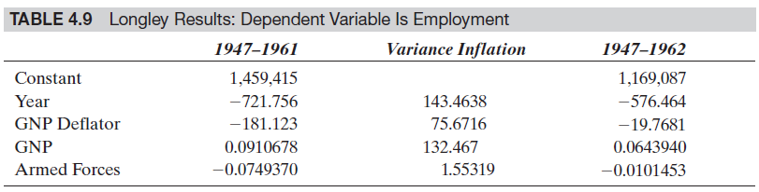
The Longley Data

Slide 57
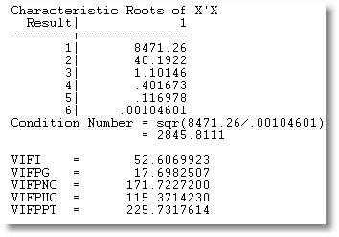
Condition Number and
Variance Inflation Factors
Condition number larger than 30 is ‘large.’
What does this mean?

Slide 58
Variance Inflation in Gasoline Market
Regression Analysis:
logG versus logIncome, logPG
The regression equation is
logG = - 0.468 + 0.966 logIncome - 0.169 logPG
Predictor Coef SE Coef T P
Constant -0.46772 0.08649 -5.41 0.000
logIncome 0.96595 0.07529 12.83 0.000
logPG -0.16949 0.03865 -4.38 0.000
S = 0.0614287 R-Sq = 93.6% R-Sq(adj) = 93.4%
Analysis of Variance
Source DF SS MS F P
Regression 2 2.7237 1.3618 360.90 0.000
Residual Error 49 0.1849 0.0038
Total 51 2.9086

Slide 59
Gasoline Market
Regression Analysis: logG versus logIncome, logPG, ...
The regression equation is
logG = - 0.558 + 1.29 logIncome - 0.0280 logPG
- 0.156 logPNC + 0.029 logPUC - 0.183 logPPT
Predictor Coef SE Coef T P
Constant -0.5579 0.5808 -0.96 0.342
logIncome 1.2861 0.1457 8.83 0.000
logPG -0.02797 0.04338 -0.64 0.522
logPNC -0.1558 0.2100 -0.74 0.462
logPUC 0.0285 0.1020 0.28 0.781
logPPT -0.1828 0.1191 -1.54 0.132
S = 0.0499953 R-Sq = 96.0% R-Sq(adj) = 95.6%
Analysis of Variance
Source DF SS MS F P
Regression 5 2.79360 0.55872 223.53 0.000
Residual Error 46 0.11498 0.00250
Total 51 2.90858
The standard error on logIncome doubles when the three variables are added to the equation while the coefficient only changes slightly.

Slide 60

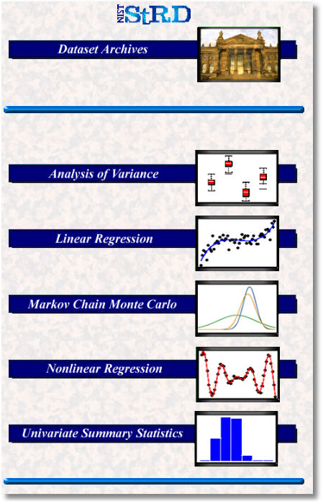

Slide 61
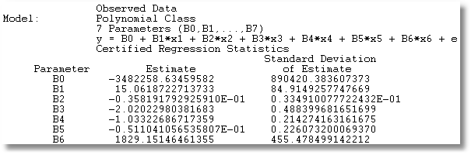
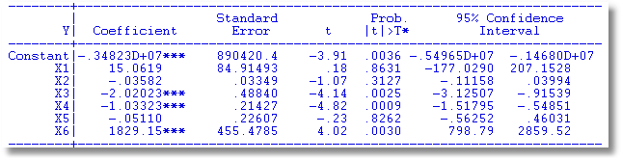
NIST Longley Solution

Slide 62
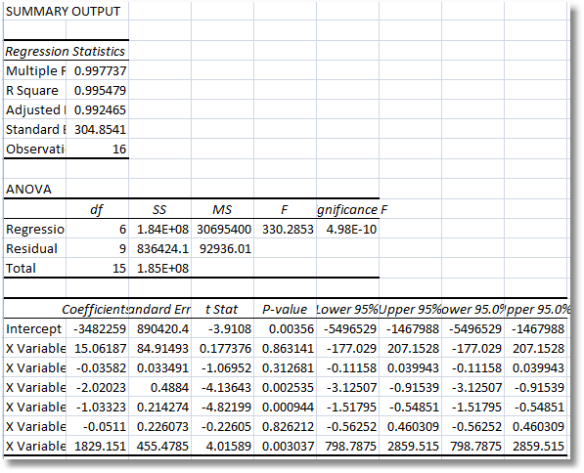
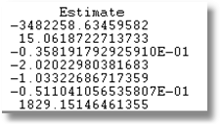
Excel Longley Solution

Slide 63
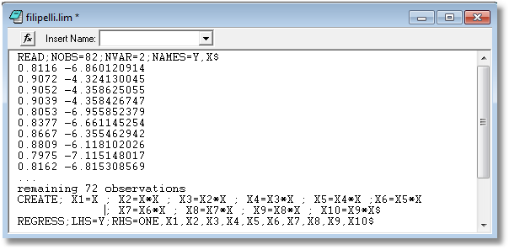
The NIST Filipelli Problem

Slide 64
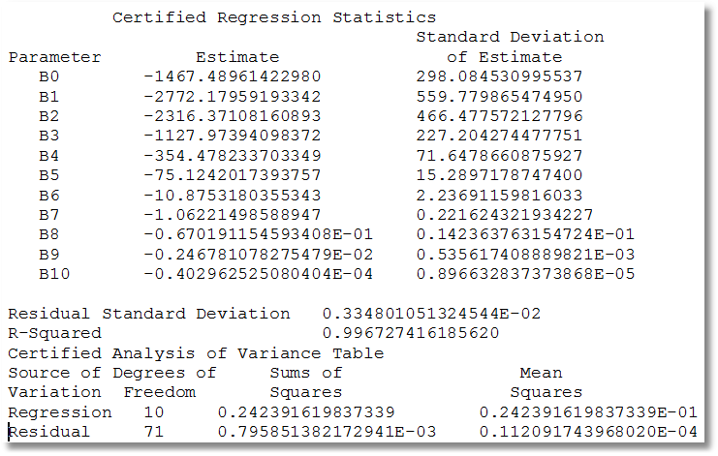
Certified Filipelli Results

Slide 65
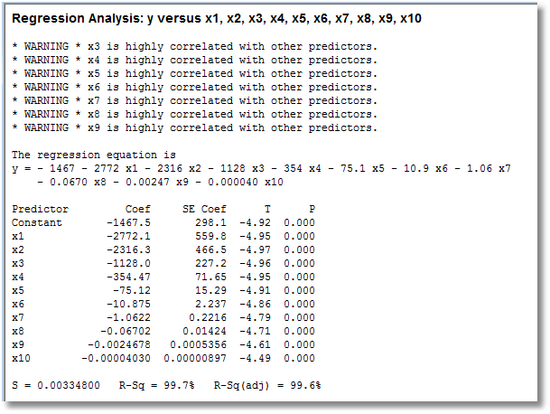
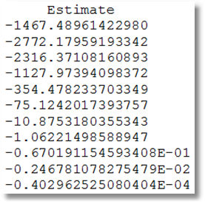
Minitab Filipelli Results

Slide 66
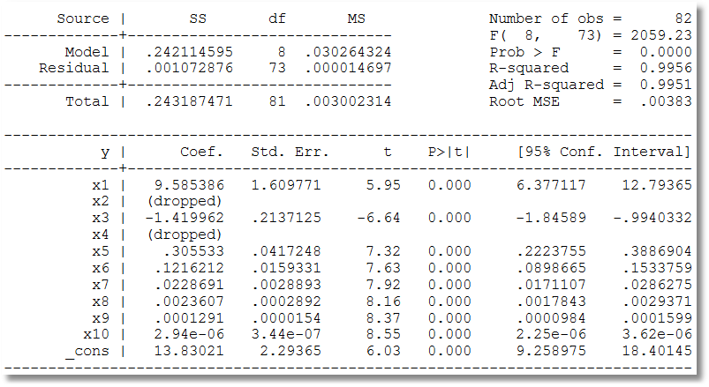
Stata Filipelli Results
In the Filippelli test, Stata found two coefficients so collinear that it dropped them from the analysis. Most other statistical software packages have done the same thing, and most authors have interpreted this result as acceptable for this test.

Slide 67
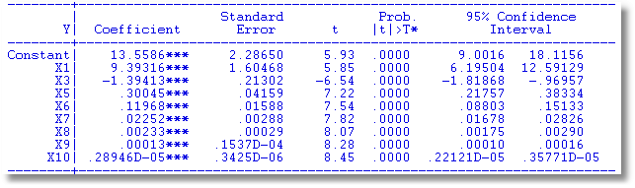
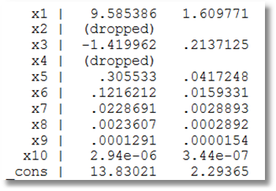
Even after dropping two (random columns), results are only correct to 1 or 2 digits.

Slide 68
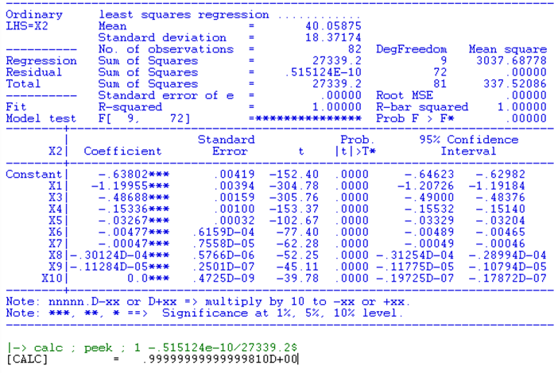
Regression of x₂ on all other variables

Slide 69
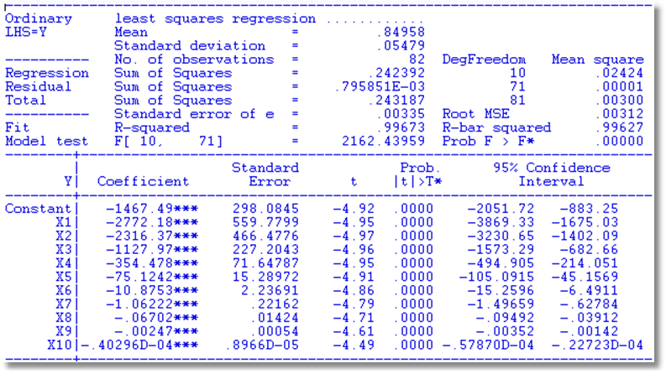
Using QR Decomposition

Slide 70
Multicollinearity
There is no “cure” for collinearity. Estimating something else is not helpful (principal components, for example).
There are “measures” of multicollinearity, such as the condition number of X and the variance inflation factor.
Best approach: Be cognizant of it. Understand its implications for estimation.
What is better: Include a variable that causes collinearity, or drop the variable and suffer from a biased estimator?
Mean squared error would be the basis for comparison.
Some generalities. Assuming X has full rank, regardless of the condition,
b is still unbiased
Gauss-Markov still holds

Slide 71
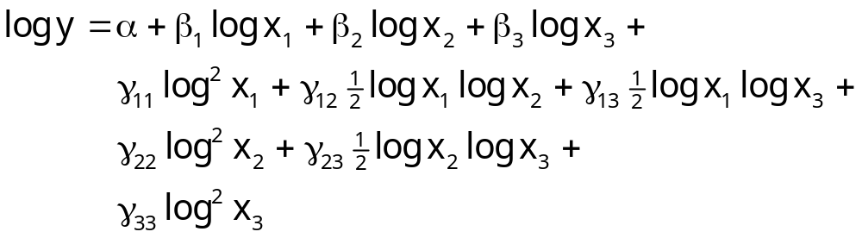
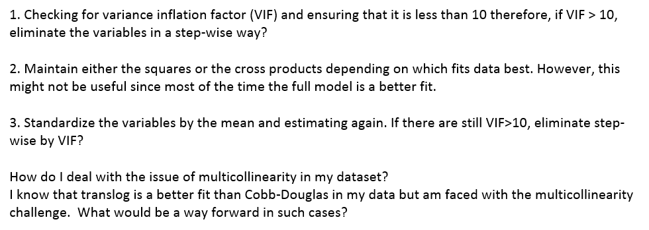
How (not) to deal with multicollinearity in a
Translog Production Function

Slide 72
I have a sample of 24025 observations in a logit model. Two predictors are highly collinear (pairwaise corr .96; p<.001); vif are about 12 for each of them; average vif is 2.63; condition number is 10.26; determinant of correlation matrix is 0.0211; the two lowest eigen vales are 0.0792 and 0.0427. Centering/standardizing variables does not change the story. Note: most obs are zeros for these two variables; I only have approx 600 non-zero obs for these two variables on a total of 24.025 obs. Both variable coefficients are significant and must be included in the model (as per specification). -- Do I have a problem of multicollinearity?? -- Does the large sample size attenuate this concern, even if I have a correlation of .96? -- What could I look at to ascertain that the consequences of multi-collinearity are not a problem? -- Is there any reference I might cite, to say that given the sample size, it is not a problem? I hope you might help, because I am really in trouble!!!

