Slide 1

Econometrics I
Professor William Greene
Stern School of Business
Department of Economics

Slide 2
Econometrics I
Part 8 – Asymptotic Distribution Theory

Slide 3
Asymptotics: Setting
Most modeling situations involve stochastic regressors, nonlinear models or nonlinear estimation techniques. The number of exact statistical results, such as expected value or true distribution, that can be obtained in these cases is very low. We rely, instead, on approximate results that are based on what we know about the behavior of certain statistics in large samples. Example from basic statistics: We know a lot about . What can we say about 1/ ?

Slide 4
Convergence
Definitions, kinds of convergence as n grows large:
1. To a constant; example, the sample mean,
converges to the population mean.
2. To a random variable; example, a t statistic with n -1 degrees of freedom converges to a standard normal random variable

Slide 5
Convergence to a Constant
Sequences and limits.
Convergence of a sequence of constants, indexed by n:
(Note the use of the “leading term”)
Convergence of a sequence of random variables.
What does it mean for a random variable to converge to a
constant? Convergence of the variance to zero. The
random variable converges to something that is not
random.

Slide 6
Convergence Results
Convergence of a sequence of random variables to a constant - Convergence in mean square:
Mean converges to a constant, variance converges to zero. (Far from the most general, but definitely sufficient for our purposes.)
A convergence theorem for sample moments.
Sample moments converge in probability to their population counterparts.
Generally the form of The Law of Large Numbers. (Many forms; see Appendix D in your text. This is the “weak” law of large numbers.)
Note the great generality of the preceding result.
(1/n)Σ_{i}g(z_{i}) converges to E[g(z_{i})].

Slide 7
Extending the Law of Large Numbers

Slide 8
Probability Limit

Slide 9
Mean Square Convergence

Slide 10
Probability Limits and Expecations
What is the difference between
E[b_{n}] and plim b_{n}?

Slide 11
Consistency of an Estimator
If the random variable in question, b_{n} is an estimator (such as the mean), and if
plim b_{n} = θ,
then b_{n} is a consistent estimator of θ.
Estimators can be inconsistent for θ for two reasons:
(1) They are consistent for something other than the thing that interests us.
(2) They do not converge to constants. They are not consistent estimators of anything.
We will study examples of both.

Slide 12
The Slutsky Theorem
Assumptions: If
b_{n} is a random variable such that plim b_{n} = θ.
For now, we assume θ is a constant.
g(.) is a continuous function with continuous derivatives.
g(.) is not a function of n.
Conclusion: Then plim[g(b_{n})] = g[plim(b_{n})] assuming g[plim(b_{n})] exists. (VVIR!)
Works for probability limits. Does not work for expectations.

Slide 13
Slutsky Corollaries

Slide 14
Slutsky Results for Matrices
Functions of matrices are continuous functions of the
elements of the matrices. Therefore,
If plimA_{n} = A and plimB_{n} = B (element by element), then
plim(A_{n}⁻¹) = [plim A_{n}]⁻¹ = A⁻¹
and
plim(A_{n}B_{n}) = plimA_{n}plim B_{n} = AB

Slide 15
Limiting Distributions
Convergence to a kind of random variable instead of to a constant
x_{n} is a random sequence with cdf F_{n}(x_{n}). If plim x_{n} = θ (a constant), then F_{n}(x_{n}) becomes a point. But, x_{n} may converge to a specific random variable. The distribution of that random variable is the limiting distribution of x_{n}. Denoted

Slide 16
A Limiting Distribution

Slide 17
A Slutsky Theorem for Random Variables (Continuous Mapping Theorem)

Slide 18
An Extension of the Slutsky Theorem

Slide 19
Application of the Slutsky Theorem

Slide 20
Central Limit Theorems
Central Limit Theorems describe the large sample behavior of random variables that involve sums of variables. “Tendency toward normality.”
Generality: When you find sums of random variables, the CLT shows up eventually.
The CLT does not state that means of samples have normal distributions.

Slide 21
A Central Limit Theorem

Slide 22
Lindeberg-Levy vs. Lindeberg-Feller
Lindeberg-Levy assumes random sampling – observations have the same mean and same variance.
Lindeberg-Feller allows variances to differ across observations, with some necessary assumptions about how they vary.
Most econometric estimators require Lindeberg-Feller (and extensions such as Lyapunov).

Slide 23
Order of a Sequence
Order of a sequence
‘Little oh’ o(.). Sequence h_{n} is o(n^{δ}) (order less than n^{δ}) iff n^{-δ} h_{n} → 0.
Example: h_{n} = n^{1.4} is o(n^{1.5}) since n^{-1.5} h_{n} = 1 /n^{.1} → 0.
‘Big oh’ O(.). Sequence h_{n} is O(n^{δ}) iff n^{-δ} h_{n} → a finite nonzero constant.
Example 1: h_{n} = (n² + 2n + 1) is O(n²).
Example 2: Σ_{i}x_{i}² is usually O(n¹) since this is n×the mean of x_{i}²
and the mean of x_{i}² generally converges to E[x_{i}²], a finite
constant.
What if the sequence is a random variable? The order is in terms of the variance.
Example: What is the order of the sequence in random sampling?
Var[ ] = σ²/n which is O(1/n). Most estimators are O(1/n)

Slide 24
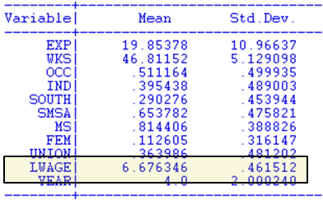
Cornwell and Rupert Panel Data
Cornwell and Rupert Returns to Schooling Data, 595 Individuals, 7 Years
Variables in the file are
EXP = work experience
WKS = weeks worked
OCC = occupation, 1 if blue collar,
IND = 1 if manufacturing industry
SOUTH = 1 if resides in south
SMSA = 1 if resides in a city (SMSA)
MS = 1 if married
FEM = 1 if female
UNION = 1 if wage set by union contract
ED = years of education
LWAGE = log of wage = dependent variable in regressions
These data were analyzed in Cornwell, C. and Rupert, P., "Efficient Estimation with Panel Data: An Empirical Comparison of Instrumental Variable Estimators," Journal of Applied Econometrics, 3, 1988, pp. 149-155.
Notes:
24

Slide 25
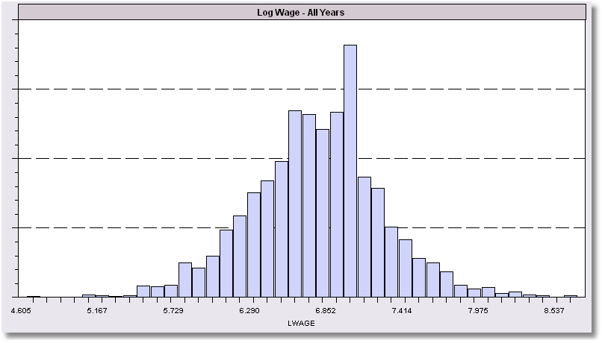
Histogram for LWAGE

Slide 26
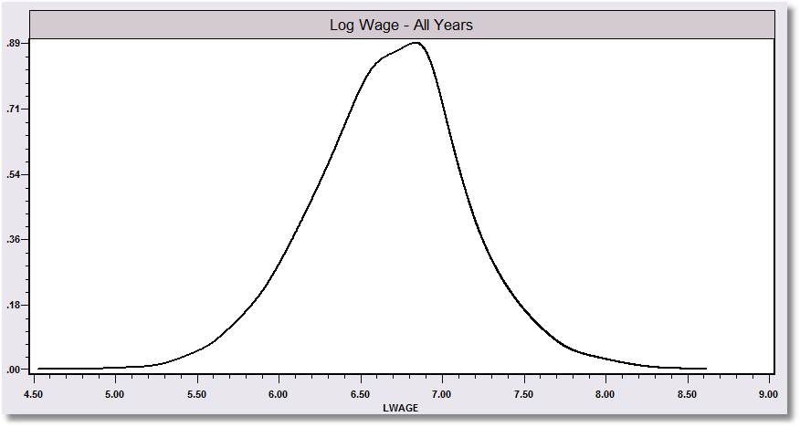
Kernel Estimator for LWAGE
X*

Slide 27
Kernel Density Estimator

Slide 28
Asymptotic Distributions
An asymptotic distribution is a finite sample approximation to the true distribution of a random variable that is good for large samples, but not necessarily for small samples.
Stabilizing transformation to obtain a limiting distribution. Multiply random variable x_{n} by some power, a, of n such that the limiting distribution of nªx_{n} has a finite, nonzero variance.
Example, has a limiting variance of zero, since the variance is σ²/n. But,
the variance of √n is σ². However, this does not stabilize the distribution because E[ ] = √ nμ.
The stabilizing transformation would be

Slide 29
Asymptotic Distribution
Obtaining an asymptotic distribution from a limiting distribution
Obtain the limiting distribution via a stabilizing transformation
Assume the limiting distribution applies reasonably well in
finite samples
Invert the stabilizing transformation to obtain the asymptotic
distribution
Asymptotic normality of a distribution.

Slide 30
Asymptotic Efficiency
Comparison of asymptotic variances
How to compare consistent estimators? If both converge to constants, both variances go to zero.
  Example: Random sampling from the normal distribution,
    Sample mean is asymptotically normal[μ,σ²/n]
    Median is asymptotically normal [μ,(π/2)σ²/n]
    Mean is asymptotically more efficient

Slide 31
The Delta Method
The delta method (combines most of these concepts)
Nonlinear transformation of a random variable:
f(x_{n}) such that plim x_{n} = μ but √n (x_{n} - μ) is asymptotically normally
distributed (μ,σ²). What is the asymptotic behavior of f(x_{n})?
Taylor series approximation: f(x_{n}) ≈ f(μ) + f′(μ) (x_{n} - μ)
By the Slutsky theorem, plim f(x_{n}) = f(μ)
√n[f(x_{n}) - f(μ)] ≈ f′(μ) [√n (x_{n} - μ)]
√n[f(x_{n}) - f(μ)] → f′(μ) × N[μ, σ²]
Large sample behaviors of the LHS and RHS sides are the same
Large sample variance is [f′(μ)]² times large sample Var[√n (x_{n} - μ)]

Slide 32
Delta Method
Asymptotic Distribution of a Function

Slide 33

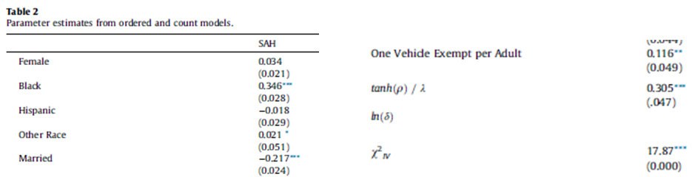

Slide 34
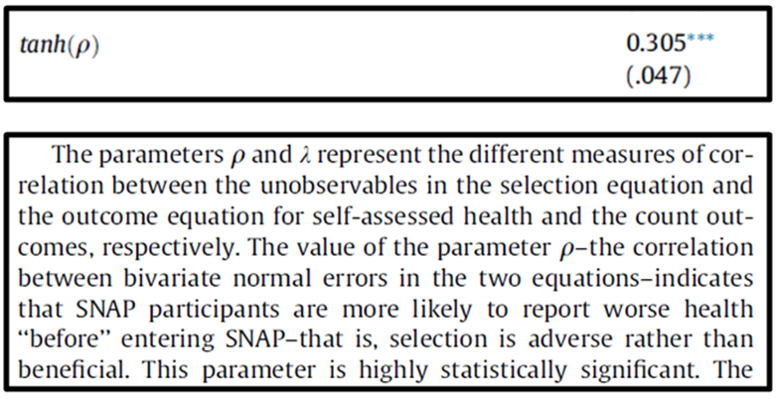

Slide 35
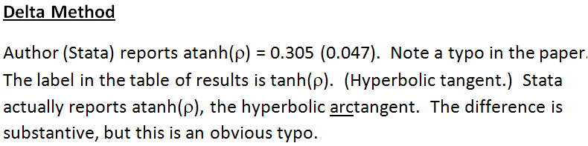
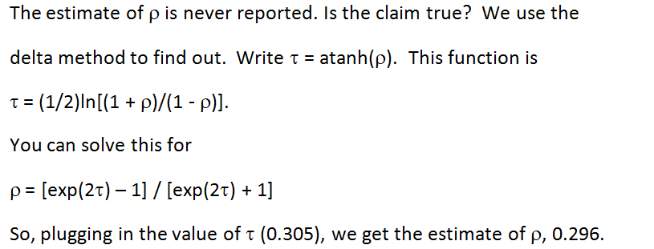

Slide 36
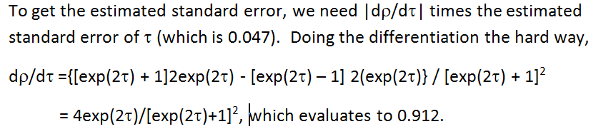

Slide 37
Delta Method – More than One Parameter

Slide 38

Log Income Equation
----------------------------------------------------------------------
Ordinary least squares regression ............
LHS=LOGY Mean = -1.15746 Estimated Cov[b1,b2]
Standard deviation = .49149
Number of observs. = 27322
Model size Parameters = 7
Degrees of freedom = 27315
Residuals Sum of squares = 5462.03686
Standard error of e = .44717
Fit R-squared = .17237
--------+-------------------------------------------------------------
Variable| Coefficient Standard Error b/St.Er. P[|Z|>z] Mean of X
--------+-------------------------------------------------------------
AGE| .06225*** .00213 29.189 .0000 43.5272
AGESQRD| -.00074*** .242482D-04 -30.576 .0000 2022.99
Constant| -3.19130*** .04567 -69.884 .0000
MARRIED| .32153*** .00703 45.767 .0000 .75869
HHKIDS| -.11134*** .00655 -17.002 .0000 .40272
FEMALE| -.00491 .00552 -.889 .3739 .47881
EDUC| .05542*** .00120 46.050 .0000 11.3202
--------+-------------------------------------------------------------

Slide 39
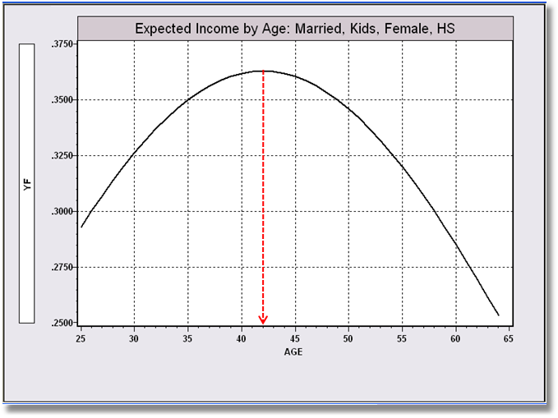
Age-Income Profile:
Married=1, Kids=1, Educ=12, Female=1

Slide 40
Application: Maximum of a Function
AGE| .06225*** .00213 29.189 .0000 43.5272
AGESQ| -.00074*** .242482D-04 -30.576 .0000 2022.99

Slide 41
Delta Method Using Visible Digits

Slide 42
Delta Method Results Built into Software
-----------------------------------------------------------
WALD procedure.
--------+--------------------------------------------------
Variable| Coefficient Standard Error b/St.Er. P[|Z|>z]
--------+--------------------------------------------------
G1| 674.399*** 22.05686 30.575 .0000
G2| 56623.8*** 1797.294 31.505 .0000
AGESTAR| 41.9809*** .19193 218.727 .0000
--------+--------------------------------------------------
(Computed using all 17 internal digits of regression results)

Slide 43
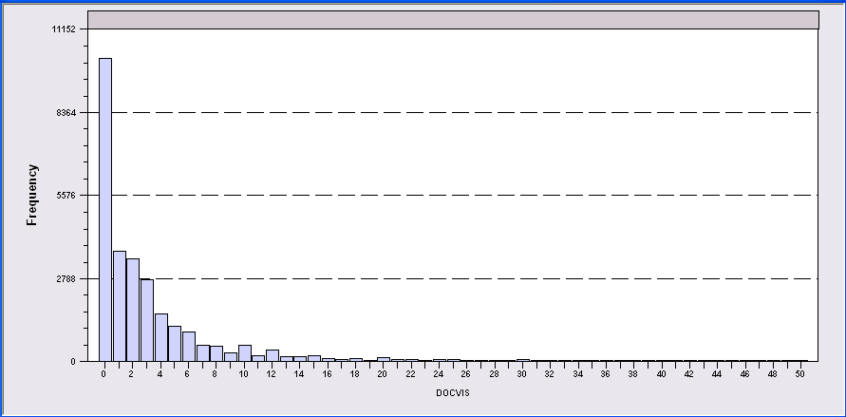
Application: Doctor Visits
German Individual Health Care data: n=27,236
Simple model for number of visits to the doctor:
  True E[v|income] = exp(1.412 - .0745*income)
  Linear regression: g*(income)=3.917 - .208*income

Slide 44
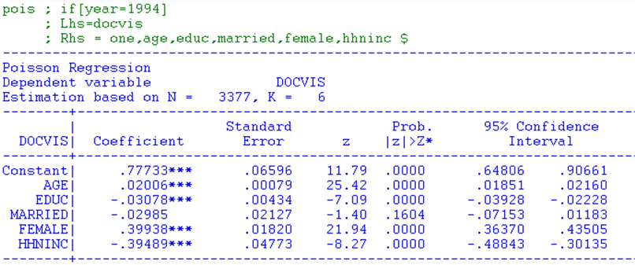
A Nonlinear Model

Slide 45
Interesting Partial Effects

Slide 46
Necessary Derivatives (Jacobian)

Slide 47
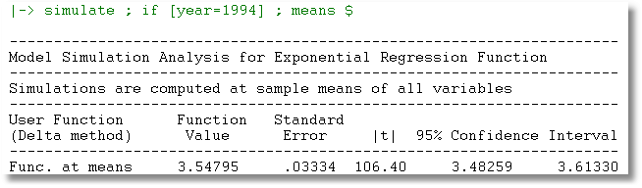
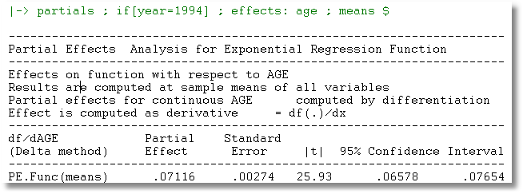

Slide 48
Partial Effects at Means vs.
Mean of Partial Effects

Slide 49
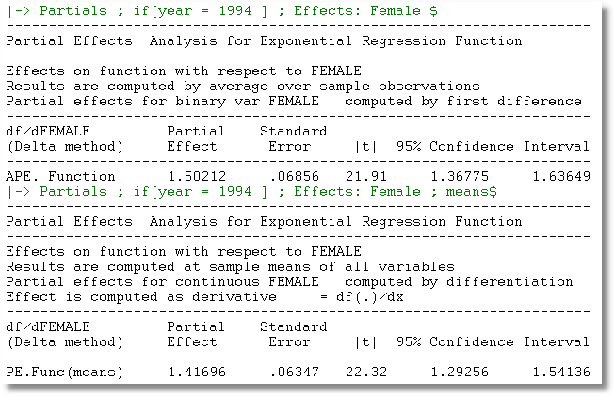
Partial Effect for a Dummy Variable?

Slide 50
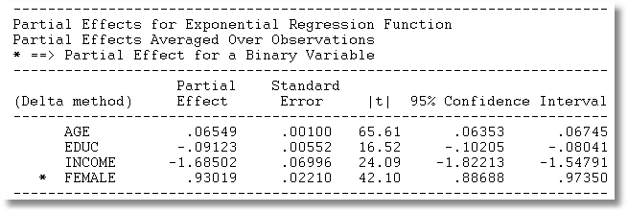

Slide 51
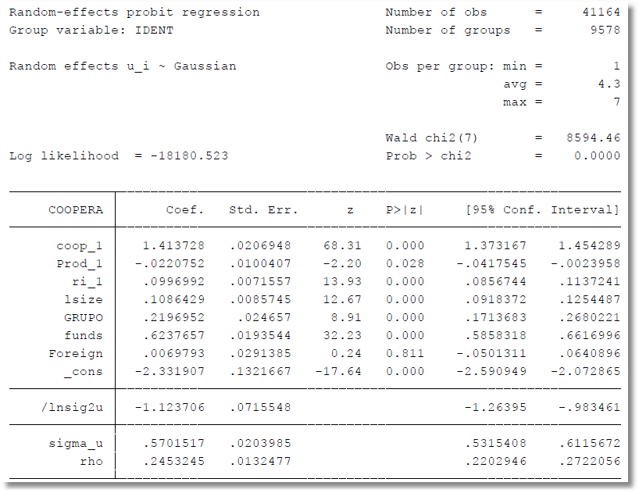
Delta Method, Stata Application

Slide 52

Delta Method

Slide 53
Delta Method

Slide 54
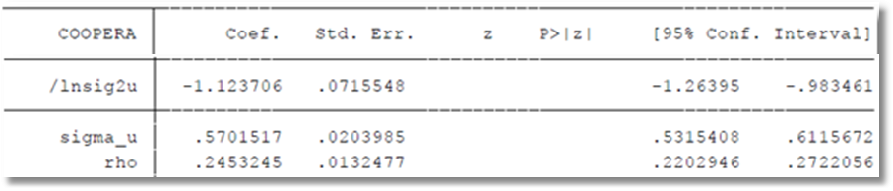
Confidence Intervals?

Slide 55
Received October 6, 2012
Dear Prof. Greene,
I am AAAAAA, an assistant professor of Finance at the xxxxx university of xxxxx, xxxxx. I would be grateful if you could answer my question regarding the parameter estimates and the marginal effects in Multinomial Logit (MNL).
After running my estimations, the parameter estimate of my variable of interest is statistically significant, but its marginal effect, evaluated at the mean of the explanatory variables, is not. Can I just rely on the parameter estimates’ results to say that the variable of interest is statistically significant? How can I reconcile the parameter estimates and the marginal effects’ results?
Thank you very much in advance!
Best,
AAAAAA

