Slide 1

Econometrics I
Professor William Greene
Stern School of Business
Department of Economics

Slide 2
Econometrics I
Part 9 – Asymptotics for the
Regression Model

Slide 3
Asymptotic Properties
Main finite sample results are not necessarily useful
  1. Unbiased: Not very useful if the estimator does not improve as more information is added. (The mean of the first 10 observations in a sample of n observations is unbiased, but not a good estimator.)
  2. Variance under narrow assumptions: Assumptions are often not met in realistic settings, so standard errors might be inaccurate.
  3. Gauss-Markov theorem: Not necessarily interested in the most efficient estimator if we have to make unrealistic assumptions.
  4. Normal distribution of estimator: We would rather not make this assumption if not necessary. It is generally not necessary.
Overriding principle: Robustness to loosened assumptions.

Slide 4
Asymptotic Properties of Interest
Consistent Estimator of β
Asymptotic Normal Distribution
Appropriate Asymptotic Variance
We develop properties that will hold in large samples then assume they hold acceptably well in finite observed samples. The objective is to relax the assumptions of the model where possible.

Slide 5
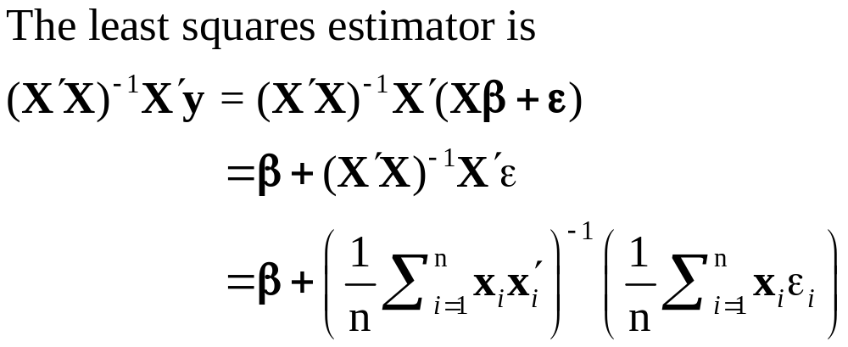
Core Results
So, it equals β plus the sampling variability = the estimation error
The question for the present is how does this sum of random variables behave in large samples?

Slide 6
Well Behaved Regressors
A crucial assumption: Convergence of the moment matrix X′X/n to a positive definite matrix of finite elements, Q.
For now, we assume that data on the rows of X act like a random sample of observations that are independent of the sample of observations on ε.

Slide 7
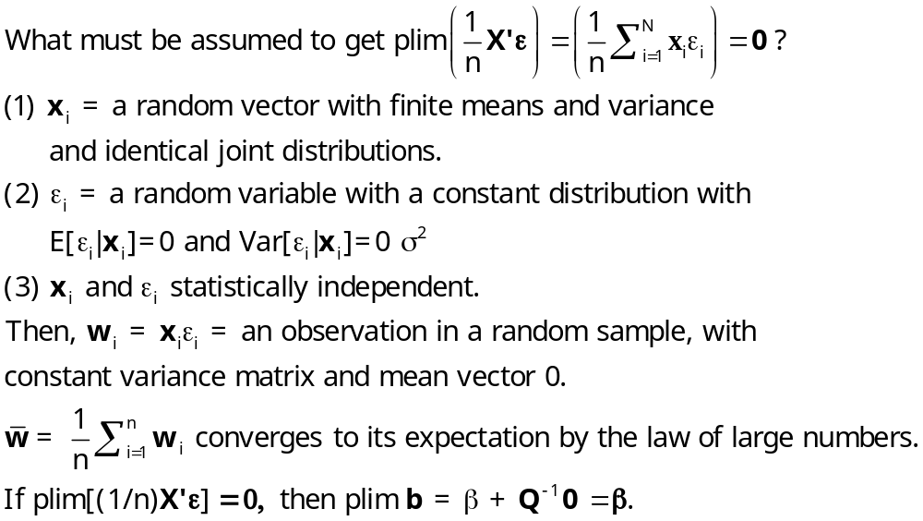
Crucial Assumption of the Model

Slide 8
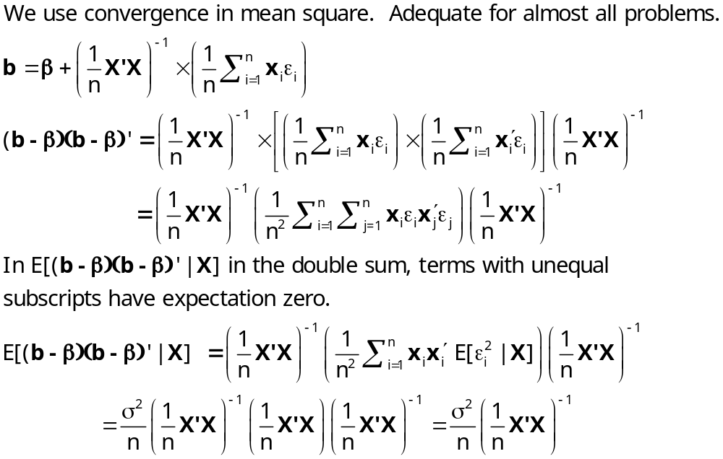
Mean Square Convergence of b
σ²

Slide 9
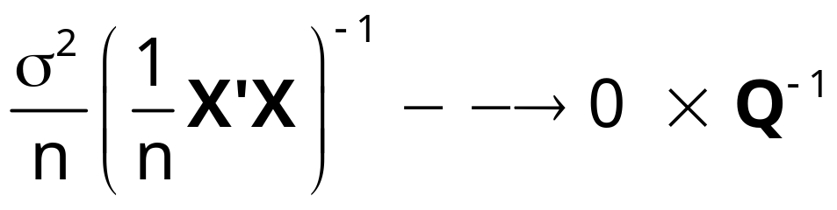
Mean Square Convergence
E[b|X]=β for any X.
Var[b|X]→0 for well behaved X
b converges in mean square to β
s² = e’e/n is a consistent estimator of σ². The usual estimator is e’e/(n-K)
The estimator of the asymptotic variance of b is (s²/n)[X’X/n]⁻¹ = s²(X’X)⁻¹

Slide 10
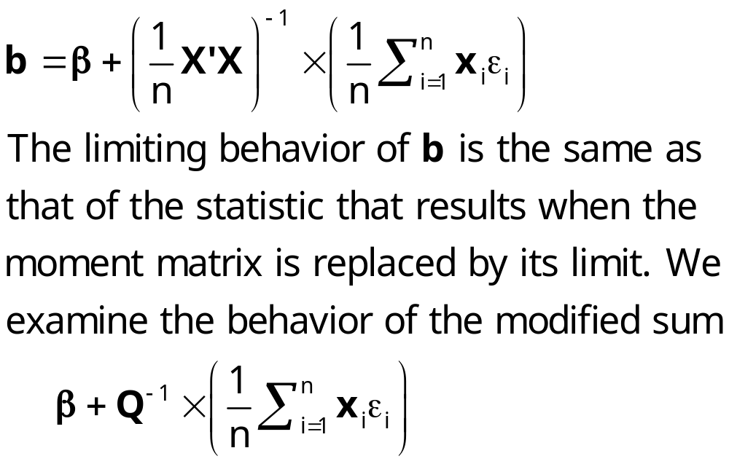
Asymptotic Distribution

Slide 11
Asymptotic Distribution
Finding the asymptotic distribution
b → β in probability. How to describe the distribution?
  ‘Limiting’ distribution
    Variance → 0; it is O(1/n)
    Stabilize the variance? Var[√n b] ~ σ²Q⁻¹ is O(1)
    But, E[√n b]= √n β which diverges.
  √n (b - β) → a random variable with finite mean and variance. (stabilizing transformation)
  b apx. β +1/√n times that random variable

Slide 12
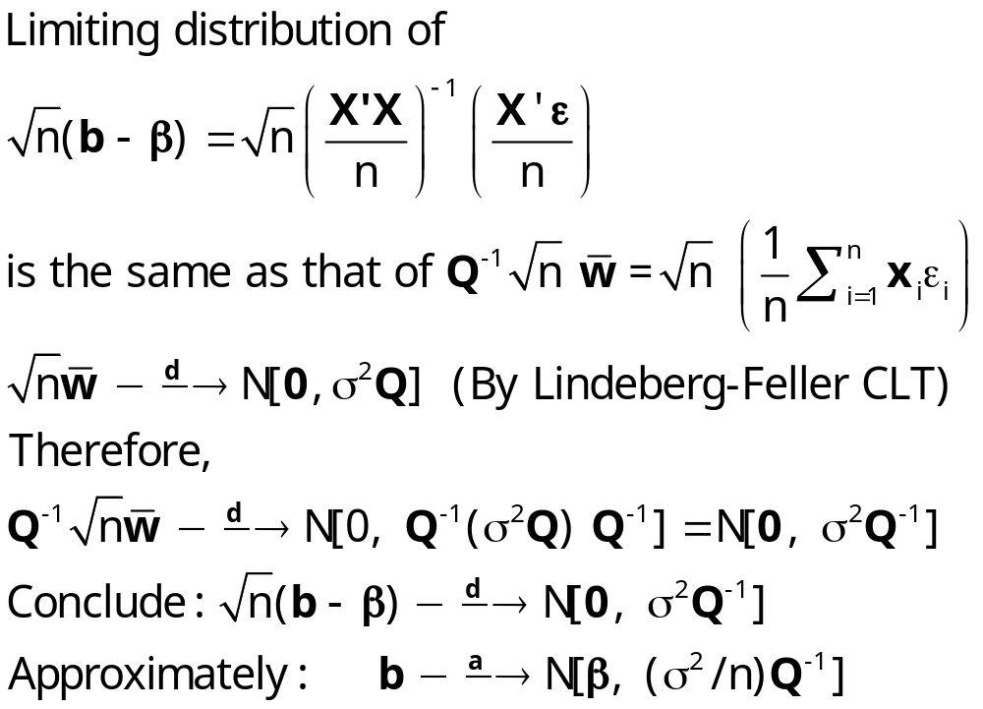
The Asymptotic Distribution

Slide 13
Asymptotic Results
b is a consistent estimator of β
Asymptotic normal distribution of b does not depend on normality of ε; it depends on the Central Limit Theorem
Estimator of the asymptotic variance (σ²/n)Q⁻¹ is
(s²/n) (X’X/n)⁻¹. (Degrees of freedom corrections are irrelevant but conventional.)
Slutsky theorem and the delta method apply to functions of b using Est.Asy.Var[b] = s²(X’X)⁻¹.

Slide 14
An Application:
Cornwell and Rupert Labor Market Data
Is Wage Related to Education?
Cornwell and Rupert Returns to Schooling Data, 595 Individuals, 7 Years
Variables in the file are
EXP = work experience
WKS = weeks worked
OCC = occupation, 1 if blue collar,
IND = 1 if manufacturing industry
SOUTH = 1 if resides in south
SMSA = 1 if resides in a city (SMSA)
MS = 1 if married
FEM = 1 if female
UNION = 1 if wage set by union contract
ED = years of education
LWAGE = log of wage = dependent variable in regressions
These data were analyzed in Cornwell, C. and Rupert, P., "Efficient Estimation with Panel Data: An Empirical Comparison of Instrumental Variable Estimators," Journal of Applied Econometrics, 3, 1988, pp. 149-155.
Notes:
14

Slide 15

Regression with Conventional Standard Errors
Reported Standard Errors are Square roots of Diagonal Elements of s²(X’X)⁻¹

Slide 16
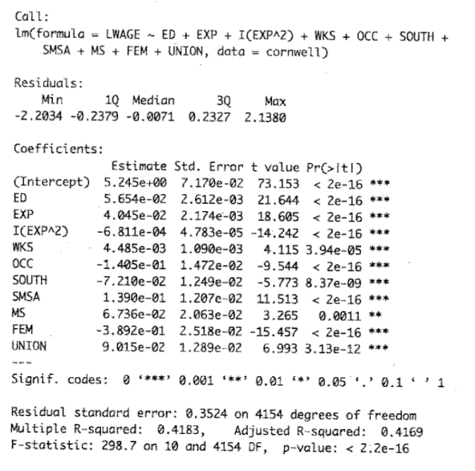

Slide 17
Robustness
Thus far, the model is a specific set of assumptions.
Consistency and asymptotic normality of b, and the form of the asymptotic covariance matrix follow from the assumptions.
Robust Estimation and Inference
  Estimators that “work” even if some of the assumptions are not met.
  E.g., LS is robust to failure of normality of ε - only the finite sample distribution is incorrect. It is still unbiased and Var[b|X]=σ²(X’X)⁻¹.
  Is least squares robust to failures of other assumptions?
Robustness to failures of other assumptions:
  (E) Suppose Cov[x_{i},ε_{i}] ≠ 0? (Endogeneity) No. Unbiasedness fails.
  (H) Heteroscedasticity? Still unbiased. Variance is no longer σ²(X’X)⁻¹.
  (A) Autocorrelation? Same.
We continue to use b but look for an alternative to s²(X’X)⁻¹ that will be appropriate in cases H and A. (Case E is not workable yet.)

Slide 18
A Robust Covariance Matrix
Crucial assumptions about ε
  Homoscedastic, Var[ε_{i}]=σ².
  Nonautocorrelation, Cov[ε_{i},ε_{j}] = 0 for all i,j.
Leading cases
  Heteroscedasticity; Var[ε_{i}]=σ_{i}².
  Groupwise correlation; Cov[ε_{it},ε_{is}] ≠ 0 for observations t and s in group i, i = 1,…,C_{i}.
  Time series autocorrelation; Cov[ε_{t},ε_{s}] ≠ 0
General result: b remains consistent and asymptotically normally distributed. Asymptotic covariance matrix is incorrect.

Slide 19
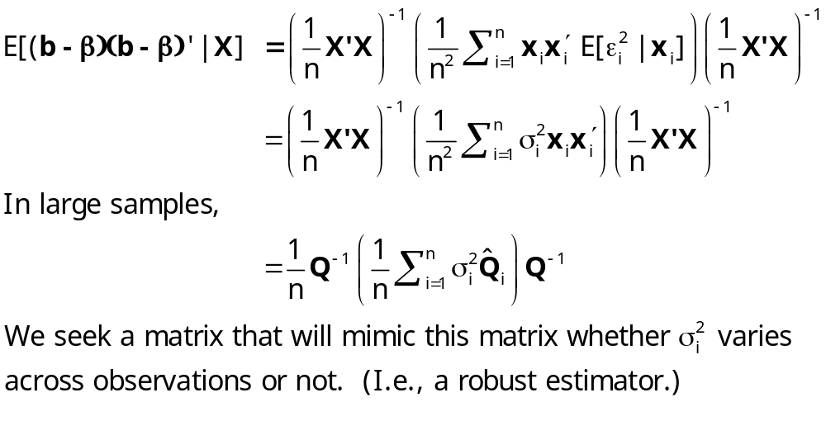
Robustness to Heteroscedasticity

Slide 20
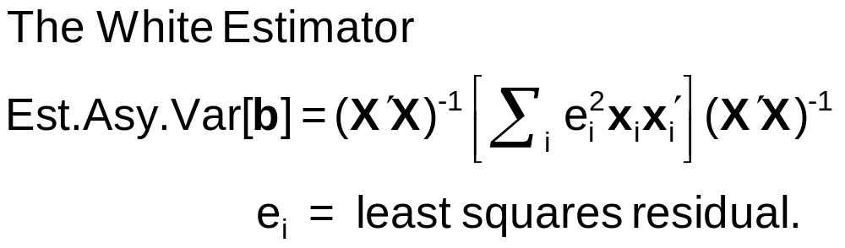
Heteroscedasticity Robust Covariance Matrix
Robust standard errors; (b is not “robust”)
  Robust to: Heteroscedasticty
  Not robust to: (all considered later)
    Correlation across observations
    Individual unobserved heterogeneity
    Incorrect model specification
Robust inference means hypothesis tests and confidence intervals using robust covariance matrices
Wisdom: Robust standard errors are usually larger, but not always.

Slide 21
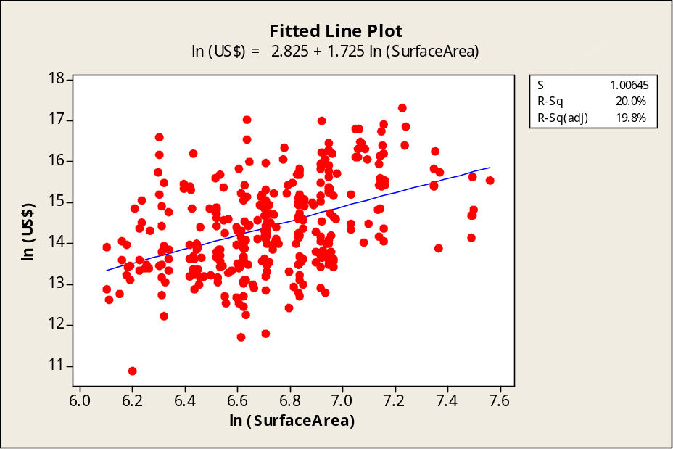

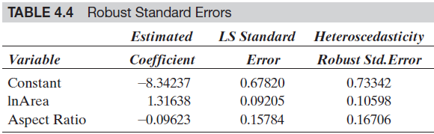
Monet in Large and Small
Sale prices of 430 signed Monet paintings
Log of $price = a +
b₁ log surface area +
b₂ aspect ratio + ε

Slide 22
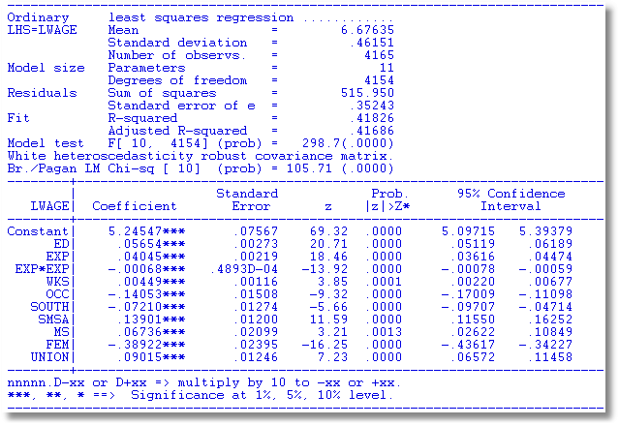
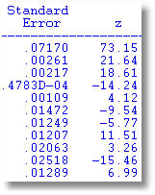
Heteroscedasticity Robust Covariance Matrix
Uncorrected
Note the conflict: Test favors heteroscedasticity.
Robust VC matrix is essentially the same.

Slide 23
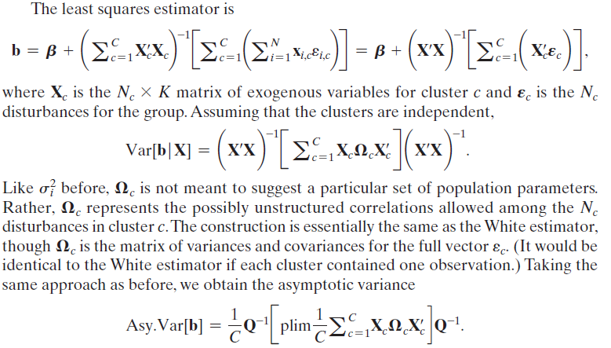
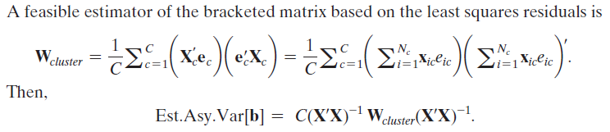
Cluster Robust Covariance Matrix

Slide 24
http://cameron.econ.ucdavis.edu/research/Cameron_Miller_Cluster_Robust_October152013.pdf

Slide 25
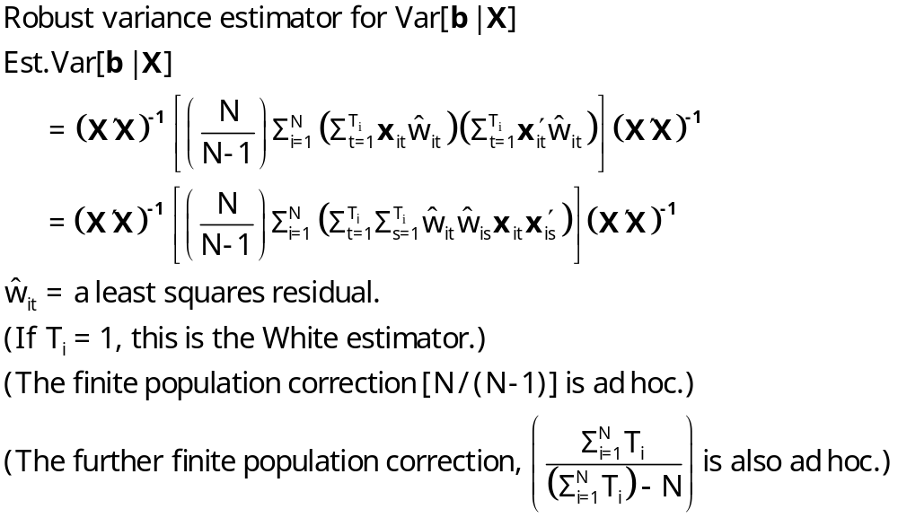
A Cluster Estimator

Slide 26
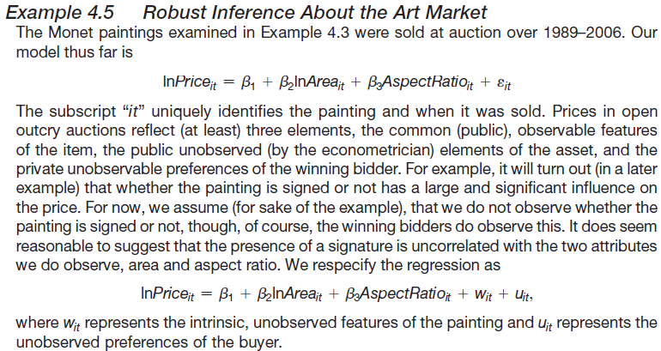
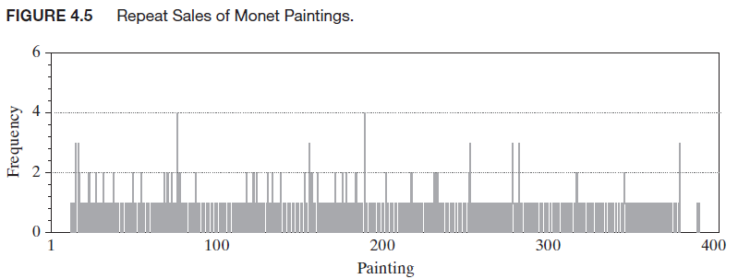

Slide 27
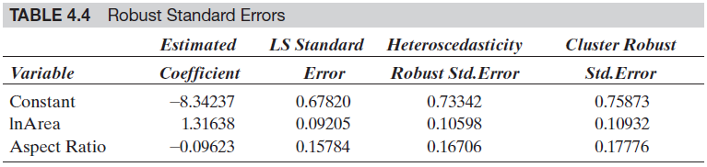
Robust Asymptotic Covariance Matrices

Slide 28

Alternative OLS Variance Estimators
Cluster correction increases SEs
+---------+--------------+----------------+--------+---------+
|Variable | Coefficient | Standard Error |b/St.Er.|P[|Z|>z] |
+---------+--------------+----------------+--------+---------+
Constant 5.40159723 .04838934 111.628 .0000
EXP .04084968 .00218534 18.693 .0000
EXPSQ -.00068788 .480428D-04 -14.318 .0000
OCC -.13830480 .01480107 -9.344 .0000
SMSA .14856267 .01206772 12.311 .0000
MS .06798358 .02074599 3.277 .0010
FEM -.40020215 .02526118 -15.843 .0000
UNION .09409925 .01253203 7.509 .0000
ED .05812166 .00260039 22.351 .0000
Robust
Constant 5.40159723 .10156038 53.186 .0000
EXP .04084968 .00432272 9.450 .0000
EXPSQ -.00068788 .983981D-04 -6.991 .0000
OCC -.13830480 .02772631 -4.988 .0000
SMSA .14856267 .02423668 6.130 .0000
MS .06798358 .04382220 1.551 .1208
FEM -.40020215 .04961926 -8.065 .0000
UNION .09409925 .02422669 3.884 .0001
ED .05812166 .00555697 10.459 .0000

Slide 29
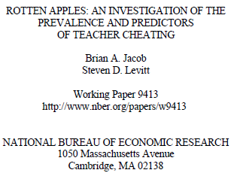
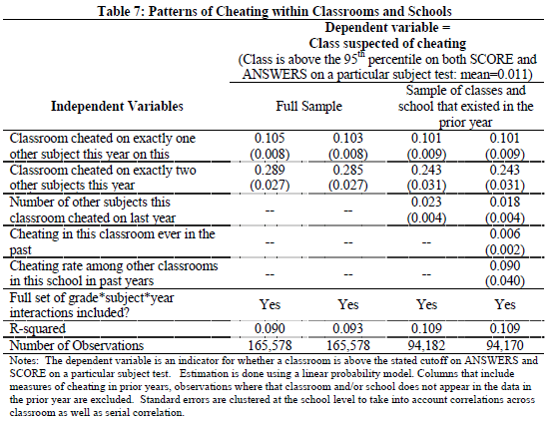

Slide 30
Bootstrap Estimation of the Asymptotic
Variance of an Estimator
Known form of asymptotic variance:
Compute from known results
Unknown form, known generalities about properties: Use bootstrapping
  Root n consistency
  Sampling conditions amenable to central limit theorems
  Compute by resampling mechanism within the sample.

Slide 31
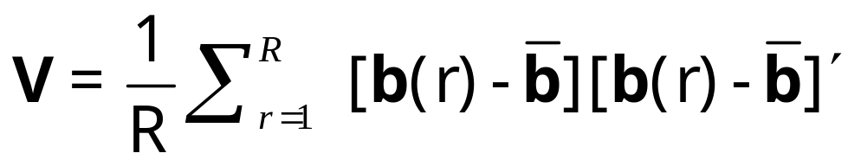
Bootstrapping Algorithm
1. Estimate parameters using full sample: → b
2. Repeat R times:
Draw n observations from the n, with replacement
Estimate β with b(r).
3. Estimate variance with

Slide 32
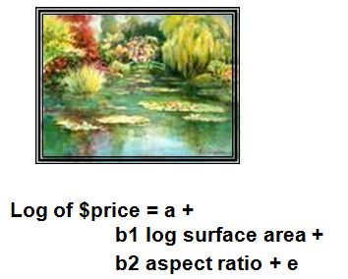
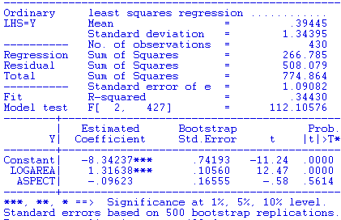

Slide 33
Application to Spanish Dairy Farms lny=b₁lnx₁+b₂lnx₂+b₃lnx₃+b₄lnx₄+ε
Input | Units | Mean | Std. Dev. | Minimum | Maximum
Y Milk | Milk production (liters) | 131,108 | 92,539 | 14,110 | 727,281
X1 Cows | # of milking cows | 2.12 | 11.27 | 4.5 | 82.3
X2 Labor | # man-equivalent units | 1.67 | 0.55 | 1.0 | 4.0
X3 Land | Hectares of land devoted to pasture and crops. | 12.99 | 6.17 | 2.0 | 45.1
X4 Feed | Total amount of feedstuffs fed to dairy cows (tons) | 57,941 | 47,981 | 3,924.14 | 376,732
N = 247 farms, T = 6 years (1993-1998)

Slide 34
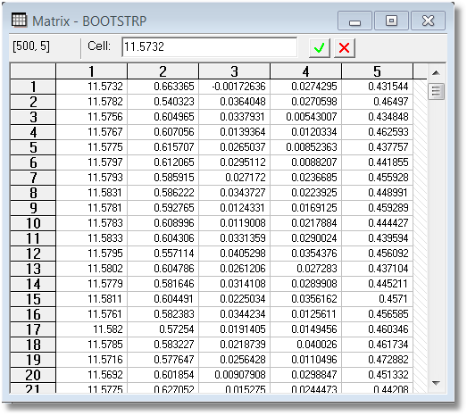
Example: Bootstrap Replications

Slide 35
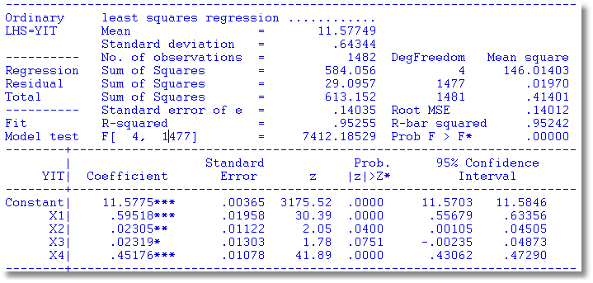
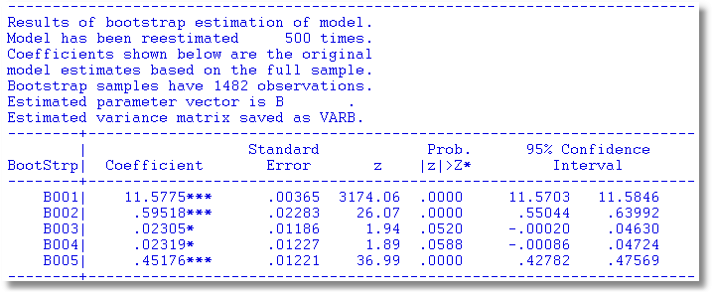
Bootstrapped Regression

Slide 36
Quantile Regression
Q(y|x,α) = β′x, α = quantile
Estimated by linear programming
Q(y|x,.50) = β′x, .50 ➔ median regression
Median regression estimated by LAD (estimates same parameters as mean regression if symmetric conditional distribution)
Why use quantile (median) regression?
  Semiparametric
  Robust to some extensions (heteroscedasticity?)
  Complete characterization of conditional distribution

Slide 37
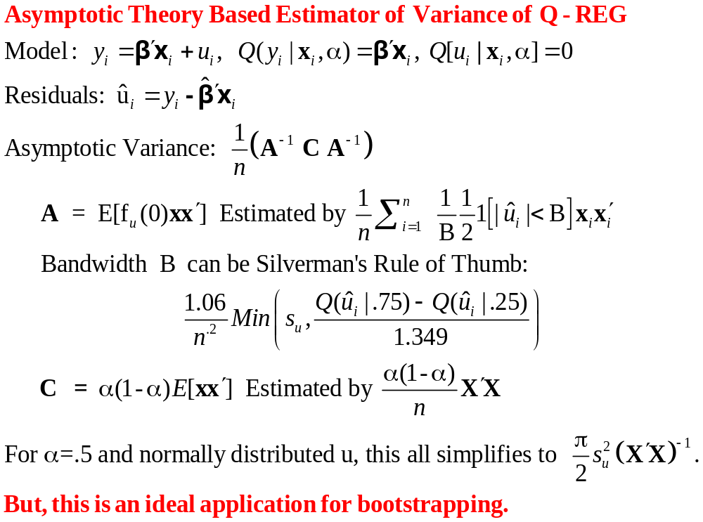
Estimated Variance for Quantile Regression

Slide 38
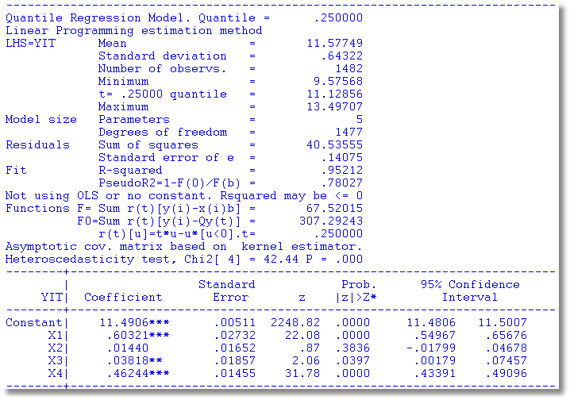
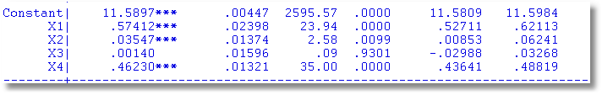
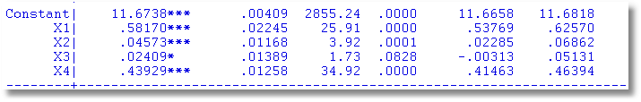
Quantile Regressions
α = .25
α = .50
α = .75

Slide 39

The bootstrap replication must account for panel data nature of the data set.
Bootstrap variance for a panel data estimator
Panel Bootstrap =
Block Bootstrap
Data set is N groups of size T_{i}
Bootstrap sample is N groups of size T_{i} drawn with replacement.

Slide 40
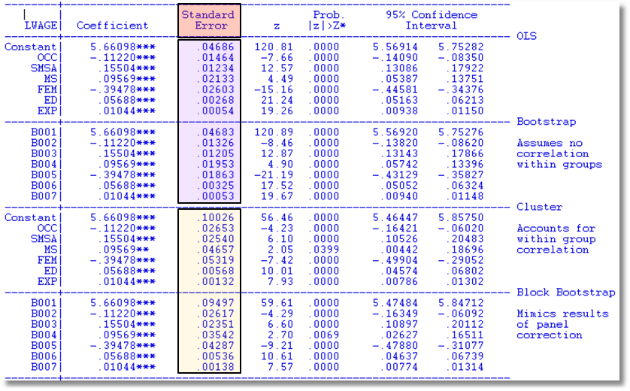
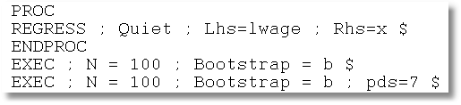

Slide 41
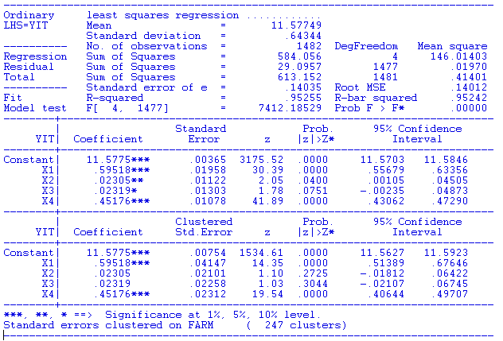
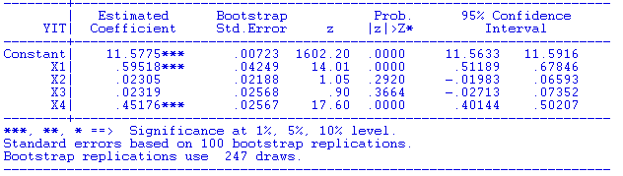
Conventional
Cluster
Robust
Block
Bootstrap

