Slide 1




Microeconometric Modeling
William Greene
Stern School of Business
New York University
New York NY USA
4.2 Latent Class Models

Slide 2
Agenda
Tuesday 12/5 Latent Class Models
  http://people.stern.nyu.edu/wgreene/Econometrics/LatentClassModels.pptx
Thursday 12/7 Simulation Based Estimation
  http://people.stern.nyu.edu/wgreene/Econometrics/Econometrics-I-23.pptx
Tuesday 12/12 Bayesian Estimation
  http://people.stern.nyu.edu/wgreene/Econometrics/Econometrics-I-24.pptx
Bonus – Spatial Discrete Choice Models
http://people.stern.nyu.edu/wgreene/Econometrics/SpatialDCModels.pptx

Slide 3

Concepts
Models
Latent Class
Prior and Posterior Probabilities
Classification Problem
Finite Mixture
Normal Mixture
Health Satisfaction
EM Algorithm
ZIP Model
Hurdle Model
NB2 Model
Obesity/BMI Model
Misreporter
Value of Travel Time Saved
Decision Strategy
Multinomial Logit Model
Latent Class MNL
Heckman – Singer Model
Latent Class Ordered Probit
Attribute Nonattendance Model
2^{K} Model

Slide 4
Latent Classes
A population contains a mixture of individuals of different types (classes)
Common form of the data generating mechanism within the classes
Observed outcome y is governed by the common process F(y|x,θ_{j} )
Classes are distinguished by the parameters, θ_{j}.

Slide 5

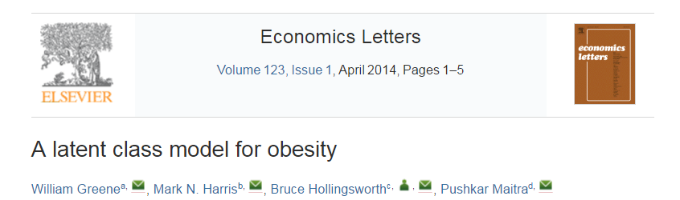

Slide 6
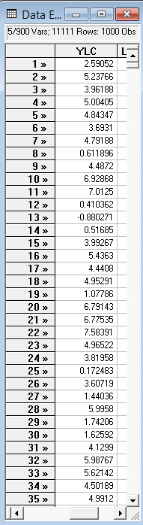
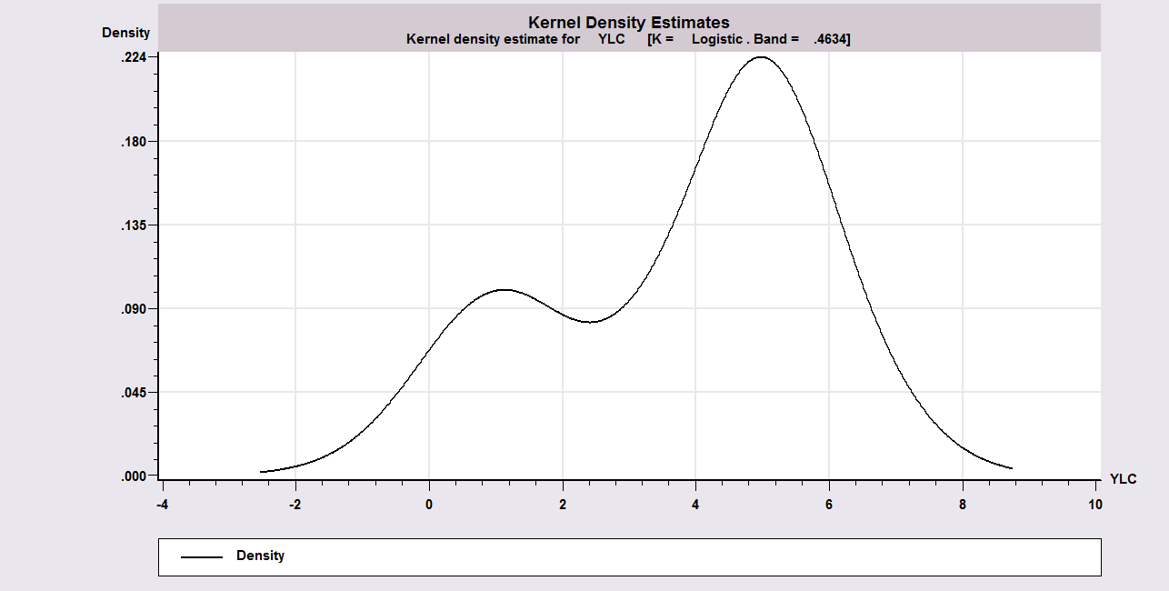
Unmixing a Mixed Sample
Sample ; 1 – 1000$
Calc ; Ran(123457)$
Create ; lc1=rnn(1,1) ;lc2=rnn(5,1)$
Create ; class=rnu(0,1)$ Uniform[0,1]
Create ; if(class<.3)ylc=lc1 ; (else)ylc=lc2$
Kernel ; rhs=ylc $
Regress ; lhs=ylc;rhs=one;lcm;pts=2;pds=1$

Slide 7
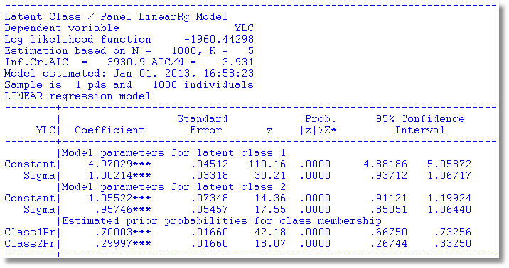
A Mixture of Normals

Slide 8

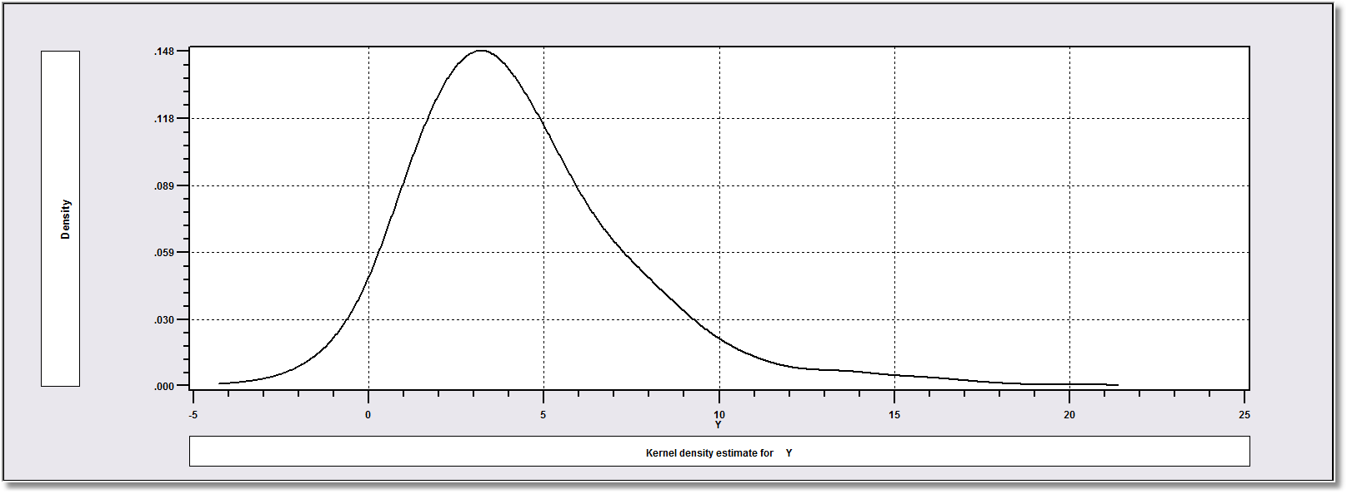
How Finite Mixture Models Work
Density? Note significant mass below zero. Not a gamma or lognormal or any other familiar density.

Slide 9
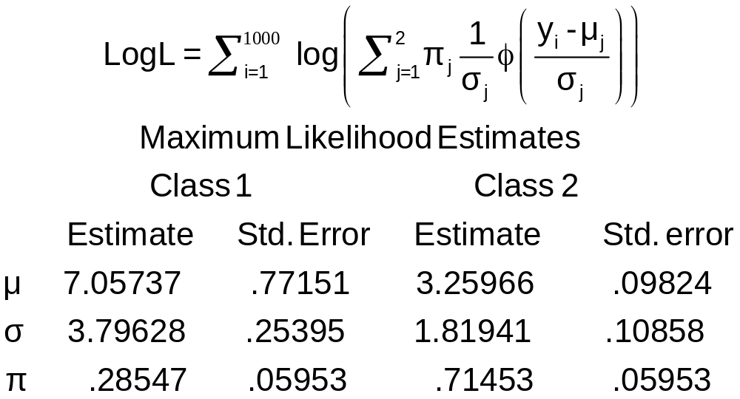
Find the ‘Best’ Fitting Mixture of Two Normal Densities

Slide 10
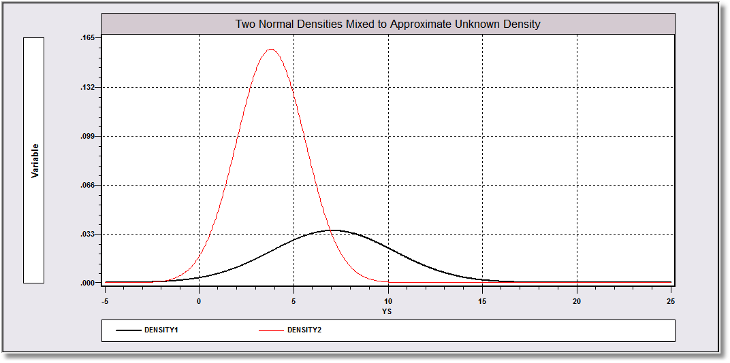
Mixing probabilities .715 and .285

Slide 11
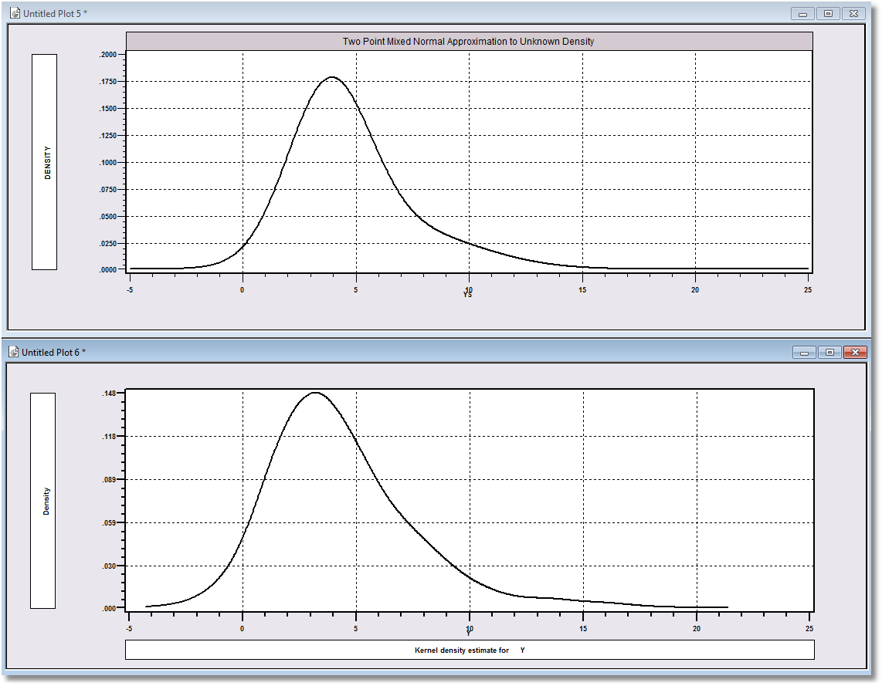
Approximation
Actual Distribution

Slide 12
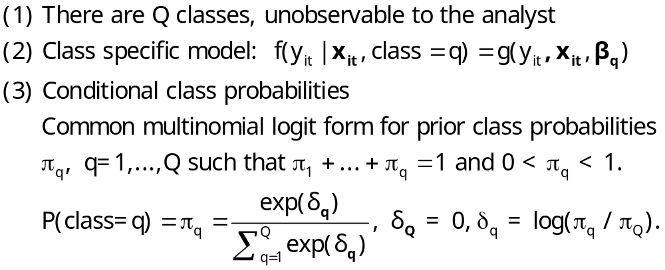
The Latent Class Model

Slide 13
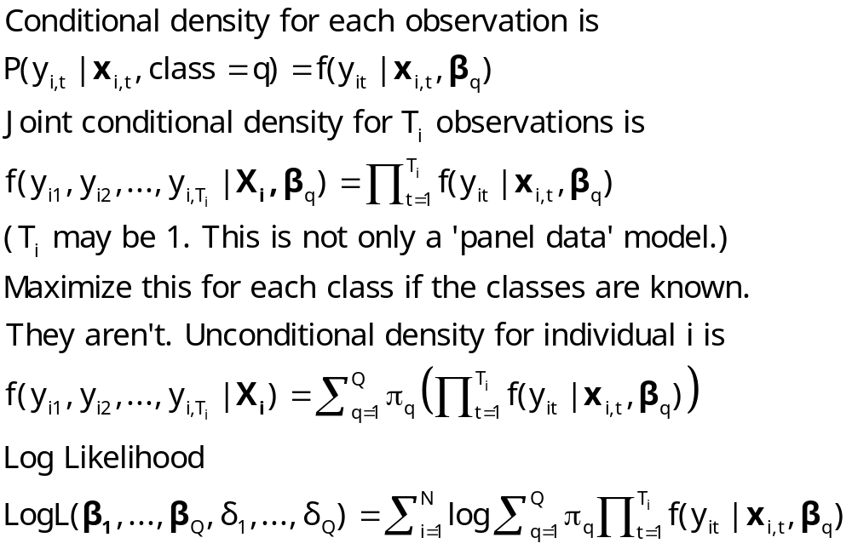
Log Likelihood for an LC Model

Slide 14
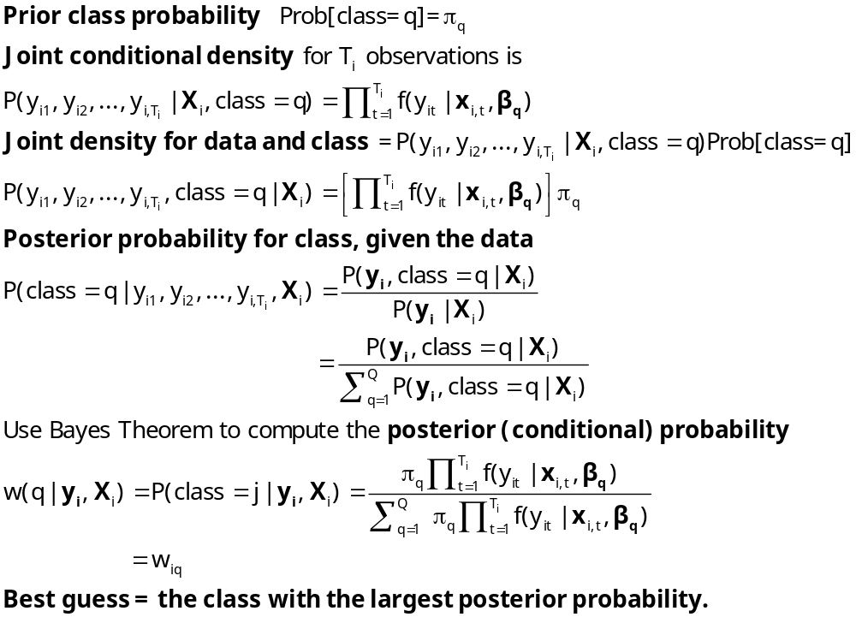
Estimating Which Class

Slide 16
Latent Class Modeling
Several ‘types’ or ‘classes. Obesity be due to genetic reasons (the FTO gene) or lifestyle factors
Distinct sets of individuals may have differing reactions to various policy tools and/or characteristics
The observer does not know from the data which class an individual is in.
Suggests a latent class approach for health outcomes
(Deb and Trivedi, 2002, and Bago d’Uva, 2005)

Slide 17
An Ordered Probit Approach
A Latent Regression Model for “True BMI”
BMI* = β′x + ε, ε ~ N[0,σ²], σ² = 1
“True BMI” = a proxy for weight is unobserved
Observation Mechanism for Weight Type
WT = 0 if BMI* < 0 Normal
1 if 0 < BMI* < μ Overweight
2 if μ < BMI* Obese

Slide 18
Latent Class Application
Two class model (considering FTO gene):
  More classes make class interpretations much more difficult
  Parametric models proliferate parameters
Two classes allow us to correlate the unobservables driving class membership and observed weight outcomes.
Theory for more than two classes not yet developed.

Slide 19
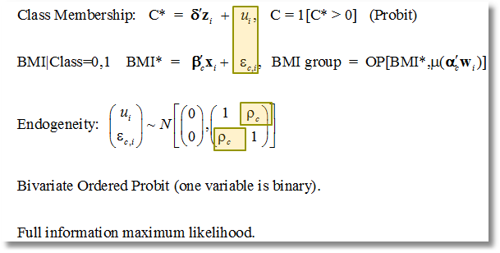
Correlation of Unobservables in Class Membership and BMI Equations

Slide 20
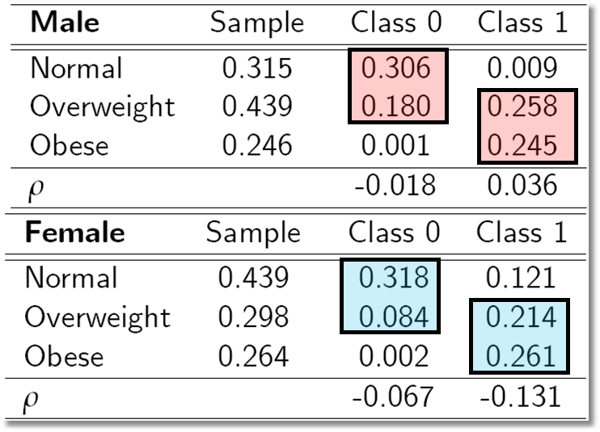
Outcome Probabilities
Class 0 dominated by normal and overweight probabilities ‘normal weight’ class
Class 1 dominated by probabilities at top end of the scale ‘non-normal weight’
Unobservables for weight class membership, negatively correlated with those determining weight levels:

Slide 21
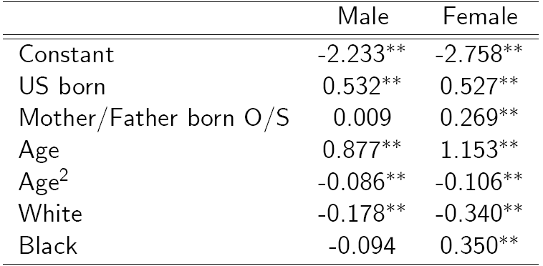
Classification (Latent Probit) Model

Slide 22
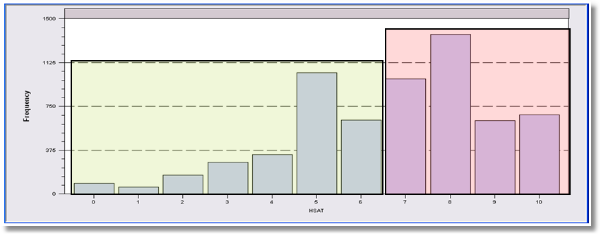
LCM for Health Status
Self Assessed Health Status = 0,1,…,10
Recoded: Healthy = HSAT > 6
Using only groups observed T=7 times; N=887
Prob = Φ(Age,Educ,Income,Married,Kids)
2, 3 classes

Slide 23
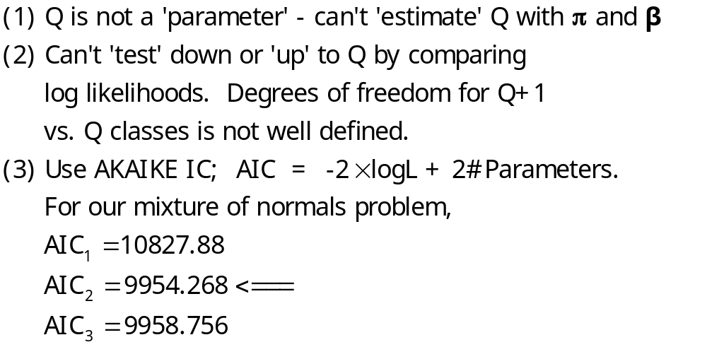
How Many Classes?

Slide 24
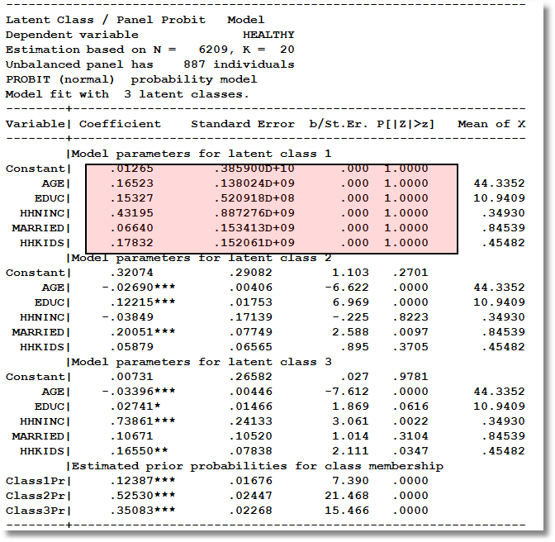
Too Many Classes

Slide 25
Two Class Model
----------------------------------------------------------------------
Latent Class / Panel Probit Model
Dependent variable HEALTHY
Unbalanced panel has 887 individuals
PROBIT (normal) probability model
Model fit with 2 latent classes.
--------+-------------------------------------------------------------
Variable| Coefficient Standard Error b/St.Er. P[|Z|>z] Mean of X
--------+-------------------------------------------------------------
|Model parameters for latent class 1
Constant| .61652** .28620 2.154 .0312
AGE| -.02466*** .00401 -6.143 .0000 44.3352
EDUC| .11759*** .01852 6.351 .0000 10.9409
HHNINC| .10713 .20447 .524 .6003 .34930
MARRIED| .11705 .09574 1.223 .2215 .84539
HHKIDS| .04421 .07017 .630 .5287 .45482
|Model parameters for latent class 2
Constant| .18988 .31890 .595 .5516
AGE| -.03120*** .00464 -6.719 .0000 44.3352
EDUC| .02122 .01934 1.097 .2726 10.9409
HHNINC| .61039*** .19688 3.100 .0019 .34930
MARRIED| .06201 .10035 .618 .5367 .84539
HHKIDS| .19465** .07936 2.453 .0142 .45482
|Estimated prior probabilities for class membership
Class1Pr| .56604*** .02487 22.763 .0000
Class2Pr| .43396*** .02487 17.452 .0000

Slide 26
Hurdle Models
Two decisions:
  Whether or not to participate: y=0 or +.
  If participate, how much. y|y>0
One ‘regime’ – individual always makes both decisions.
Implies different models for zeros and positive values
  Prob(0) = 1 – F(γ′z), Prob(+) = F(γ′z)
  Prob(y|+) = P(y)/[1 – P(0)]

Slide 27


Slide 28

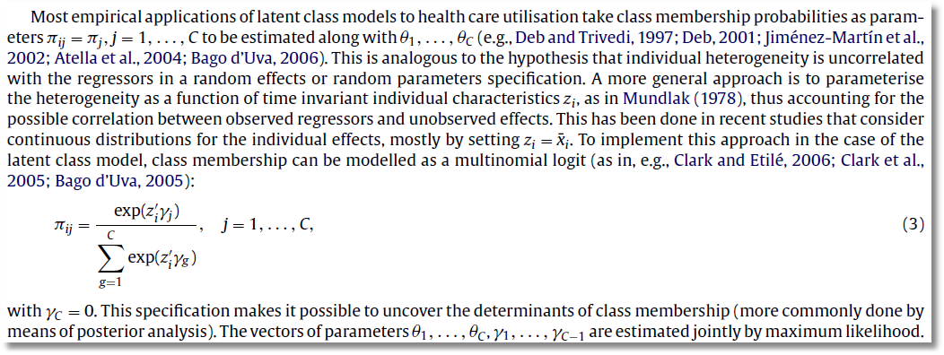

Slide 29
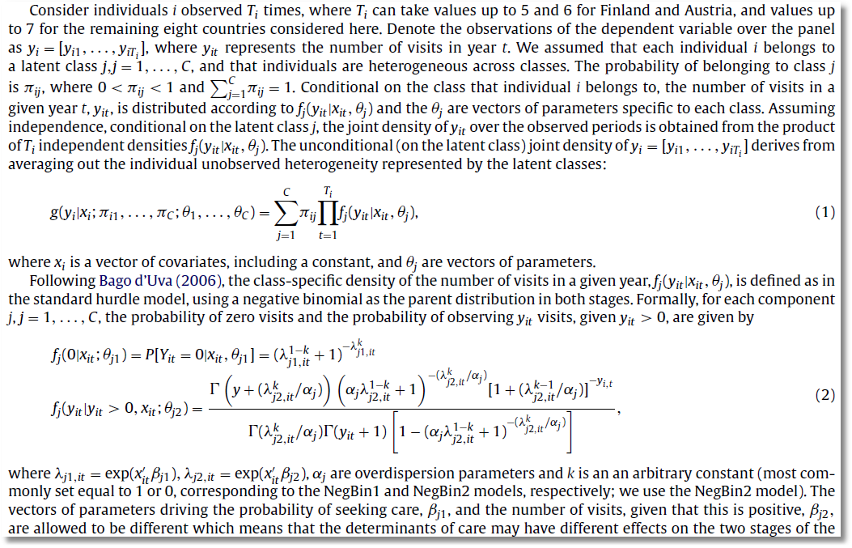

Slide 30
A Latent Class Hurdle NB Model
Analysis of ECHP panel data (1994-2001)
Two class Latent Class Model
  Typical in health economics applications
Hurdle model for physician visits
  Poisson hurdle for participation and negative binomial intensity given participation
  Contrast to a negative binomial model

Slide 31
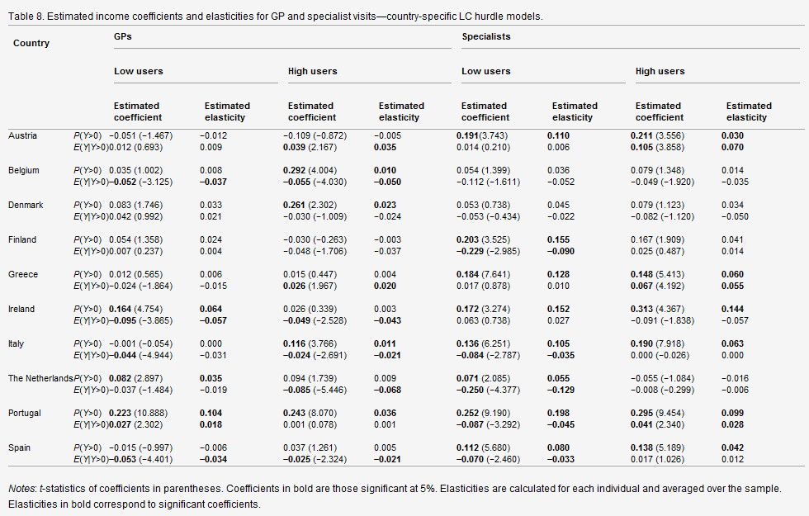

Slide 32
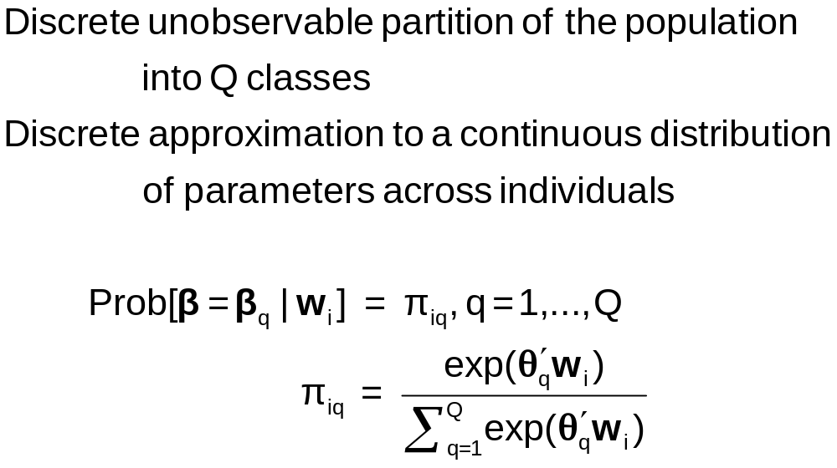
Discrete Parameter Heterogeneity
Latent Classes

Slide 33
Latent Class Probabilities
Ambiguous – Classical Bayesian model?
  The randomness of the class assignment is from the point of view of the observer, not a natural process governed by a discrete distribution.
Equivalent to random parameters models with discrete parameter variation
  Using nested logits, etc. does not change this
  Precisely analogous to continuous ‘random parameter’ models
Not always equivalent – zero inflation models – in which classes have completely different models

Slide 34
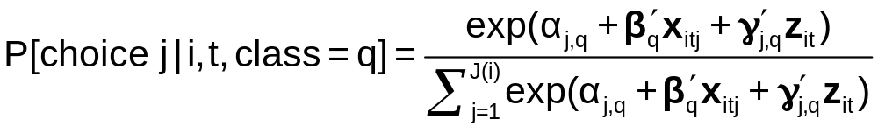
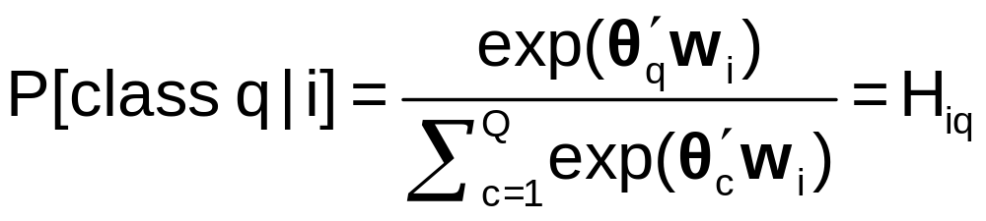
A Latent Class MNL Model
Within a “class”
Class sorting is probabilistic (to the analyst) determined by individual characteristics

Slide 35
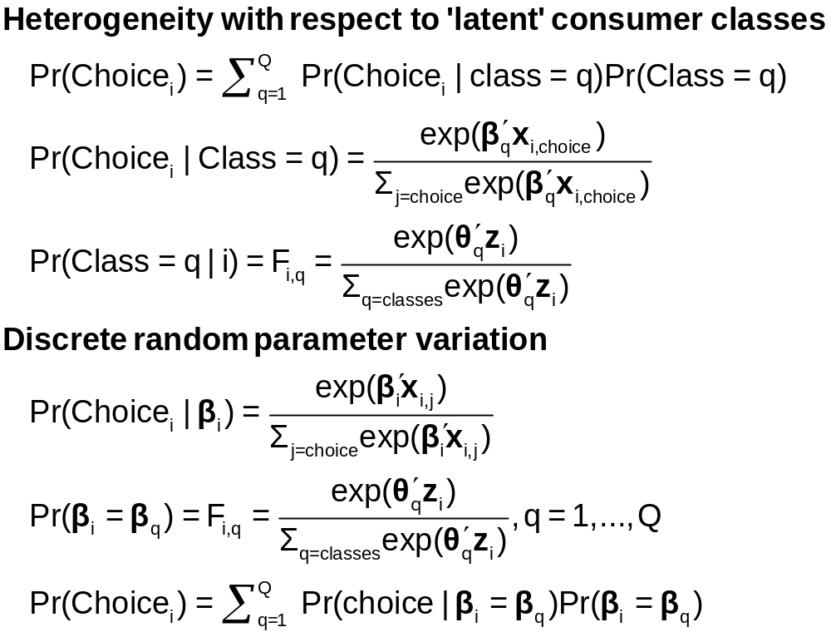
Two Interpretations of Latent Classes

Slide 36
Estimates from the LCM
Taste parameters within each class β_{q}
Parameters of the class probability model, θ_{q}
For each person:
  Posterior estimates of the class they are in q|i
  Posterior estimates of their taste parameters E[β_{q}|i]
  Posterior estimates of their behavioral parameters, elasticities, marginal effects, etc.

Slide 37
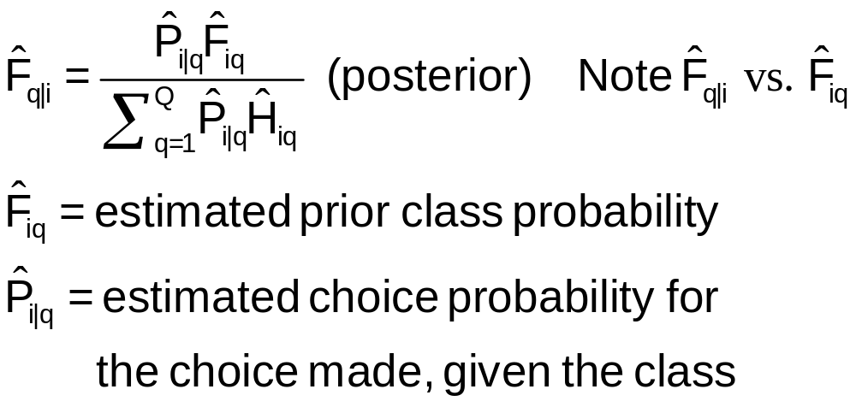
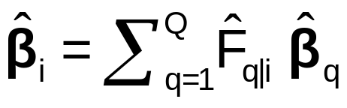
Using the Latent Class Model
Computing posterior (individual specific) class probabilities
Computing posterior (individual specific) taste parameters

Slide 38
Application: Shoe Brand Choice
Simulated Data: Stated Choice, 400 respondents, 8 choice situations, 3,200 observations
3 choice/attributes + NONE
  Fashion = High / Low
  Quality = High / Low
  Price = 25/50/75,100 coded 1,2,3,4
Heterogeneity: Sex (Male=1), Age (<25, 25-39, 40+)
Underlying data generated by a 3 class latent class process (100, 200, 100 in classes)

Slide 39

Stated Choice Experiment: Unlabeled Alternatives
1 observation = 8 stated choice tasks
t=1
t=2
t=3
t=4
t=5
t=6
t=7
t=8

Slide 40
One Class MNL Estimates
-----------------------------------------------------------
Discrete choice (multinomial logit) model
Dependent variable Choice
Log likelihood function -4158.50286
Estimation based on N = 3200, K = 4
R2=1-LogL/LogL* Log-L fncn R-sqrd R2Adj
Constants only -4391.1804 .0530 .0510
Response data are given as ind. choices
Number of obs.= 3200, skipped 0 obs
--------+--------------------------------------------------
Variable| Coefficient Standard Error b/St.Er. P[|Z|>z]
--------+--------------------------------------------------
FASH|1| 1.47890*** .06777 21.823 .0000
QUAL|1| 1.01373*** .06445 15.730 .0000
PRICE|1| -11.8023*** .80406 -14.678 .0000
ASC4|1| .03679 .07176 .513 .6082
--------+--------------------------------------------------

Slide 41
Application: Brand Choice
True underlying model is a three class LCM
NLOGIT
; Lhs=choice
; Choices=Brand1,Brand2,Brand3,None
; Rhs = Fash,Qual,Price,ASC4
; LCM=Male,Age25,Age39
; Pts=3
; Pds=8
; Parameters (Save posterior results) $

Slide 42
Three Class LCM
Normal exit from iterations. Exit status=0.
-----------------------------------------------------------
Latent Class Logit Model
Dependent variable CHOICE
Log likelihood function -3649.13245
Restricted log likelihood -4436.14196
Chi squared [ 20 d.f.] 1574.01902
Significance level .00000
McFadden Pseudo R-squared .1774085
Estimation based on N = 3200, K = 20
R2=1-LogL/LogL* Log-L fncn R-sqrd R2Adj
No coefficients -4436.1420 .1774 .1757
Constants only -4391.1804 .1690 .1673
At start values -4158.5428 .1225 .1207
Response data are given as ind. choices
Number of latent classes = 3
Average Class Probabilities
.506 .239 .256
LCM model with panel has 400 groups
Fixed number of obsrvs./group= 8
Number of obs.= 3200, skipped 0 obs
--------+--------------------------------------------------
LogL for one class MNL = -4158.503
Based on the LR statistic it would seem unambiguous to reject the one class model. The degrees of freedom for the test are uncertain, however.

Slide 43
Estimated LCM: Utilities
--------+--------------------------------------------------
Variable| Coefficient Standard Error b/St.Er. P[|Z|>z]
--------+--------------------------------------------------
|Utility parameters in latent class -->> 1
FASH|1| 3.02570*** .14549 20.796 .0000
QUAL|1| -.08782 .12305 -.714 .4754
PRICE|1| -9.69638*** 1.41267 -6.864 .0000
ASC4|1| 1.28999*** .14632 8.816 .0000
|Utility parameters in latent class -->> 2
FASH|2| 1.19722*** .16169 7.404 .0000
QUAL|2| 1.11575*** .16356 6.821 .0000
PRICE|2| -13.9345*** 1.93541 -7.200 .0000
ASC4|2| -.43138** .18514 -2.330 .0198
|Utility parameters in latent class -->> 3
FASH|3| -.17168 .16725 -1.026 .3047
QUAL|3| 2.71881*** .17907 15.183 .0000
PRICE|3| -8.96483*** 1.93400 -4.635 .0000
ASC4|3| .18639 .18412 1.012 .3114

Slide 44
Estimated LCM: Class Probability Model
--------+--------------------------------------------------
Variable| Coefficient Standard Error b/St.Er. P[|Z|>z]
--------+--------------------------------------------------
|This is THETA(01) in class probability model.
Constant| -.90345** .37612 -2.402 .0163
_MALE|1| .64183* .36245 1.771 .0766
_AGE25|1| 2.13321*** .32096 6.646 .0000
_AGE39|1| .72630* .43511 1.669 .0951
|This is THETA(02) in class probability model.
Constant| .37636 .34812 1.081 .2796
_MALE|2| -2.76536*** .69325 -3.989 .0001
_AGE25|2| -.11946 .54936 -.217 .8279
_AGE39|2| 1.97657*** .71684 2.757 .0058
|This is THETA(03) in class probability model.
Constant| .000 ......(Fixed Parameter)......
_MALE|3| .000 ......(Fixed Parameter)......
_AGE25|3| .000 ......(Fixed Parameter)......
_AGE39|3| .000 ......(Fixed Parameter)......
--------+--------------------------------------------------

Slide 45
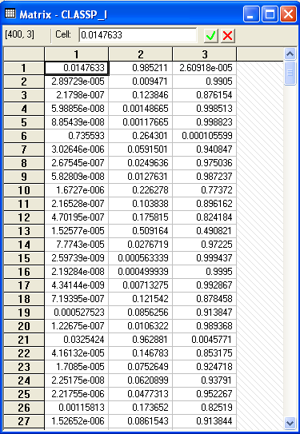
Estimated LCM: Conditional (Posterior) Class Probabilities

Slide 46
Average Estimated Class Probabilities
MATRIX ; list ; 1/400 * classp_i'1$
Matrix Result has 3 rows and 1 columns.
1
+--------------
1| .50555
2| .23853
3| .25593
This is how the data were simulated. Class probabilities are .5, .25, .25. The model ‘worked.’

Slide 47
Inflated Responses in Self-Assessed Health
Mark Harris
Department of Economics, Curtin University
Bruce Hollingsworth
Department of Economics, Lancaster University
William Greene
Stern School of Business, New York University

Slide 48
SAH vs. Objective Health Measures
Favorable SAH categories seem artificially high.
• 60% of Australians are either overweight or obese (Dunstan et. al, 2001)
• 1 in 4 Australians has either diabetes or a condition of impaired glucose metabolism
• Over 50% of the population has elevated cholesterol
• Over 50% has at least 1 of the “deadly quartet” of health conditions
(diabetes, obesity, high blood pressure, high cholestrol)
• Nearly 4 out of 5 Australians have 1 or more long term health conditions
(National Health Survey, Australian Bureau of Statistics 2006)
• Australia ranked #1 in terms of obesity rates
Similar results appear to appear for other countries

Slide 49
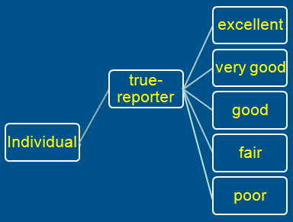
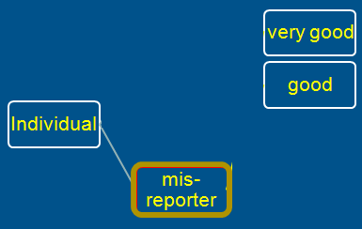
A Two Class Latent Class Model
True Reporter
Misreporter

Slide 50
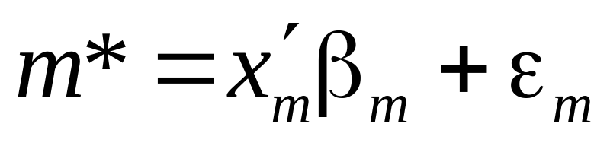
Mis-reporters choose either good or very good
The response is determined by a probit model
Y=3
Y=2

Slide 51
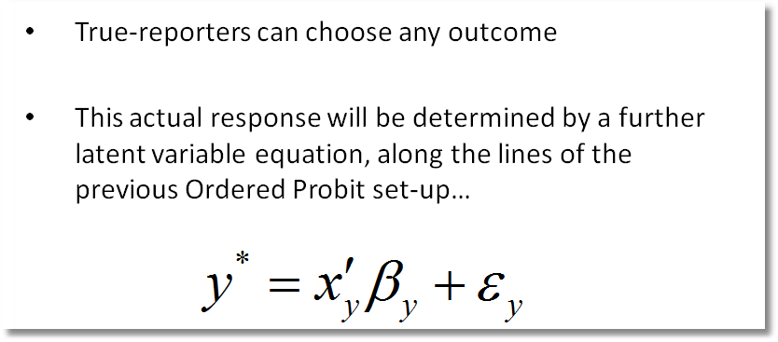
Y=4
Y=3
Y=2
Y=1
Y=0

Slide 52
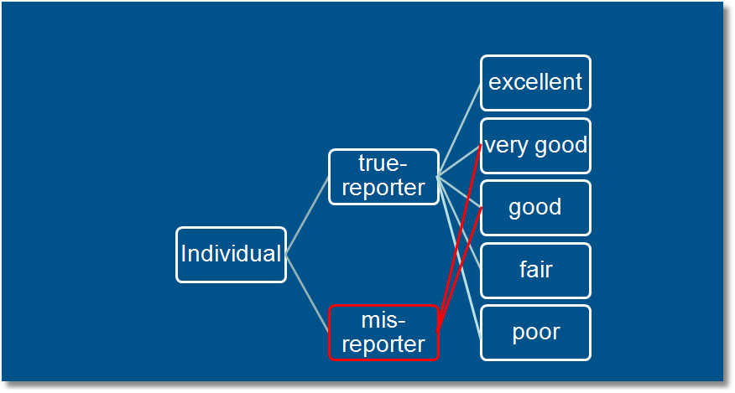
Observed Mixture of Two Classes

Slide 53
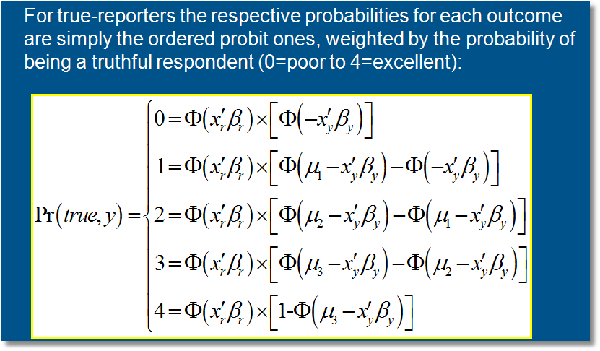
Pr(true,y) = Pr(true) * Pr(y | true)

Slide 54
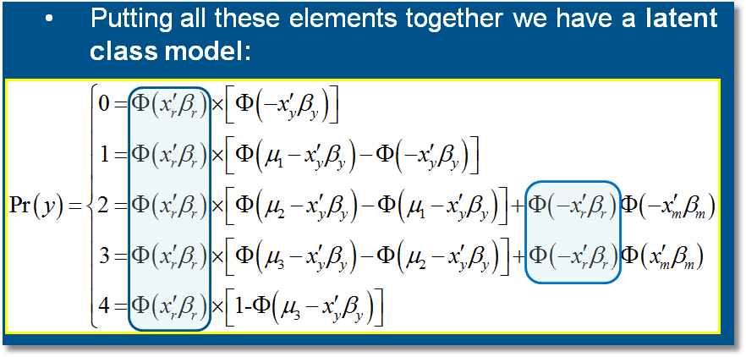

Slide 55
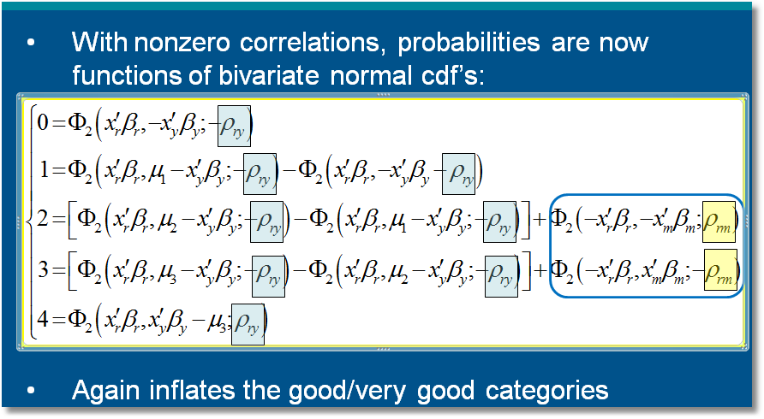

Slide 56
General Result

Slide 57
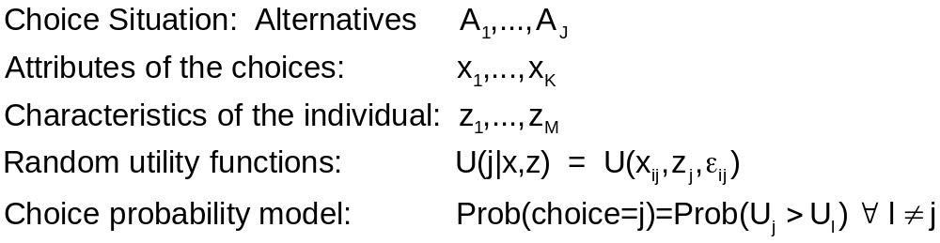
Decision Strategy in Multinomial Choice

Slide 58
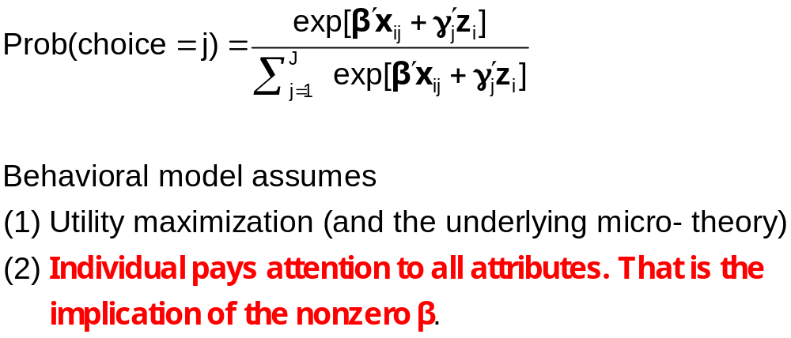
Multinomial Logit Model

Slide 59
The 2^{K} model
The analyst believes some attributes are ignored. There is no indicator.
Classes distinguished by which attributes are ignored
Same model applies, now a latent class. For K attributes there are 2^{K} candidate coefficient vectors

Slide 60
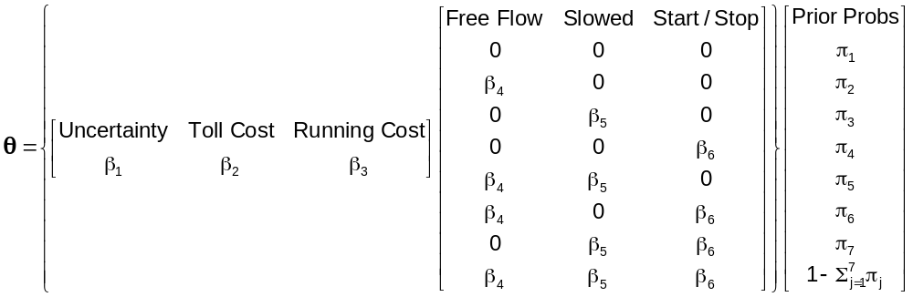
Latent Class Models with
Cross Class Restrictions
8 Class Model: 6 structural utility parameters, 7 unrestricted prior probabilities.
Reduced form has 8(6)+8 = 56 parameters. (π_{j} = exp(α_{j})/∑_{j}exp(α_{j}), α_{J} = 0.)
EM Algorithm: Does not provide any means to impose cross class restrictions.
“Bayesian” MCMC Methods: May be possible to force the restrictions – it will not be simple.
Conventional Maximization: Simple

Slide 61


Slide 62
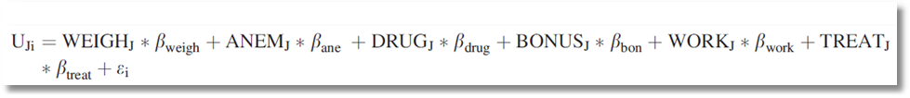
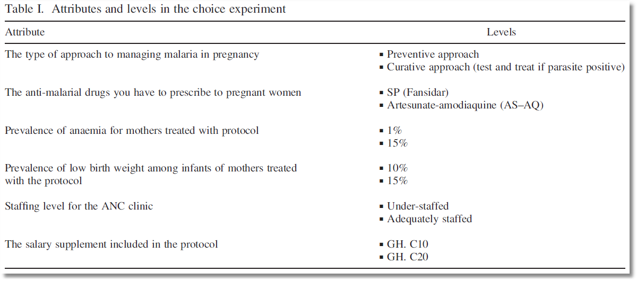
Choice Model with 6 Attributes

Slide 63
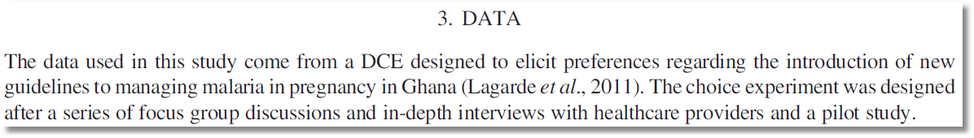
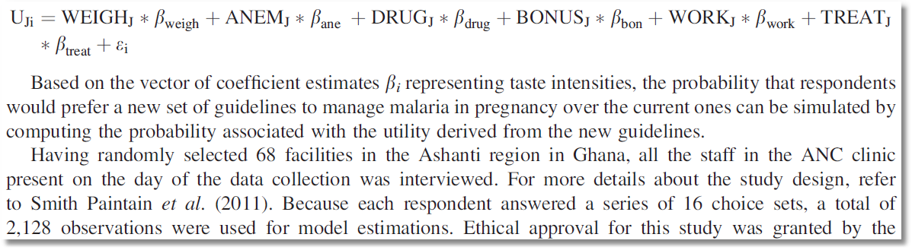
Stated Choice Experiment

Slide 64
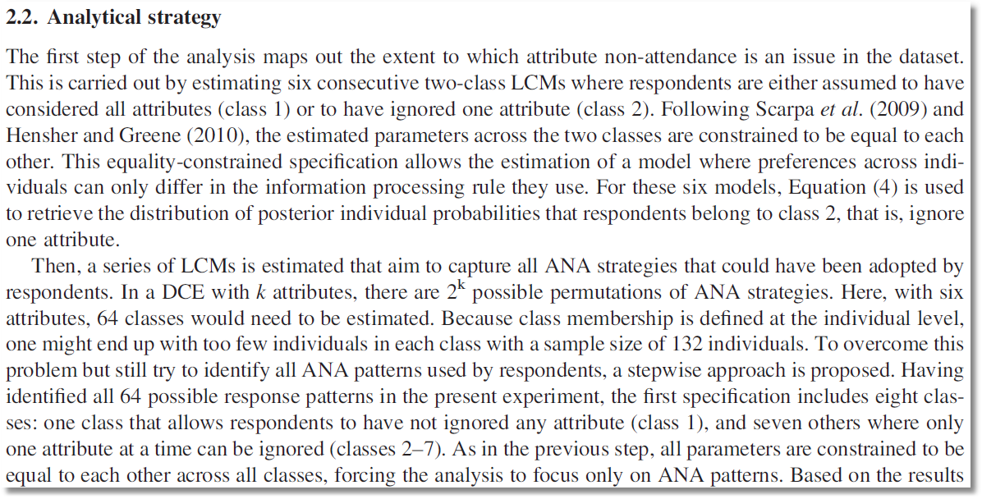
6 attributes implies 64 classes. Strategy to reduce the computational burden on a small sample

