Slide 1





http://people.stern.nyu.edu/Econometrics/OrderedChoices.pptx
Microeconometric Modeling
Models for OrderedChoices
William Greene
Stern School of Business
New York University
New York NY USA

Slide 2
Ordered Discrete Outcomes
E.g.: Taste test, credit rating, course grade, preference scale
Underlying random preferences:
  Existence of an underlying continuous preference scale
  Mapping to observed choices
Strength of preferences is reflected in the discrete outcome
Censoring and discrete measurement
The nature of ordered data

Slide 3

Ordered Choices at IMDb

Slide 4
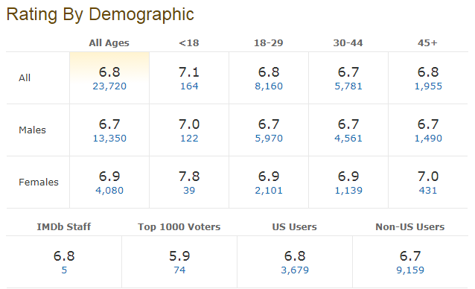

Slide 5
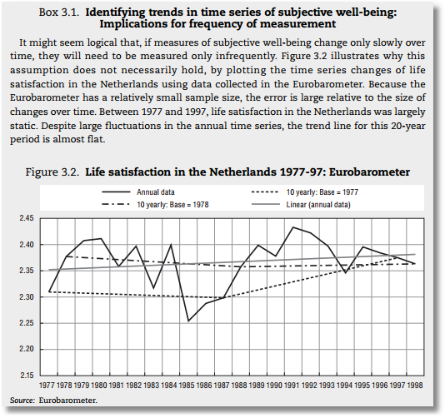


Slide 6
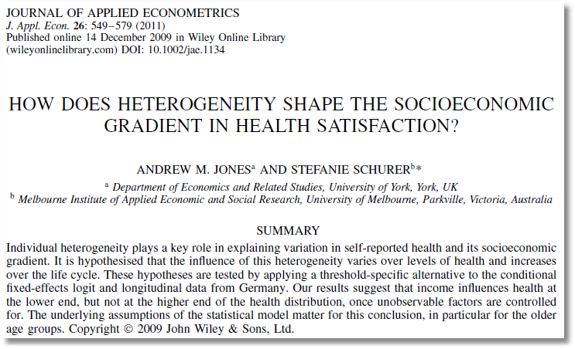

Slide 7
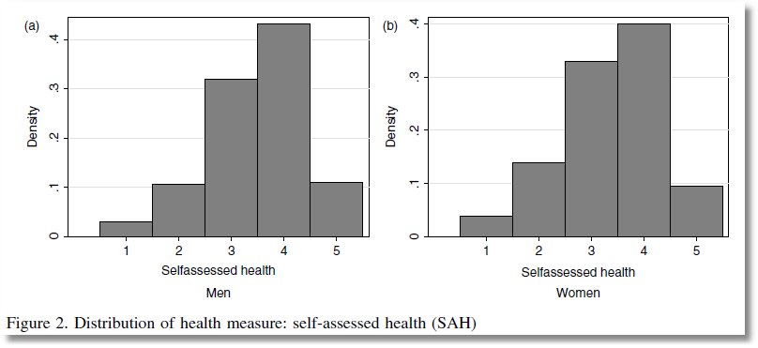
This study analyzes ‘self assessed health’ coded
1,2,3,4,5 = very low, low, med, high very high

Slide 8

Health Satisfaction (HSAT)
Self administered survey: Health Care Satisfaction (0 – 10)
Continuous Preference Scale

Slide 9
Modeling Ordered Choices
Random Utility (allowing a panel data setting)
Uit = α + β’xit + ε_{it}
= a_{it} + ε_{it}
Observe outcome j if utility is in region j
Probability of outcome = probability of cell
Pr[Yit=j] = F(μ_{j} – a_{it}) - F(μ_{j-1} – a_{it})

Slide 10
Ordered Probability Model

Slide 11

Combined Outcomes for Health Satisfaction
(0,1,2) (3,4,5) (6,7,8) (9) (10)

Slide 12
Ordered Probabilities

Slide 13
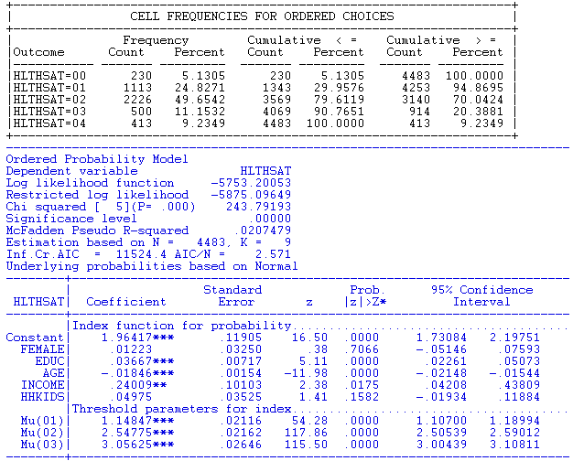
An Ordered Probability
Model for Health Satisfaction

Slide 14
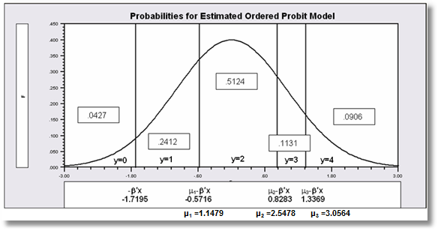

Slide 15
Analysis of Model Implications
Partial Effects
Fit Measures
Predicted Probabilities
  Averaged: They match sample proportions.
  By observation
  Segments of the sample
  Related to particular variables

Slide 16
Coefficients

Slide 17
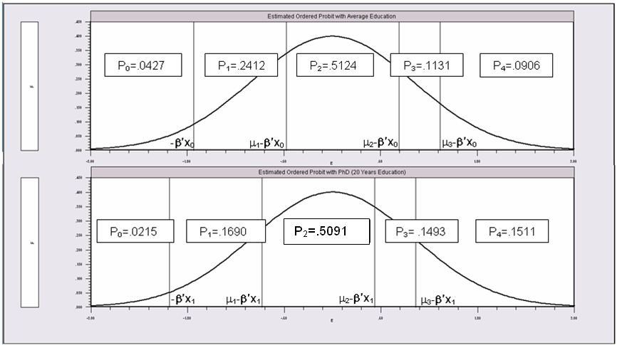
Partial Effects of 8 Years of Education

Slide 18
Ordered Probability Partial Effects
-----------------------------------------------------------------------------
Marginal effects for ordered probability model
M.E.s for dummy variables are Pr[y|x=1]-Pr[y|x=0]
Names for dummy variables are marked by *.
--------+--------------------------------------------------------------------
| Partial Prob. 95% Confidence
HLTHSAT| Effect Elasticity z |z|>Z* Interval
--------+--------------------------------------------------------------------
|--------------[Partial effects on Prob[Y=00] at means]--------------
*FEMALE| -.00117 -.02600 -.38 .7065 -.00726 .00492
EDUC| -.00351*** -.89008 -5.04 .0000 -.00488 -.00215
AGE| .00177*** 1.70456 11.15 .0000 .00146 .00208
INCOME| -.02298** -.17806 -2.37 .0178 -.04199 -.00398
*HHKIDS| -.00472 -.10470 -1.42 .1545 -.01121 .00177
|--------------[Partial effects on Prob[Y=01] at means]--------------
...
|--------------[Partial effects on Prob[Y=02] at means]--------------
...
|--------------[Partial effects on Prob[Y=03] at means]--------------
*FEMALE| .00146 .01323 .38 .7067 -.00614 .00906
EDUC| .00437*** .45292 4.82 .0000 .00259 .00615
AGE| -.00220*** -.86738 -9.36 .0000 -.00266 -.00174
INCOME| .02863** .09061 2.35 .0189 .00473 .05254
*HHKIDS| .00594 .05386 1.40 .1607 -.00236 .01424
|--------------[Partial effects on Prob[Y=04] at means]--------------
*FEMALE| .00192 .02209 .38 .7067 -.00808 .01191
EDUC| .00575*** .75573 5.05 .0000 .00352 .00798
AGE| -.00289*** -1.44727 -11.11 .0000 -.00341 -.00238
INCOME| .03764** .15118 2.37 .0178 .00651 .06878
*HHKIDS| .00786 .09053 1.40 .1618 -.00315 .01888
--------+--------------------------------------------------------------------
z, prob values and confidence intervals are given for the partial effect
***, **, * ==> Significance at 1%, 5%, 10% level.

Slide 19
Partial Effects at Means vs. Average Partial Effects
-----------------------------------------------------------------------------
Marginal effects for ordered probability model
M.E.s for dummy variables are Pr[y|x=1]-Pr[y|x=0]
Names for dummy variables are marked by *.
[Partial effects on Prob[Y=j] at means]
--------+--------------------------------------------------------------------
| Partial Prob. 95% Confidence
HLTHSAT| Effect Elasticity z |z|>Z* Interval
--------+--------------------------------------------------------------------
*FEMALE| -.00117 -.02600 -.38 .7065 -.00726 .00492
*FEMALE| -.00304 -.01232 -.38 .7066 -.01890 .01281
*FEMALE| .00084 .00164 .38 .7065 -.00352 .00520
*FEMALE| .00146 .01323 .38 .7067 -.00614 .00906
*FEMALE| .00192 .02209 .38 .7067 -.00808 .01191
---------------------------------------------------------------------
Partial Effects Analysis for Ordered Probit Prob[Y =All]
Effects on function with respect to FEMALE
Results are computed by average over sample observations
Partial effects for binary var FEMALE computed by first difference
---------------------------------------------------------------------
df/dFEMALE Partial Standard
(Delta Method) Effect Error |t| 95% Confidence Interval
---------------------------------------------------------------------
APE Prob(y= 0) -.00124 .00329 .38 -.00768 .00521
APE Prob(y= 1) -.00288 .00765 .38 -.01788 .01212
APE Prob(y= 2) .00077 .00204 .38 -.00323 .00477
APE Prob(y= 3) .00138 .00367 .38 -.00581 .00857
APE Prob(y= 4) .00197 .00524 .38 -.00829 .01223

Slide 20
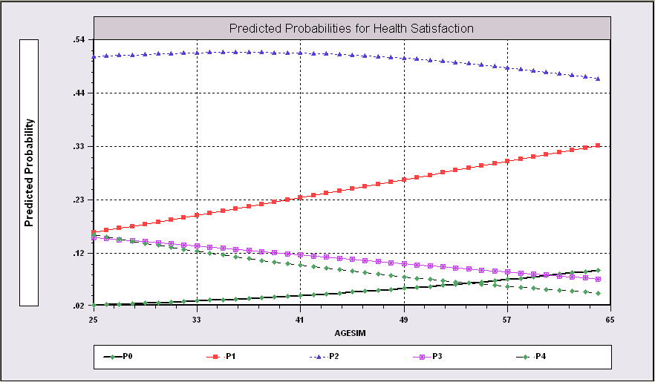
Predictions from the Model Related to Age

Slide 21
Fit Measures
There is no single “dependent variable” to explain.
There is no sum of squares or other measure of “variation” to explain.
Predictions of the model relate to a set of J+1 probabilities, not a single variable.
How to explain fit?
  Based on the underlying regression
  Based on the likelihood function
  Based on prediction of the outcome variable

Slide 22
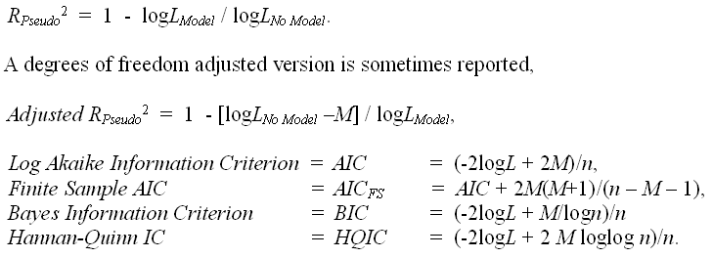
Log Likelihood Based Fit Measures

Slide 23
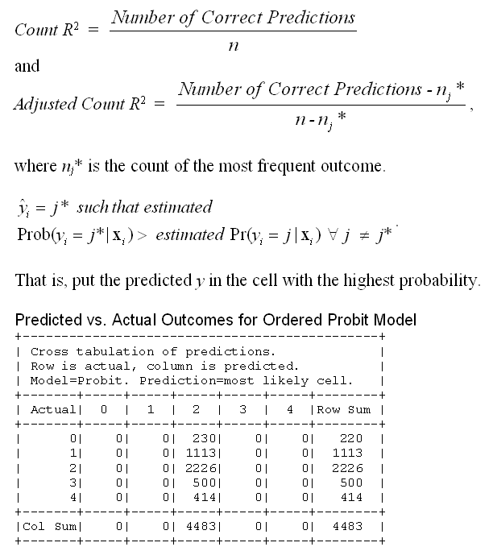

Slide 24
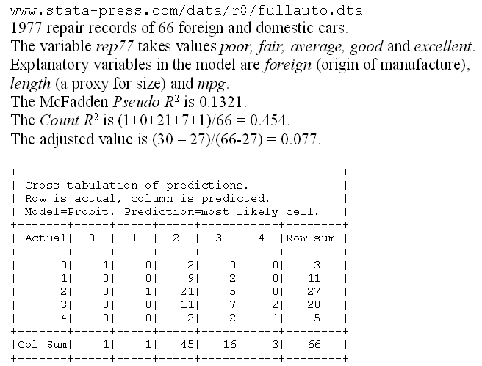
A Somewhat Better Fit

Slide 25
Panel Data
Fixed Effects
  The usual incidental parameters problem
  Partitioning Prob(y_{it} > j|x_{it}) produces estimable binomial logit models. (Find a way to combine multiple estimates of the same β.
Random Effects
  Standard application
  Extension to random parameters
Dynamics
Attrition

Slide 26
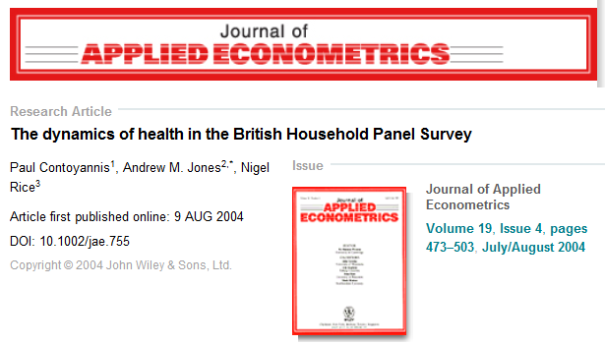
A Study of Health Status in the Presence of Attrition

Slide 27
Model for Self Assessed Health
British Household Panel Survey (BHPS)
  Waves 1-8, 1991-1998
  Self assessed health on 0,1,2,3,4 scale
  Sociological and demographic covariates
  Dynamics – inertia in reporting of top scale
Dynamic ordered probit model
  Balanced panel – analyze dynamics
  Unbalanced panel – examine attrition

Slide 28
Dynamic Ordered Probit Model
It would not be appropriate to include h_{i,t-1} itself in the model as this is a label, not a measure

Slide 29
Random Effects Dynamic Ordered Probit Model

Slide 30
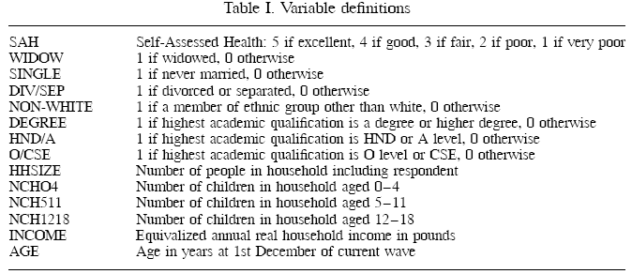
Data

Slide 31
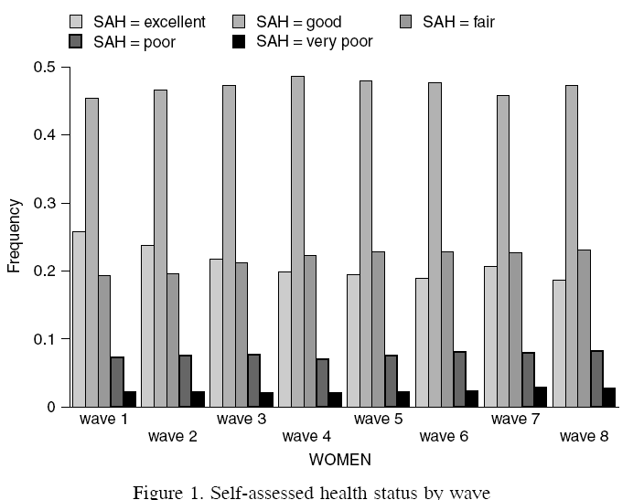
Variable of Interest

Slide 32
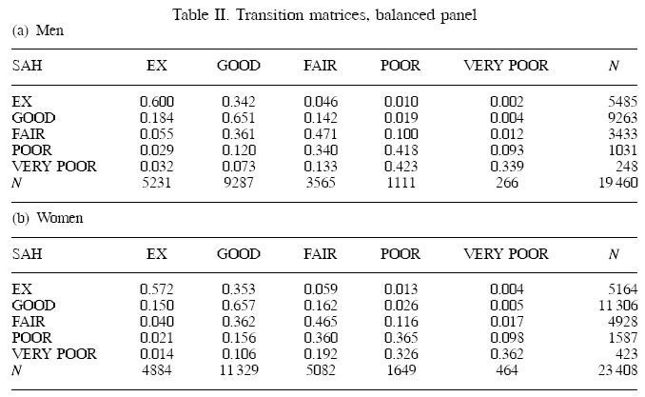
Dynamics

Slide 33
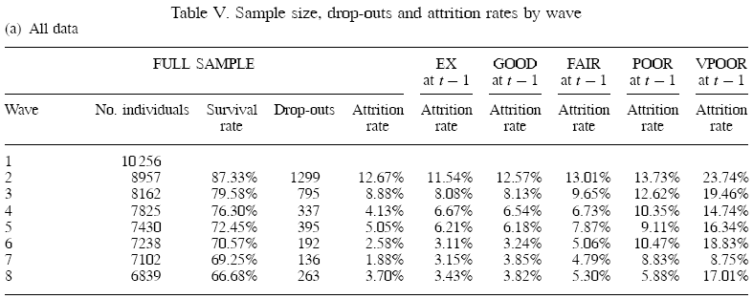
Attrition

Slide 34
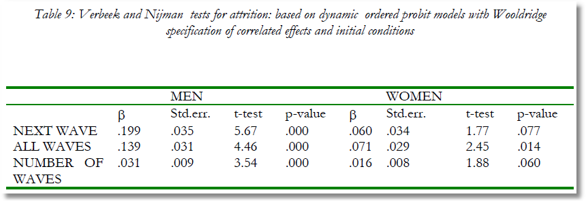
Testing for Attrition Bias
Three variables added to full model with unbalanced panel suggest presence of attrition effects.

Slide 35

Estimated Partial Effects by Model

Slide 36
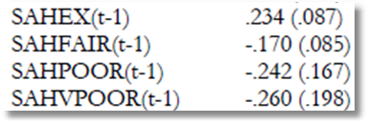
Partial Effect for a Category
These are 4 dummy variables for state in the previous period. Using first differences, the 0.234 estimated for SAHEX means transition from EXCELLENT in the previous period to GOOD in the previous period, where GOOD is the omitted category. Likewise for the other 3 previous state variables. The margin from ‘POOR’ to ‘GOOD’ was not interesting in the paper. The better margin would have been from EXCELLENT to POOR, which would have (EX,POOR) change from (1,0) to (0,1).

Slide 37
Appendix.
Ordered Choice Model Extensions

Slide 38
Different Normalizations
NLOGIT
  Y = 0,1,…,J, U* = α + β’x + ε
  One overall constant term, α
  J-1 “cutpoints;” μ₋₁ = -∞, μ₀ = 0, μ₁,… μ_{J-1}, μ_{J} = + ∞
Stata
  Y = 1,…,J+1, U* = β’x + ε
  No overall constant, α=0
  J “cutpoints;” μ₀ = -∞, μ₁,… μ_{J}, μ_{J+1} = + ∞

Slide 39
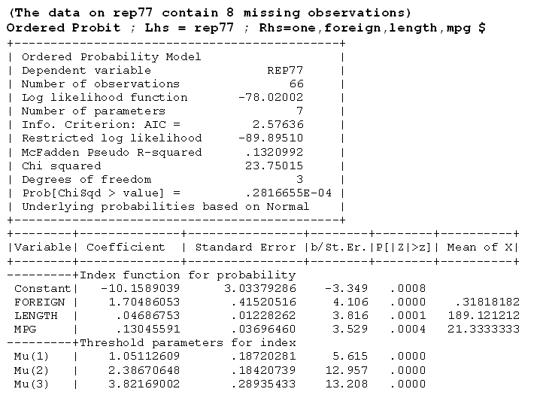

Slide 40
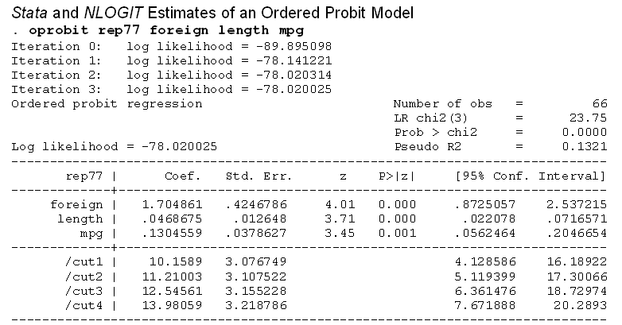

Slide 41
--------+--------------------------------------------------------------------
| Standard Prob. 95% Confidence
HLTHSAT| Coefficient Error z |z|>Z* Interval
--------+--------------------------------------------------------------------
|Index function for probability......................................
Constant| 1.96417*** .11905 16.50 .0000 1.73084 2.19751
FEMALE| .01223 .03250 .38 .7066 -.05146 .07593
EDUC| .03667*** .00717 5.11 .0000 .02261 .05073
AGE| -.01846*** .00154 -11.98 .0000 -.02148 -.01544
INCOME| .24009** .10103 2.38 .0175 .04208 .43809
HHKIDS| .04975 .03525 1.41 .1582 -.01934 .11884
|Threshold parameters for index......................................
Mu(01)| 1.14847*** .02116 54.28 .0000 1.10700 1.18994
Mu(02)| 2.54775*** .02162 117.86 .0000 2.50539 2.59012
Mu(03)| 3.05625*** .02646 115.50 .0000 3.00439 3.10811
As reported by Stata
--------+--------------------------------------------------------------------
|Index function for probability......................................
FEMALE| .01223 .03250 .38 .7066 -.05146 .07593
EDUC| .03667*** .00717 5.11 .0000 .02261 .05073
AGE| -.01846*** .00154 -11.98 .0000 -.02148 -.01544
INCOME| .24009** .10103 2.38 .0175 .04208 .43809
HHKIDS| .04975 .03525 1.41 .1582 -.01934 .11884
|Threshold parameters for index model................................
/Cut(1)| -1.96417*** .11905 -16.50 .0000 -2.19751 -1.73084
/Cut(2)| -.81570*** .11956 -6.82 .0000 -1.05004 -.58136
/Cut(3)| .58358*** .12079 4.83 .0000 .34684 .82033
/Cut(4)| 1.09208*** .12112 9.02 .0000 .85468 1.32947
Hypothesis tests about threshold values are not meaningful.

Slide 42
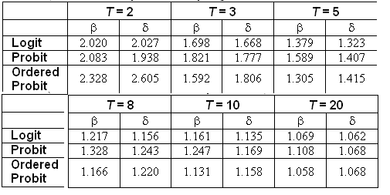
The Incidental Parameters Problem
Table 9.1 Monte Carlo Analysis of the Bias of the MLE in Fixed Effects Discrete Choice Models (Means of empirical sampling distributions, N = 1,000 individuals, R = 200 replications)

Slide 43
Zero Inflated Ordered Probit

Slide 44
Teenage Smoking

Slide 45
Inflated Responses in Self-Assessed Health
Mark Harris
Department of Economics, Curtin University
Bruce Hollingsworth
Department of Economics, Lancaster University
William Greene
Stern School of Business, New York University

Slide 46
SAH vs. Objective Health Measures
Favorable SAH categories seem artificially high.
• 60% of Australians are either overweight or obese (Dunstan et. al, 2001)
• 1 in 4 Australians has either diabetes or a condition of impaired glucose metabolism
• Over 50% of the population has elevated cholesterol
• Over 50% has at least 1 of the “deadly quartet” of health conditions
(diabetes, obesity, high blood pressure, high cholestrol)
• Nearly 4 out of 5 Australians have 1 or more long term health conditions
(National Health Survey, Australian Bureau of Statistics 2006)
• Australia ranked #1 in terms of obesity rates
Similar results appear to appear for other countries

Slide 47
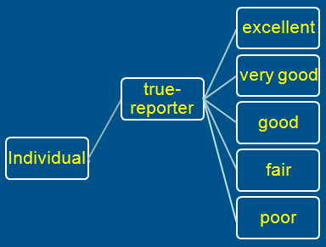
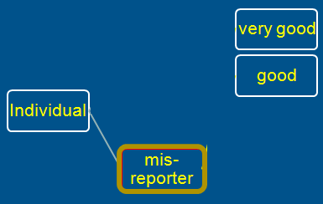
A Two Class Latent Class Model
True Reporter
Misreporter

Slide 48
Mis-reporters choose either good or very good
The response is determined by a probit model
Y=3
Y=2

Slide 49
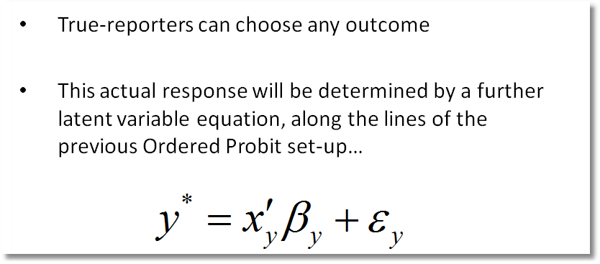
Y=4
Y=3
Y=2
Y=1
Y=0

Slide 50
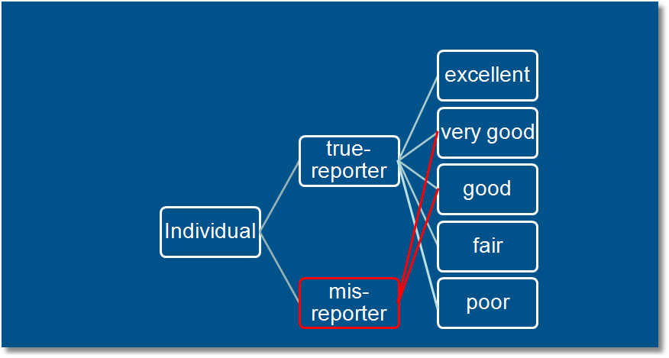
Observed Mixture of Two Classes

Slide 51
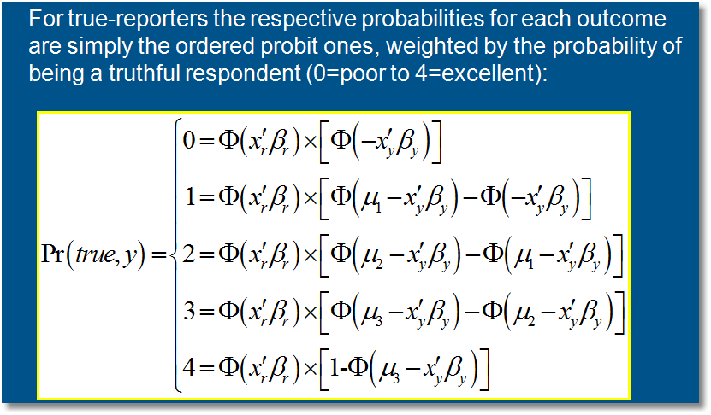
Pr(true,y) = Pr(true) * Pr(y | true)

Slide 52
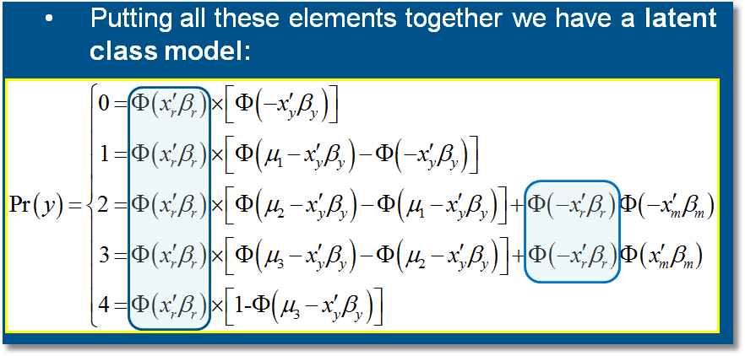

Slide 53
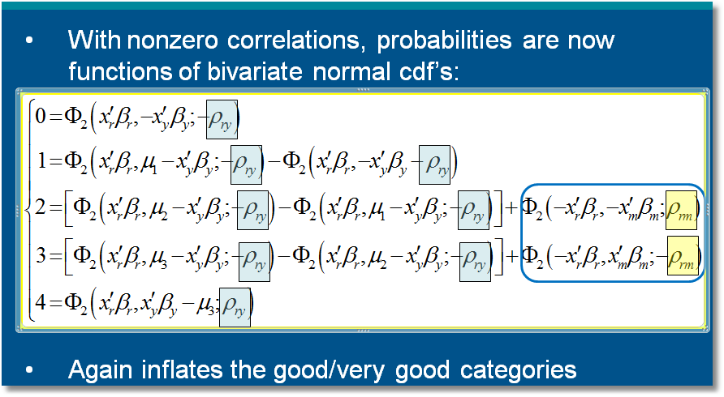

Slide 54
General Result

