Slide 1




Microeconometric Modeling
William Greene
Stern School of Business
New York University
New York NY USA
2.2 Binary Choice
Extensions

Slide 2
Endogenous RHS Variable
U* = β’x + θh + ε
y = 1[U* > 0]
E[ε|h] ≠ 0 (h is endogenous)
  Case 1: h is binary = a treatment effect
  Case 2: h is continuous
Approaches
  Parametric: Maximum Likelihood
  Semiparametric (not developed here):
    GMM
    Various approaches for case 2
  2 Stage least squares – a good approximation?

Slide 3
Endogenous Binary Variable
U* = β’x + θh + ε
y = 1[U* > 0]
h* = α’z + u
h = 1[h* > 0]
E[ε|h*] ≠ 0 ⬄ Cov[u, ε] ≠ 0
Additional Assumptions:
(u,ε) ~ N[(0,0),(σ_{u}², ρσ_{u}, 1)]
z = a valid set of exogenous
variables, uncorrelated with (u,ε)
⇐
Correlation = ρ.
This is the source of the endogeneity
This is not IV estimation. Z may be uncorrelated with X without problems.

Slide 4
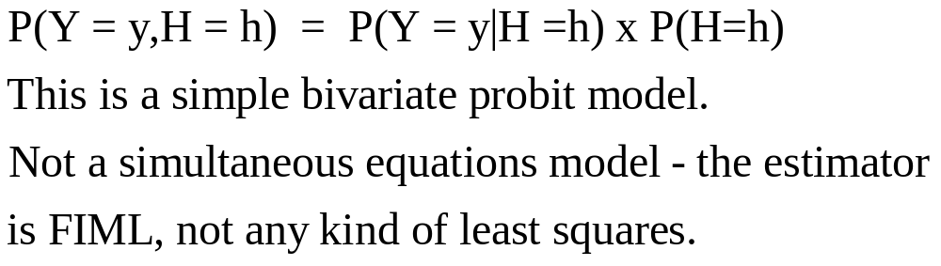

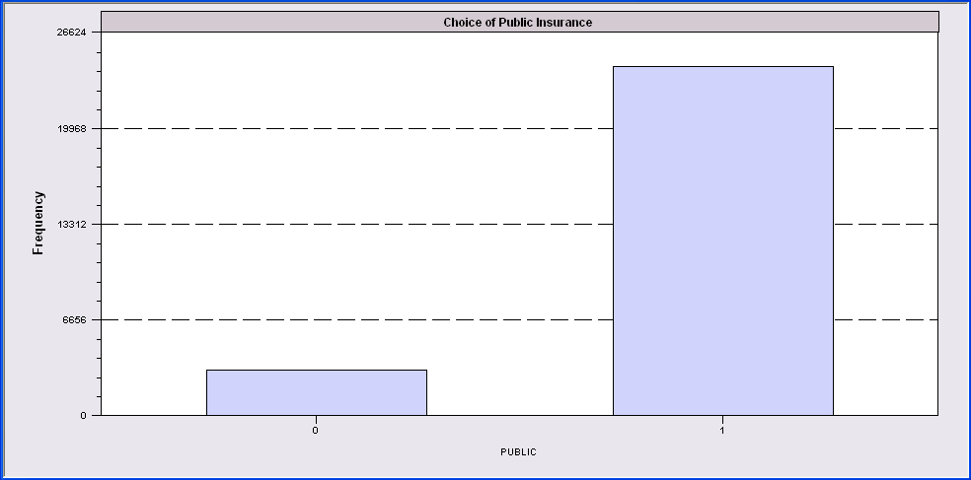
Endogenous Binary Variable
Doctor = F(age,age²,income,female,Public)
Public = F(age,educ,income,married,kids,female)

Slide 5
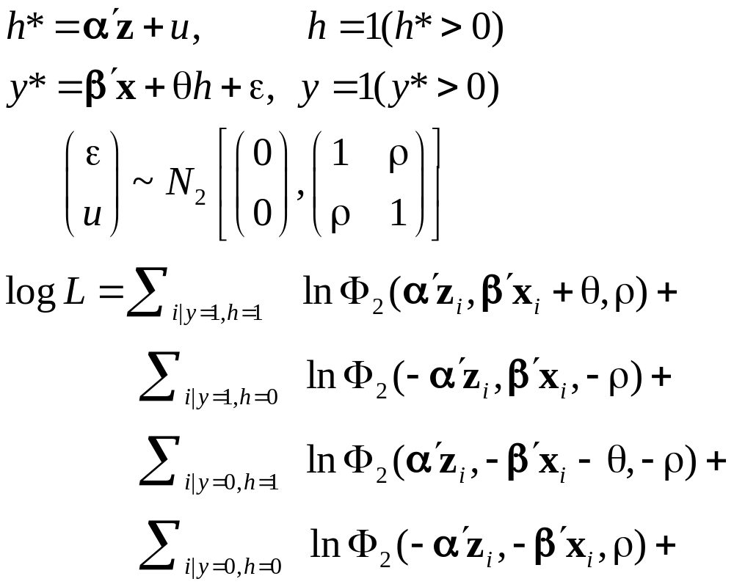
Log Likelihood for the RBP Model
What about instruments and identification?

Slide 6
FIML Estimates
-----------------------------------------------------------------------------
FIML - Recursive Bivariate Probit Model
Dependent variable PUBDOC
Log likelihood function -25671.32339
Estimation based on N = 27326, K = 14
Inf.Cr.AIC = 51370.6 AIC/N = 1.880
--------+--------------------------------------------------------------------
PUBLIC| Standard Prob. 95% Confidence
DOCTOR| Coefficient Error z |z|>Z* Interval
--------+--------------------------------------------------------------------
|Index equation for PUBLIC........................................
Constant| 3.55056*** .07446 47.68 .0000 3.40462 3.69650
AGE| .00067 .00115 .58 .5626 -.00159 .00293
EDUC| -.16835*** .00416 -40.48 .0000 -.17650 -.16020
INCOME| -.98735*** .05172 -19.09 .0000 -1.08872 -.88598
MARRIED| -.00997 .02922 -.34 .7329 -.06724 .04729
HHKIDS| -.08094*** .02510 -3.22 .0013 -.13014 -.03174
FEMALE| .12140*** .02231 5.44 .0000 .07768 .16512
|Index equation for DOCTOR........................................
Constant| .58983*** .14474 4.08 .0000 .30615 .87351
AGE| -.05740*** .00601 -9.56 .0000 -.06917 -.04563
AGESQ| .00082*** .6817D-04 12.10 .0000 .00069 .00096
INCOME| .08900* .05097 1.75 .0808 -.01091 .18890
FEMALE| .34580*** .01629 21.22 .0000 .31386 .37773
PUBLIC| .43595*** .07358 5.92 .0000 .29174 .58016
|Disturbance correlation.............................................
RHO(1,2)| -.17317*** .04075 -4.25 .0000 -.25303 -.09330
--------+--------------------------------------------------------------------

Slide 7
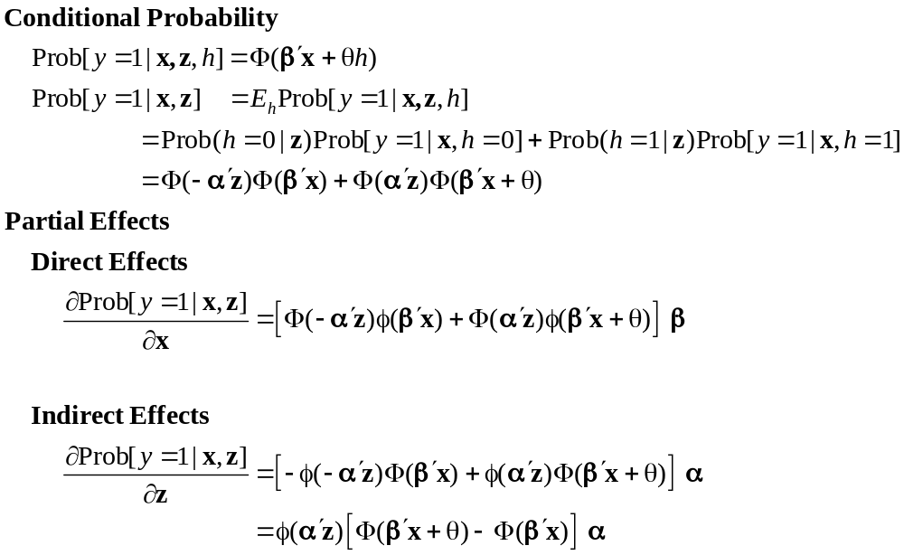
Partial Effects for Exogenous Variables

Slide 8
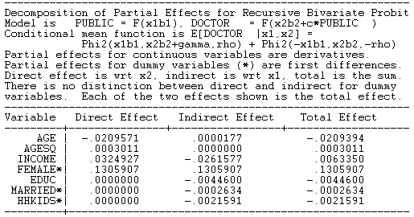
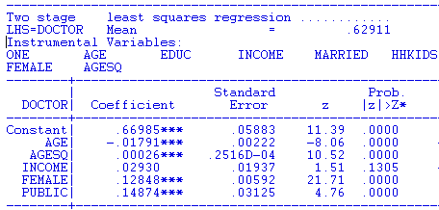
FIML Partial
Effects
Two Stage Least Squares Effects

Slide 9
Identification Issues
Exclusions are not needed for estimation
Identification is, in principle, by “functional form”
Researchers usually have a variable in the treatment equation that is not in the main probit equation “to improve identification”

Slide 10
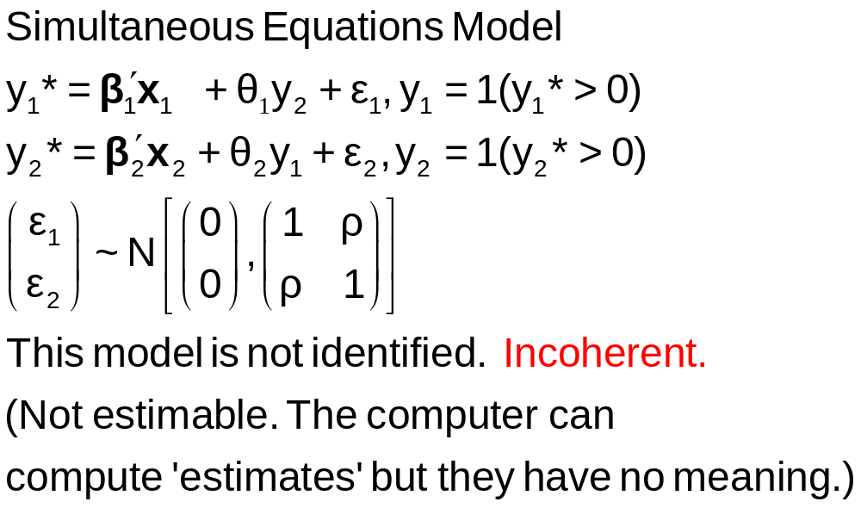
A Simultaneous Equations Model

Slide 11
Fully Simultaneous “Model”
----------------------------------------------------------------------
FIML Estimates of Bivariate Probit Model
Dependent variable DOCHOS
Log likelihood function -20318.69455
--------+-------------------------------------------------------------
Variable| Coefficient Standard Error b/St.Er. P[|Z|>z] Mean of X
--------+-------------------------------------------------------------
|Index equation for DOCTOR
Constant| -.46741*** .06726 -6.949 .0000
AGE| .01124*** .00084 13.353 .0000 43.5257
FEMALE| .27070*** .01961 13.807 .0000 .47877
EDUC| -.00025 .00376 -.067 .9463 11.3206
MARRIED| -.00212 .02114 -.100 .9201 .75862
WORKING| -.00362 .02212 -.164 .8701 .67705
HOSPITAL| 2.04295*** .30031 6.803 .0000 .08765
|Index equation for HOSPITAL
Constant| -1.58437*** .08367 -18.936 .0000
AGE| -.01115*** .00165 -6.755 .0000 43.5257
FEMALE| -.26881*** .03966 -6.778 .0000 .47877
HHNINC| .00421 .08006 .053 .9581 .35208
HHKIDS| -.00050 .03559 -.014 .9888 .40273
DOCTOR| 2.04479*** .09133 22.389 .0000 .62911
|Disturbance correlation
RHO(1,2)| -.99996*** .00048 ******** .0000
--------+-------------------------------------------------------------

Slide 12
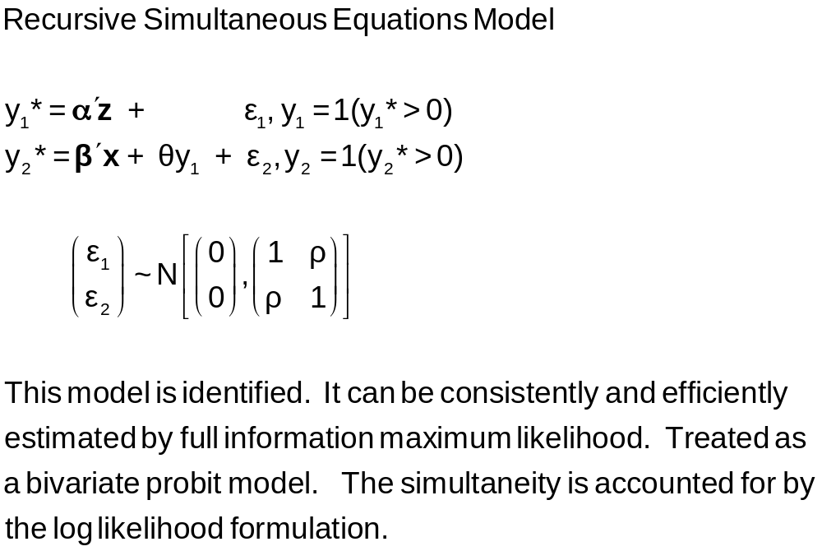
A Recursive Bivariate Probit Model
Treatment Effects

Slide 13
-----------------------------------------------------------------------------
FIML - Recursive Bivariate Probit Model
Dependent variable PUBDOC
Log likelihood function -25671.32339
Estimation based on N = 27326, K = 14
Inf.Cr.AIC = 51370.6 AIC/N = 1.880
--------+--------------------------------------------------------------------
PUBLIC| Standard Prob. 95% Confidence
DOCTOR| Coefficient Error z |z|>Z* Interval
--------+--------------------------------------------------------------------
|Index equation for PUBLIC....................................
Constant| 3.55056*** .07446 47.68 .0000 3.40462 3.69650
AGE| .00067 .00115 .58 .5626 -.00159 .00293
EDUC| -.16835*** .00416 -40.48 .0000 -.17650 -.16020
INCOME| -.98735*** .05172 -19.09 .0000 -1.08872 -.88598
MARRIED| -.00997 .02922 -.34 .7329 -.06724 .04729
HHKIDS| -.08094*** .02510 -3.22 .0013 -.13014 -.03174
FEMALE| .12140*** .02231 5.44 .0000 .07768 .16512
|Index equation for DOCTOR....................................
Constant| .58983*** .14474 4.08 .0000 .30615 .87351
AGE| -.05740*** .00601 -9.56 .0000 -.06917 -.04563
AGESQ| .00082*** .6817D-04 12.10 .0000 .00069 .00096
INCOME| .08900* .05097 1.75 .0808 -.01091 .18890
FEMALE| .34580*** .01629 21.22 .0000 .31386 .37773
PUBLIC| .43595*** .07358 5.92 .0000 .29174 .58016
|Disturbance correlation.........................................
RHO(1,2)| -.17317*** .04075 -4.25 .0000 -.25303 -.09330
--------+--------------------------------------------------------------------

Slide 14
Treatment Effects
y₁ is a “treatment”
Treatment effect of y₁ on y₂.
Prob(y₂=1)_{y1=1} – Prob(y₂=1)_{y1=0}
= Φ(β’x + θ) - Φ(β’x)
Treatment effect on the treated involves an unobserved counterfactual. Compare being treated to being untreated for someone who was actually treated.
Prob(y₂=1|y₁=1)_{y1=1} - Prob(y₂=1|y₁=1)_{y1=0}

Slide 15
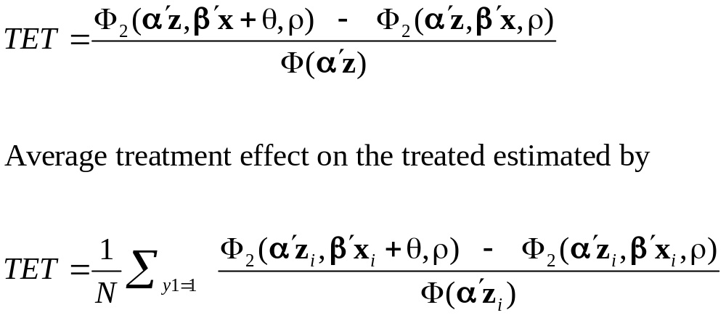
Treatment Effect on the Treated

Slide 16
Treatment Effects
---------------------------------------------------------------------
Partial Effects Analysis for RcrsvBvProb: ATE of PUBLIC on DOCTOR
---------------------------------------------------------------------
Effects on function with respect to PUBLIC
Results are computed by average over sample observations
Partial effects for binary var PUBLIC computed by first difference
---------------------------------------------------------------------
df/dPUBLIC Partial Standard
(Delta Method) Effect Error |t| 95% Confidence Interval
---------------------------------------------------------------------
APE. Function .16446 .02820 5.83 .10920 .21973
---------------------------------------------------------------------
Partial Effects Analysis for RcrsvBvProb: ATET of PUBLIC on DOCTOR
---------------------------------------------------------------------
Effects on function with respect to PUBLIC
Results are computed by average over sample observations
Partial effects for binary var PUBLIC computed by first difference
---------------------------------------------------------------------
df/dPUBLIC Partial Standard
(Delta Method) Effect Error |t| 95% Confidence Interval
---------------------------------------------------------------------
APE. Function .15417 .02482 6.21 .10553 .20282

Slide 17


Slide 18
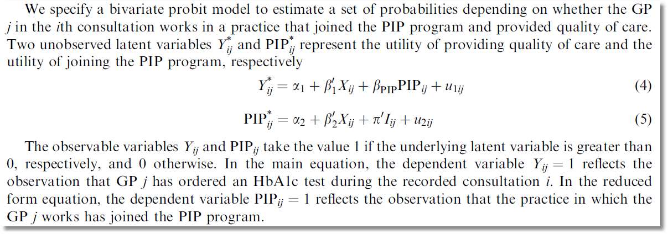
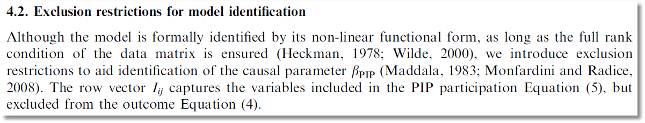
recursive

Slide 19

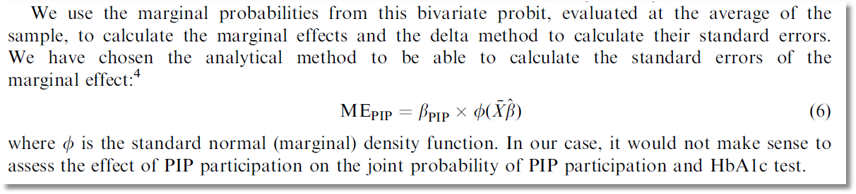
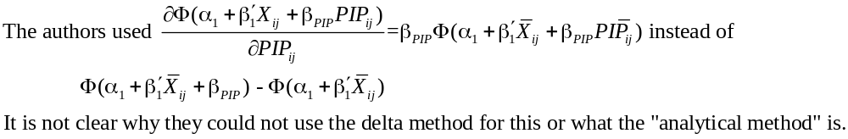
Causal Inference

Slide 20
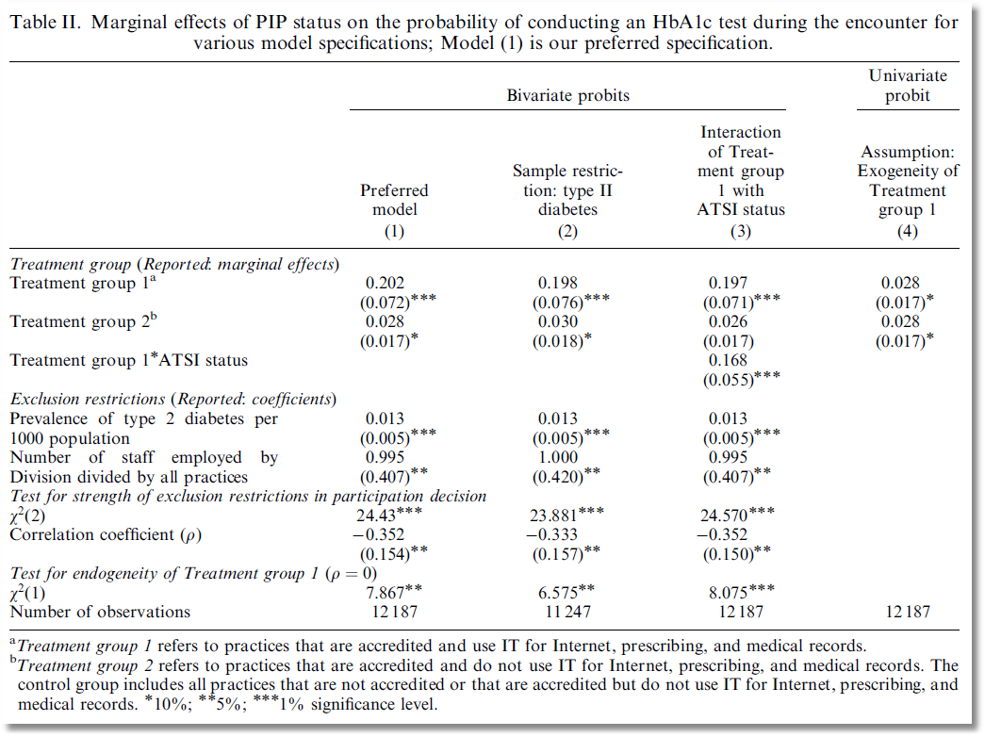

Slide 21
Endogenous Continuous Variable
U* = β’x + θh + ε
y = 1[U* > 0] ⇐
h = α’z + u
E[ε|h] ≠ 0 ⬄ Cov[u, ε] ≠ 0
Additional Assumptions:
(u,ε) ~ N[(0,0),(σ_{u}², ρσ_{u}, 1)]
z = a valid set of exogenous
variables, uncorrelated with (u,ε)
Correlation = ρ.
This is the source of the endogeneity
This is not IV estimation. Z may be uncorrelated with X without problems.

Slide 22


Endogenous Income
Income responds to
Age, Age², Educ, Married, Kids, Gender
0 = Not Healthy
1 = Healthy
Healthy = 0 or 1
Age, Married, Kids, Gender, Income
Determinants of Income (observed and unobserved) also determine health satisfaction.
Notes:
22

Slide 23
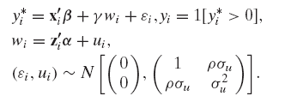
Control Function Approach
This is Stata’s “IVProbit Model.” A misnomer, since it is not an instrumental variable approach at all – they and we use full information maximum likelihood. (Instrumental variables do not appear in the specification.)

Slide 24
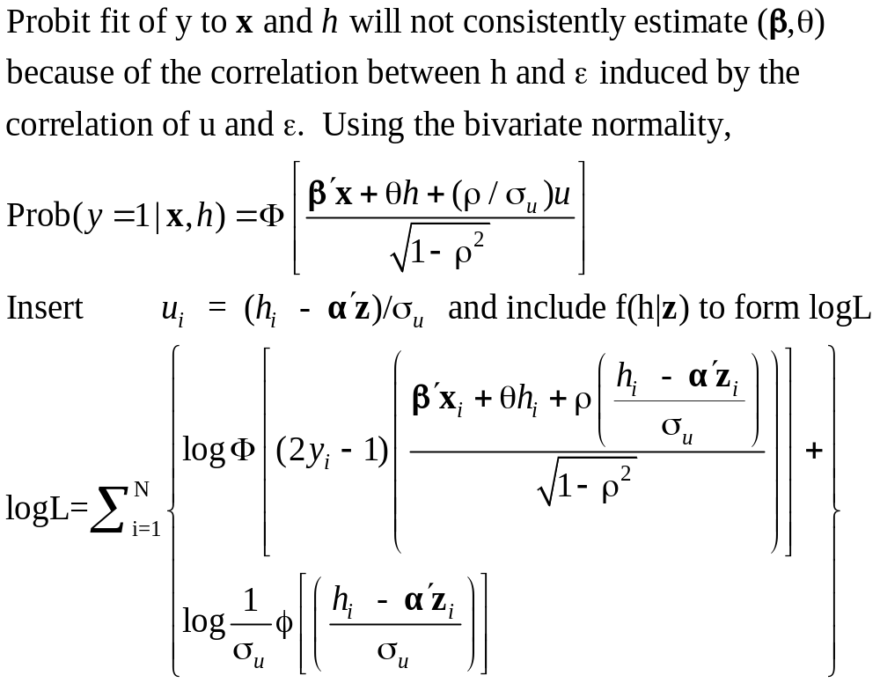
Estimation by ML (Control Function)

Slide 25
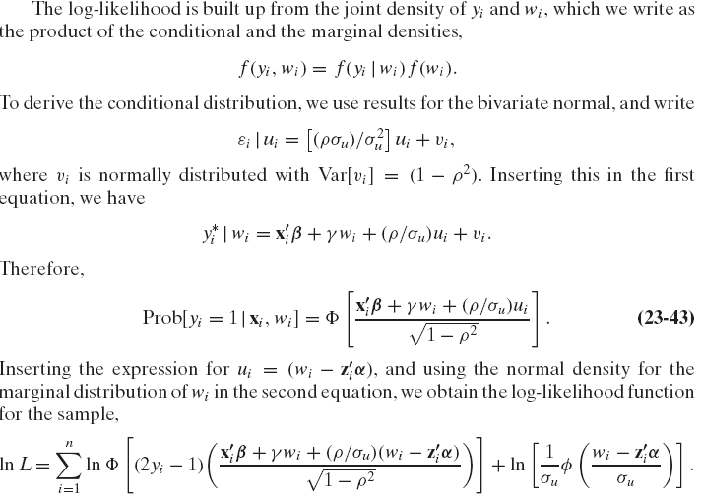
Likelihood Function

Slide 26
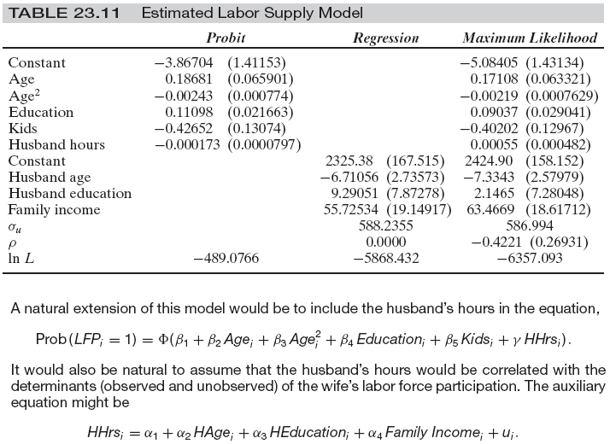
Labor Supply Model

