Slide 1
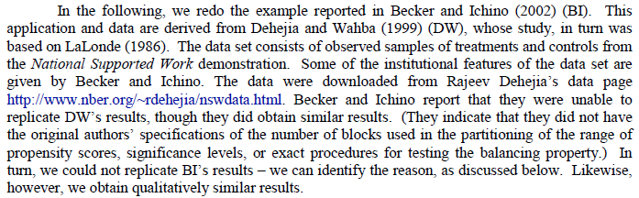
National Supported Work Demonstration

Slide 2
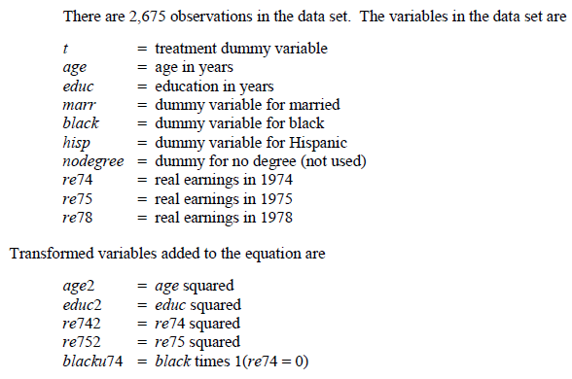
Propensity Score Matching
A Work Training Application

Slide 3
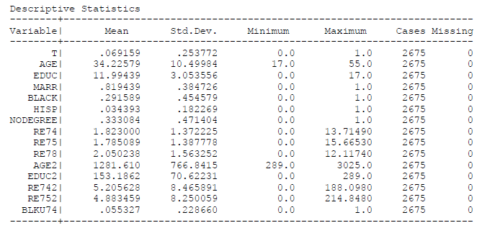
The Data

Slide 4
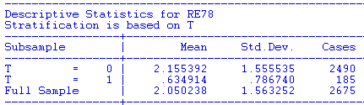
Naïve Comparison of Means

Slide 5
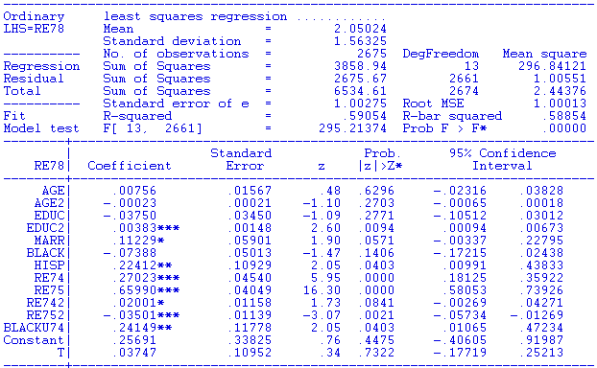
Treatment Effect Regression

Slide 6
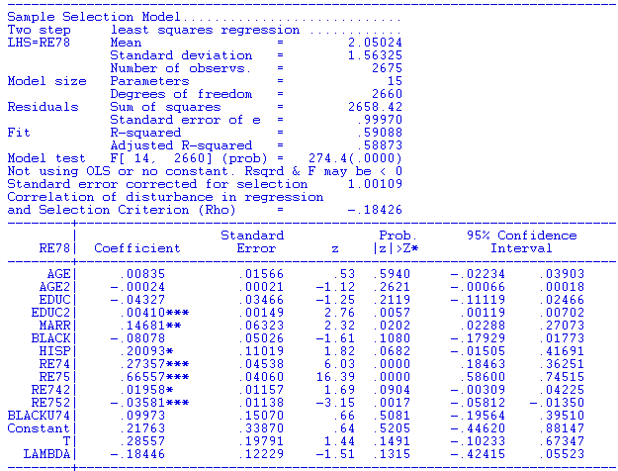
Heckman Model
Underlying Probit equation for T has the same exogenous variables as the regression. No “exclusions.”

Slide 7
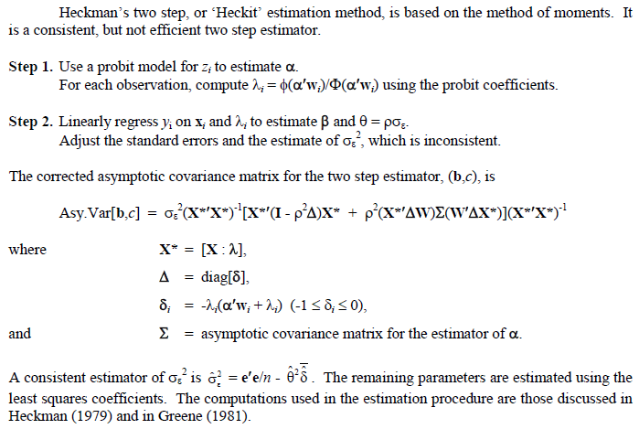

Slide 8
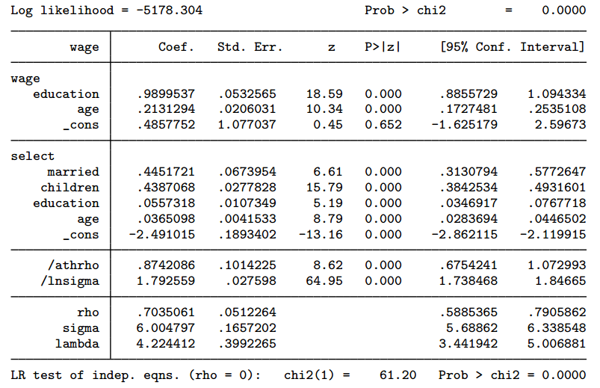

Slide 9
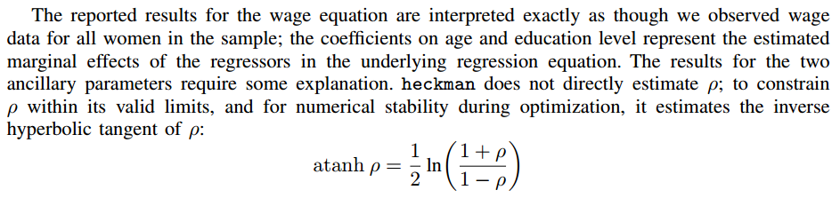
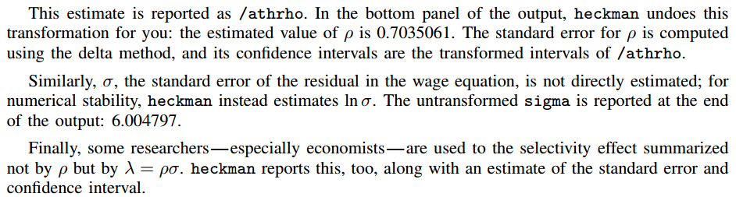

Slide 10
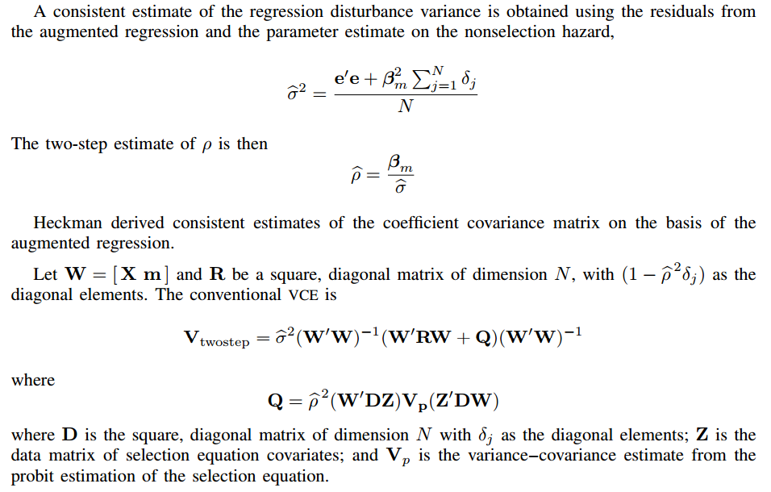

Slide 11
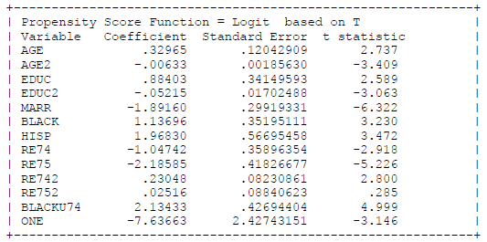
Logit Based Propensity Scores

Slide 12
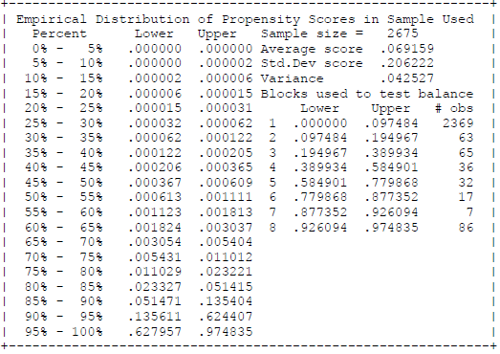
Matching Based On Propensities

Slide 13
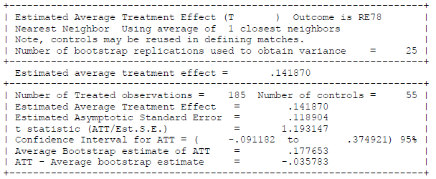
Estimated Treatment Effect
Simple Pairwise Matching

