Slide 1

Statistics and Data Analysis
Professor William Greene
Stern School of Business
IOMS Department
Department of Economics

Slide 2
Statistics and Data Analysis
Part 22 – Multiple
Regression: 2

Slide 3
Multiple Regression Models
Using Minitab To Compute A Multiple Regression
Basic Multiple Regression
Using Binary Variables
Logs and Elasticities
Trends in Time Series Data
Using Quadratic Terms to Improve the Model
Mini-seminar: Cost benefit test with a dynamic model

Slide 4
Application: WHO
Data Used in Assignment 1: WHO data on 191 countries in 1995-1999.
  Analysis of Disability Adjusted Life Expectancy = DALE
  EDUC = average years of education
  PCHexp = Per capita health expenditure
DALE = α + β₁EDUC + β₂HealthExp + ε

Slide 5
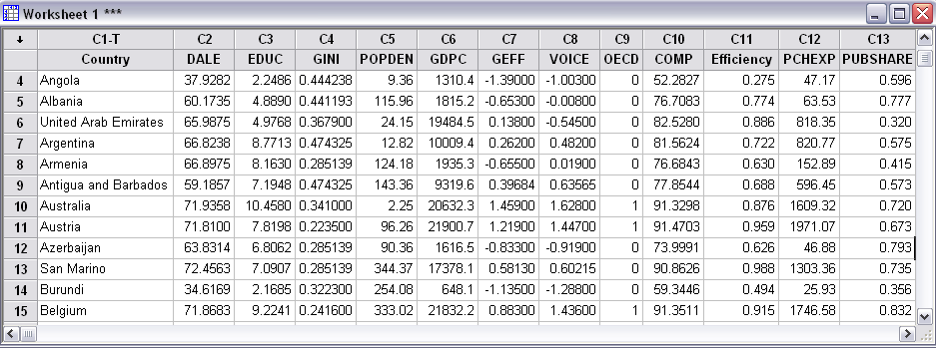
The (Famous) WHO Data

Slide 6
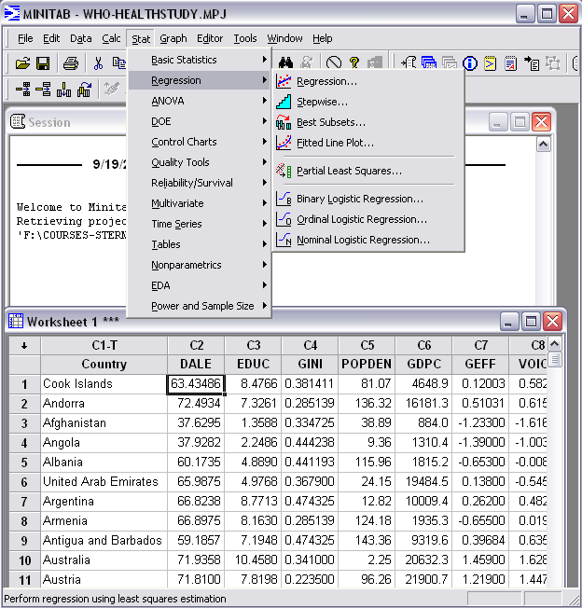

Slide 7
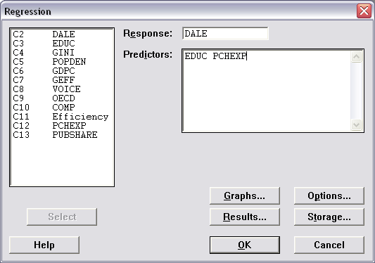
Specify the Variables in the Model

Slide 8
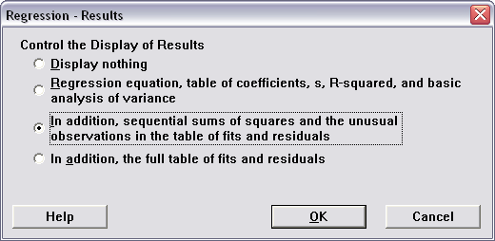

Slide 9
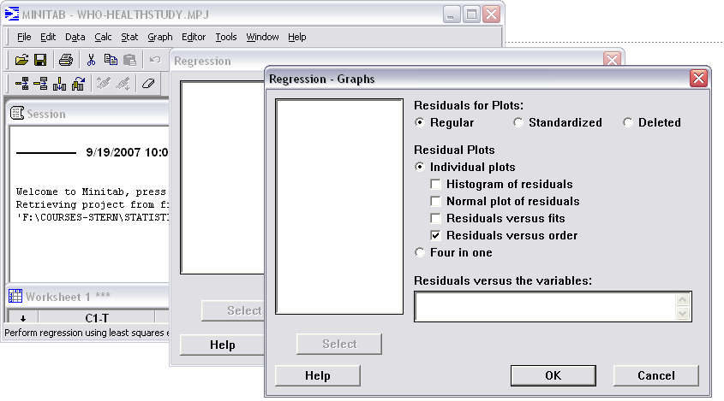
Graphs

Slide 10
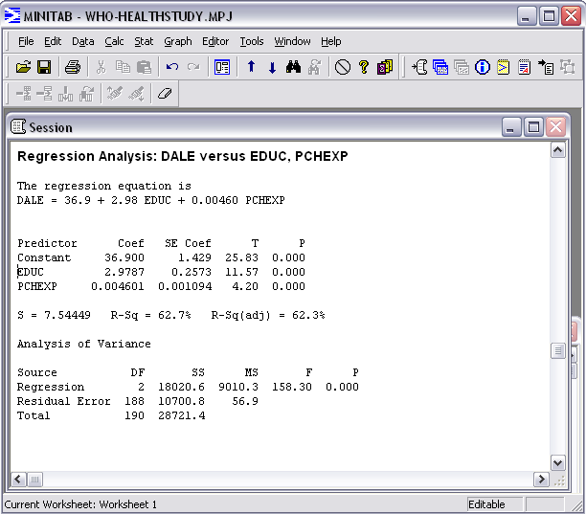
Regression Results

Slide 11
Practical Model Building
Understanding the regression: The left out variable problem
Using different kinds of variables
  Dummy variables
  Logs
  Time trend
  Quadratic

Slide 12
A Fundamental Result
What happens when you leave a crucial variable out of your model? Nothing good.
Regression Analysis: g versus GasPrice (no income)
The regression equation is
g = 3.50 + 0.0280 GasPrice
Predictor Coef SE Coef T P
Constant 3.4963 0.1678 20.84 0.000
GasPrice 0.028034 0.002809 9.98 0.000
Regression Analysis: G versus GasPrice, Income
The regression equation is
G = 0.134 - 0.00163 GasPrice + 0.000026 Income
Predictor Coef SE Coef T P
Constant 0.13449 0.02081 6.46 0.000
GasPrice -0.0016281 0.0004152 -3.92 0.000
Income 0.00002634 0.00000231 11.43 0.000

Slide 13
Using Dummy Variables
Dummy variable = binary variable
= a variable that takes values 0 and 1.
E.g. OECD Life Expectancies compared to the rest of the world:
  DALE = α + β₁ EDUC + β₂ PCHexp
  + β₃ OECD + ε
Australia, Austria, Belgium, Canada, Czech Republic, Denmark, Finland, France, Germany, Greece, Hungary, Iceland, Ireland, Italy, Japan, Korea, Luxembourg, Mexico, The Netherlands, New Zealand, Norway, Poland, Portugal, Slovak Republic, Spain, Sweden, Switzerland, Turkey, United Kingdom, United States.

Slide 14
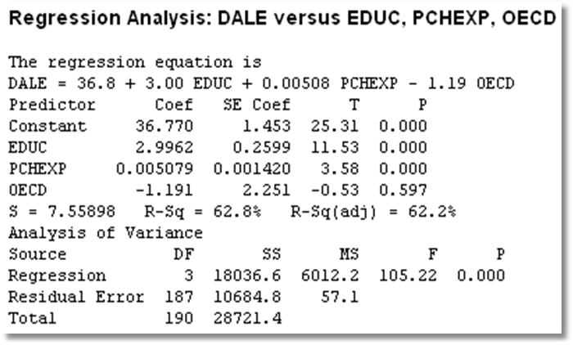
OECD Life Expectancy
According to these results, after accounting for education and health expenditure differences, people in the OECD countries have a life expectancy that is 1.191 years shorter than people in other countries.

Slide 15
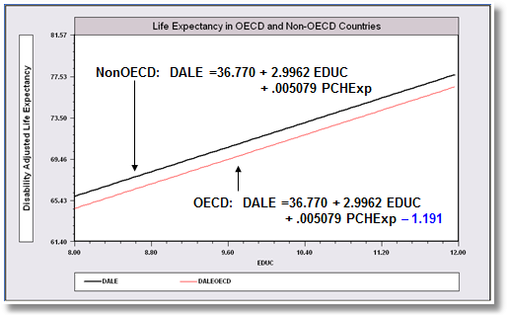
A Binary Variable in Regression
The regression shifts down by 1.191 years for the OECD countries
We set PCHExp to 1000, approximately the sample mean.

Slide 16
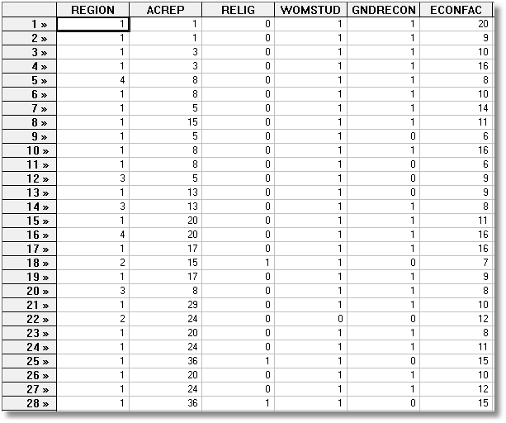
Academic Reputation

Slide 17
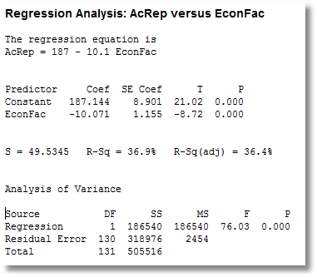

Slide 18
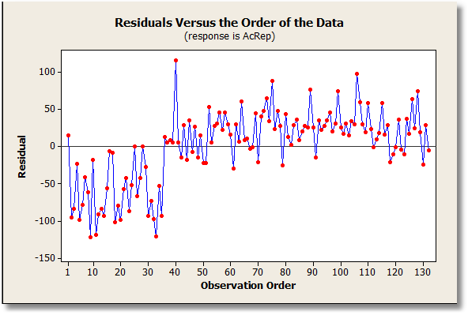

Slide 19
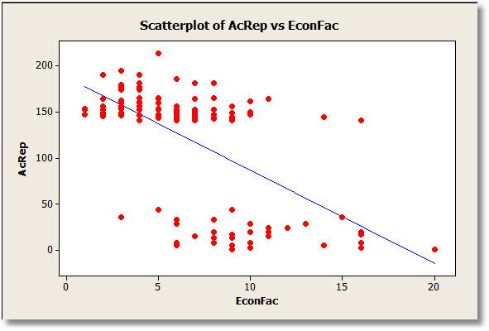

Slide 20
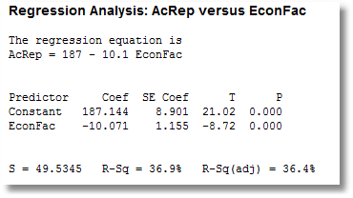
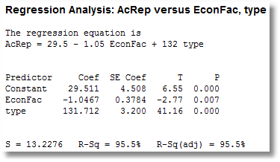

Slide 21
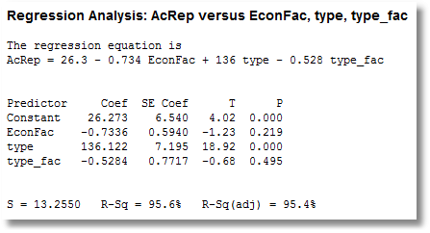
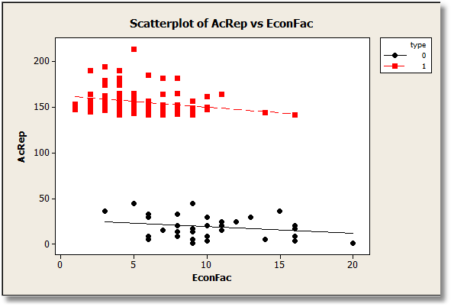

Slide 22
Dummy Variable in a Log Regression
E.g., Monet’s signature equation
  Log$Price = α + β₁ logArea + β₂ Signed
  Unsigned: Price_{U} = exp(α) Area^{β1}
  Signed: Price_{S} = exp(α) Area^{β1} exp(β₂)
  Signed/Unsigned = exp(β₂)
  %Difference = 100%(Signed-Unsigned)/Unsigned
  = 100%[exp(β₂) – 1]

Slide 23
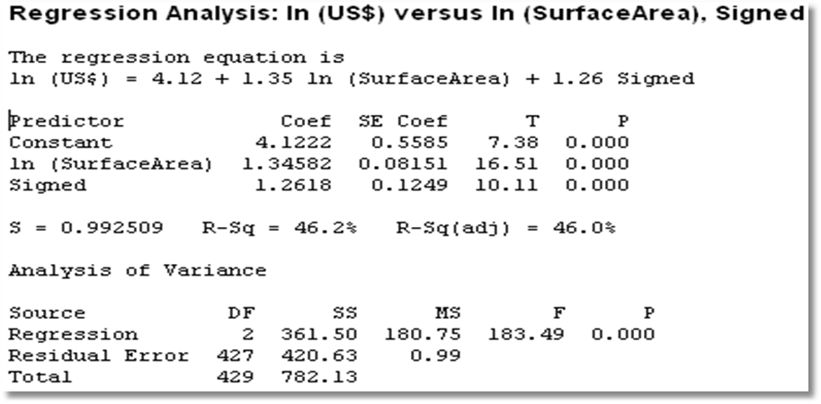
The Signature Effect: 253%
100%[exp(1.2618) – 1] = 100%[3.532 – 1] = 253.2 %

Slide 24
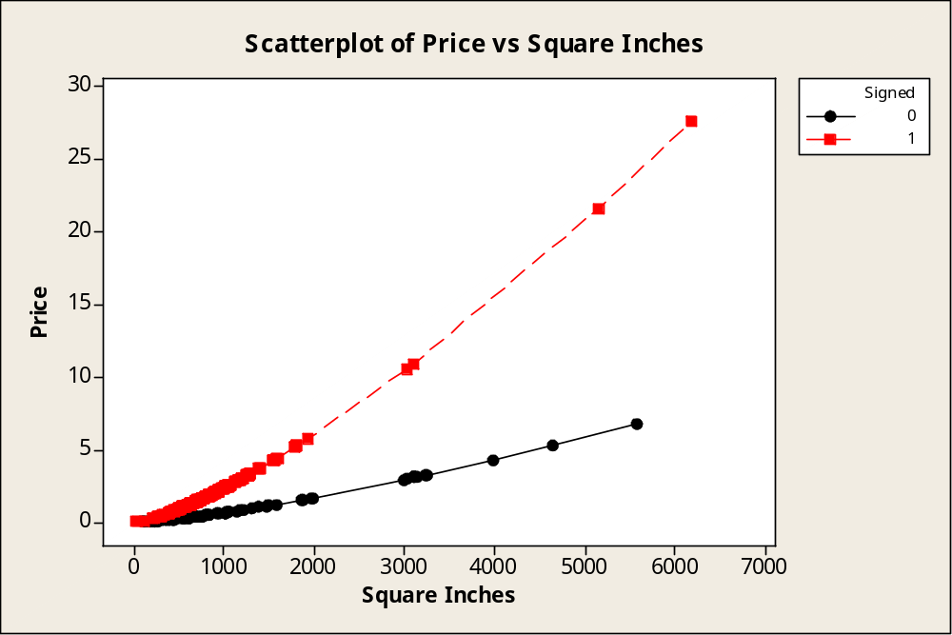
Monet Paintings in Millions
Difference is about 253%
Predicted Price is exp(4.122+1.3458*logArea+1.2618*Signed) / 1000000

Slide 25
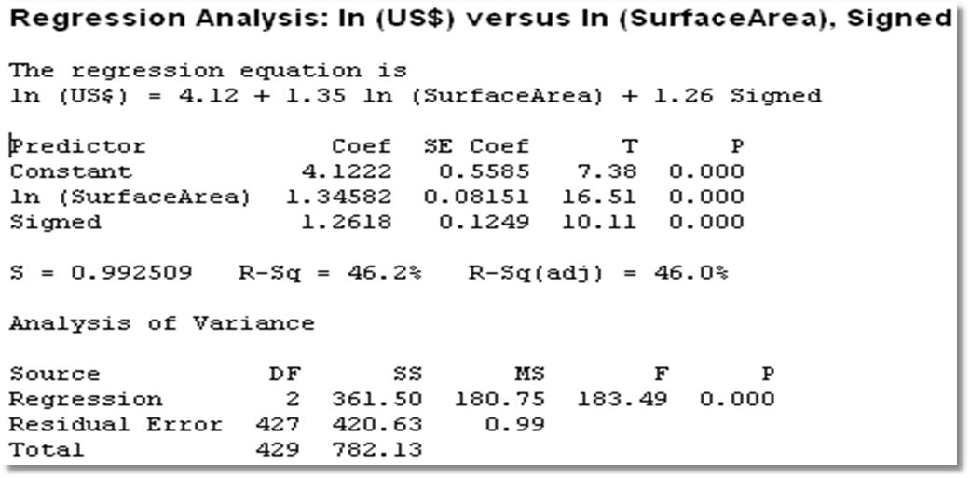
Logs in Regression

Slide 26
Elasticity
The coefficient on log(Area) is 1.346
For each 1% increase in area, price goes up by 1.346% - even accounting for the signature effect.
The elasticity is +1.346
Remarkable. Not only does price increase with area, it increases much faster than area.

Slide 27
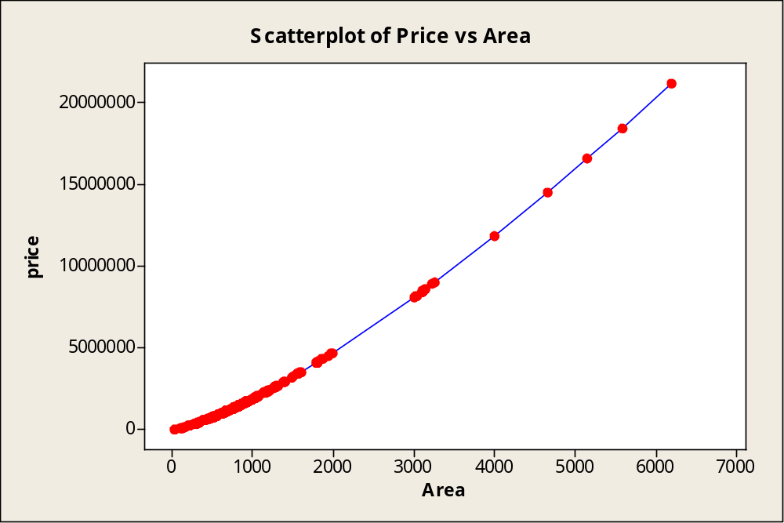
Monet: By the Square Inch

Slide 28
Logs and Elasticities
Theory: When the variables are in logs:
change in logx = %change in x
log y = α + β₁ log x₁ + β₂ log x₂ + … β_{K} log x_{K} + ε
Elasticity = β_{k}

Slide 29
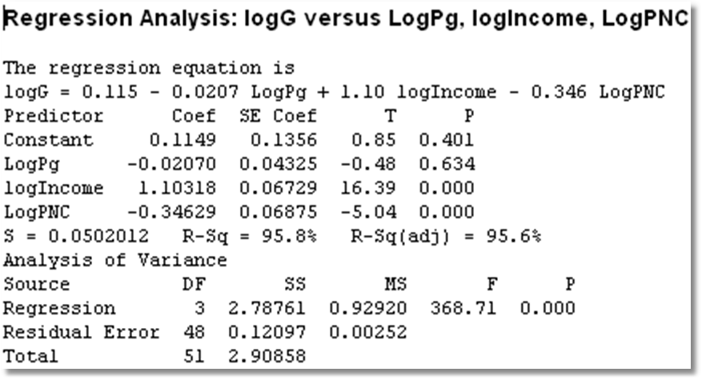
Elasticities
Price elasticity = -0.02070 Income elasticity = +1.10318

Slide 30
A Set of Dummy Variables
Complete set of dummy variables divides the sample into groups.
Fit the regression with “group” effects.
Need to drop one (any one) of the variables to compute the regression. (Avoid the “dummy variable trap.”)

Slide 31
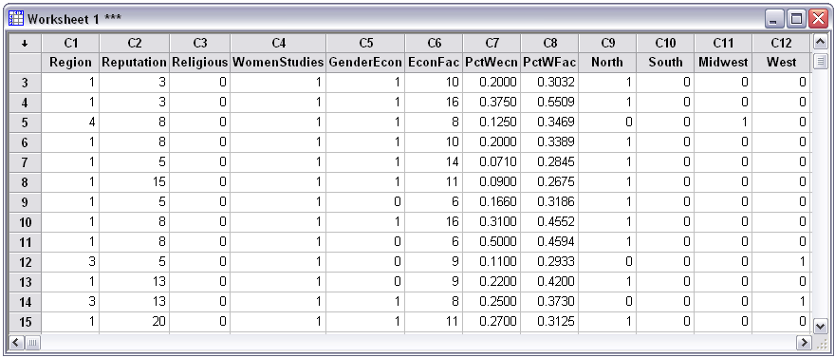
Rankings of 132 U.S.Liberal Arts Colleges
Reputation = α + β₁Religious + β₂GenderEcon + β₃EconFac +
β₄North + β₅South + β₆Midwest + β₇West + ε
Nancy Burnett: Journal of Economic Education, 1998

Slide 32
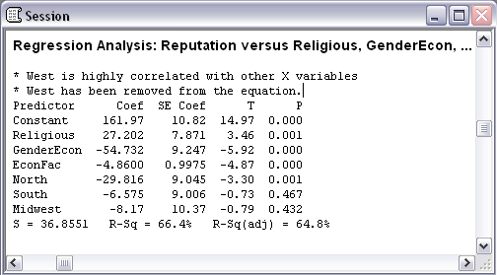
Minitab does not like this model.

Slide 33
Too many dummy variables
If we use all four region dummies, a is redundant
  Reputation = a + bn + … if north
  Reputation = a + bm + … if midwest
  Reputation = a + bs + … if south
  Reputation = a + bw + … if west
Only three are needed – so Minitab dropped west
  Reputation = a + bn + … if north
  Reputation = a + bm + … if midwest
  Reputation = a + bs + … if south
  Reputation = a + … if west
Why did it drop West and not one of the others? It doesn’t matter which one is dropped. Minitab picked the last.

Slide 34
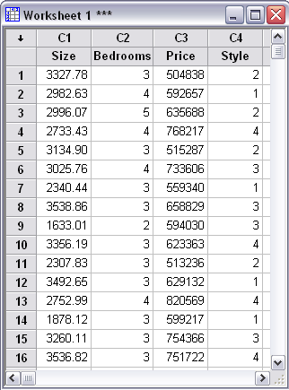
Unordered Categorical Variables
House price data (fictitious)
Style 1 = Split level
Style 2 = Ranch
Style 3 = Colonial
Style 4 = Tudor
Use 3 dummy variables for this kind of data. (Not all 4)
Using variable STYLE in the model makes no sense. You could change the numbering scale any way you like. 1,2,3,4 are just labels.

Slide 35
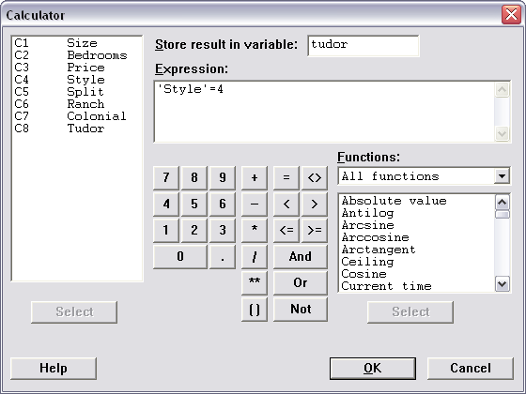
Transform Style to Types

Slide 36
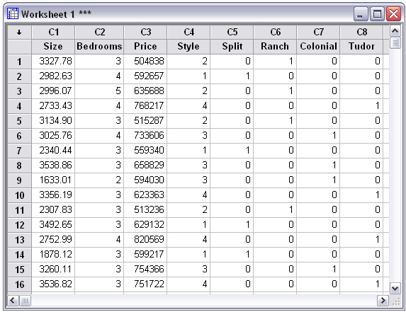

Slide 37
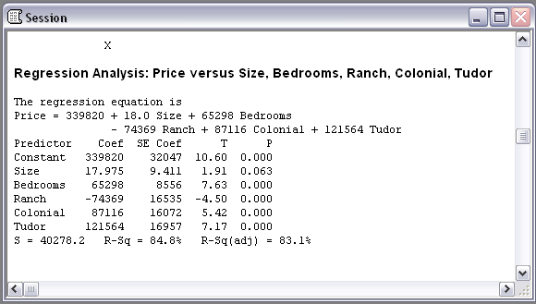
House Price Regression
Each of these is relative to a Split Level, since that is the omitted category. E.g., the price of a Ranch house is $74,369 less than a Split Level of the same size with the same number of bedrooms.

Slide 38
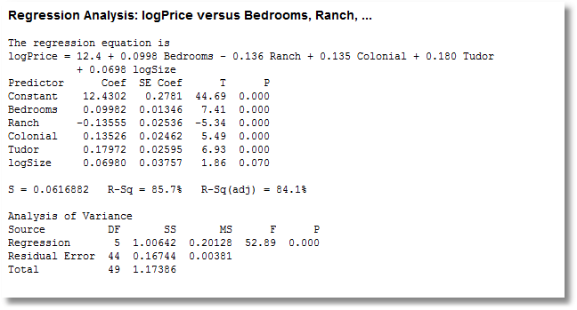
Better Specified House Price Model Using Logs

Slide 39
Time Trends in Regression
y = α + β₁x + β₂t + ε
β₂ is the year to year increase not
explained by anything else.
log y = α + β₁log x + β₂t + ε
(not log t, just t)
100β₂ is the year to year
% increase
not explained by anything else.

Slide 40
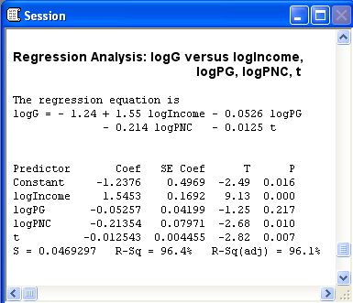
Time Trend in Multiple Regression
After accounting for Income, the price and the price of new cars, per capita gasoline consumption falls by 1.25% per year. I.e., if income and the prices were unchanged, consumption would fall by 1.25%. Probably the effect of improved fuel efficiency

Slide 41
A Quadratic Income vs. Age Regression
+----------------------------------------------------+
| LHS=HHNINC Mean = .3520836 |
| Standard deviation = .1769083 |
| Model size Parameters = 3 |
| Degrees of freedom = 27323 |
| Residuals Sum of squares = 794.9667 |
| Standard error of e = .1705730 |
| Fit R-squared = .7040754E-01 |
+----------------------------------------------------+
+--------+--------------+--+--------+
|Variable| Coefficient | Mean of X|
+--------+--------------+-----------+
Constant| -.39266196
AGE | .02458140 43.5256898
AGESQ | -.00027237 2022.85549
EDUC | .01994416 11.3206310
+--------+--------------+-----------+
Note the coefficient on Age squared is negative. Age ranges from 25 to 65.
Notes:
41

Slide 42
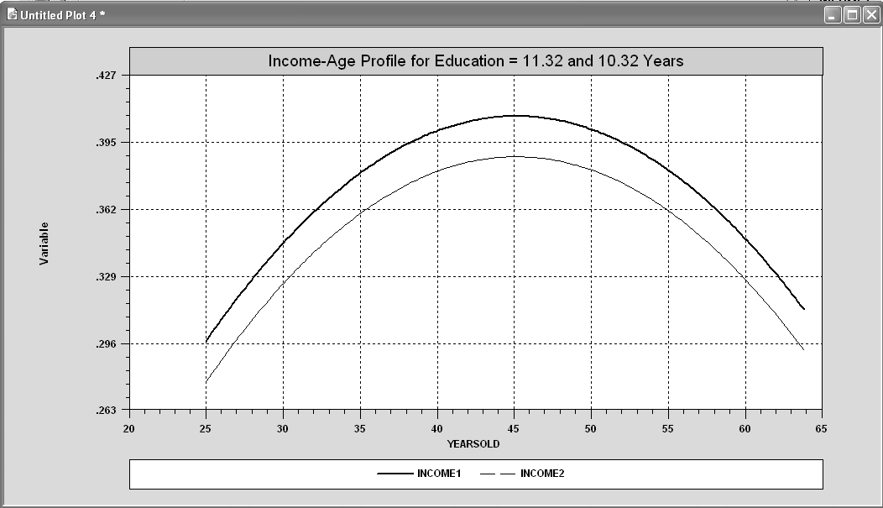
Implied By The Model
Careful: This shows the incomes of people of different ages, not the path of income of a particular person at different ages.
Notes:
42

Slide 43
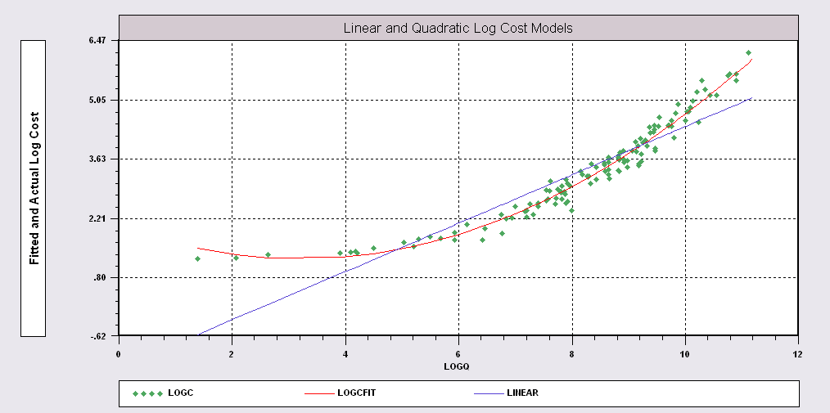
Candidate Models for Cost
The quadratic equation is the appropriate model.
Logc = a + b1 logq + b2 log²q + e

Slide 44
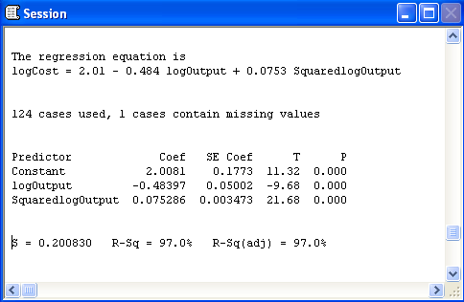
A Better Model?
Log Cost = α + β₁ logOutput + β₂ [logOutput]² + ε

Slide 45
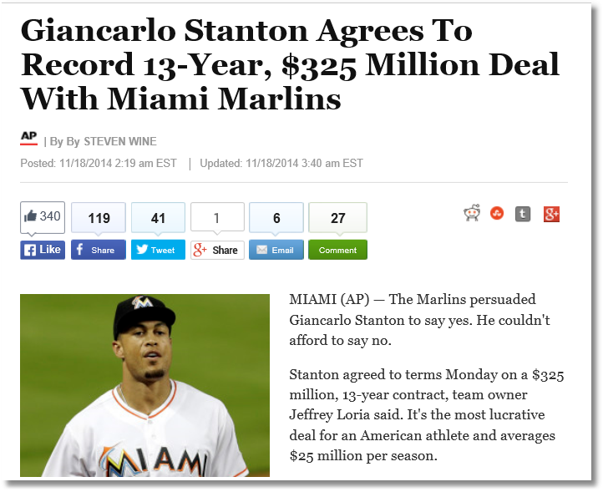

Slide 46
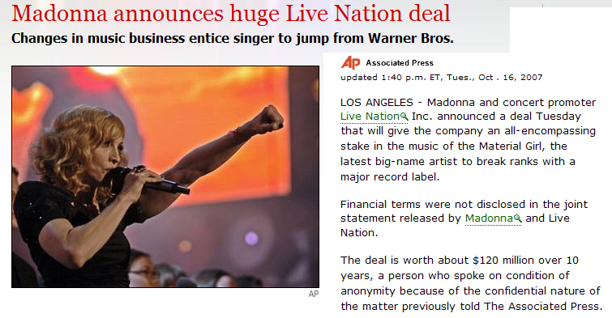

Slide 47
Case Study Using A Regression Model: A Huge Sports Contract
Alex Rodriguez hired by the Texas Rangers for something like $25 million per year in 2000.
Costs – the salary plus and minus some fine tuning of the numbers
Benefits – more fans in the stands.
How to determine if the benefits exceed the costs? Use a regression model.

Slide 48
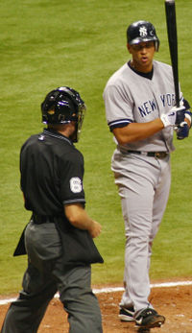
The Texas Deal for Alex Rodriguez
2001 Signing Bonus = 10M
2001 21
2002 21
2003 21
2004 21
2005 25
2006 25
2007 27
2008 27
2009 27
2010 27
Total: $252M ???

Slide 49
The Real Deal
Year Salary Bonus Deferred Salary
2001 21 2 5 to 2011
2002 21 2 4 to 2012
2003 21 2 3 to 2013
2004 21 2 4 to 2014
2005 25 2 4 to 2015
2006 25 4 to 2016
2007 27 3 to 2017
2008 27 3 to 2018
2009 27 3 to 2019
2010 27 5 to 2020
Deferrals accrue interest of 3% per year.

Slide 50
Costs
Insurance: About 10% of the contract per year
(Taxes: About 40% of the contract)
Some additional costs in revenue sharing revenues from the league (anticipated, about 17.5% of marginal benefits – uncertain)
Interest on deferred salary - $150,000 in first year, well over $1,000,000 in 2010.
(Reduction) $3M it would cost to have a different shortstop. (Nomar Garciaparra)

Slide 51
PDV of the Costs
Using 8% discount factor
Accounting for all costs including insurance
Roughly $21M to $28M in each year from 2001 to 2010, then the deferred payments from 2010 to 2020
Total costs: About $165 Million in 2001 (Present discounted value)

Slide 52
Benefits
More fans in the seats
  Gate
  Parking
  Merchandise
Increased chance at playoffs and world series
Sponsorships
(Loss to revenue sharing)
Franchise value

Slide 53
How Many New Fans?
Projected 8 more wins per year.
What is the relationship between wins and attendance?
  Not known precisely
  Many empirical studies (The Journal of Sports Economics)
  Use a regression model to find out.

Slide 54
Baseball Data
31 teams, 17 years (fewer years for 6 teams)
Winning percentage: Wins = 162 * percentage
Rank
Average attendance. Attendance = 81*Average
Average team salary
Number of all stars
Manager years of experience
Percent of team that is rookies
Lineup changes
Mean player experience
Dummy variable for change in manager

Slide 55
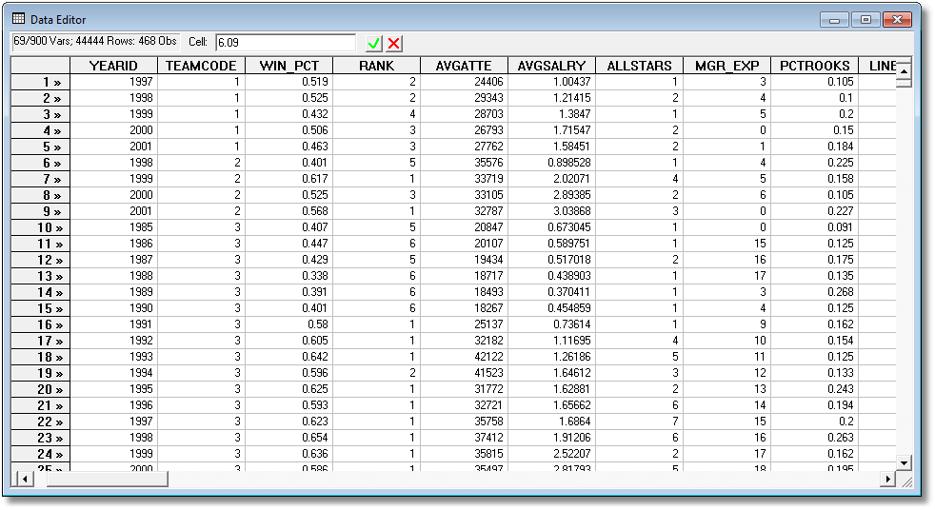
Baseball Data
(Panel Data – 31 Teams, 17 Years)

Slide 56
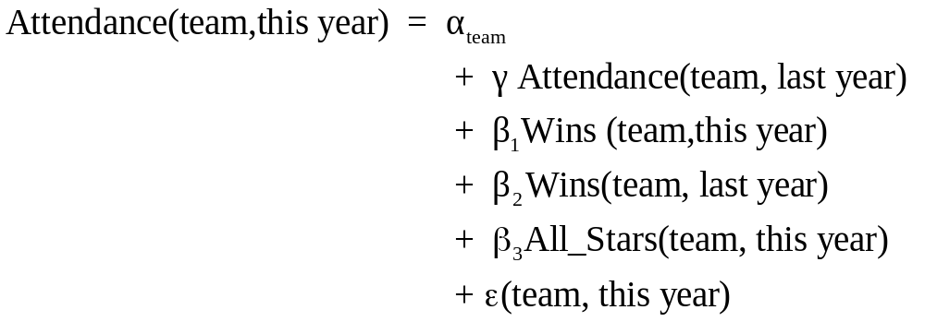
A Regression Model

Slide 57
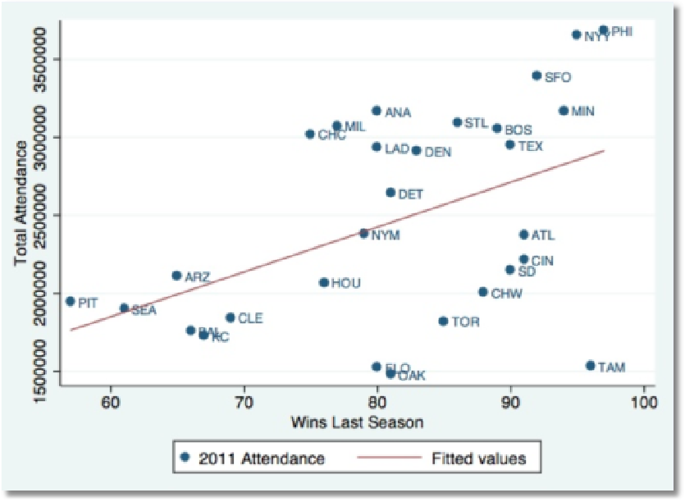

Slide 58
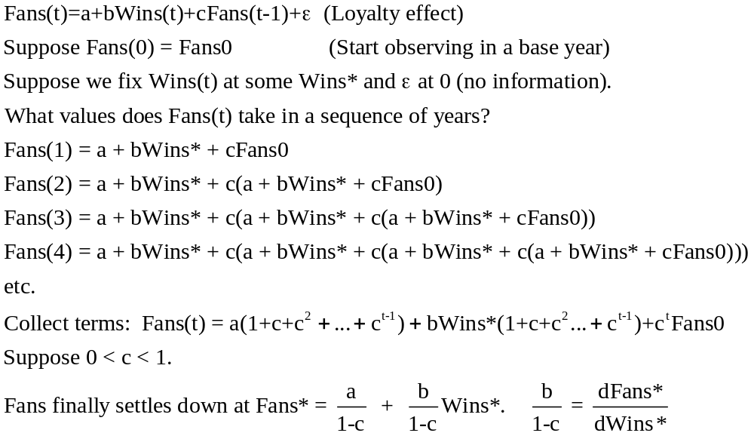
A Dynamic Equation y(this year) = f[y(last year)…]

Slide 59
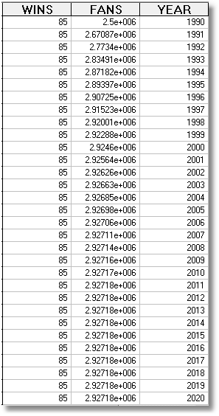
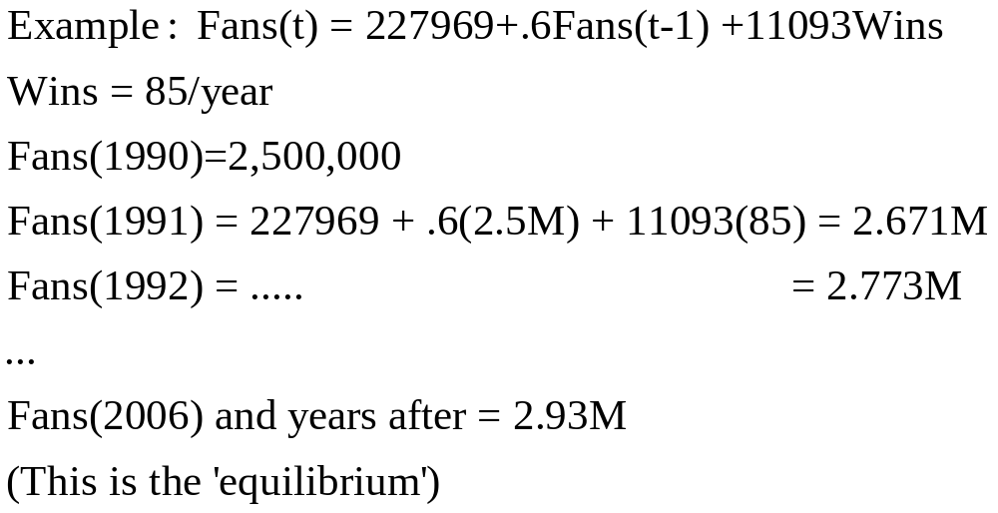

Slide 60
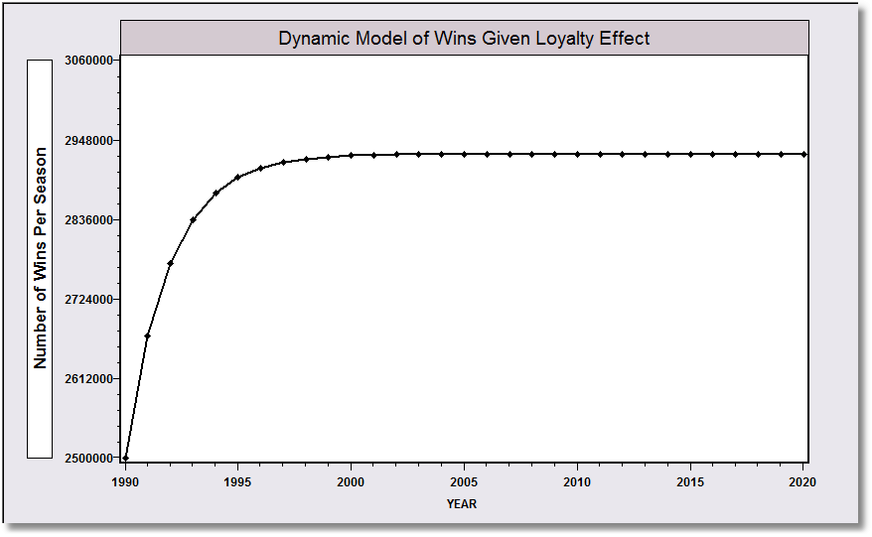

Slide 61
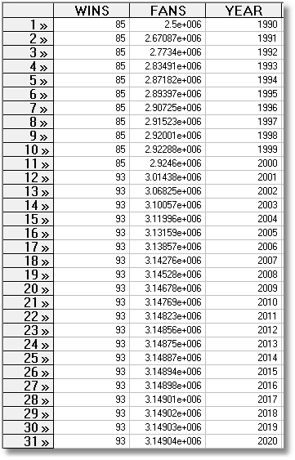
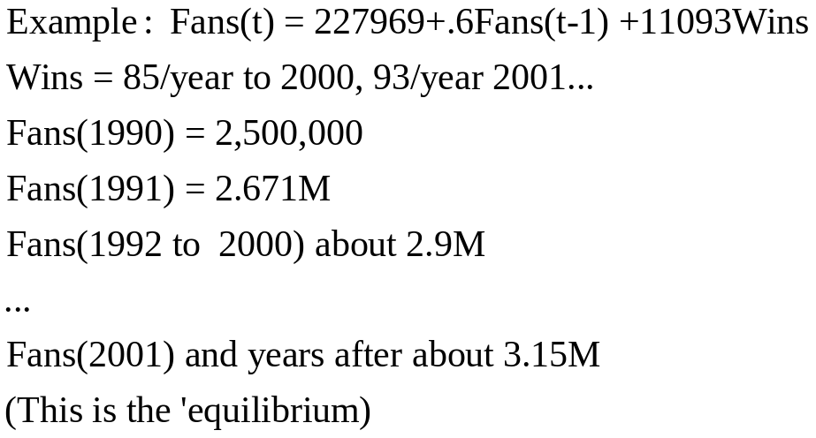

Slide 62
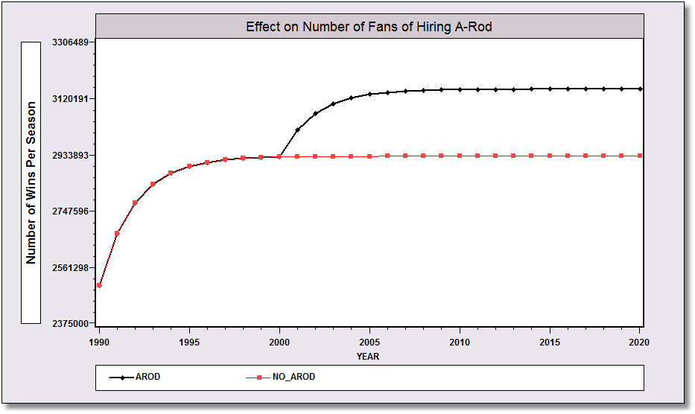
About 220,000 fans

Slide 63
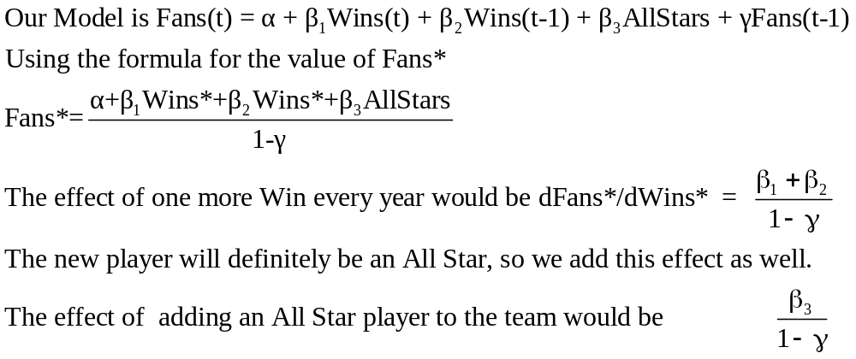
Marginal Value of One More Win

Slide 64
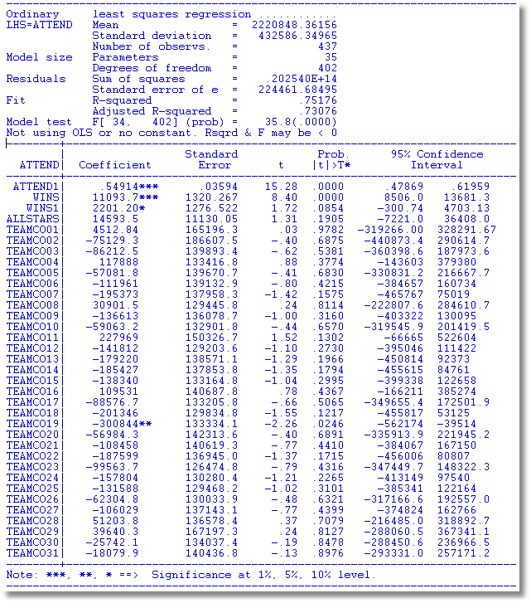
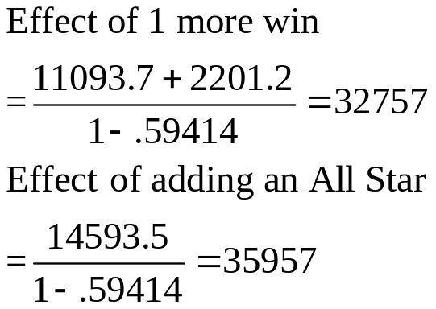
γ = .54914
β₁ = 11093.7
β₂ = 2201.2
β₃ = 14593.5

Slide 65
Marginal Value of an A Rod
(8 games * 32,757 fans) + 1 All Star = 35957
= 298,016 new fans
298,016 new fans *
  $18 per ticket
  $2.50 parking etc. (Average. Most people don’t park)
  $1.80 stuff (hats, bobble head dolls,…)
$6.67 Million per year !!!!!
It’s not close. (Marginal cost is at least $16.5M / year)

Slide 66
Summary
Using Minitab To Compute a Regression
Building a Model
  Logs
  Dummy variables
  Qualitative variables
  Trends
  Effects across time
  Quadratic

